Slide 1
MB
BLACKBELT ON AGENTIC ABM — MEGABRAIN ACADEMY — MODULE 4
4. ABM Metrics
Three groups of metrics, the waterfall funnel by tier, and how to prove progress before deals close.

Slide 2
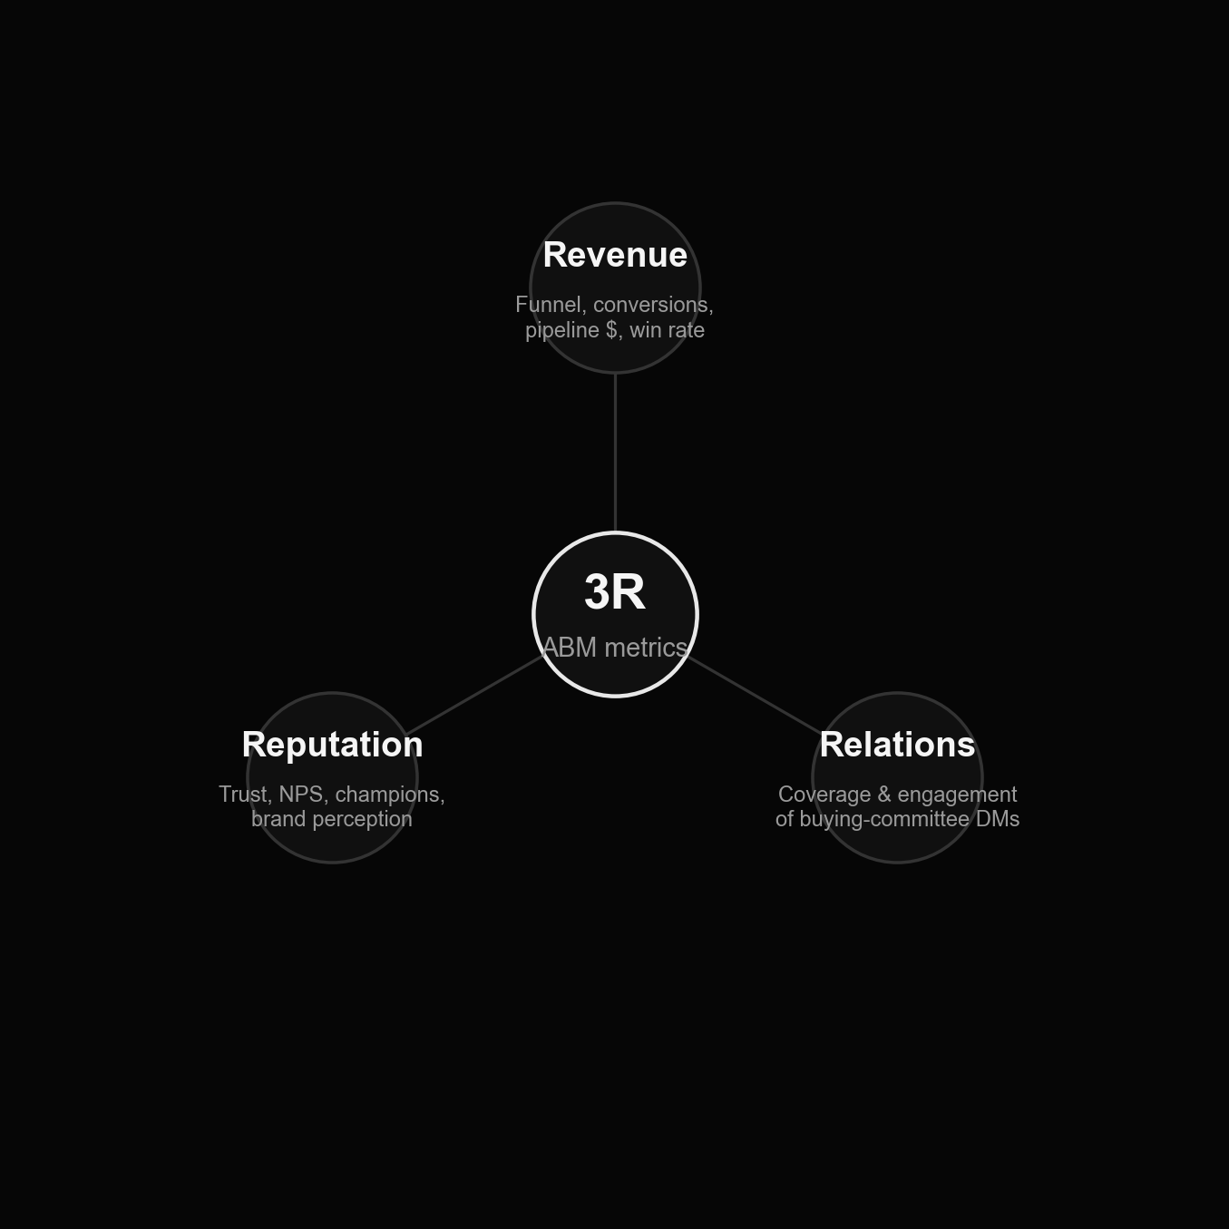
4.1 The 3R framework: Revenue, Relations, Reputation
MB
Before you can prove an ABM program works, agree what "working" means. Three groups of metrics, tracked together — not revenue alone.

Slide 3
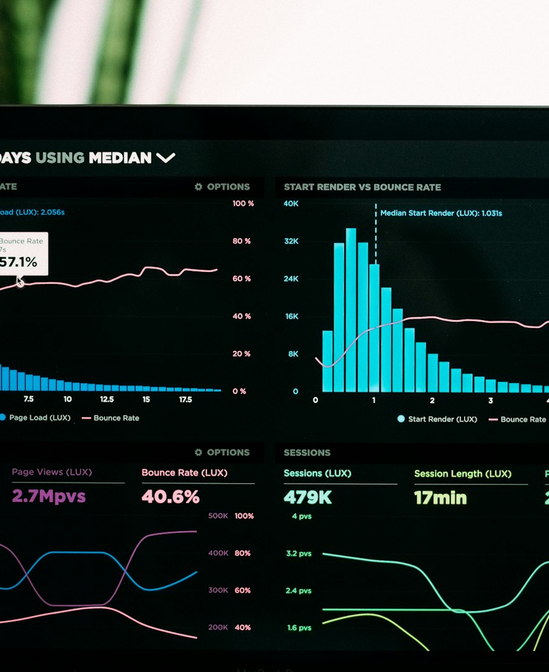
MB
WHY THIS MATTERS
Stop counting leads. Start counting companies.
"We sign contracts with COMPANIES" — a line from the source training, aimed at a room full of marketers still reporting MQLs and click-through rate. David Ogilvy, decades earlier, made the same point: don't count the people you reach — reach the people who count.

Slide 4
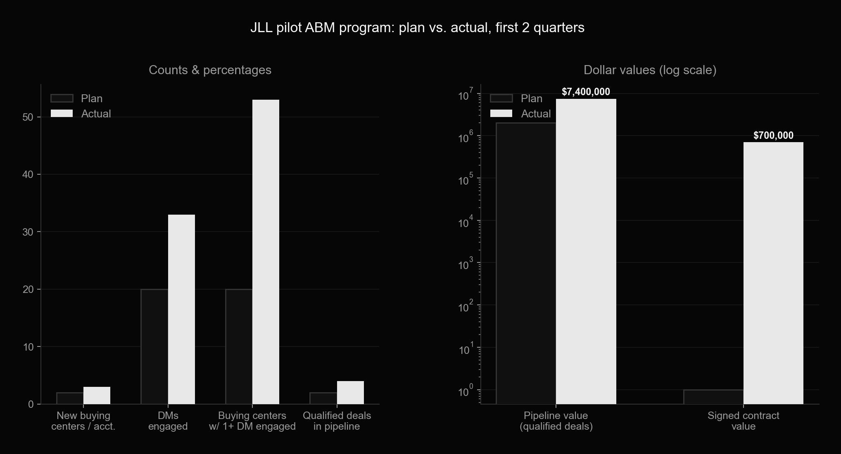
Case study: JLL's pilot ABM program, plan vs. actual
MB
13 target accounts, a demand map worth $21.2M across 49 buying centers, 144 validated DM/influencer contacts. Six months in, actuals beat plan on every tracked metric. (Contact-map detail anonymized here — the original named real individuals at a real account.)

Slide 5
MB
4.2 Reputation — the trust metrics

Slide 6
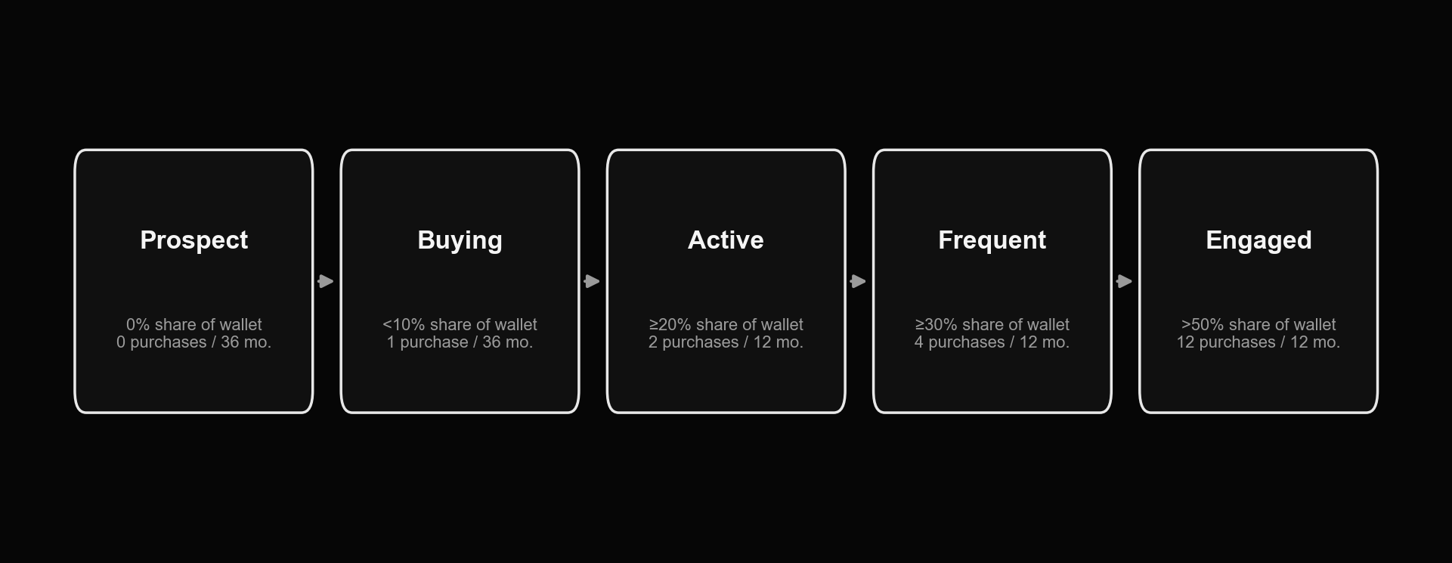
Customer loyalty ladder: from Prospect to Engaged
MB
A share-of-wallet framework for judging whether a target account is actually deepening its relationship with you, not just buying once.

Slide 7
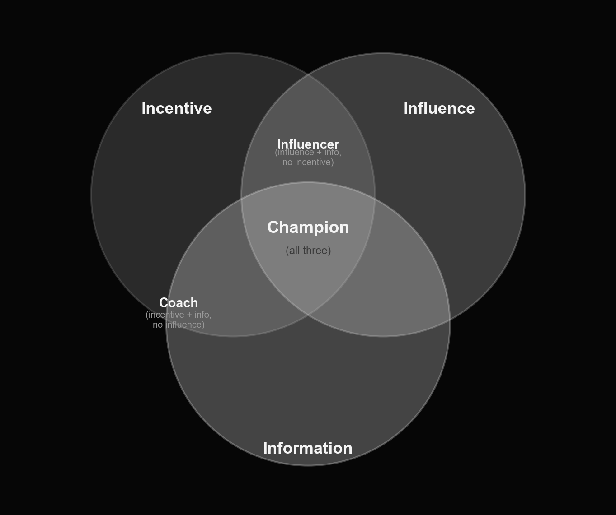
Champion vs. Influencer vs. Coach
MB
A real champion has all three: incentive (something personal riding on your deal), influence (social capital to move others), and information (they help you navigate the account). Missing incentive = an Influencer. Missing influence = a Coach.

Slide 8
MB
Four tests to confirm you actually have a champion
— Channel switch — end a call by asking to move to a more personal channel (text, WhatsApp); a real champion says yes without hesitation
— Ask them to describe their own buying process — a committed champion maps it out freely; a hesitant one keeps the map to themselves
— The small ask — request an intro or five minutes of feedback on a deck; did they actually do it?
— Teach-back — ask how they'd explain your solution internally with you not in the room, and offer to role-play the objections they'd get

Slide 9
MB
Reputation — possible metrics
— Number of coaches / champions developed per target account
— Awareness of the target account's internal strategic initiatives
— Brand-perception trend and target-account website traffic
— Opt-in rate: downloads of thought-leadership content
— Campaign response rate; satisfaction / NPS
— Customer loyalty trend (ladder stage); references given; case-study consent

Slide 10
MB
4.3 Relations — coverage & engagement

Slide 11
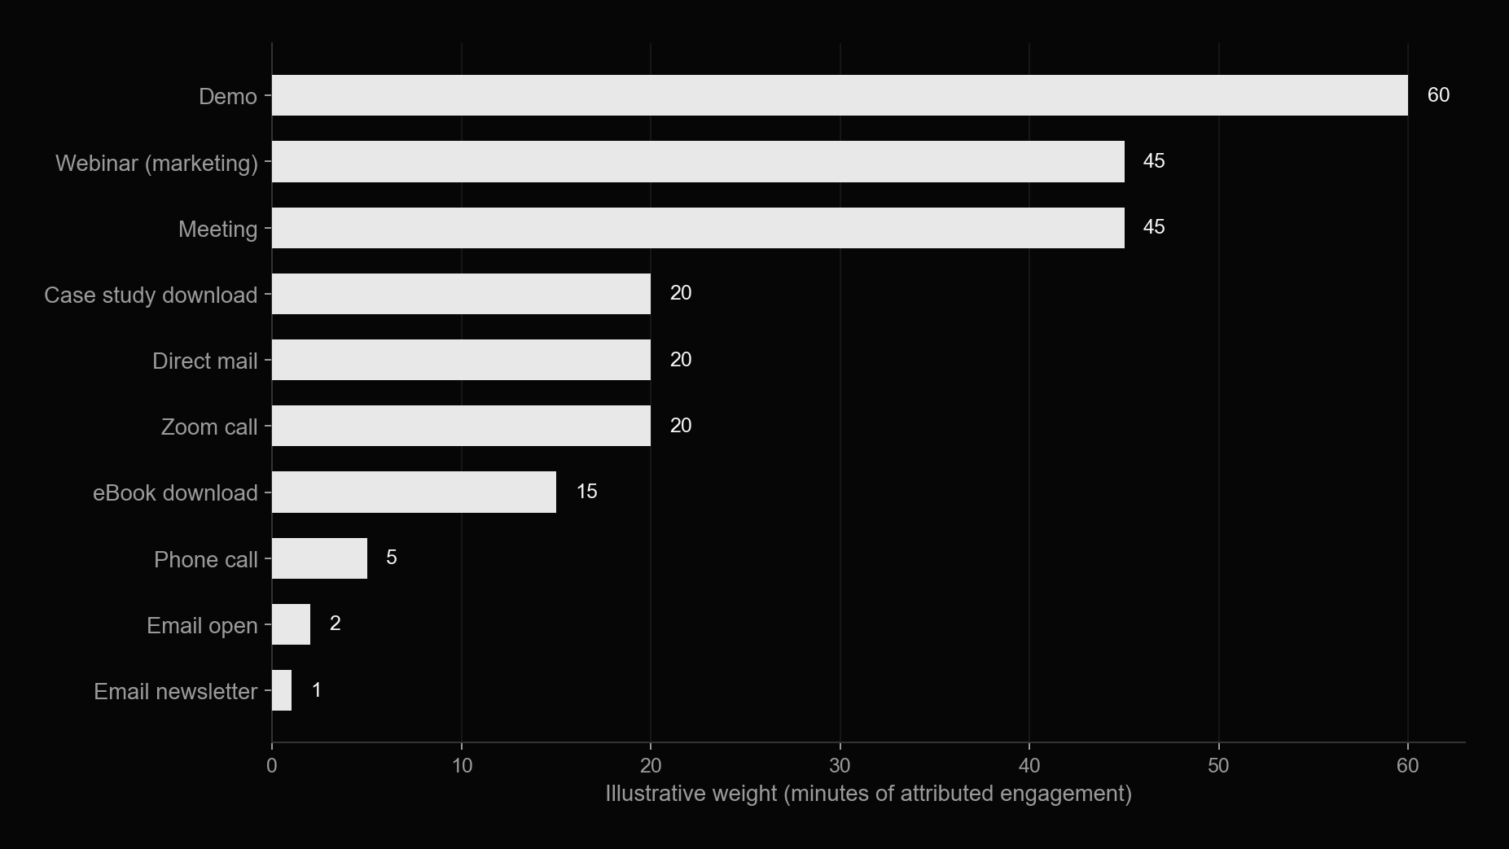
Weighting engagement: an "attribution in minutes" model
MB
Assign every touch type a weight, then sum weighted minutes per contact and per account. Two published examples of the same idea: Grant Thornton's points-based engagement score, and Localytics' engagement-minutes × role-multiplier model (5x for CXO down to 1x for "other").

Slide 12
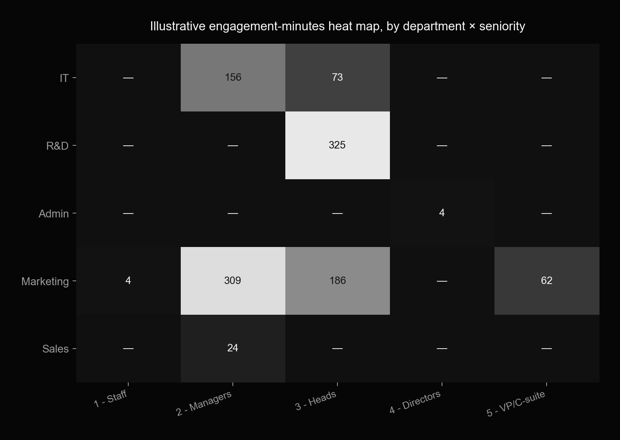
Illustrative engagement heat map: department × seniority
MB
The same weighted-minutes data, rolled up by department and seniority level, shows you exactly where in the buying committee you're actually landing — and where you have zero coverage.

Slide 13
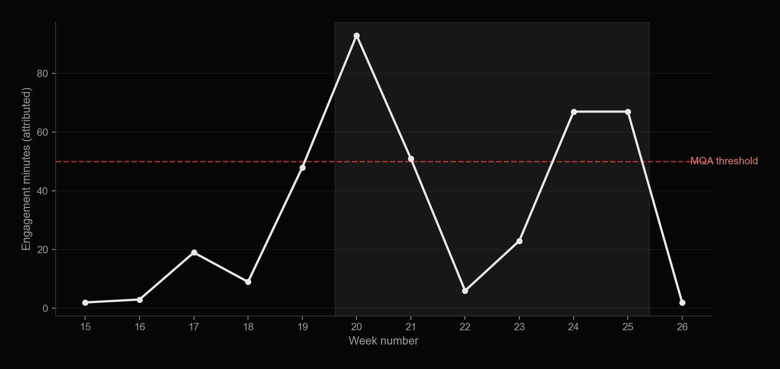
Account engagement over time, against an MQA threshold
MB
MQA = Marketing Qualified Account: the account has earned enough weighted engagement to justify a hand-off to sales' most experienced closers, not a generic SDR sequence.

Slide 14
MB
The "dark funnel": what attribution never sees
— Chris Walker's core argument: traditional b2b attribution models lose accuracy as more of the real buying journey moves outside trackable channels
— Untrackable signals that still move a deal: competitor research, anonymous site visits, word-of-mouth, internal brainstorms, community discussions, online reviews, a colleague's Slack message
— Practical response: don't over-trust last-touch or first-touch attribution alone — triangulate with self-reported "how did you hear about us" and directional signals (branded search volume, direct traffic) instead of chasing false precision

Slide 15
MB
Relations — possible metrics
— New target-account contacts added to the database; contacts at DM/VP-and-above level
— Engaged contacts / engaged directors; meetings, demos, audits, feasibility studies held
— Directors participating in advisory councils or communities; joint innovation days
— Subjective engagement-strength score per contact; growth in touches with target-account DMs
— Attribution-weighted minutes and MQA status per account

Slide 16
MB
4.4 Revenue — the funnel

Slide 17
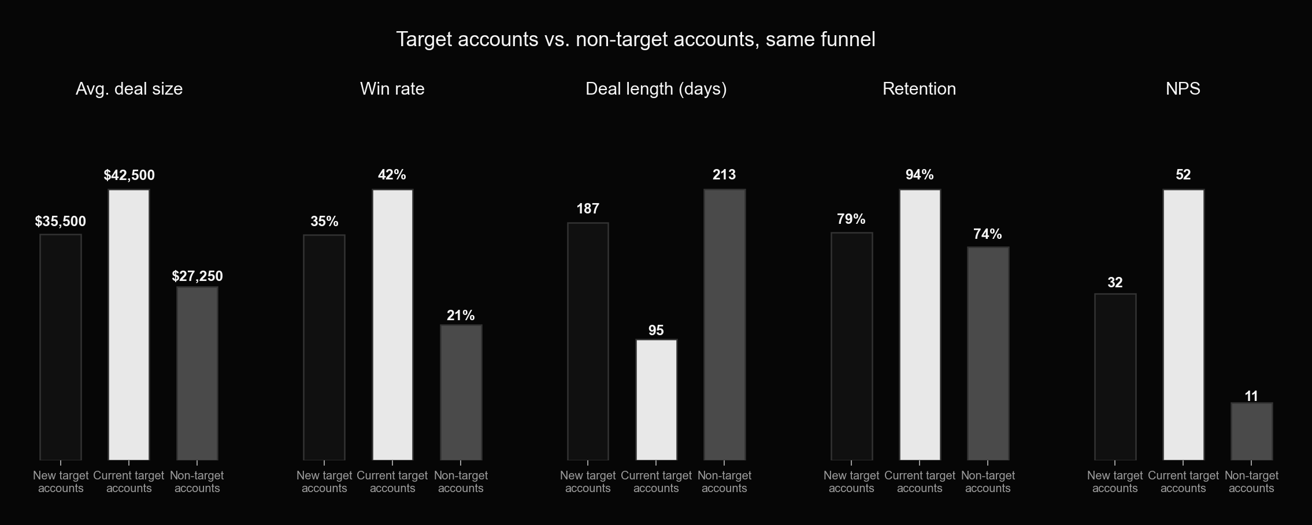
Target accounts convert differently — same funnel, different economics
MB
Illustrative comparison, adapted from the source material: current target accounts out-perform both brand-new target accounts and non-target accounts on every revenue metric that matters — bigger deals, higher win rate, shorter cycles, better retention, higher NPS.

Slide 18
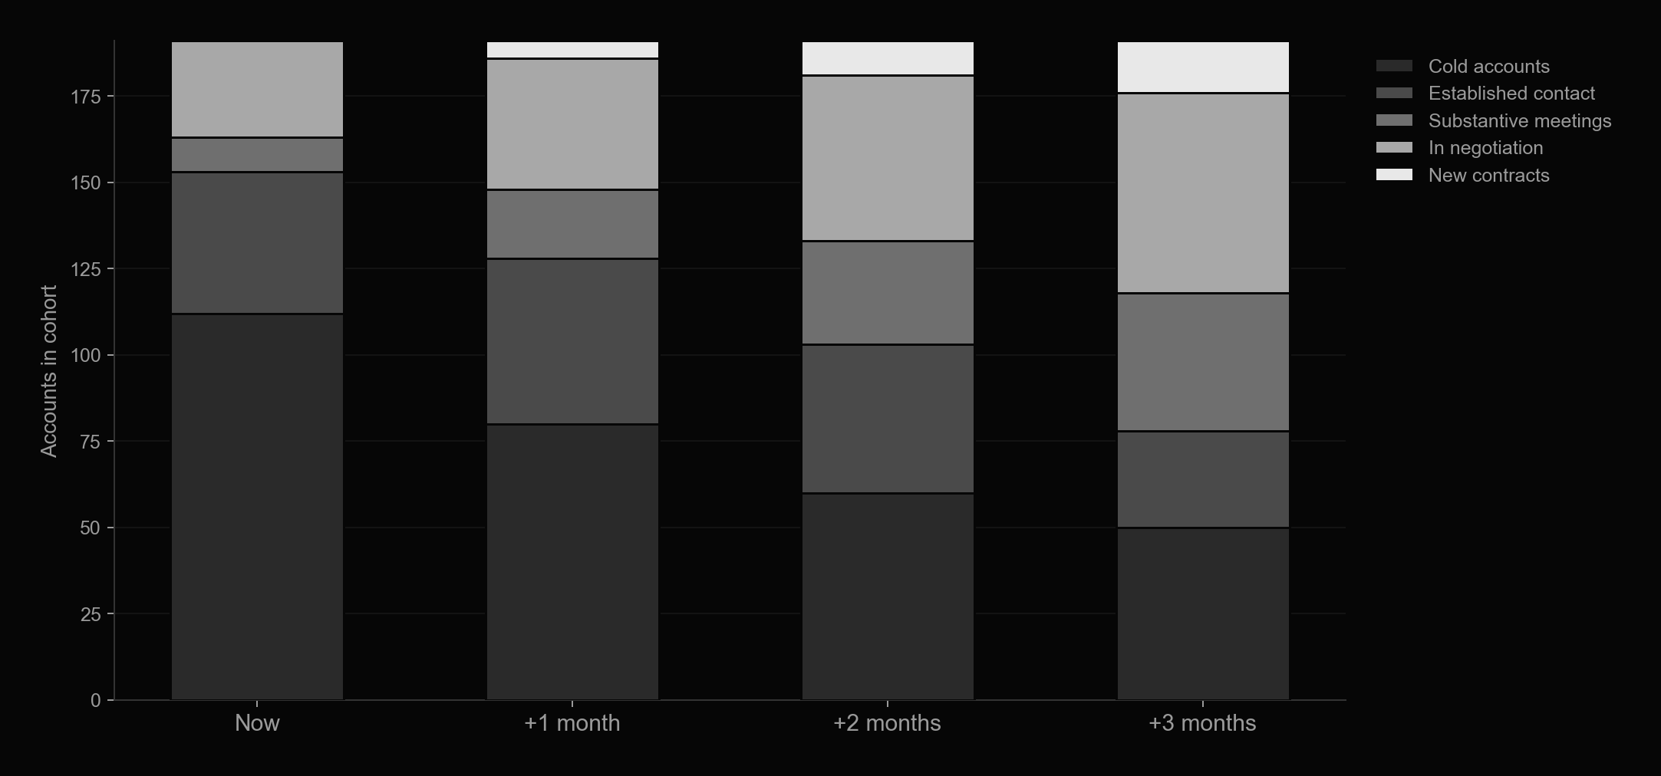
The waterfall funnel: cohorts moving through the pipeline by tier
MB
A simple goal-setting template: track how many accounts sit in each pipeline stage today, and where you expect that stack to shift over the next 1-3 months. This is the chart to rebuild in your own KPI workbook.

Slide 19
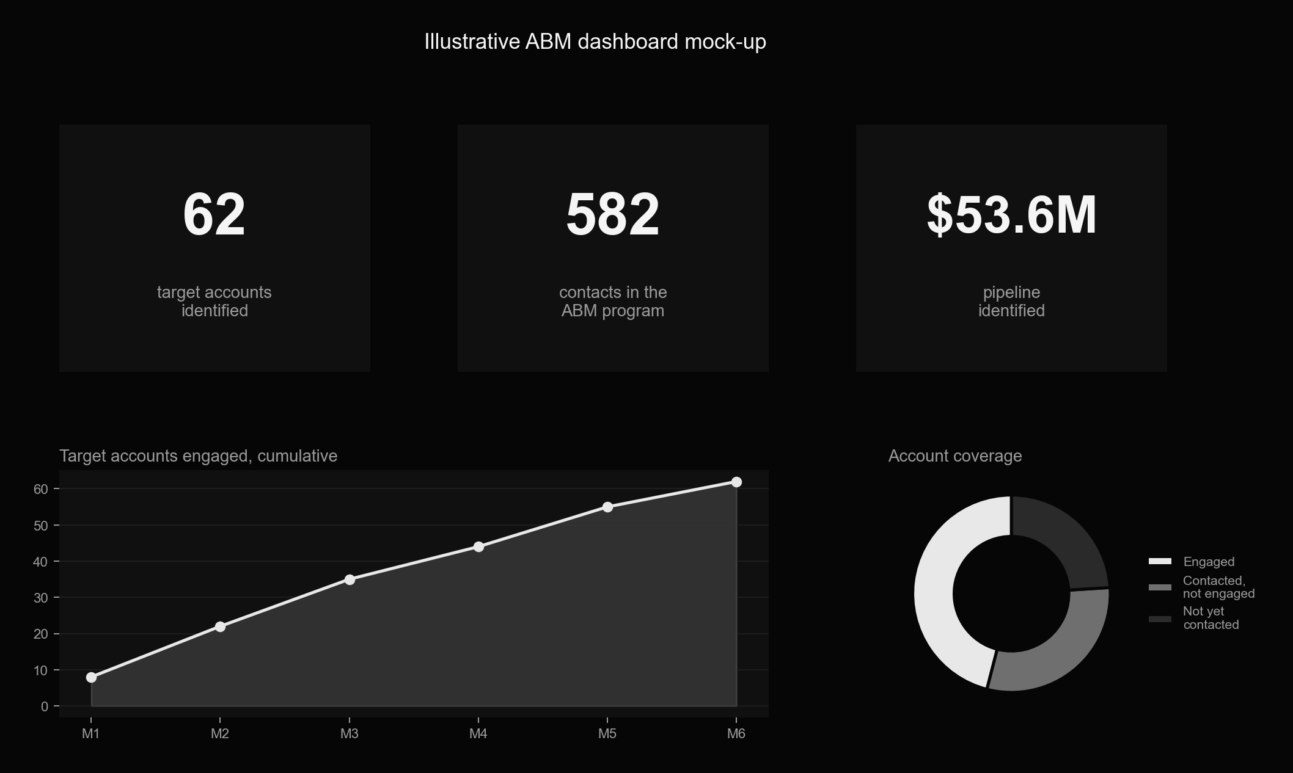
Illustrative dashboard: what a live ABM scorecard shows
MB
The source deck's real screenshots showed a live client's actual named target accounts inside their CRM — not reproduced here. This mock-up shows the same shape: coverage, cumulative engagement, and pipeline value in one view.

Slide 20
MB
Revenue — possible metrics
— RFP / tender invitations from target accounts
— Number, growth rate and velocity of opportunities in the pipeline
— New pipeline opportunities this period; portfolio penetration (products sold per account)
— Stage-to-stage conversion rate and average sales-cycle length
— Win rate and average contract value
— Target-account cohort performance vs. a non-target-account control group

Slide 21
MB
4.5 Proving progress before deals close

Slide 22
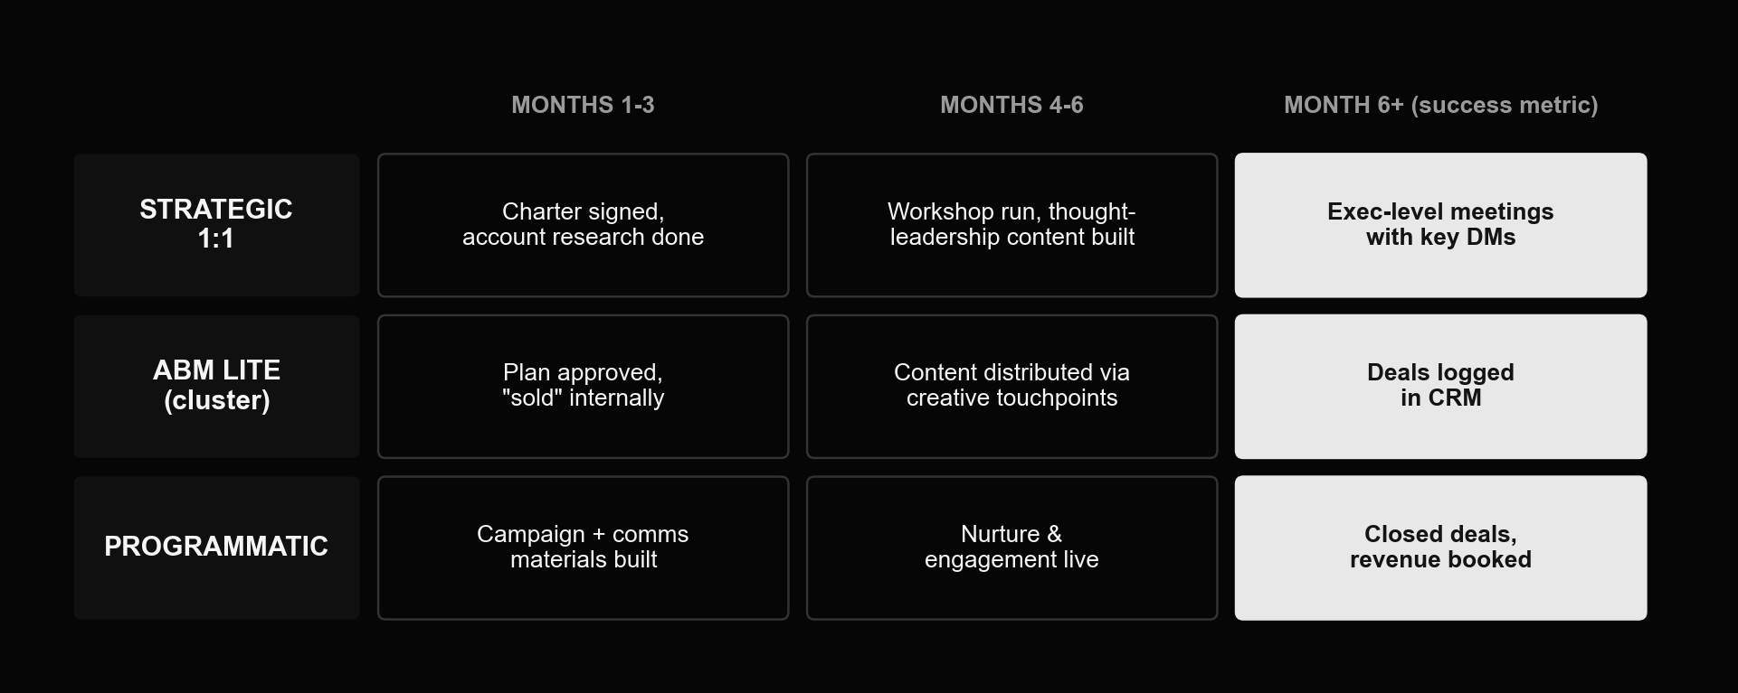
What "proof of progress" looks like, by ABM tier
MB
A signed contract can be 6-12+ months out, especially at the 1:1 strategic tier. Each tier has an earlier, honest proxy for "this is working" that you can report on before revenue shows up.

Slide 23
MB
Keep it simple: one KPI table is enough
Metric | Now | +3 months | +6 months | +12 months
Contacts in DB with email | 10 | 20 | 25 | 30
Engaged contacts | 3 | 10 | 13 | 15
Director-level meetings | — | 3 | 6 | —
Deals logged in CRM | — | 1 | 2 | —
Contract value (illustrative) | — | — | $300,000 | $600,000

Slide 24
MB
4.6 Agentic ABM in practice

Slide 25
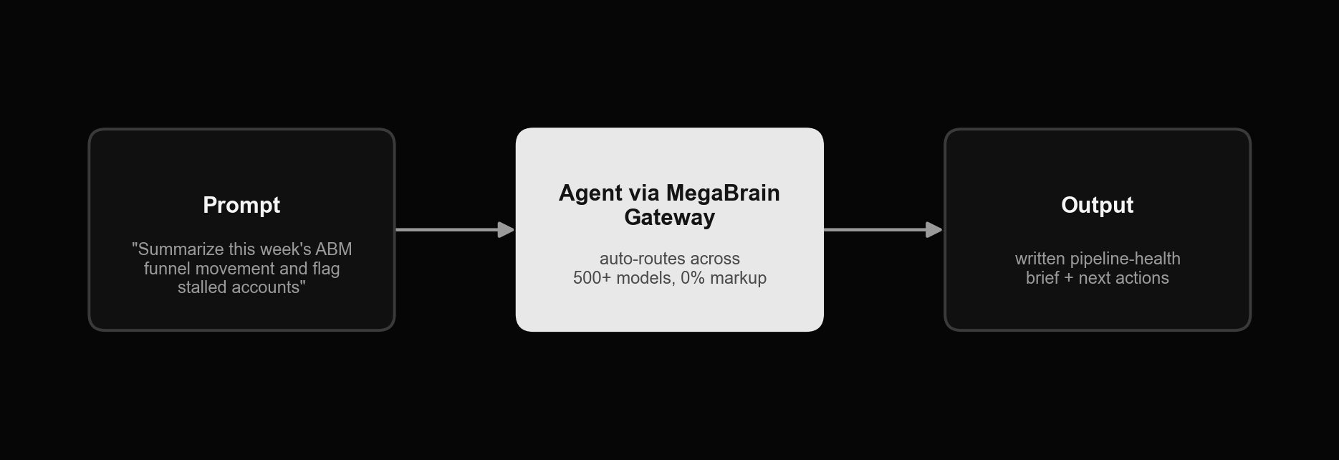
MegaBrain: an agent workflow for this module
MB
One weekly prompt, routed through MegaBrain's model-agnostic gateway, turns raw CRM and engagement exports into a written pipeline-health brief — which accounts moved, which stalled, and what to do about it — without a dedicated BI hire.

Slide 26

MB
Other agent tools for metrics & reporting
Dreamdata — B2B revenue-attribution platform, now shipping AI agents that turn multi-touch attribution data into plain-language pipeline narratives. Databox — connects 130+ data sources into real-time KPI dashboards with an AI layer that surfaces summaries and forecasts. HubSpot Breeze Assistant — CRM-native AI that drafts quick-look reports straight out of your existing HubSpot data. Make / n8n — a scheduled workflow that pulls the week's funnel movement and posts a digest to Slack every Monday morning.

Slide 27
MB
Exercises

Slide 28
MB
Homework 1 — build your own 3R metrics plan
— Pick the ABM tier you're actually running (Strategic 1:1, ABM Lite/cluster, or Programmatic) and state your target account count for this program
— For each of the three groups — Revenue, Relations, Reputation — pick 2-3 metrics from this module's "possible metrics" lists that you can actually measure with your current tools
— Set a target for each metric at four horizons: now, +3 months, +6 months, +12 months — round numbers are fine, precision isn't the point yet
— Fill in the KPI workbook that ships with this module using your own numbers, not the illustrative example
— Share the filled-in workbook with whoever owns sales for these accounts before the next session — a KPI plan nobody on the sales side has seen isn't a shared plan

Slide 29
MB
Homework 2 — build an attribution-in-minutes model
— List every touch type your team actually uses today: calls, demos, webinars, direct mail, gated content downloads, email opens, meetings
— Assign each one a weight (minutes, points — the unit doesn't matter, the relative ranking does) using this module's example as a starting point
— Add a role multiplier: weight a CXO's engagement higher than an individual contributor's, the way Localytics' model does
— Run the model against 3-5 real target accounts using whatever CRM/analytics data you can pull manually this week
— Flag which accounts already look like an MQA (marketing-qualified account) by your own threshold, and send that shortlist to sales

Slide 30
MB
Homework 3 — map your own "proof before close" timeline
— Using the tier-by-tier grid from section 4.5 as a template, write down what "progress" will concretely look like for your program at months 1-3, 4-6, and 6+
— Be specific: not "more engagement" but "3 workshop-style calls booked with VP-or-above contacts at 5 of our 8 target accounts"
— Share this timeline with your manager or executive sponsor now, before the program starts — it's much easier to get buy-in on what counts as progress before the numbers exist than after
— Calendar a check-in at each milestone date to compare actual vs. this plan, the same way the JLL case study did

Slide 31
MB
Homework 4 — run your first MegaBrain reporting brief
— Export this week's account and opportunity data from your CRM (or use last week's homework's manual pull if you don't have full CRM access yet)
— Using your MegaBrain account from Module 1, send a prompt asking the model to summarize funnel movement, flag stalled accounts, and suggest next actions — see the 4.6 workflow example
— Compare the agent's brief against your own read of the same data: what did it get right, what did it miss or get wrong
— Keep a running note of which prompts produce a brief you'd actually forward to your manager unedited — you'll refine this further in later modules

