Slide 1
MB
BLACKBELT ON AGENTIC ABM — MEGABRAIN ACADEMY — MODULE 5
5. Offer & Content Personalization
Three types of offers and the industry -> persona -> company layers of personalization, with templates.

Slide 2
MB
5.1 Where personalization fits in the ABM loop

Slide 3
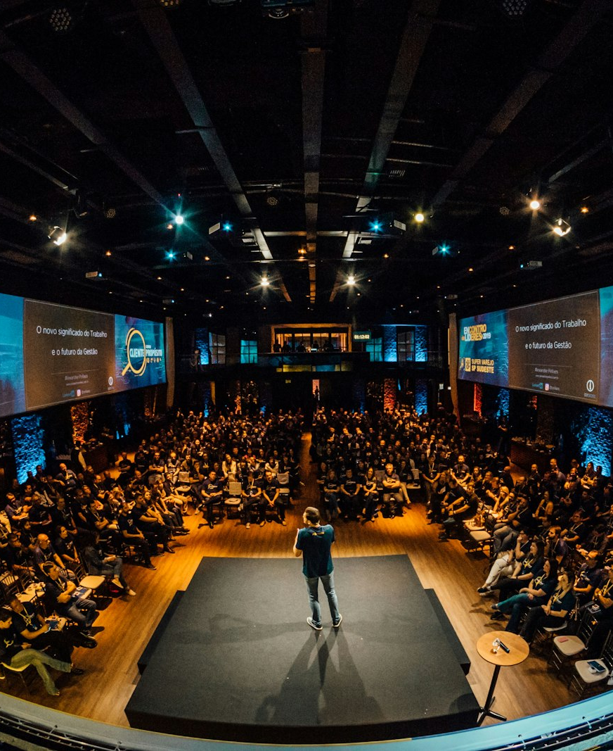
MB
5.2 CASE IN POINT
Baker Hughes: what full personalization looks like end to end
A published ABM case for an industrial-additives business unit: content segmented by industry (auto, aviation, oil & gas, electronics), personas mapped to their psychographic fears (compliance risk, "don't let this be my fault"), and messaging synced to the funnel stage. Result: 500+ new contacts, 100+ MQLs, 11 deals, 3 signed contracts, 1,300%+ ROI, and a Content Marketing Awards finalist.

Slide 4
MB
5.3 Customer personas

Slide 5
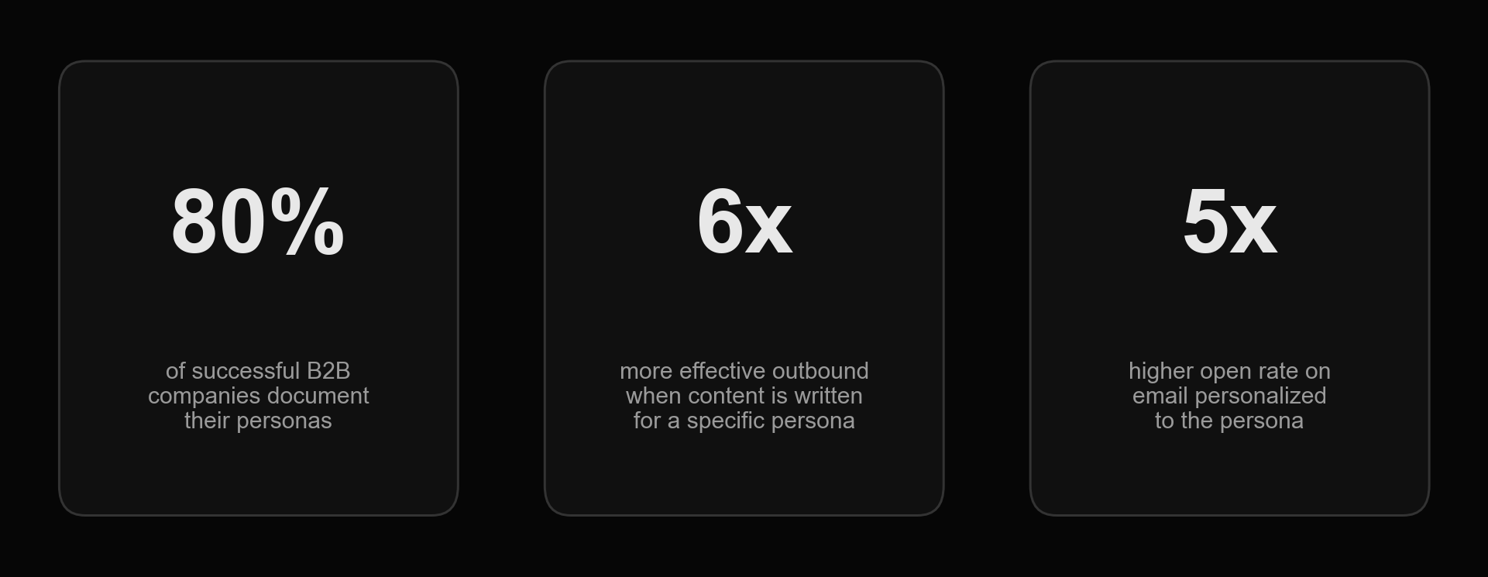
Why documented personas move the needle
MB
A persona is a portrait of what your buyer thinks, does, wants and fears — in their own words, not yours.

Slide 6

MB
SOURCING THE PERSONA
Personas come from research, not guesswork
5-10 interviews with real customers and lost deals (ideally run by someone outside your team) · CRM win/loss analysis · sitting in on sales calls and call recordings · job postings for the role · the person's own social profiles and communities · what your international peers and competitors already know.

Slide 7
MB
Three ways to write down a persona
— Variant 1 — "5 rings of buying insight" (Adele Revella, Buyer Personas): priority initiatives, success factors, perceived barriers, buyer's journey, decision criteria. Adele Revella's book uses Boon Edam's published "Architect" persona as its worked example — summarized here, not reproduced in full.
— Variant 2 — Pains / Objections / Important-to-know: the format this module's homework uses. 3 pains, 3 objections, 3 must-know points per persona, plus "what do they compare us to"
— Variant 3 — empathy map canvas: what the persona thinks & feels, hears, sees, says & does, plus their pains and gains
— Insight aggregator, in 5 steps: transcribe every interview and tag each quote → pull the quotes with real specifics or emotion → write a one-line headline insight per quote → group similar headlines (4-5 quotes usually support one insight) → rewrite the grouped insight as one precise statement

Slide 8
MB
AI-drafted persona brief: a reusable prompt
— Give the model your business context first, then this structure (Role / Instruction / Steps / Expectation):
— R — "You are a strategic analyst researching a target customer for a B2B company."
— I — "{target persona} is a typical decision-maker at companies in {industry} that we sell to. Build a detailed profile focused on pains, objections, and must-know facts for personalized outreach."
— S — gather (reports, interviews, public statements) → analyze (priorities, motivations, objections) → synthesize into Pains / Objections / Important blocks
— E — a 50-60 point summary across the three blocks, sourced from material no older than 2 years
— Treat the output as a first draft — verify against your own interviews before you ship messaging built on it

Slide 9
MB
5.4 The personalization hierarchy

Slide 10
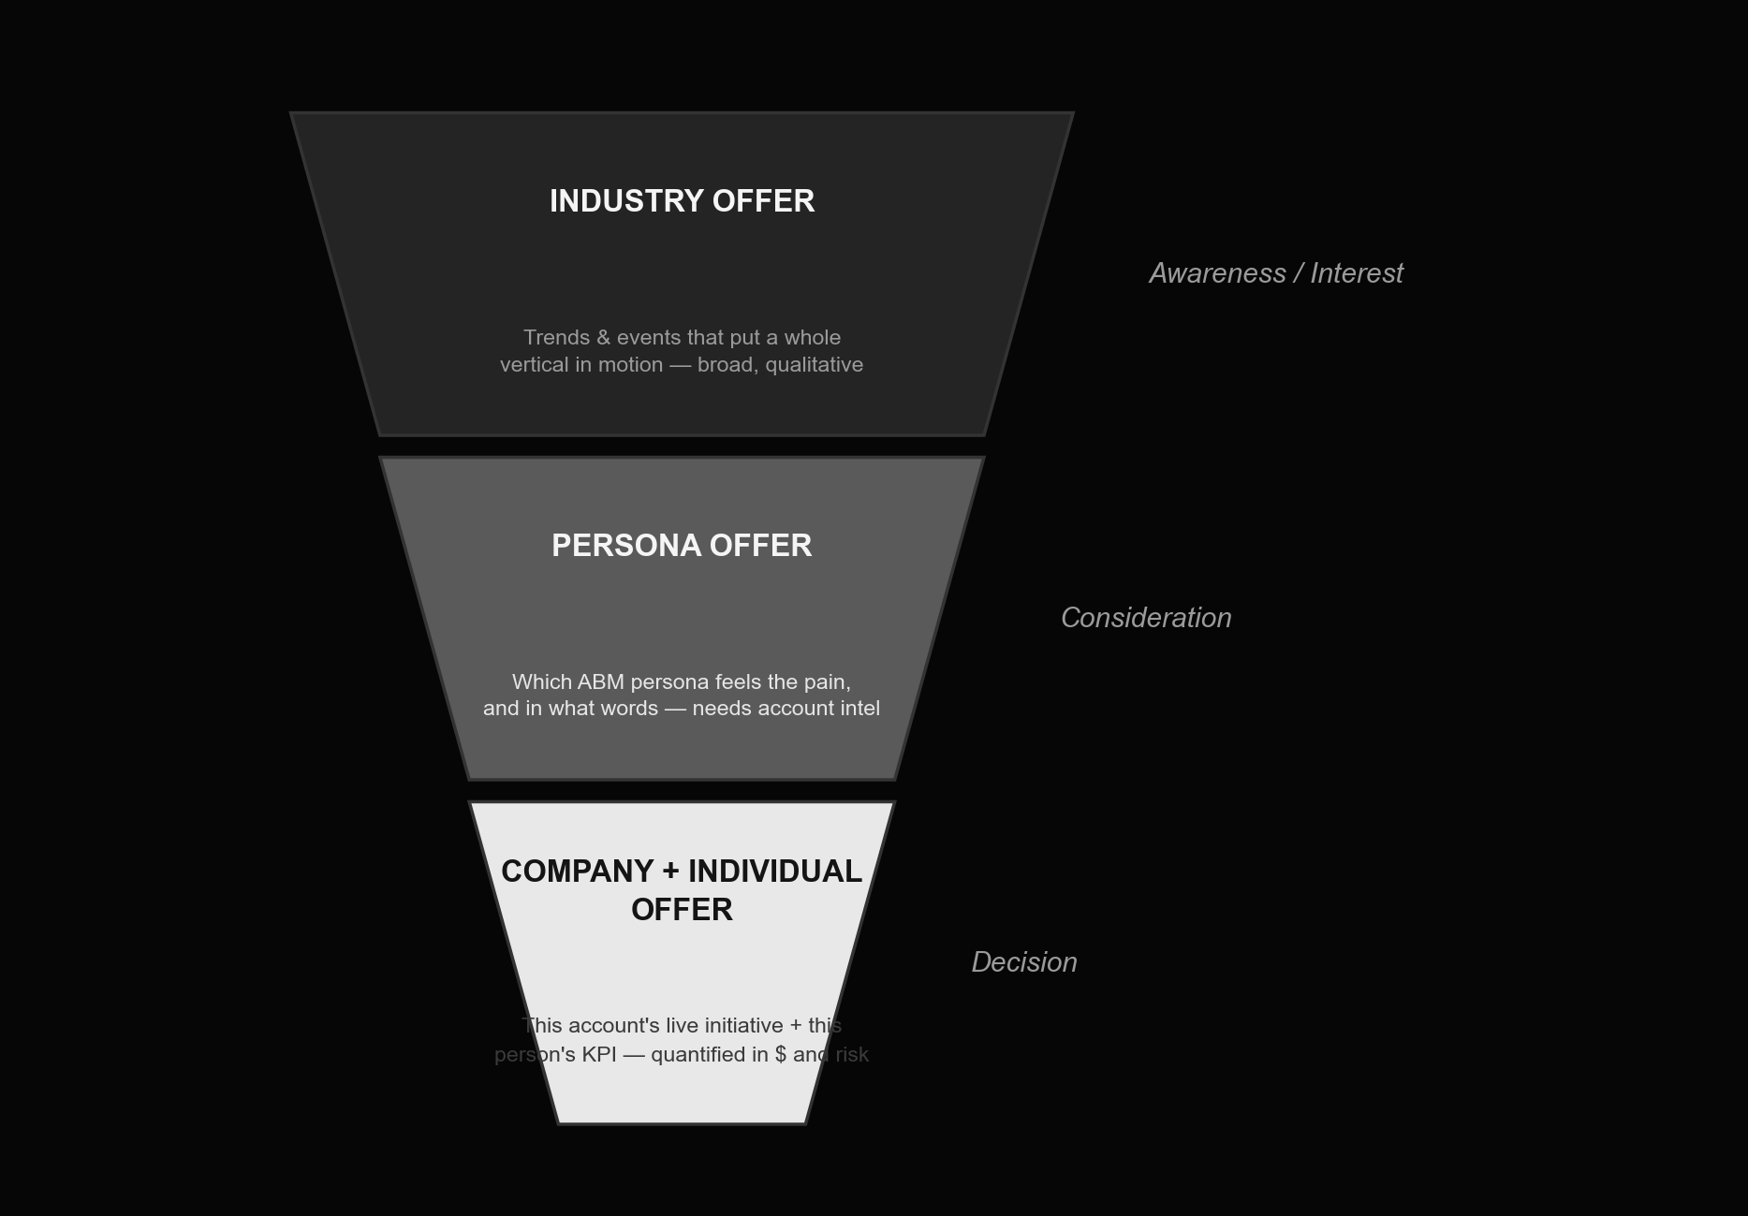
Three layers, three offer types
MB
Industry trends create company initiatives; company initiatives change what a specific persona is measured on. Your offer should personalize at the same three layers — wide and qualitative at the top, narrow and quantified at the bottom.

Slide 11
MB
What each offer type actually contains
— Industry offer — broad, quality-over-numbers value: not built to sell, built to earn the next click (visit the site, take a call, join a webinar, download an e-book)
— Persona offer — built around one functional role's perception of value; requires real understanding of that persona's fears, motivations, expectations and priorities
— Company + individual offer — solves one named person's problem at one named company; built entirely from account-intelligence data; designed to break a specific mental model, and must be expressed in numbers — revenue, cost, risk
— Map each type to the funnel: industry offer dominates awareness/interest, persona offer dominates interest/consideration, company+individual offer dominates decision

Slide 12
MB
Content by customer-journey stage
Stage | Our goal | Role of content | Example content
Awareness | Attract the audience | Spark interest; be a trustworthy source that understands the market | Articles, blog posts, checklists, infographics, podcasts, thought leadership, guides, research
Interest | Get the lead | Show a concrete solution to the persona's needs and pains | Explainer videos, assessment tools, product pages, frameworks, workbooks, virtual/in-person events
Consideration | Build brand preference | Show the value we can deliver and what makes us different | Solution guides, ROI examples, webinars, case studies, testimonials, technical data, comparisons
Decision | Convert to buyer | Show value in money and help our internal champion get approval | ROI calculators, detailed project estimates, corporate workshops, account-specific proposals

Slide 13
MB
5.5 Awareness-stage content: the lead magnet

Slide 14
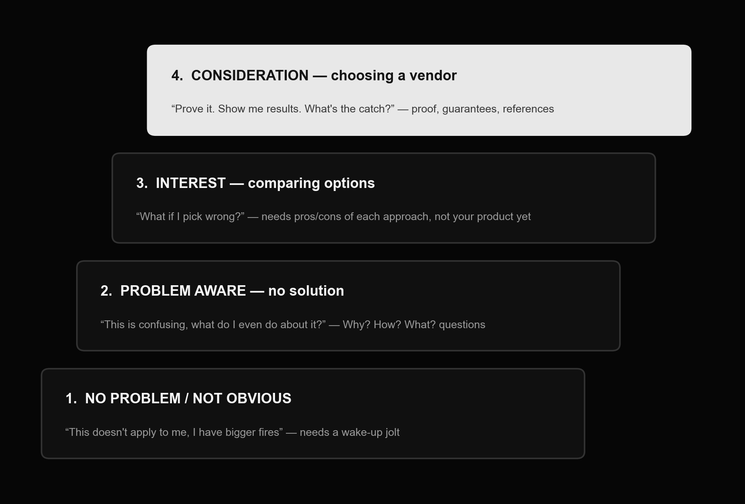
Ben Hunt's ladder of awareness
MB
Diagnose which rung your target persona is standing on before you write a headline — "10 ways to cut X" lands very differently on rung 1 than on rung 4.

Slide 15
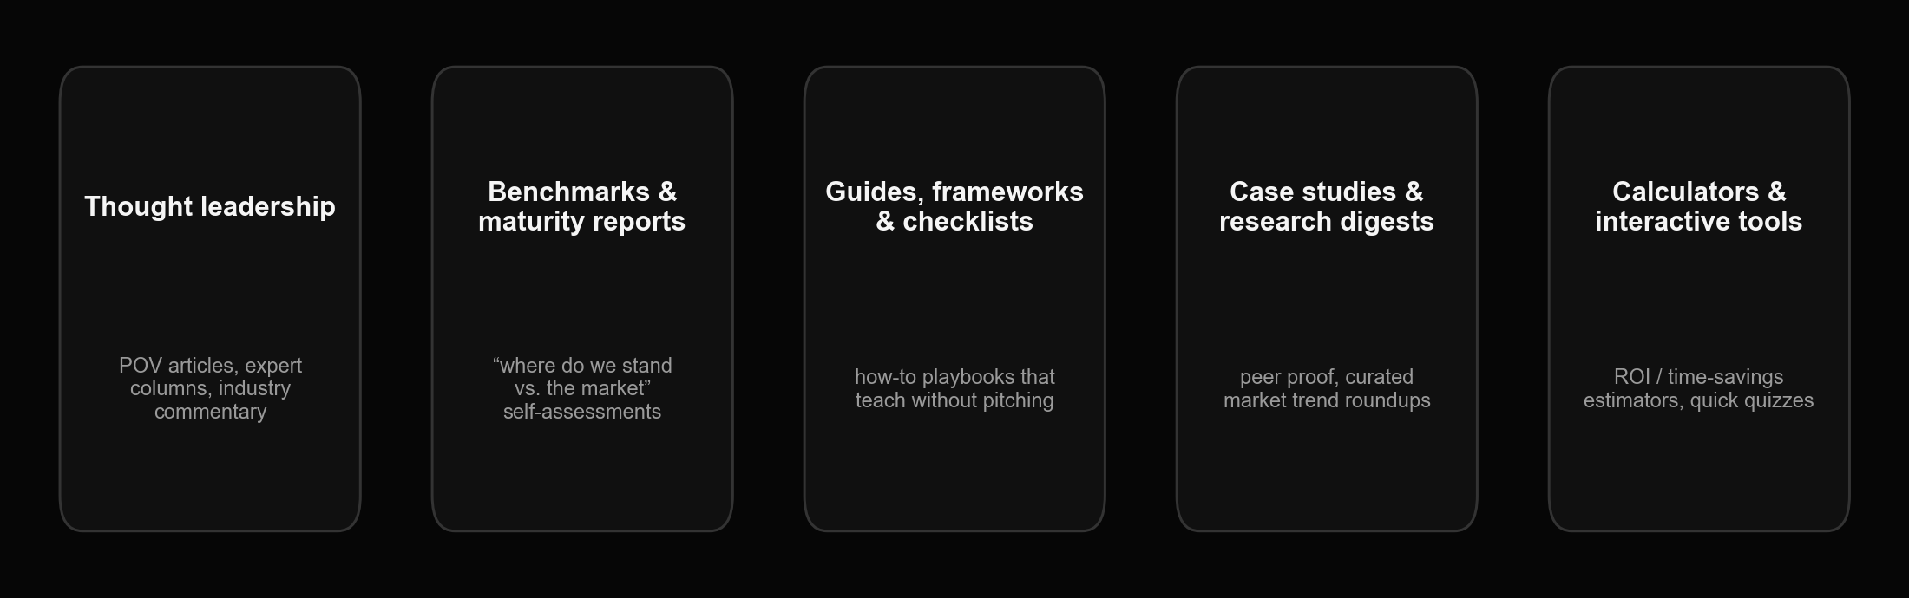
Five awareness-stage content formats
MB
A lead magnet asks nothing of the reader in return — no form, no gate, no "share your company info." Save the form for when you actually need contact details: a tool, a webinar seat, a demo request.

Slide 16

MB
Distributing awareness content without a content studio
NotebookLM (Google) turns a research doc or deck into an auto-generated explainer podcast for passive distribution. HeyGen renders your own on-camera presence into an avatar-led video without a studio or a camera crew — useful for scaling one script across personas or languages.

Slide 17
MB
5.6 Nurture: content chains by persona

Slide 18
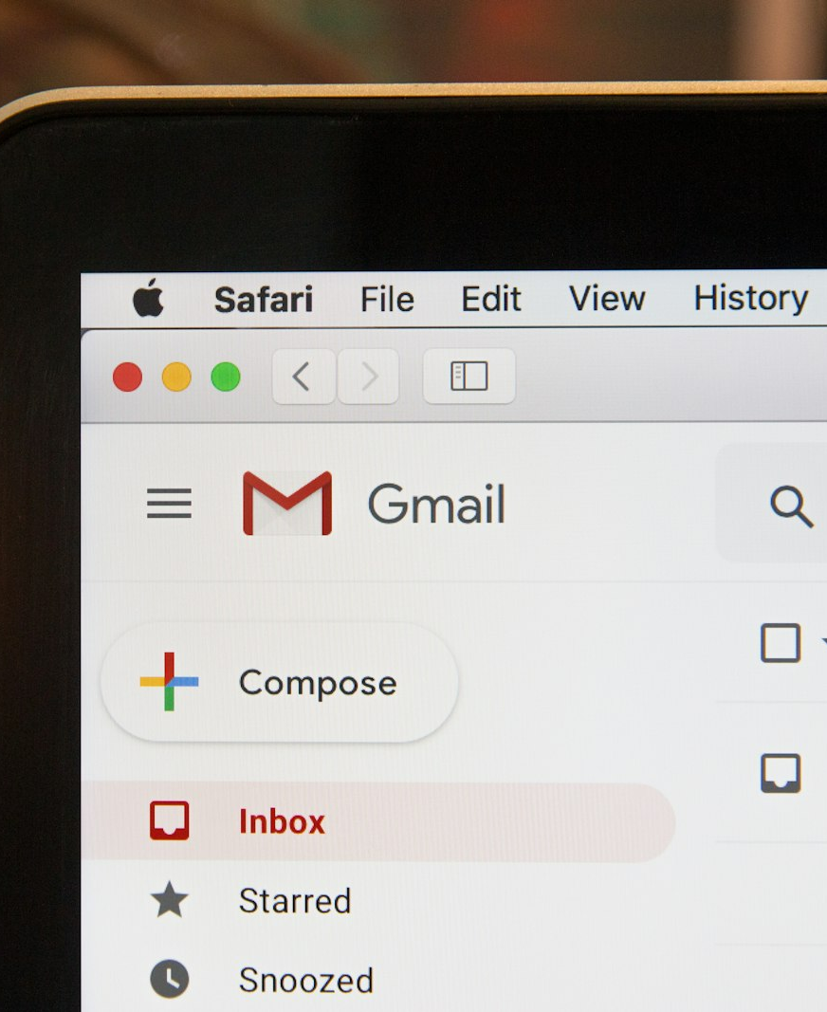
MB
THE FOREVER-NURTURE FORMULA
1 message / every 10 days / 4 easy pieces
One touch, sent roughly every 10 days, carrying content that's easy to consume in one sitting: one tip, one tool, one useful resource, one quote or industry note. A worked example from this module's source case built a 7-email sales sequence and a 16-email marketing sequence for a single persona, each keyed to a specific pain and objection with its own CTA. Educational webinars and business breakfasts built around one persona's real question slot into the same chain as a soft, low-commitment touchpoint.

Slide 19
MB
5.7 The intermediate offer (tripwire)

Slide 20
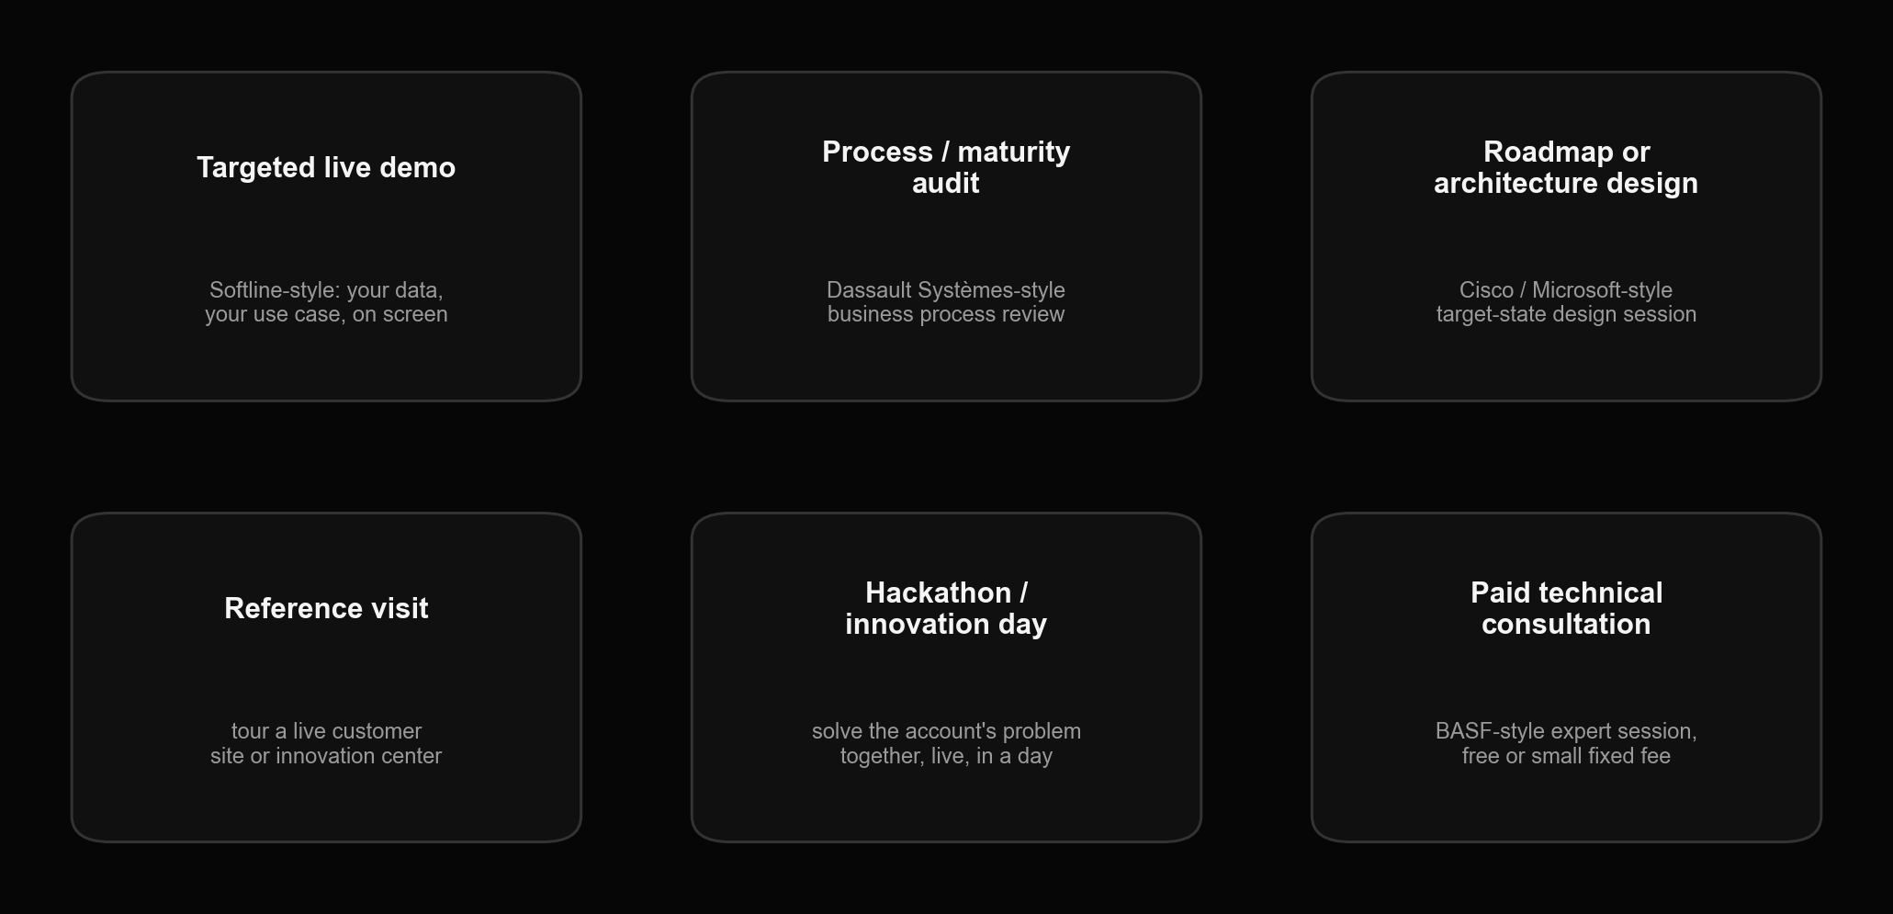
The tripwire offer: six formats, with real published examples
MB
"Demonstrate our expertise, confirm our solution moves this person's KPIs — free, low-cost, or credited to the project if they buy." It sits between content and a full sales cycle: the account has to act and hand over information, which makes it a stronger signal than a download. Softline, Dassault Systèmes, Cisco, Microsoft and BASF are published, public examples of the format.

Slide 21

MB
Tripwire in practice: a 3-hour AI hackathon
A worked example from this module: a 3-hour, coffee-break-included hackathon on "AI in acquiring and growing key accounts" — target audience B2B marketing/sales directors, priced modestly, positioned entirely as a taste of the real engagement to come.

Slide 22
MB
5.8 Consideration & decision: buyer enablement

Slide 23
MB
Buyer-enablement content for the late funnel
— Argument kits for your internal champion to use in a room you're not in — ROI benchmarks, competitor comparisons, calculators, best-practice case studies, demo recordings, testimonials, and a ready-made slide or email template
— Detailed case studies: customer background, the problem, how they chose a vendor, why they chose you, the project in detail (phases, process, diagrams), the result in photos and numbers, a quote, and a call to action
— Ten common proposal mistakes worth checking your own template against: pitching the technical buyer's language to the economic buyer (and vice versa); no cost-of-inaction framing; sending a bare spreadsheet with no narrative; no quantified financial benefit; no clear resourcing ask of the client's own team; testimonials instead of case studies; no reference list; a generic, uncustomized document; a confusing structure (the Minto Pyramid principle helps); and no tracking of whether the document was even opened

Slide 24

MB
What "decision-stage" content actually closes
By this stage the content is doing one job: make the ROI undeniable and make it easy for your internal champion to get budget approval without you in the room. (The original training also pointed to NetApp's own published persona-research deck as an outside example of documented personas at scale — that's NetApp's IP and isn't reproduced here.)

Slide 25
MB
5.9 Agentic ABM in practice

Slide 26
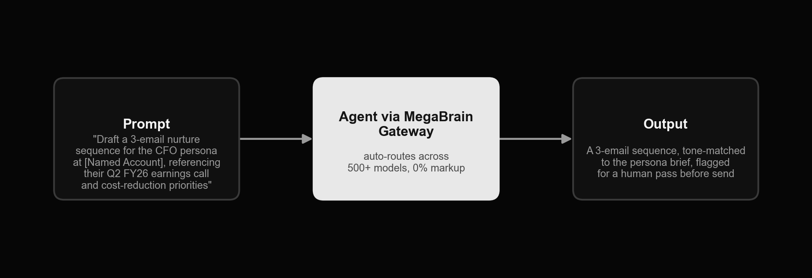
MegaBrain: an agent workflow for this module
MB
One prompt, routed through MegaBrain's model-agnostic gateway, turns a named account's public signals into a ready-to-edit, persona-specific email sequence — no separate copywriting tool, no per-model contract.

Slide 27
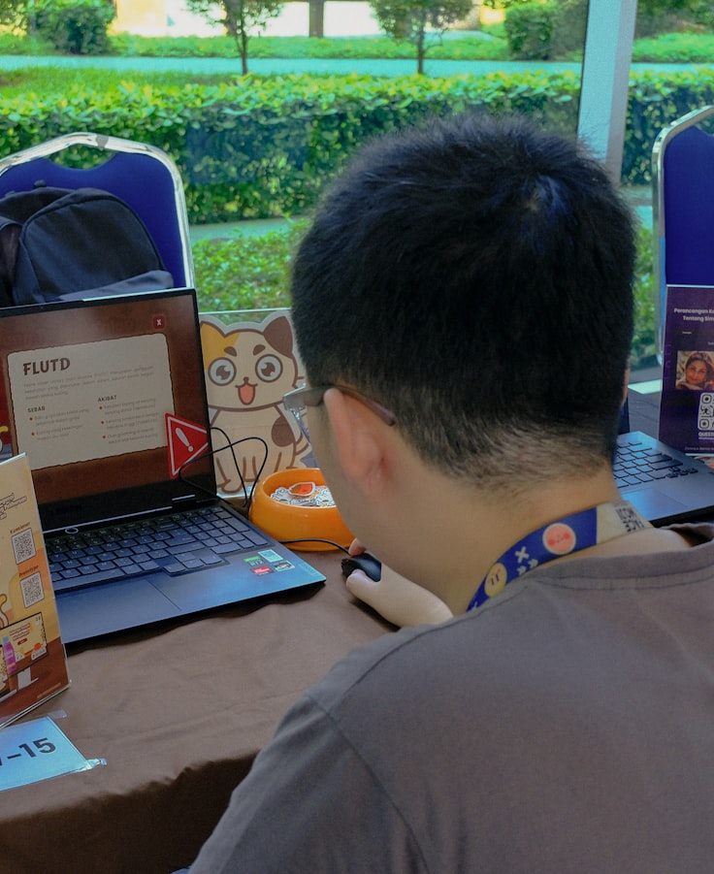
MB
Other agent tools for content personalization
Copy.ai — rebranded from a copywriting tool into a full "GTM AI platform"; drafts persona- and account-specific email and landing copy at scale. Mutiny — pivoted in 2024-25 from website A/B-test personalization into an agent-first platform that generates personalized content across the whole deal cycle. NotebookLM (Google) — turns your research and decks into an auto-generated explainer podcast for passive distribution. HeyGen — avatar-led video content, so one script can scale across personas and languages without a camera crew.

Slide 28
MB
Exercises

Slide 29
MB
Homework 1 — build your 3 core personas (Variant 2 format)
— Pick your 3 highest-priority personas from the ICP and account plans you built in Modules 2-3
— Gather source material for each: 5+ real customer/lost-deal interviews if you can get them, CRM win/loss notes, sales call recordings, job postings for the role
— For each persona, write down at least 3 pains, 3 objections, and 3 must-know points, plus what they compare you to
— Cross-check the draft with your sales team before finalizing — they hear these objections live and will correct you
— Save the result in the persona-brief-template.xlsx workbook — bring all 3 personas to Module 6

Slide 30
MB
Homework 2 — design one awareness-stage lead magnet
— Choose one format from the 5 in section 5.5 (thought leadership, benchmark report, guide/checklist, case-study digest, or calculator)
— Define: which persona, which single pain, what the reader learns, and the one CTA at the end (no gate, no form)
— Draft a full outline — section by section — and write the first section yourself, in full
— Decide your distribution: on-site article, LinkedIn post, or an auto-generated podcast/video version

Slide 31
MB
Homework 3 — build a 9-email nurture chain for one persona
— Pick one of your 3 personas and list every pain/objection you want to address across the chain
— Apply the 1/10/4 rule: one email every ~10 days, each carrying one easy-to-consume piece of content
— Write a subject line and a one-CTA content plan for all 9 emails, in sequence, building from awareness to decision
— Produce two versions of the same content plan: a marketing-automation version (HTML, unsubscribe link) and a from-a-rep version (plain text, sent from a real inbox)

Slide 32
MB
Homework 4 — design your tripwire (intermediate) offer
— Pick one format from section 5.7 that fits your business (audit, demo, roadmap session, hackathon, technical consult, etc.)
— Define: target audience, the pains it resolves, and the 3 concrete outcomes the account walks away with
— Set the format's mechanics: duration, what you need from the client in return, and price (free / small fixed fee / credited to the main project)
— Write the one-page pitch you'd actually send to invite an account in

Slide 33
MB
Homework 5 — draft persona messaging with MegaBrain (required)
— Confirm the getmegabrain.com account and API key you set up in Module 1's Homework 4 — this exercise uses it directly
— In the MegaBrain dashboard, pick a model from the Gateway (any general-purpose model is fine to start)
— Use the RISE prompt from section 5.3 to draft a full persona brief for one of your Homework 1 personas
— Then prompt the same model: "Draft a 3-email nurture sequence for the {persona} at {a real target account from your list}, referencing their most recent public earnings call, product launch, or leadership change, and their likely cost/growth priorities."
— Read the output against your own persona brief and account intelligence — mark anything you'd cut, and rewrite the parts a human reader would catch as generic
— Bring the edited sequence, plus a one-line note on which model you used, to Module 6

