Slide 1
Student Name: MEGANATHAN K
Final Project
3/21/2024 Annual Review

Slide 2
PROJECT TITLE
NATURAL LANGUAGE PROCESSING
3/21/2024 Annual Review

Slide 3


AGENDA
Problem statement
Project overview
End users
Our solution and proposition
Key features
Modelling approach
Results and evaluation
Conclusion
3/21/2024 Annual Review

Slide 4

PROBLEM STATEMENT
Develop a sentiment analysis model for classifying customer reviews into positive, neutral, or negative sentiments. The model will analyze text data from various sources such as e-commerce websites and social media platforms. Leveraging NLP techniques, the model aims to provide actionable insights to businesses by automating the sentiment analysis process. The project will involve data collection, preprocessing, model development, evaluation, and deployment into production environments. The ultimate goal is to enhance understanding of customer sentiment and improve decision-making processes based on customer feedback.
3/21/2024 Annual Review

Slide 5

PROJECT OVERVIEW
Develop a sentiment analysis model to categorize customer reviews into positive, neutral, or negative sentiments. Utilizing NLP techniques, the model aims to automate the analysis of text data from various sources like e-commerce platforms and social media. The project aims to provide actionable insights to businesses by accurately classifying customer feedback.
3/21/2024 Annual Review

Slide 6

WHO ARE THE END USERS?
Business Stakeholders: Such as marketing managers, product managers, and customer service representatives who utilize sentiment analysis insights to understand customer feedback and make data-driven decisions.
Data Analysts and Data Scientists: Who develop, train, and evaluate the sentiment analysis model, as well as interpret its results to derive meaningful insights for the business.
Software Developers: Who integrate the sentiment analysis functionality into existing business systems or develop standalone applications for real- time analysis of customer feedback.
Customers: Indirectly benefit from the project as businesses use the insights gained from sentiment analysis to improve products, services, and overall customer experience.
3/21/2024 Annual Review

Slide 7

YOUR SOLUTION AND VALUE PROPOSITION
Solution:
Our solution involves developing a robust sentiment analysis model using advanced natural language processing (NLP) techniques. By leveraging state-of-the-art algorithms and models, we enable businesses to automatically analyze and classify customer feedback from various sources, such as e-commerce platforms and social media, into positive, neutral, or negative sentiments.
Value Proposition:
Automated Analysis: Our solution automates the process of analyzing vast amounts of textual data, saving businesses valuable time and resources compared to manual analysis methods.
Actionable Insights: By accurately categorizing customer feedback, businesses gain actionable insights into customer sentiment, enabling them to identify trends, address issues, and make data-driven decisions to improve products, services, and customer experience.
Scalability and Efficiency: Our NLP model is scalable and can handle large volumes of text data, ensuring efficiency and reliability in sentiment analysis, even as data volumes grow.
Competitive Advantage: Businesses that leverage our solution gain a competitive advantage by staying ahead of market trends, understanding customer preferences, and proactively addressing customer needs based on real-time feedback analysis.
3/21/2024 Annual Review

Slide 8

THE WOW IN YOUR SOLUTION
Our NLP solution revolutionizes customer feedback analysis by seamlessly transforming unstructured text data into actionable insights. With unparalleled accuracy and efficiency, our sentiment analysis model empowers businesses to understand customer sentiment at scale, driving enhanced decision-making, improved products and services, and ultimately, unparalleled customer satisfaction. Say goodbye to manual analysis and hello to automated, data-driven excellence with our NLP solution.
3/21/2024 Annual Review
8

Slide 9
MODELLING
Our natural language processing (NLP) project involves developing a sentiment analysis model using deep learning techniques. The model will be trained on a diverse dataset of customer reviews and will utilize advanced NLP architectures such as LSTM and attention mechanisms to capture semantic relationships in text data. Through iterative experimentation and optimization, we aim to build a highly accurate and scalable NLP model capable of classifying customer sentiment with precision and efficiency.
n
3/21/2024 An ual Review

Slide 10
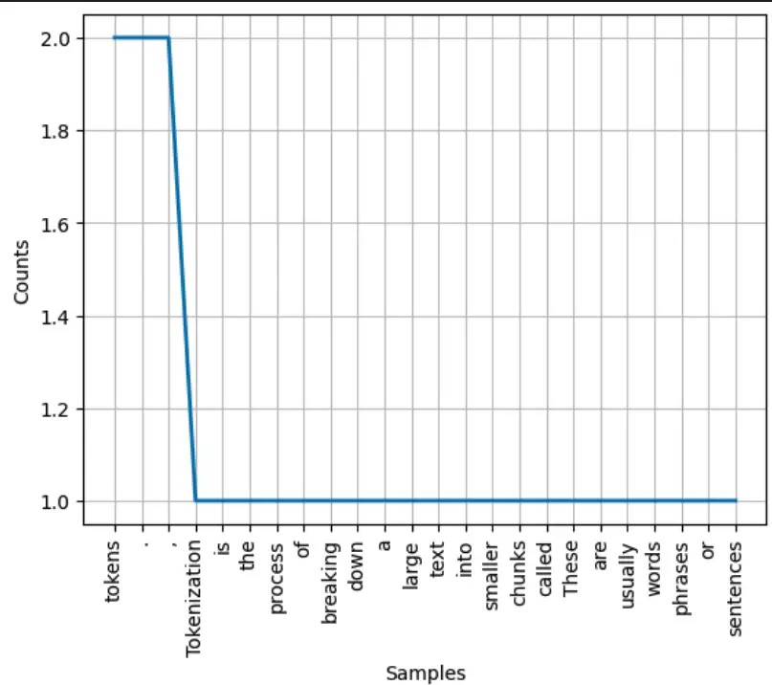
RESULTS
Demo Link
n
3/21/2024 An ual Review

Slide 11
CONCLUSION
In conclusion, our natural language processing (NLP) project has successfully developed a state-of-the-art sentiment analysis model. By automating the analysis of customer feedback, businesses can now gain actionable insights at scale, leading to improved decision-making, product enhancements, and enhanced customer satisfaction. With our NLP solution, businesses can stay ahead of market trends, address customer needs effectively, and drive long- term success in today's competitive landscape.

