Slide 1


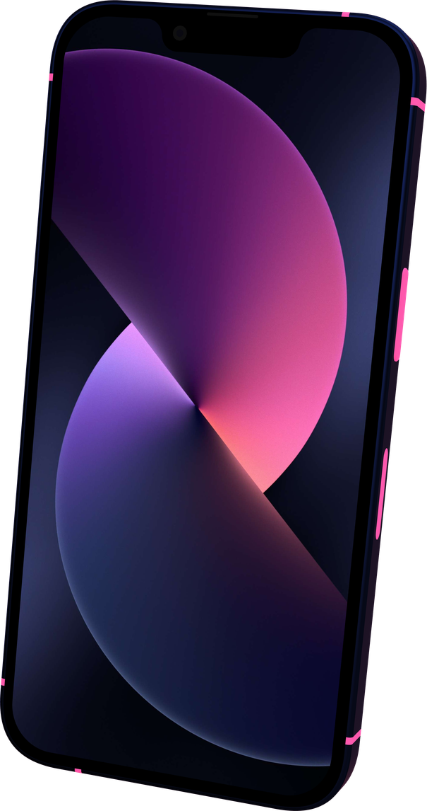

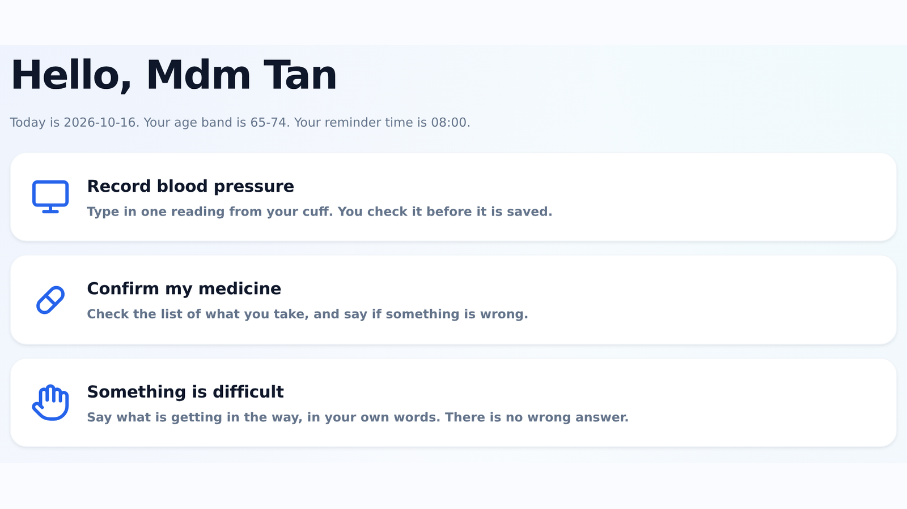
CARESteps / ARCHITECTURE
16 OCT 2026
TENCENT CLOUD AI SINGAPORE HACKATHON 2026
CareSteps
Architecture &
Trust Boundaries
A safety-first self-care companion for older adults
managing blood pressure.
Local application • Optional model • Human confirmation
3
10
13
ordered safety gates
model-facing tools
SQLite tables
One local source of truth
Routes, safety, tools and SQLite stay together.
Healthcare Challenge 2 | AI Healthier Every Day | Competition prototype
CareSteps | Healthcare Challenge 2
Handbook pp. 35, 37 | Source review: 16 October 2026
01 / 09
Notes:
CareSteps architecture submission. Healthcare Challenge Statement 2: AI Healthier Every Day. The deck is a source-checked prototype overview using simulated data.

Slide 2
CARESteps / ARCHITECTURE
16 OCT 2026
System Architecture
A local FastAPI application owns decisions, validation and storage; the model is optional.
APPLICATION HOST / FastAPI + Python
Browser UI
Jinja + JS + CSS
Routes
Safety router
Orchestrator
External model
Forms + /api/chat
3 ordered gates
Live loop / fallback
OpenAI-compatible endpoint
Context + tool results out
Prose + tool requests in
Output check
Tools + statistics
Repository
Live prose + numbers
10 named contracts
Validated SQL
SQLite
Health content
Records + audit
Source-linked JSON
Safety can return early • Forms use server validation • Model availability never owns storage
CareSteps | Healthcare Challenge 2
app/main.py | app/routes/api.py | app/llm/orchestrator.py | app/repository.py
02 / 09
Notes:
Solid arrows represent local flow. Dashed arrows cross the optional model or content boundary. The three chat safety gates run before the orchestrator; SQLite is local to the application host.

Slide 3
CARESteps / ARCHITECTURE
16 OCT 2026
Trust Boundaries
Every model request is re-validated; browser, model and imported content have limited authority.
01 USER DEVICE
02 TRUSTED APPLICATION
03 LOCAL STORAGE
04 EXTERNAL INPUTS
Browser
Input + safety
SQLite + audit
Model + education
Untrusted forms + chat
Readable signed cookie
Route, validate, decide
Scope user + session
Records, sources
Redacted audit trail
Minimal context out
Seed-time content checks
Server owns user_id
No encryption at rest
Endpoint is optional
Tools cannot issue SQL
Corrections preserve history
Content has source metadata
Prototype boundary: shared demo profile, local HTTP and readable cookie state still need production hardening.
CareSteps | Healthcare Challenge 2
app/routes/deps.py | app/tools/handlers.py | app/content_loader.py | app/db.py
03 / 09
Notes:
Four zones separate user device, trusted application, local storage and external inputs. The model has no database credential, arbitrary SQL tool or confirm_draft contract. The signed cookie provides integrity, not production authentication.

Slide 4
CARESteps / ARCHITECTURE
16 OCT 2026
Safety Gates Run Before the Model
The first decisive verdict ends the turn; model instructions cannot bypass this ordering.
FIXED ORDER / ONE MATCH CAN END THE TURN
01 Red flags
match
Emergency / urgent guidance
WHEN ALL THREE ALLOW
Symptoms + reading context
Fixed response; no model call
otherwise
Continue to:
• live model tools
• rule-based degraded support
02 Boundaries
match
Refuse + redirect
Dose changes or unclear medicine
Fixed response; no model call
otherwise
Priority is deterministic. Detection remains limited to authored rules.
03 Clarification
match
Ask for details
Missing values or intent
Fixed response; no model call
Red flags > boundaries > clarification | Safety is evaluated before the orchestrator.
CareSteps | Healthcare Challenge 2
app/safety/__init__.py: route | app/llm/orchestrator.py: run_turn
04 / 09
Notes:
route() evaluates red flags, boundaries and clarification in order. emergency, urgent_advice, refuse and clarify all block model access. Detection uses authored patterns and context; it is not a clinical diagnostic system.

Slide 5
CARESteps / ARCHITECTURE
16 OCT 2026
Tool Calling & Human Confirmation
The server owns identity, argument checks and database operations; the model only requests named tools.
READ / COMPUTE
"What was my average blood pressure this week?"
Safety
Request
Validate
Compute
Answer
Gates pass
get_period_stats
{days: 7}
Schema + context
user_id server-owned
repo + stats.py
window, gaps, n
Facts -> prose
Live output check
Readings and medication reports
PREPARE / CONFIRM
Prepare
Preview
Confirm
Persist
Validate + stage
No health record
Show draft values
User sees before save
POST /api/chat/confirm
UI-only handler
Repository saves
Duplicate protection
10 model-facing contracts | Human confirmation protects staged health records | Scoped direct writes stay explicit
CareSteps | Healthcare Challenge 2
app/tools/contracts.py | app/tools/handlers.py | app/routes/api.py | app/stats.py
05 / 09
Notes:
The read example uses the real get_period_stats tool with days=7. user_id comes from ToolContext. Readings and medication reports stage a draft, then a user action confirms the write. record_barrier, add_question and set_reminder_preference are scoped direct-write exceptions.

Slide 6
CARESteps / ARCHITECTURE
16 OCT 2026
Degraded Mode & Partial Failure
Core workflows remain available when the optional model is missing, unavailable or interrupted.
No live endpoint
Call fails before tools
Tools already ran
Unset configuration
or forced degraded
Timeout or unreadable
provider response
Later failure or
round budget exhausted
Rule-based reply
Rule-based reply
Tool-result fallback
mode = degraded
mode = degraded
mode = live + check
LOCAL WORKFLOWS REMAIN AVAILABLE
BP entry forms
Trends + statistics
Medicine reports
Visit summary
A later model failure does not undo completed tool writes; the application records actual outcomes.
CareSteps | Healthcare Challenge 2
app/config.py | app/llm/provider.py | app/llm/orchestrator.py
06 / 09
Notes:
Missing configuration or forced degraded mode uses _degraded_turn. A provider failure before tools also degrades. If tools already ran, the fallback text can still return mode live and is checked. Completed writes are not rolled back.

Slide 7
CARESteps / ARCHITECTURE
16 OCT 2026
Data Model & Provenance
13 SQLite tables grouped by responsibility; the repository owns request-path database access.
user_profile
Profile, preferences and simulated-data marker
HEALTH RECORDS
SUPPORT + PREPARATION
KNOWLEDGE + TRACE
care_plan
barrier_event
education_source
medication_item
support_action
education_fact
bp_reading
consultation_question
conversation_message
medication_report
visit_summary
audit_event
Preserved corrections • Unique dedupe keys • Source metadata • Audit events
Patient data is fictional and simulated; source checks do not equal clinical review.
CareSteps | Healthcare Challenge 2
app/db.py: SCHEMA | app/repository.py: corrections, dedupe and audit
07 / 09
Notes:
The table count is checked by executing SCHEMA in memory. This is a responsibility map, not a complete ER diagram. Corrections preserve history through superseded_by; missing reports remain unknown rather than compliant/non-compliant.

Slide 8
CARESteps / ARCHITECTURE
16 OCT 2026
Prompting, Grounding & Traceability
The prompt sets tone and limits; deterministic code controls routing, tools, calculations and checks.
System prompt
Minimal context
Bounded tool loop
Live output check
Role, tone, limits
caresteps.system.v3
Profile + latest
12 messages
Named operations
Default: 4 rounds
Known numbers + phrases
Replace on failure
PROMPT POLICY SUMMARY
INSPECTABLE AT /trace
Numbers: use tool results
Active contracts + provider status
Education: retrieve, then cite
Rule version + source IDs
Unknowns: ask or defer
Prompt version + fingerprint
Medication changes: refuse
Tool outcomes + response mode
Output checks are grounding heuristics; they do not provide clinical validation.
CareSteps | Healthcare Challenge 2
app/llm/prompts.py | app/llm/orchestrator.py | app/main.py: /trace
08 / 09
Notes:
The system prompt is caresteps.system.v3. Context includes profile orientation and the latest 12 messages; tool results are appended. check_output uses heuristic numeric and phrase checks. /trace exposes contracts, rule metadata, provider status, source IDs and audit events.

Slide 9
CARESteps / ARCHITECTURE
16 OCT 2026
Key Design Trade-offs & Prototype Limits
Each constraint makes the local prototype easier to inspect and leaves a clear production task.
CHOICE
WHY IT HELPS
COST / NEXT STEP
Deterministic gates first
Immediate, inspectable safety routing
Expand clinical review + rule coverage
SQLite + local browser assets
One-process, reproducible demo
Add auth, encryption and scaling
Scoped tools + confirm flow
Validated operations + visible drafts
Add atomic turn boundaries
Optional model endpoint
Core workflows survive downtime
Verify live provider in production
170 automated tests passed | 10 model tools | 13 tables | Source-linked rules and education
Simulated data | No clinical validation | No health-system integration | No accessibility conformance audit
CareSteps | Healthcare Challenge 2
Handbook p. 35 | docs/decisions.md | Source assertions checked against current app/ code
09 / 09
Notes:
Automated validation recorded 170 passed tests on 16 October 2026. Tests do not establish clinical safety, accessibility conformance or live model performance. Known limits include no production login, no encryption at rest, no atomic whole-turn transaction and no health-system integration.

