Slide 1
Crossflow filtration model
Model interpretation and implementation
Serverless end-to-end full stack model deployment on AWS
Ethan de Villiers

Slide 2
Presentation Outline
Model interpretation and encoding
Algorithms and implementation
Sample results
Backend AWS Deployment
AWS Architecture
AWS Step Function

Slide 3
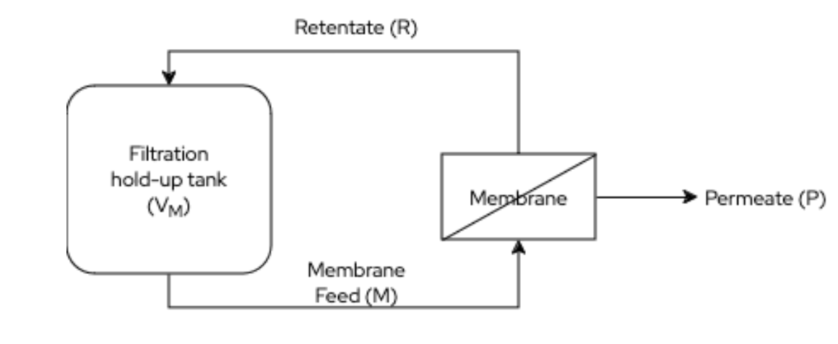
Model Interpretation
Crossflow filtration “concentration mode”
Unable to pull protein out of system without water in filtration (eg. nickel protein purification columns)
= focused on efflux of water from system
Q_{P} = Permeate flow rate, efflux rate of water from the system
How to model concentration changes: 100% or 0% Protein loss in Qp
If MWCO < MW_{Bov Cas} then C_{BovCas, R} = 100%
If MWCO => MW_{Bov Cas} then C_{BovCas, R} lost proportional to water, no change in C_{BovCas, M}
Cross flow filtration only works when MWCO < MW, then calculate permeate flow rate

Slide 4

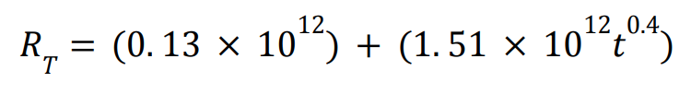
Q_{P} = JA
m³ = 1,000 L
ΔP given in Pascals (Pa)

Slide 5
Ballpark figure with equation
System at Maximum efflux =
100,000 tmp * 10 m2
t = 0 (least resistance)
1,00,000 / 130,000,000 = 0.00077 m3 hr-1 = 0.77 L hr-1
1000 L 2x Conc = 500 L / 0.77 = ~650 hrs

Slide 6
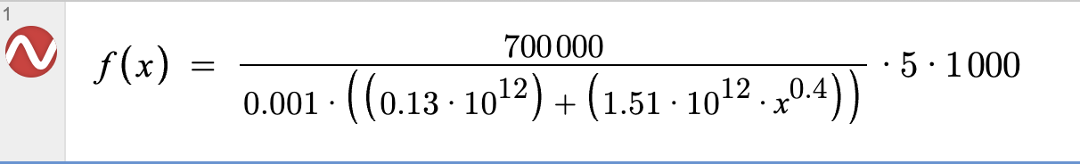
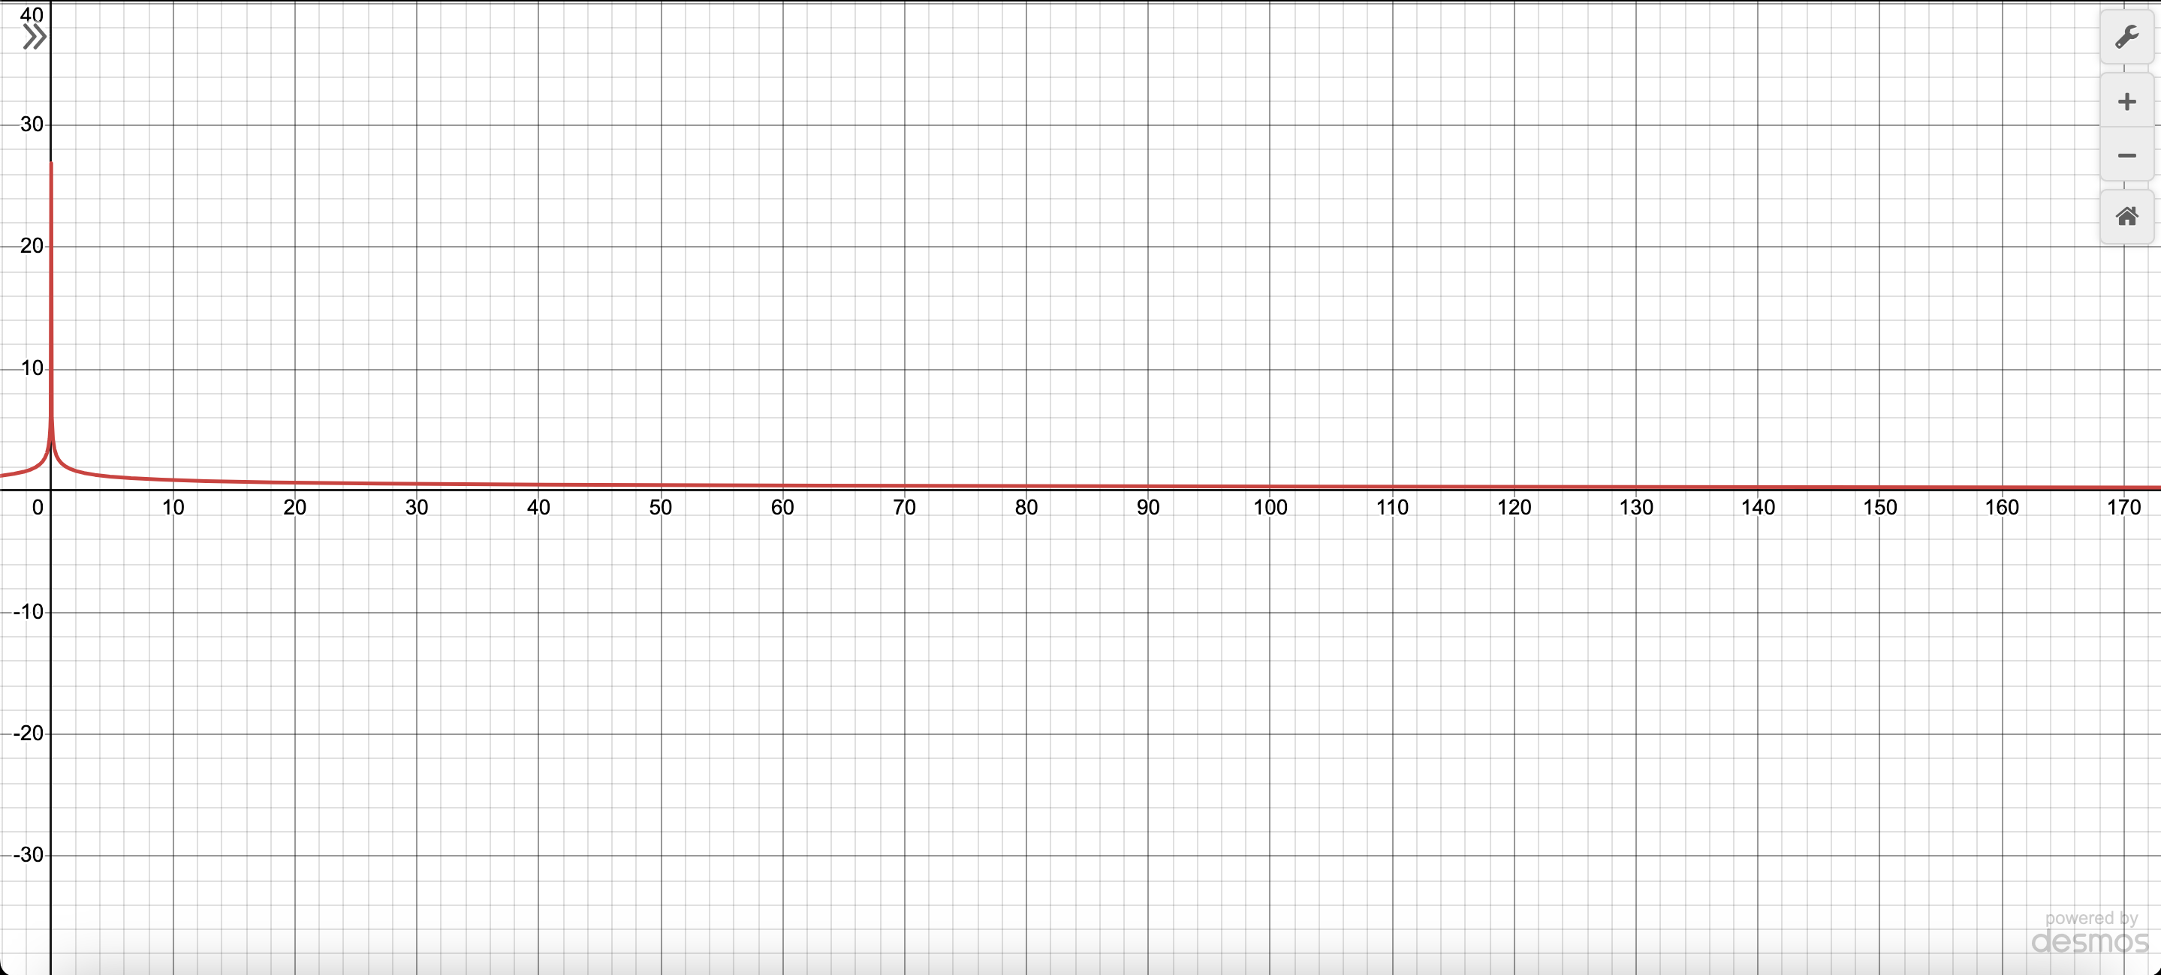
F(x=0) = ~27m3
F(x=1) = ~2m3
= ~93% loss
High Volatility,
Consistent Range
Majority of data, variable range
Remainder Compute

Slide 7
3 compute-efficient algorithms for accuracy
Cut-off Regular-interval, high resolution, frequently updated permeate flow rates
First 20 hours where most critical data lies
50 iterations over 20 hours = flow rate updated every 0.4h
Problem: If problem takes thousands of hours, cannot iterate 1000/0.4
Scaling refresh intervals to handle most data
Cannot hard-code an interval to perform:
One query may take 100 hours (80 hours interval at every 8 hours)
Another query may take 10,000 hours (8 hour intervals not feasible)
Calculate remaining time at t=20, use % of remainder to scale intervals
Problem: cannot capture small-scale, highly volatile changes
Use final rate at end of Stage 2. to estimate remaining time

Slide 8
1/5 {estimated width}
Regular Intervals
Scaled intervals

Slide 9
1/5 {estimated width}
. . .
Regular Intervals
Scaled intervals
Flat rate

Slide 10
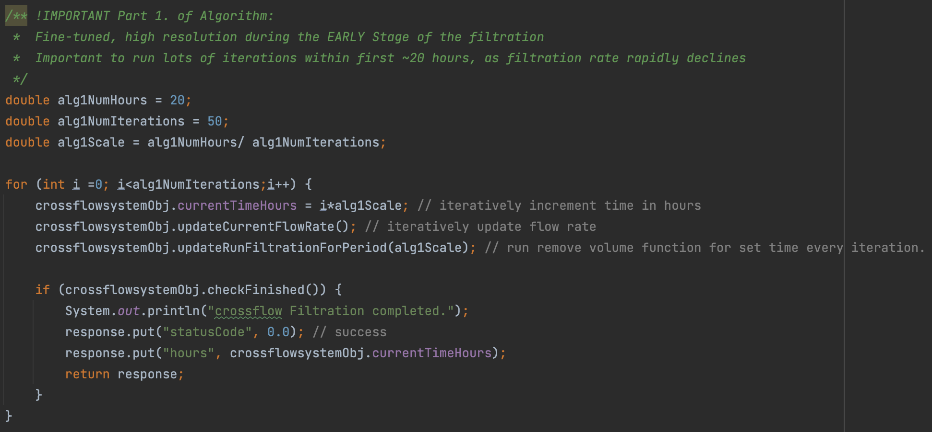
Algorithm 1: Cut-off Regular Interval: Implementation

Slide 11
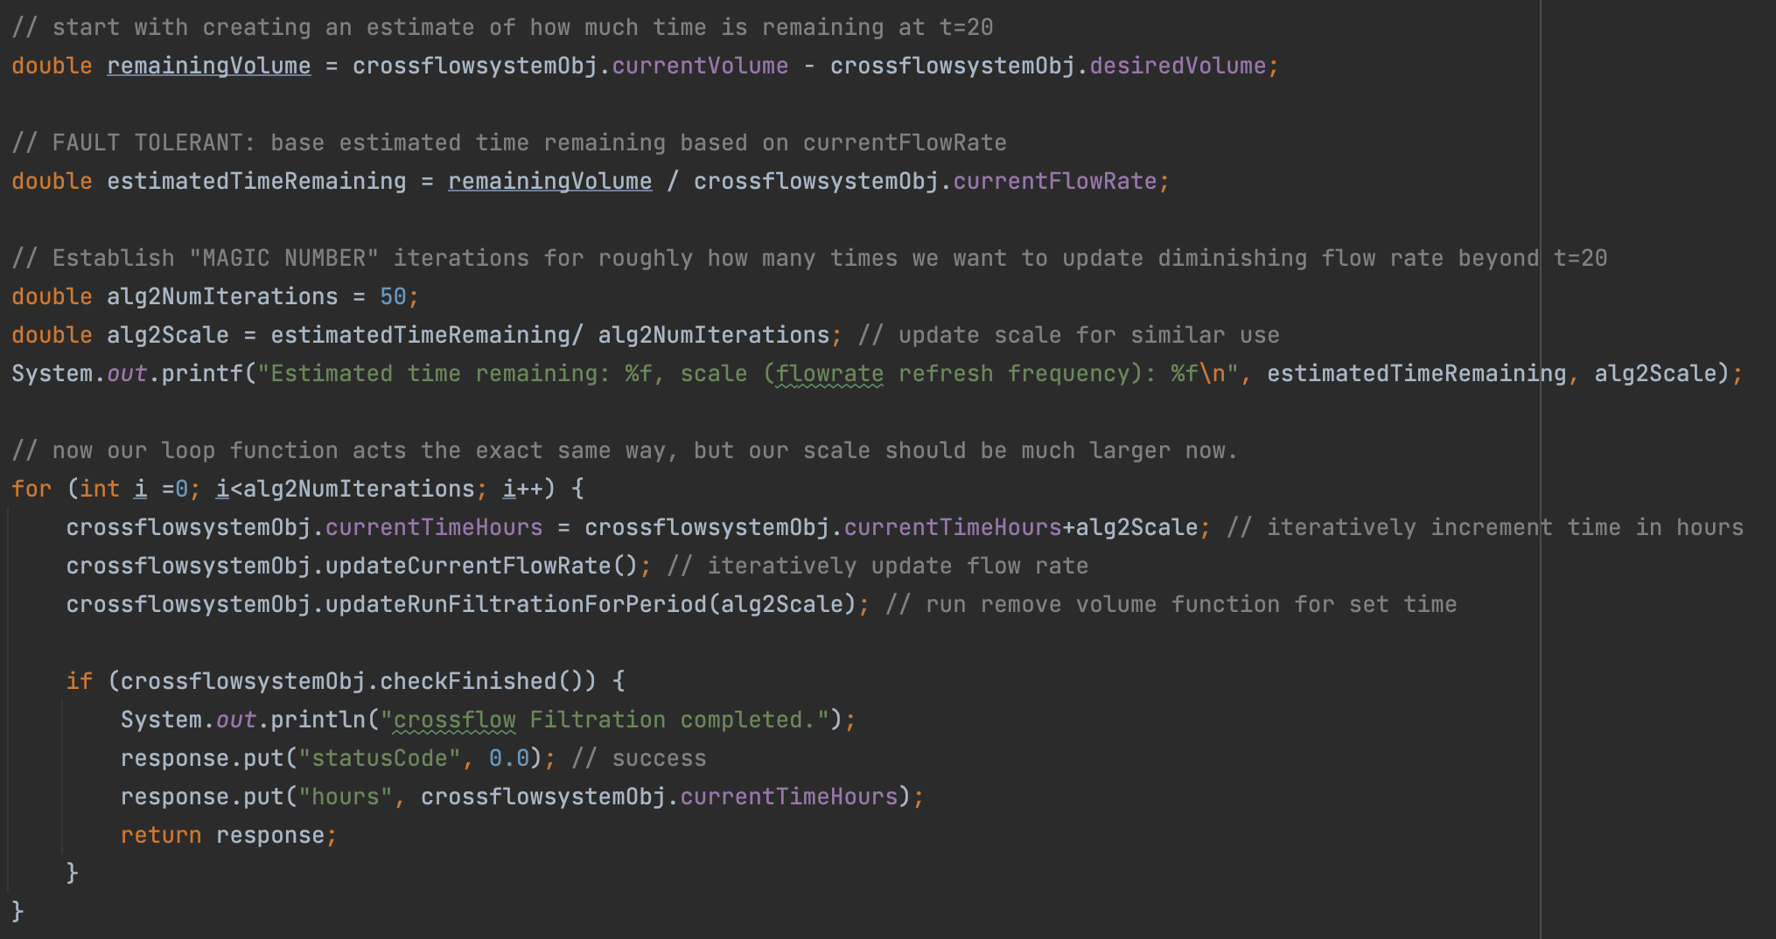
Algorithm 2: Scaled intervals for 50 iterations

Slide 12
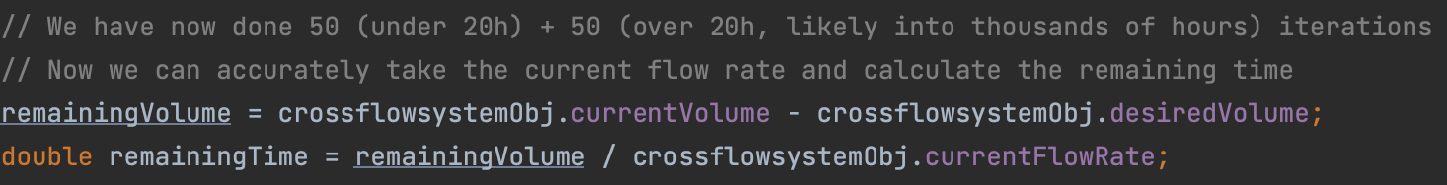
Easy Algorithm 3: flat flow rate, no more refresh

Slide 13
Example test results: Hours too high
Starting Volume (L) | Transmembrane Pressure (Pa) | Membrane Area (m2) | Concentration Factor | Filtration Hours
100 | 120,000 | 2 | 5 | 8,735
1000 | 200,000 | 5 | 2 | 15,758
15,000 | 700,000 | 10 | 3 | 71,244

Slide 14
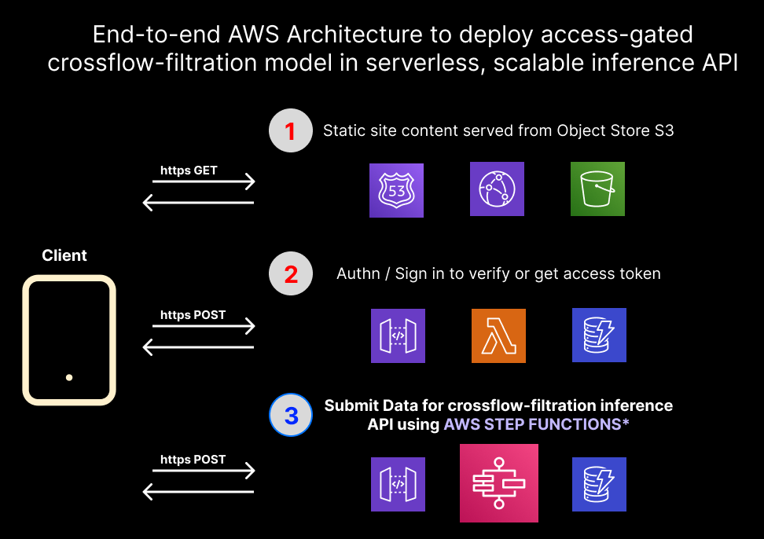
AWS Deployment:
Java Extremely Light → Can afford request/response architecture
With larger/longer models will require Long Polling (WorkID) architecture

Slide 15
Access-gated via custom Authn/Authz ecosystem
User database stored on DynamoDB, salted and SHA256-hashed
Session / token based validation → Exchange sign in credentials for 12hr token
Token exchanged when accessing step function
Facilitated by jQuery
Security: hashed and salted credentials , tokens stored as same-site cookies, (vs. CSRF, CSX), all endpoints HTTPS-exposed

Slide 16
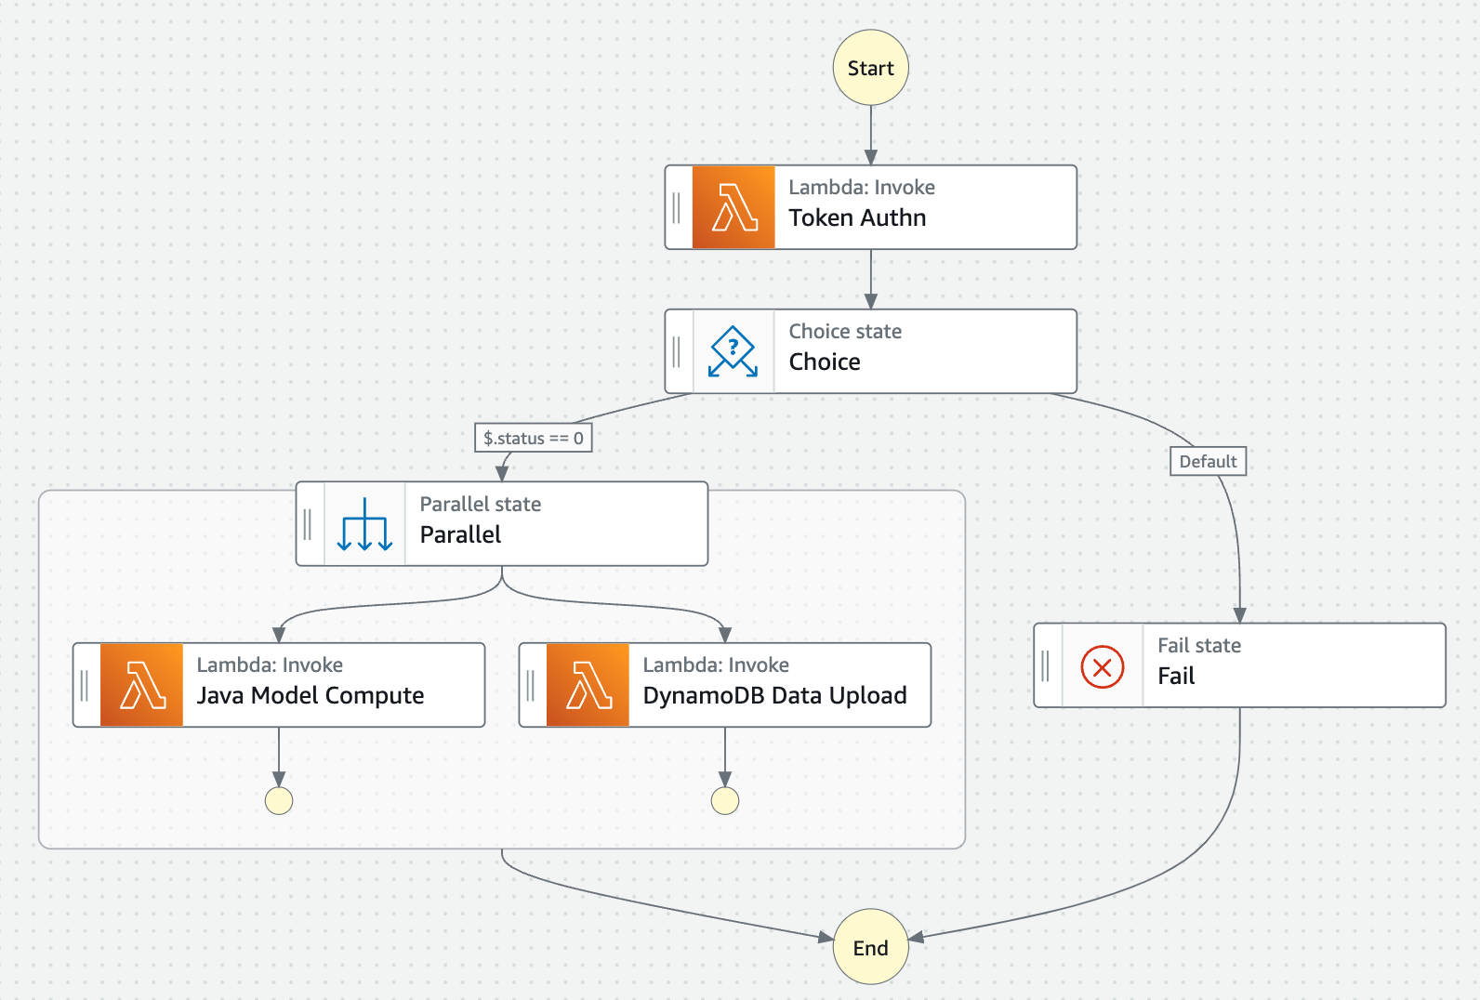
Step Function Architecture
Exposed from API Gateway
Extremely easy to develop client-friendly API:
Existing token ecosystem
Existing endpoints for POST requests
Missing Documentation

Slide 17
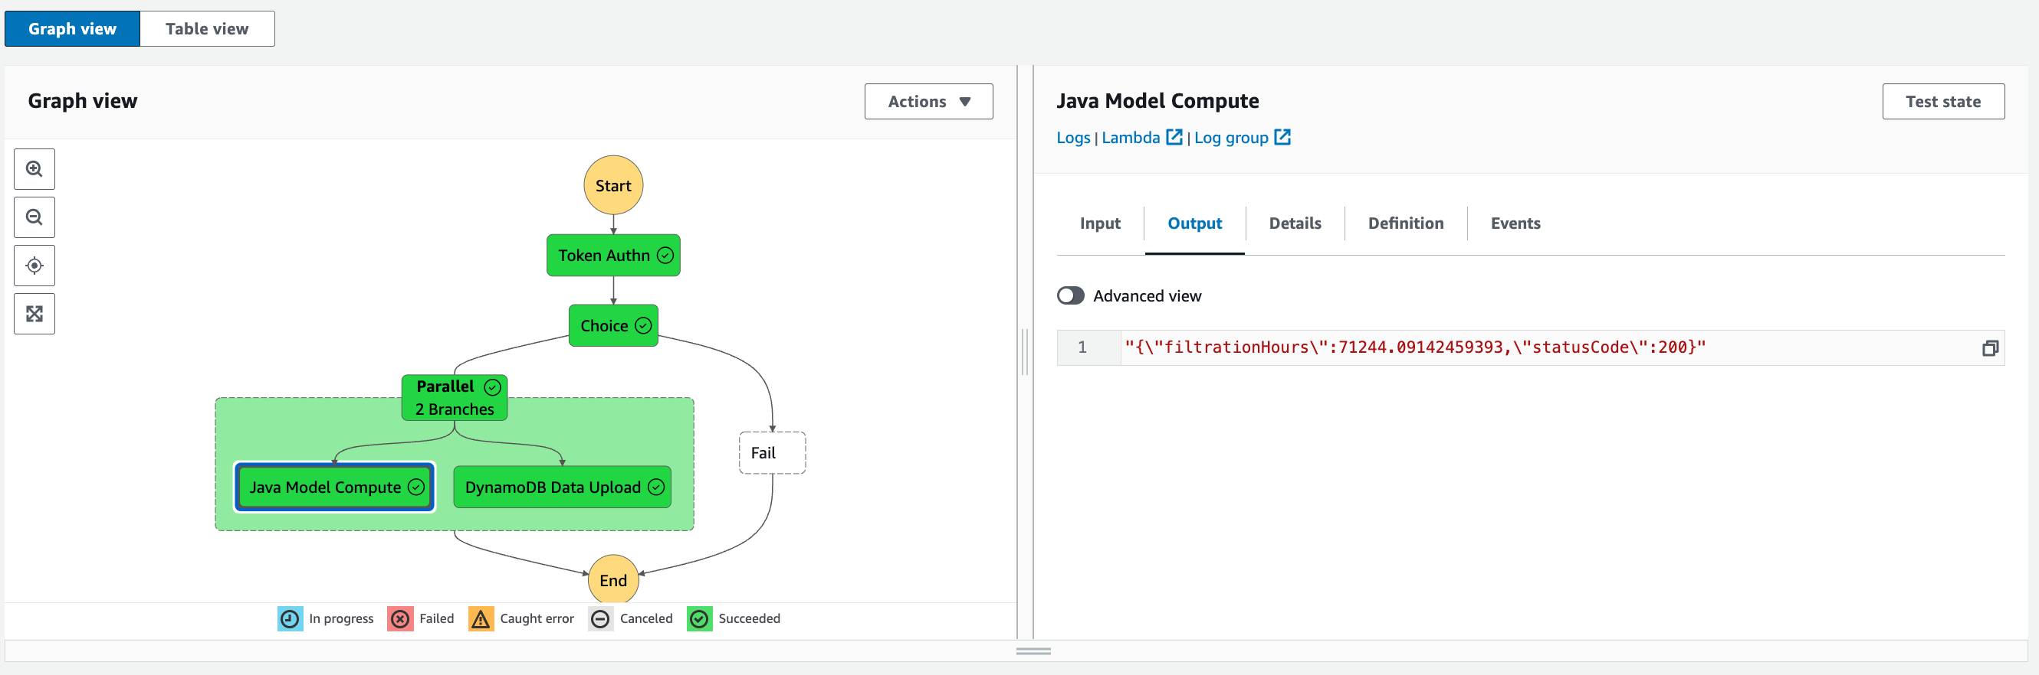
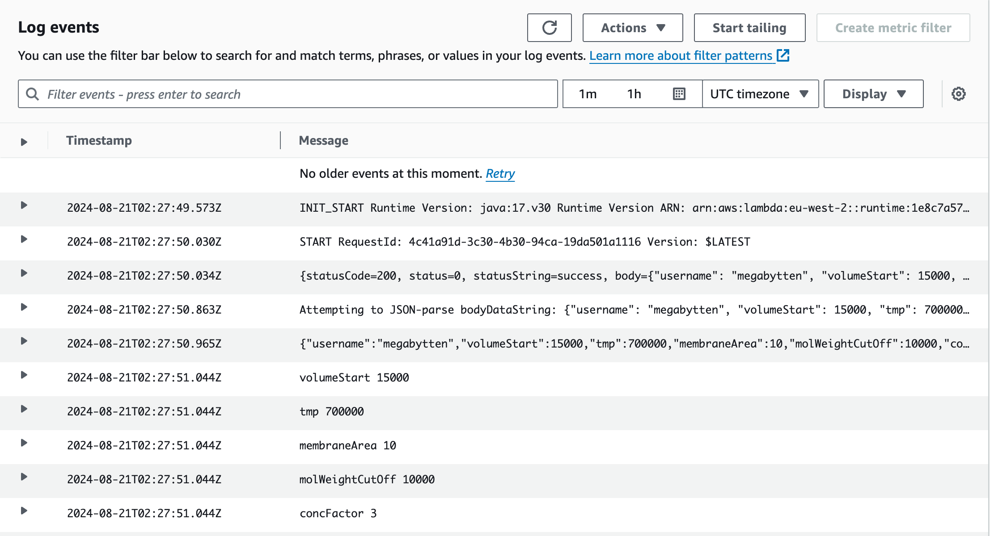
Logging, Monitoring
Intellij / Vscode Local Deployment configuration
CloudWatch Logs (Integrated), Xray (paid, improved)
AWS Step Functions State Machine dashboard

Slide 18
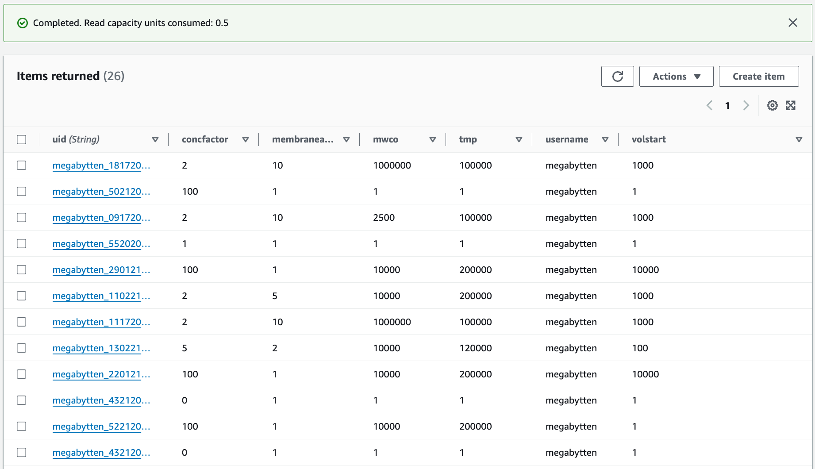
Integrating new training data - DynamoDB
Critical to capture and generate usable data across the DataEng lifecycle
Capturing User-submitted data allows training of RNNs
Consideration: Integrating customer-provided labelling of failed/successful model predictions:

Slide 19
Extra notes:
API Gateway VTL
Next Steps:
Client dashboard for previous requests:
Allow to provide feedback on specific request by unique model IDs (DynamoDB)
”closes the loop” – client labelled success/failure of model predictions
Training RNN to better predict outcomes using labelled data
Developing Client API
Create documentation for exposed HTTPS endpoint
Data models, errors, troubleshooting, bug reporting

