Slide 1








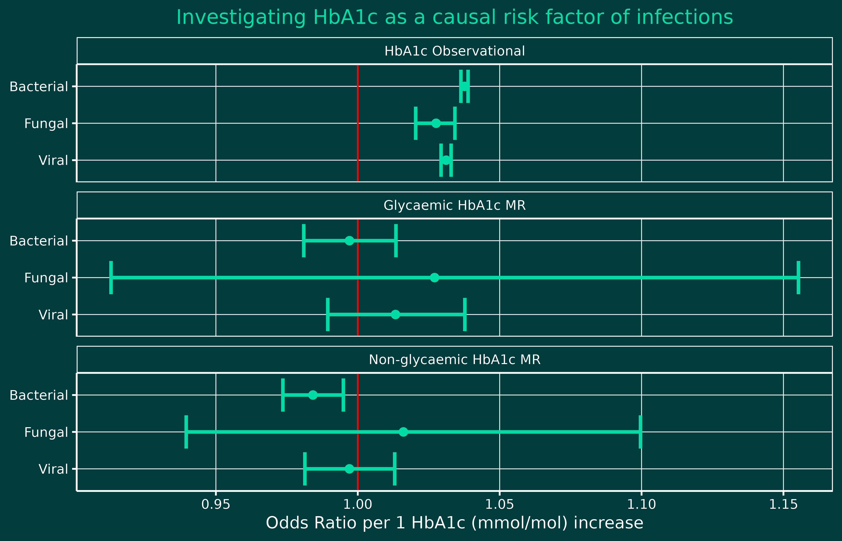
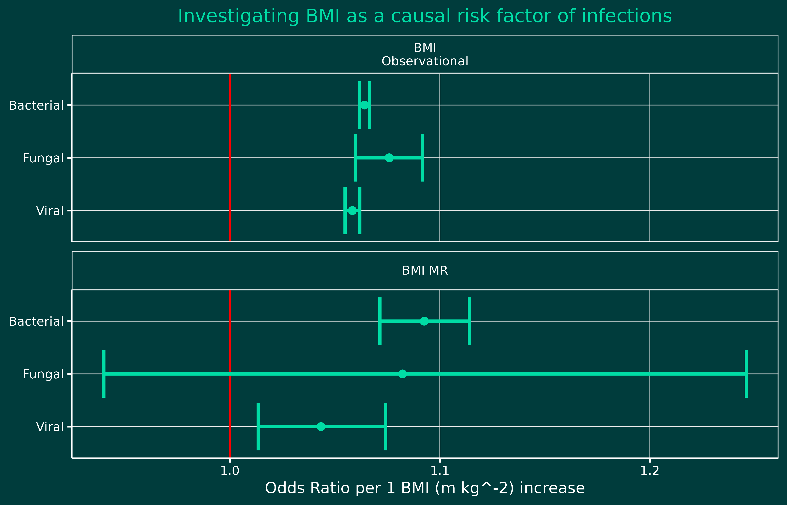
Investigating the causal link between prolonged hyperglycaemia and hospitalisation for infection: a Mendelian randomisation study
Ethan de Villiers, Rhian Hopkins, Michael N Weedon, John M Dennis, Harry D Green
Background
Methods: Mendelian randomisation
Diabetes treatment focuses on controlling glycaemia between hypoglycaemic and hyperglycaemic levels. (1)
Personalised diabetes treatment commonly involves trading off polypharmacy for decreased glycaemic control. (1)
Mendelian randomisation (MR) tests for causal role of genetically predicted HbA1c on risk of infections.
Glycaemic and non-glycaemic HbA1c-related variants taken from MAGIC.
Recent studies have implicated prolonged elevated glycaemia in the development of numerous complications. (2, 3)
Previous research has observed associations between diabetes and increased risk of infections, with no current causality. (4)
Aim
Why MR?
Robust method adjusting for unmeasured confounding on HbA1c.
No reverse causality, HbA1c genes come first, MR results indicate one-way effect of HbA1c on infections.
Investigate if elevated glycaemia is a causal risk factor for increased risk of infections.
Cohort
491,026
UK BIOBANK participants classified into 4 groups based on ICD10 hospital records:
Bacterial (N = 40,389) | Fungal (N = 703) | Viral (N = 17,961) | Control (N = 431,973)
Results
median (LQ – UQ) | bacterial | fungal | viral | control
HbA1c | 36.2 (33.5 - 39.4) | 36.1 (33.2 - 39.2) | 36.1 (33.4 - 39.1) | 35.1 (32.7 - 37.6)
BMI | 27.9 (24.9 - 31.6) | 28.0 (25.1 - 31.7) | 27.9 (25.0 - 31.4) | 26.6 (24.0 - 29.6)
Assessment age | 61.5 | 59.8 | 60.6 | 57.7
Sex (0 male) | 0.45 | 0.66 | 0.52 | 0.56
Diabetes Prevalence | 0.45 | 0.66 | 0.52 | 0.56
Waist-hip-ratio | 0.91 | 0.87 | 0.89 | 0.87
Plasma Glucose | 4.98 | 4.99 | 4.97 | 4.92
Table 1. UK BIOBANK participant baseline characteristics at study recruitment, stratified by infection type. Infection groups shared similar characteristics, including HbA1c, BMI, plasma glucose, Waist-hip-ratio, with minor differences in age, sex and diabetes prevalence. Using linear regressions, HbA1c and BMI were shown to be significantly associated with all 3 infection outcomes.
Figure 1. No significant causal association was shown between glycaemically or non-glycaemically predicted HbA1c on any infections outcomes. The significant observational association between HbA1c and infection outcomes was not replicated when using genetically-predicted HbA1c in an MR logistic regression. Non-glycaemic HbA1c was the only significant finding, showing a protective effect against bacterial infections.
Discussion
Triangulation of evidence using MR showed that gycaemia is not causal for increased risk of infections, validated with subsequent analysis using Fisher’s exact test of Glucokinase (GCK) mutations and infections outcomes, further showing no significance. However, BMI was identified as a causal factor for increased risk of infections.
These results suggest that risk-stratifying patients by glycaemia for infections risk may be ineffective, when patient glycaemia is not over 45 mmol/mol. BMI can instead act as a better marker for infections risk.
Limitations:
MR assumes that genetically-raised HbA1c/BMI acts the same as if environmentally raised, which has not yet been explicitly shown.
Genetic HbA1c as an instrument for glycaemia does not provide the spatial resolution to capture the effects of short-term glycaemic changes on infections risk.
UK BioBank participants are predominantly white European, and glycaemic levels were significantly lower than what can be observed in diabetes patients.
Infections data was captured using hospital records, which only represents extreme infections cases, excluding GP or secondary care data.
Figure 2. The causal MR analysis validated the observational association seen between BMI and increased infections risk, showing significant association of genetically-predicted BMI and bacterial and viral infection outcomes. The no significance seen with fungal infections is likely due to small sample size.
References:
1. NICE. Recommendations | Type 2 Diabetes in adults: Management | Guidance | NICE [Internet]. www.nice.org.uk. 2022. | 2. Green HD, Burden E, Chen J, Evans J, Patel K, Wood AR, et al. Hyperglycaemia is a causal risk factor for upper limb pathologies. International Journal of Epidemiology. 2024 Jan 10; | 3. Levitan EB, Song Y, Ford ES, Liu S. Is Nondiabetic Hyperglycemia a Risk Factor for Cardiovascular Disease? Archives of Internal Medicine. 2004 Oct 25;164(19):2147. | 4. Alves C, Casqueiro J, Casqueiro J. Infections in patients with diabetes mellitus: A review of pathogenesis. Indian Journal of Endocrinology and Metabolism. 2012;16(7):27.
Notes:
References:
1) https://www.nice.org.uk/guidance/ng28/chapter/Recommendations
2) https://www.ncbi.nlm.nih.gov/pmc/articles/PMC10859137/
3) https://jamanetwork.com/journals/jamainternalmedicine/fullarticle/217549
4) https://www.ncbi.nlm.nih.gov/pmc/articles/PMC3354930/

