Slide 1
Introduction to Data Warehouse and Business Intelligence
Samuel I. G. Situmeang
Modified slides provided by: Michael A. Fudge, Jr.
Data Warehousing, Syracuse University, 2017

Slide 2
Lecture Objectives
Data As An Organizations Asset
Data Warehouse & Business Intelligence
Inmon’s Corporate Information Factory (CIF) and Kimball Lifecycle
Notes:
The goal of this lecture is to
This is the 10,000 foot view of the course.
Help you understand how and why data warehousing exists
Introduce you to the terminology associated with data warehousing
Show you where we’ll go in the course

Slide 3
What is the most important asset of any organization?
Notes:
What do you think it could be? The products it sells? It’s customers? It’s revenue stream?

Slide 4
DATA
Answer:
Why?
Notes:
Think about it this way

Slide 5
Without data:
Do you know your customers?
Understand their needs?
Can you figure out what products to put on sale?
Which ones to discontinue?
Do you know your expenses?
Your Profitability?
Notes:
The answer is a resounding …

Slide 6
NOPE
Notes:
Which is why data is so valuable. With it you can’t value other things like customers products, or revenue streams.

Slide 7
This reminds me of a story…
Notes:
All of this reminds me of a story.

Slide 8

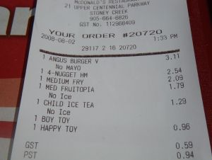
The Informational Needs of an Organization…
Notes:
Imagine we work for a fast-food company. Now imagine you start at the bottom working the register, then move on to fries, then to store manager, then regional manager, and finally all the way to up the executive team.
Think of your informational needs as you work you way up through the organization. Are they the same? Different?

Slide 9
The Informational Needs of an Organization…
Each level of an organization has different informational needs and requirements:
Customers who purchase fries are also likely to buy milkshakes.
How many fries did I sell this week?
Strategic Management
Tactical Management
Operational Management
Do you want fries with that?
Demand for fries in our China locations is up 200%
Non-Management
Organizational Hierarchy
Notes:
We moved up from non management through to strategic management our informational needs changed.

Slide 10
The Technology Behind It All…
Data like this goes into a….
Notes:
When you buy a burger and get a receipt that’s part of a transaction. And the data goes into a

Slide 11
Starts with the Transactional Database
A.k.a. Operational Database
Stored in a Relational Database or files.
Highly Normalized (Data stored as efficiently as possible, lots of tables.)
Optimized for processing speed and handling the “now”.
Designed for capturing data, not for reporting on it.
Designed to support the operational needs of the org.
Notes:
[After slides]
These are great at storing and processing data but not designed to allows us to report on it in ways which meet all the informational needs of the organization.

Slide 12
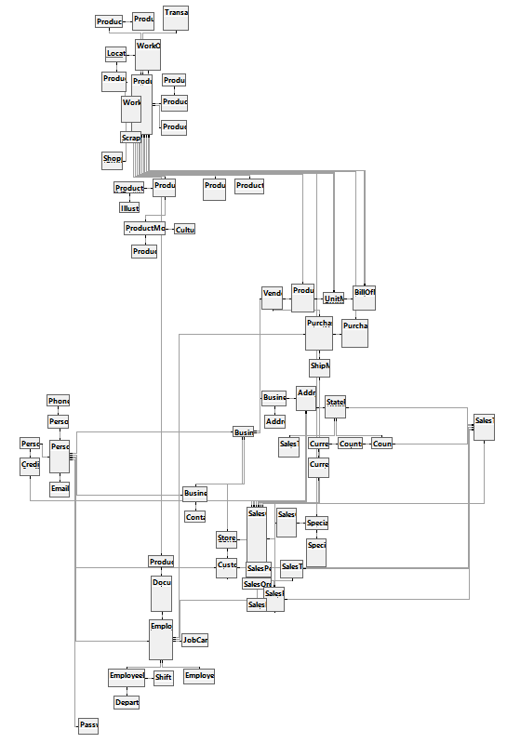
Transactional Databases Are Complex
⬅Adventure works fictitious bicycle manufacturer. 72 tables.
Blackboard Learning Management System. 592 tables.
SU’s Oracle PeopleSoft ERP Implementation 40,000+ tables.
Notes:
Why so complex? They’re designed to minimize data redundancies and store data efficiently. As such they have many tables, generally the more tables the more complex the database.

Slide 13
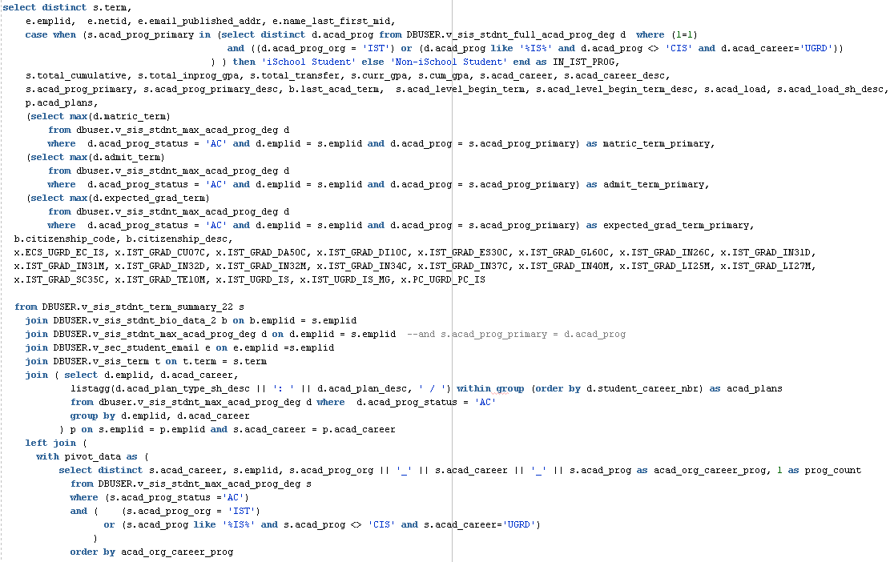
Example: A Query of “iSchool Students”
Students in the current term with gpa, demographics, major, minor, program of study, etc... Either enrolled in one of our programs or taking one of our courses.

Slide 14
Issues Reporting with Transactional Databases
Difficult, Time-consuming & Error prone.
Many joins, sub-selects, Due to vast number of tables.
How do you know your query is correct?
Resource-intensive
The database is not optimized for this purpose.
Multi table joins are RAM and CPU hogs
Impossible
transactional systems are flushed or archived frequently to maintain performance.
You can’t query data you no longer have
Notes:
Resource Intensive
- Optimized writes, not reads. CPU hogging is a problem during its usage when user feels that computer performence is getting slower and slower.
Impossible
- Some transactional database do not store data in a format conducive to the informational need. They lack trending and historical information.

Slide 15
Solution? The Data Warehouse
Designed to support an organization’s informational needs.
Data is re-structured conducive to reporting and analytic applications.
Transactional databases are data sources for the Data Warehouse.
Data grows over time; existing data in the warehouse very seldom changes.

Slide 16
What is Data Warehouse?
A data warehouse is a subject-oriented, integrated, time-variant and non-volatile collection of data in support of management's decision making process. ~Bill Inmon
A data warehouse is a copy of transaction data specifically structured for query and analysis. ~ Ralph Kimball
Kimball did not address how the data warehouse is built like Inmon did; rather he focused on the functionality of a data warehouse.

Slide 17
Characteristics of the Data Warehouse
Time Variant
Flow of data through time
Projected data
Non-Volatile
Data never removed
Always growing
Copy of source data
Integrated
Centralized
Holds data retrieved from entire organization
Subject-Oriented
Optimized to give answers to diverse questions
Used by all functional areas
Notes:
Time-Variant: Historical data is kept in a data warehouse. For example, one can retrieve data from 3 months, 6 months, 12 months, or even older data from a data warehouse. This contrasts with a transactions system, where often only the most recent data is kept. For example, a transaction system may hold the most recent address of a customer, where a data warehouse can hold all addresses associated with a customer.
Non-volatile: Once data is in the data warehouse, it will not change. So, historical data in a data warehouse should never be altered.
Integrated: A data warehouse integrates data from multiple data sources. For example, source A and source B may have different ways of identifying a product, but in a data warehouse, there will be only a single way of identifying a product.
Subject-Oriented: A data warehouse can be used to analyze a particular subject area. For example, "sales" can be a particular subject.

Slide 18
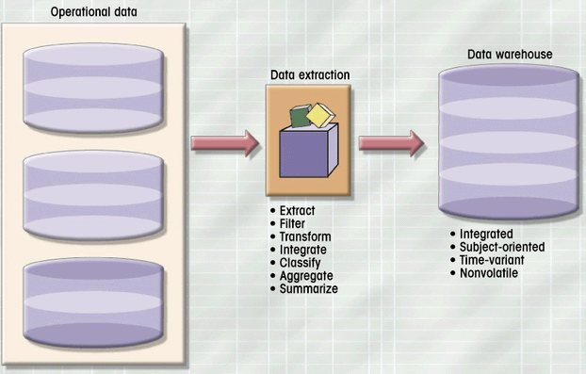
ETL: For Populating the Data Warehouse
Payroll
Sales
Purchasing
Notes:
Explain Diagram

Slide 19
The Data Mart
Single-subject subset of the data warehouse
Provides Decision support to small group
Address local or departmental needs
Notes:
Addressing the informational needs at a small scale is the Data Mart.
We’ll build a few data marts in the class.

Slide 20
The Evolution of the DW
Data Warehouse
Improved Decision Making
Business Intelligence
Notes:
As the data warehouse caught fire it led to improved decision making which in turn led to business intelligence.

Slide 21
Business Intelligence
Analytical and Decision-Support capabilities of the Data warehouse.
The “Glitz and Glam” of Data Warehousing
Notes:
What is BI?

Slide 22
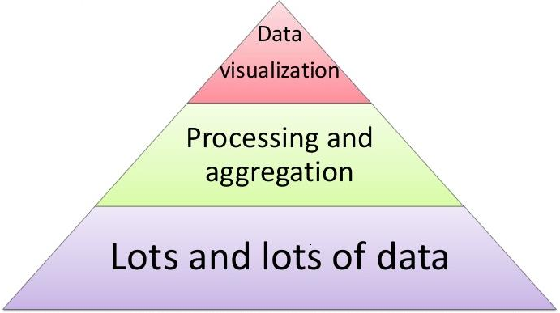
What is Business Intelligence?
Business intelligence (BI) is a set of theories, methodologies, architectures, and technologies that transform raw data into meaningful and useful information for business purposes.

Slide 23
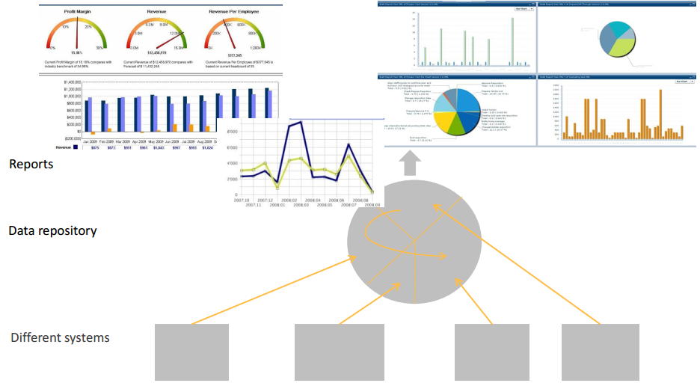
Business Intelligence

Slide 24
Specialized Roles
Data Warehouse DBA
OLAP Designer
ETL System Developer
DW/BI Management Tools Developer
BI Applications Developer

Slide 25
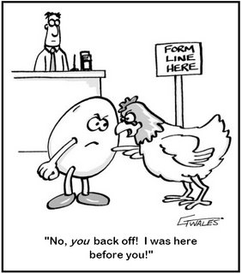
Data Warehouse or Business Intelligence?
Is the data warehouse a component of business intelligence?
or
Is business intelligence a component of the data warehouse?
Notes:
Both of your textbook authors believe they are components to a larger system. For Inmon they’re part of the CIF.

Slide 26
But how does this work?
Here’s a hyper-abridged example…

Slide 27
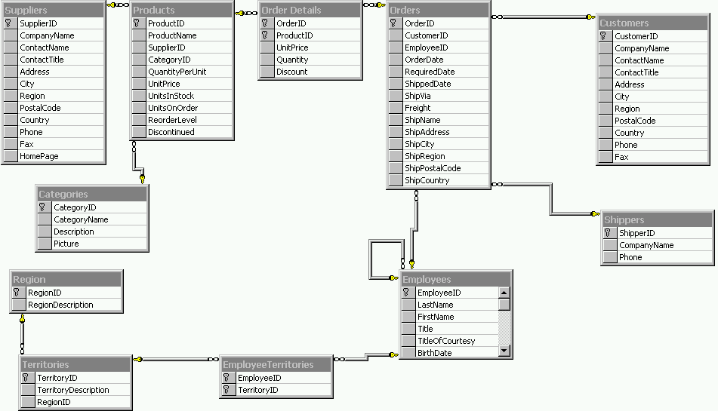
#1: We Have Northwind OLTP Database
Insufficient reporting capabilities
Can only report “In the now”
Complex queries to get questions answered.

Slide 28
#2: Identify business process to model
Business Process & Grain
Orders – products sold to customers over time by sale.
One row per product order (product on the order)
Dimensions
Products, Employees (Sales), Time (Order Date), Customer
Facts
Order Quantity, Order Amount
This represents our Data Mart in the DW

Slide 29
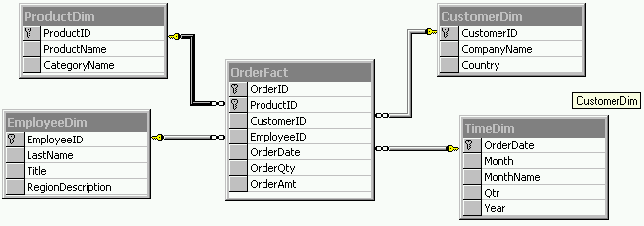
#3: Create Northwind Orders Star Schema
Build the data mart in the Data warehouse
Fact Table + outer Dimensions
No data (yet)
Fields are based on what’s available in the source data

Slide 30
#4: Create Northwind Source to Target Map
ProductDim
CustomerDim
How does the OLTP align with OLAP?
Helps us define the ETL process
Fact Table:
OrderFact
EmployeeDim
TimeDim

Slide 31
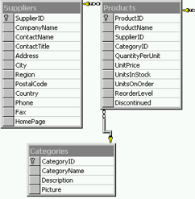

#5: Populate targets with ETL
Products Source
Dimensions before Facts.
Need a strategy to handle changes to data.
Tooling exists to assist with the process.
ProductsDim
Data

Slide 32
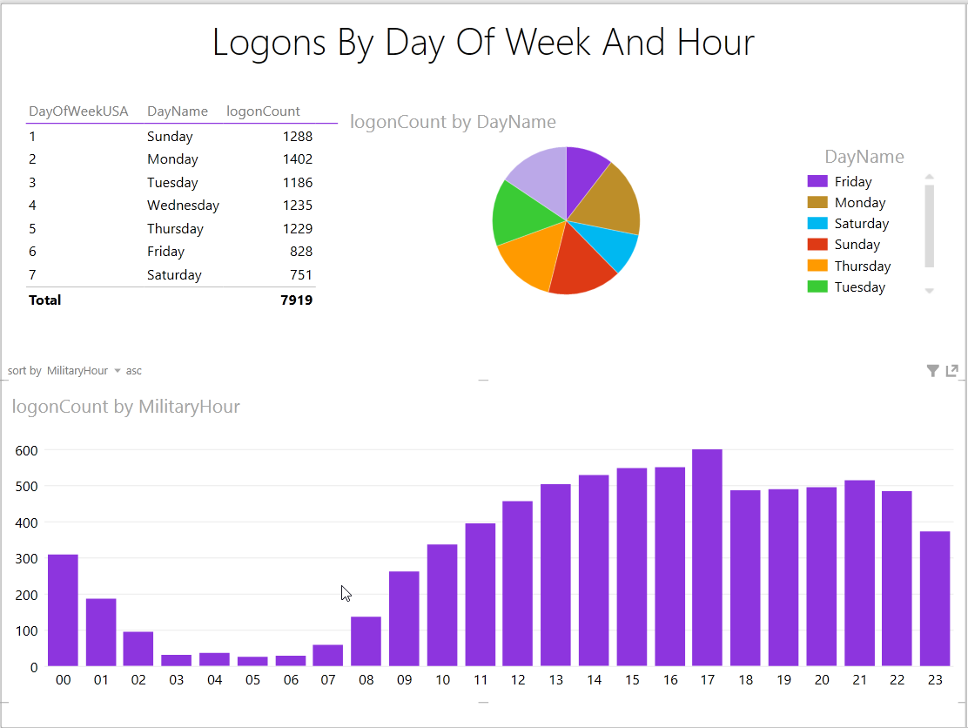
#6: Visualize with a BI Tool
You can easily query star schemas in SQL or better yet use a BI tool like Excel or Tableau

Slide 33
The Fathers of Data Warehousing
 | W.H. Inmon | Ralph Kimball
The “Father” of… | Data Warehousing | Business Intelligence
Million Dollar Idea: | “Corporate Information Factory” | “Kimball Lifecycle”
“Data Warehouse” Definition | Strict. Subject-oriented summarized data. | Loose. Any query able data.
Approach: How is the Data Warehouse built? | As a whole, over time (Waterfall, Top-down) | In parts, by business process (Iterative, Bottom-up)

Slide 34
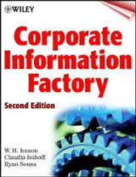
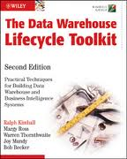
Your Textbooks
“What”
Inmon
“How To”
Kimball
We’ll use the Inmon definitions, and apply the Kimball Approach.

Slide 35
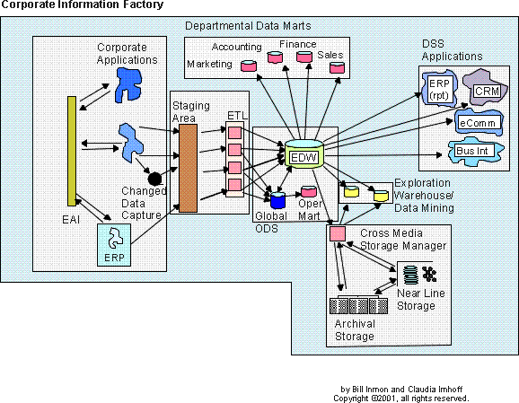
Inmon’s Corporate Information Factory
A reference architecture for an “Information Ecosystem”
Notes:
Enterprise application integration (EAI) adalah penggunaan prinsip arsitektur perangkat lunak dan sistem komputer untuk mengintegrasikan satu set aplikasi komputer perusahaan.
Change data capture (CDC) is the process of capturing changes made at the data source and applying them throughout the enterprise. CDC minimizes the resources required for ETL ( extract, transform, load ) processes because it only deals with data changes.
Staging area is a place where you hold temporary tables on data warehouse server. Staging tables are connected to work area or fact tables. We basically need staging area to hold the data, and perform data cleansing and merging, before loading the data into warehouse.
An ODS is a database designed to integrate data from multiple sources for additional operations on the data, for reporting, controls and operational decision support. Unlike a production master data store, the data is not passed back to operational systems.
An oper mart is to the ODS what a data mart is to the data warehouse. The oper mart is used for analytical processing. But there is an essential difference between an oper mart and a data mart. In a data mart there is stability of analytical values. If you need to rerun a query or an analysis against the data mart in the exact form in which it was previously run, the query against the data mart should be repeatable. (If you can’t do that then you have built your data mart incorrectly.)
But with an oper mart, you can still do analytical processing as you did in the data mart environment. However, in an oper mart you cannot expect repeatability of results. Data is subject to change at a moment’s notice in the oper mart. So the second time you run a query against an oper mart you may be running on different data. Other than that, data marts and oper marts are pretty much the same.
Inmon proposes a top-down model approach to create a centralized Enterprise Data Warehouse using traditional database modeling techniques (ER Model), where the data is stored in 3NF

Slide 36
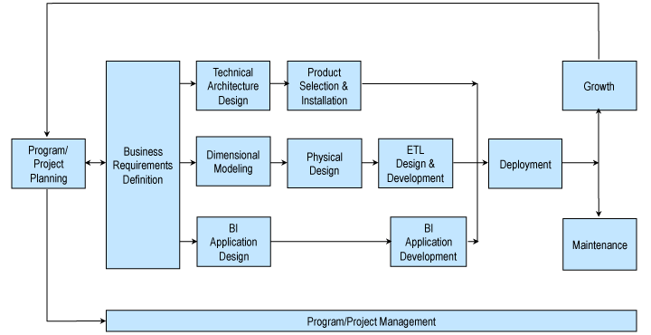
The Kimball Lifecycle
Notes:
Describes an approach for data warehouse projects

Slide 37
This Course is About:
Understand the CIF/DW/BI components
Requirements Gathering / Analysis
Dimensional Modeling and Design
Physical design
ETL – Moving data Around
Business Intelligence
Technical architecture, Data Governance, Master data Management
Notes:
What is essential to future steps in the course
Then we shift to the approach. Starting with requirements gathering and analysis
Then while you’re on campus, we’ll get into the meat of the course covering dimensional modeling techniques
Learning how to build a physical design of your dimensional model in a relational datbaase
Next we move to the most time-consuming step in the warehousing process. ETL we’ll cover the various ETL systems and approaches to moving data into the DW.
In the BI unit we will learn about multidimensional structures , dashboard, and KPI’s – ways of presenting the information in you data warehouse to various levels of users within the organization.
Along the way we’ll discuss issues like ….
It should be an exciting course!

Slide 38
The Informational Needs of an Organization, In Summary…
Strategic Management
Decision-Support Data in the Data Warehouse
Tactical Management
Operational Management
Operational Data in Transactional Databases
Non-Management
Organizational Hierarchy

Slide 39
Relational Philosophies, In Summary…
OLTP
OLAP
Denormlaized
Just Star Schemas
Dimension and Fact tables
Supports the Analytical needs of the organization.
Data mart in the data warehouse
Highly normalized
One or more tables per business entity.
Supports the Operational needs of the organization
Lots of tables

Slide 40
In Summary…
Data is an organizations most important asset.
The transactional systems we use to collect and manage data are not suitable for analysis and reporting.
The data warehouse is a subject-oriented, time-variant, non-volitile collection of operational data.
The data mart supports the decision-support needs of a group or department within the organization.
Business intelligence is the use of information to improve decision making.
Inmon’s Corporate Information factory is a model for business intelligence.
The Kimball Lifecycle is a methodology for creating data warehousing solutions.

Slide 41
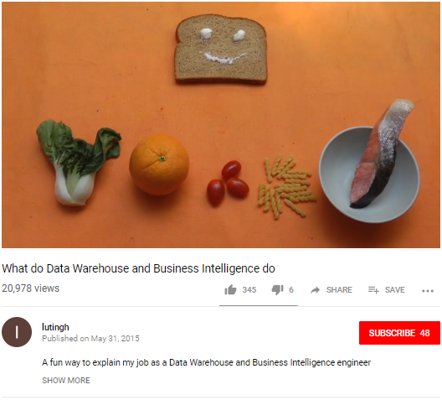
Resources
Reading:
Kimball Ch. 1
Inmon Ch. 1-2
Videos:
What do Data Warehouse and Business Intelligence do

Slide 42
EOF

