Slide 1
Dimensional Modeling I
Samuel I. G. Situmeang
Modified slides provided by: Michael A. Fudge, Jr.
Data Warehousing, Syracuse University, 2017

Slide 2
Lecture Objectives
What is Dimensional Modeling
Components of the Dimensional Model
Four-Step Dimensional Model Design Process

Slide 3
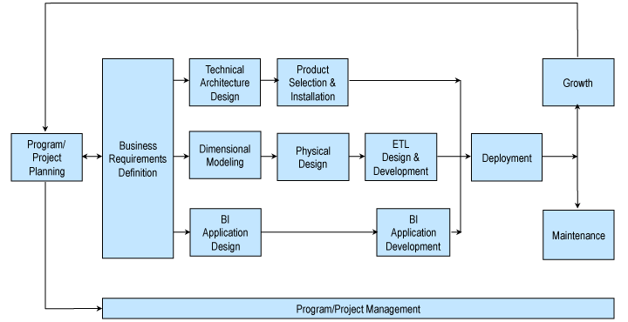
Recall: Kimball Lifecycle
Notes:
Describes an approach for data warehouse projects

Slide 4
Dimensional Model Design

Slide 5
What is Dimensional Modeling
A Logical design technique for structuring data with the following objectives:
Intuitive: Easy for business users to understand
Fast: Excellent query performance
Think of a Dimensional Model as a fact table + the dimensions it requires.
Dimensional Models are implemented in the Relational DBMS as star schemas. The exist in MOLAP databases as cubes.
Notes:
Remember one of the key reasons the discipline of data warehousing exists, is that the STRUCTURE of data we have in our transactional systems is not very conducive to ad-hoc querying and analytics. The goal of dimensional modeling is to re-shape our data into a form more queryable by end-users.
Dimensional modeling is a logical design technique for structuring data so that it’s intuitive to business users and delivers fast query performance.

Slide 6
Benefits of Dimensional Modeling
Understandability: data warehouse is easier for the user to understand and to use.
Query performance: the retrieval of data from the data warehouse tends to operate very quickly.

Slide 7
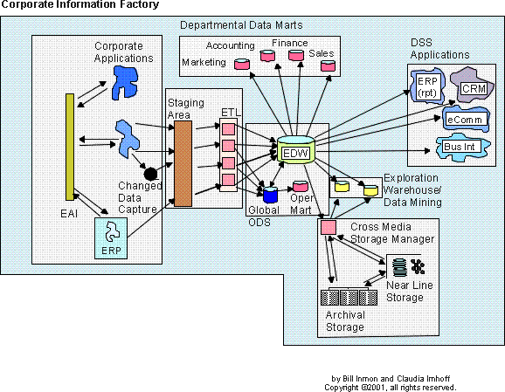
Where are the Dimensional Models in the CIF?
Red: NO Green: YES

Slide 8
Components of the Dimensional Model
Fact Table – A database table of quantifiable performance measurements (facts). Originate from business processes. Has FK’s to each of the dimensions.
Ex. Sales Amount, Days To Ship, Quantity on Hand.
Dimension Table – A table of contexts for the facts.
Ex. Date/Time, Location, Customer, Product
Attribute – A characteristic of a dimension.
Ex. Product: Name, Category, Department
Star Schema – Connections among facts and dimensions which define a business process.
Ex: Sales, Inventory Management

Slide 9
Four-Step Dimensional Model Design Process
Approach the design of a dimensional model by consistently considering four steps, as the following:
Select the business process (from your requirements)
Declare the fact grain (type & granularity)
Identify the dimensions of the business process
Identify the facts of the business process

Slide 10


Demo
Business User Says:
“I need to know: How many sneakers did we sell last week?”
What I hear
Quantity (Fact)
Product Type (Attribute of a Product Dimension)
Business
Process (Sales)
Duration of Time (Attribute of a Sales Date Dimension)
Facts are the business process measurement events
Dimensions provide the context for that event.

Slide 11
#1: Select the Business Process
A business process is a low-level activity performed by an organization, such as taking orders, invoicing, receiving payments, handling service calls, registering students, performing a medical procedure, or processing claims.
To identify your organization’s business processes, it’s helpful to understand several common characteristics:
Business processes are frequently expressed as action verbs because they represent activities that the business performs.
Business processes are typically supported by an operational system, such as the billing or purchasing system.
Business processes generate or capture key performance metrics.
Business processes are usually triggered by an input and result in output metrics.
Notes:
To identify your organization’s business processes, it’s helpful to understand several common characteristics:
Business processes are frequently expressed as action verbs because they represent activities that the business performs. The companion dimensions describe descriptive context associated with each business process event.
Business processes are typically supported by an operational system, such as the billing or purchasing system.
Business processes generate or capture key performance metrics. Sometimes the metrics are a direct result of the business process; the measurements are derivations at other times. Analysts invariably want to scrutinize and evaluate these metrics by a seemingly limitless combination of filters and constraints.
Business processes are usually triggered by an input and result in output metrics. In many organizations, there’s a series of processes in which the outputs from one process become the inputs to the next. In the parlance of a dimensional modeler, this series of processes results in a series of fact tables.

Slide 12
#2: Declare the Grain
Declaring the grain means specifying exactly what an individual fact table row represents.
The grain conveys the level of detail associated with the fact table measurements.
It provides the answer to the question, “How do you describe a single row in the fact table?”
Example granularity declarations include:
One row per scan of an individual product on a customer’s sales transaction
One row per line item on a bill from a doctor
One row per individual boarding pass scanned at an airport gate
One row per daily snapshot of the inventory levels for each item in a warehouse
One row per bank account each month
Notes:
An inappropriate grain declaration will haunt a data warehouse implementation.
Declaring the grain is a critical step that can’t be taken lightly.
If in steps 3 or 4 we see that the grain statement is wrong we must return to step 2, redeclare the grain correctly, and revisit steps 3 and 4 again.

Slide 13
#2: Declare the Grain
Fact Grain Type
Events or Transactions
Workflows a.k.a. Accumulating Snapshots
Points in time a.k.a Periodic Snapshots
Business processes contain facts which we use end up being the fact tables in our ROLAP star schemas.
Transaction
Accumulating Snapshot
Periodic Snapshot

Slide 14
Transaction Fact
The most basic fact grain
One row per line in a transaction
Corresponds to a point in space and time
Once inserted, it is not revisited for update
Rows inserted into fact table when transaction or event occurs
Examples:
Sales, Returns, Telemarketing, Registration Events

Slide 15
Accumulating Snapshot Fact
Less frequently used, application specific.
Used to capture a business process workflow.
Fact row is initially inserted, then updated as milestones occur
Fact table has multiple date FK that correspond to each milestone
Special facts: milestone counters and lag facts for length of time between milestones
Examples:
Order processing, Claims processing, Service call resolution and College admissions

Slide 16
Periodic Snapshot Fact
At predetermined intervals snapshots of the same level of details are taken and stacked consecutively in the fact table
Snapshots can be taken daily, weekly, monthly, hourly, etc…
Complements detailed transaction facts but does not replace them
Share the same conformed dimensions but has less dimensions
Examples:
Financial reports, Bank account values, Semester class schedules, Daily classroom Lab Logins, Student GPAs

Slide 17
Group Activity: Which Fact Table Grain?
Transaction
Accumulating Snapshot
Periodic Snapshot
Concert ticket purchases?
Voter exit polls in an election?
Mortgage loan application and approval?
Auditing software use in a computer lab?
Daily summaries of visitors to websites?
Tracking Law School applications?
Attendance at sporting events?
Admissions to sporting events at 15 minute intervals?
Notes:
Transaction
Transaction
Accumulating Snapshot
Transaction
Periodic Snapshot
Accumulating Snapshot
Transaction
Periodic Snapshot

Slide 18
Answers: Which Fact Table Grain?
Transaction
Accumulating Snapshot
Periodic Snapshot
Concert ticket purchases? T
Voter exit polls in an election? T
Mortgage loan application and approval? AS
Auditing software use in a computer lab? T
Daily summaries of visitors to websites? PS
Tracking Law School applications? AS
Attendance at sporting events? T
Admissions to sporting events at 15 minute intervals? PS

Slide 19
#3: Identify the Dimensions
Dimensions provide context for our facts.
We can easily identify dimensions because of the “by” and/or “for” words.
Ex. Total accounts receivables for the IT Department by Month.
Dimensions have attributes which describe and categorize their values.
Ex. Student: Major, Year, Dormitory, Gender.
The attributes help constrain and summarize facts.

Slide 20
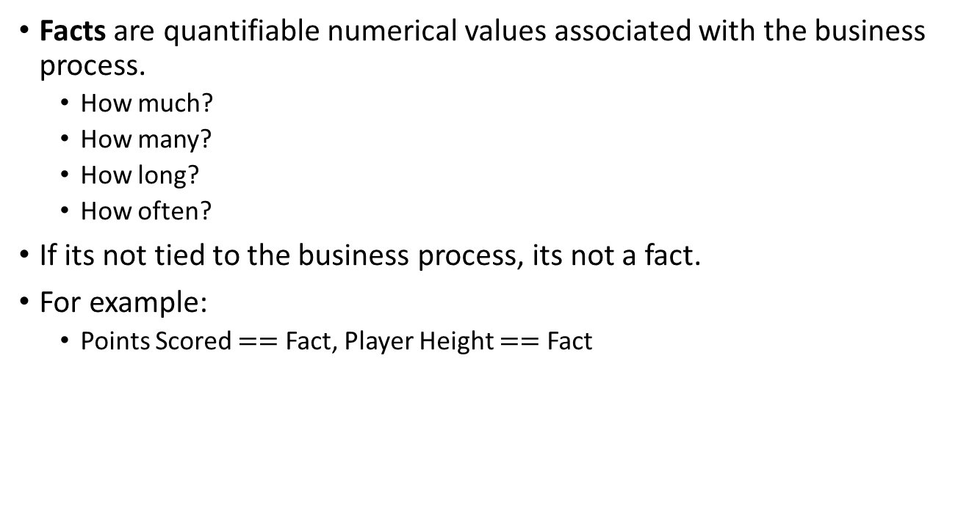
#4: Identify the Facts
Facts are quantifiable numerical values associated with the business process.
How much?
How many?
How long?
How often?
If its not tied to the business process, its not a fact.
For example:
Points Scored $==$ Fact, Player Height $==$ Fact

Slide 21
3 Types of Facts
Additive - Fact can be summed across all dimensions.
The most useful kind of fact.
Quantity sold, hours billed.
Semi-Additive - Cannot be summed across all dimensions, such as time periods.
Sometime these are averaged across the time dimension.
Quantity on Hand, Time logged on to computer.
Non-Additive - Cannot be summed across any dimension.
These do not belong in the fact table, but with the dimension.
Basketball player height, Retail Price
Notes:
Additive: Additive facts are the facts that are summed up through all dimensions in the fact table.
Ex: Assume that we have a fact table which contains
Date
Product
store
Sales_amount
Here Sales_amount is additive fact because we can sum up this fact using any of the dimensions present i.e date,product,store.
Semi-Additive: Semi-additive facts are the facts that are summed up with some of the dimensions in the fact table, but not others.
Ex: You can take a bank account as semiadditive since a current balance for the account can't be summed as time period; but if you want see current balance of a bank you can sum all accounts current balance.
Non-Additive: Non-additive facts are the facts that are not summed up with any of the dimensions in the fact table.
Ex: suppose percentage cannot be roll up in non-additive

Slide 22
Group Activity: Facts or Not?? Additive? Semi? Non?
Number of page views on a website?
The amount of taxes withheld on an employee’s weekly paycheck?
Credit card balance.
Pants waist size? 32, 34, etc…
Tracking when a student attends class?
Product Retail Price?
Vehicle’s MPG rating?
The number of minutes late employees arrive to work each day.
Notes:
1. Fact, Additive
2. Fact, Additive
3. Fact, Semi?
4. Attribute of product Dimension
5. Fact, Additive (Factless fact)
6. Attribute of the product dimension
7. Attribute of the vehicle dimension
8. Fact, Additive

Slide 23
Answers: Facts or Not? Additive? Semi? Non?
Number of page views on a website? F/A
The amount of taxes withheld on an employee’s weekly paycheck? F/A
Credit card balance. F/S
Pants waist size? 32, 34, etc… N/A
Tracking when a student attends class? F/A
Product Retail Price? N/A
Vehicle’s MPG rating? N/A
The number of minutes late employees arrive to work each day. F/A

Slide 24
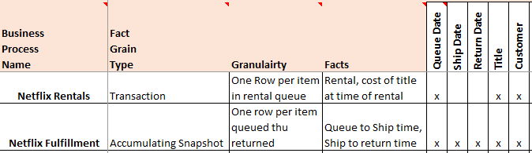
Enterprise Bus Matrix – A documentation tool
A key deliverable from requirements gathering, the bus matrix documents your business processes, grain, facts and dimensions across all projects in your program.
Notes:
For example the sales forecasting business process requires the following dimensions.
Grain : The business meaning of a single row in a fact table. The declaration of the grain of a fact table is the second of four key steps in the design of a dimensional model.
Granularity The level of detail captured in a fact table.

Slide 25
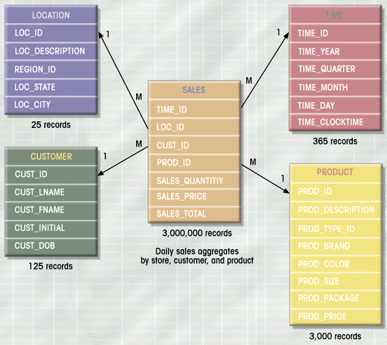
Star Schema: Relational answer to the DM
Dimension Table
The Star Schema
is a Relational Database
Implementation
of a
Dimensional
Model
Primary Key
Fact Table
Attribute
Foreign Key
Fact

Slide 26
Resources
Reading:
R. Kimball and M. Ross. (2007). The Data Warehouse Toolkit (2nd Edition), Wiley & Sons.
R. Kimball and M. Ross. (2013). The Data Warehouse Toolkit (3rd Edition), Wiley & Sons.

Slide 27
EOF

