Slide 1
Dimensional Modeling III
Samuel I. G. Situmeang

Slide 2
Lecture Objectives
Case Study

Slide 3
Retail Case Study
Imagine you work in the headquarters of a large grocery chain.
The business has 100 grocery stores spread across five states.
Each store has a full complement of departments, including grocery, frozen foods, dairy, meat, produce, bakery, floral, and health/beauty aids.
Each store has approximately 60,000 individual products, called stock keeping units (SKUs), on its shelves.

Slide 4
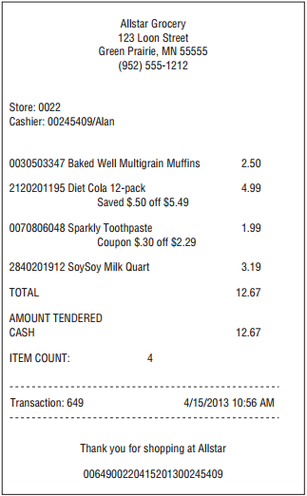
Retail Case Study
Data is collected at several interesting places in a grocery store.
Some of the most useful data is collected at the cash registers as customers purchase products.
The point-of-sale (POS) system scans product barcodes at the cash register, measuring consumer takeaway at the front door of the grocery store.
Other data is captured at the store’s back door where vendors make deliveries.
Sample cash register receipt.

Slide 5
Retail Case Study
At the grocery store, management is concerned with the logistics of ordering, stocking, and selling products while maximizing profit.
The profit ultimately comes from charging as much as possible for each product, lowering costs for product acquisition and overhead, and at the same time attracting as many customers as possible in a highly competitive environment.
Some of the most significant management decisions have to do with pricing and promotions.
Both store management and headquarters marketing spend a great deal of time tinkering with pricing and promotions.

Slide 6
Retail Case Study
Promotions in a grocery store include temporary price reductions, ads in newspapers and newspaper inserts, displays in the grocery store, and coupons.
The most direct and eﬀective way to create a surge in the volume of product sold is to lower the price dramatically.

Slide 7
Retail Case Study
A 50-cent reduction in the price of paper towels, especially when coupled with an ad and display, can cause the sale of the paper towels to jump by a factor of 10.
Unfortunately, such a big price reduction usually is not sustainable because the towels probably are being sold at a loss.
As a result of these issues, the visibility of all forms of promotion is an important part of analyzing the operations of a grocery store.

Slide 8
Retail Case Study Step 1: Select the Business Process
The first step in the design is to decide what business process to model by combining an understanding of the business requirements with an understanding of the available source data.
The first DW/BI project should focus on the business process that is both the most critical to the business users, as well as the most feasible.
Feasibility covers a range of considerations, including data availability and quality, as well as organizational readiness.

Slide 9
Retail Case Study Step 1: Select the Business Process
In retail case study, management wants to better understand customer purchases as captured by the POS system. Thus, the business process you’re modeling is POS retail sales transactions.
This data enables the business users to analyze which products are selling in which stores on which days under what promotional conditions in which transactions.

Slide 10
Retail Case Study Step 2: Declare the Grain
What level of data detail should be made available in the dimensional model?
Atomic data is highly dimensional.
The more detailed and atomic the fact measurement, the more things you know for sure.
Atomic data provides maximum analytic flexibility because it can be constrained and rolled up in every way possible.

Slide 11
Retail Case Study Step 2: Declare the Grain
A DW/BI system almost always demands data expressed at the lowest possible grain, not because queries want to see Individual rows but because queries need to cut through the details in very precise ways.
In retail case study the most granular data is an individual product on a POS transaction.

Slide 12
Retail Case Study Step 3: Identify the Dimensions
Date
Product
Store
Promotion
Cashier
Payment Method
Sample cash register receipt.

Slide 13
Retail Case Study Step 3: Identify the Dimensions
Date
Product
Store
Promotion
Cashier
Payment Method
Sample cash register receipt.

Slide 14

Retail Case Study Step 3: Identify the Dimensions
Product
Merchandise hierarchy
SKU $→$ Brand $→$ Category $→$ Department
Other attributes
Product Name, Size, Weight, Package Type, etc.

Slide 15

Retail Case Study Step 3: Identify the Dimensions
Store
Geography hierarchy
Store $→$ ZIP Code $→$ County $→$ State
Admistrative hierarchy
Store $→$ District $→$ Region
Other attributes
Address, Store Name, Store Manager, Square Footage, etc.

Slide 16
Retail Case Study Step 3: Identify the Dimensions
Hierarchies
Common in dimension tables.
Multiple hierarchies can appear in the same dimension.
Don’t need to be strict hierarchies.
E.g. ZIP Code that spans 2 counties

Slide 17
Retail Case Study Step 3: Identify the Dimensions
How many dimensions?
Should two concepts be modeled as separate dimensions or two aspects of the same dimension?
Example: Different types of promotions
Ads, discounts, coupons, end-of-aisle displays
Option A: 4 dimensions
Separate dimension for each type of promotion
Option B: 1 dimension
Each dimension row captures a combination of ad, discount, coupon, and end-of-aisle display

Slide 18
Retail Case Study Step 3: Identify the Dimensions
How many dimensions?
Factors to consider
How do the users think about the data?
Are an ad and a coupon separate promotions or two aspects of the same promotion?
Fewer tables = good
Generally fewer tables = simpler design
Performance implications
See following slides…

Slide 19
Retail Case Study Step 3: Identify the Dimensions
Performance Implication
Most OLAP queries are “I/O bound”
Data-intensive not compute-intensive
Reading the data from disk is the bottleneck
For “typical” queries, on “typical” hardware
Size of data on disk ≈ query performance
Keeping storage requirements small is important
Dimensional modeling impacts storage requirements

Slide 20
Retail Case Study Step 3: Identify the Dimensions
Performance Implication
Let’s consider the extremes
Assumptions:
100 million fact rows
3 four-byte measurement columns in the fact table
100 dimensional attributes, average size = 20 bytes
Three modeling options
One “Everything” dimension
Each attribute gets its own dimension table
5 dimensions (Date, Product, Store, Promotion, Transaction ID)

Slide 21
Retail Case Study Step 3: Identify the Dimensions
Option A: One “Everything” dimension
Fact table is very thin (16 bytes per row)
3 four-byte fact columns
1 four-byte foreign key to the Everything dimension
Dimension table is very wide (2000 bytes per row)
100 attributes * 20 bytes each
Dimension table has as many rows as fact table!
Each fact row has a different combination of attributes
Total space = 1.6 GB fact + 200 TB dimension
16 bytes * 100 million rows = 1.6 GB
2000 bytes * 100 million rows = 200 TB

Slide 22
Retail Case Study Step 3: Identify the Dimensions
Option B: Each attribute gets its own dimension table
Store Manager First Name dimension, Store Manager Last Name dimension, etc.
Fact table is wide (212 bytes per row)
Assume 2-byte keys for all dimension tables
This is a generous assumption
Dimension tables are very thin, have few rows
Space for fact table = 21.2 GB
Space for dimension tables = negligible
< 132 MB total for all dimensions
No dimension table has more than 60,000 rows
Each dimension row is 22 bytes
100 dimension tables

Slide 23
Retail Case Study Step 3: Identify the Dimensions
Option C: Four dimensions (Date, Product, Store, Promotion)
Fact table is quite thin (28 bytes)
2-byte keys for Date and Store
4-byte keys for Product, Promotion, Transaction ID
3 4-byte fact columns
Dimension tables are wide, have few rows
No dimension table has more than 60,000 rows
Space for fact table = 2.8 GB
28 bytes * 100 million rows
Space for dimension tables = negligible
< 130 MB for all dimensions

Slide 24
Why option C is the best?
Attributes that pertain to the same logical object have a high degree of correlation
Correlated attributes
(product name, brand)
Number of distinct combinations = number of distinct products
Product name and brand are completely correlated
Uncorrelated attributes
(product name, date)
Number of distinct combinations = number of products * number of dates
No correlation between date and product
Most possible combinations of values will appear in the fact table
Combining non-correlated attributes in the same dimension leads to blow-up in size of dimension table

Slide 25
Why option C is the best?
When attributes are semi-correlated, designer has a choice
Frequently, multiple types of promotion occur together
E.g. product being promoted has ad, coupon, and in-store display
Number of (ad, coupon, discount, display) combinations is small
Combining them in a single Promotion dimension is reasonable

Slide 26
Retail Case Study Step 4: Identify the Facts
Grain : the individual product line item on the POS transaction in this case.
The facts collected by the POS system include
sales quantity (for example, the number of cans of chicken noodle soup),
per unit regular,
discount,
net paid prices,
extended discount sales dollar amounts.
extended sales dollar amount = sales quantity * the net unit price.
extended discount dollar amount =sales quantity * the unit discount amount.
Some sophisticated POS systems also provide a standard dollar cost for the product as delivered to the store by the vendor. Presuming this cost fact is readily available and doesn’t require a heroic activity-based costing initiative, you can include
extended cost dollar amount

Slide 27
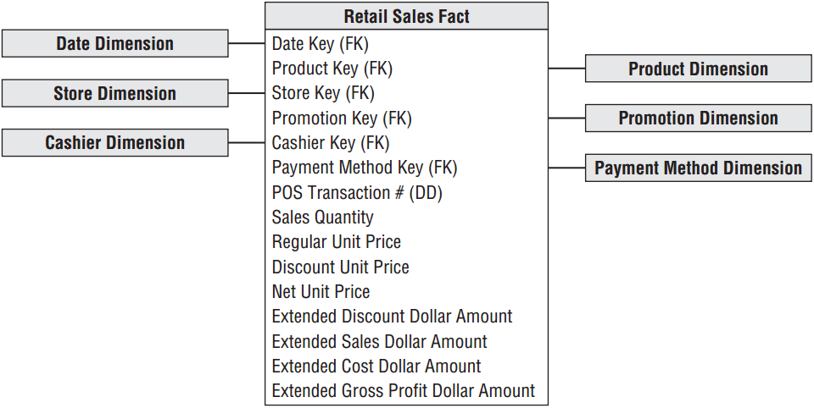
Retail Case Study Step 4: Identify the Facts
extended gross
profit dollar
amount???
Measured facts in retail sales schema

Slide 28
Derived Facts
You can compute the gross profit by subtracting the extended cost dollar amount from the extended sales dollar amount, or revenue.
Dimensional modelers sometimes question whether a calculated derived fact should be stored in the database. Generally recommend it be stored physically.
In this case study, the gross profit calculation is straightforward, but storing it means it’s computed consistently in the ETL process, eliminating the possibility of user calculation errors.
Storing it also ensures all users and BI reporting applications refer to gross profit consistently.

Slide 29
Non-Additive Facts
Gross margin can be calculated by dividing the gross profit by the extended sales dollar revenue.
Gross margin is a non-additive fact because it can’t be summarized along any dimension.
You can calculate the gross margin of any set of products, stores, or days by remembering to sum the revenues and costs respectively before dividing.
Unit price is another non-additive fact. Unlike the extended amounts in the fact table, summing unit price across any of the dimensions results in a meaningless, nonsensical number.

Slide 30
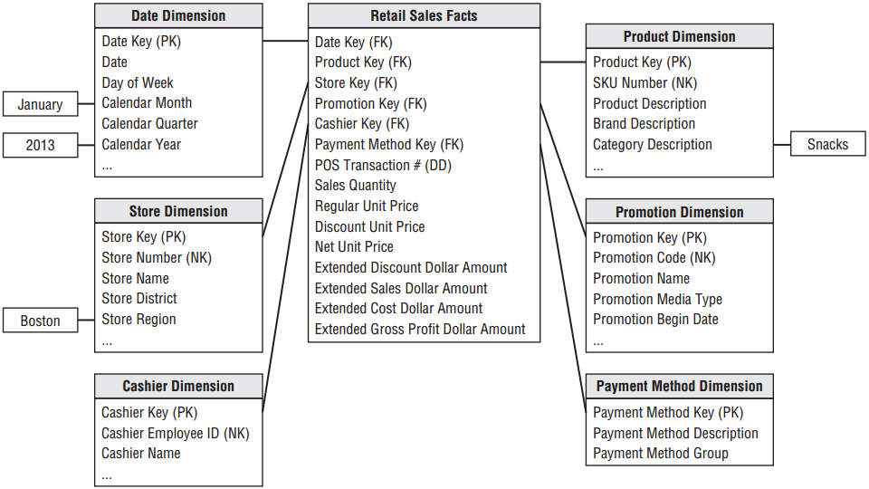
The Retail Sales Schema

Slide 31
Retail Schema in Action: Query Results and Cross-Tabular Report
A business user might be interested in better understanding weekly sales dollar volume by promotion for the snacks category during January 2013 for stores in the Boston district.
As illustrated in the schema, you would place query constraints on month and year in the date dimension, district in the store dimension, and category in the product dimension.

Slide 32
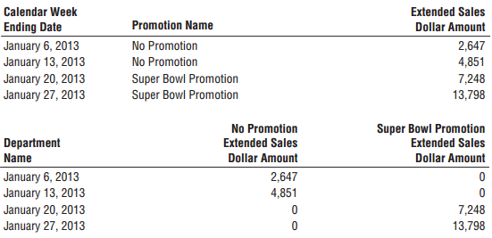
Retail Schema in Action: Query Results and Cross-Tabular Report
The query tool summed the sales dollar amount grouped by week ending date and promotion.

Slide 33
Changes in Source Data
Changes in source data and/or modeling assumptions without invalidating existing BI applications
New dimension attributes : Not Available or its equivalent should be populated in the old dimension rows
New dimensions : you can add a dimension to an existing fact table by adding a new foreign key column and populating it correctly with values of the primary key from the new dimension
New measured facts
when the new facts are available in the same measurement event and at the same grain as the existing facts the fact table is altered to add the new columns, and the values are populated into the table. If the new facts are only available from a point in time forward, null values need to be placed in the older fact rows.
new measured facts occur naturally at a different grain. If the new facts cannot be allocated or assigned to the original grain of the fact table, the new facts belong in their own fact table because it’s a mistake to mix grains in the same fact table.

Slide 34
Resources
Reading:
R. Kimball and M. Ross. (2007). The Data Warehouse Toolkit (2nd Edition), Wiley & Sons.
R. Kimball and M. Ross. (2013). The Data Warehouse Toolkit (3rd Edition), Wiley & Sons.

Slide 35
EOF

