Slide 1
ETL Components and Architecture
Samuel I. G. Situmeang
Modified slides provided by: Michael A. Fudge, Jr.
Data Warehousing, Syracuse University, 2017

Slide 2
Lecture Objectives
ETL Components
ETL Subsystems
Notes:
Define and explain the ETL architecture in terms of components and subsystems

Slide 3
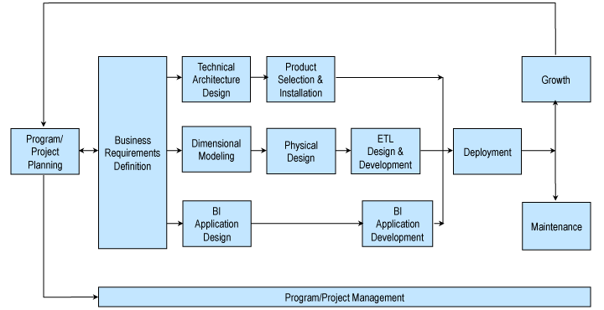
Recall: Kimball Lifecycle
Notes:
Describes an approach for data warehouse projects

Slide 4
ETL Components
ETL Definition and 4 Major ETL Operations

Slide 5
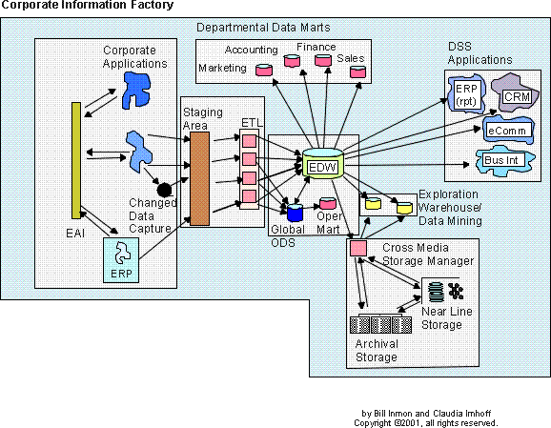
ETL or Extract, Transform and Load is a method for populating data into our data warehouse with consistency and reliability.
What Exactly is ETL?

Slide 6
Kimball: 4 Major ETL Operations
Extract the data from its source.
Cleanse and Conform to improve data accuracy and quality (transform).
Deliver the data into the presentation server (load).
Managing the ETL process itself.
Notes:
As mentioned in the previous lecture, the ETL performs three major operations: (E) extracts the data from the data sources, (T) cleanses and conforms them, and (L) delivers them to the presentation server, to be loaded into the DW. Managing these operations can be considered a fourth major operation.

Slide 7
ETL Tools
70% of the DW/BI effort is ETL.
In the past developers used to program by hand.
ETL tooling is a popular choice today.
All the DBMS vendors offer tools.
Tooling not required but aids the process greatly.
Tooling is visual and self-documenting.
Notes:
Most ETL services are available today as off-the-shelf tools, which are a must for any serious DW/BI project. However, the ETL development still takes 70% of the time and effort to build the DW/BI system. It is particularly important that the ETL tools work with our key data sources – otherwise, we need to implement the extract code ourselves.

Slide 8









ETL Tools
Improvado
Skyvia
HEVO
Matillion
Xplenty
IRI Voracity
Informatica – PowerCenter
IBM – Infosphere Information Server
Oracle Data Integrator
Microsoft – SQL Server Integrated Services (SSIS)
Ab Initio
Talend – Talend Open Studio for Data Integration
CloverDX Data Integration Software
Pentaho Data Integration
Apache Nifi
SAS – Data Integration Studio
SAP – BusinessObjects Data Integrator
Oracle Warehouse Builder
Sybase ETL
DBSoftlab
Jasper
Source: https://www.softwaretestinghelp.com/best-etl-tools/, February 6, 2020

Slide 9
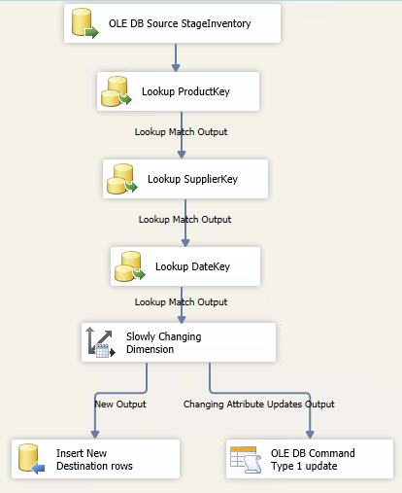
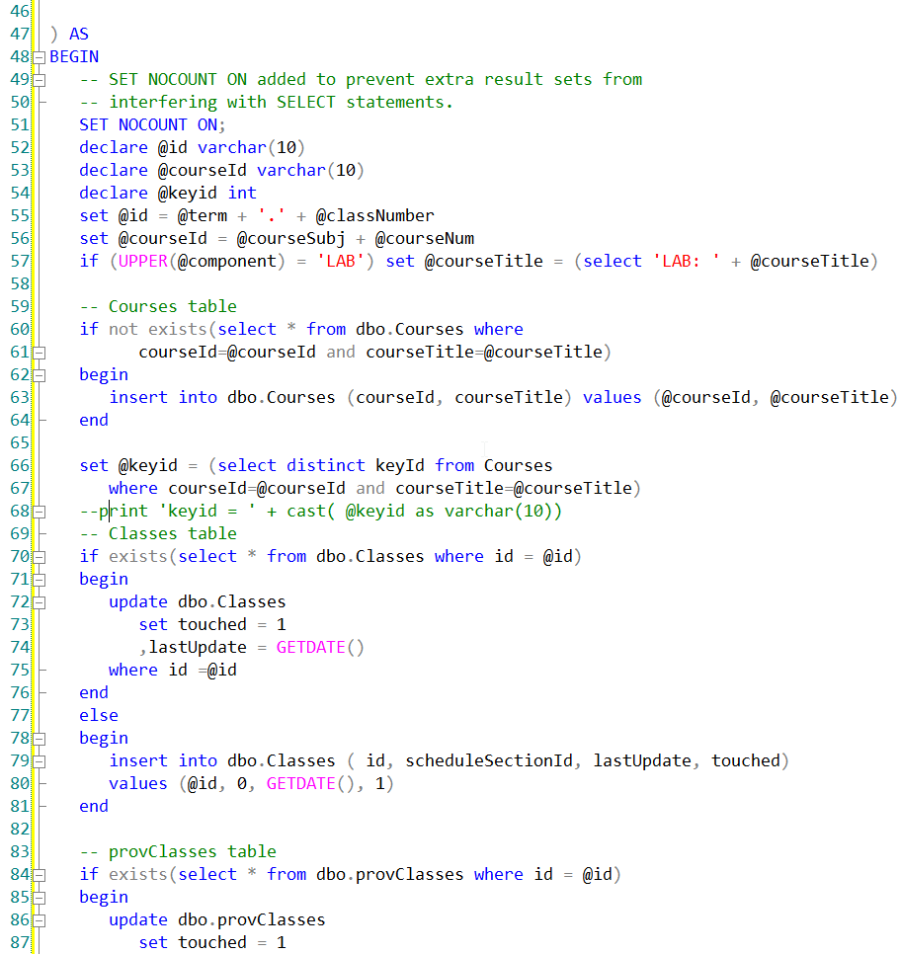
ETL Tool vs. Custom Coding
Which of these is easier to understand?

Slide 10
34 Essential ETL Subsystems
Each one of these systems is part of the E,T,L or Management process
Notes:
With the wisdom of hindsight from thousands of successful data warehouses, a set of ETL best practices have emerged. There is no reason to tolerate an unstructured approach. Careful consideration of these best practices has revealed 34 subsystems that are required in almost every dimensional data warehouse back room.

Slide 11
Extracting Data
Subsystems for extracting data.

Slide 12

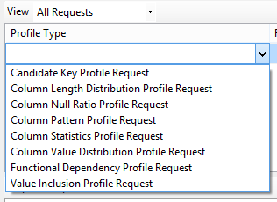
1 – Data Profiling
Helps you to understand the source data.
Identify candidate business keys
Functional dependencies
Nulls
Etc..
Helps us figure out the facts, dimensions, and source-to-target mapping.
Valuable tool when you do not have the SQL chops to query the source data.
Notes:
Data profiling is the technical analysis of data to describe its content, consistency, and structure. In some sense, any time you perform a SELECT DISTINCT investigative query on a database field, you are doing data profiling. There are a variety of tools specifically designed to do powerful profiling. It probably pays to invest in a tool rather than roll your own because the tools allow many data relationships to be explored easily with simple user interface gestures. You will be much more productive in the data profiling stages of your project using a tool rather than hand coding all your data content questions.
Data Profiling (subsystem 1) – Explores a data source to determine its fit for inclusion as a source and the associated cleaning and conforming requirements.

Slide 13

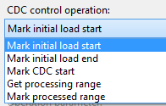
2- Change Data Capture System
A means to detect which data is part of the incremental load (selective processing)
Difficult to get right, needs a lot of testing.
Common Approaches:
Audit columns in source data (last update)
Timed extracts (ex. yesterday’s records)
Diff Compare with CRC / Hash
Database Transactions Logs
Triggers / Message Queues
Notes:
During the data warehouse's initial historic load, capturing source data content changes is not important because you are loading all data from a point in time forward. However, many data warehouse tables are so large that they cannot be refreshed during every ETL cycle. You must have a capability to transfer only the relevant changes to the source data since the last update. Isolating the latest source data is called change data capture (CDC). The idea behind change data capture is simple enough: Just transfer the data that has been changed since the last load. But building a good change data capture system is not as easy as it sounds.
Change Data Capture (subsystem 2) – Isolates the changes that occurred in the source system to reduce the ETL processing burden.

Slide 14
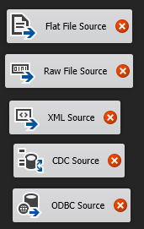
3 – Extract System
Getting data from the source system – a fundamental component!
Two Methods:
File – extracted output from a source system. Useful with 3rd parties / legacy systems.
Stream –initiated data flows out of a system: Middleware query, web service.
Files are useful because they provide restart points without re-querying the source.
Notes:
Extract System (subsystem 3) – Extracts and moves source data into the data warehouse environment for further processing.

Slide 15
Cleaning & Conforming Data
The “T” in ETL

Slide 16
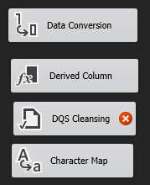
4 – Data Cleansing System
Balance these conflicting goals:
fix dirty data yet maintain data accuracy.
Quality screens act as diagnostic filters:
Column Screens – test data in fields
Structure Screens – test data relationships, lookups
Business Rule Screens – test business logic
Responding to Quality events:
Fix (ex. Replace NULL w/value)
Log Error and continue or abort (depending on severity)
Notes:
Data Cleansing System (subsystem 4) – Implements data quality processes to catch quality violations.

Slide 17
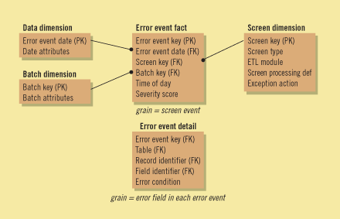
5 – Error Event Schema
A centralized dimensional model for logging errors.
Fact table grain is an error event.
Dimensions are Date, ETL Job, Quality Screen source
A row added whenever there is a quality screening event that results in an error.
Notes:
The error event schema is a centralized dimensional schema whose purpose is to record every error event thrown by a quality screen anywhere in the ETL pipeline.
Error Event Tracking (subsystem 5) – Captures all error events that are vital inputs to data quality improvement.

Slide 18
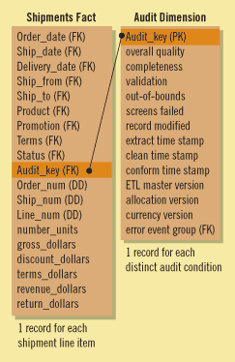
6 – Audit Dimension Assembler
A special dimension, assembled in the back room by the ETL system.
Useful for tracking down how data in your schema “got there” or “was “changed”
Each fact and dimension table uses the audit dimension for recording results of the ETL process.
There are two keys in the audit dimension for original insert and most recent update
Notes:
Audit Dimension Creation (subsystem 6) – Attaches metadata to each fact table as a dimension. This metadata is available to BI applications for visibility into data quality.

Slide 19
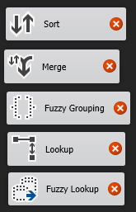
7- Deduplication System
When dimensions are derived from several sources.
Ex. Customer information merges from several lines of business.
Survivorship – the process of combining a set of matched records into unified image of authoritative data.
Master Data Management – centralized facilities to store master copies of data.
Notes:
Deduplication (subsystem 7) – Eliminates redundant members of core dimensions, such as customers or products. May require integration across multiple sources and application of survivorship rules to identify the most appropriate version of a duplicate row.

Slide 20
8 – Conforming System
Responsible for creating conformed dimensions and facts.
Typically conformed dimensions are managed in one place and distributed as a copy into the required dimensional model.
Sales DM
Marketing DM
Authoritative Dimensions
Finance DM
Notes:
Data Conformance (subsystem 8 ) – Enforces common dimension attributes across conformed master dimensions and common metrics across related fact tables.

Slide 21
Delivering Data for Presentation
The “L” in ETL

Slide 22

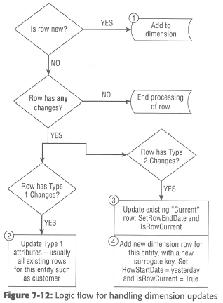
9 – Slowly Changing Dimension Manager
The ETL system must determine how to handle a dimension attribute value that has changed from what is already in the warehouse.
Notes:
Slowly Changing Dimension (SCD) Manager (subsystem 9) – Implements logic for slowly changing dimension attributes.

Slide 23
10 – Surrogate Key Manager
Surrogate keys are recommended for PK’s of your dimension tables.
In SQL Server, use IDENTITY
In other DBMS’s use a sequence with a database trigger can be used.
The ETL system can also manage them.
Notes:
Surrogate Key Generator (subsystem 10) – Produces surrogate keys independently for every dimension.

Slide 24
11 – Hierarchy Manager
Hierarchies are common among dimensions. Two Types:
Fixed – a consistent number of levels. Modeled as attributes in the dimension
Example: Product → Manufacturer
Ragged – a variable number of levels. Must be modeled as a snowflake with recursive bridge table.
Example: Outdoors → Camping → Tents → Multi-Room
Master Data Management can help with hierarchies outside the OLTP
Hierarchy Rules are added to the MOLAP Databases
Notes:
Hierarchy Manager (subsystem 11) – Delivers multiple, simultaneous, embedded hierarchical structures in a dimension.

Slide 25
12 – Special Dimensions Manager
A placeholder for supporting an organization’s specific dimensional design characteristics.
Date and/or Time Dimensions
Junk Dimensions
Shrunken Dimensions
Conformed Dimensions which are subsets of a larger dimension.
Small Static Dimensions
Lookup tables not sourced elsewhere
Notes:
Special Dimensions Manager (subsystem 12) – Creates placeholders in the ETL architecture for repeatable processes supporting an organization’s specific dimensional design characteristics, including standard dimensional design constructs such as junk dimensions, mini-dimensions and behavior tags.

Slide 26
13 – Fact Table Builders
Focuses on the architectural requirements for building the fact tables.
Transaction
Loaded as the transaction occurs, or on an interval
Periodic Snapshots
Loaded on an interval based on periods
Accumulating
Since facts are updated the ETL design must accommodate that.
Notes:
Fact Table Builders (subsystem 13) – Construct the three primary types of fact tables: transaction grain, periodic snapshot and accumulating snapshot.

Slide 27

14 – Surrogate Key Pipeline
A system for replacing operational natural keys in the incoming fact table record with appropriate dimension surrogate keys.
Approaches to handling referential integrity errors:
Throw away fact rows – bad idea
Write bad rows to an error table – most common
Insert placeholder row into the dimension – most complex
Fail the package and abort – draconian
Staged Lookups (Below)
Table joins (Like in Initial Load Example)
Notes:
Surrogate Key Pipeline (subsystem 14) – Replaces operational natural keys in the incoming fact table record with the appropriate dimension surrogate keys.

Slide 28
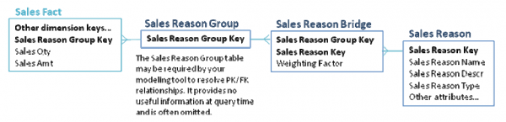
15 – Multi-Valued Dimension Bridge Table Builder
Support for M-M relationships among Fact and Dimensions is required.
Rebalancing the weighted values in the bridge table to add up to 1 is important.
Examples: Patients and diagnoses, Classes and instructors
Notes:
Multi-Valued Bridge Table Builder (subsystem 15) – Builds and maintains bridge tables to support multi-valued relationships.

Slide 29
16 – Late Arriving Data Handler
Ideally we want all data to arrive at the same time.
In some circumstances that is not the case.
Example: Orders are updated daily, but Salesperson changes are processed monthly
The ETL system must handle these situations and still maintain referential integrity.
Placeholder row technique.
Fact assigned a default value for the dimension until it is known. Ex: -2 Customer TBD Once known the dimension value is updated by a separate ETL Task.
Notes:
Data warehouses are usually built around the ideal assumption that measured activity (fact records) arrive in the data warehouse at the same time as the context of the activity (dimension records). When you have both the fact records and the correct contemporary dimension rows, you have the luxury of maintaining the dimension keys first, and then using these up-to-date keys in the accompanying fact rows. However, for a variety of reasons, your ETL system may need to process late arriving fact or dimension data.
Late Arriving Data Handler (subsystem 16) – Applies special modifications to the standard processing procedures to deal with late-arriving fact and dimension data.

Slide 30
17 – Dimension Manager
A Centralized authority, typically a person, who prepares and publishes conformed dimensions to the DW community.
Responsibilities:
Implement descriptive labels for attributes
Add rows to the conformed dimension
Manage attribute changes
Distribute dimensional updates
Notes:
Dimension Manager (subsystem 17) – Centralized authority who prepares and publishes conformed dimensions to the data warehouse community.

Slide 31
18 – Fact Provider System
Owns the administration of fact tables
Responsibilities:
Receive duplicated dimensions from the dimension manager
Adds / Updates fact tables
Adjusts / updates stored aggregates which have been invalidated.
Ensure quality of fact data
Notify users of changes, updates, and issues
Notes:
Fact Table Provider (subsystem 18) – Owns the administration of one or more fact tables and is responsible for their creation, maintenance and use.

Slide 32

19 – Aggregate Builder
Aggregates are specific data structures created to improve performance.
Aggregates must be chosen carefully – over aggregation is as problematic as not enough.
Summary Facts and Dimensions are generated from the base facts /dimensions.
Notes:
Aggregate Builder (subsystem 19) – Builds and maintains aggregates to be used seamlessly with aggregate navigation technologies for enhanced query performance.

Slide 33

20 – OLAP Cube Builder
Cubes (MOLAP) present dimensional data in an intuitive way which is easy to explore.
The ROLAP star schema is the foundation for your MOLAP cube.
Cube must be refreshed when fact and dimension data is added or updated.
Notes:
OLAP Cube Builder (subsystem 20) – Feeds data from the relational dimensional schema to populate OLAP cubes.

Slide 34

21 – Data Propagation Manager
Responsible for moving Warehouse data into other environments for special purposes.
Examples:
Reimbursement programs
Independent auditing
Data mining systems
Notes:
Data Propagation Manager (subsystem 21) – Prepares conformed, integrated data from the data warehouse presentation server for delivery to other environments for special purposes.

Slide 35
Managing the ETL Environment
The last piece of the puzzle, these components help manage the ETL process.
Notes:
A DW/BI environment can have a great dimensional model, well-deployed BI applications, and strong management sponsorship. But it cannot be a success until it can be relied upon as a dependable source for business decision making. One of the goals for the DW/BI system is to build a reputation for providing timely, consistent, and reliable data to empower the business.
To achieve this goal, the ETL system must constantly work toward fulfilling three criteria:
Reliability. The ETL processes must consistently run. They must run to completion to provide data on a timely basis that is trustworthy at any level of detail.
Availability. The data warehouse must meet its service level agreements (SLAs). The warehouse should be up and available as promised.
Manageability. A successful data warehouse is never done. It constantly grows and changes along with the business. The ETL processes need to gracefully evolve as well.
The ETL management subsystems are the key components of the architecture to help achieve the goals of reliability, availability, and manageability. Operating and maintaining a data warehouse in a professional manner is not much different than any other systems operations: Follow standard best practices, plan for disaster, and practice. Most of the requisite management subsystems that follow might be familiar to you.

Slide 36
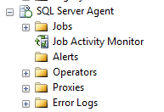
22 – Job Scheduler
As the name implies, the job scheduler is responsible for:
Job Definition
Job Scheduling – when the job runs
Metadata capture – which steps are you on, etc…
Logging
Notification
Notes:
Every enterprise data warehouse should have a robust ETL scheduler. The entire ETL process should be managed, to the extent possible, through a single metadata-driven job control environment. Major ETL tool vendors package scheduling capabilities into their environments. If you elect not to use the scheduler included with the ETL tool, or do not use an ETL tool, you need to utilize existing production scheduling or perhaps manually code the ETL jobs to execute.
Scheduling is much more than just launching jobs on a schedule. The scheduler needs to be aware of and control the relationships and dependencies between ETL jobs. It needs to recognize when a fi le or table is ready to be processed. If the organization is processing in real time, you need a scheduler that supports your selected real-time architecture. The job control process must also capture metadata regarding the progress and statistics of the ETL process during its execution. Finally, the scheduler should support a fully automated process, including notifying the problem escalation system in the event of any situation that requires resolution.
The infrastructure to manage this can be as basic (and labor-intensive) as a set of SQL stored procedures, or as sophisticated as an integrated tool designed to manage and orchestrate multiplatform data extract and loading processes. If you use an ETL tool, it should provide this capability. In any case, you need to set up an environment for creating, managing, and monitoring the ETL job stream.
The job control services needed include:
■ Job definition. The first step in creating an operations process is to have some way to define a series of steps as a job and to specify some relationship among jobs. This is where the execution flow of the ETL process is written. In many cases, if the load of a given table fails, it can impact your ability to load tables that depend on it. For example, if the customer table is not properly updated, loading sales facts for new customers that did not make it into the customer table is risky. In some databases, it is impossible.
■ Job scheduling. At a minimum, the environment needs to provide standard capabilities, such as time- and event-based scheduling. ETL processes are often based on some upstream system event, such as the successful completion of the general ledger close or the successful application of sales adjustments to yesterday’s sales figures. This includes the ability to monitor database flags, check for the existence of fi les, and compare creation dates.
■ Metadata capture. No self-respecting systems person would tolerate a black box scheduling system. The folks responsible for running the loads will demand a workflow monitoring system (subsystem 27) to understand what is going on. The job scheduler needs to capture information about what step the load is on, what time it started, and how long it took. In a handcrafted ETL system, this can be accomplished by having each step write to a log file. The ETL tool should capture this data every time an ETL process executes.
■ Logging. This means collecting information about the entire ETL process, not just what is happening at the moment. Log information supports the recovery and restarting of a process in case of errors during the job execution. Logging to text fi les is the minimum acceptable level. We prefer a system that logs to a database because the structure makes it easier to create graphs and reports. It also makes it possible to create time series studies to help analyze and optimize the load process.
■ Notification. After the ETL process has been developed and deployed, it should execute in a hands-off manner. It should run without human intervention, without fail. If a problem does occur, the control system needs to interface to the problem escalation system (subsystem 30).
The data warehouse is subject to the same risks as any other computer system. Disk drives will fail, power supplies will go out, and sprinkler systems will accidentally turn on. In addition to these risks, the warehouse also has a need to keep more data for longer periods of time than operational systems. Although typically not managed by the ETL team, the backup and recovery process is often designed as part of the ETL system. Its goal is to allow the data warehouse to get back to work after a failure. This includes backing up the intermediate staging data necessary to restart failed ETL jobs. The archive and retrieval process is designed to enable user access to older data that has been moved out of the main warehouse onto a less costly, usually lower-performing media.
Job Scheduler (subsystem 22) – Reliably manages the ETL execution strategy, including the relationships and dependencies between ETL jobs.

Slide 37
23 – Backup System
A means to backup, archive and retrieve elements of the ETL system.
Notes:
Backup System (subsystem 23) – Backs up the ETL environment for recovery, restart and archival purposes.

Slide 38
24 – Recovery & Restart System
Jobs must be designed to recover from system errors and have the capability to automatically restart, if desired.
Notes:
Recovery and Restart (subsystem 24) – Processes for recovering the ETL environment or restarting a process in the event of failure.

Slide 39
25 – Version Control System
Versioning should be part of the ETL process.
ETL is a form of programming and should be placed in a source code management system. (SCM)
Products
GIT
Mercurial
SVN
Check in
ETL Tooling code
SQL
Scripts to run Jobs
Notes:
Version Control (subsystem 25) – Takes snapshots for archiving and recovering all the logic and metadata of the ETL pipeline.

Slide 40
26 – Version Migration System
There needs to be a means to transfer changes between environments like Development, Test and production.
Test
Prod
Dev
Notes:
Version Migration (subsystem 26) – Migrates a complete version of the ETL pipeline from development into test and finally into production.

Slide 41
27 – Workflow Monitor
There must be a system to monitor the ETL processes are operating efficiently and promptly.
There should be:
An audit system
ETL logs
Database monitoring
Notes:
Workflow Monitor (subsystem 27) – Ensures that the ETL processes are operating efficiently and that the warehouse is being loaded on a consistently timely basis.

Slide 42

28 – Sorting System
Sorting is a transformation within the data flow.
Is it typically a final step in loading process when applicable.
A common feature in ETL tooling.
Notes:
Sorting (subsystem 28) – Serves the fundamental, high-performance ETL processing role.

Slide 43
29 – Lineage and Dependency Analyzer
Lineage – the ability to look at a data element and see how it was populated.
Audit Tables help here
Dependency – is opposite direction. Look at a source table and identify the Cubes and star schemas which use it.
Custom Metadata tables
Notes:
Lineage and Dependency (subsystem 29) – Identifies the source of a data element and all intermediate locations and transformations for that data element or, conversely, start with a specific data element in a source table and reveals all activities performed on that data element.

Slide 44
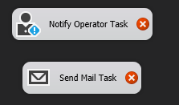
30 – Problem Escalation System
ETL should be automated, but when major issues occur be a system in place to alert administrators.
Minor errors should simply be logged and notified at their typical levels.
Notes:
Problem Escalation (subsystem 30) – Support structure that elevates ETL problems to appropriate levels for resolution.

Slide 45
31 – Parallelizing / Pipelining System
Take advantage of multiple processors or computers in order to complete the ETL in a timely fashion.
SSIS supports this feature.
Notes:
Paralleling and Pipelining (subsystem 31) – Enables the ETL system to automatically leverage multiple processors or grid computing resources to deliver within time constraints.

Slide 46
32 – Security System
Since it is not a user-facing system, there should be limited access to the ETL back-end.
Staging tables should be off-limits to business users.
Notes:
Security (subsystem 32) – Ensures authorized access to (and a historical record of access to) all ETL data and metadata by individual and role.

Slide 47
33 – Compliance Manager
A means of maintaining the chain of custody for the data in order to support compliance requirements of regulated environments.
Notes:
Compliance Manager (subsystem 33) – Supports the organization’s compliance requirements typically through maintaining the data’s chain of custody and tracking who had authorized access to the data.

Slide 48
34 – Metadata Repository Manager
A system to manage the metadata associated with the ETL process.
Notes:
Metadata Repository (subsystem 34) – Captures ETL metadata including the process metadata, technical metadata and business metadata, which make up much of the metadata of the total DW/BI environment.

Slide 49
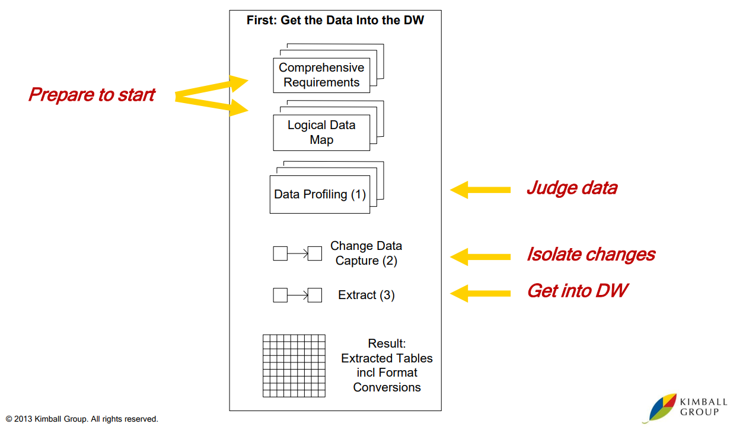
E: Getting the Data Into the DW Note: Numbers in the parentheses refer to Kimball’s 34 ETL subsystems.

Slide 50
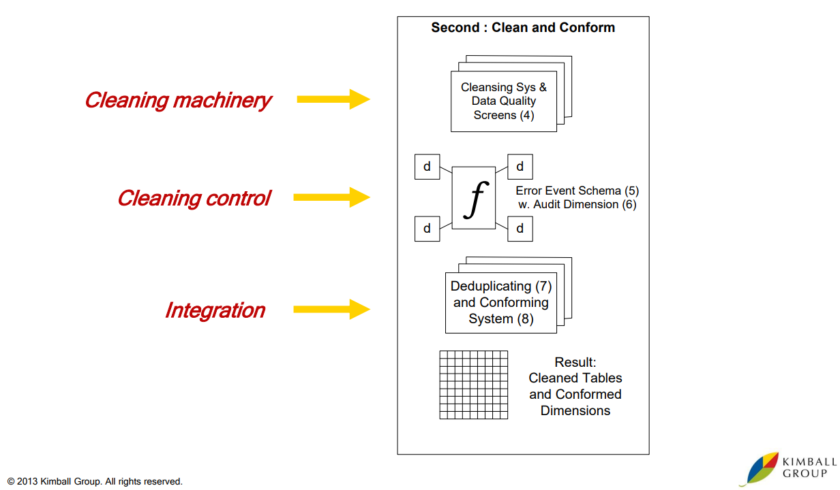
T: Clean and Conform Note: Numbers in the parentheses refer to Kimball’s 34 ETL subsystems.

Slide 51
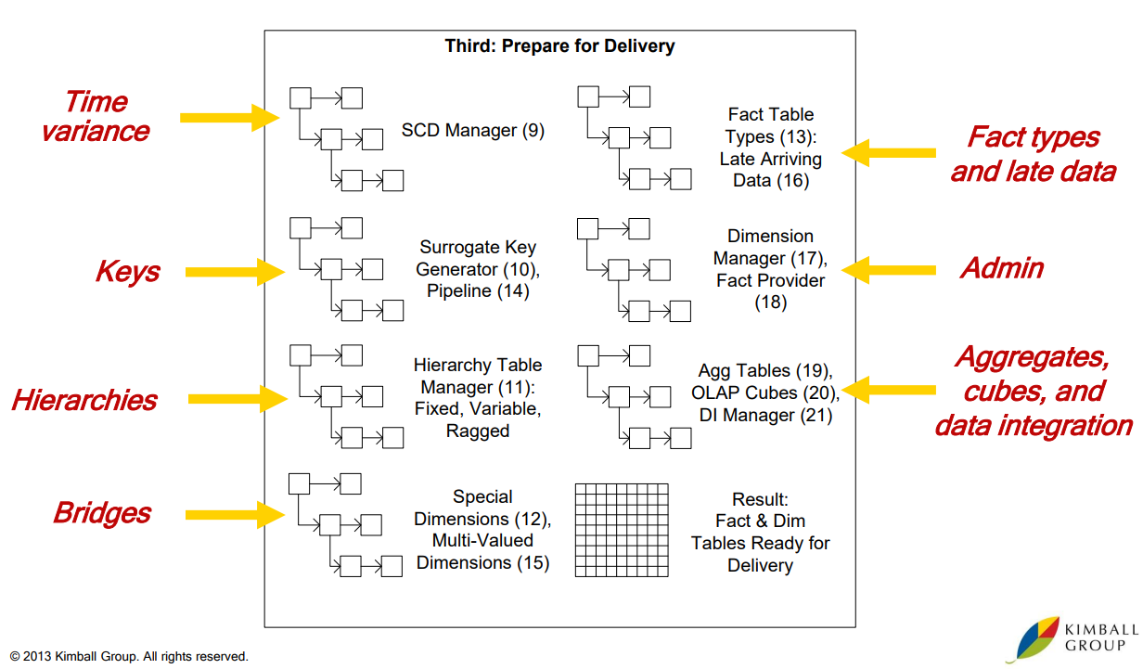
L: Prepare for Presentation Note: Numbers in the parentheses refer to Kimball’s 34 ETL subsystems.

Slide 52
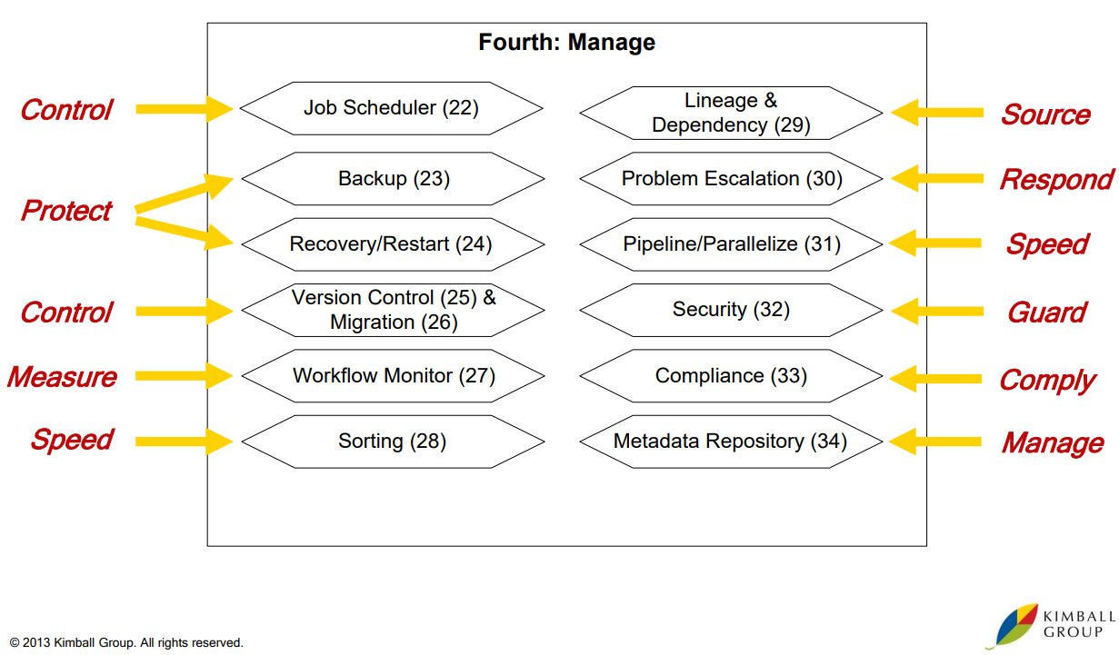
M: Manage All the Processes Note: Numbers in the parentheses refer to Kimball’s 34 ETL subsystems.

Slide 53
Resources
Reading:
Kimball Ch. 9
Group discussion:
https://ecourse.del.ac.id/

Slide 54
EOF

