Slide 1
PerfStack
Load Testing Platform
K6 · Grafana · InfluxDB · Kubernetes
FICO — epc_owner@fico.com

Slide 2
Agenda
01
The Problem
02
Architecture
Why load testing matters before going to production
Components, data flow, and deployment topology
03
Tech Stack
04
How it Works
K6, FastAPI, React, InfluxDB, Grafana, Kubernetes
End-to-end flow: from UI click to rendered report
05
Reporting
06
Live Demo
Metrics, KPIs, Grafana charts — all in one HTML report
Running a real load test against a target API

Slide 3
The Problem
Performance issues discovered in production — not before.
✕
No visibility
✕
Manual & slow
APIs fail under real concurrency. Problems only surface after deployment.
Running k6 locally means copy-pasting commands, reading raw JSON output.
✕
No shared context
✕
OAuth complexity
Individual developers test in silos. No historical comparison, no team reports.
Target APIs require bearer tokens. Token lifecycle is a manual chore.
PerfStack solves all of this — one platform, zero manual steps.

Slide 4
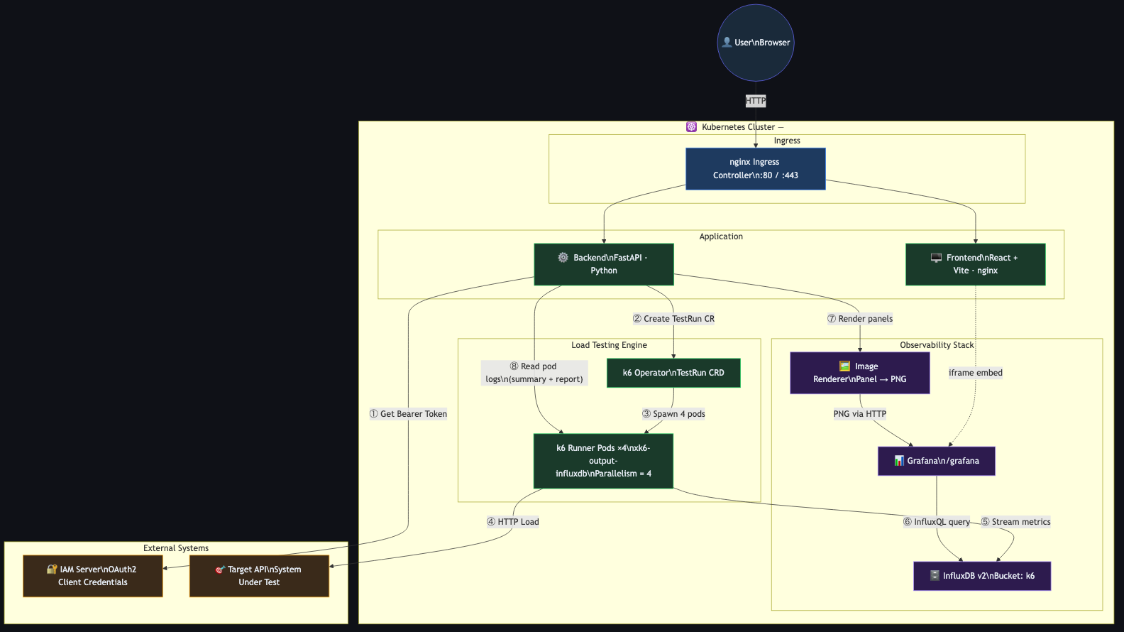
Architecture

Slide 5
Tech Stack
K6
k6 Operator
Load testing engine — VU-based, JS scripts, Streams metrics to InfluxDB via xk6-output-influxdb
Kubernetes CRD — runs K6 as parallelized Jobs (4 pods × configured VUs)
FastAPI
React + Vite
Python backend — IAM auth, job lifecycle, Grafana render API, HTML report generation
Frontend SPA — test config, live pod monitor, progressive chart loader
InfluxDB v2
Grafana 12
Time-series store — receives K6 metrics in real-time Queried via InfluxQL compatibility layer
Dashboard + image renderer — panels rendered to PNG via headless Chromium
K3d
nginx Ingress
Local Kubernetes cluster on Docker — production-identical topology on a laptop
Single entry point — routes /api → backend, / → frontend, /grafana → Grafana

Slide 6
How it Works
①
②
③
④
⑤
Configure
Auth
Deploy
Load
Report
Pick target URL, payload, VUs, duration, IAM creds in the React UI
Backend calls IAM OAuth2 (client credentials flow) and caches Bearer token
K6 Operator creates a TestRun CRD — spins up 4 parallel K6 pods
K6 pods hammer the target API and stream metrics to InfluxDB every second
Backend renders 5 Grafana panels progressively and serves self-contained HTML
▶
▶
▶
▶

Slide 7
Performance Report
Auto-generated HTML — no manual post-processing
●
Total Requests
●
Peak req/s
●
Error Rate
●
p95 / p99
●
Checks Passed
All HTTP calls made during the test
Max throughput observed from InfluxDB timeseries
% of failed requests with color thresholds
Response time percentiles from K6 summary JSON
Custom K6 check results pass/fail breakdown
Grafana Panels — rendered progressively as they load
Virtual Users
Requests per Second
Errors per Second
Live VU ramp-up / ramp-down
Throughput timeline
Error spikes visualised
Response Time (p90/p95)
Response Time Heatmap
Latency percentile bands
Distribution over time

Slide 8
Live Demo
1
Open http://localhost in the browser
2
Add a service — enter IAM credentials, target URL, payload
3
Configure VUs & duration (e.g. 10 VUs · 60 s)
4
Click Run Test — watch pod status in real time
5
Click Download Report — see charts load progressively
6
Open Grafana → K6 Load Testing Results for live dashboard
Access: http://localhost | Grafana: http://localhost/grafana (admin / admin)

Slide 9
Key Takeaways
Zero manual steps
Production-identical
From IAM auth to rendered report — fully automated. No YAML editing, no command line, no copy-paste.
K3d cluster mirrors EC2 deployment exactly. Same images, same manifests, same network paths.
Observable by default
Extensible
Every test streams metrics to InfluxDB and Grafana in real time — no post-processing needed.
Add scenarios, save services, run against any OAuth2-protected API without code changes.

Slide 10
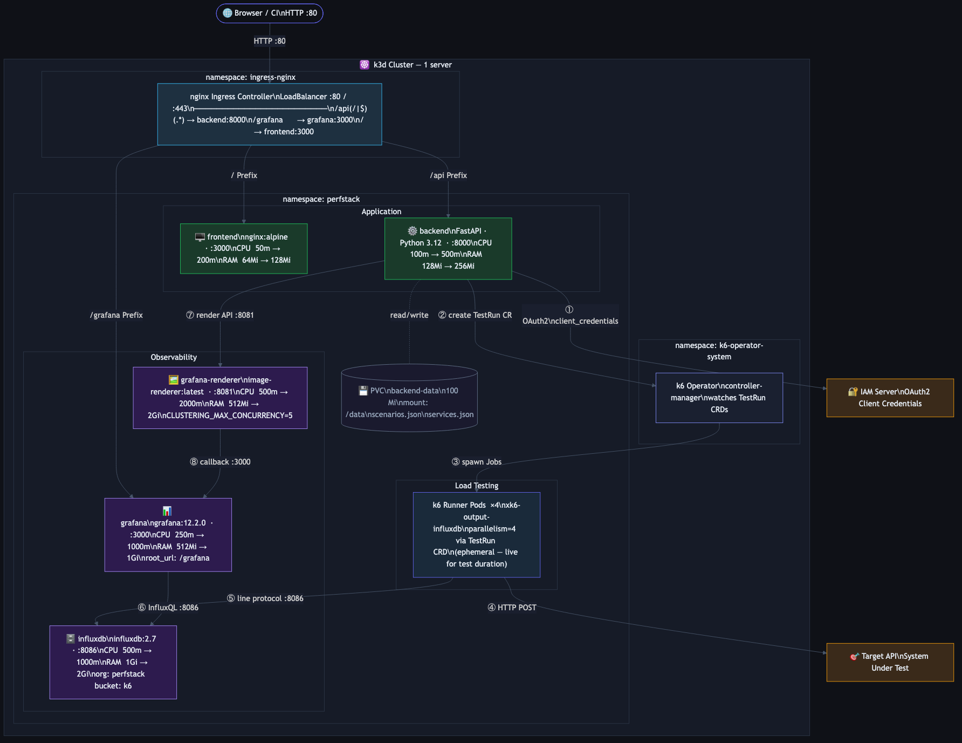
Infrastructure View
Kubernetes resources · namespaces · CPU / RAM limits · network paths · storage

Slide 11
Questions?
github · epc_owner@fico.com
PerfStack — Load Testing Platform

