Slide 1

Efficiency comparison for metaheuristics in solving the Traveling Thief Problem
Filip Mazur
Piotr Neumann
Dawid Ryl

Slide 2
Roadmap
Our goals and motivations
Greedy Algorithm
Experiment 1 results
Travelling Thief Problem
Literature review
Simulated Annealing
Genetic Algorithm
Experiment 2 results
Experimentation plan
Summary

Slide 3
Our goals and motivations
GOALS
Find the optimal solution using 3 different approaches
Introduce comparative experiments between used methods
Interpret experiments’ results

Slide 4
Our goals and motivations
MOTIVATIONS
Complexity of real-world problems is growing very fast (e.g. due to globalization)
Real-world problems usually consist of two or more sub-problems that are interdependent (to each other)
Lack of comparative experiments between metaheuristics for this particular problem

Slide 5
Literature review
A Comprehensive Benchmark Set and Heuristics for the Traveling Thief Problem
https://dl.acm.org/citation.cfm?id=2598249

Slide 6
Literature review
Authors’ GOALS
Study TTP as a combination of TSP and KP
Compare the problem instances
Provide algorithms that can effectively solve problems with interdependencies

Slide 7
Literature review
Authors’ Experiment results
The number of cities plays no role in this particular decision tree
Evolutionary algorithm ea dominates small ttp instances with few cities and few items, as many of the leftmost leaves in the decision tree are labelled ea. It performs better than rls since it can escape local optima
Random local search rls performs well across mid-sized and several larger ttp instances. This is due to the fact that ea effectively wastes evaluations, as the packing status change of an item is not enforced

Slide 8
Literature review
Authors’ Problems
Keep a balance between two components of the problem
Near-optimal solution of one sub-problem must not dominate over the optimal solution of another sub-problem
Solving the shortest tour problem to optimality must not make the knapsack packing aspect negligible
The most profitable loading plan must not reduce the importance of a shorter tour

Slide 9
Literature review
Authors’ „Algorithms”
Simple Heuristic
Random Local Search
Evolutionary Algorithm

Slide 10
What is TTP?
Combination of:
0-1 Knapsack Problem
Maximum weight
Current weight
Profit
+Rent
Traveling Salesman Problem
Distance between cities
+Vmax / Vmin
+set of items
Notes:
There are n cities, and the distance matrix D is given. Also, there are m items each of them having a value pk and weight wk. There is a thief who is going to visit these cities exactly once and pick some items from the cities and fill his knapsack. The maximum weight for the knapsack is W. The aim is to find a tour that visits all of the cities exactly once and gets back to the starting city, optimizing objective function(s) while the total weight of the knapsack is not violated. Note that the objective function(s) might be related to the time of the travel and/or the total value the thief gains from picking the items. In the rest of this paper, it is assumed that the thief starts from the first city. Also, the thief can pick the items from the first city only at the beginning.

Slide 11
Traveling Thief Problem
The problem is a combination of two well-known optimization problems (TSP and KP)
These two models are different from each other based on the way in which the sub-problems are interdependent
It is shown that solving each sub-problem in isolation is not effective and the two sub-problems have to be considered together.

Slide 12
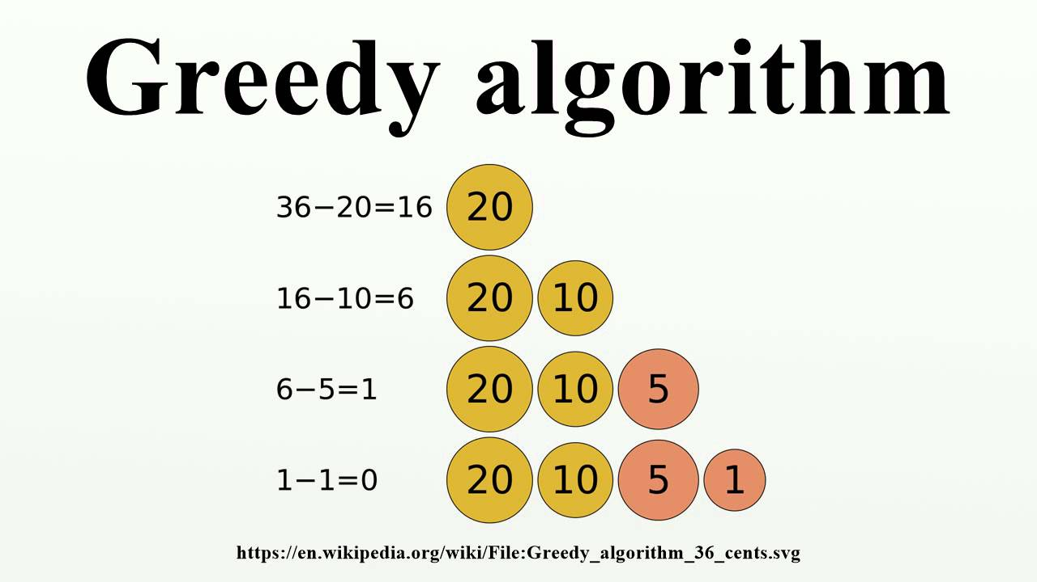
Greedy Algorithm
Always choose locally best solution
This is how a human would determine how to give out change with smallest possible amount of coins
Notes:
We choose cities to which the thief goes based on distance. The thief will go to the nearest unvisited city.
Items are sorted by price / weight and loaded into the backpack until it fills the entire place

Slide 13
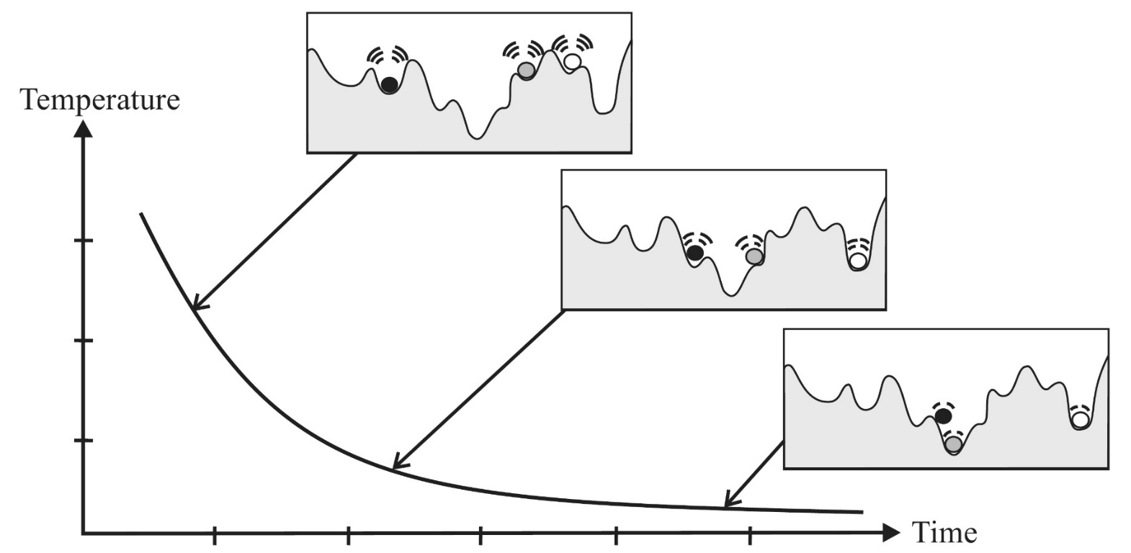
Simulated Annealing
Searches local solutions' space for a better fit neighbour
Starts in a "hot" state and cools down over time
The "hotter" the state, the more likely it is for algorithm to do something "random" to escape local minimum or maximum
https://www.intechopen.com/books/simulated-annealing-advances-applications-and-hybridizations/simulated-annealing-evolution

Slide 14
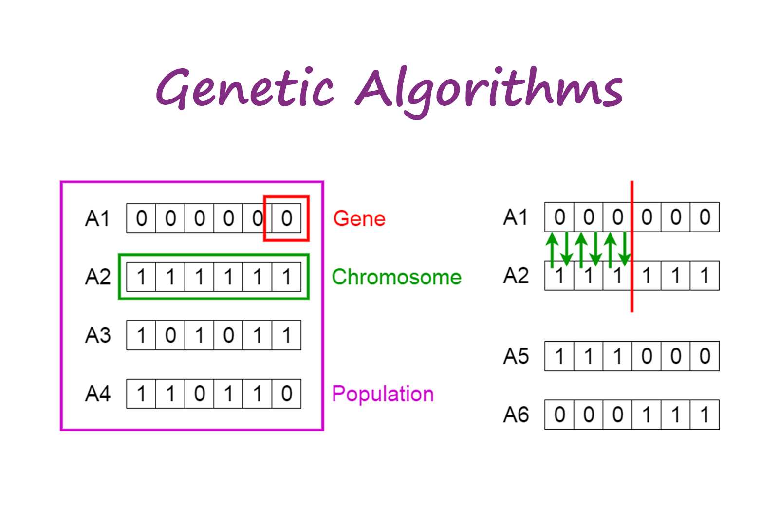
Genetic Algorithm
Represent solutions as "chromosomes" which form "population"
Choose fittest specimens (f.e. via "tournament" or "roulette wheel")
Make them mate ( ͡° ͜ʖ ͡°) (f.e. via crossover)
Some children can undergo mutation (f.e. 2 random genes in a child will swap places)
New (usually better than previous) generation arises
Repeat until best solution found (or until bored)
https://towardsdatascience.com/introduction-to-genetic-algorithms-including-example-code-eo-g396e98d8bf3

Slide 15
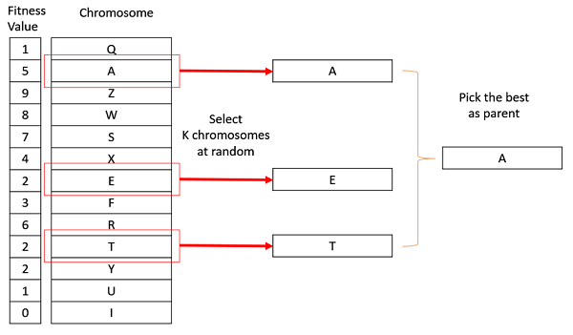
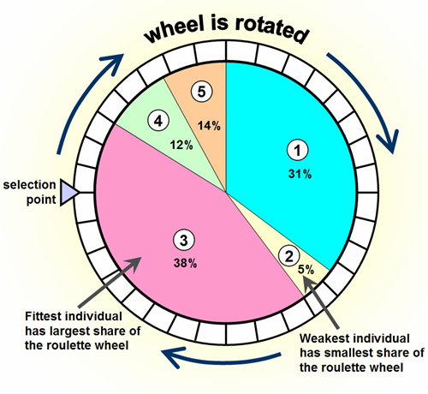
Genetic Algorithm
Selection:
tournament
roulette wheel
https://www.geeksforgeeks.org/tournament-selection-ga/
https://www.codewars.com/kata/genetic-algorithm-series-number-5-roulette-wheel-selection

Slide 16
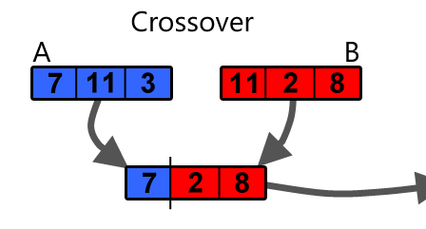
Genetic Algorithm
Crossover:
One-Point Order One Crossover
Two-Point Order One Crossover
https://becominghuman.ai/understanding-genetic-algorithms-a-use-case-in-organizational-field-2087c30fb61e

Slide 17

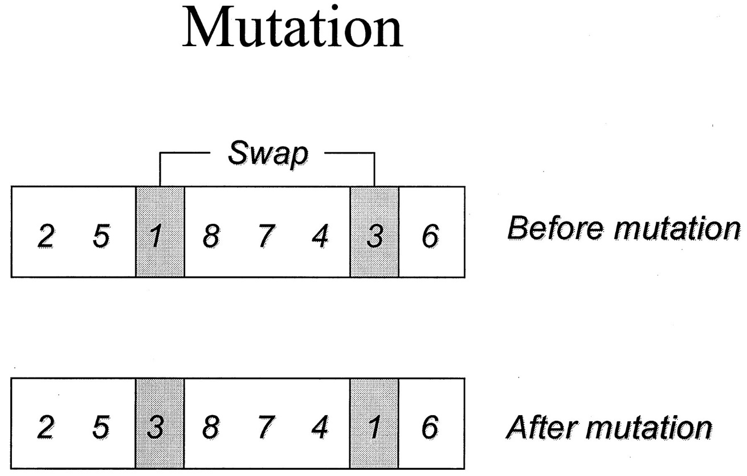



Genetic Algorithm
http://clinchem.aaccjnls.org/content/47/1/118/tab-figures-data

Slide 18

Experimentation plan
Dataset
Dataset origin – https://sites.google.com/site/mohammadrezabonyadi/standarddatabases/travelling-thief-problem-data-bases-and-raw-results
Dataset description
Number of problem’s instances: 3
file 1 – 9 cities, 9 items
file 2 – 52 cities, 510 items
file 3 – 439 cities, 4380 items
File features:
number of cities - integer
number of items - integer
max knapsack capacity - integer min speed <float>
max speed - real
renting ration - real
city index - integer
city X coordinate - real
city Y coordinate - real
item index - integer
item profit - integer
item weight - integer
assigned city index - integer

Slide 19

Experimentation plan
Research environment
Implementation language: C++17
Compiler: GCC 9.2
CPU specification: Intel® Core™ i5-5200U CPU @ 2x2.2GHz
Memory available: 6393760 kB

Slide 20

Experimentation plan
Measurements
To perform measurements in our experiments we used our own implementation of stopwatch which measures time with precision ± 1 nanosecond

Slide 21

Experimentation plan
Experiment 1
Goal - find out which set of parameters results in generally best quality solutions for tested instances for a given time limit so in the main experiment both “Simulated Annealing Team” and “Genetic Algorithm Team” are at their best performance.
Assumptions
Constant parameters:
Time limit (10 seconds)
Changing parameters:
File - instance of a problem (file 1, file 2, file 3)
Simulated Annealing:
T max (1, 10, 100, 1000)
T min (0.00000001 (1E-8), 0.000000001 (1E-9), 0.0000000001 (1E-10), 0.00000000001 (1E-11)
T coefficient (0.9, 0.99, 0.995, 0.999)
Genetic Algorithm:
Size of population (50, 75, 100, 200)
Crossover chance (50%, 55%, 60%, 65%)
Mutation chance (0.5%, 1%, 1.5%, 2%)
Selection type (tournament, roulette wheel)
Crossover type (One-Point Order One Crossover, One-Point Order One Crossover,)
Course of experiment
Perform a time measurement experiment while fiddling with each changing parameter one by one 100 times and handpick the set of parameters which performs the best on average.

Slide 22

Experimentation plan
Experiment 2
Goal - find out which metaheuristic is more efficient and under which circumstance (or in which instance of a problem) for the set of parameters found in Experiment 1
Assumptions
Constant parameters:
Metaheuristic’s parameters chosen in Experiment 1
Changing parameters
File - instance of a problem (file 1, file 2, file 3)
Time limit (1, 10, 100, 1000 seconds)
Course of experiment
Perform a time measurement experiment with set of parameters found in Experiment 1 repeated 100 times
Plot and compare the results

Slide 23
Experiment 1 results
Profit
50457,90

Slide 24
Experiment 1 results

Slide 25
Experiment 1 results

Slide 26
Experiment 1 results

Slide 27
Experiment 1 results

Slide 28
Experiment 1 results

Slide 29
Experiment 1 results

Slide 30
Experiment 1 results
OX | MIN | AVG | MAX
OPOOX | 55263,20 | 55691,63 | 56182,70
TPOOX | 55434,10 | 56451,35 | 57215,50

Slide 31
Experiment 1 results
OX | MIN | AVG | MAX
tournament | 55409,30 | 55784,21 | 56600,00
roulette | 55515,10 | 56435,78 | 57550,10

Slide 32
Experiment 2 results
 | avg | min | max
SA_1sec_trivial_0 | 3368 | 3368 | 3368
GA_1sec_trivial_0 | 3367,99 | 3367,99 | 3367,99
Greedy_trivial_0 | 3305,98 | 3305,98 | 3305,98

Slide 33
Experiment 2 results
 | avg | min | max
SA_1sec_medium_0 | 56217,84 | 55824,1 | 56834,7
GA_1sec_medium_0 | 55883,29 | 55231,2 | 56737,9
Greedy_medium_0 | 50457,9 | 50457,9 | 50457,9

Slide 34
Experiment 2 results
 | avg | min | max
SA_10sec_hard_0 | 212212,7 | 209629 | 214573
GA_10sec_hard_0 | 214793,8 | 212034 | 218299
Greedy_medium_0 | 50457,9 | 50457,9 | 50457,9

Slide 35
Experiment 2 results
 | avg | min | max
SA_100sec_medium_0 | 57630,08 | 57311,7 | 58349,2
GA_100sec_medium_0 | 55700,02 | 55349,7 | 56209,9
Greedy_medium_0 | 50457,9 | 50457,9 | 50457,9

Slide 36
Experiment 2 results
 | avg | min | max
SA_1sec_hard_0 | 207521,3 | 204736 | 212487
GA_1sec_hard_0 | 214185,2 | 212589 | 216443
Greedy_hard_0 | 379105 | 379105 | 379105

Slide 37
Experiment 2 results
 | avg | min | max
SA_10sec_hard_0 | 212212,7 | 209629 | 214573
GA_10sec_hard_0 | 214793,8 | 212034 | 218299
Greedy_hard_0 | 379105 | 379105 | 379105

Slide 38
Experiment 2 results
 | avg | min | max
SA_100sec_hard_0 | 217734,6 | 214937 | 221914
GA_100sec_hard_0 | 218599,2 | 215576 | 224532
Greedy_medium_0 | 50457,9 | 50457,9 | 50457,9

Slide 39
Experiment 2 results
 | result
SA_1000sec_hard_0 | 221702
GA_1000sec_hard_0 | 225121
Greedy_medium_0 | 50457,9

Slide 40

Summary
Experiment 1 found this set of parameters to perform the best:
SA
T max = 10
T min = 0.00000000001 (1E-11)
T coefficient = 0.999
GA
Crossover ratio = 50%
Mutation ratio = 1%
Population size = 200
Crossover method = TPOOX
Selection method = roulette wheel

Slide 41

Summary
Experiment 2 found that:
Genetic Algorithm isn’t best suited for this problem (possibly because of items being binary)
Despite that it managed to outperform Simulated Annealing in very big instance of TTP (439 cities, over 4k items)

Slide 42
REFERENCES
https://cs.adelaide.edu.au/~zbyszek/Papers/TTP.pdf
https://dl.acm.org/citation.cfm?id=2598249
https://www.intechopen.com/books/simulated-annealing-advances-applications-and-hybridizations/simulated-annealing-evolution
https://towardsdatascience.com/introduction-to-optimization-with-genetic-algorithm-2f5001d9964b
https://www.geeksforgeeks.org/genetic-algorithms/
https://sites.google.com/site/mohammadrezabonyadi/standarddatabases/travelling-thief-problem-data-bases-and-raw-results
https://sites.google.com/site/mohammadrezabonyadi/standarddatabases/travelling-thief-problem-data-bases-and-raw-results

Slide 43
Thank You for Your attention!
Filip Mazur
Dawid Ryl
Piotr Neumann

