Slide 1

Efficiency comparison for metaheuristics in solving the Traveling Thief Problem
Filip Mazur
Dawid Ryl
Piotr Neumann

Slide 2
Roadmap
Travelling thief problem
Literature reviews
Results we hope for
What we chose to implement
Our goals and motivations

Slide 3
What is TTP?
Combination of:
0-1 Knapsack Problem
Maximum weight
Current weight
Profit
+Rent
Traveling Salesman Problem
Distance between cities
+Vmax / Vmin
+set of items
Notes:
There are n cities, and the distance matrix D is given. Also, there are m items each of them having a value pk and weight wk. There is a thief who is going to visit these cities exactly once and pick some items from the cities and fill his knapsack. The maximum weight for the knapsack is W. The aim is to find a tour that visits all of the cities exactly once and gets back to the starting city, optimizing objective function(s) while the total weight of the knapsack is not violated. Note that the objective function(s) might be related to the time of the travel and/or the total value the thief gains from picking the items. In the rest of this paper, it is assumed that the thief starts from the first city. Also, the thief can pick the items from the first city only at the beginning.

Slide 4
TRAVELLING THIEF PROBLEM
The problem is a combination of two well-known optimization problems (TSP and KP). These two models are different from each other based on the way in which the sub-problems are interdependent. It is shown that solving each sub-problem in isolation is not effective and the two sub-problems have to be considered together.

Slide 5
Our goals and motivations
What MOTIVATED US:
complexity of real-world problems is growing very fast (e.g. due to globalisation)
real-world problems usually consist of two or more sub-problems that are interdependent (to each other).
LACK COMPARATIVE TESTS

Slide 6
Combination – the real-world problems usually consist of two or more sub-problems that are “combined together”, and
Interdependence – in real-world problems these subproblems are interdependent in the sense that a solution for one sub-problem influences the quality of the solutions for other sub-problems.

Slide 7
Our goals and motivations
The travelling thief problem
NP-hard, so that solving “large” instances of these problems to optimality is not possible
PROBLEMS REPESENTED REAL-WORLD INDUSTRIAL ENVIROMENTS SO THAT SOLVING THAT TO OPTIMALITY WAS IMPORTANT
Enable researches to investigate the hardness the two classical subproblems’ combination

Slide 8
Results we hope for
GOALS
SOLVE PROBLEM IN AN ACCEPTABLE TIME
IMPLEMENTING 3 DIFFERENT APPROACHES TO SOLVE PROBLEM
INTRODUCE COMPARATIVE TESTS

Slide 9
Literature reviews
A Comprehensive Benchmark Set and Heuristics for the Traveling Thief Problem
https://dl.acm.org/citation.cfm?id=2598249

Slide 10
Literature reviews
Authors GOALS
Study TTP as a combination of TSP and KP
Compare the problem instances
Provide algorithms that can effectively solve problems with interdependencies

Slide 11
Literature reviews
Authors Problem
Keep a balance between two components of the problem
Near-optimal solution of one sub-problem must not dominate over the optimal solution of another sub-problem
Solving the shortest tour problem to optimality must not make the knapsack packing aspect negligible
The most profitable loading plan must not reduce the importance of a shorter tour

Slide 12
Literature reviews
Authors „Algorithms”
Simple Heuristic
Random Local Search
Evolutionary Algorithm

Slide 13
Literature reviews
Authors Experiment results
The number of cities plays no role in this particular decision tree
Evolutionary algorithm ea dominates small ttp instances with few cities and few items, as many of the leftmost leaves in the decision tree are labelled ea. It performs better than rls since it can escape local optima
Random local search rls performs well across mid-sized and several larger ttp instances. This is due to the fact that ea effectively wastes evaluations, as the packing status change of an item is not enforced

Slide 14

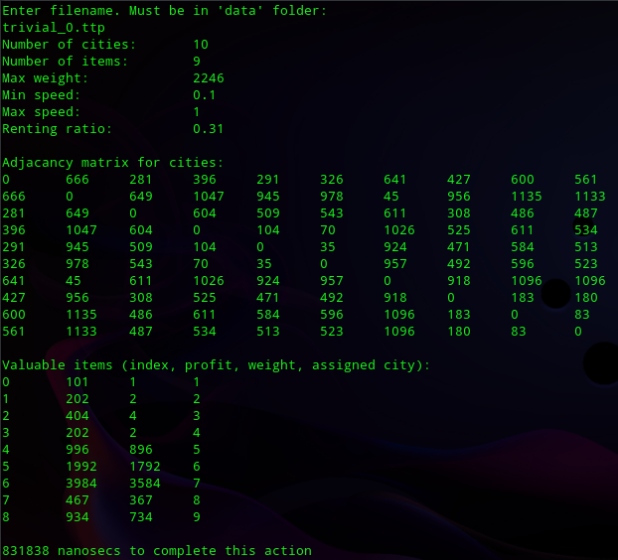



What we chose to implement
What we’ve done so far:
- Loading the data

Slide 15
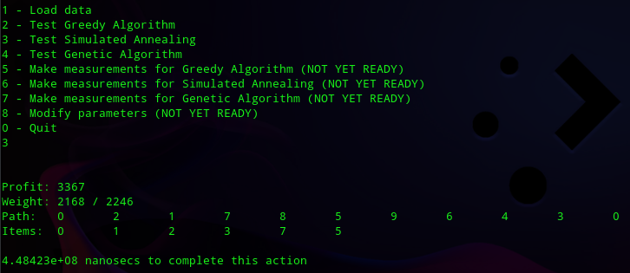
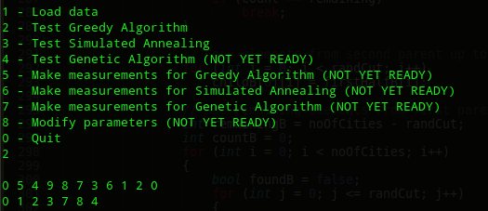
What we chose to implement
What we’ve done so far:
- Simulated Annealing - Greedy for reference

Slide 16
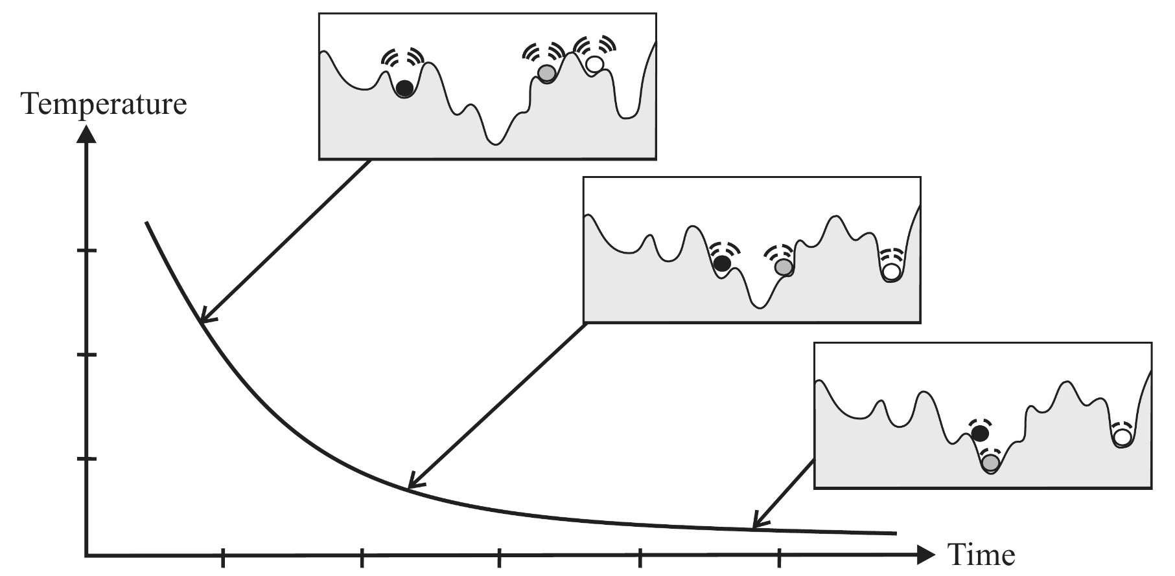
What we chose to implement
What we’ve done so far:
- Simulated Annealing
A short recap:
Searches local solutions' space for a better fit neighbour
Starts in a "hot" state and cools down over time
The "hotter" the state, the more liokely it is for algorithm to do something "random" to escape local minimum or maximum
https://www.intechopen.com/books/simulated-annealing-advances-applications-and-hybridizations/simulated-annealing-evolution

Slide 17
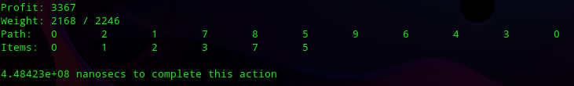
What we chose to implement
What we’ve done so far:
- Solution representation
A single member of population is represented as a pair of two structures
Path that the Thief took
Items which the thief stole
Solution is printed exactly as we’ve seen before with information on total Profit and current Weight for printed solution

Slide 18
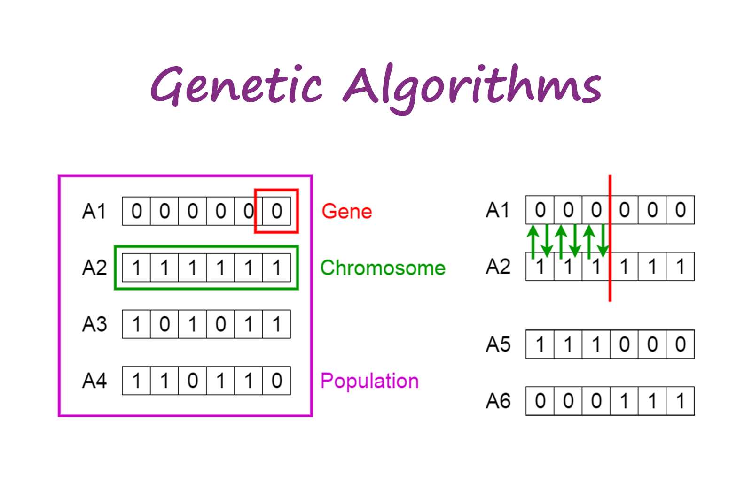
What we chose to implement
What we’ve done so far:
- Genetic Algorithm
A short recap:
Represent solutions as "chromosomes" which form "population"
Choose fittest specimens (f.e. via "tournament" or "roulette wheel")
Make them mate ( ͡° ͜ʖ ͡°) (f.e. via crossover)
Some children can undergo mutation (f.e. 2 random genes in a child will swap places)
New (usually better than previous) generation arises
Repeat until best solution found (or until bored)
https://towardsdatascience.com/introduction-to-genetic-algorithms-including-example-code-eo-g396e98d8bf3

Slide 19
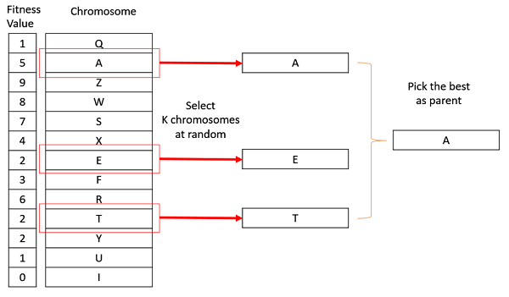
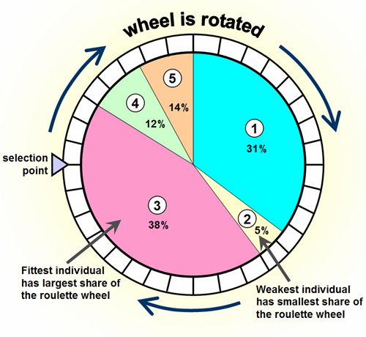
What we chose to implement
https://www.geeksforgeeks.org/tournament-selection-ga/
What we’ve done so far:
- Greedy Algorithm
Selection will be based on either tournament or roulette wheel
https://www.codewars.com/kata/genetic-algorithm-series-number-5-roulette-wheel-selection

Slide 20
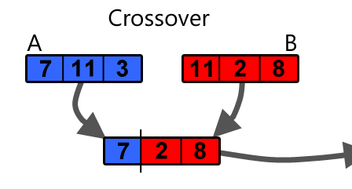
What we chose to implement
What we’ve done so far:
- Greedy Algorithm
Our one-point-crossover and two-point-crossover “cuts” both parents in random points and attempts to make a new solution using one half from one parent and second half from the other
Implementations for TSP part already exist
If the solution is incorrect (f.e. we went over MAX weight) it will be fixed
https://becominghuman.ai/understanding-genetic-algorithms-a-use-case-in-organizational-field-2087c30fb61e

Slide 21
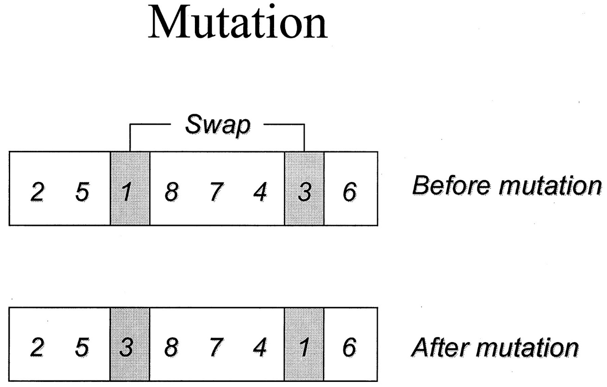
What we chose to implement
What we’ve done so far:
- Greedy Algorithm
Mutation swaps two random cities in path and swaps some stolen item with some ignored item
If the solution is incorrect (f.e. we went over MAX weight) it will be fixed
http://clinchem.aaccjnls.org/content/47/1/118/tab-figures-data

Slide 22
What we chose to implement
What do we plan to do:
Finish Genetic Algorithm module
Implement measurements-performing units
Define experiment plan
Carry out our experiment

Slide 23
Thank You for Your attention!
Filip Mazur
Dawid Ryl
Piotr Neumann

Slide 24
REFERENCES
https://cs.adelaide.edu.au/~zbyszek/Papers/TTP.pdf
https://dl.acm.org/citation.cfm?id=2598249
https://www.intechopen.com/books/simulated-annealing-advances-applications-and-hybridizations/simulated-annealing-evolution
https://towardsdatascience.com/introduction-to-optimization-with-genetic-algorithm-2f5001d9964b
https://www.geeksforgeeks.org/genetic-algorithms/
https://sites.google.com/site/mohammadrezabonyadi/standarddatabases/travelling-thief-problem-data-bases-and-raw-results

