Slide 1

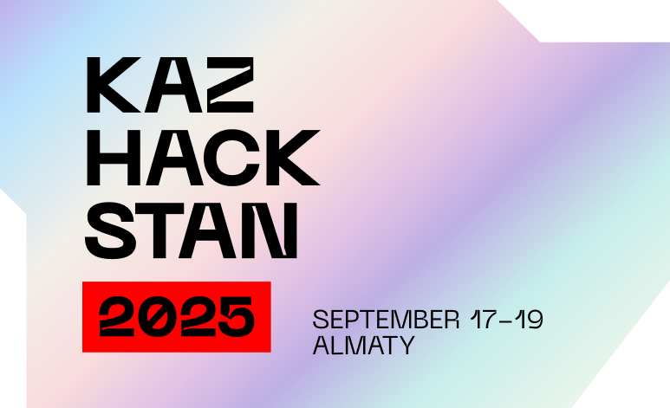


HACKDAY
Hacking with AI SASTs: From Hype to Hands-On Results
SPEAKER
Joshua Rogers

Slide 2
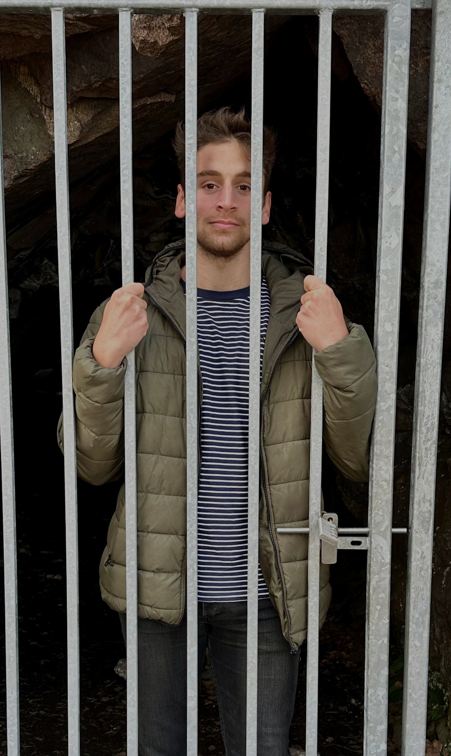

ABOUT ME
HACKDAY
Joshua Rogers
Executive Senior Principal Lead Head of Security Architectural Engineering
15 years in the scene. experience in troublemaking, asking the difficult/wrong questions, hacking, exploit dev, sec engineering, programming, incident responding, incident creating, problem solving, trend-setting, trolling, bartending, travelling, … and so on.
Taking the ethical out of ethical hacking, and putting the offensive into offensive security.
Currently: Freelance work + AppSec Engineer/Security Researcher …… for a Crypto Company.

Slide 3

HACKDAY
TL;DR; Why you should care
Multiple AI-native SASTs on the market today.
They work extremely well.
They find real vulnerabilities and logic bugs in minutes.
They can “think”/”reason” about business logic issues.
They match developer intent with actual code.
They aren’t based on static rule-sets and queries.
They have low false positive rates.
They’re cheap (for now).

Slide 4
HACKDAY
Context
Trying to find some magic.

Slide 5
HACKDAY
AI SAST: A Working Definition
A tool whose input is source code, and whose output is (any of) the following:
1. Vulnerabilities that create security risk.
2. Malicious code (intentional or not).
3. Major bugs that impact stability/security.
Anything else is just a bonus.

Slide 6
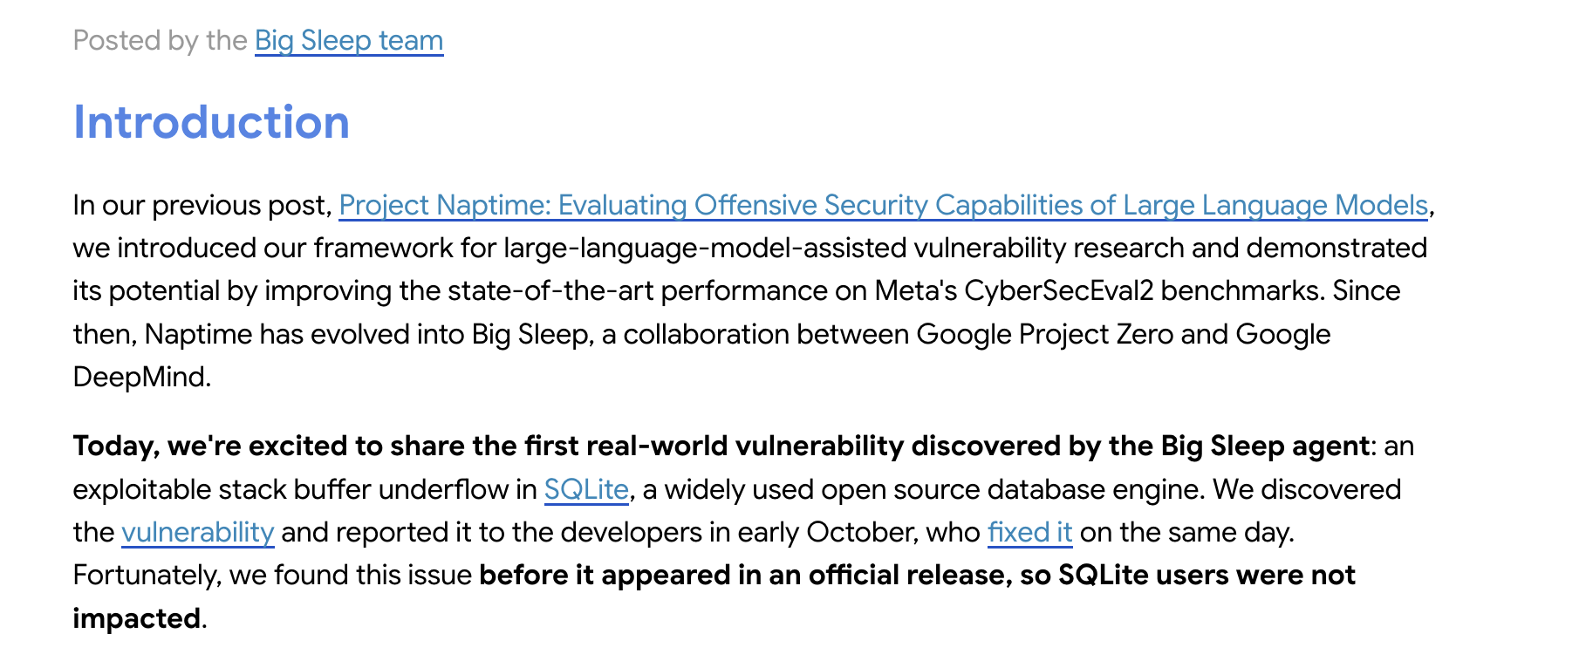
HACKDAY
Google’s Magic Bug Hunter: Big Sleep
2024: Begins finding vulns.
2025: Continues to find criticals in ffmpeg, V8, Ghostscript, JavaScriptCore, imagemagick, etc.
Public Bug Tracker: https://goo.gle/bigsleep

Slide 7
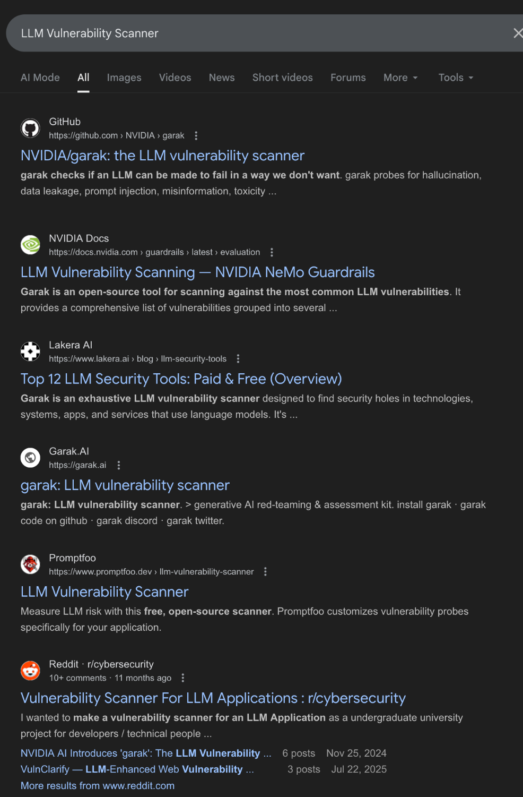
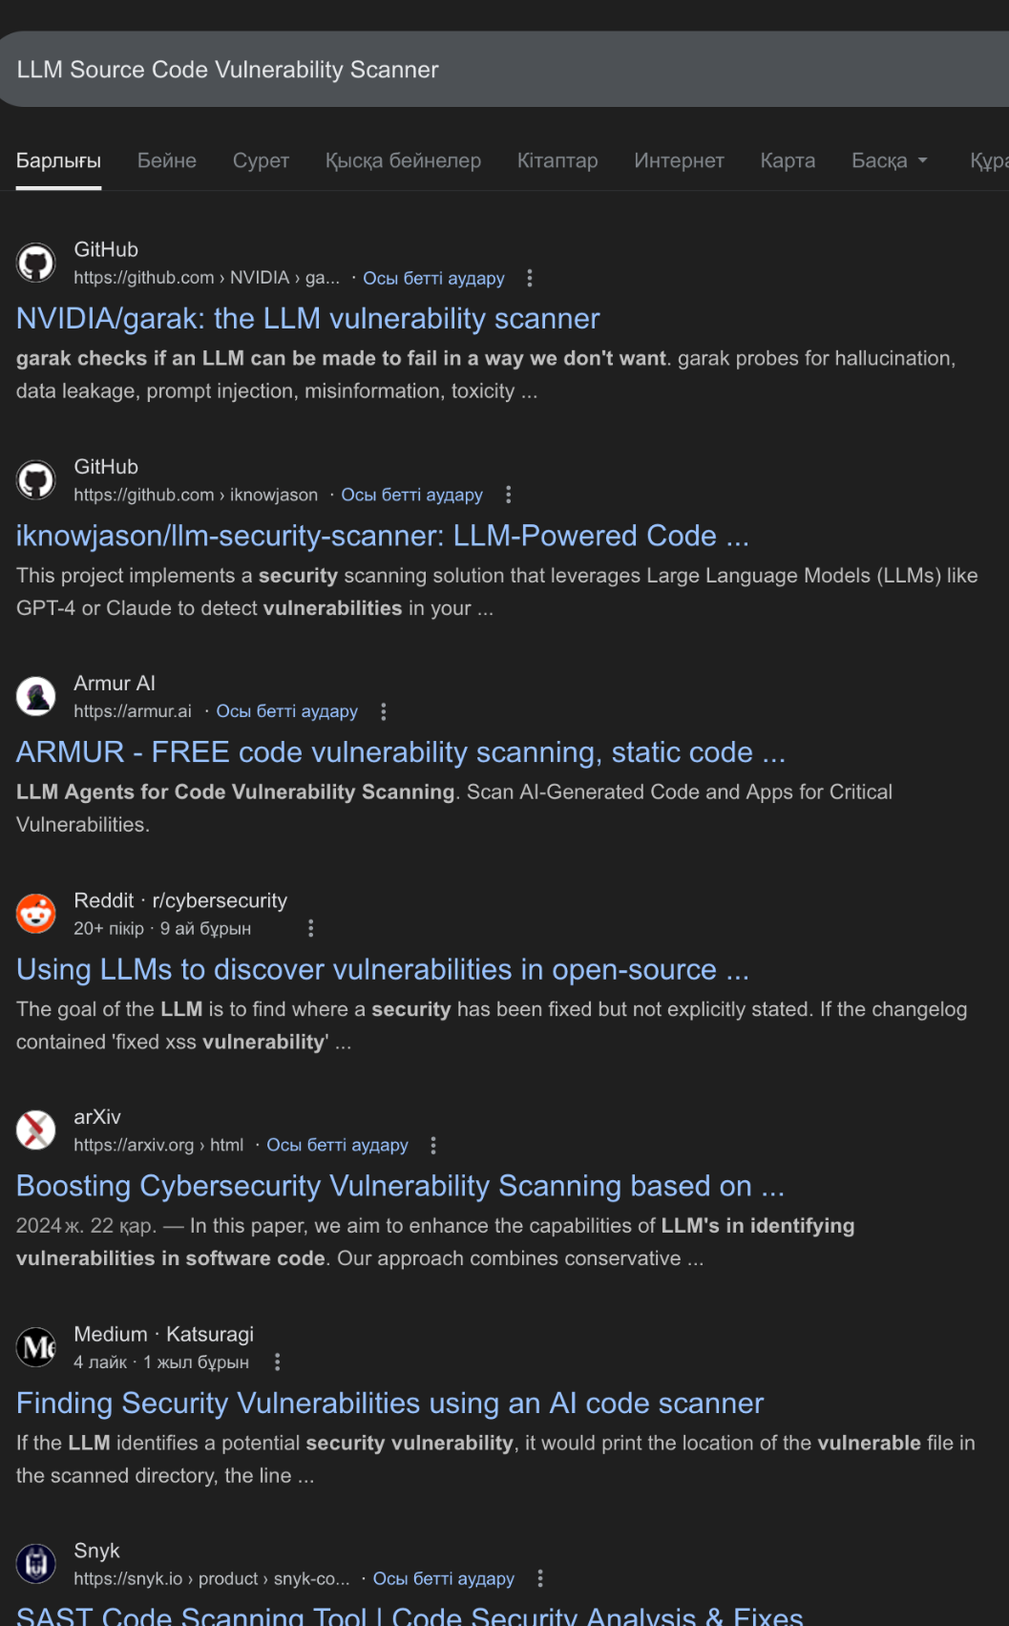
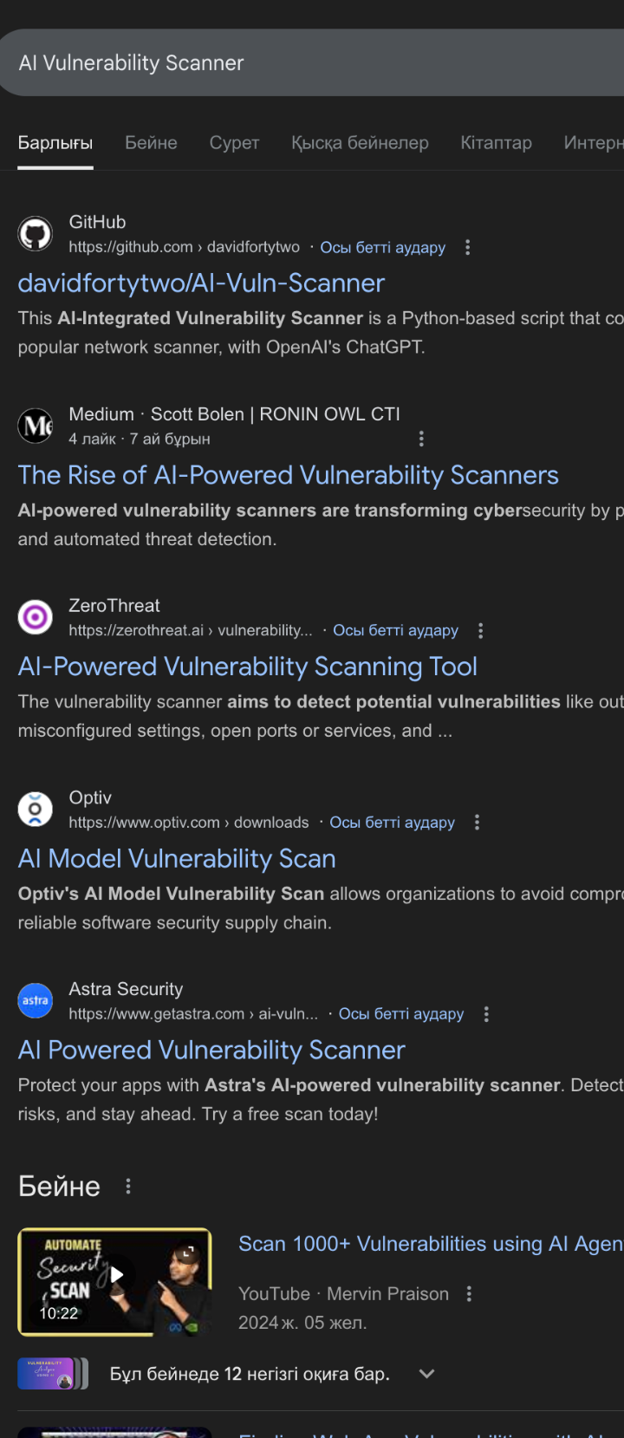
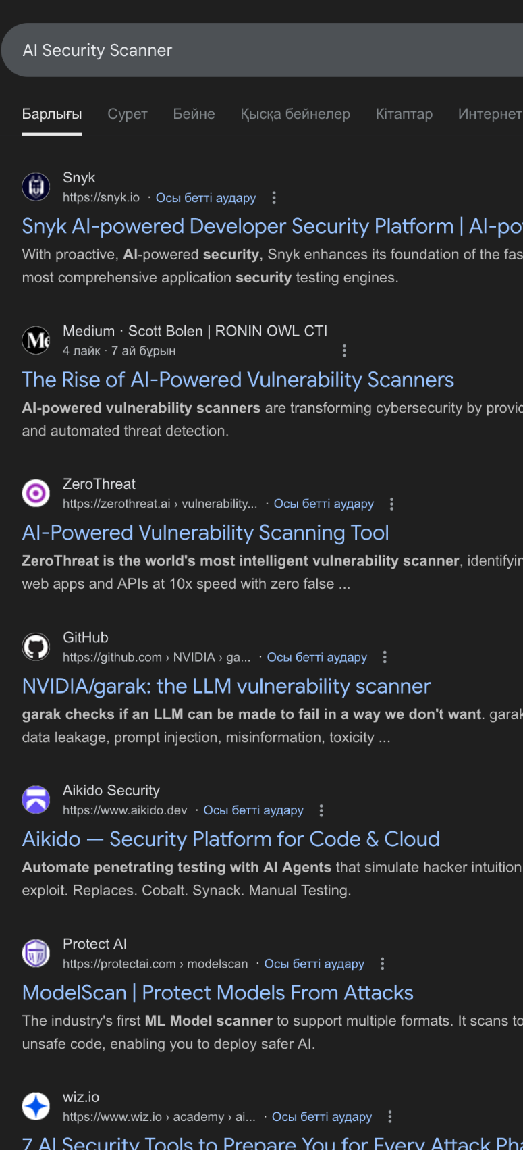
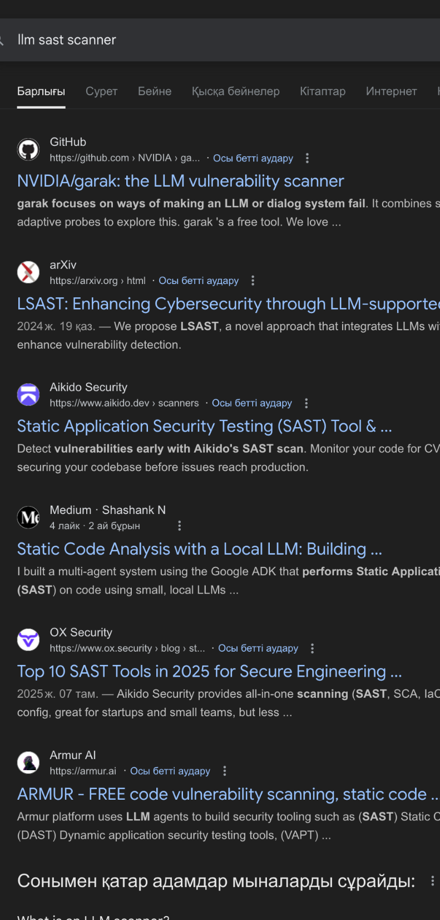
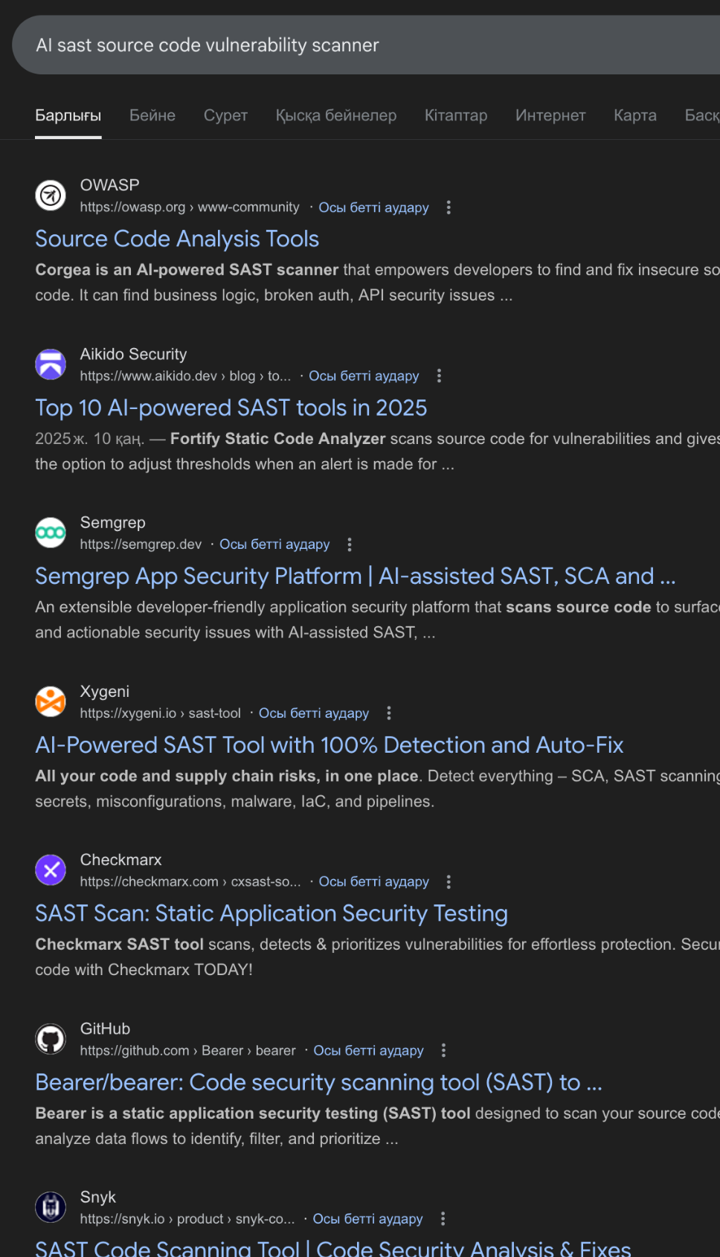
HACKDAY
How do I find somebody to give money to?

Slide 8
HACKDAY
Landscape
What’s out there & common capabilities.

Slide 9
HACKDAY
Current Vendors
Almanax: "The AI Security Engineer"
Amplify Security: "Develop Secure Software Confidently"
Corgea: "Smarter AppSec, built with AI"
DryRun Security: "Codebase Risk Averted w/ Contextual Security Analysis"
Gecko Security: "AI Security Engineer"
ZeroPath: "AI-Native SAST & AppSec Platform"

Slide 10


KAZHACKSTAN
Common Functionality
HACKDAY
Code Scans
CI/CD Hooks
Auto-Patching
GH/GL/… & File Upload.
Full Code Scans.
Branch Scans.
PR/MR Scans.
“Taint/Flow” Analysis.
F/P Detection.
Custom Policies/Rules.
Scheduled, Automatic, Recurring, On-Demand.
Remediation Guidance.
Offer suggested patches.
Submit patches as PRs.
Hooks to scan changes.
Blocking/non-blocking.
Bot responses in PRs.
Alerts to Slack, et al.
IDE Plugins (some).

Slide 11

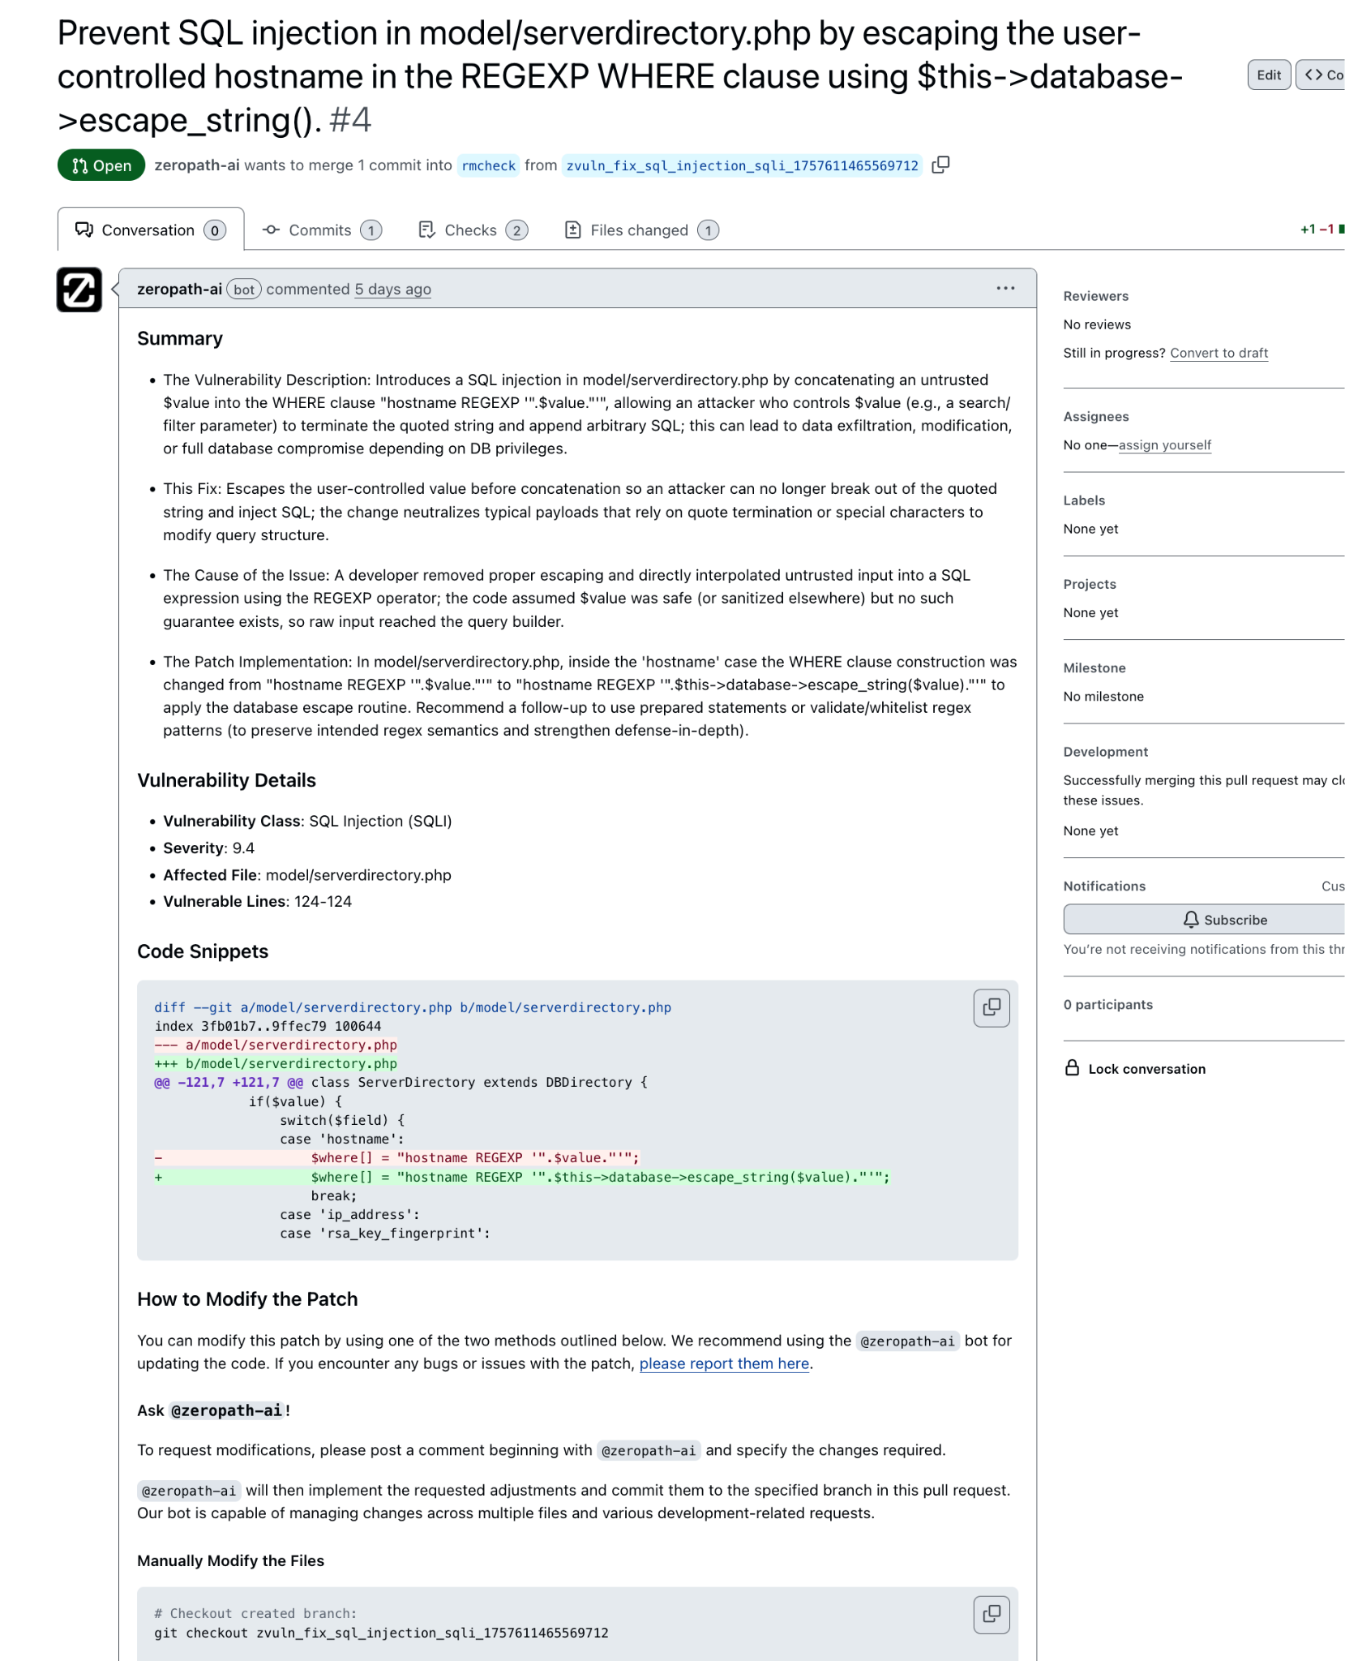
HACKDAY
Bonus Stuff
SSO Support.
No-Retention Policies.
Audit Trails & Logging.
RBAC Permissions.
Cross-Domain Identity Management (SCIM).
Reporting Dashboards.
Reporting Exports.
Dependency Scanning.
APIs.
Integrations (other SASTs).
Report Exporting (CSV, SARIF, PDF).
Policy-As-Scan.

Slide 12
HACKDAY
How They Work
Maybe.

Slide 13
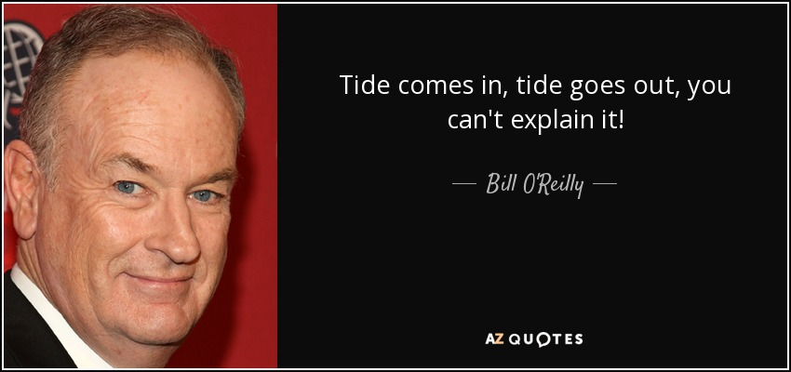
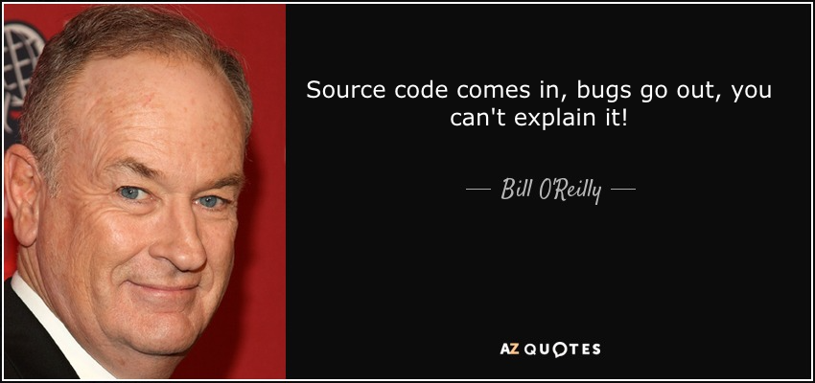
HACKDAY

Slide 14

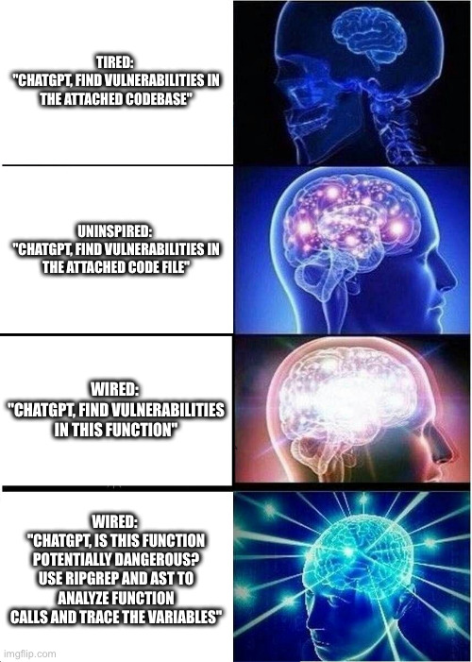
HACKDAY

Slide 15
How They Work.. Maybe.
HACKDAY
Stage 1: Intake
Stage 2: Discovery
Stage 3: Validation
Code Retrieval.
AST Generation.
Indexing of Code.
Context Enrichment.
App Identification.
Dependency Identification.
Behavior Analysis.
Query LLM with data.
Query with opengrep rules.
Custom SASTs.
Tools e.g. ripgrep.
Function Analysis.
Risky Behavior Analysis.
Protection Checks.
Contextual Checks.
Authorization Checks.
Usage Identification.
Source/Sink Analysis.
Custom “Rules”.
False Positive Detection.
(More) Context Retrieval.
Taint Reasoning.
Function-Level Prompts.
Duplicate Detection.
Reachability Analysis.
Context Analysis.
Trust Boundary Analysis.
Severity Scoring.
Patch Generation.

Slide 16
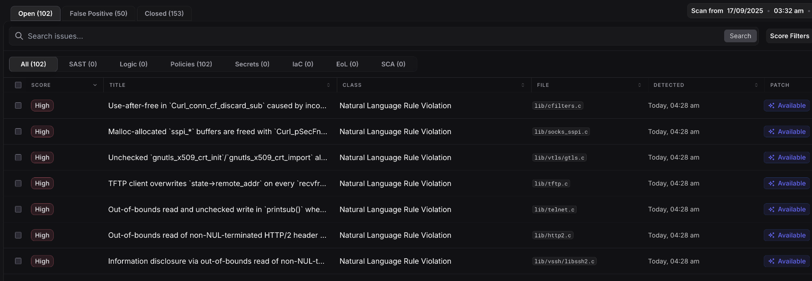
ZeroPath: Result Viewer
HACKDAY

Slide 17
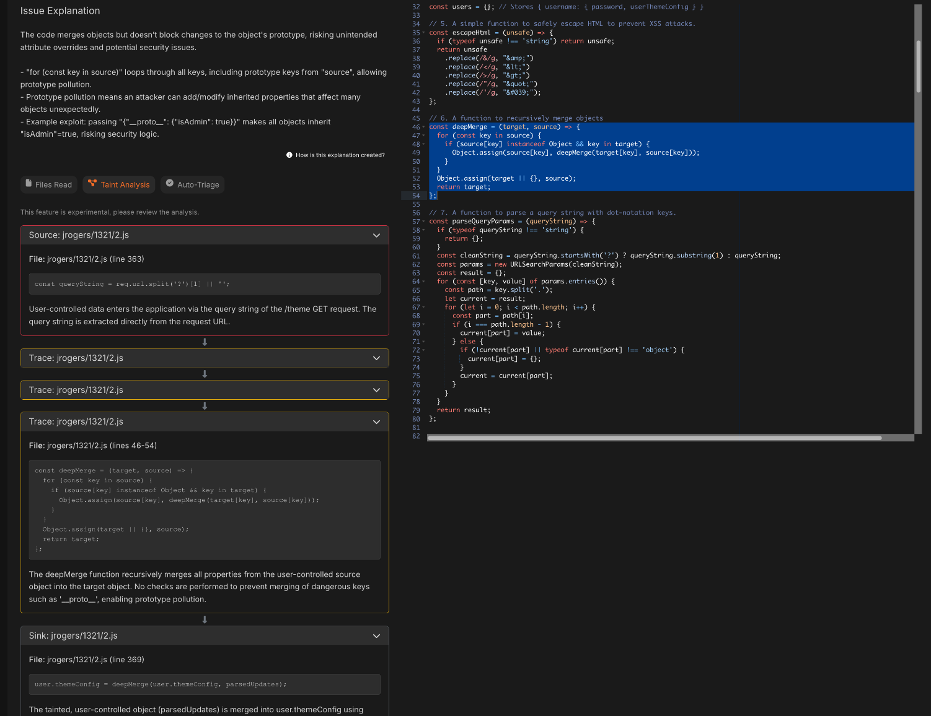
HACKDAY
Corgea: Issue Viewer

Slide 18
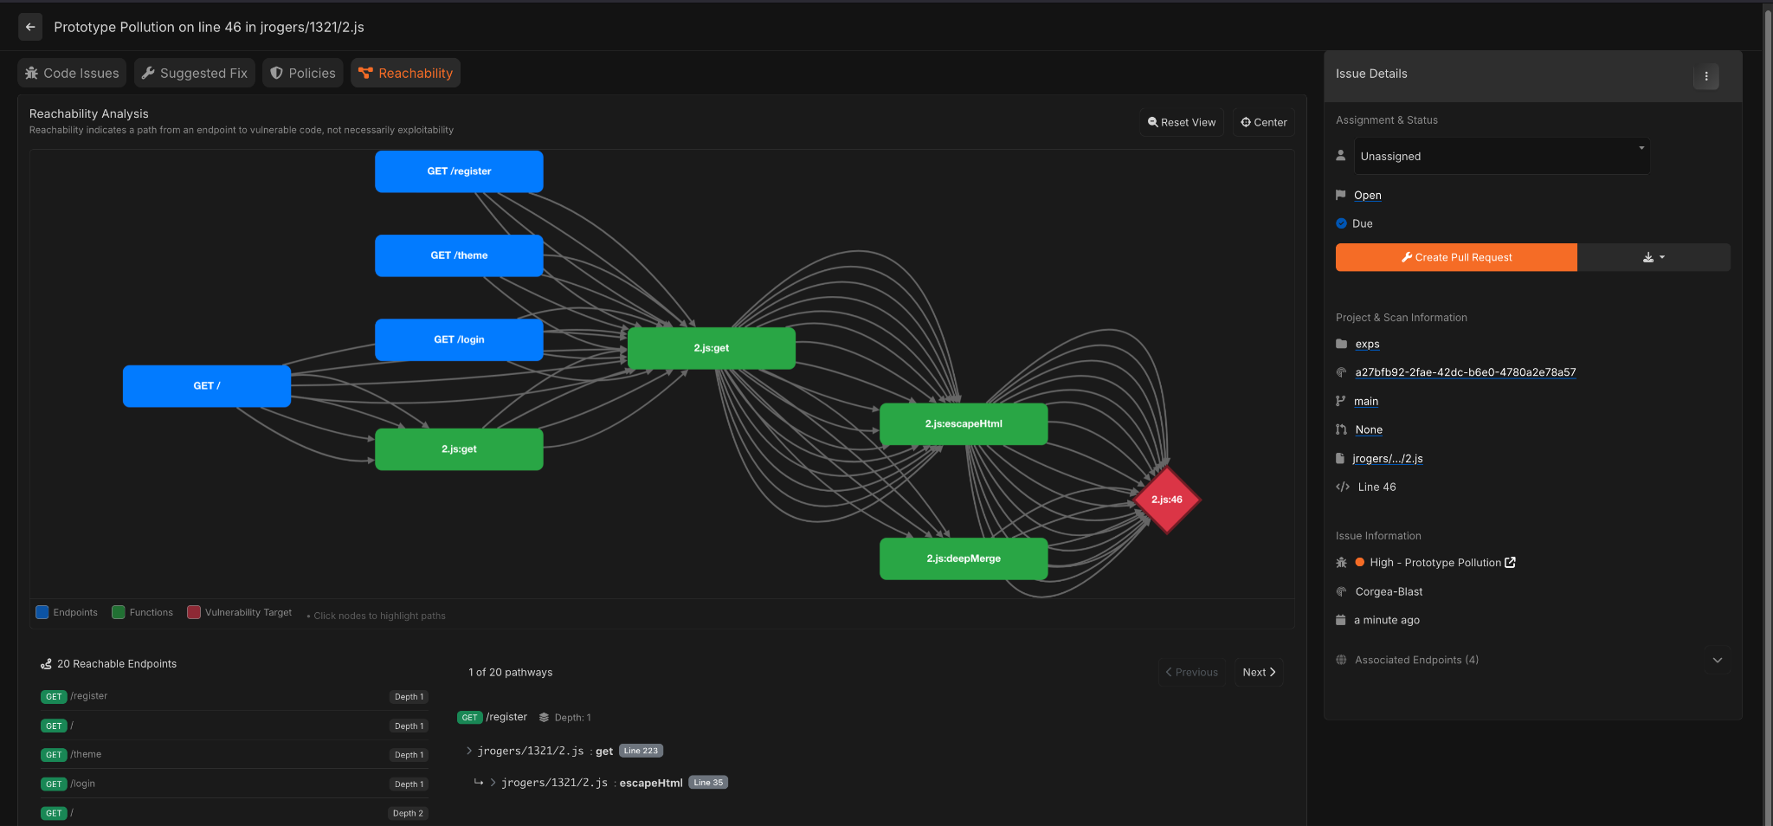
Corgea: Reachability
HACKDAY

Slide 19
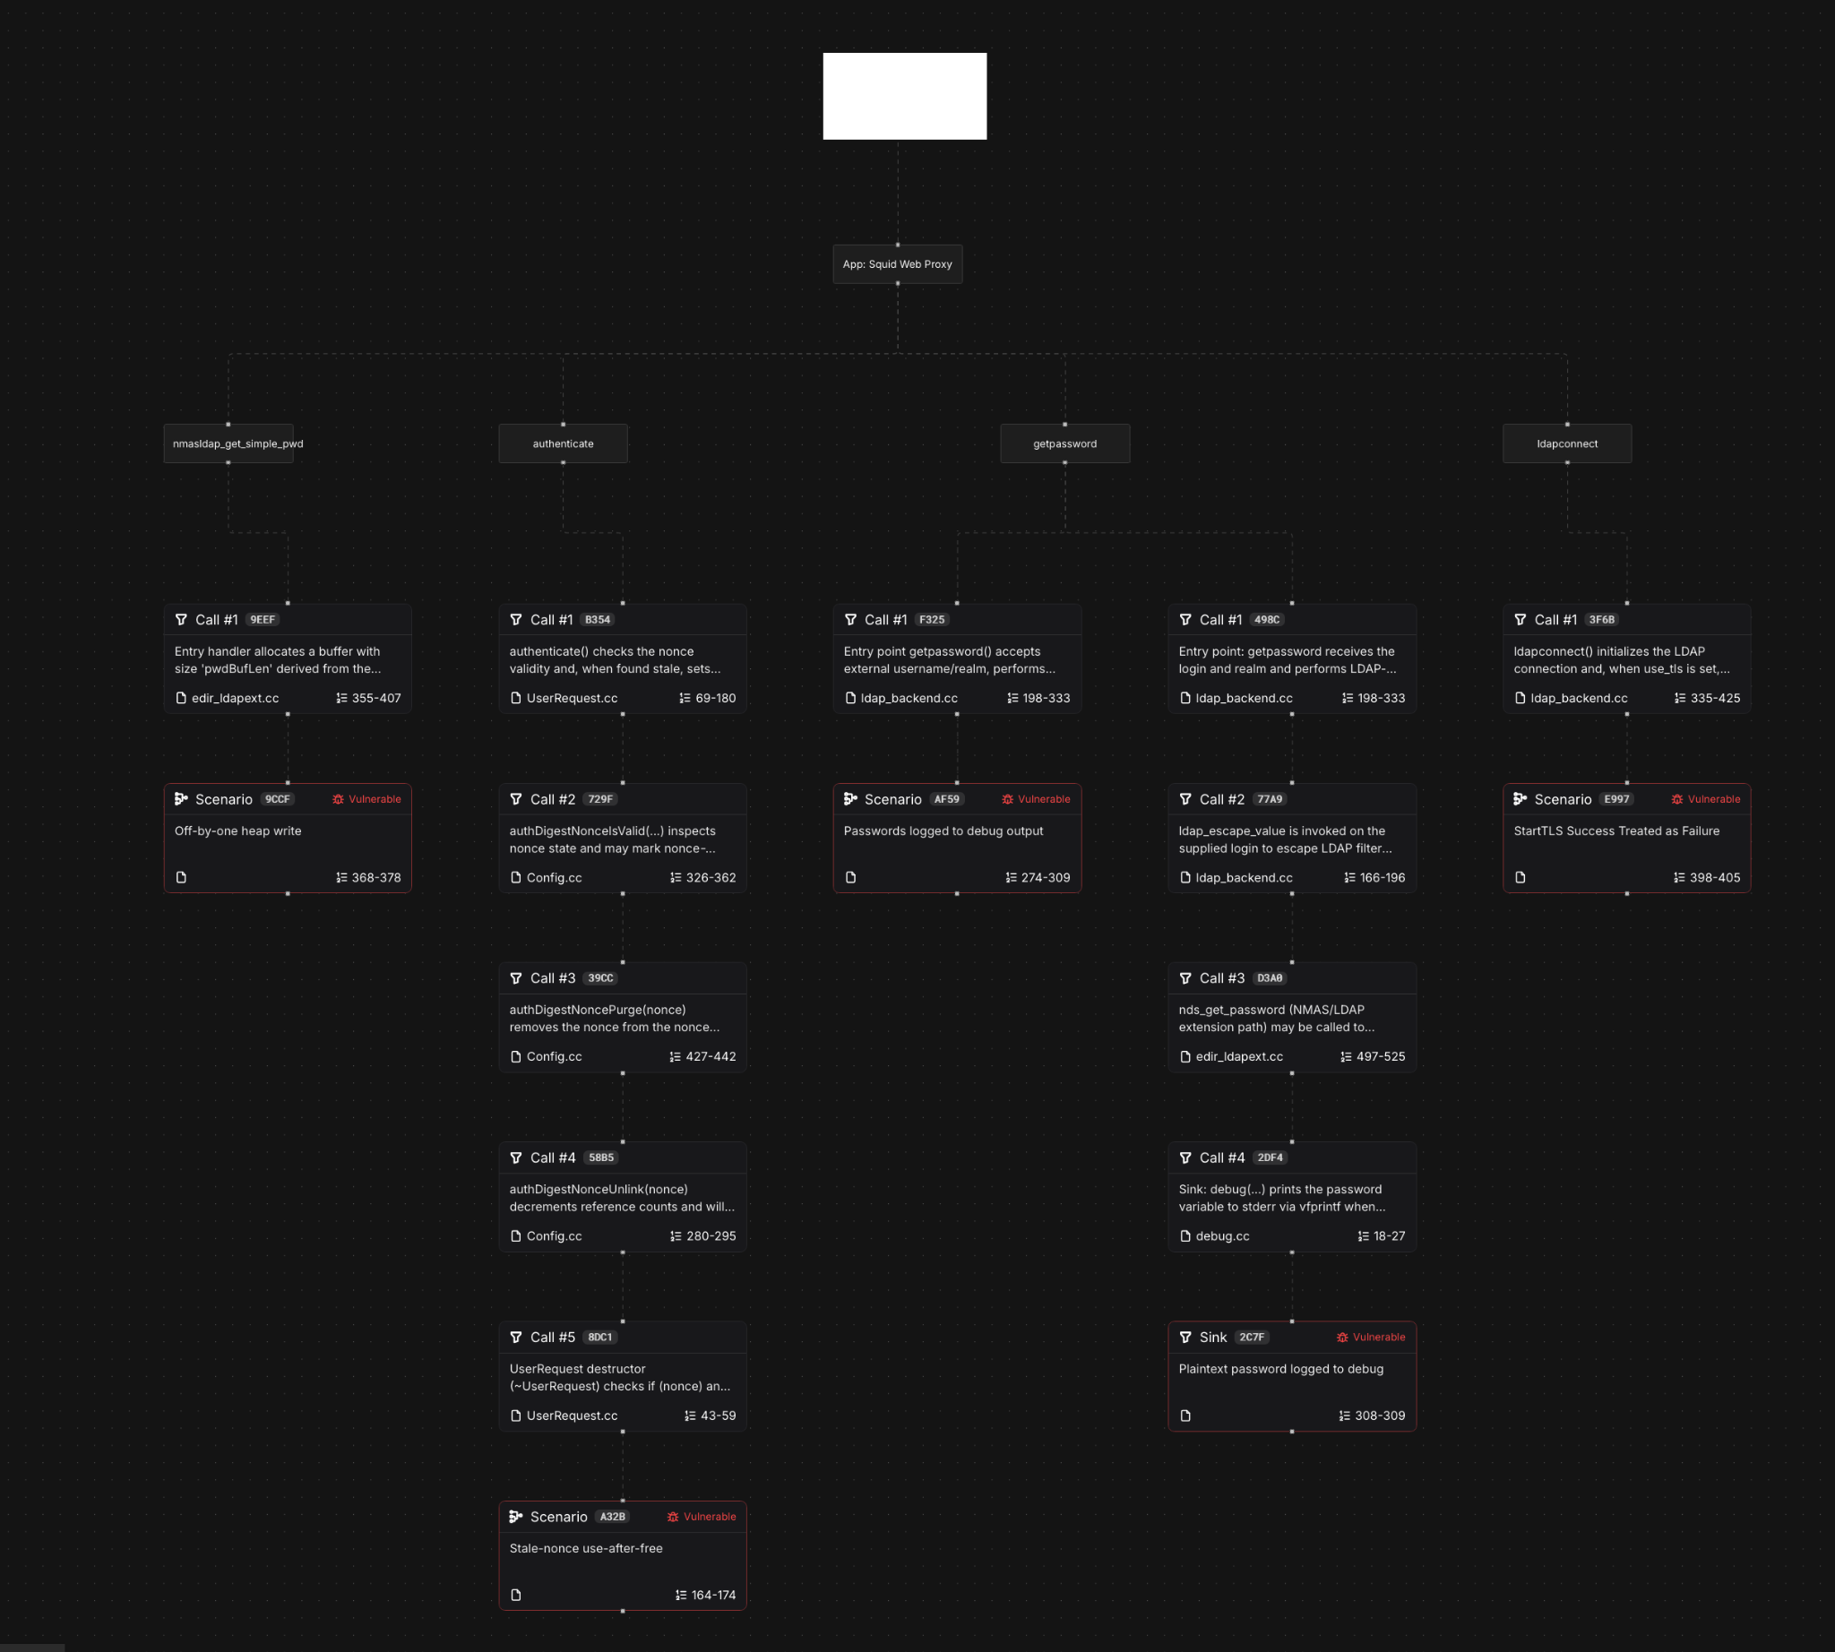
ZeroPath: Reachability
HACKDAY

Slide 20
HACKDAY
Results
What went well; what didn’t.

Slide 21

The Good
HACKDAY
Findings:
Top 3:
Hundreds of real vulns.
Excellent bug-hunting results.
Serious logic/business bugs.
Serious architectural issues.
Esoteric/context-specific issues.
High coverage even in neglected code.
Completely broken functionality.
RFC/Spec violations.
Low(-ish) false positive rate.
Low false negative rate.
ZeroPath.
Corgea.
Almanax.
Needs Improving:
Gecko Security.
Amplify Security.
Top Findings In:
Untested:
sudo.
libwebm.
Next.js.
avahi
wpa_supplicant
curl
squid (200+)
DryRun Security.

Slide 22
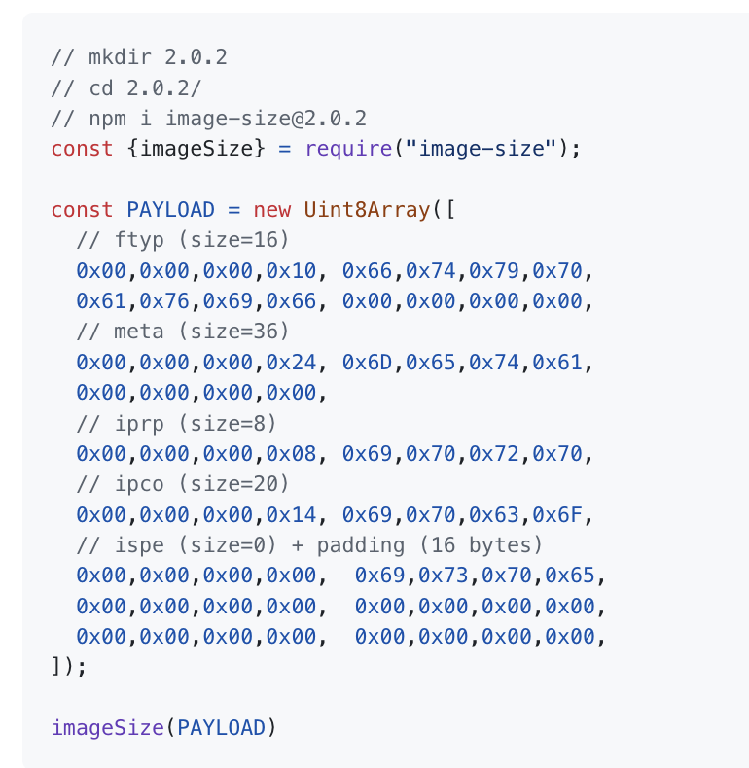
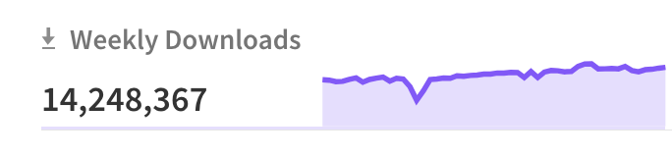
The Not So Good
HACKDAY
Findings:
Some inconsistent critical findings (“Just run it a second time”).
Malicious code detection didn’t work at all (except Almanax).
False positive detection didn't always work so well.
Deduplication gaps.
Security drift: trivial issues labeled critical and vice-versa.
Difficult to understand report descriptions (sometimes).
Poor patch generation.
Some poor interoperability understanding and indexing techniques.
Poor issue taxonomy.
Some logic bugs missed.
Prompt Injection (lol).
Lots of UI bugs (but all companies VERY appreciative+quick to fix)
image-size:

Slide 23
General Results
HACKDAY
Almanax
Corgea
ZeroPath
Excellent single-function “obvious” results.
Not so good at large/complicated code.
Great at simple malicious code detection.
Raw-bones solutions, not yet a mature product.
Discovered nearly all “test-case” issues.
Discovered real vulns in big codebases.
Tons of F/Ps.
Malicious detection sucks.
Excellent UI & reports.
Tons of bugs in UI.
PR reviews failed hard.
Discovered all “test-case” issues.
Intimidatingly good bug and vuln findings.
Excellent PR scanning.
In-built issue chatbot.
Even better with policies.
Extremely slow UI.
Complex issuedescriptions.

Slide 24
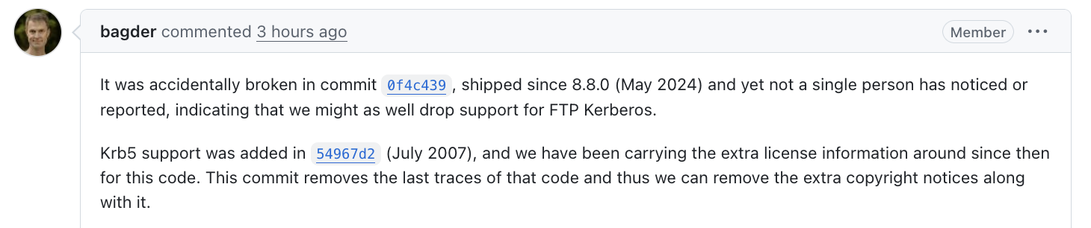
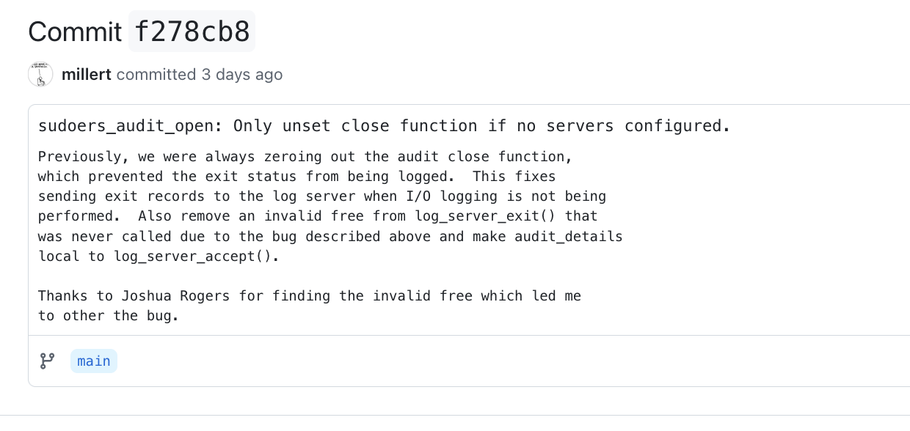
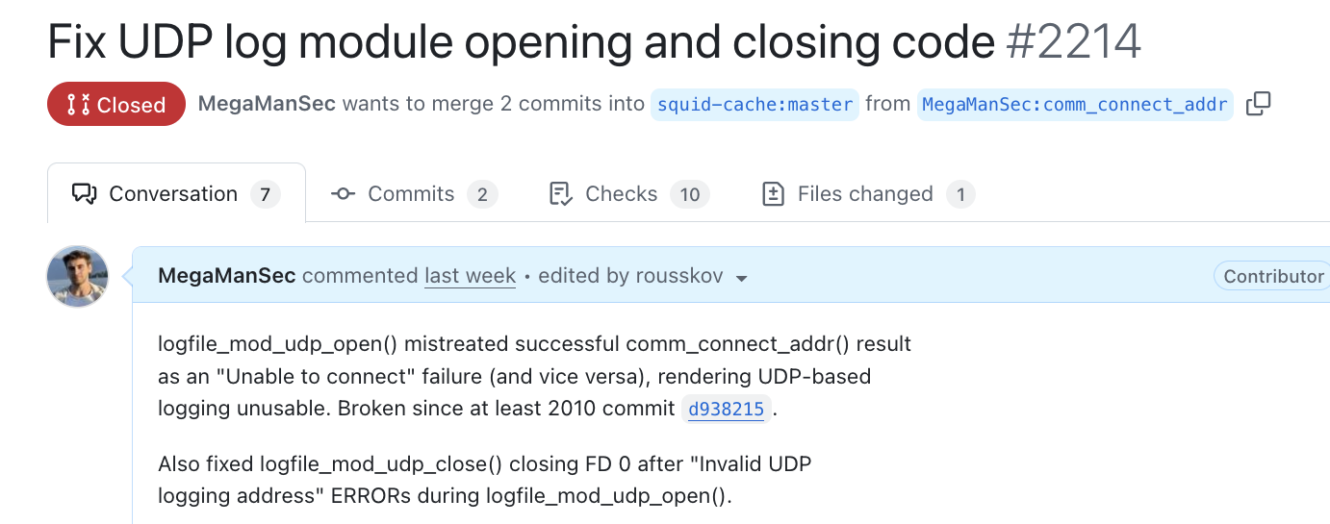
Funny Findings
HACKDAY
curl: vulnerability in .. broken code.
sudo: vulnerability in .. broken code.
squid: vulnerability in .. broken code.

Slide 25
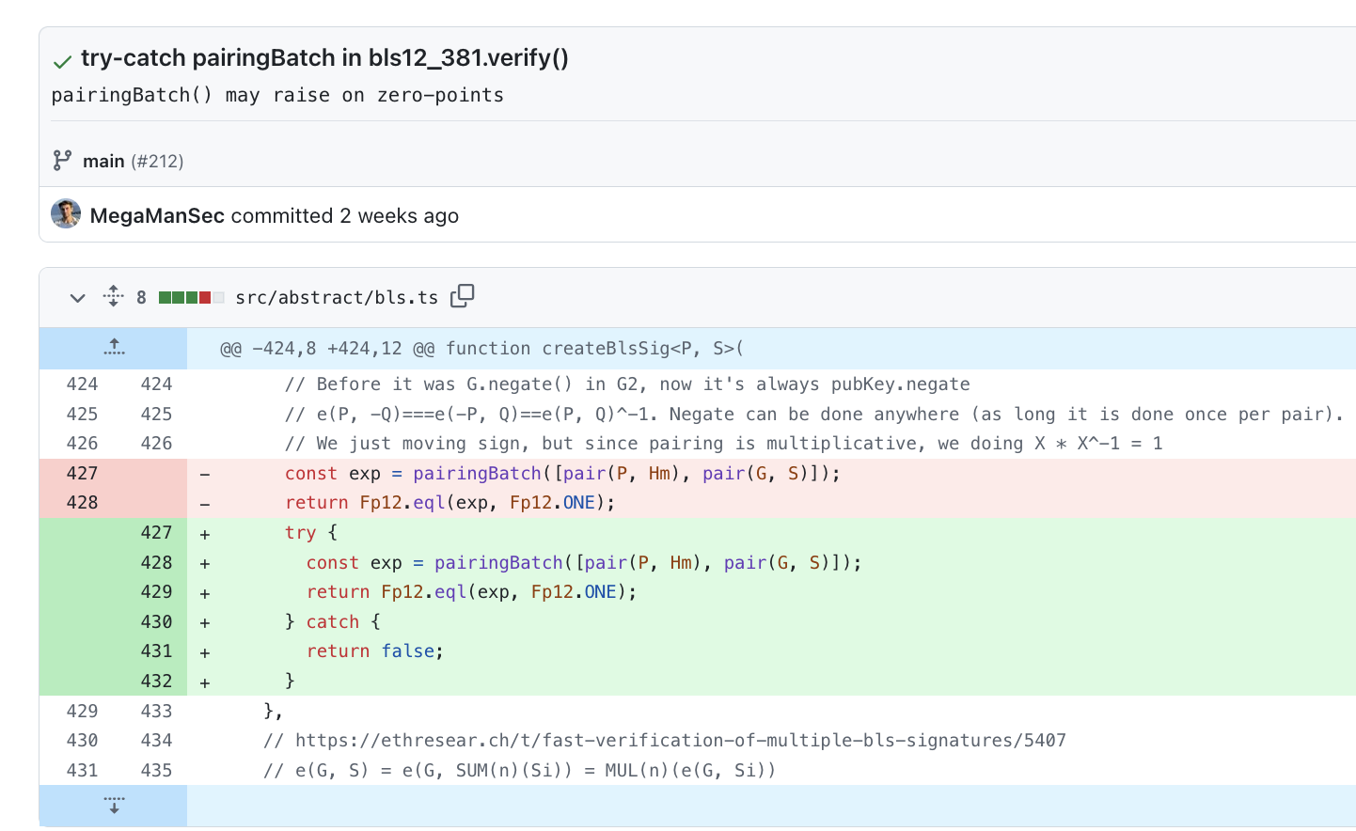
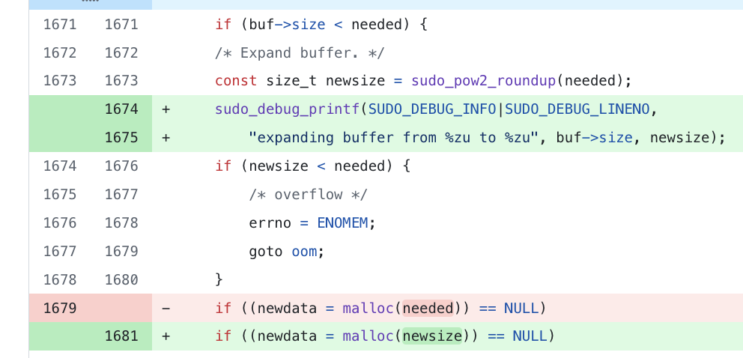
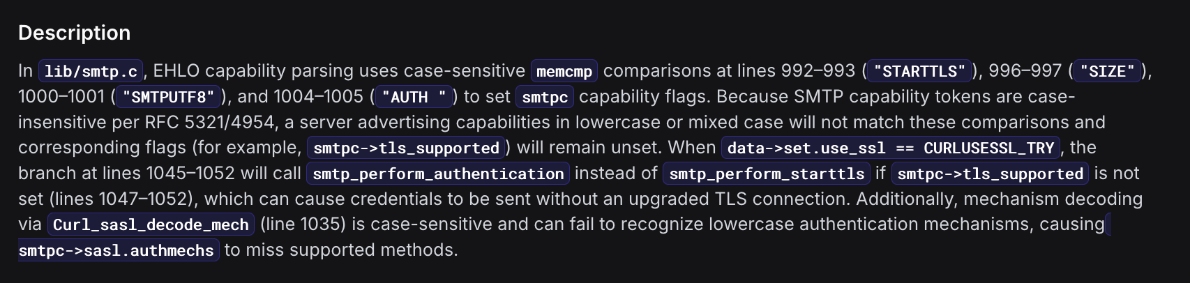
“Logical” Findings
HACKDAY
noble-curves: reachable raise
sudo: incorrect buffer allocation
curl: SMTP keywords bug

Slide 26
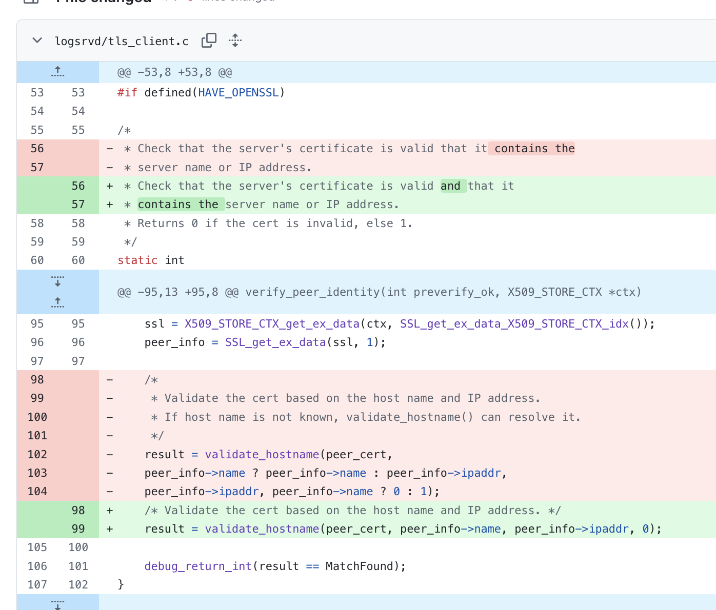
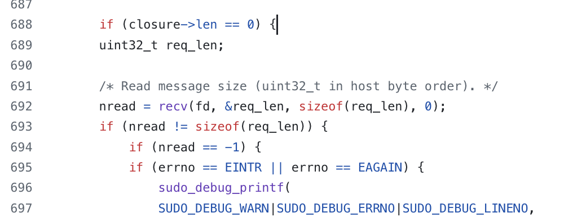
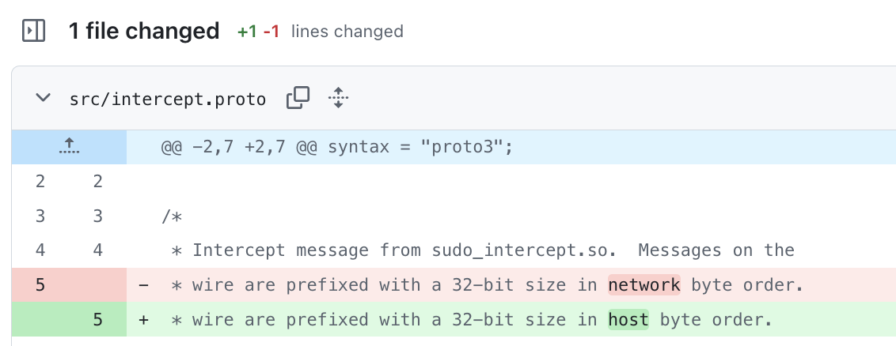
More “Logical” Findings
HACKDAY
sudo: TLS cert check for remote logging
sudo: host<->network byte order?
Logging to https://1.1.1.1/ or https://logging.com/. Connect.
if https certificate is for example.com, check if example.com resolves to 1.1.1.1 or the same IP address as logging.com.
if yes, certificate pass.

Slide 27
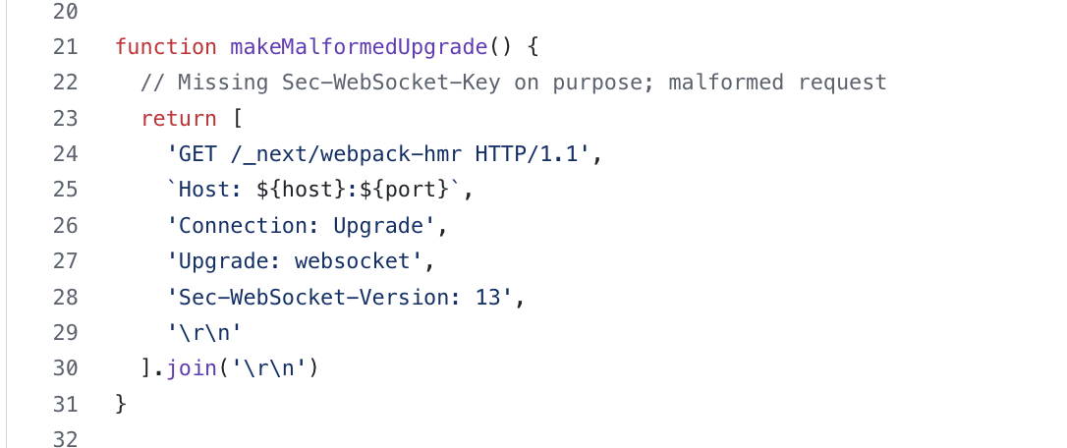
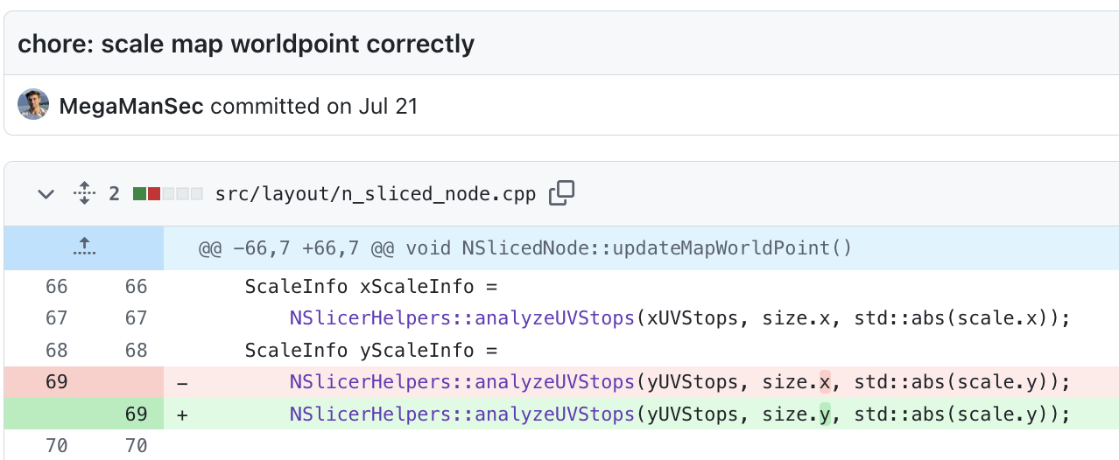
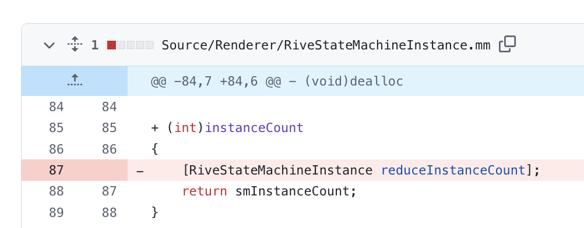
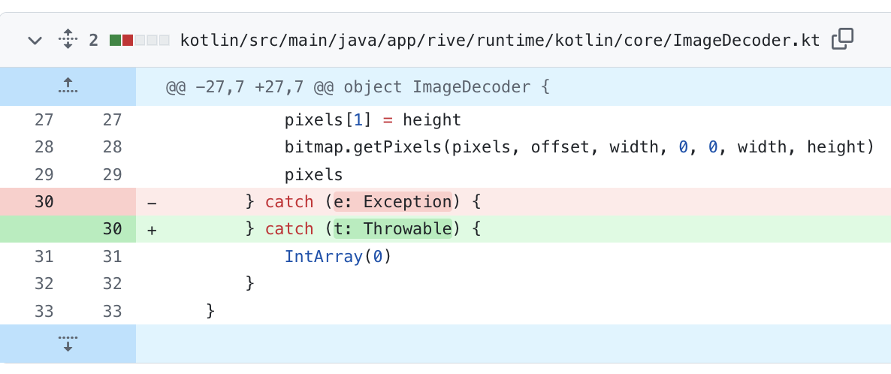
Other Languages
HACKDAY
next.js: memory/socket leak on websocket upgrade
Incorrect map building in c++ (x,y mixup)
Incorrect refcount code in Obj-C
Incorrect Except/Throw catch in Kotlin

Slide 28
HACKDAY
Operationalizing
How to effectively use these tools.

Slide 29
KAZHACKSTAN
HACKDAY
Patterns That Win (For Pentesters)
1/ Treat these systems like human code reviewers.
2/ Provide meaningful input.
3/ Guide them with policies.
4/ Pipe difficult-to-understand issues into ChatGPT.

Slide 30
KAZHACKSTAN
HACKDAY
Patterns That Win (For Sec. Teams)
1/ Treat these systems like human code reviewers.
2/ Provide meaningful input.
3/ Guide them with policies.
4/ Periodic full scans; embrace non‑determinism.
5/ PR scans; blocking on high-severity findings.
6/ Keep a human in the loop; treat auto-fixes as technical description.

Slide 31
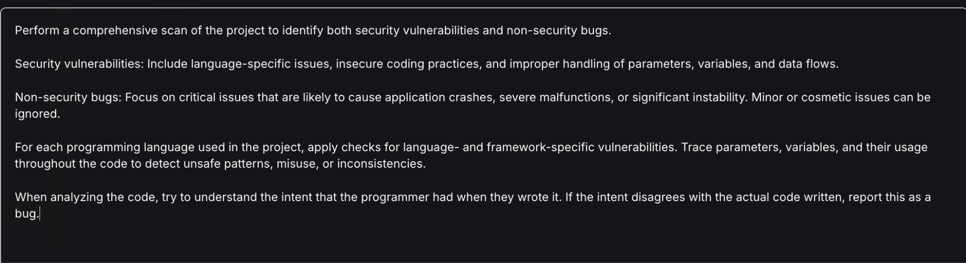
KAZHACKSTAN
HACKDAY
Testing Runbook
1/ Perform a full repo scan.
2/ Perform a full repo scan again.
3/ Perform a full repo scan with a rule/policy.
4/ Perform an (automatic) PR scan.

Slide 32
HACKDAY
Key Takeaways
So what?

Slide 33
KAZHACKSTAN
HACKDAY
Takeaways
AI SASTs are real and extremely useful already.
Especially strong at logic and architectural flaws.
Made even stronger with policies.
Biggest value IMO: finding inconsistencies between intent and implementation.
Already beyond most SCAs.
Pentesters: Use them for recon, easy findings, and odd-path exploration.
Security/Product Teams: Integrate into PR checks, run periodically. Easy wins for old, large codebases.
Try out Almanax, Corgea, ZeroPath (and DryRun, if possible).

Slide 34
HACKDAY
THANK YOU FOR YOUR ATTENTION
greetz
Joshua Rogers <mail: hackday@joshua.hu>

