Slide 1
NAMASTE!
I’m Sagar Devkota.
@info_devkota

Slide 2
git

Slide 3
…not sure how to pronounce, right? ;)
Me, either!

Slide 4
But, I checked it last night!
/ɡɪt/
Thanks!

Slide 5
INTRODUCTION

Slide 6
What is git?
So….

Slide 7
Version Control System

Slide 8
Local VCS
Centralized VCS
Distributed VCS
By the way, VCS stands for Version Control System. These are the types.

Slide 9
Local
Version Control System

Slide 10
Centralized
Version Control System

Slide 11

Lordy, HELP?!
Image Source: Venngage Website, Hindu Gods
https://infograph.venngage.com/p/185195/top-3-most-worshiped-hindu-gods

Slide 12
Distributed Version Control

Slide 13

git, our Savior!

Slide 14
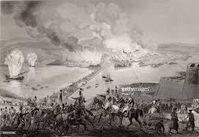
History

Slide 15
Why?
Speed
Unlimited(nearly) parallel branches
Fully distributed
Able to handle large projects

Slide 16
Snapshots

Slide 17
Remember the hassle of being offline
LOCAL
Nearly Every Operation is Local

Slide 18
CHECKSUM
348ab4ce1029ea1d53fb322b13feafde98350155
INTEGRITY

Slide 19
3
STATES

Slide 20
Solid
Liquid
Gas

Slide 21
NO!

Slide 22
Nothing here.

Slide 23
Working Directory
Staging Area
Git Repository

Slide 24
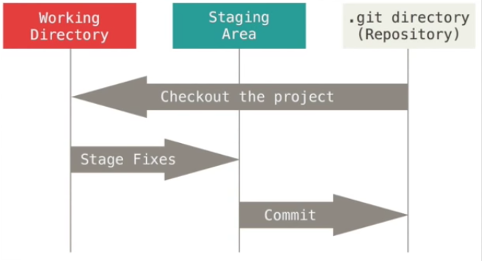
Image Source: Pro Git Book
https://git-scm.com/book/en/v2

Slide 25
Nothing here.

Slide 26
INSTALL

Slide 27
TERMS
Repository
Fork
Clone

Slide 28
Let’s do it!
Demo

Slide 29
Picture time!
Cell phone on your hand.

Slide 30
Take a picture of this.
Homework ;-)
Browse to github.com/infodevkota/talkGit
Fork the repository and then clone it to your desktop.
There’s a file named attendees.txt. Add your name, save, add, commit and then push.
Create a pull request and wait for that to get accepted.

Slide 31
THANKS!
Drop me a line
info@devkotasagar.com.np
Twitter: @info_Devkota
GitHub: infodevkota
On the Web
https://devkotasagar.com.np

