Slide 1
NAMASTE!
BONJOUR!
HELLO!
HOLA!
I’m Sagar Devkota.
@info_devkota

Slide 2
git

Slide 3
…not sure how to pronounce, right? ;)
Me, either!

Slide 4
But, I checked it last night!
/ɡɪt/
Welcome! ;-)

Slide 5
INTRODUCTION

Slide 6
What is git?
So….

Slide 7
Version Control System

Slide 8
Local VCS
Centralized VCS
Distributed VCS
By the way, VCS stands for Version Control System. These are the types.

Slide 9
Local
Version Control System

Slide 10
Centralized
Version Control System

Slide 11
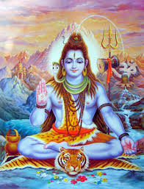
Lordy, HELP?!
Image Source: Venngage Website, Hindu Gods
https://infograph.venngage.com/p/185195/top-3-most-worshiped-hindu-gods

Slide 12
Distributed Version Control

Slide 13

git, our Savior!

Slide 14
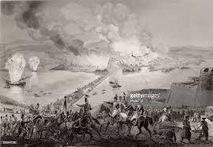
History

Slide 15
Why?
Speed
Unlimited(nearly) parallel branches
Fully distributed
Able to handle large projects

Slide 16
Snapshots

Slide 17
Remember the hassle of being offline
LOCAL
Nearly Every Operation is Local

Slide 18
Commit

Slide 19
CHECKSUM
348ab4ce1029ea1d53fb322b13feafde98350155
INTEGRITY

Slide 20
3
STATES

Slide 21
Solid
Liquid
Gas

Slide 22
NO!

Slide 23
Nothing here.

Slide 24
Working Directory
Staging Area
Git Repository

Slide 25
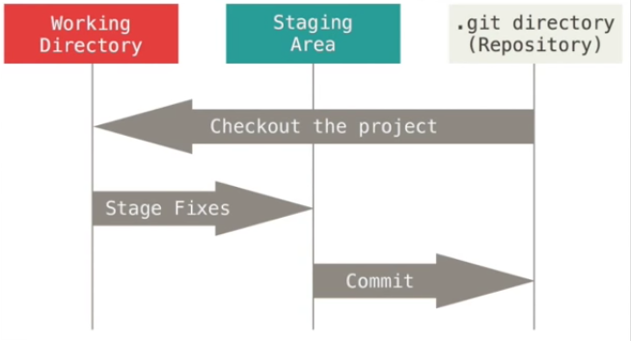
Image Source: Pro Git Book
https://git-scm.com/book/en/v2

Slide 26
Nothing here.

Slide 27
INSTALL

Slide 28
TERMS
Fork
Clone

Slide 29
Let’s do it!
Demo

Slide 30
Picture time!
Cell phone on your hand.

Slide 31
Take a picture of this.
Homework ;-)
Browse to github.com/megamind98/gitTalk
Fork the repository and then clone it to your desktop.
There’s a file named attendees.txt. Add your name, save, add, commit and then push.
Create a pull request and wait for that to get accepted.

Slide 32
THANKS!
Drop me a line
info@devkotasagar.com.np
Twitter: @info_Devkota
GitHub: infodevkota
On the Web
https://devkotasagar.com.np

