Slide 1

UCS2612 - Machine Learning Lab Mini Project Project Title : Predicting the Candidates vote in Indian general Election
Team Members
Anand K 3122 21 5001 0
Tejaswi Kakarla 3122 21 5001 0
Karthikeyan A 3122 21 5001 041
Mega V 3122 21 5001 051
Class: CSE - A

Slide 2
Problem Statement
Now a days opinion polls often employ random sampling techniques to gather data from a representative sample of the population. In the context of telephone-based polling, researchers choose only limited number of phone numbers randomly . This ensures that every phone number in the target population has an equal chance of being selected for the survey. Once a phone number is dialed, interviewers conduct the survey by asking questions about voter preferences, opinions on political issues, and other relevant topics . But that count is nearly less than one percent in our population. But this itself is a very complicated process for our massive population. Reduce the man power and improve the accuracy of opinion poll results we are trying to build a machine learning models.

Slide 3
Domain
Domain : Indian Politics - Indian General Election
Data Type : Text Data
Model Type : Regression

Slide 4
Objectives
Efficiency and Scalability
One objective is to streamline the polling process by reducing the reliance on manual labor and human interviewers.
Cost Reduction
By reducing the need for a large number of human interviewers, the project aims to lower the overall cost of conducting opinion polls.
Improved Accuracy and Representativeness
The project seeks to enhance the accuracy and representativeness of opinion poll results by leveraging advanced statistical techniques and machine learning algorithms.
Real-time Analysis and Insight
Machine learning models can enable real-time analysis of polling data, allowing for quicker turnaround times and more timely insights into shifting voter sentiments and trends.

Slide 5
Development Environment
IDE / Editor | Jupyter Notebook, VS Code
Programming Language | Python
Libraries/Frameworks | scikit-learn
Data Exploration Tools | Pandas, Matplotlib , Numpy
Model Evaluation Tools | scikit-learn metrics
Deployment Tool | Rapid Minor

Slide 6
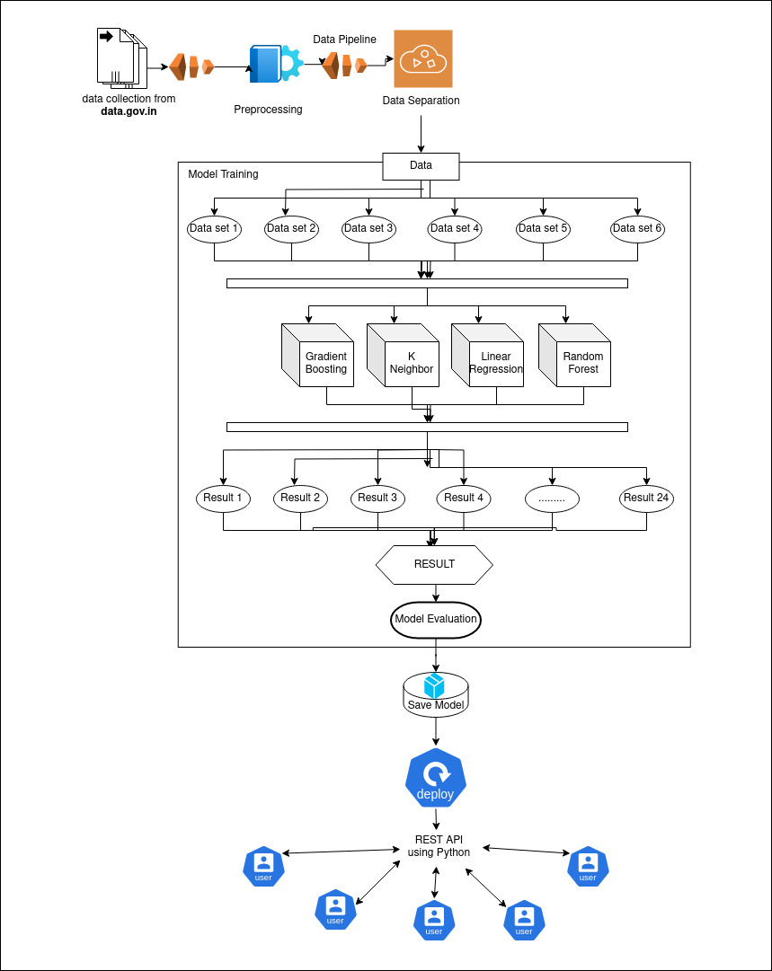
System Architecture

Slide 7
Steps In Building Model
1 ) Loading dataset
Using Pandas
Exploratory Data Analysis
Details Of Dataset
Display The Each Parliament Constitution victory Person in Each election
Display Election Results in Each Year
Display Correlation between each attributes using heatmap
Display Correlation Graph
3 ) Data Preprocessing
Handling Missing Values
Label encoder
Normalization
4) Feature Engineering
Select K best K=3
Select K best K=4
Select K best K=5
Select K best K=6
PCA
LDA

Slide 8
Steps In Building Model
4) Model Building
Random Forest Regression
Linear Regression
K Neighbour Regression
Gradient Boosting Regression
5 ) Model Training and testing
6) Model Deployment in Rapid Minor
Dataset Upload
Model Select
Processing Models
Obtain results

Slide 9
Comparison of Four Models
Model | Feature Engineering | Mean Squared Error | R Squared Score | Accuracy
Gradient Boosting Regression Model | K = 3 | 4689954366.56 | 0.572450 | 57.25 %
 | K = 4 | 4691351252.52 | 0.572323 | 57.23 %
 | K = 5 | 4651621664.73 | 0.5759450 | 57.59 %
 | K = 6 | 4651487603.76 | 0.575957 | 57.6 %
 | PCA | 4468413418.89 | 0.592646 | 59.26 %
 | LDA | 8283375210.57 | 0.244864 | 24.49 %
K Neighbor Regression Model | K = 3 | 4358090945.67 | 0.602704 | 60.27 %
 | K = 4 | 4620176737.24 | 0.578811 | 57.88 %
 | K = 5 | 4353191882.72 | 0.603150 | 60.32 %
 | K = 6 | 4353191882.72 | 0.603150 | 60.32 %
 | PCA | 2828647999.62 | 0.742132 | 74.21 %
 | LDA | 6685534694.59 | 0.390527 | 39.05 %
Linear Regression Model | K = 3 | 10869082765.09 | 0.0091438 | 0.91 %
 | K = 4 | 10857343649.72 | 0.010213 | 1.02 %
 | K = 5 | 10857354163.93 | 0.010213 | 1.02 %
 | K = 6 | 10857354163.93 | 0.010213 | 1.02 %
 | PCA | 10857162242.02 | 0.010230 | 1.02 %
 | LDA | 10857162242.02 | 0.010230 | 1.02 %
Random Forest Regression Model | K = 3 | 3751661185.88 | 0.657988 | 65.8 %
 | K = 4 | 4116258138.62 | 0.624750 | 62.48 %
 | K = 5 | 3362184729.95 | 0.693493 | 69.35 %
 | K = 6 | 1504170913.24 | 0.862875 | 86.29 %
 | PCA | 2055588563.91 | 0.812606 | 81.26 %
 | LDA | 3516979397.51 | 0.679382 | 67.94 %
Results For Four Models

Slide 10
Based On Accuracy
Based on accuracy,
Random Forest Regression model with K = 6 achieves the highest accuracy of 86.29%, followed by the PCA- based Random Forest model with an accuracy of 81.26%.
The Random Forest regression models with different data provides the higher Accuracy compare than the other three models.
The K Neighbor Regression model comparatively provides the higher accuracy than Linear Regression models and Gradient Boosting Regression models
Linear Regression models, along with Gradient Boosting Regression models, generally perform poorly compared to Random Forest and K Nearest Neighbors models.
Best Models For The dataset based on Accuracy,
1) Random Forest Regression
2) K Neighbor Regression Model

Slide 11
Comparison of Four Models
Computational Time For Models
Model | Computational Time
Random Forest Regression | 26.039166927337646 seconds
Linear Regression | 0.10006356239318848 seconds
K neighbor Regression | 0.15254878997802734 seconds
Gradient Boosting Regression | 10.362363815307617 seconds

Slide 12
Based On Accuracy
By seeing the above result the Linear regression model takes the least computational time but provides the very low accuracy which is less than 1 %.So this is worst model for the our prediction
The K Neighbor regression takes the second least computational time among four and also provide the best accuracy during the testing data . K Neighbor regression is the best model for the prediction
The Gradient Boosting Regression takes more than 10 sec computational time and also provide the average accuracy during the testing data . So Gradient Boosting regression is the worst model for the prediction.
The Random Forest Regression takes more than 20 seconds computational time which is the highest among four and also provide the best accuracy during the testing data . So Random Forest Regression is the best model for the prediction based on the Accuracy not for the computational time.
Best Models For The dataset based on Computational Time ,
K Neighbor Regression Model
Random Forest Regression

Slide 13
Based On Fitting
In Random Forest Regression
while increasing the dataset size the validation accuracy goes nearly to the training accuracy. So the Random Forest regression fits a Good fit . So Linear Regression is a Good fit model for this dataset
In Linear Regression
while increasing the dataset size the training accuracy and validation accuracy both goes nearly to 0. So the linear regression fits underfitting . So Linear Regression is a underfit model for this dataset
In K neighbor Regression
There is a huge difference between the training accuracy and validation accuracy. So the K neighbor fits a over fit . So K neighbor is a over fit model for this dataset
In Gradient Boosting Regression
while increasing the dataset size the validation accuracy goes nearly to the training accuracy. So the Gradient Boosting regression fits a Good fit. So Gradient Boosting regression is a Good fit model for this dataset

Slide 14
Comparison of Four Models
Fitting Results
Model | Fitting
Random Forest Regression | Good fit
Linear Regression | Under Fit
K neighbor Regression | Over fit
Gradient Boosting Regression | Good fit

Slide 15
Comparison of Four Models
Comparison Results
Model | Accuracy | Computational Time | Fitting
Random Forest Regression | High Accuracy | High | Good fit
Linear Regression | Worst Accuracy | Low | Under Fit
K Neighbor Regression | High Accuracy | Low | Over fit
Gradient Boosting Regression | Worst Accuracy | High | Good fit

Slide 16
Inferences
Random Forest Regression
Achieves high accuracy.
Requires a relatively high computational time.
Provides a good fit to the data.
Inference: Random Forest Regression is suitable for tasks where accuracy is crucial and computational resources are available.
Linear Regression
Yields the worst accuracy.
Requires low computational time.
Tends to underfit the data.
Inference: Linear Regression is efficient but may not capture the complexity of the data well, making it suitable for simpler problems with fewer features

Slide 17
Inferences
K Nearest Neighbors Regression
Achieves high accuracy.
Requires low computational time.
Tends to overfit the data.
Inference: K Nearest Neighbors Regression is efficient and effective for smaller datasets but may not generalize well to unseen data due to overfitting.
Gradient Boosting Regression
Yields the worst accuracy.
Requires a relatively high computational time.
Provides a good fit to the data.
Inference: Gradient Boosting Regression provides a good fit but may require more computational resources and tuning compared to other models.

Slide 18
Impact of Project on Society
Political parties and candidates could use the predictions to optimize their campaign strategies.
Resource Allocation: Parties could use the predictions to strategically allocate campaign resources such as funding, manpower, and time.
Voter Targeting: ML models could help parties identify potential swing voters or undecided voters more accurately.
ML-based predictions could challenge traditional political strategies and the role of intuition and experience in decision-making. Parties and candidates may rely more on data-driven approaches, potentially leading to a shift in the political landscape.
Voters may benefit from a better understanding of electoral dynamics and candidate performance.
Predictive models could stimulate interest and engagement in the political process.
There's a risk that predictive models could be used to manipulate or influence voters.

Slide 19
Conclusion
In Conclusion,
The choice of the best model depends on the specific requirements of the problem, such as the importance of accuracy, computational resources available, and the trade-off between overfitting and underfitting. Random Forest Regression and K Nearest Neighbors Regression are suitable for tasks where accuracy is crucial and computational resources are limited, while Linear Regression may be preferred for simpler problems with low computational requirements. Gradient Boosting Regression can be effective but may require more computational resources and tuning to achieve optimal performance.
By considering the results The best Model for predicting the Voters in Indian general election is Random Forest Regression

Slide 20
Future Work
In the current election voting prediction models, only the previous year's election results are considered. This approach relies solely on historical data to make predictions about future elections. However, it doesn't take into account the current situation or any new factors that may influence voter behavior, such as prevailing emotions or emerging issues.
In future work, it is proposed to include these additional factors, such as emotions and sentiments (like “pity" votes in the election), to enhance the accuracy and relevance of the prediction models. Here's a brief explanation of how this inclusion could improve the models:
Emotions and Sentiments
By incorporating emotions and sentiments prevalent among voters during the current election cycle, the models can better capture the mood of the electorate. Analyzing sentiment from social media, news articles, or surveys can provide valuable insights into the prevailing mood and sentiment of voters.

Slide 21
Future Work
Improved Predictive Power
Incorporating current situation factors enhances the predictive power of the models by providing a more comprehensive understanding of voter behavior. By considering both historical trends and present-day dynamics, the models can better anticipate shifts in voter sentiment and behavior, leading to more accurate predictions of election outcomes.
Overall, By integrating emotions, sentiments, and other current situation factors into election voting prediction models, we can create more robust and insightful tools for understanding and forecasting electoral dynamics. This approach enables us to capture the complexities of voter behavior more accurately and adaptively, thereby enhancing the effectiveness of election prediction efforts.

Slide 22
Learning Outcome
Better understanding about the various machine learning regression model
We learnt about the strengths, weaknesses, and suitability of ML model
The Machine learning models are evaluated by several evaluation metrics
We learnt about the importance of feature engineering in improving the machine model performance
Better understanding about how to select and preprocess features to enhance the predictive power of machine learning models.
learnt how to compare different machine learning models based on performance metrics and make inferences about their suitability for specific tasks
Gain knowledge about the trade-offs between model accuracy, computational efficiency, and fitting.
We understand that the additional information may increase the performance of the machine learning models.
We identifying limitations in existing models and proposing future work to address them

Slide 23
References
https://en.wikipedia.org/wiki/Linear_regression
https://www.geeksforgeeks.org/random-forest-regression-in-python/
https://scikit-learn.org/stable/modules/generated/sklearn.neighbors.KNeighborsRegressor.html
https://scikit-learn.org/stable/modules/generated/sklearn.neighbors.KNeighborsRegressor.html
https://lms.ssn.edu.in/course/view.php?id=2231

