Slide 1
🏰
ASGARD
AI PLATFORM
"Asgard is not a place, it's a people."
"แอสการ์ดไม่ใช่สถานที่ แต่คือประชาชน"
— Odin, Thor: Ragnarok (2017)
Asgard เป็นของทุกคนแล้ว — Asgard belongs to everyone.
Self-Hosted AI Agent Platform · 12 Services · 484+ Tests
Pitch to Sakura Internet × Sojitz Corporation
March 20, 2026 · 14:00 · Sojitz Office, Lumphini, Bangkok
MegaWiz Co., Ltd. · paripol@megawiz.co

Slide 2
📋 AGENDA
01
Who We Are
MegaWiz & Asgard Platform
3 min
02
The Problem
Why Self-Hosted AI Matters Now
3 min
03
The Platform
12-Service Architecture & Demo
8 min
04
GPU Synergy
Where Sakura Internet Fits
8 min
05
Partnership
Investment & Collaboration Proposal
5 min
06
Q&A
Discussion & Next Steps
3 min

Slide 3
🏰 WHO WE ARE
MegaWiz Co., Ltd.
Asgard AI Platform
🇹🇭 Bangkok, Thailand
Founder / CTO: Paripol
Full-stack AI Architect
▸ 15+ years software development
▸ Rust + Python + TypeScript
▸ Healthcare AI specialist
▸ ISO 29110 certified process
📧 paripol@megawiz.co
🔗 github.com/MegaWiz-Dev-Team
"Asgard เป็นของทุกคนแล้ว"
Asgard belongs to everyone.
▸ 12 Microservices
▸ 484+ Automated Tests
▸ Built in Rust + Python
▸ 30+ Sprints delivered
▸ Open Source (AGPL-3.0)
▸ Enterprise Edition available
✦ Apple Silicon (MLX) Native
✦ NVIDIA GPU (vLLM) Support

Slide 4
🏢 ABOUT COMPANY
MEGA WIZ CO., LTD.
🇹🇭 Bangkok, Thailand · Founded by Paripol
Healthcare Technology · AI Solutions · Education
↙
↓
↘
🏥 MEGA CARE
🎓 MEGA ACADEMY
📋 MEGA CONSULTANTS
We Care About Your Health
Educational Organizer
Clinic Management Experts
▸ Personalized Health Care Solutions
▸ Total Sleep Solutions
▸ Health Care On Cloud Monitoring
Sleep Clinic · ENT · Neurology
AI-powered diagnostic assistance
267+ medical RAG knowledge chunks
▸ Medical Training Programs
▸ AI & Technology Workshops
▸ Healthcare Professional Dev
Training next-gen healthcare
professionals with AI skills
▸ Expertise Doctor Network
▸ Clinic Setup Team
▸ Clinic Operation Management
▸ Service Standard Development
End-to-end clinic solutions

Slide 5
🔥 THE PROBLEM
🔒
💸
🔗
📜
🧩
Data Sovereignty
Rising Cloud Costs
Vendor Lock-in
PDPA / HIPAA
Integration
Patient data, legal docs, financial records must stay on-premise
$0.01/token × millions of requests = unsustainable budget
Stuck with OpenAI/Azure No exit strategy
Cannot send sensitive data to external cloud AI
Need to glue 5-10 different AI tools together
💰 MARKET OPPORTUNITY
$28B AI Platform Market (2025) → $147B by 2030
Self-hosted AI for regulated industries = $4.2B segment · 35% CAGR

Slide 6
🏗️ ASGARD ARCHITECTURE — 12 Services
🧠 Mimir
🛡️ Heimdall
⚡ Bifrost
🐺 Fenrir
RAG + Agent Builder + Dashboard
LLM Gateway (Multi-Backend)
Agent Runtime (ReAct+MCP)
Computer-Use Agent + FHIR
Rust, Next.js
255+ tests
Rust (Axum)
Production
Python (FastAPI)
99 tests
Python
47 tests
🏥 Eir
🌳 Yggdrasil
🛡️ Várðr
🐦‍⬛ Huginn
Healthcare Gateway + Chat UI
Auth Service (OIDC/JWT)
Monitoring Dashboard
Security Scanner + AI Pentest
Rust + PHP
47 tests
Go + Python
31 tests
Rust (Axum)
5 tests
Python
Building
🐦 Muninn
🐿️ Ratatoskr
⚖️ Forseti
🏰 Asgard
Issue Watcher + Auto-Fixer
Shared Browser Service
Test & Quality Dashboard
Docker Compose Orchestrator
Python
Building
Rust (Axum)
✅ Done
Python
✅ Done
YAML + Shell
Active

Slide 7
🏆 COMPETITIVE ADVANTAGE
Feature | Asgard | Dify | Open WebUI | AnythingLLM
LLM Gateway | ✅ Heimdall | ❌ | ❌ | ❌
Local Inference | ✅ MLX+vLLM | ❌ Cloud Only | ⚠️ via Ollama | ⚠️ via Ollama
RAG Pipeline | ✅ Full | ✅ | ⚠️ Basic | ✅
Agent Runtime | ✅ Bifrost | ✅ | ❌ | ❌
Computer Use | ✅ Fenrir | ❌ | ❌ | ❌
Multi-Tenant | ✅ | ✅ | ⚠️ | ❌
GPU Cloud Ready | ✅ Sakura ← | ❌ | ❌ | ❌
Apple + NVIDIA | ✅ Both | ❌ | ❌ | ❌
100% Self-Hosted | ✅ | ⚠️ | ✅ | ✅
Only platform combining Gateway + RAG + Agent + Computer Use + GPU Cloud
in a single self-hosted solution with native Apple Silicon & NVIDIA support

Slide 8
🌸 WHERE SAKURA INTERNET GPU FITS
1️⃣ RAG Embedding
2️⃣ LLM Inference
3️⃣ Agent Runtime
Heavy Embedding & Retrieval
Large Model Serving via Heimdall
GPU-Accelerated Bifrost Agents
▸ Doc Embedding → H100 batch (10-100x faster)
▸ Re-ranking → GPU-accelerated
▸ Scale: 267 → 100K+ chunks/tenant
▸ Model Size: 7B-35B → 70B-405B on H100
▸ Throughput: 5-20 → 100+ req/s
▸ Heimdall routes to Sakura vLLM
▸ ReAct on H100 for complex reasoning
▸ Vision model inference (Fenrir)
▸ Parallel agent execution on GPU
Sakura Internet GPU Service Tiers
Tier | GPU | Price | Asgard Use Case
DOK (Container) | H100 80GB | ¥1,008/hr (~฿240/hr) | Dev/test, batch embedding
VRT (VM) | H100 80GB | ¥385,000/mo (~฿92K/mo) | Production inference
PHY (Bare Metal) | H100/B200 | Contact | Enterprise, fine-tuning

Slide 9
🔐 HYBRID ARCHITECTURE — Local + Sakura Cloud
TODAY
TOMORROW (with Sakura)
🍎 Mac Mini / Mac Studio
🍎 Local + 🌸 Sakura H100 Cloud
→
MLX Local Inference Only 7B — 35B Models 5-20 req/s
Hybrid AI Platform 70B — 405B Models 100+ req/s (vLLM on H100)
Sakura Internet — 3 Security Levels
🟢 Internet
🟡 VPN
🔴 TrueIDC OCX
Public API + TLS
Site-to-site VPN
Private Interconnect
Development, Testing
Production Workloads
Healthcare, Financial (PDPA)

Slide 10
💰 BUSINESS MODEL & REVENUE
Revenue Stream | Year 1 (2026) | Year 2 (2027) | Year 3 (2028)
Enterprise Licenses | $0 | $180K | $774K
GPU Cloud Referral (Sakura) | $0 | $50K | $200K
Hardware Bundles | $15K | $80K | $200K
Consulting + Training | $30K | $80K | $150K
TOTAL | $45K | $390K | $1,324K
Target Markets (ASEAN Focus)
🏥 Healthcare (TH)
⚖️ Legal Firms
🏦 Financial Services
🎮 Game Studios
$4.2B SAM
High WTP
Very High WTP
Growing
PDPA, Medical RAG
Confidential docs
Compliance, Audit
NPC AI, IP Protection

Slide 11
🤝 PARTNERSHIP PROPOSAL
Option A
Option B
Option C
Technology Partnership
Joint Go-to-Market
Strategic Investment
▸ Sakura provides GPU credits for Asgard dev
▸ Asgard becomes Sakura-certified platform
✦ Sakura Gets: Ready-made platform that drives GPU consumption
✦ MegaWiz Gets: GPU resources for development + customer demos
▸ Co-sell Asgard + Sakura GPU to enterprises
▸ Revenue share on GPU referrals
✦ Sakura Gets: New enterprise customers in Thailand
✦ MegaWiz Gets: Brand credibility + GPU pricing advantage
▸ Seed Round: $500K (Q2 2027)
▸ Pre-money: $3-5M valuation
✦ Sakura Gets: Equity in AI platform driving GPU usage in ASEAN
✦ Milestone: $100K ARR, 500+ GitHub stars
Sojitz-Sakura Alliance Goal: "Joint partnership to create new business models for GPU cloud services and develop use cases"

Slide 12
🗺️ INTEGRATION ROADMAP
APR 2026
MAY 2026
JUN 2026
Q3 2026
Q4 2026
PoC Integration
→
Benchmark
→
VPN Setup
→
Joint Demo
→
Co-sell Launch
Connect Heimdall → Sakura H100 (DOK)
MLX vs Sakura H100 Performance test
Production-grade VPN connection
Techsauce & Healthcare events
Asgard + Sakura bundle for Thai market
Product Milestones
Version | Codename | Target | Key Deliverables
v0.5 | Foundation | Q2 2026 | 12 services, 484+ tests, Docker Compose
v0.8 | Growth | Q3 2026 | Workflow Builder, A2A, Fenrir MVP
v1.0 | Community Launch | Q4 2026 | Product Hunt, HackerNews, Marketplace
v2.0 | Enterprise | 2027 | SSO, HA Clustering, White-Label

Slide 13
🎯 WHY ASGARD × SAKURA = WIN-WIN
🌸 What Sakura Internet Gets
🏰 What MegaWiz Gets
✅ Ready-made AI platform that drives GPU consumption
✅ New enterprise customers in Thailand / ASEAN market
✅ Aligns with Sojitz alliance goal: 'develop use cases for GPU cloud'
✅ Every Asgard Enterprise customer = a Sakura GPU customer
✅ GPU resources for development and customer demos
✅ Sakura brand credibility for enterprise sales
✅ GPU pricing advantage for competitive bundling
✅ Partnership foundation for future investment round
ONE-LINE PITCH
"Asgard makes Sakura's GPU cloud instantly useful for ASEAN enterprises — from a $7K Mac Mini to an H100 cluster, one platform scales it all."

Slide 14
🏰
THANK YOU
ขอบคุณครับ · ありがとうございます
"Asgard is not a place, it's a people."
Asgard เป็นของทุกคนแล้ว — Asgard belongs to everyone.
Paripol
Founder / CTO — MegaWiz Co., Ltd.
📧 paripol@megawiz.co
🔗 github.com/MegaWiz-Dev-Team
🎪 Techsauce Healthspan Festival 2026

Slide 15
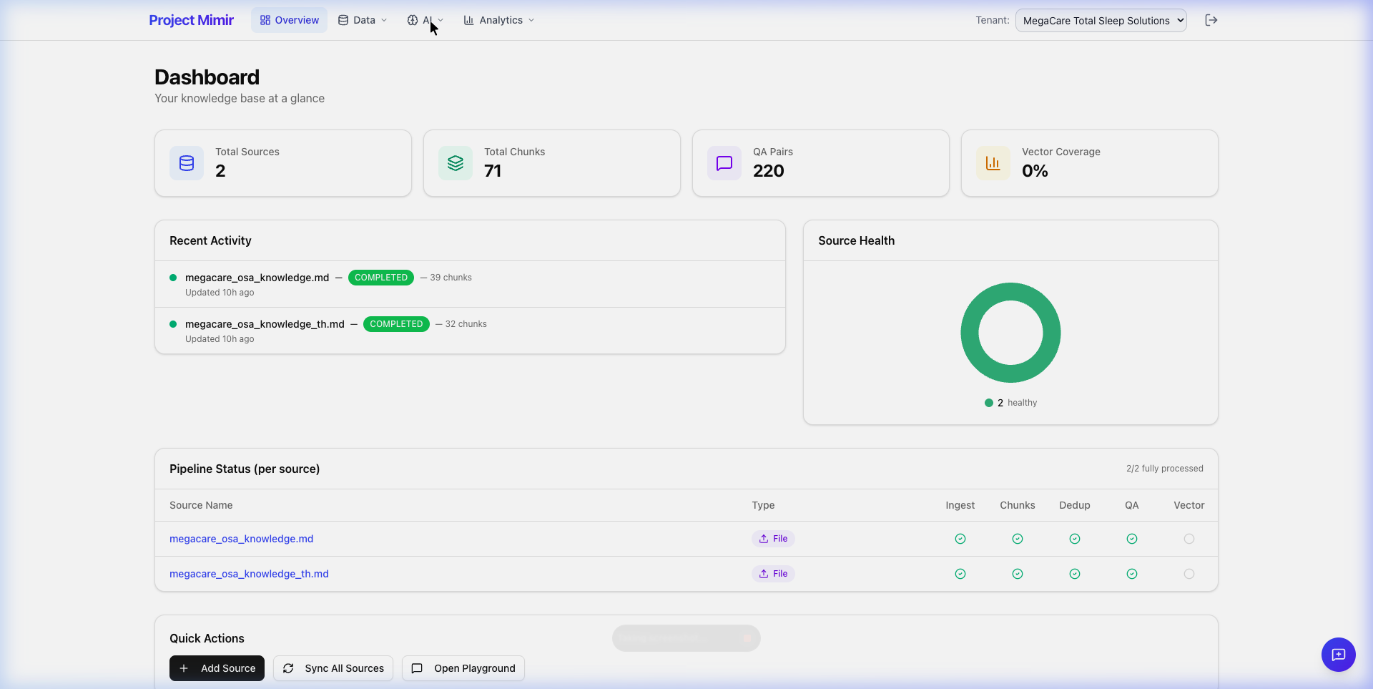
Mimir Dashboard — Overview

Slide 16
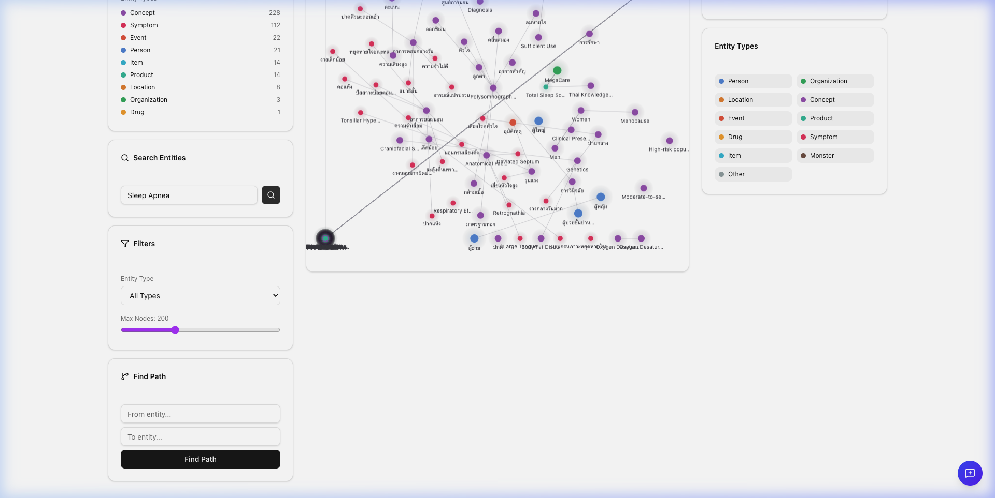
Knowledge Graph — 423 Entities, 727 Relations

Slide 17
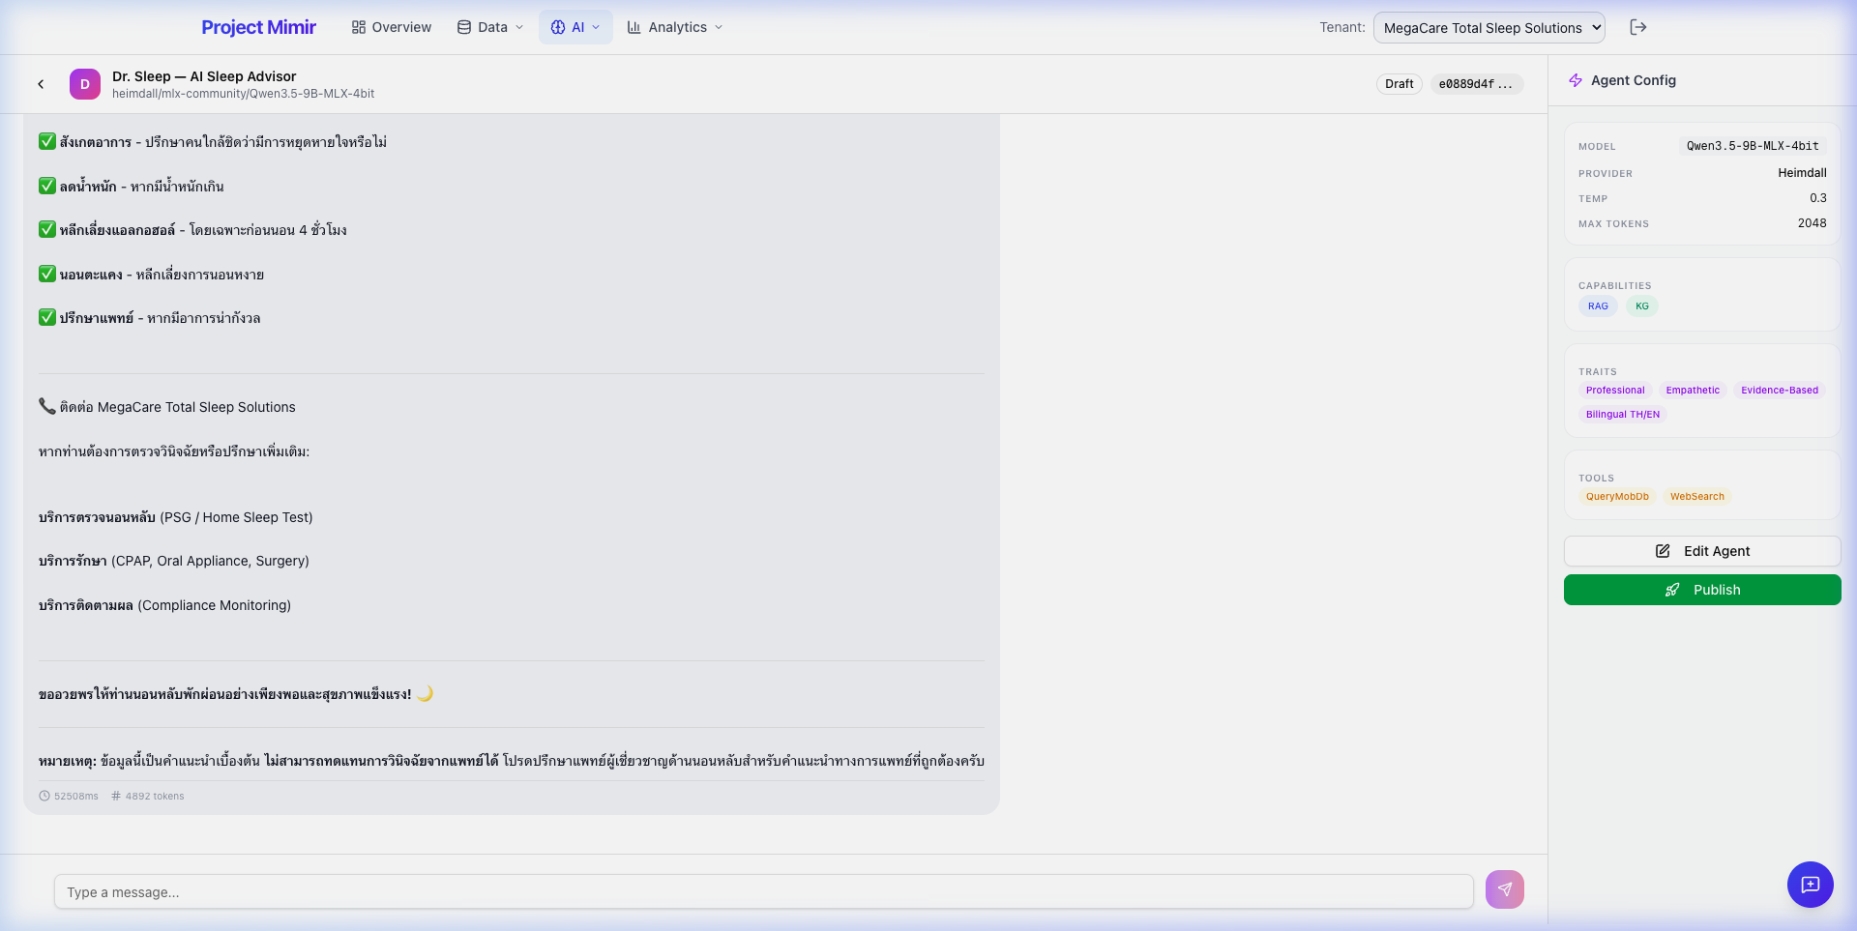
AI Agent Chat — Dr. Sleep (Multilingual)

Slide 18
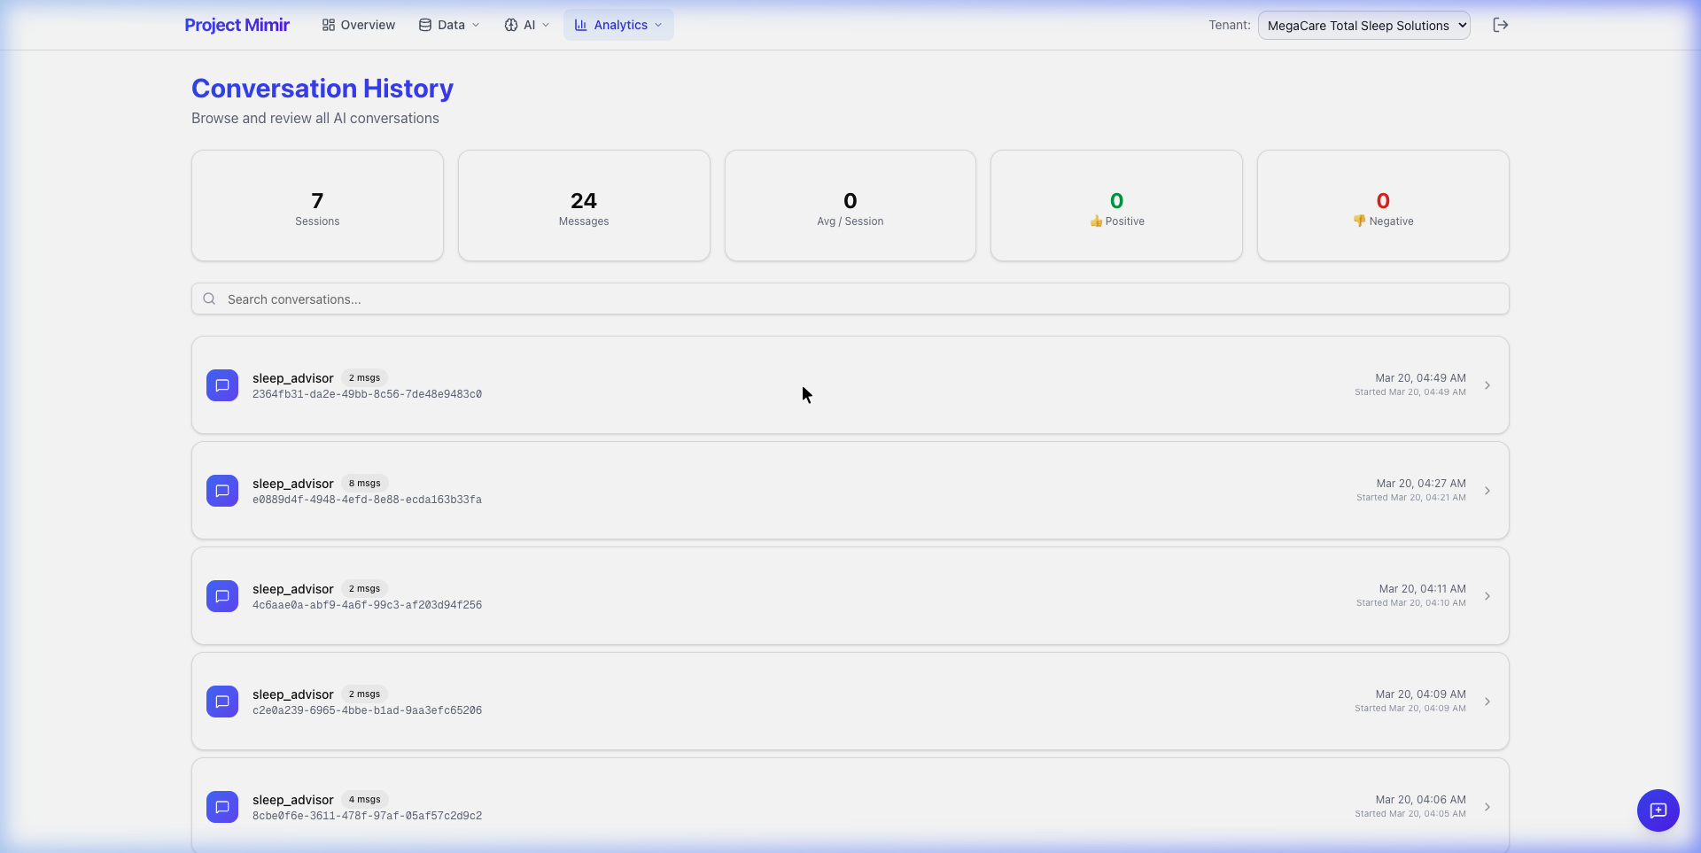
Conversation Analytics — 7 Sessions, 24 Messages

