Slide 1
20217154_지준오
12주차 과제

Slide 2
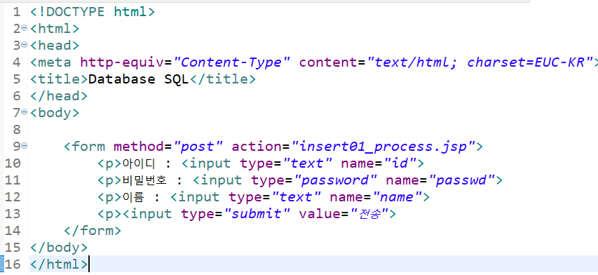
1. main.html

Slide 3
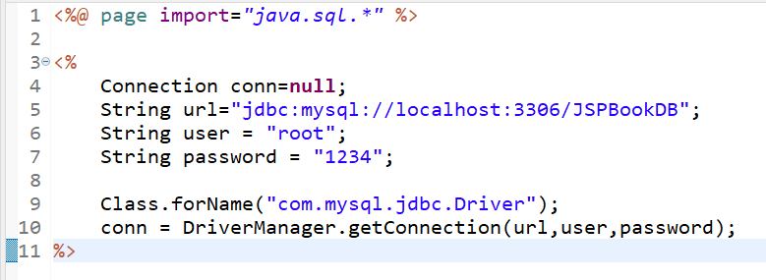
2. Dbconn.jsp

Slide 4
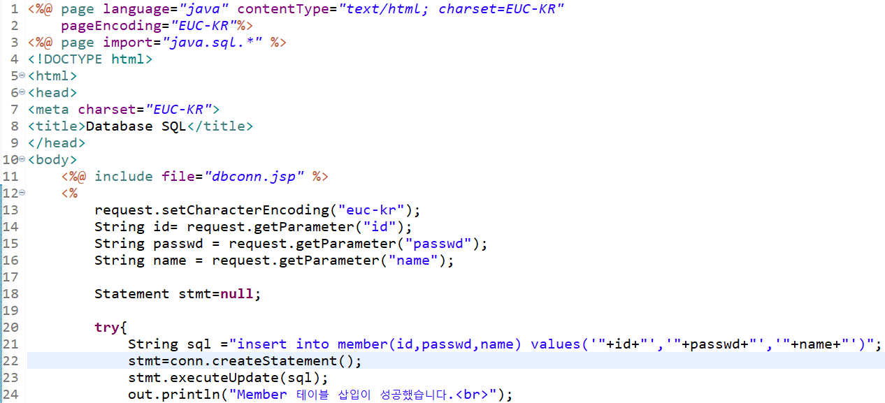
3. Insert01_process.jsp _1

Slide 5
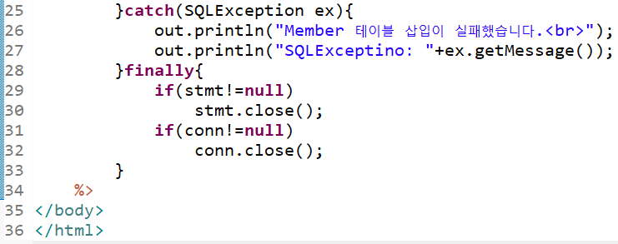
3. Insert01_process.jsp _2

Slide 6
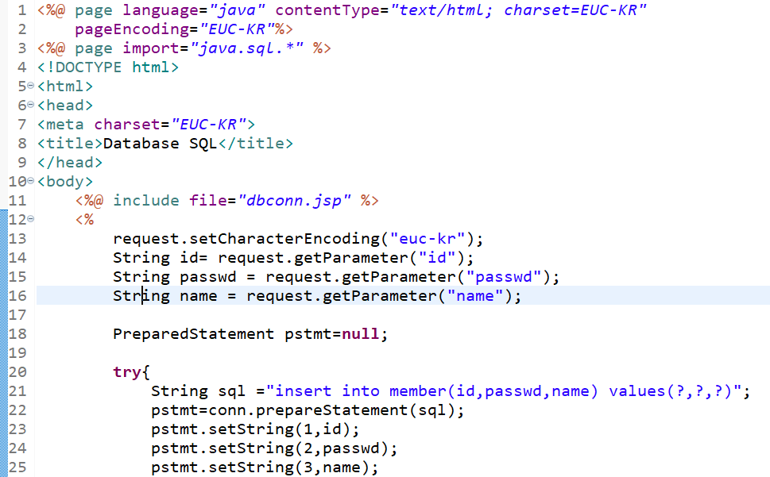
4. Insert02_process.jsp _1

Slide 7
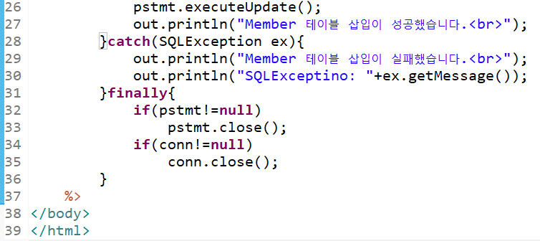
4. Insert02_process.jsp _2

Slide 8
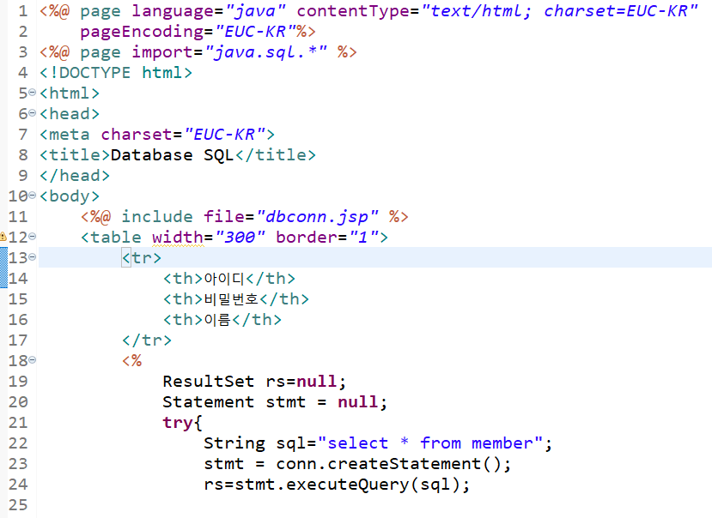
5. Select01.jsp _1

Slide 9
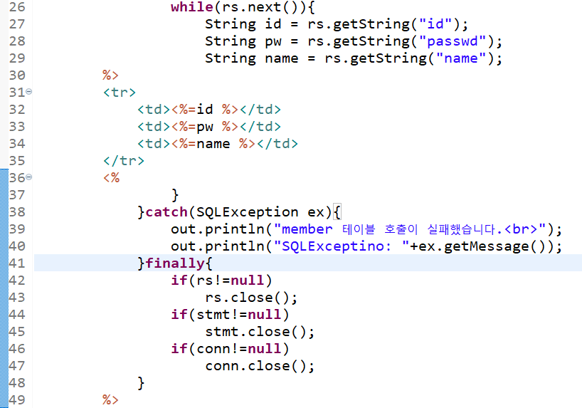

5. Select01.jsp _2

Slide 10
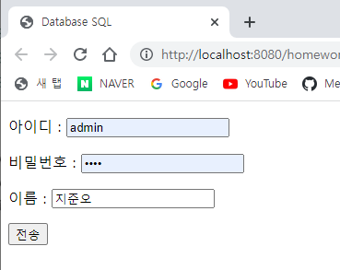
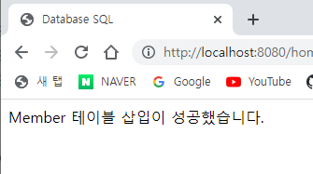
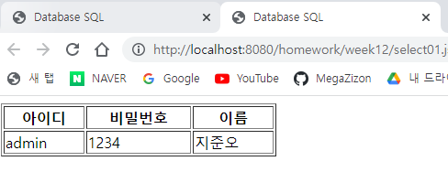
실행결과

