Slide 1

Gesture Driven Object Manipulation using YOLO in Unity

Slide 2
Team Members
Kankipati Venkata Meghana cb.sc.u4aie24022
Kondakindi Supriya cb.sc.u4aie24025
Korumilli Siva Kumar cb.sc.u4aie24027
M Mahendra cb.sc.u4aie24033

Slide 3
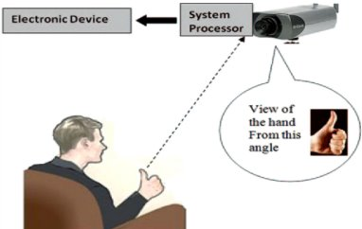
Objective
This project aims to develop a gesture-driven object manipulation system in Unity using YOLO, leveraging deep learning-based object detection for reliable gesture recognition. The system will enable real-time object control, improving interaction efficiency and user experience in 3D environments.

Slide 4
Literature Review
Paper (Name, Year) | Methodology | Advantages | Limitations | Metrics
3D Interaction Techniques Using Gesture Recognition (2015) | Fused Leap Motion + gForcePro+ sensors with data gloves | Practical multi-sensor interaction | Accuracy drops due to background & lighting | Detection errors minimized
Force Push: Expressive Gesture to Force Mappings (2018) | Physics-driven gesture mapping for indirect object manipulation | Supports coarse & precise manipulation | Less accurate; poor performance when object starts too close | Better average performance (survey-based)
Fingertip Interaction in Handheld AR (2020) | Leap Motion tracks hand skeleton from raw calibration data | Fingertip gestures allow control beyond touch UI | Internet-based processing causes delay; limited to single user | Touchscreen control outperformed fingertip use
Unified Learning for Egocentric Gesture & Fingertip (2021) | Single CNN pass for finger class & fingertip position | High efficiency, real-time performance | Large model; dataset limitations | 99.9% accuracy, 0.99 F1, low pixel error
Real-time Object Detection for Robot Vision (2021) | Hololens + ROS + YOLOv4 via Rosebridge & Unity3D | AR-based real-time detection; v4 detects small objs | Lower FPS for YOLOv4 vs v3 due to hardware | 13 FPS (v4), 28 FPS (v3), 13 FPS (video stream)

Slide 5
Paper (Name, Year) | Methodology | Advantages | Limitations | Metrics
Gesture Recognition with SEMG & Leap Motion (2022) | Combines SEMG armband signals with Leap Motion infrared tracking | Higher accuracy by combining palm, fingertip & muscle data | Armband orientation changes may cause inconsistent signal readings | Evaluates gesture recognition, grasping, and response time in real time
Python Programming Education via Unity (2022) | Unity-based 2D interactive platform for Python learning with surveys | Interactive environment boosts engagement; supports labs | Requires skill in both Unity and Python, may hinder beginners | Entry/exit surveys tracked programming skill improvement & feedback
Hand Gesture Recognition using CNN & TOF in VR (2023) | TOF depth sensors + CNN (YOLO) for hand shape recognition with preprocessing | Handles low light & complex backgrounds via depth sensing | Higher cost due to specialized TOF hardware | 99.98% precision, high classification rate (tested on 2 datasets)
YOLO-Based Deep Learning for Gesture Recognition (2023) | YOLO v5/v6/v8 on 5000-image dataset, labeled via Roboflow, split datasets | Real-time multi-gesture recognition | Demands high-quality data and large computational power | Measured via accuracy and speed

Slide 6
Gaps in papers, Our Novelty
Gaps:
They used YOLO for gesture detection, but need extensive resources (like a Super GPU funded by NVIDIA), or used specific tools(like the TOF cameras) for high accuracy in object detection. VR interaction was done mostly through headsets (Hololens), or Leap Motion (sensor-controller).
All of these require additional hardware or tools, or more computation.
Novelty:
Our approach is to implement a pipeline, use inbuilt webcam and an entry level GPU for gesture-based object manipulation, without any external hardware or tools.
This can reframe how we view gesture-based interaction: not just as something related to 'gaming', but as a practical way for anyone to interact with a computer.

Slide 7
Methodology
Stream in webcam input in real time, convert it into frames using OpenCV.
Send the frames continuously to the YOLO model, which will detect an object(if present) and store it in a variable within python.
Using TCP sockets(used for smaller data), continually send the variable data to Unity. This method is better than Websockets(used in webpages), as the data synced is very small, having low latency.
The data is received in Unity, and by scripting in C#, we make the object previously imported into unity, to move according to the content/gesture detected in the variable synced.

Slide 8
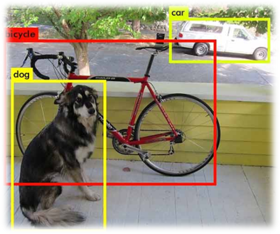
How YOLO works
Image resized & normalized.
Passes through backbone (CSPDarknet53) → extracts features.
Passes through neck (FPN + PAN) → refines features.
Passes through head → generates bounding boxes.
Post-processing (NMS + confidence thresholding).
Returns final detected objects with bounding boxes.

Slide 9
How YOLO works (Backbone –CSP(Cross Stage Partial) Darknet)
Convolutional Layer 1 – passes a weight matrix through the input image, generates feature map. Batch normalises feature map, decides how much the neuron is activated.
CSP Bottleneck Block – The input feature map is divided into two sets randomly. One set is sent directly to merging while another set goes through bottleneck layer, before merging.
Bottleneck layer – go through multiple convolutions.
Conv Layer 2 (Downsampling using Strided Conv)
Function: Reduce spatial dimensions (640 → 320).
CSP2 – 2 bottleneck blocks, etc.

Slide 10


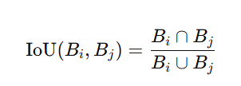
How YOLO works
Activation Functions
Non Max Supression:

Slide 11
How YOLO works :-(Neck (FPN +PAN))
Before the batch of images are sent to the neck layers SPP is done:-
SPP (Spatial Pyramid Pooling): for downsampling/reducing image size
Uses different sized filters for extracting different levels of abstract information.
Smaller filters/kernels get more details
Combine all the pooled feature maps by adjusting sizes
The Neck in YOLOv5 is responsible for multi-scale feature fusion, helping to detect objects of different sizes. It consists of:
⃣ FPN (Feature Pyramid Network)- Upsamples deeper layers and merges them with earlier layers PAN (Path Aggregation Network))- Enhances spatial details by reintroducing low-level features
These structures combine feature maps from different layers of the Backbone + SPP to ensure that both small and large objects are well detected.

Slide 12
How YOLO works :- (Head & NMS )
Once the Neck (FPN + PAN) processes multi-scale feature maps, the Head takes these features and does the following:-
Predictions are made (bounding boxes, objectness, and class scores).
Weights are applied from the trained model to generate meaningful detections.
Loss is calculated during training to optimize the mode
NMS(Non –Max Suppression)
The Head may predict multiple overlapping boxes for the same object.
NMS keeps only the most confident detection for each object. It does the Following:-
1) Remove low-confidence boxes
2) Sort by confidence (Prioritize best detections)
3) Compute IoU
4) Suppress Overlapping Boxes (If IoU > IoU threshold, discard the lower-confidence box.)

Slide 13



How YOLO works
Back propagation: Gradient Descent
(error)
Errors:
Bounding Box Loss:
Confidence Loss
Classification loss
After all these steps the a little bit of post processing is done and then classification results are sent to external systems for veiwing.

Slide 14

How OpenCV works
OpenCV asks OS for access to camera, uses default API (platform specific)
Webcam frames are stored in queue
When read fn is called, OpenCV takes the oldest frame from queue
It is then processed in python

Slide 15
How TCP Works
Python
1. Establishing the Connection (Handshake Process)
2. Socket creation and binding to address
Unity
1. Accepts connection
2. Receives data

Slide 16
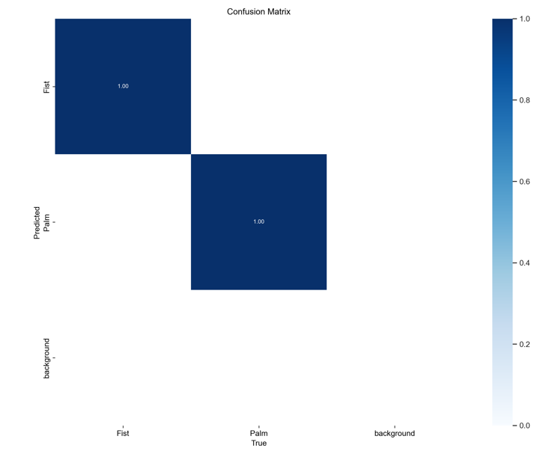
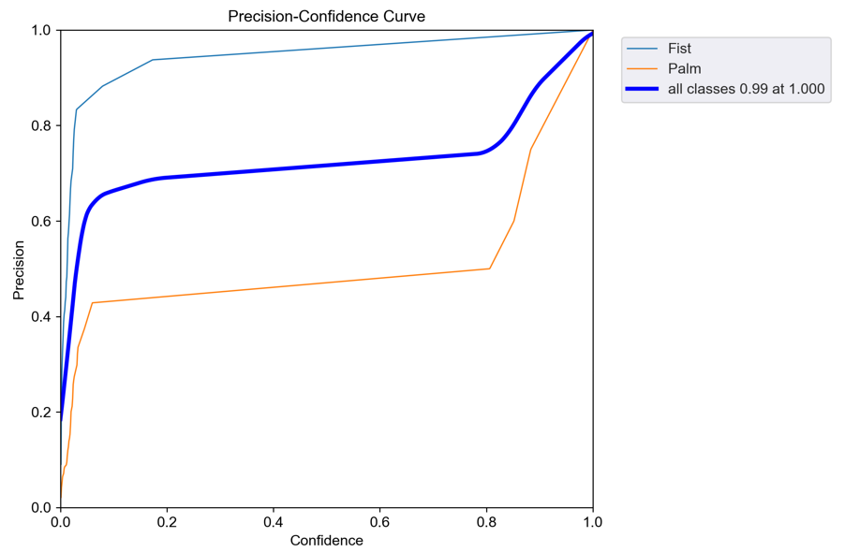
Results
Data set training results:-
Confusion Matrix-

Slide 17
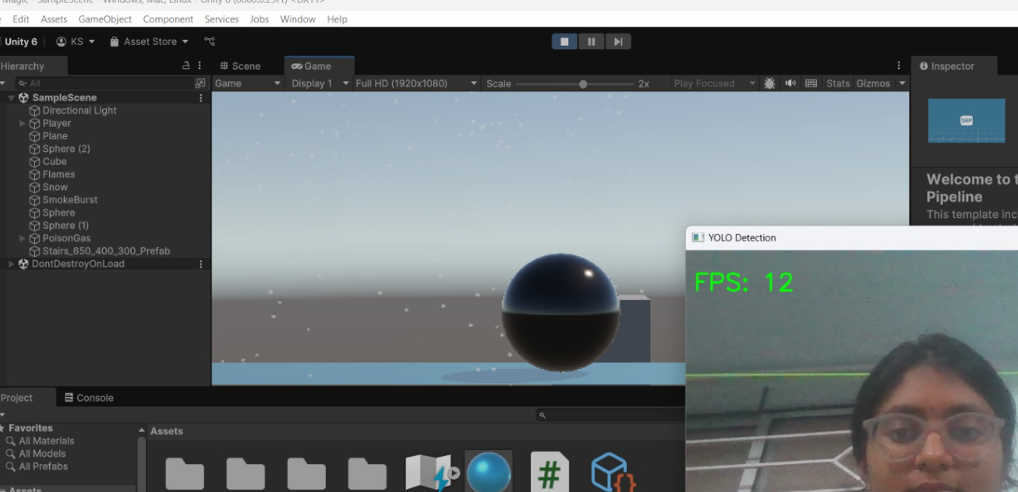
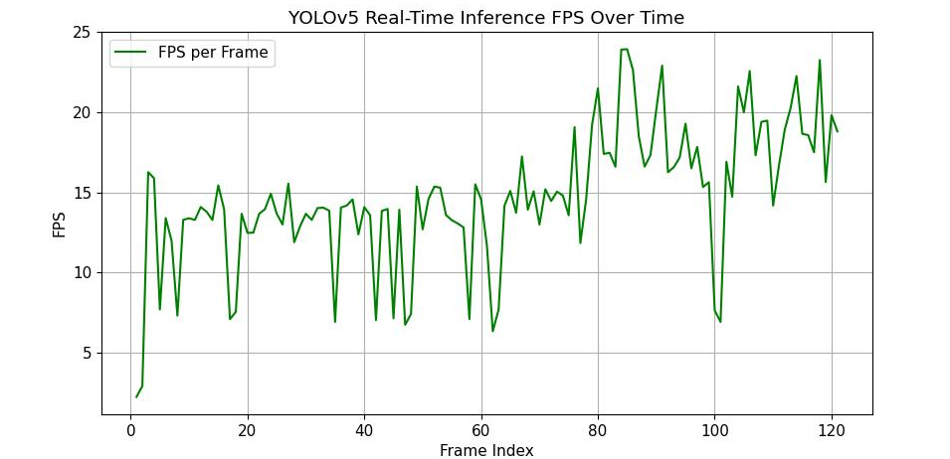
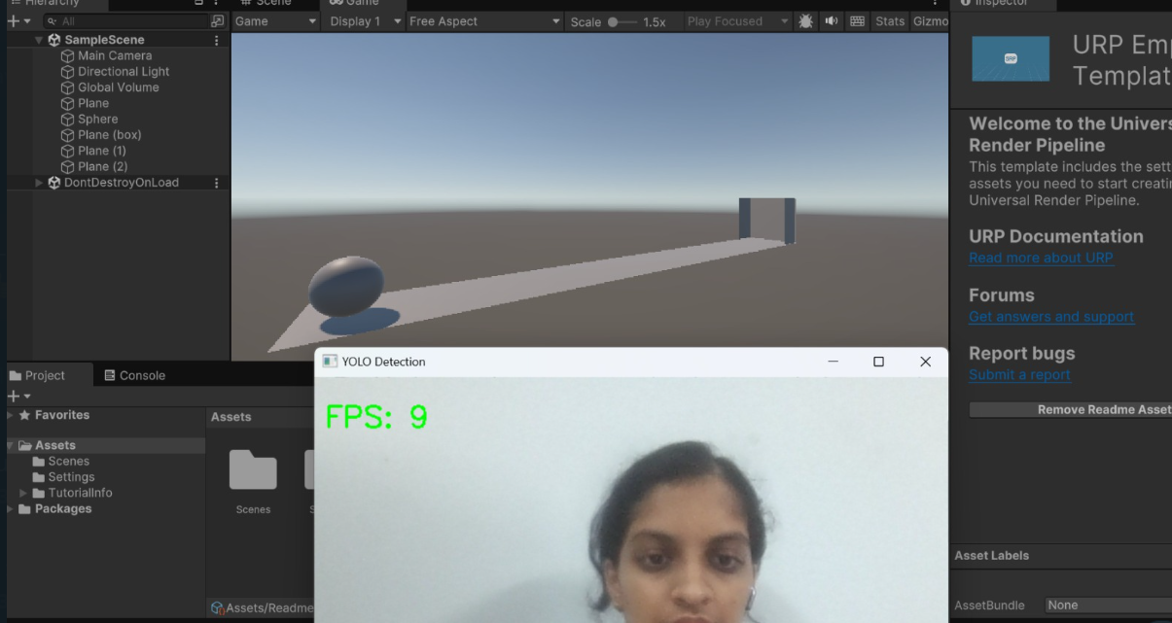
Results
FPS results:-

Slide 18
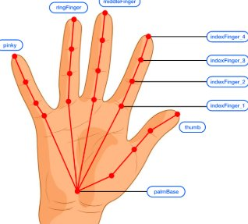
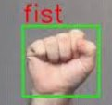
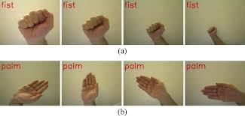
Future Work
Instead of connecting Python to Unity, we can connect it to HTML and JS to similarly manipulate a webpage using gestures, showcasing broader applications beyond gaming/designing related work.

Slide 19
Timeline
1 week- setting up TCP, UDP, preparing custom dataset
1 week- Streaming in webcam input as frames to YOLO and checking for object detection
1 week- training YOLO with custom dataset and testing to ensure it detects gestures.
1 week- figuring out writing custom code in Unity
1 week- connecting YOLO's output in python to Unity in c#, using the TCP or UDP
1 week- testing it actually works
1 week- getting performance as close to real time as possible
Total: 6-7 weeks, ~1.5 to 2 months
THANK YOU !
We are Group 6..

