Slide 1
Minesweeper DSA Semester 2 2022-2023
Presenter: Nguyễn ĐÌNH MINH PHÚC – ITITWE17029

Slide 2
INTRODUCTION
Minesweeper is a popular board game shipped with many operating systems by default.
The goal of the game is to clear the board without detonating any mine on the board.
If the player clicks on the block which contains a mine, the mine detonates and the game is over.

Slide 3
GAME RULES
GOAL: open all the covered blocks that aren’t contained with mine
An empty block can contain a number or it can be blank. If a block is blank (have zero mines around it), it will continue to open more blocks surrounding it until it hits blocks with a number ( a block which has 1 or more mines around it ).The number indicates how many mines are adjacent to this particular block.
We can also set flags on blocks by right clicking on it, to keep track the blocks with mine.

Slide 4



IMPLEMENTATION

Slide 5
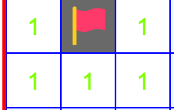
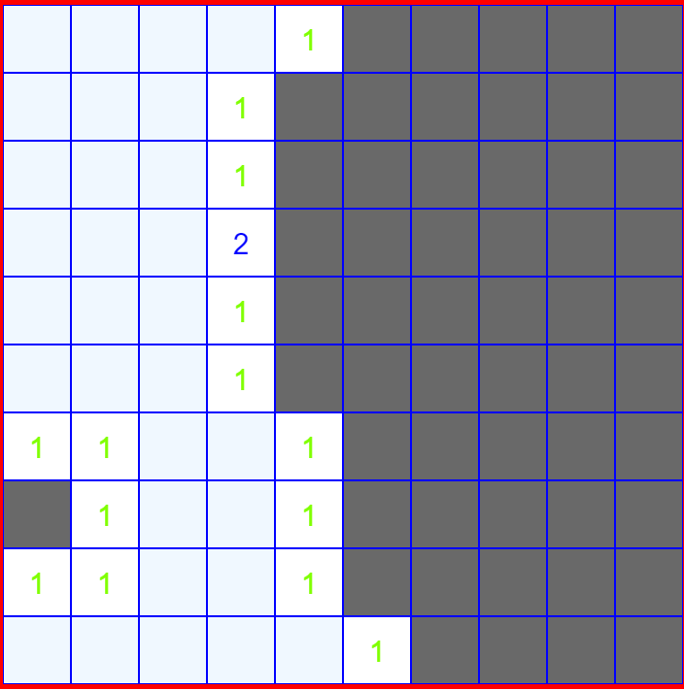
GAME LOGIC

Slide 6
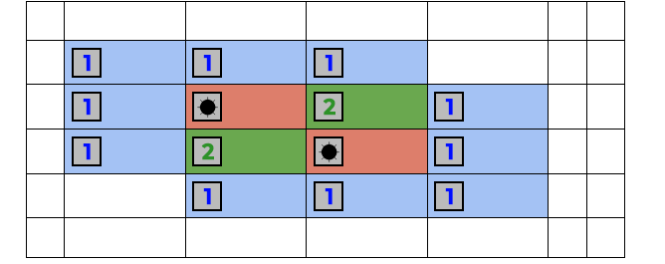
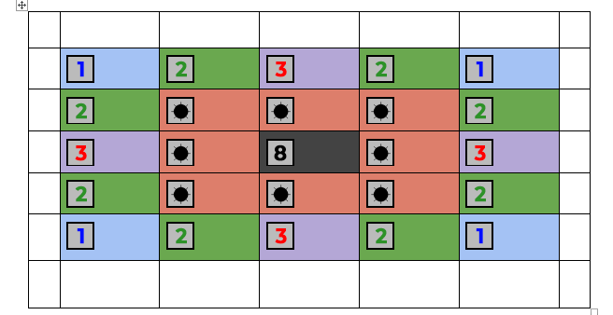
GAME LOGIC

Slide 7
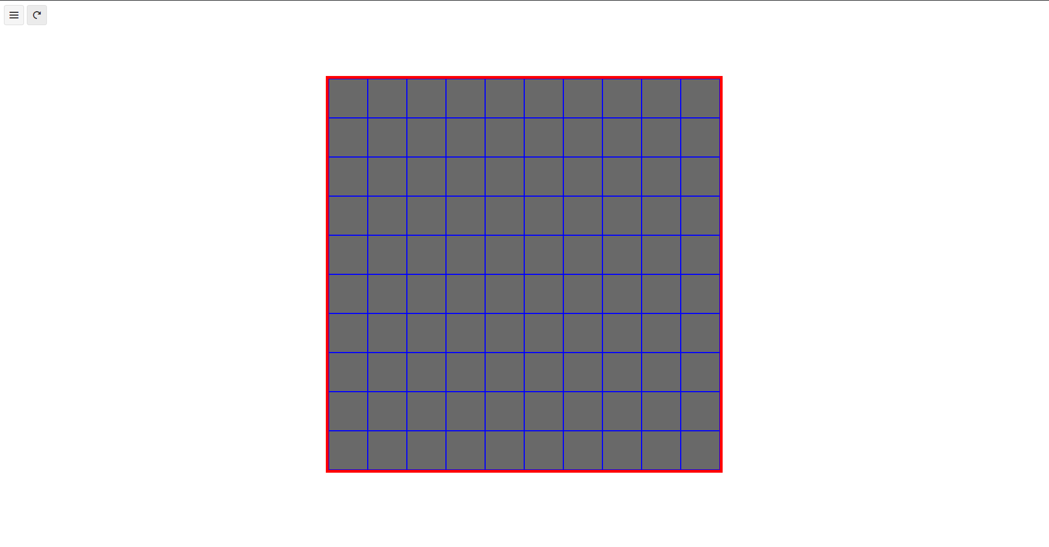
DEMO

Slide 8
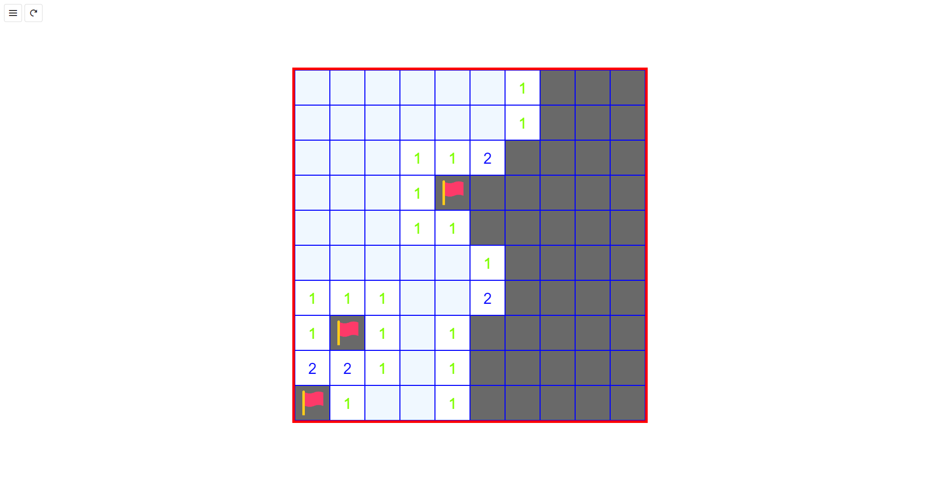
DEMO

Slide 9
THANK YOU FOR LISTENING

