Slide 1

Plants vs Zombies
Member :
Nguyễn Đình Minh Phúc - ITITUN17003

Slide 2

Class Diagram

Slide 3
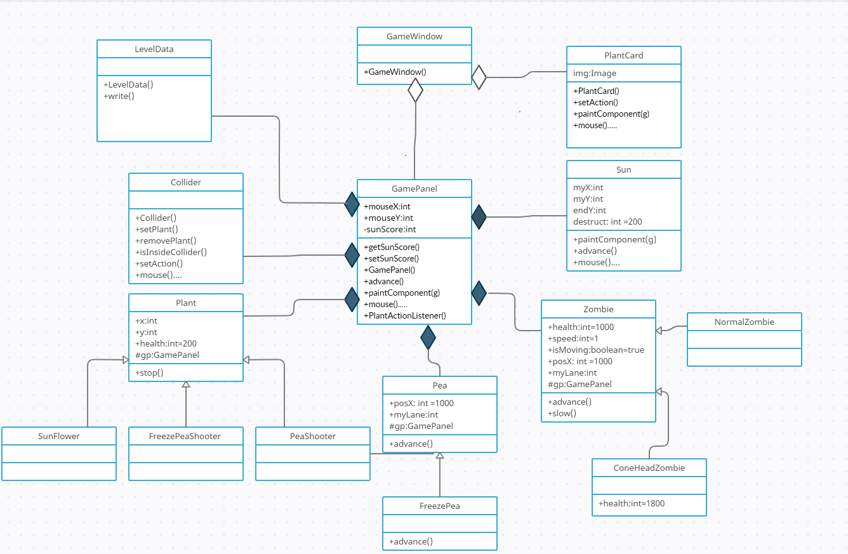

Slide 4
Demo

Slide 5
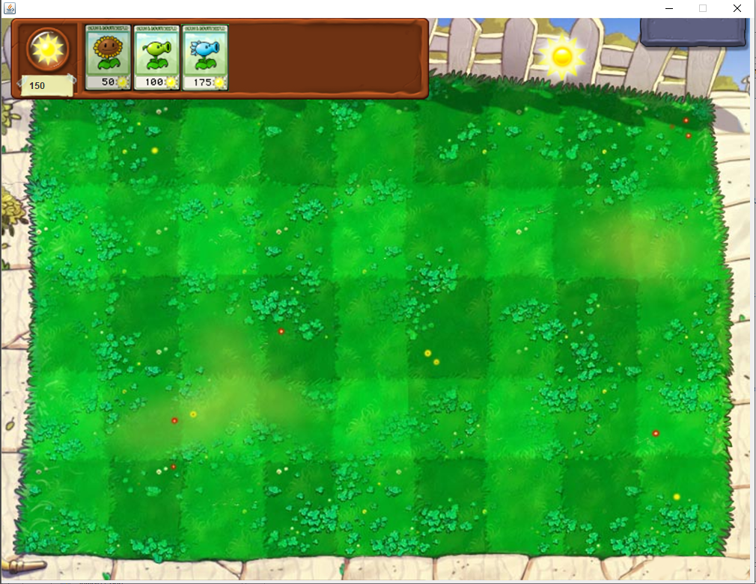

Slide 6
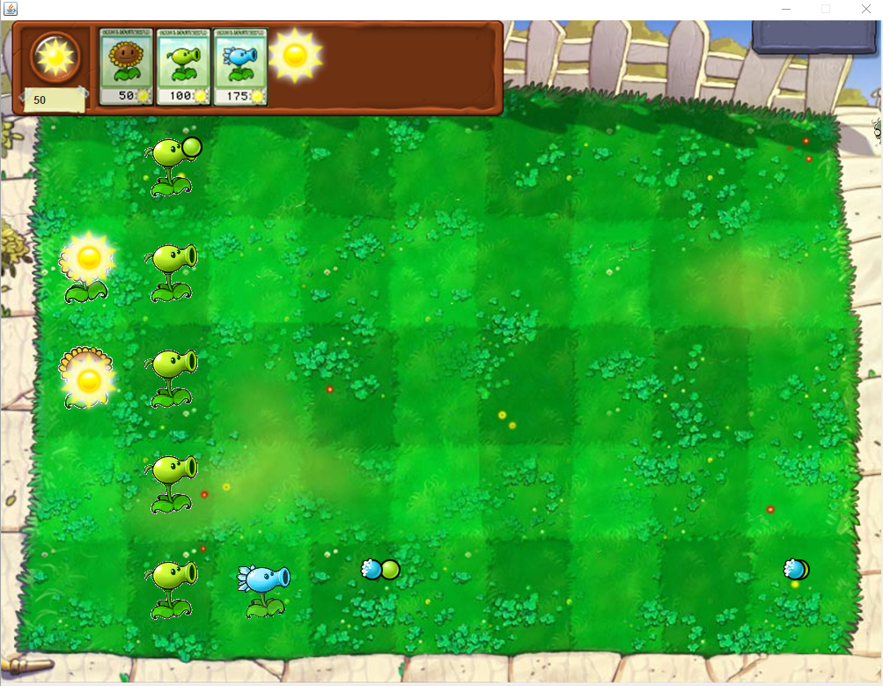

Slide 7
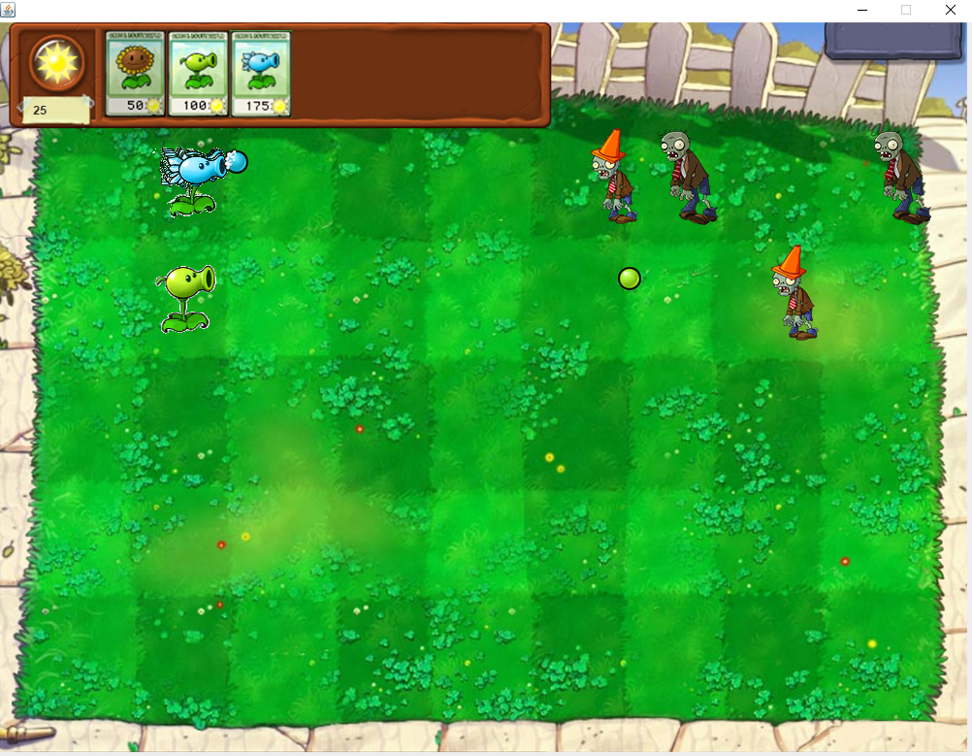

Slide 8
Thank you for listening

