Slide 1

Présentation finale de projet Rope Man
Margot Pellegrin
Nathan Vetter
Louan Ourvouai
01

Slide 2
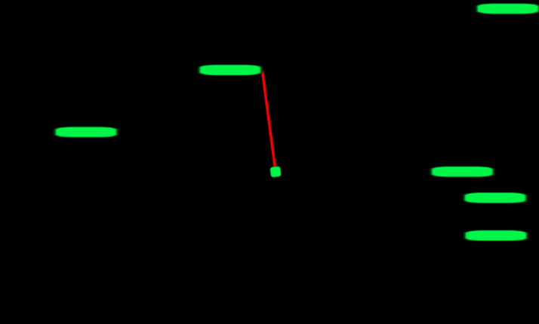
Rope man
1 Players, first person, 3D
ZQSD for moving
Left/right click for throwing Left/right rope
SDF Procedural generation of platforms
« infinite world »
Ray marching
Easy collision detection
Tons of effect & texturing
Player can throw/drop ropes to climb. Lava goes up, player lose if too slow
Ropes as chains of springs
CPU or GPU simulation
Line rendering (geometry shader ? )
02

Slide 3
Demo & features
Plateforme
Lave
Cordes
Player
Ray-marching
03

Slide 4
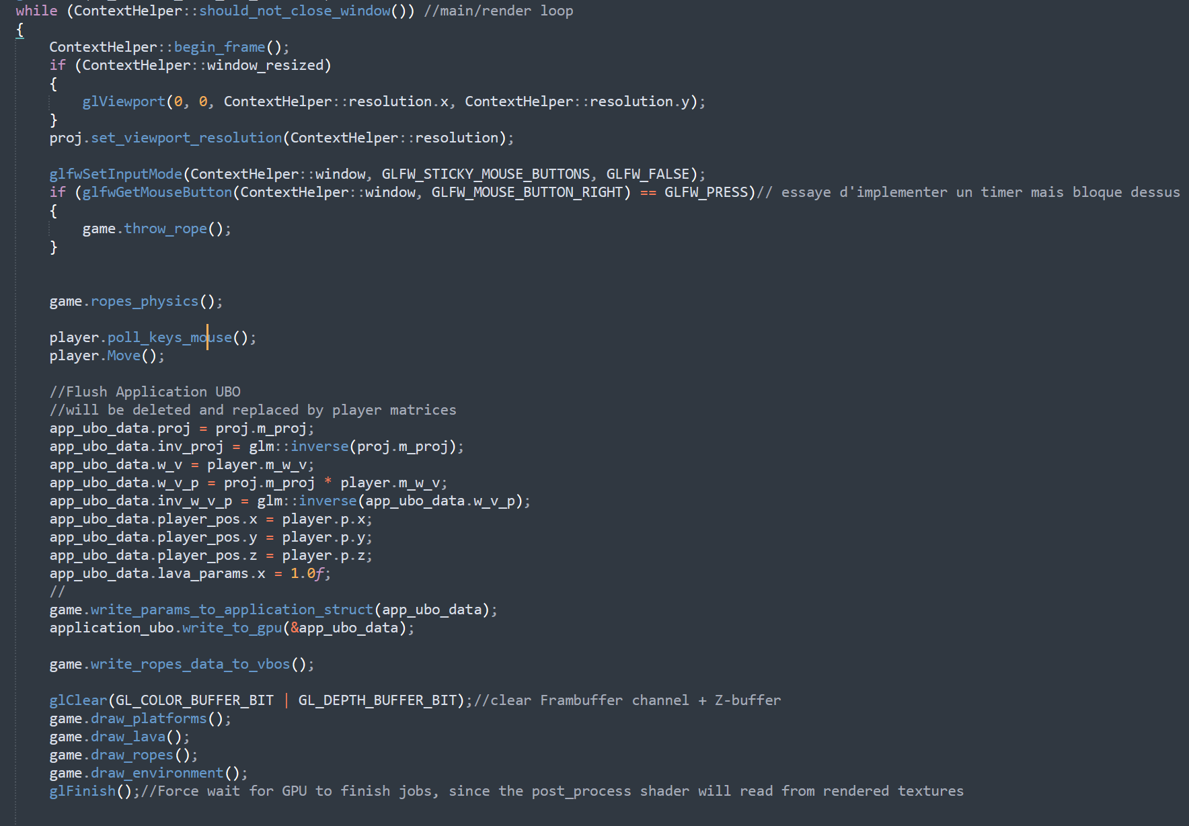
Frame
-On teste si on lance une corde
-On charge la physique des cordes - On vérifie les touches du joueur et on le fait se déplacer
- On charge l’UBO
- On dessine les plateformes, la lave, les cordes et l’environnement.
04

Slide 5
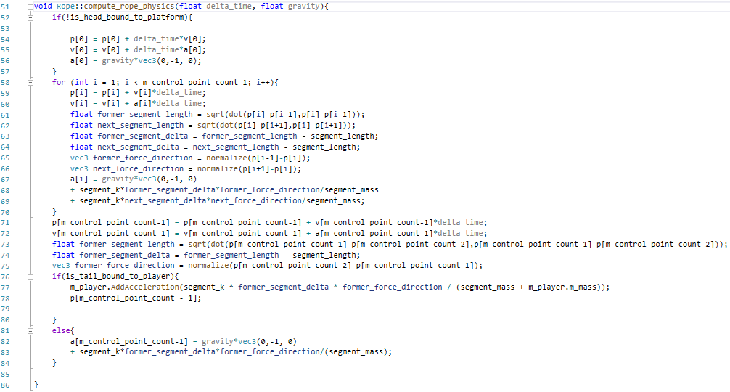
Point technique 1: Les Cordes
05

Slide 6
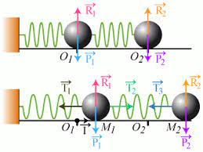
Point technique 1: Les Cordes
06

Slide 7
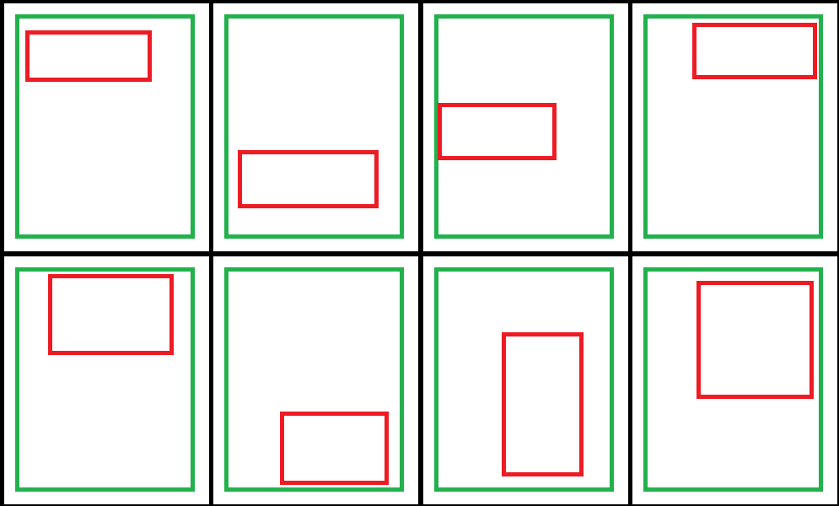
Point technique 2: Les Plateformes
07

Slide 8
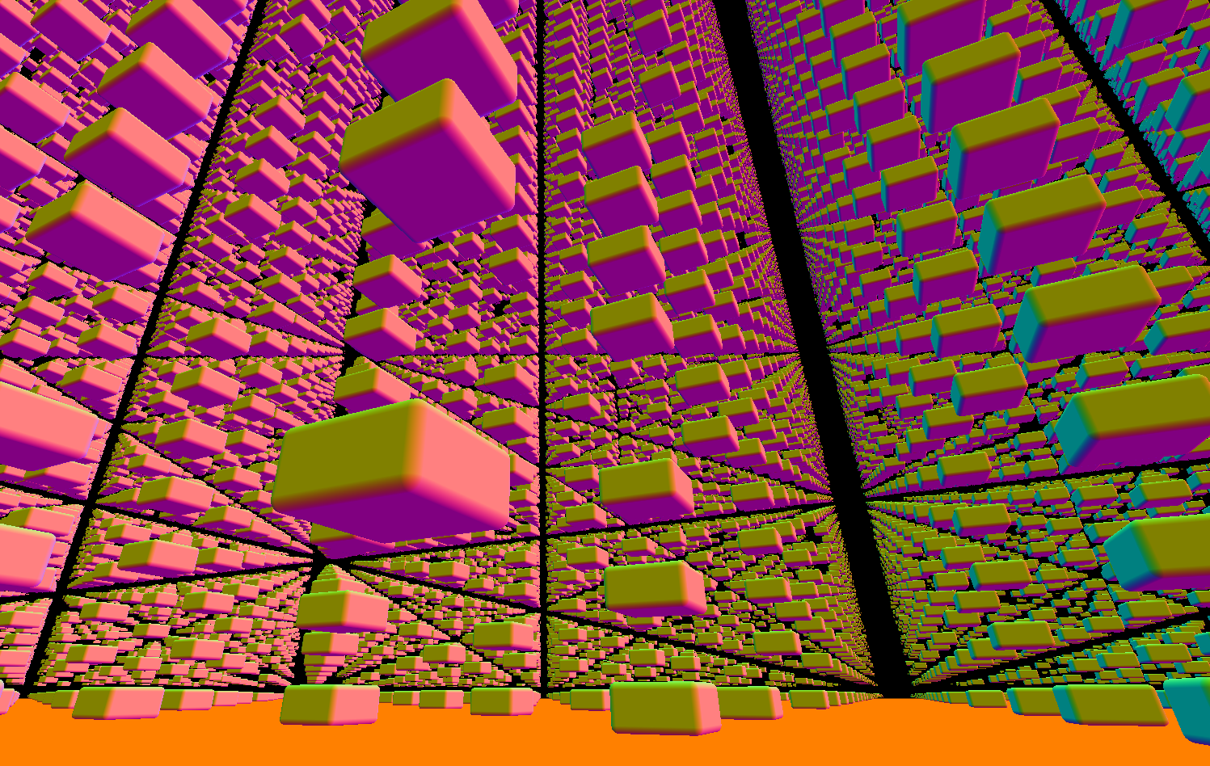
Point technique 2: Les Plateformes
08

Slide 9
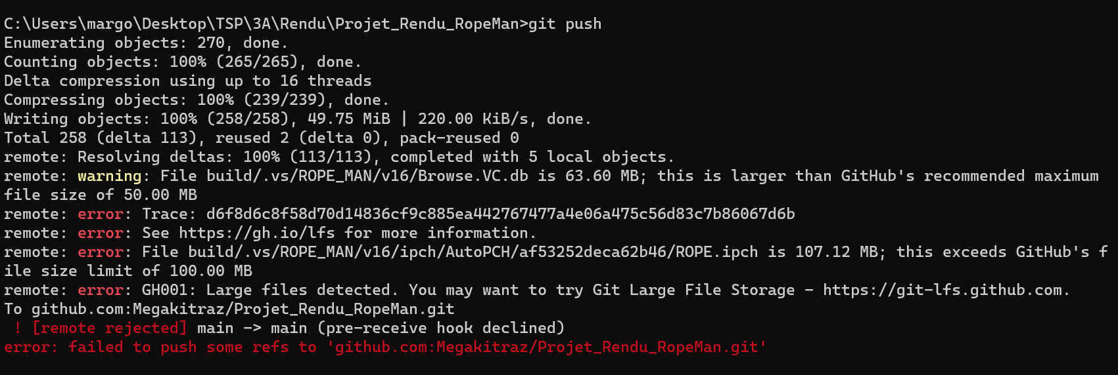
Limitations
Carte graphique qui ne font pas le rendu des images 3D
Le temps: On a pas eu le temps de faire/ajouter des features
Git qui fait des erreurs incompréhensibles
Compréhension du code de base
09

Slide 10
Ce que j’ai appris
La programmation CPU/GPU
La gestion de projet court
Le co-programming
Mise au point sur un système masse ressort multiple
10

Slide 11
Rappel slide projet, à supprimer les autres

Slide 12
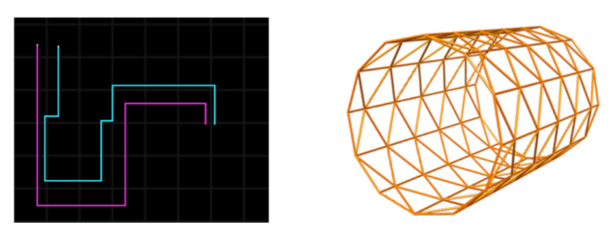
Snake3D
2 Players split-screen
Multi-viewport rendering pipeline
Keyboard control (6 keys per player)
Control of snake from first person
Iterated moving frame for control
Snakes as growing generalized cylinders
Tessellation shader for rendering
Compute shader for collision detection
First player to hit the border of the map / the other player loses

Slide 13
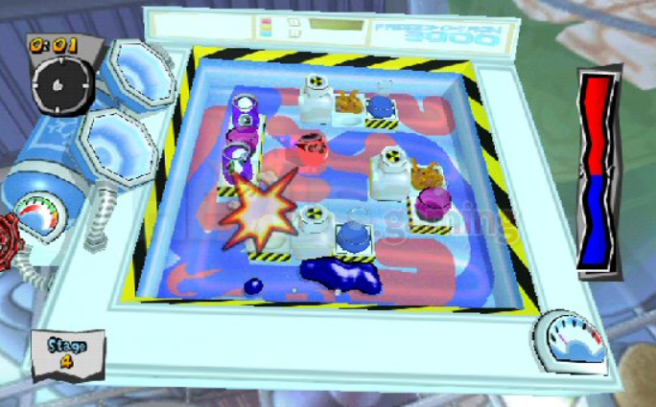
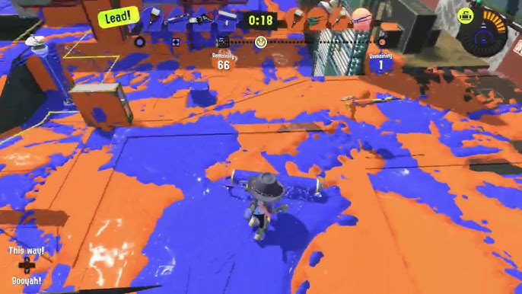
Paint War
2 Players, same screen
Isometric view ?
4 key per player
Blob/metaball rendering & simulation
Ray marching shader
Control of blobs direction with arrows
Physics simulation in compute shader
Paint simulation in compute shader
Players paint ground when moving. Player with most paint wins when timer at 0
Bonus/perk mechanics to improve gameplay/strategies ?

Slide 14
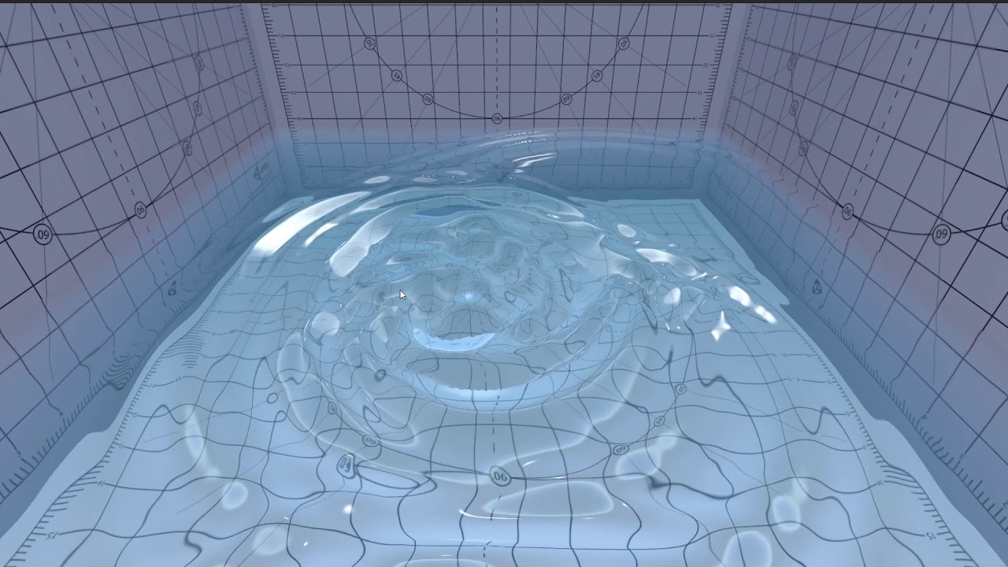
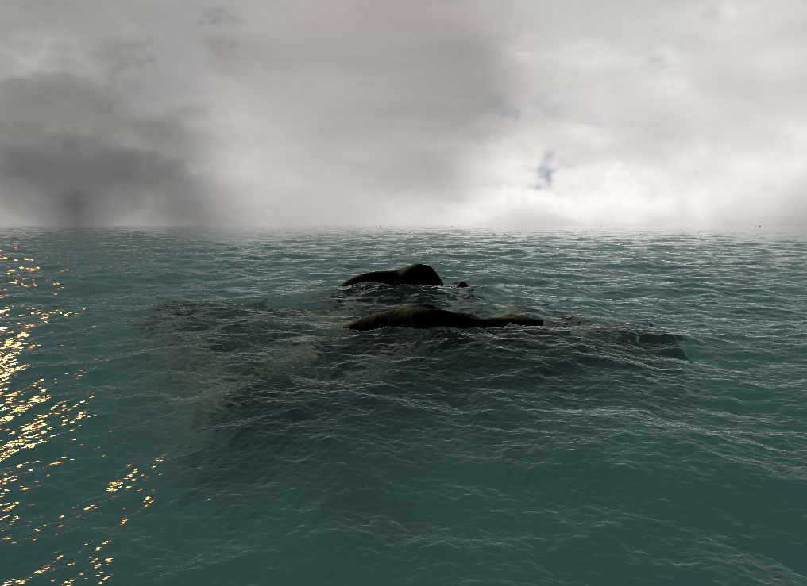
Shallow water
Shallow hypothesis
No droplets (unless you really want !)
Water as a surface, not a volume=> vertical displacement
Simulation of waves (+ High-Frequency noise ?)
In texture space
Compute shader
Rendering of water
Refracted ray
Depth absorption ?
Fake caustics (projective texturing?)
Reflected ray
Envmap reflection
Screen-space reflection ?

Slide 15

Windows XP
Rendering of the legendary background from windows XP
Cloud rendering
Procedural volume
Ray-marching
Absorbtion-scattering
Grass rendering
Instanciated rendering (+Tesselation?)
Procedural height-map
Choice for grass modelisation
Ray-marched shadows (of clouds)
Probably SSAO

Slide 16
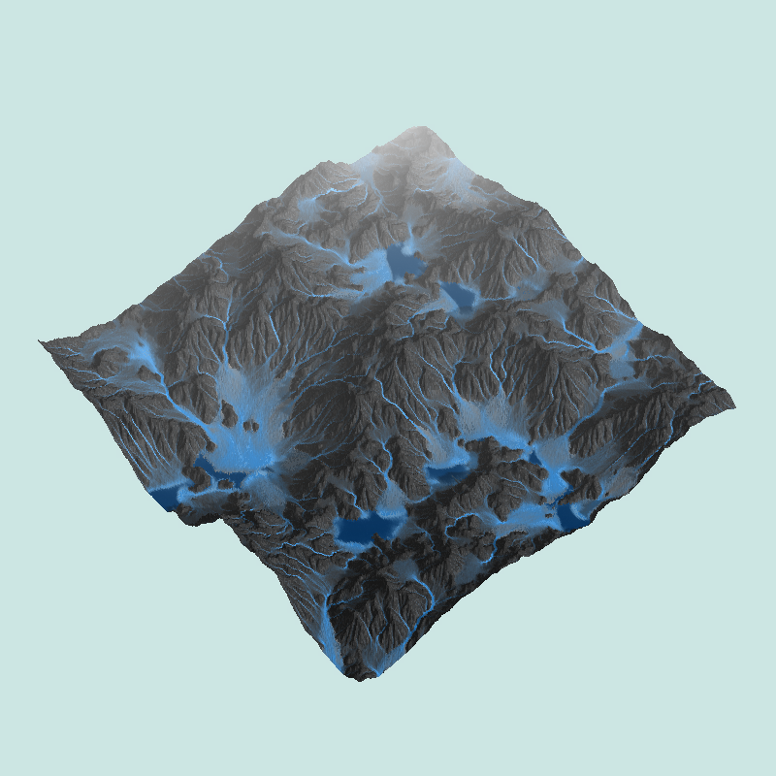
Terrain erosion
Terrain as a 3d volume (voxels)
3d texture
« 3d » compute shader for simulation
Simulation
Definition of types of soil and relationships
(soil, rock, water, empty ?)
Modeling exchanges in neighbooring cells
Matter exchanges: water carry some soil.
Quantities exchanges: Water speed accumulates & turns rock to soil
Shading/rendering
Performing drawcall from 3d texture
Shading of water: transparency ?
Soil should look like grass if at surface, brown if burried
Cut in volume ?

