Slide 1
Cloud Computing
Google Cloud
Linus Moser

Slide 2
Table of Contents
Cloud Overview
Google Cloud
Example – Dinosaur API
Conclusion
Notes:
To show you an example of how important cloud computing could be, I will show an example and describe Google Cloud in more detail.

Slide 3
Cloud Overview

Slide 4
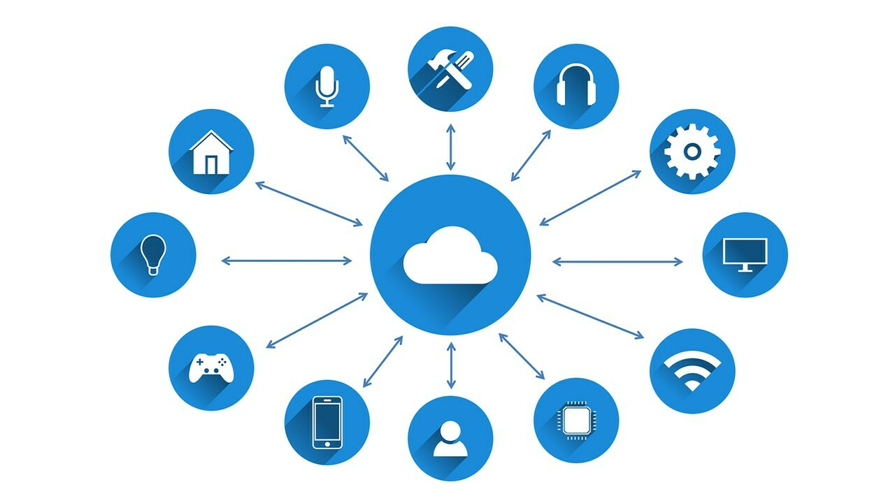
Cloud Overview – Cloud benefits (1/3)
Scalability and flexibility
Cost saving
Availability
Data loss prevention
Notes:
Scalability and flexibility -> Using a cloud gives you easy scalability, if you need more/less performance for your solution you can easily scale it in seconds. Public cloud providers have also integrated services that automatically scale your services
Cost saving -> Is a very important point in using a cloud, with a cloud you only pay what you use.
Availability -> With cloud storage, you can access your data from anywhere.
Data loss prevention -> Most cloud providers offer backup and disaster recovery capabilities, this results in very fast recovery times if something goes wrong.

Slide 5
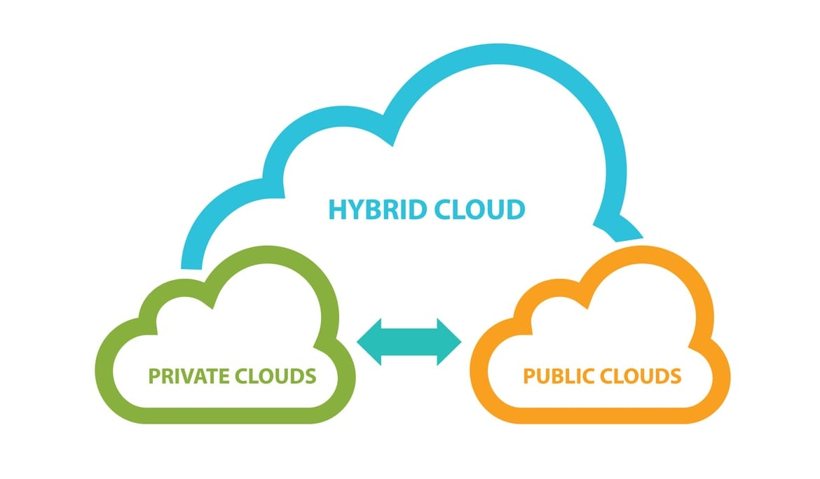
Cloud Overview – Deployment models (2/3)
Private cloud
Public cloud
Hybrid cloud
Notes:
Private Cloud is a deployment model where a single organization manages a the cloud service. It doesnt matter if ist hosted on-premise or in another cloud (off-premise). Many SME companies offer their customers a private cloud solution.
The public cloud model is the model that I will explain in more detail later in the presentation. A public cloud offers its services online and is mostly owned by huge companies. An example is the Google Cloud or AWS.
Hybrid cloud is a model in which an on-premise solution or a private cloud is connected to a public cloud, this model can be implemented in very different ways.
There are also some other Deployments/Cloud models, but these are the most used of them.

Slide 6
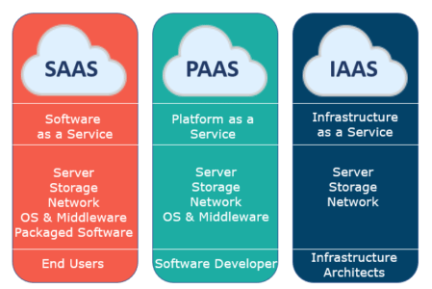
Cloud Overview – Service models (3/3)
Infrastructure as a service (IaaS)
Platform as a service (PaaS)
Software as a service (SaaS)
Function as a service (FaaS)
Notes:
IaaS -> used to build the whole infrastructur at your own, the consumer has access to various low-level APIs to configure the Network/Hypervisor/VMs etc.
PaaS -> is a service where the consumer has access to the provided applications and can also partially configure the hosting platform.
SaaS -> is a service model that runs software in the cloud without the need to manage the cloud's virtual machine or infrastructure. However, the applications provided cannot be configured and managed as with the “Platform as a Service” model.
FaaS -> is a service model where you only run your Software as a Container in the cloud. In this service model the infrastuctur is handled by the provider.

Slide 7
Google Cloud

Slide 8
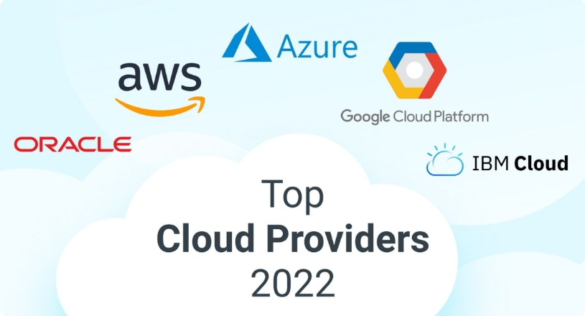
Google Cloud – Benefits (1/3)
Outstanding availability and uptime
Live maintenance
Leading Global Infrastructure
SDKs
*$300 starting credit
Notes:
Google offers a wide range of SDKs (Software development kit) to interopt with their services over programs.

Slide 9
Google Cloud – Service Models (2/3)
Infrastructure as a service (IaaS)
Platform as a service (PaaS)
Serverless computer environments
Notes:
Google Cloud offers you Infrastructur as a Service, Platform as a Service and serverless computer environments, as deployment models.
The most used is the Function as a service model.

Slide 10
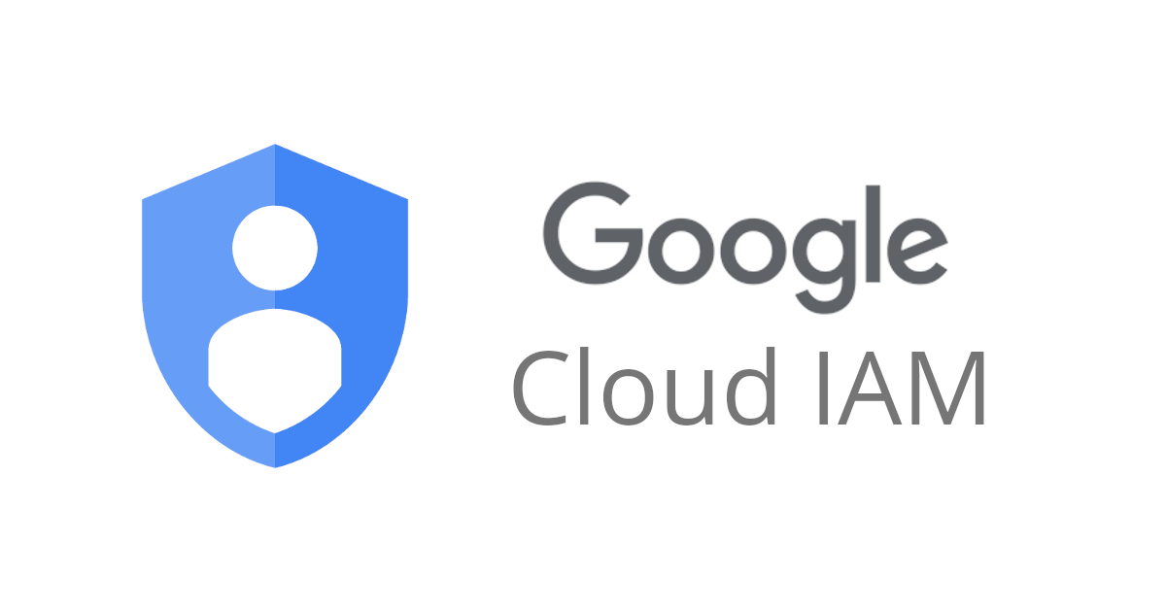

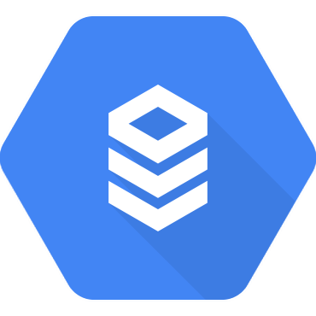
Google Cloud – Microservices (3/3)
Microservices
Cloud IAM
Cloud Run
Cloud SQL
Notes:
-> Google Cloud is known for being good at handling microservices.
-> The most common used services for Microservices are:
-> Cloud IAM, IAM handles the authentication and management of users and services
-> Cloud Run, You can deploy and manage individual applications on Cloud Run
-> Cloud SQL, This is a service for maintaining SQL databases redundantly.

Slide 11
Example
Dinosaur API
Notes:
I did a simple Example of an API on Google Cloud

Slide 12

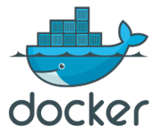
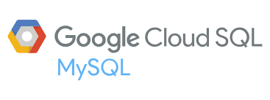
Dinosaur API – Overview (1/3)
Goal
Function as a service (FaaS)
Microservices
Technologys
Notes:
-> Goal: The Goal is to create a database to be filled with dinosaurs. It should then be possible to query the database using an API over the Internet.
-> This example will be a Function as a service.
-> In this case we will use microservices. For the database we will use the Cloud SQL service. The application that exposes the API runs on Cloud Run. To connect the both microservices we will use the VPC Network service.
-> The database technology will be MySQL. To execute the program which runs the API we use the NodeJS runtime. The program is then built as a Docker container that we can deploy on the Google Cloud Run service

Slide 13
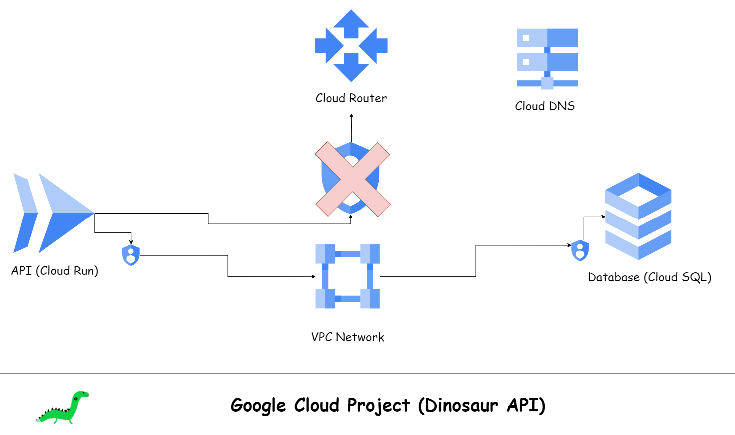
Dinosaur API – Infrastructur overview (2/3)
Notes:
Explain how the connections/infrastructur works. In this case, we don't use an IAM service to authenticate to the API, so any of you can use it.

Slide 14

Dinosaur API – Preview (1/3)
Simple web interface
Visit web interface: api.gehege.ch
Use API directly: api.gehege.ch/[api-parameters]
About
Notes:
To use the API I created a simple web interface.
If you go to the URL https://api.gehege.ch/ you will see a web interface for interacting with the API.
-> In case you are interested how I did the project exactly. In the presentation you will find a link to the source code on Github.
Github: https://github.com/Megakuul/api.gehege.ch

Slide 15
Conclusion

Slide 16
Conclusion (1/1)
Cloud Computing
Google Cloud
Microservices
Notes:
-> In my opinion, cloud computing is a very important topic for the future. I think in the future we will see more and more companies switching from on-premise to cloud solutions. You not only achieve more redundant but usually also cheaper solutions in the cloud.
-> Google Cloud is a very well-respected public cloud provider, so I think we will see Google Cloud among the best cloud providers in the near future. I really like working on Google Cloud because more and more is outsourced to microservices. Microservices are an enormously efficient way to run applications. Since the infrastructure under the microservices is managed by Google, it is always consistent. This is leading to a certain standard, which is a very positive development.

Slide 17
Thank you for your attention
Notes:
If you have any other questions, don't hesitate to ask me.

Slide 18
Sources
https://en.wikipedia.org/wiki/Cloud_computing/
https://www.esds.co.in/
https://cloud.google.com/
Dinosaur API Github: https://github.com/Megakuul/api.gehege.ch

