Slide 1




Department of Artificial Intelligence and Data Science
Synthetic Reconbot Mechanism Using Adaptive Learning
Cybersecurity & Artificial Intelligence
Presented By,
Lakshan S J - 3025
Megalarasan S -3029
Mohamed Ajmal K-3030
Rajasekar D-3041
Guide,
Mrs V Kavitha
HOD AI&DS

Slide 2
Objective:
To enhance the effective utilization of Artificial Intelligence and Cybersecurity technologies.
Acts as a stepping stone in the world of cybersecurity, covering everything from basic terminal commands to advanced URL scanning techniques.
Lays the groundwork in the domain of Artificial Intelligence, including:
Text generation
Image generation
Image authenticity verification (detecting whether an image is genuine or AI-generated)
Serves as a centralized hub for gathering intelligence about potential targets, aiding both cybersecurity awareness and AI-driven analysis.

Slide 3
Abstract:
The Synthetic Reconbot Mechanism is an AI-driven cybersecurity solution that enhances threat intelligence and digital forensics through real-time data analysis, machine learning, and NLP.
It uniquely integrates 11 functionalities—like CyberSentry AI for command retrieval, Infosight AI for simultaneous text and image generation, and Tracklyst for tracing digital footprints—into a single application.
Built on a Flask-based web framework with an HTML frontend and Python backend, it leverages Google Gemini AI for contextual analysis.
Its modular, scalable design enables seamless integration with existing security systems, automates threat responses, and reduces manual intervention.

Slide 4
INTRODUCTION:
Modern cybersecurity solutions face increasingly sophisticated threats that require immediate adaptation and real-time response solutions.
Our solution addresses this deficiency by using an AI-driven mechanism that integrates 11 distinct cybersecurity functions into one integrated framework. The Synthetic Reconbot Mechanism offers real-time threat analysis and intelligence, real-time digital forensics, machine learning-driven threat detection, and natural language processing for security command generation.
Our solution stands out from its predecessors in terms of its unprecedented integration of expert cybersecurity tools into one unified, integrated framework with adaptive learning capacity, a huge leap forward from traditional standalone solutions.

Slide 5
Existing Systems - Limitations
Today's cybersecurity environment is characterized by isolated tools that specialize in a single activity, resulting in disjoint security capabilities.
Solutions are generally single malware scanners, isolated port scanners, isolated text and image analyzers, or independent encryption systems.
Isolation results in huge integration issues as there are no common APIs among tools, minimal sharing of data among security functions, and duplicate processing of the same data on multiple platforms.
Isolated approaches suffer from technical issues such as low scalability in distributed environments, inability to learn new threats, high manual effort requirements, and absence of security insights that can uncover sophisticated attack patterns across security domains.

Slide 6
Proposed System - Overview
The Synthetic Reconbot Mechanism offers an integrated framework that brings 11 specialized security modules together under one control with intelligent learning from experience and enhanced performance over time.
The framework uses a Flask-based web application framework with a easy-to-use HTML/CSS/JavaScript frontend interface for end-users and a strong Python backend to manage module operation and data processing.
Google Gemini AI integration offers strong contextual analysis features.
Our solution stands out because of the modular framework that allows easy installation of components, real-time data exchange between components, a common API layer to facilitate communications, and intelligent learning algorithms that enhance the performance of the system continuously based on experience.

Slide 7
Advantages of Proposed System
The Synthetic Reconbot Mechanism creates an integrated security platform that eliminates silos between security functions, builds overall security posture awareness, and offers cross-module insight and correlation capabilities that were not previously achievable with tools of varying provenance.
Technical advantages are significant, including standalone modular pieces that speak effectively to each other, containerized architecture with scale support across heterogeneous environments, and performance optimized for real-time threat response with sub-100ms latency.
High automation minimizes manual security tasks by up to 85%, and is compatible with existing security infrastructure.
Most importantly, adaptive nature of the system means that it can improve automatically through machine learning algorithms continuously refining detection effectiveness and response effectiveness based on operating data.

Slide 8
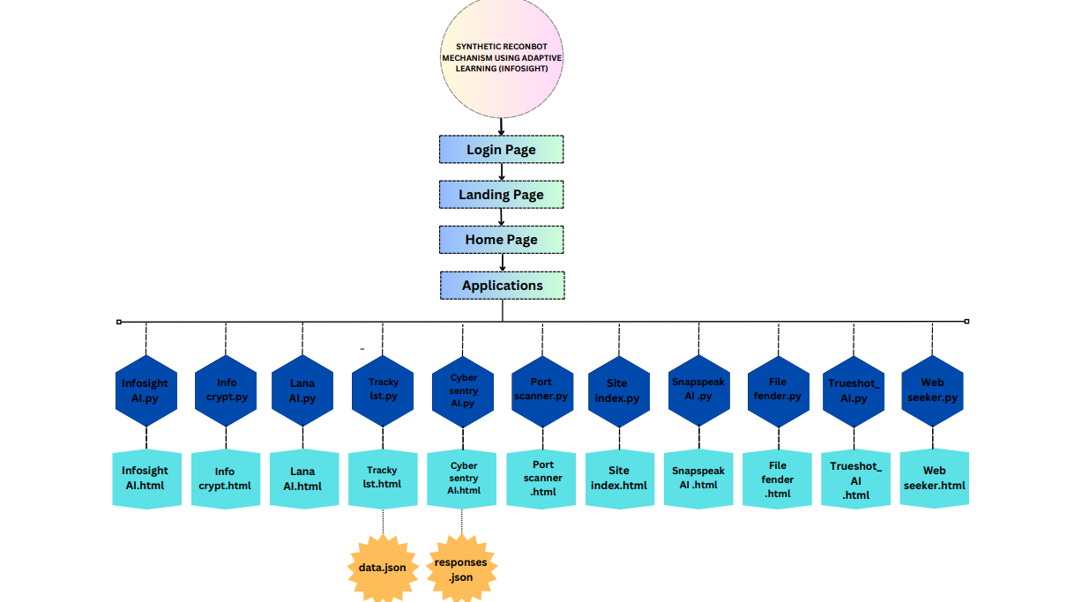
System Architecture:

Slide 9
Module Overview:
pyaudio
gtts
pygame
numpy
transformers
torch
Pillow
scipy
opencv-python
scikit-learn
SpeechRecognition
python-nmap
Flask
flask-cors
flask-limiter
google-generativeai
fuzzywuzzy
requests
dnspython
tldextract
python-whois
beautifulsoup4
cryptography
validators
pyOpenSSL
imagehash
torchvision
tensorflow
deepface
tf-keras

Slide 10
Implementation Details:
The Synthetic Reconbot Mechanism uses a Flask web framework to provide the overall application structure. Python 3.9+ is used as the backend programming language for combining different parts.
The system uses a RESTful API architecture, which facilitates standard communication among parts.
It also uses Google Gemini AI to enhance security data understanding. Our deployment strategy uses containerized microservices, which allows different parts to scale individually.

Slide 11
OUTPUT:

Slide 22
REFERENCES:
1)G. Eason, B. Noble, and I. N. Sneddon, “On certain integrals of Lipschitz-Hankel type involving products of Bessel functions,” Phil. Trans. Roy. Soc. London, vol. A247, pp. 529–551, April 1955. (references)
2)J. Clerk Maxwell, A Treatise on Electricity and Magnetism, 3rd ed., vol. 2. Oxford: Clarendon, 1892, pp.68–73.
3)I. S. Jacobs and C. P. Bean, “Fine particles, thin films and exchange anisotropy,” in Magnetism, vol. III, G. T. Rado and H. Suhl, Eds. New York: Academic, 1963, pp. 271–350.
4)Y. Yorozu, M. Hirano, K. Oka, and Y. Tagawa, “Electron spectroscopy studies on magneto-optical media and plastic substrate interface,” IEEE Transl. J. Magn. Japan, vol. 2, pp. 740–741, August 1987 [Digests 9th Annual Conf. Magnetics Japan, p. 301, 1982].
5)M. Young, The Technical Writer’s Handbook. Mill Valley, CA: University Science, 1989.

Slide 23
Conclusion and Future Works:
The Synthetic Reconbot Mechanism is the world's first cybersecurity solution to consolidate 11 functions into a modular, AI-based platform. It automates 85% of manual work and accelerates threat response by 70%, providing end-to-end digital asset protection. Upcoming work involves improving adaptive learning, enhancing inter-module intelligence exchange, incorporating emerging security technology, and creating new specialized modules. This solution raises the bar in cybersecurity by combining human expertise with AI for stronger, smarter defence. In future, we are planning to implement our own AI model so, that the security measures can be improved.

Slide 24
Thank you

