Slide 1
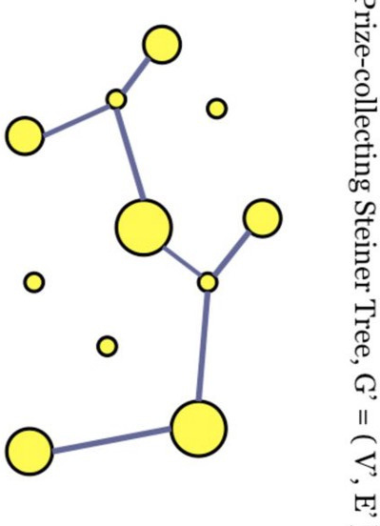
Steiner Tree:
A solution using a
genetic algorithm
Daniele Petrillo Maria Zampella

Slide 2

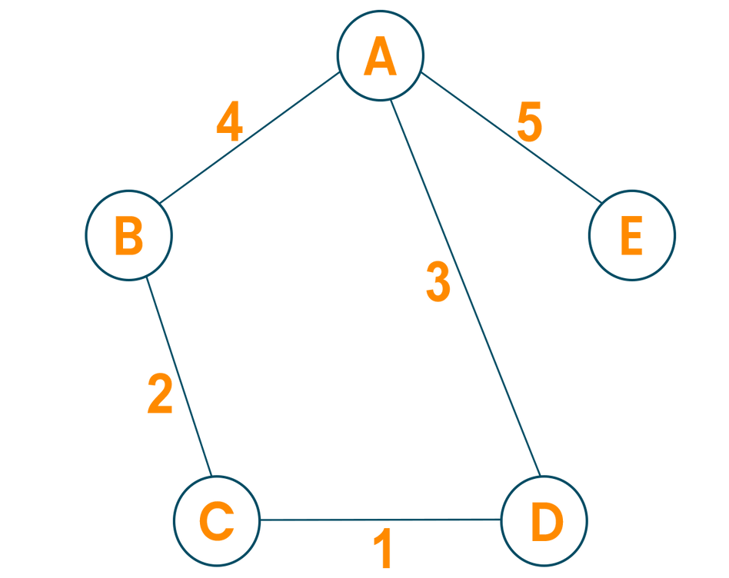
STEINER PROBLEM
What is a tree?
A tree is a non oriented graph, in which every couple of vertices are connected by one and only one path.

Slide 3
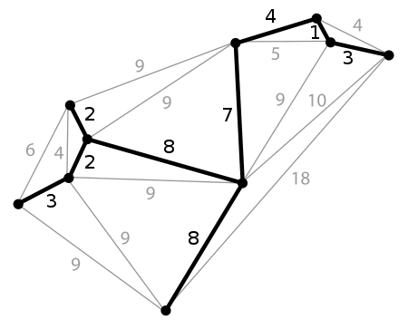

STEINER PROBLEM
Minimum Spanning Tree (MST)
It is the tree interconnecting N given points, such that it has the shortest length possible,
according to some distance metric.

Slide 4

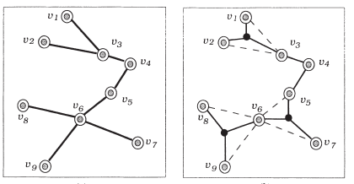
STEINER PROBLEM
Minimum euclidean Streiner tree (MEStT)
Given a set of N coplanar points, called site nodes, the Minimum Euclidean Steiner tree problem (MEStT) is to find the shortest tree connecting all N points, where the tree may contain nodes in the plane other than the site nodes. These extra vertices are called the Steiner Points.

Slide 5

MAIN APPLICATIONS
Networking
Design of Integrated Circuit
STEINER TREES
Cloud computing
Telecommunications
Computational biology
Machine Learning

Slide 6



GENETIC ALGORITHM
X
STEINER PROBLEM

Slide 7


GENETIC ALGORITHM
Why using a genetic algorithm?
MEStT problem is NP-complete;
The problem grows exponentially with increase in N (number of fixed points);
Even the best traditional algorithms need heavy optimizations and a lot of heuristic knowledge.

Slide 8
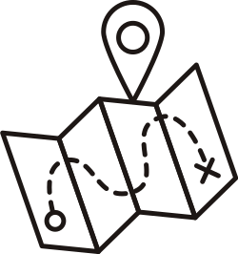







COMPLETE ALGORITHM
Workflow
Genetic Algorithm
Initialization
Optimization
Visualization
The fixed points are given as input and their MST is calculates.
The genetic algorithm is executed and it returns as output the best configuration of the Steiner points.
Delete all the useless Steiner point according to some criteria such as the number of connections with the fixed vertices.
Finally, the optimal steiner tree is plotted and compared with the starting MST.

Slide 9
GENETIC ALGORITHM
Genetic encoding: Individual
The genetic algorithm only works on the points that must be added (Steiner points) in order to obtain the shortest path which links all the fixed vertices.
Coordinate of
Steiner Point:
[Xo,Yo], ... , [Xn,Yn]
List of real numbers:
[Xo,Yo, ... , Xn,Yn]
Phenotype
Genotype

Slide 10


GENETIC ALGORTIHM
Genetic encoding: Fitness
What is it?
How to find it?
Prim's Algorithm
It is the total length of the minimum spanning tree (containing both fixed and steiner vertices).
By analizing the possible paths which link all the points.
Starting from a set with only one point, it iteratively includes the closest point not yet in the set, saving its connection.

Slide 11
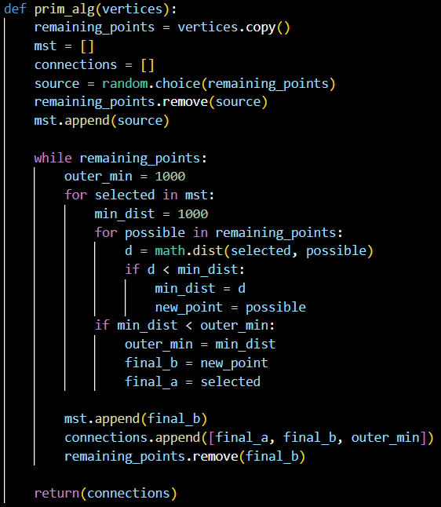

Slide 12

GENETIC ALGORITHM
Algortihm instance
Parent selection
Survival Selection
Recombination
Mutation
Tournament Slection
Generational
with Elitism
Blend Crossover
Gaussian Mutation
N inidividuals are randomly chosen from the population
and the best one is selected. This process is repeted population size time.
Selected two parentes x and y, a new individual is randomly selected in
[x-a(y-x), y+a(y-x)] .
It adds a random value from a Gaussian distribution to each element of an individual’s vector to create a new offspring.
At each generation, all parents are replaced by the offsprings; the worst offspring is replaced by the best individual yet.
Parameters
Parameters
Parameters
N = 10
a = 0.5
CXPB = 0.9
MUTPB = 0.1
INDPB = 0.5
mu = 0; sigma = 0.3

Slide 13
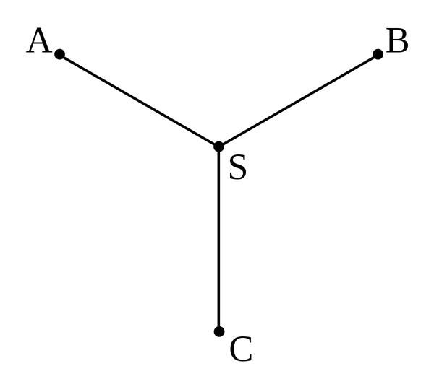
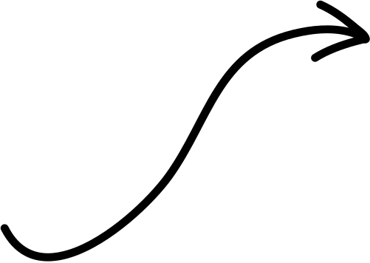
OPTIMIZATION
Heuristics
120°
120°
120°
Number of Steiner points
1
The maximum possible number of Steiner Point for N fixed point is N-2,
so this number was selected.
2
Number of links of Steiner points
Each optimal Steiner point always has 3 connections with the other points.
3
Degree of links of Steiner points
Each optimal Steiner point's connections form angles of 120° degrees.

Slide 14

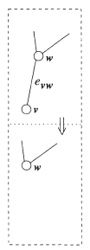
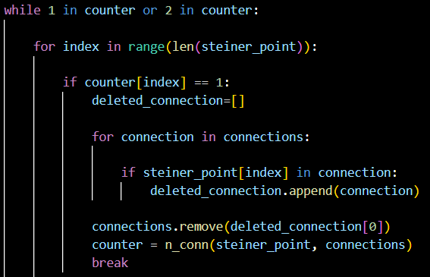
OPTIMIZATION
Algorithm

Slide 15
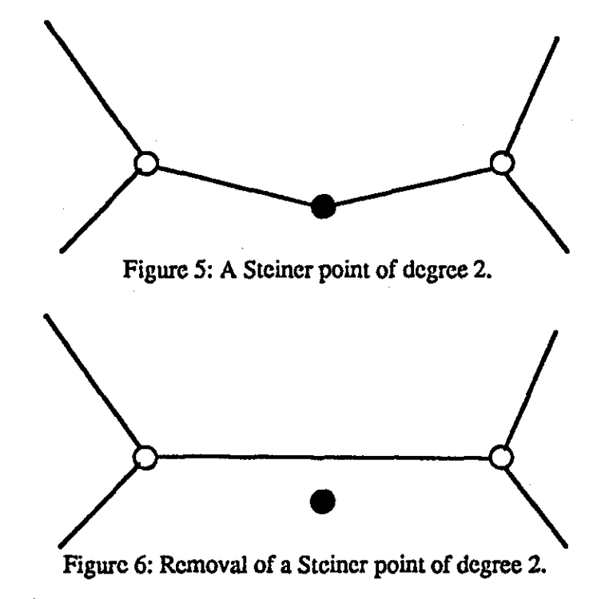
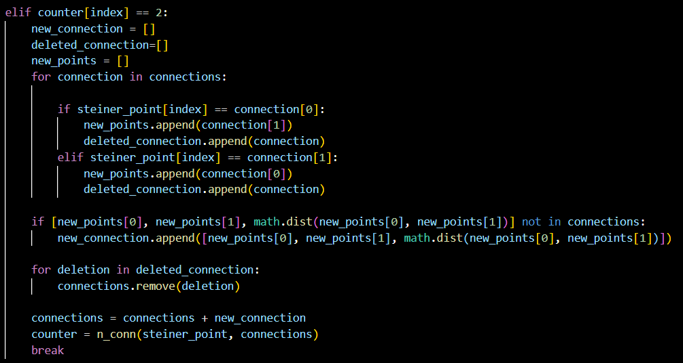

OPTIMIZATION
Algorithm

Slide 16
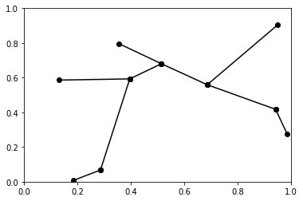
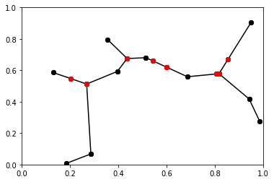
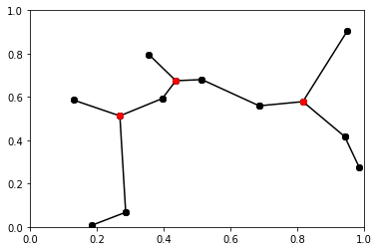
1
OPTIMIZATION
Example
2
3

Slide 17
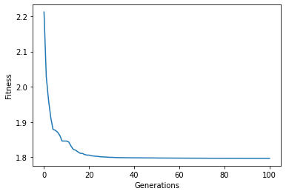
PERFORMANCES
Fitness VS Generations
Population size = 400
Number of Generation = 100
After several run we noticed that the curve was reaching a plateau after around (at maximum) 50 generations.
For this reason, we set the number of generations of all following runs to 50.

Slide 18

PERFORMANCES
Metrics
MST = length of minimum spanning tree (only including the fixed points).
MEStT = length of optimized minimum spanning tree (including both fixed and Steiner points).
The metrics used for the evaluation of performances are:
Difference = MST - MEStT
Ratio = MEStT / MST (a lower ratio represents a better approximization)

Slide 19

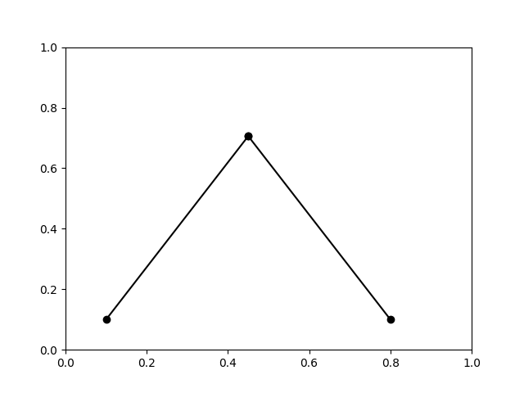
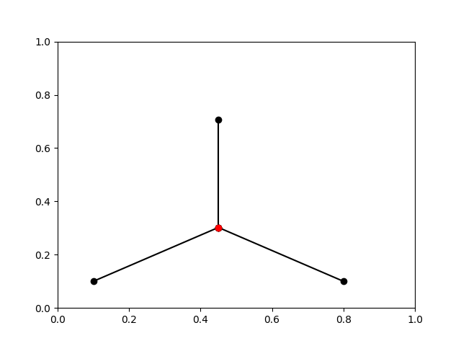


PERFORMANCES
Example (n = 3)
MST
MEStT

Slide 20

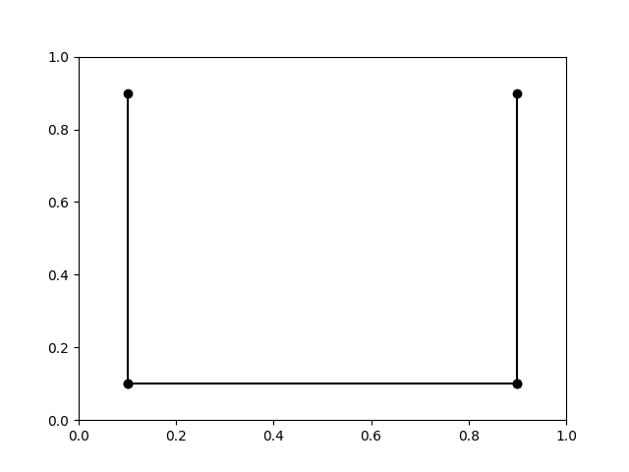
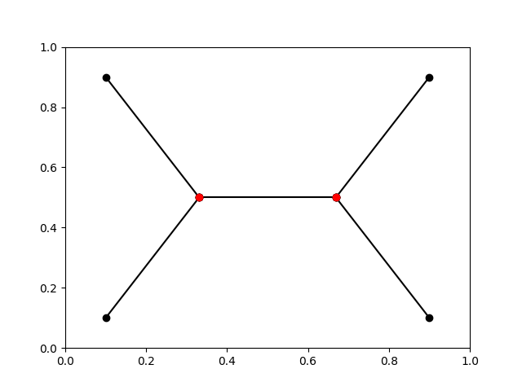

PERFORMANCES
Example (n = 4)
MST
MEStT

Slide 21
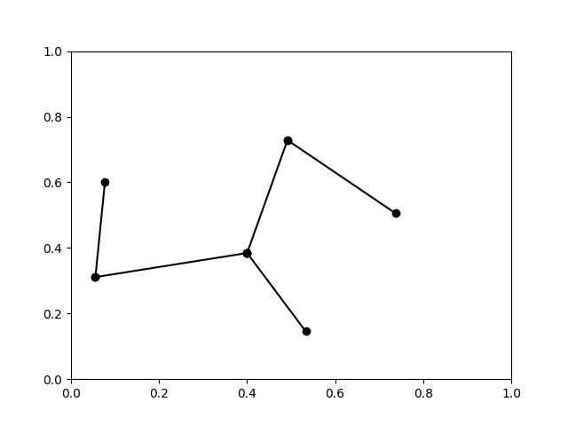
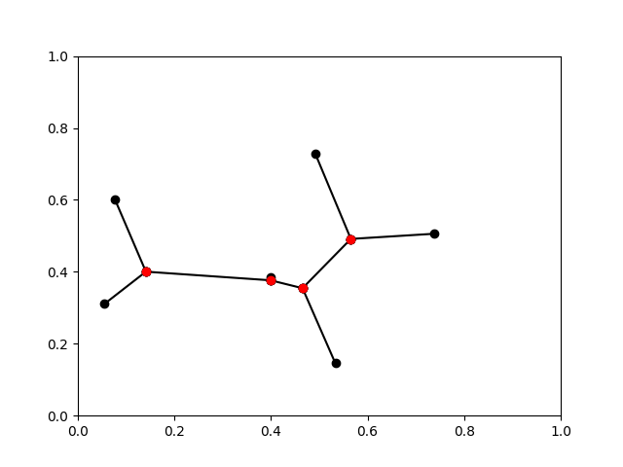

PERFORMANCES
Example (n = 6)
MST
MEStT

Slide 22
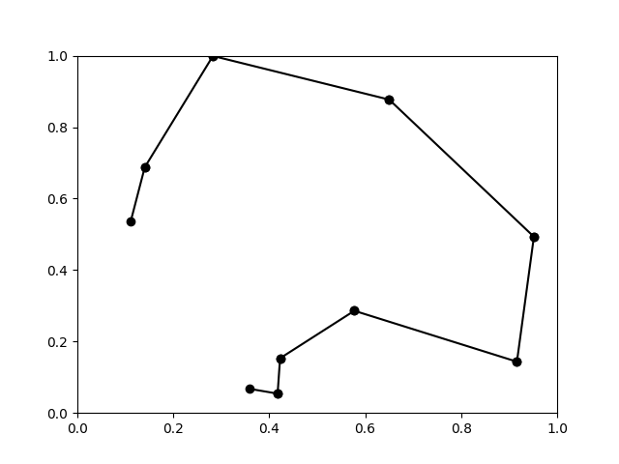
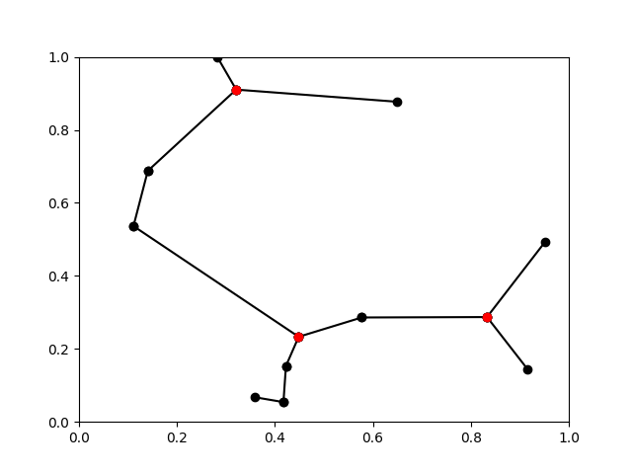

PERFORMANCES
Example (n = 10)
MST
MEStT

Slide 23
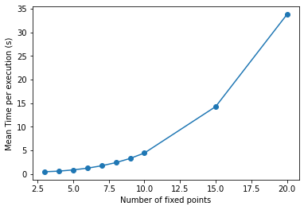
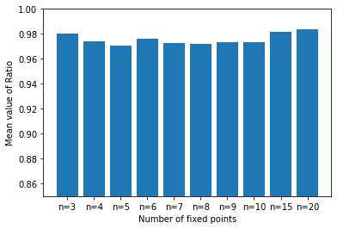
PERFORMANCES
Statistics
 | n = 3 | n = 4 | n = 5 | n = 6 | n = 7 | n = 8 | n = 9 | n = 10 | n = 15 | n = 20
Ratio | 0.9799 | 0.9739 | 0.9706 | 0.9758 | 0.9724 | 0.9716 | 0.9734 | 0.9734 | 0.9816 | 0.9838
Time (s) | 0.46 | 0.59 | 0.85 | 1.21 | 1.73 | 2.40 | 3.28 | 4.43 | 14.26 | 33.77

Slide 24




The problem can be trasformed in a maximization one, consequently, it is possible to use different types of crossover operators.
the number of Steiner points may be occasionally set to less than: (fixed points - 2).
It is possible to use the 3rd heuristic about the angle of the links.
OBSERVATIONS
Increasing the number of fixed point still considerably increase the computational time.

Slide 25
GENETIC ALGORITHM
References
[1] = "Combinatorial Optimizatioin, Steiner Trees in industry", Xiuzhen Cheng and Ding - Zhu Du
DOI : 10.1007/978-1-4613-0255-1
[2] = "On steiner trees and genetic algorithms", J. Hesser, R. Männer and O. Stucky
DOI: 10.1007/3-540-55027-5_30

Slide 26
Thank
you!

