Slide 1
Community Detection of S&P500 stocks
Hardware & Software for Big Data project
Daniele Petrillo P37000102

Slide 2
Aim of the project
The objective of the project is to demonstrate the utilization of PySpark and Kafka environments, as a preparation phase for a community detection analysis of financial stocks.
The work is divided into four parts:
Preparation of the dataset using PySpark
Simulation of the streaming of the dataset through Kafka
Exploratory Data Analysis
Community Detection

Slide 3
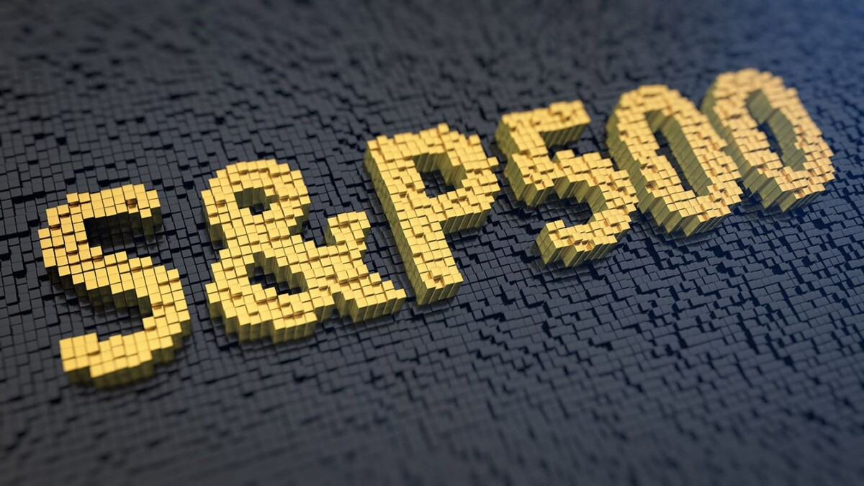
Dataset description
It consists in a time series of general information about each stock contained in the S&P500 index.
The Standard and Poor 500 tracks the performance of 500 large companies listed on stock exchanges in the United States.
It is considered the most famous financial benchmark in the world.
The dataset is extracted from Kaggle
(https://www.kaggle.com/datasets/andrewmvd/sp-500-stocks?select=sp500_stocks.csv)

Slide 4

1. Preparation of the dataset
Apache Spark:
Fast and general engine for large scale data processing
MapReduce-like
40x faster than Hadoop
Fast iterative queries through in-memory data storage
Spark’s fundamental data structures are Resilient Distributed Datasets (RDDs):
Distributed collection of objects
Automatically rebuilt upon failure
Immutable, partitioned, logical tables
Not materialized, keep track of changes on original data
Only materialized once an action is executed on them

Slide 5
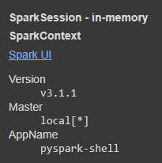
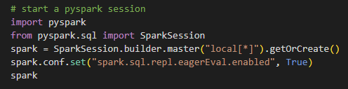
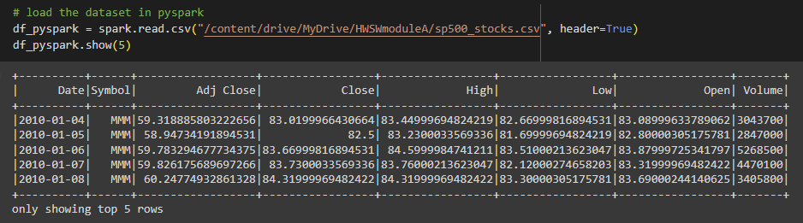
1. Preparation of the dataset
PySpark: Python API for Apache Spark
The dataset looks like this:

Slide 6
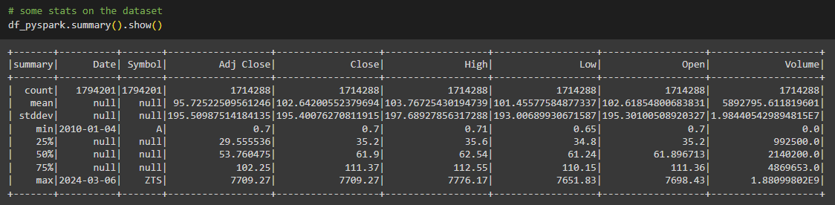
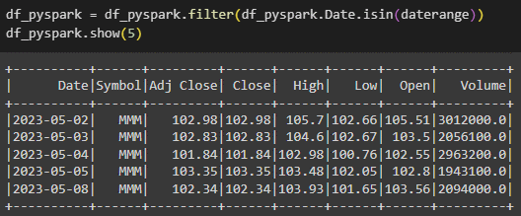
1. Preparation of the dataset
We focus on a small window of time for our analysis, from 2023-05-02 to 2023-07-31.
This corresponds to 62 effective days of stock exchange.

Slide 7
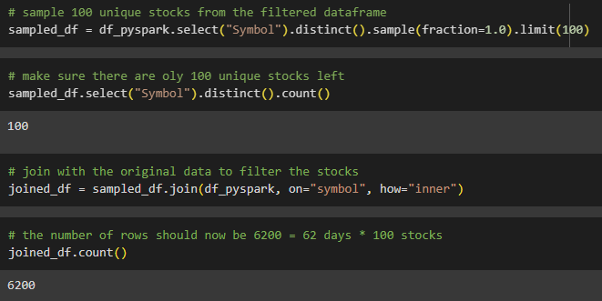
1. Preparation of the dataset
To stream the dataset into a Kafka process, we limit the number of stocks to 100, this also helps us showcase basic operations in PySpark:
The dataset is saved in csv format in order to stream it:

Slide 8
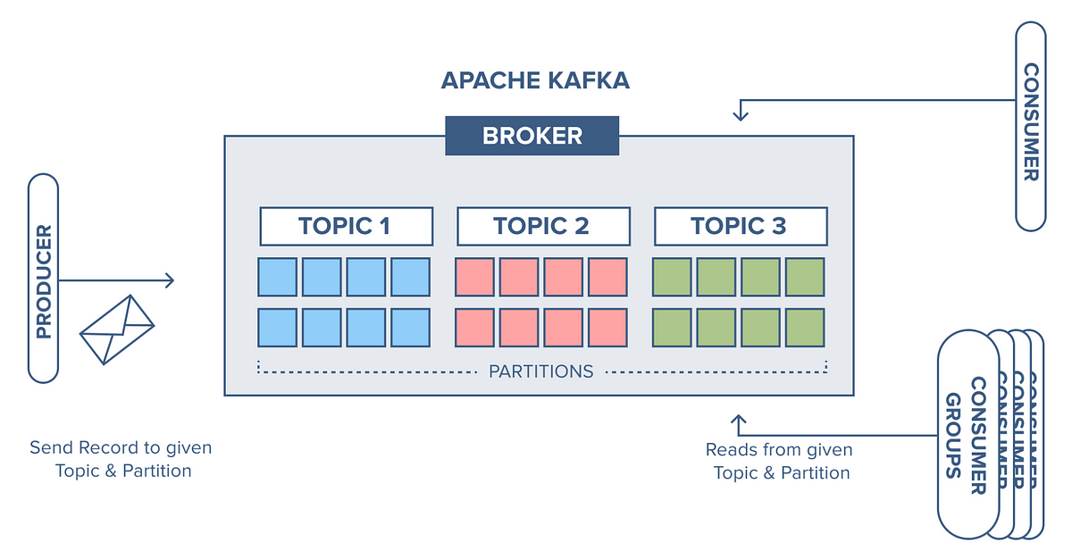
2. Streaming through Kafka
Apache Kafka:
Open Source distributed event streaming platform
Publish/Subscribe model
Events are posted on and read from structures called Topics
Enables partitioning of topics for memory and speed optimization
Replication of topics grants high consistency and availability
Kafka’s three main entities are:
Producer: posts the events in the topic
Consumer: reads the events from the topic
Broker: a server that hosts a topic or part of it

Slide 9
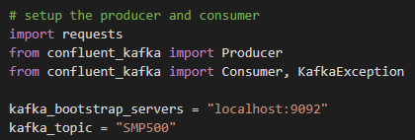

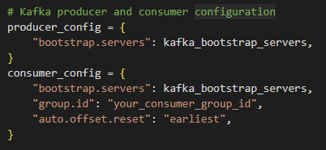
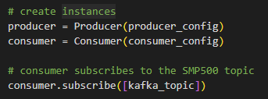
2. Streaming through Kafka
Setup Kafka in Python:
Configure Producer and Consumer:
Create instances and subscribe to the topic:

Slide 10

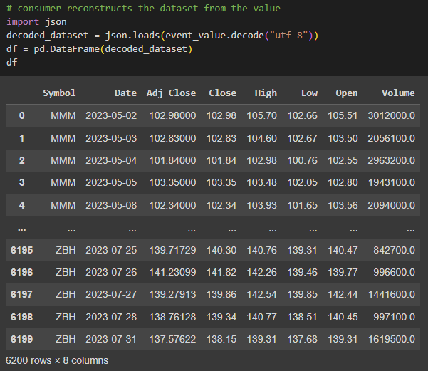

2. Streaming through Kafka
Post the event into the topic:
Finally, the event gets succesfully decoded and is ready for use:
Read the event:

Slide 11
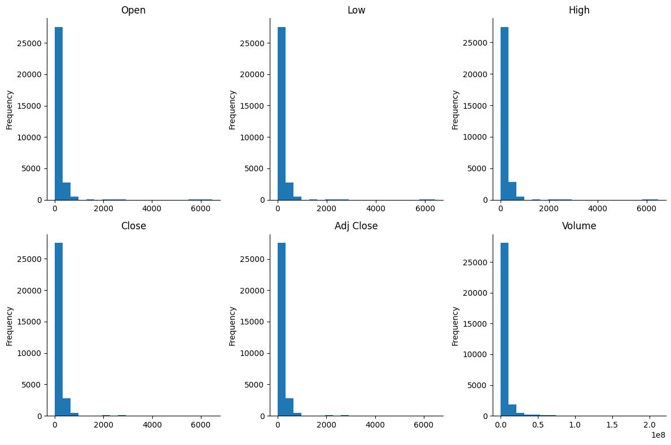
3. Exploratory Data Analysis
Distribution of variables value across the dataset:
The distributions are quite similar, this is because the variables have high dependancy from each other.

Slide 12
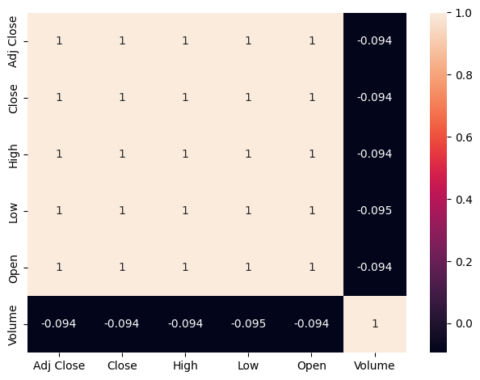
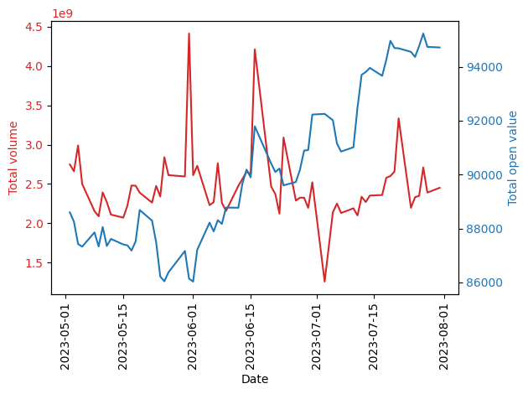
3. Exploratory Data Analysis
As expected, all variables except Volume are highly correlated:
Total volume of the index vs total open value:

Slide 13
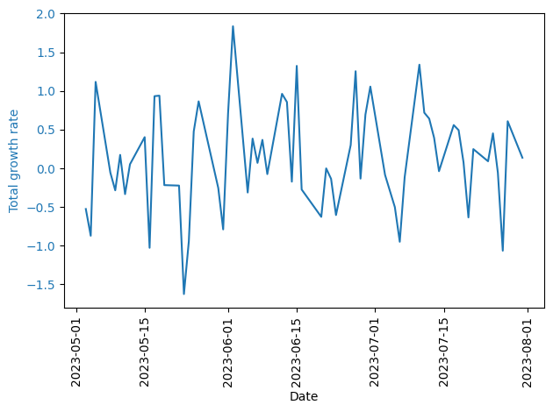
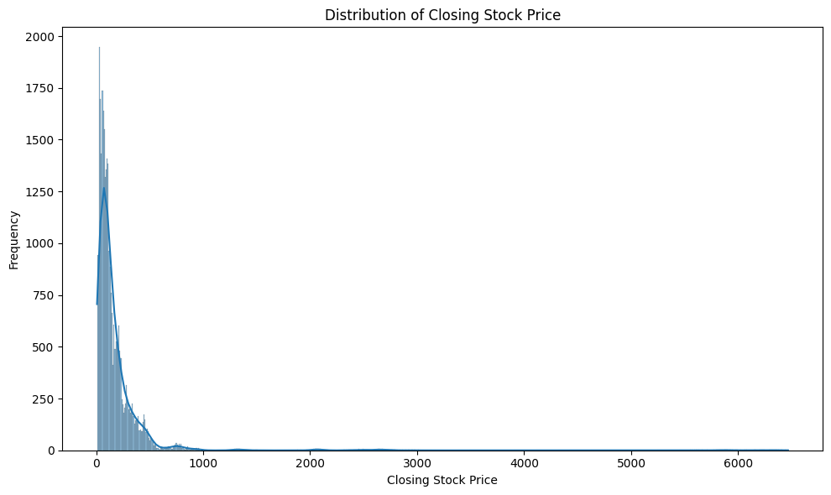
3. Exploratory Data Analysis
Evolution of the grow rate of the index:
Closer look at the distribution of closing price:

Slide 14
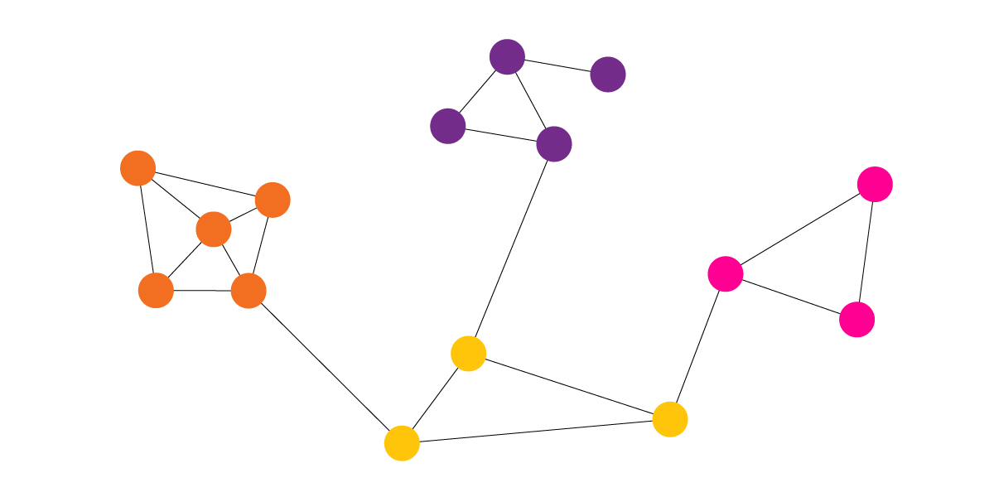
4. Community Detection
Subfield of Graph Theory that focuses in finding communities in a network graph.
Communities in a network are the dense groups of the vertices, which are tightly coupled to each other inside the group and loosely coupled to the rest of the vertices in the network.
Many algorithms have been proposed in the literature to this day, each one differing in structure, complexity and suitable use cases.

Slide 15
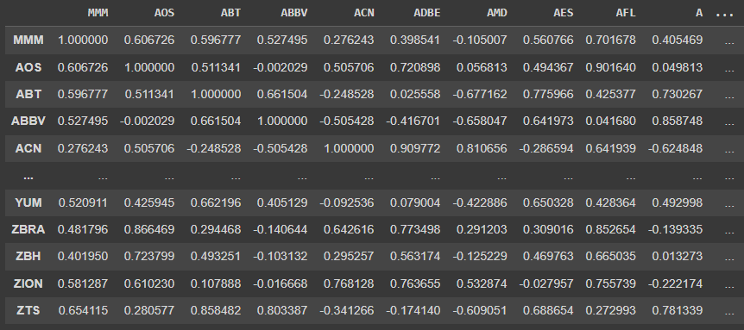

4. Community Detection
To make use of community detection algorithms to find families of similar stocks in the S&P500 index, we need to transform the dataset into a graph.
We construct a Cross Correlation Matrix between all the stocks.
Each entry contains the correlation of two corresponding stocks given by the formula:
$$ρ_{mn}=\frac{\sum_{t}{[\left(p_{m}\left(t\right)−\overline{p_{m}}\right)\left(p_{n}\left(t\right)−\overline{p_{n}}\right)]}}{\sqrt{\sum_{t}{{\left(p_{m}\left(t\right)−\overline{p_{m}}\right)}^{2}}}\sqrt{\sum_{t}{{\left(p_{n}\left(t\right)−\overline{p_{n}}\right)}^{2}}}}$$

Slide 16
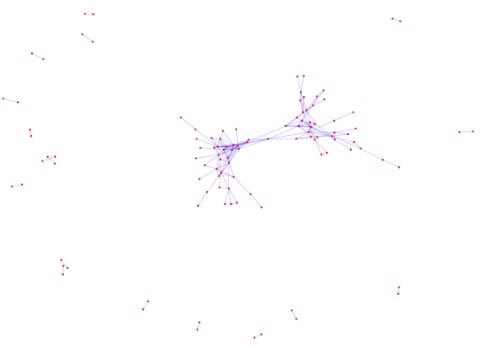
4. Community Detection
Each node in the graph represents a stock, while each edge the correlation between stocks.
An edge between two stocks is created only if the correlation is greater (in absolute value) than a given threshold (typically 0.97), in order to link together only highly connected stocks.
The graph can be either weighted (edge weight = cross correlation) or unweighted (1/0 connection).

Slide 17
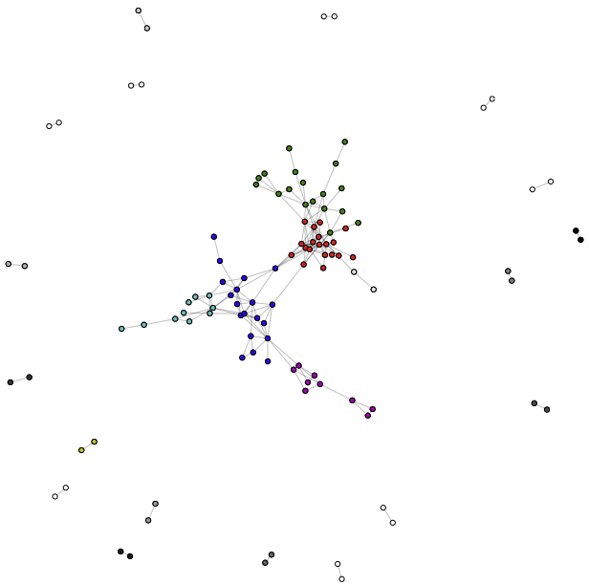
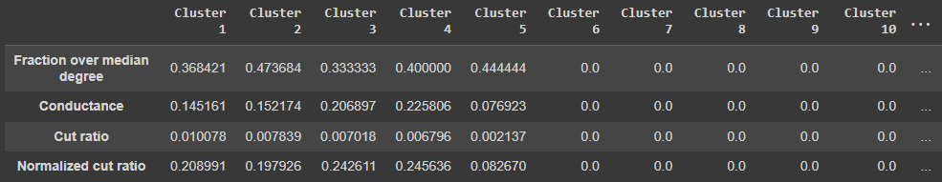
4. Community Detection
Once created the graph, we can run different algorithms to find some clusters.
Lovuain (unweighted)
Note: a lot of the small clusters usually consist in pairs of correlated and isolated stocks, so their benchmark doesn’t have significance

Slide 18
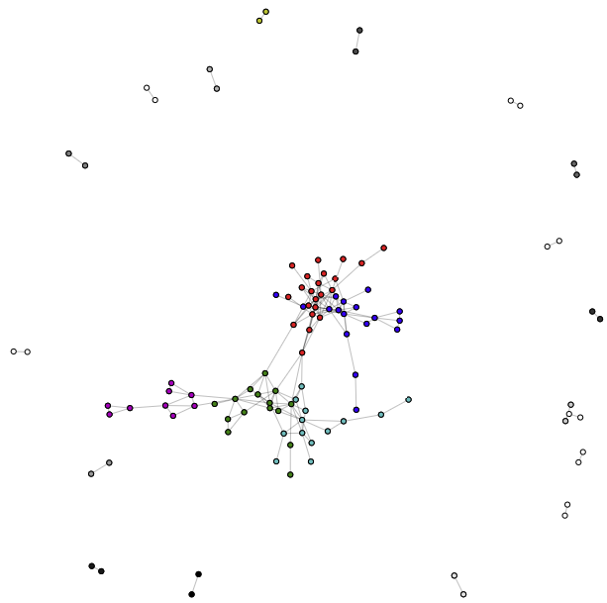
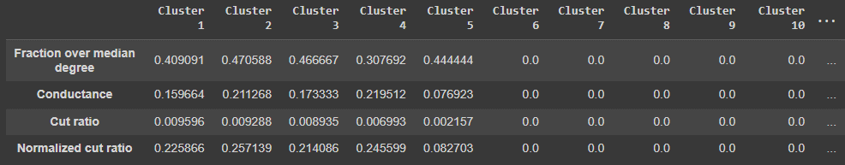
4. Community Detection
Results of the algorithms
Lovuain (weighted)

Slide 19
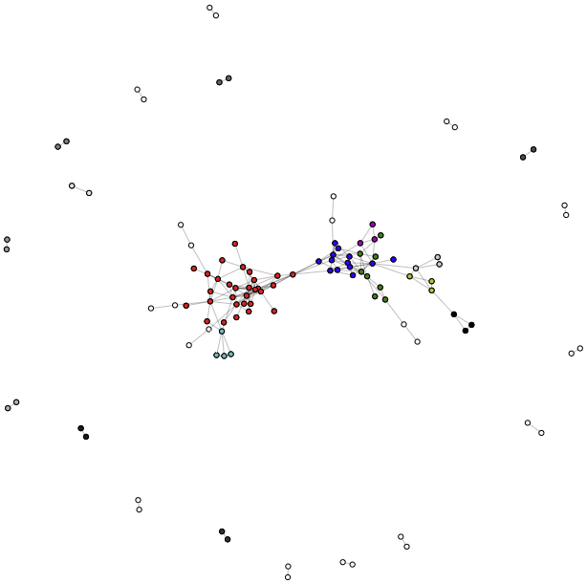
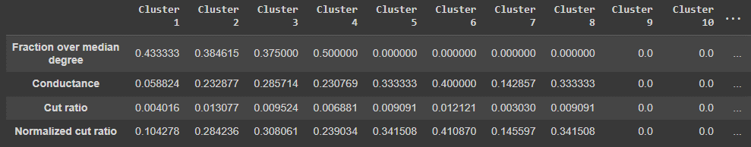
4. Community Detection
Results of the algorithms
Label Propagation (unweighted)

Slide 20
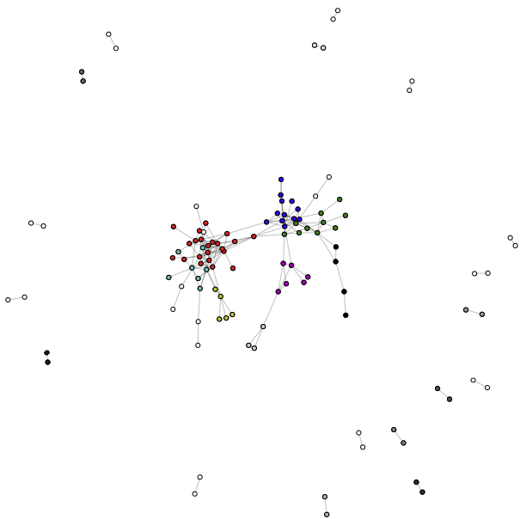
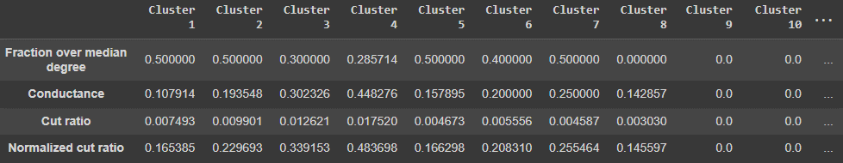
4. Community Detection
Results of the algorithms
Infomap (unweighted)

Slide 21
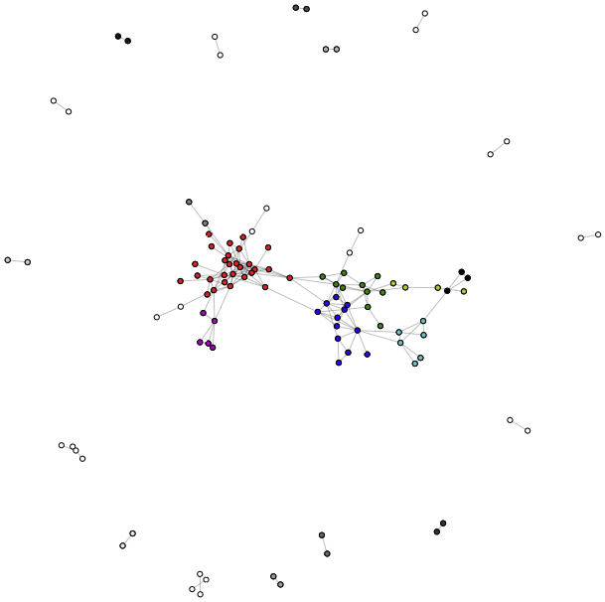
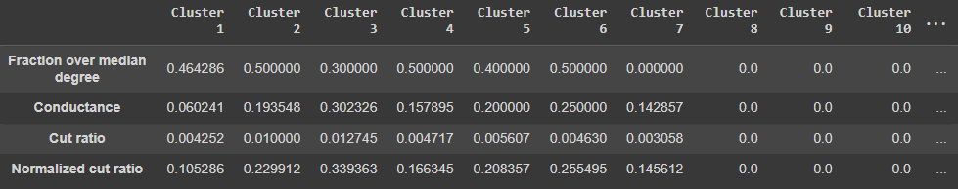
4. Community Detection
Results of the algorithms
Infomap (weighted)

Slide 22
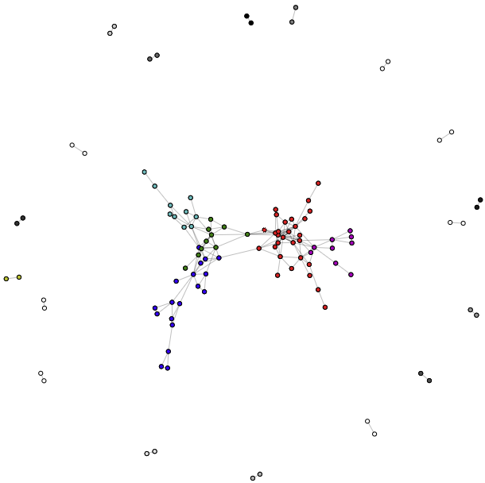
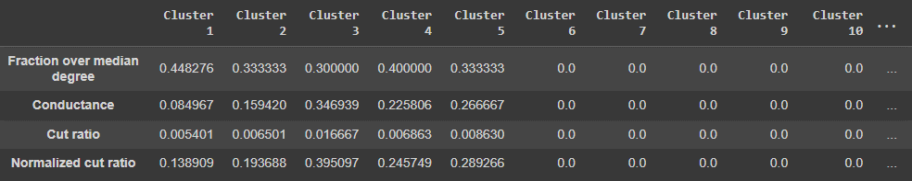
4. Community Detection
Results of the algorithms
AGDL (weighted)

Slide 23
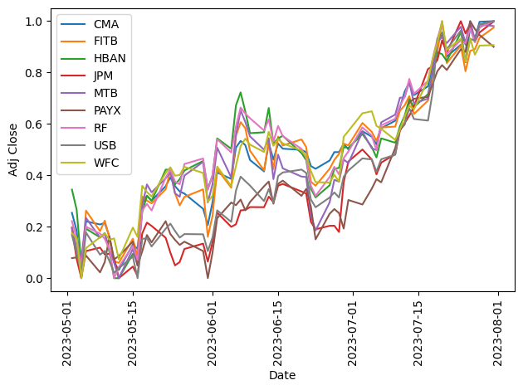
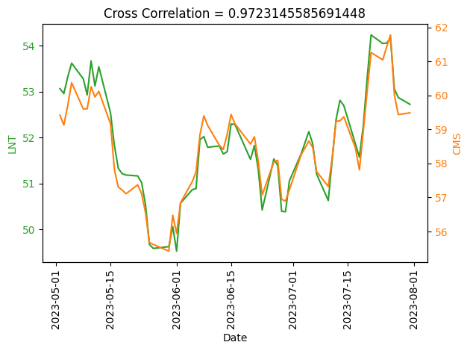
4. Community Detection
As an example, let’s visualize some of the families generated by the Louvain algorithm:

Slide 24
Conclusions
The algorithms seem to output valuable stock families
The benchmarks may be better but are justified by the dimension of the dataset
Cross correlation looks reasonably effective as indicator of relations between stocks
Future improvements:
A bigger dataset and/or extended period of time shall be exploited
Further tuning of hyperparameters could give better algorithm performance
A natural evolution of the work would be to correlate stocks at given lagged periods, in order to predict the rise or fall of a stock price in the immediate future

