Slide 1



YOLO in
Vongani Maluleke
Consultant (Deloitte)
Msc (University of Cape Town)
malulekevon@gmail.com
SATRDAY ‘19

Slide 2
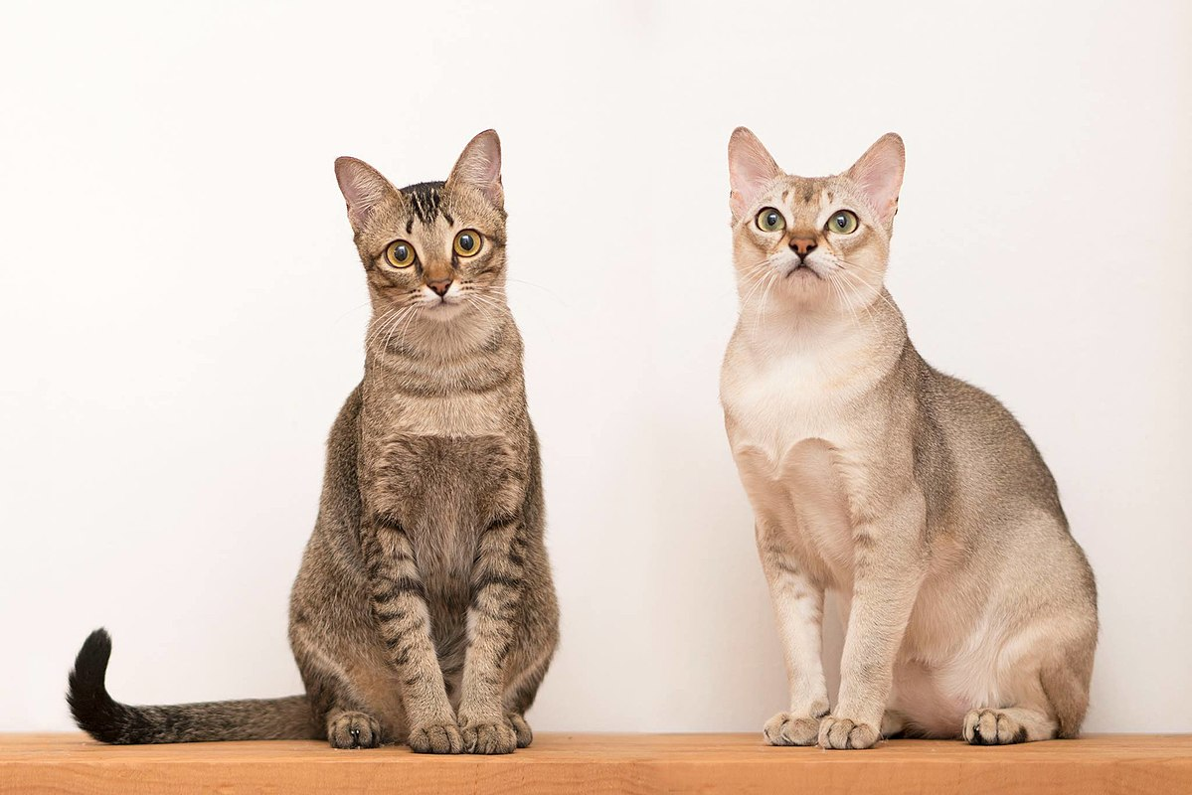
YOU ONLY LOOK ONCE (YOLO)
YOLO is a state-of-the-art object detection algorithm that was first introduced by Redmon et al in 2015.
It involves the combination of classification (class labels) and localisation (bounding box coordinates) of objects found in an image.
It is popularly known for it’s speed because the algorithm requires only one forward pass to make detections.
cat
cat

Slide 3
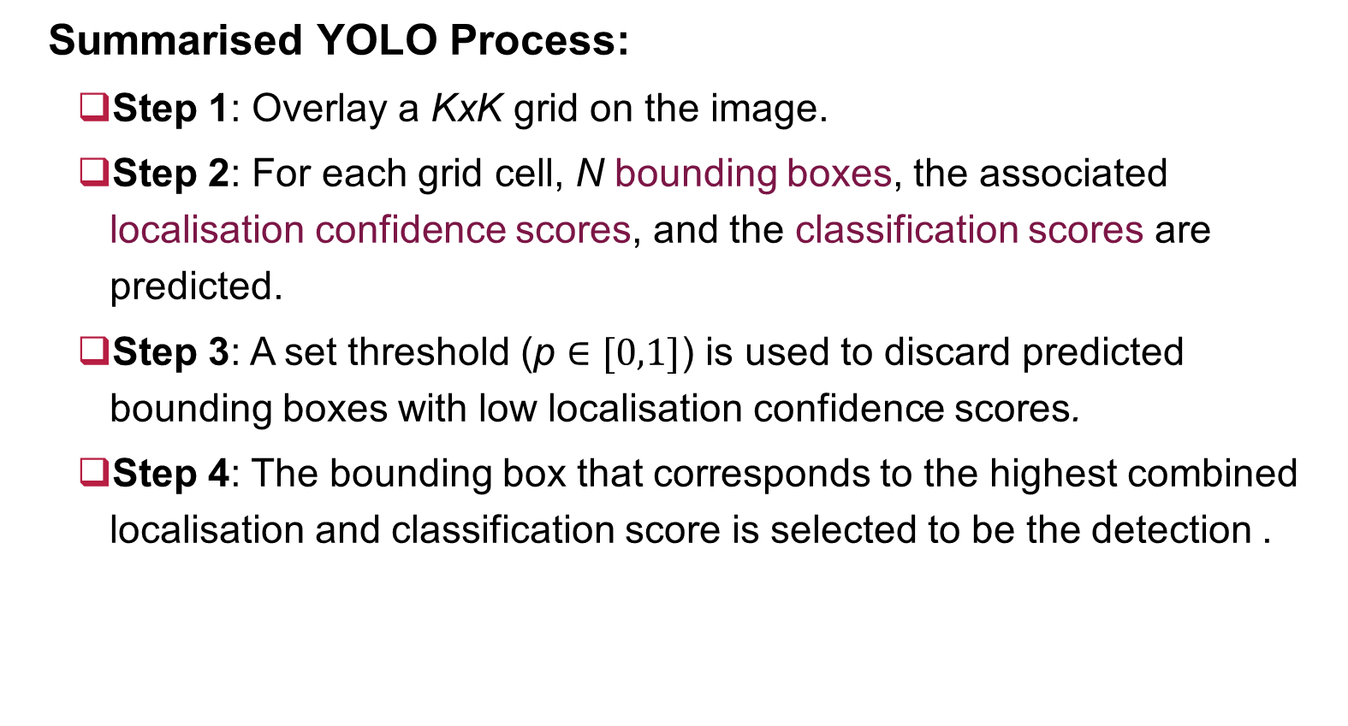
YOU ONLY LOOK ONCE (YOLO)
Summarised YOLO Process:
Step 1: Overlay a KxK grid on the image.
Step 2: For each grid cell, N bounding boxes, the associated localisation confidence scores, and the classification scores are predicted.
Step 3: A set threshold (p $∈[0,1]$) is used to discard predicted bounding boxes with low localisation confidence scores.
Step 4: The bounding box that corresponds to the highest combined localisation and classification score is selected to be the detection .

Slide 4
Let’s YOLO in R

Slide 5

Setup
Install image.darknet Package via github :
Required Libraries:
devtools::install_github("bnosac/image", subdir = "image.darknet", build_vignettes = TRUE)
library(image.darknet)

Slide 6
1. Instantiate Detection Model
Function : image_darknet_model(…)
Arguments:
type = type of computer vision task (“detect” for object detection)
model = file path to the model configuration
weights= file path to the trained model weights
labels = vector of labels

Slide 7
2. Detect objects
Function : image_darknet_detect(…)
Arguments:
file = image file path
object = instantiated model object
threshold = detection threshold

Slide 8

Demo: Car Detection

Slide 9
1. Instantiate YOLO Model
yolo_model = image_darknet_model(type = "detect",
model = "tiny-yolo-voc.cfg",
weights = system.file(package="image.darknet",
"models", "tiny-yolo-voc.weights"),
labels = c(“car"))

Slide 10
2. Detect Cars
x = image_darknet_detect(file =“example.png” ,
object = yolo_model ,
threshold = 0.65)

Slide 11
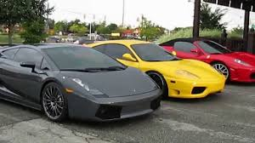
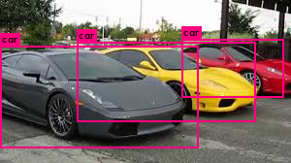
Car Detection Output
Input
Output
image_darknet_detect

Slide 12
References
Redmon. J and Farhadi, A. 2016. YOLO9000: Better, Faster, Stronger. CoRR abs/1612.08242
Redmon. J, et al. 2015. You Only Look Once: Unified, Real-Time Object Detection. CoRR abs/1506.02640
https://github.com/bnosac/image
Wijffels, J. 2017. Computer vision algorithms for R users. https://github.com/bnosac/image/blob/master/presentation-user2017.pdf

Slide 13
Thank you

