Slide 1
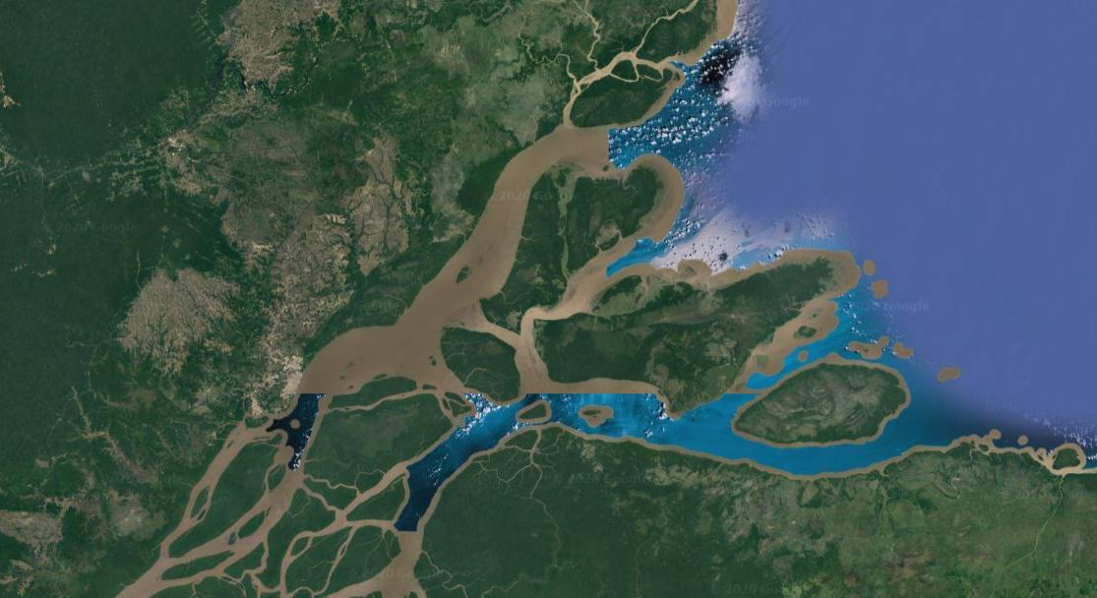
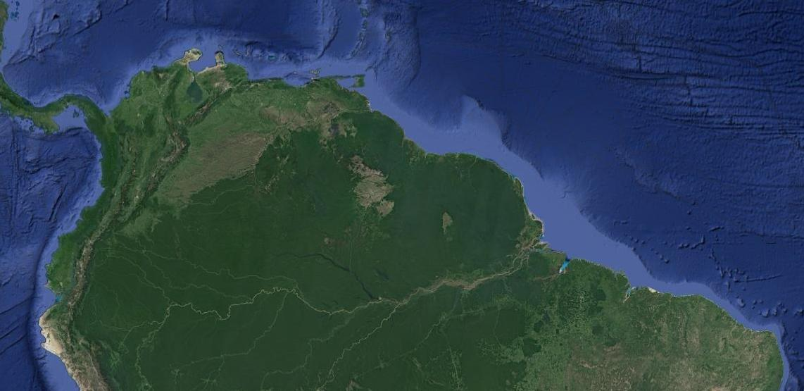
Baylique (BAY)
Macapá North (MACN)
Chaves (CHV)
Macapá South (MACS)

Slide 2
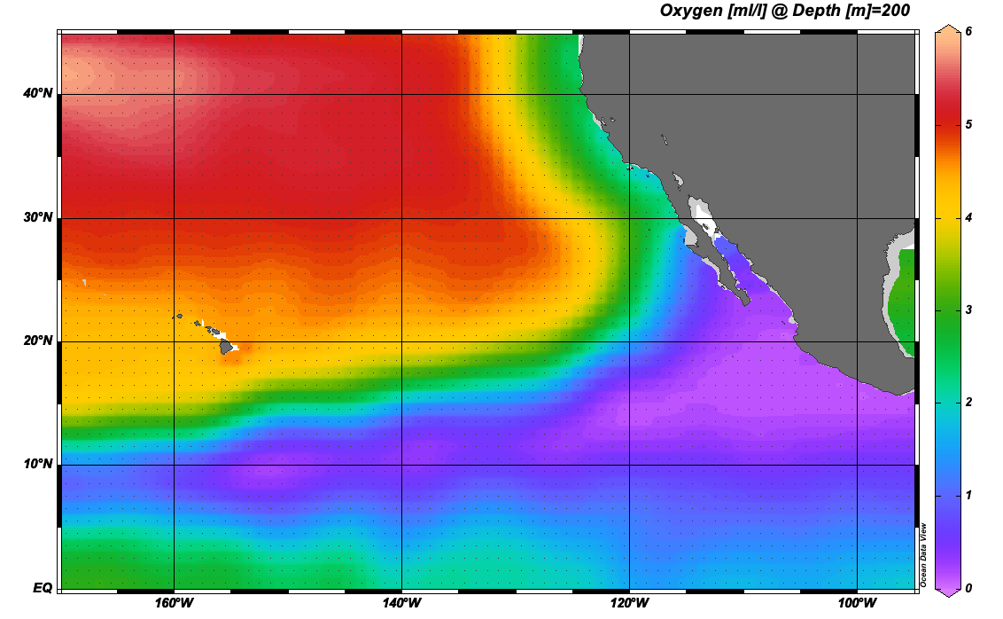
POMZ sediment trapping
P1 onshore
Jan 2 – Jan 6 2017
P2 offshore
Jan 8 – Jan 11 2017
R/V Sikuliaq
P1 onshore
Apr 21 – Apr 27 2018
P2 offshore
Apr 15 – Apr 20 2018
P3
P1
R/V Revelle
P2
P3 peripheral ODZ
Oct 15 – Oct 18 2019
P2 offshore
Oct 3 – Oct 13 2019
R/V Kilo Moana

