Slide 1
The Best Dc Neighborhoods
According to Airbnb

Slide 2
Sub-prompt 4
Which neighborhoods receive the most positive reviews?

Slide 3
Step 1: What is a positive review?

Slide 4
AirBnB neighborhoods had an average location rating of 9.4
Any location rating below 9.4 was considered medium, while a score below 6.7 was considered low
The average rating for all categories was 9.5
Any average rating below 9.5 was considered medium, while a score below 6.2 was considered low

Slide 5
Step 2: Deciding where to focus

Slide 6
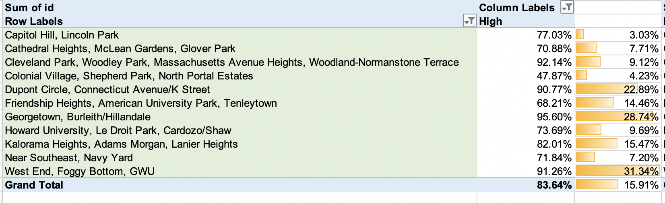
Neighborhood groups that had higher location ratings than the overall average rating

Slide 7
Step 3: Getting More details

Slide 8
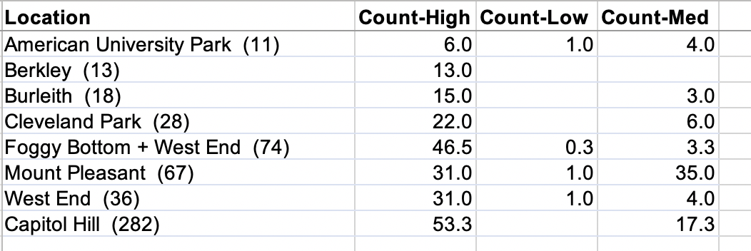
Criteria for Neighborhood selection
Neighborhood needed to have more than two listings
The average Location Rating needed to be higher than the average overall rating by 0.5 or above
The 9 winners

Slide 10
Confirming The Findings…

Slide 15
CONCLUSION
The Capitol Hill or Foggy Bottom neighborhoods get the best location ratings

