Slide 1

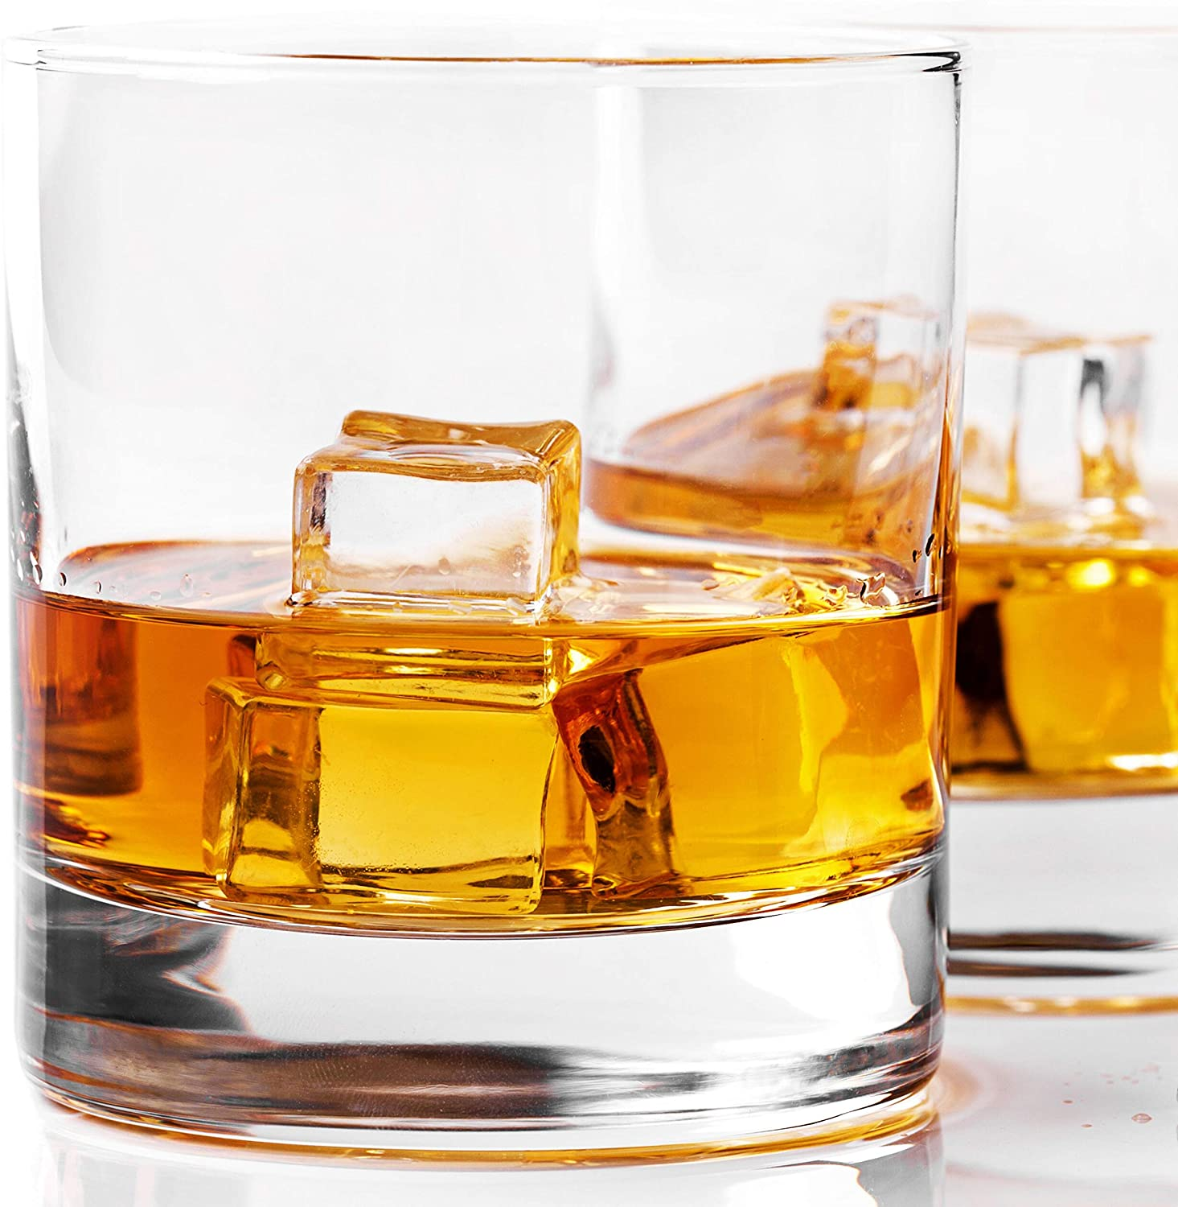
Whiskey sales in iowa

Slide 2
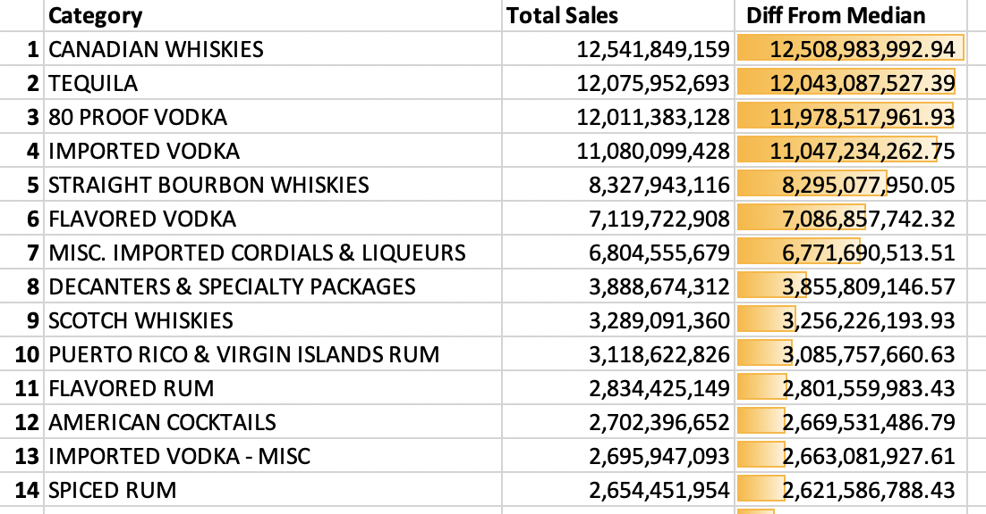
What Are Iowans drinking?
The Top Categories in total sales
Categories with total sales 2.5 billion greater than the median total sales

Slide 4
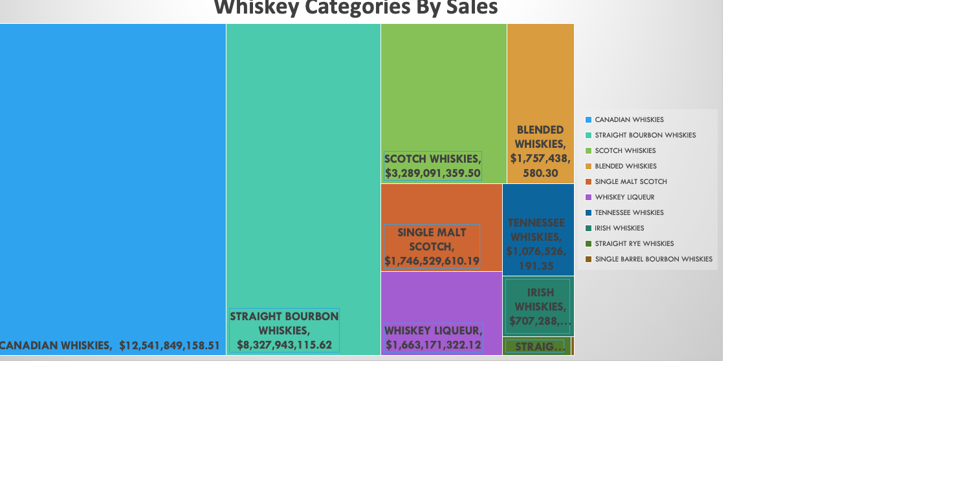

Slide 5
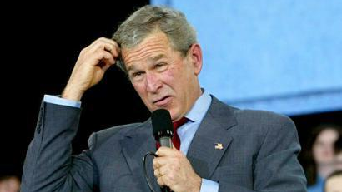

CANADIAN WHISKEY?!?

Slide 6
Top Canadian Exports
Mineral Products
Transportation
Machines
Metals
Chemical Products
Vegetable Products
Plastics and Rubbers
Paper Goods
Food stuffs
Precious metals
https://oec.world/en/visualize/tree_map/hs92/export/can/all/show/2017/

Slide 7
Canadian whiskey?
hard liquor is only .12% (or $454 Million) of Canadian exports*
In iowa, Canadian Whiskey Makes up 15% of all Whiskey products but IS 40% of all Whiskey sales
* https://oec.world/en/visualize/tree_map/hs92/export/can/all/show/2017/

Slide 8
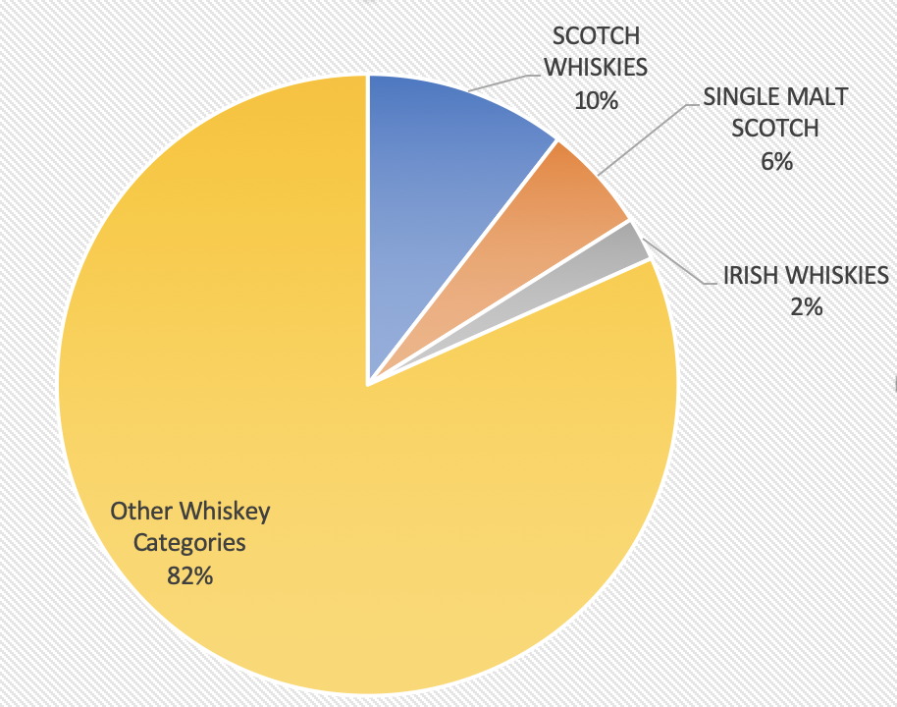
What about scotch and Irish whiskey?
*Ireland exported $1.33 billion in hard-Liquor sales in 2017, While the UK exported $7.87 billion.
Irish and scotch whiskies make up 45% of available whiskey products in iowa, but only about 18% of total sales
https://oec.world/en/profile/country/irl/#Exports
https://oec.world/en/profile/country/gbr/#Exports

Slide 9
Who is drinking Canadian whiskey and why?
Canadian whiskey is the drink of choice in counties with populations under 20,900
The average bottle price of Canadian Whiskey is $13.69 – whereas The average bottle price Whiskey over all is $16.10
the average Bottle price of irish and scotch whiskey is $28.69 – double the average price of Canadian whiskey

Slide 10
Recommendations
1. spend majority of budget on counties with smaller populations – advertise Irish and Scotch whiskey products under $16 and focus on the authenticity of whiskies made in the British isles.
2. A smaller campaign advertising the average-priced bottles of “Authentic whiskey” for special occasions.
3. Possible coordination with companies such as 23-and-me and ancestry.com who can advertise scotch and irish heritage of whiskey making.

