Slide 1
Sparse Matrix Dense Vector Multiplication

Slide 2
SPARSE MATRIX

Slide 3
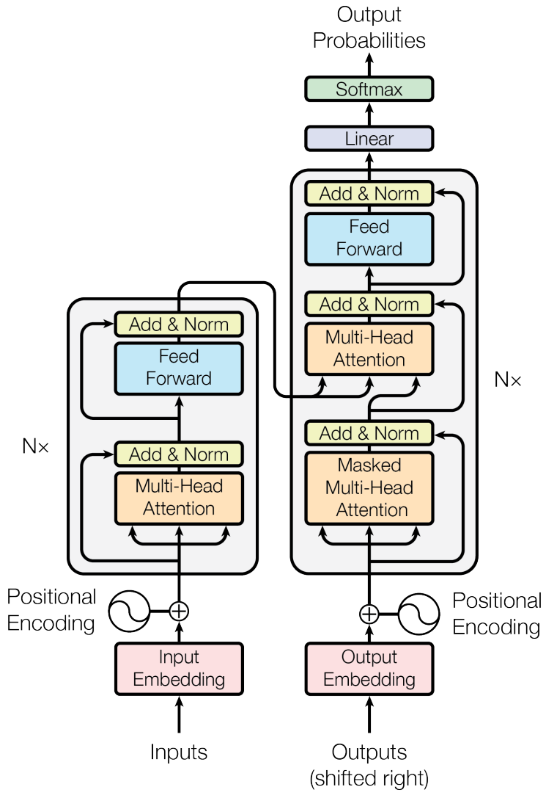
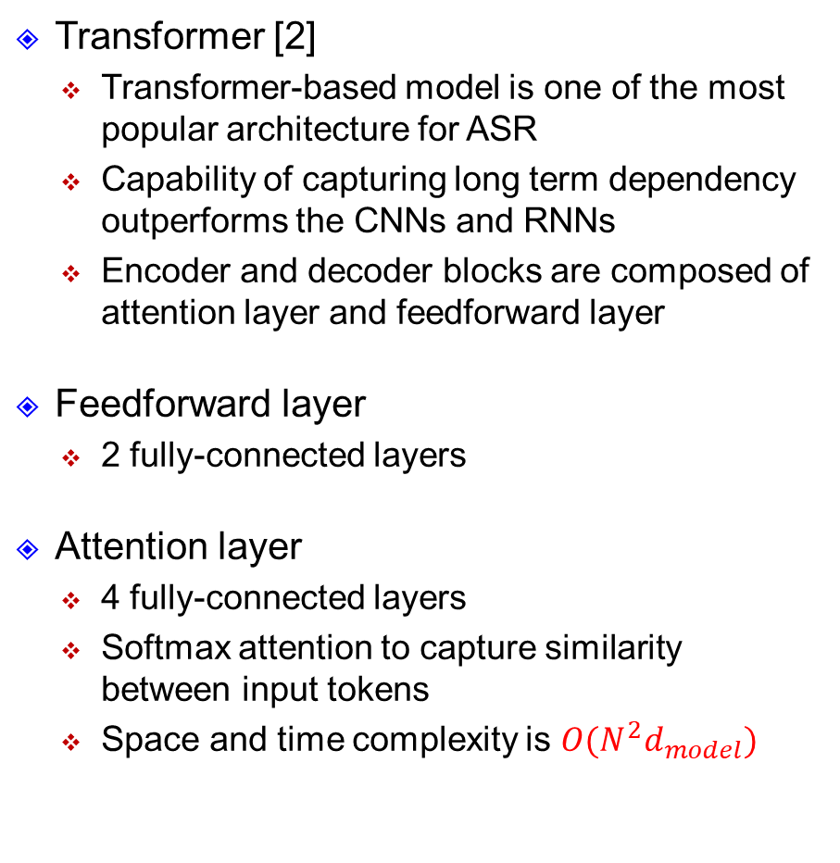
Transformer
Transformer [2]
Transformer-based model is one of the most popular architecture for ASR
Capability of capturing long term dependency outperforms the CNNs and RNNs
Encoder and decoder blocks are composed of attention layer and feedforward layer
Feedforward layer
2 fully-connected layers
Attention layer
4 fully-connected layers
Softmax attention to capture similarity between input tokens
Space and time complexity is $O(N^{2}d_{model})$
[1]

Slide 4
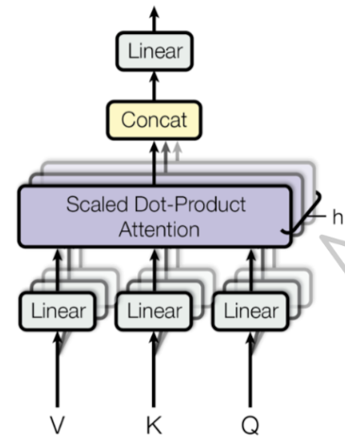
Transformer (cont.)
Self-attention layer
Static matrix multiplication

Slide 5
Transformer (cont.)
Self-attention layer
Static matrix multiplication
Static matrix multiplication

Slide 6
Transformer (cont.)
Self-attention layer
Static matrix multiplication
Static matrix multiplication
Static matrix multiplication

Slide 7
Transformer (cont.)
Self-attention layer
Static matrix multiplication
Static matrix multiplication
Static matrix multiplication
Dynamic matrix multiplication
Static matrix multiplication

Slide 8
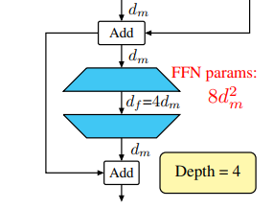
Transformer (cont.)
Self-attention layer
Static matrix multiplication
Static matrix multiplication
Static matrix multiplication
Dynamic matrix multiplication
Static matrix multiplication
Feed-forward layer
Static matrix multiplication
Static matrix multiplication

Slide 9
Transformer (cont.)
Self-attention layer
Static matrix multiplication
Static matrix multiplication
Static matrix multiplication
Dynamic matrix multiplication
Static matrix multiplication
Feed-forward layer
Static matrix multiplication
Static matrix multiplication
Matrix multiplication dominates the computation

Slide 10
Pruning
Pruning
Neural Network contains a lot of near zero values
Prune weak connections (small magnitude) to zero values
→Sparse matrix
Block pruning
Divide weight matrix into several blocks and use each block as unit for weight pruning
Simple for hardware deployment
Fixed location and fixed pattern→ Cannot achieve higher sparsity
Pruning
Notes:
接著使用pruning，pruning是透過將模型內部冗於的連結，也就是絕對值低的weight直接變成0，減少需要被計算的數值，並透且根據sparse pattern的壓縮格式來達到降低模型參數量的效果。
常見方式有幾種
第一種是block pruning，每次進行pruning的時候是以一個區塊作為單位來進行，由於有著高度且規律的結構，因此運行在硬體上的時候能夠有效率的進行硬體的映射，從而達到很高的硬體利用率，
但是因為過於規律的關係，使得這個方法無法達到很高的sparsity
再來是unstructured pruning，完全不限制pruning的位置，也因此有著高度的自由度，所以能夠達到很高的sparsity，但也因為極度不規律，使得硬體無法進行有效的映射，
導致在高sparsity的時候每個PE要被分配到要計算的數量不同，導致硬體利用率低的問題

Slide 11
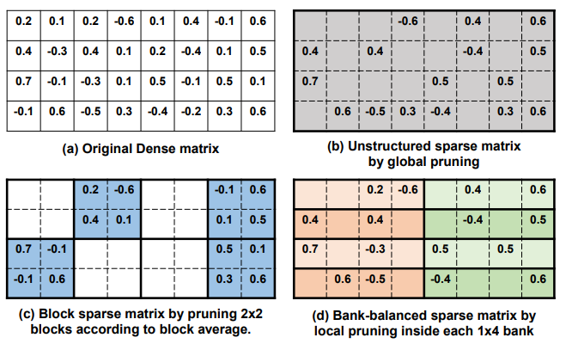
Pruning
Pruning
Pruning
Neural Network contains a lot of near zero values
Prune weak connections (small magnitude) to zero values
→Sparse matrix
Block pruning
Divide weight matrix into several blocks and use each block as unit for weight pruning
Simple for hardware deployment
Fixed location and fixed pattern→ Cannot achieve higher sparsity
Notes:
接著使用pruning，pruning是透過將模型內部冗於的連結，也就是絕對值低的weight直接變成0，減少需要被計算的數值，並透且根據sparse pattern的壓縮格式來達到降低模型參數量的效果。
常見方式有幾種
第一種是block pruning，每次進行pruning的時候是以一個區塊作為單位來進行，由於有著高度且規律的結構，因此運行在硬體上的時候能夠有效率的進行硬體的映射，從而達到很高的硬體利用率，
但是因為過於規律的關係，使得這個方法無法達到很高的sparsity
再來是unstructured pruning，完全不限制pruning的位置，也因此有著高度的自由度，所以能夠達到很高的sparsity，但也因為極度不規律，使得硬體無法進行有效的映射，
導致在高sparsity的時候每個PE要被分配到要計算的數量不同，導致硬體利用率低的問題

Slide 12
Pruning
Pruning
Neural Network contains a lot of near zero values
Prune weak connections (small magnitude) to zero values
→Sparse matrix
Block pruning
Divide weight matrix into several blocks and use each block as unit for weight pruning
Simple for hardware deployment
Fixed location and fixed pattern→ Cannot achieve higher sparsity
Notes:
接著使用pruning，pruning是透過將模型內部冗於的連結，也就是絕對值低的weight直接變成0，減少需要被計算的數值，並透且根據sparse pattern的壓縮格式來達到降低模型參數量的效果。
常見方式有幾種
第一種是block pruning，每次進行pruning的時候是以一個區塊作為單位來進行，由於有著高度且規律的結構，因此運行在硬體上的時候能夠有效率的進行硬體的映射，從而達到很高的硬體利用率，
但是因為過於規律的關係，使得這個方法無法達到很高的sparsity
再來是unstructured pruning，完全不限制pruning的位置，也因此有著高度的自由度，所以能夠達到很高的sparsity，但也因為極度不規律，使得硬體無法進行有效的映射，
導致在高sparsity的時候每個PE要被分配到要計算的數量不同，導致硬體利用率低的問題

Slide 13
Pruning (cont.)
Pruning
Neural Network contains a lot of near zero values
Prune weak connections (small magnitude) to zero values
→Sparse matrix
Block pruning
Divide weight matrix into several blocks and use each block as unit for weight pruning
Simple for hardware deployment
Fixed location and fixed pattern→ Cannot achieve higher sparsity
Notes:
接著使用pruning，pruning是透過將模型內部冗於的連結，也就是絕對值低的weight直接變成0，減少需要被計算的數值，並透且根據sparse pattern的壓縮格式來達到降低模型參數量的效果。
常見方式有幾種
第一種是block pruning，每次進行pruning的時候是以一個區塊作為單位來進行，由於有著高度且規律的結構，因此運行在硬體上的時候能夠有效率的進行硬體的映射，從而達到很高的硬體利用率，
但是因為過於規律的關係，使得這個方法無法達到很高的sparsity
再來是unstructured pruning，完全不限制pruning的位置，也因此有著高度的自由度，所以能夠達到很高的sparsity，但也因為極度不規律，使得硬體無法進行有效的映射，
導致在高sparsity的時候每個PE要被分配到要計算的數量不同，導致硬體利用率低的問題

Slide 14
Pruning (cont.)
Pruning
Neural Network contains a lot of near zero values
Prune weak connections (small magnitude) to zero values
→Sparse matrix
Block pruning
Divide weight matrix into several blocks and use each block as unit for weight pruning
Simple for hardware deployment
Fixed location and fixed pattern→ Cannot achieve higher sparsity
Unstructured pruning
Achieve higher sparsity
Hard to take the advantage of sparsity to speed up the inference with irregular pruning pattern→ memory conflict, imbalanced workload
Notes:
接著使用pruning，pruning是透過將模型內部冗於的連結，也就是絕對值低的weight直接變成0，減少需要被計算的數值，並透且根據sparse pattern的壓縮格式來達到降低模型參數量的效果。
常見方式有幾種
第一種是block pruning，每次進行pruning的時候是以一個區塊作為單位來進行，由於有著高度且規律的結構，因此運行在硬體上的時候能夠有效率的進行硬體的映射，從而達到很高的硬體利用率，
但是因為過於規律的關係，使得這個方法無法達到很高的sparsity
再來是unstructured pruning，完全不限制pruning的位置，也因此有著高度的自由度，所以能夠達到很高的sparsity，但也因為極度不規律，使得硬體無法進行有效的映射，
導致在高sparsity的時候每個PE要被分配到要計算的數量不同，導致硬體利用率低的問題

Slide 15
Pruning (cont.)
Bank-Balanced Sparsity - BBS
Partition weight into non-overlapping banks and fine-grained pruning inside each bank
Each bank have the same number of non-zero values
Pruned accuracy is almost the same as unstructured pruning
Sparsity can be exploited to speed up the model
Notes:
BBS透過融合兩種方法達到了一個平衡，首先將weight切分成幾個獨立且不重疊的bank，在每個bank當中使用finegrained pruning，並要求讓每個bank的non-zero value的數量相同
這個方法使得模型在高sparsity的時候仍然能夠跟unstructured pruning有著很相似的結果
在指派PE的時候，是根據不同的bank進行分配，由於每個bank non-zero value數量相同，所以每個PE被分配到的work load相同而使得硬體利用率能維持很高水準
Bank-size嘗試使用1x32與1x64，sparsity分別到了7/32與12/64，無論是模型大小與performance，1x64的效果都較好，因此最後選用1x64作為壓縮的pattern，將模型壓縮倍率又往下推進了3.54倍

Slide 16
Pruning (cont.)
Bank-Balanced Sparsity - BBS
Partition weight into non-overlapping banks and fine-grained pruning inside each bank
Each bank have the same number of non-zero values
Pruned accuracy is almost the same as unstructured pruning
Sparsity can be exploited to speed up the model
Each bank has the same number of non-zero value (2)
Notes:
BBS透過融合兩種方法達到了一個平衡，首先將weight切分成幾個獨立且不重疊的bank，在每個bank當中使用finegrained pruning，並要求讓每個bank的non-zero value的數量相同
這個方法使得模型在高sparsity的時候仍然能夠跟unstructured pruning有著很相似的結果
在指派PE的時候，是根據不同的bank進行分配，由於每個bank non-zero value數量相同，所以每個PE被分配到的work load相同而使得硬體利用率能維持很高水準
Bank-size嘗試使用1x32與1x64，sparsity分別到了7/32與12/64，無論是模型大小與performance，1x64的效果都較好，因此最後選用1x64作為壓縮的pattern，將模型壓縮倍率又往下推進了3.54倍

Slide 17
Pruning (cont.)
Bank-Balanced Sparsity - BBS
Partition weight into non-overlapping banks and fine-grained pruning inside each bank
Each bank have the same number of non-zero values
Pruned accuracy is almost the same as unstructured pruning
Sparsity can be exploited to speed up the model
Notes:
BBS透過融合兩種方法達到了一個平衡，首先將weight切分成幾個獨立且不重疊的bank，在每個bank當中使用finegrained pruning，並要求讓每個bank的non-zero value的數量相同
這個方法使得模型在高sparsity的時候仍然能夠跟unstructured pruning有著很相似的結果
在指派PE的時候，是根據不同的bank進行分配，由於每個bank non-zero value數量相同，所以每個PE被分配到的work load相同而使得硬體利用率能維持很高水準
Bank-size嘗試使用1x32與1x64，sparsity分別到了7/32與12/64，無論是模型大小與performance，1x64的效果都較好，因此最後選用1x64作為壓縮的pattern，將模型壓縮倍率又往下推進了3.54倍

Slide 18
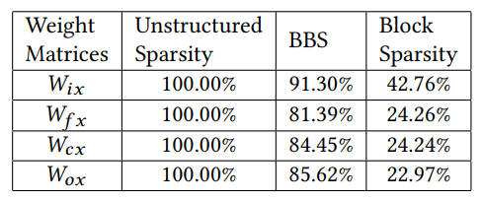
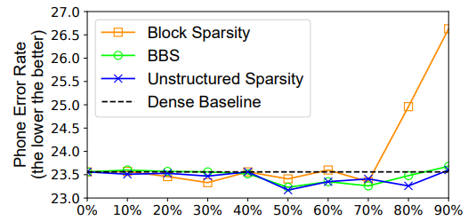
Pruning (cont.)
Bank-Balanced Sparsity - BBS
Partition weight into non-overlapping banks and fine-grained pruning inside each bank
Each bank have the same number of non-zero values
Pruned accuracy is almost the same as unstructured pruning
Sparsity can be exploited to speed up the model
[2]
[2]
[2]
Notes:
BBS透過融合兩種方法達到了一個平衡，首先將weight切分成幾個獨立且不重疊的bank，在每個bank當中使用finegrained pruning，並要求讓每個bank的non-zero value的數量相同
這個方法使得模型在高sparsity的時候仍然能夠跟unstructured pruning有著很相似的結果
在指派PE的時候，是根據不同的bank進行分配，由於每個bank non-zero value數量相同，所以每個PE被分配到的work load相同而使得硬體利用率能維持很高水準
Bank-size嘗試使用1x32與1x64，sparsity分別到了7/32與12/64，無論是模型大小與performance，1x64的效果都較好，因此最後選用1x64作為壓縮的pattern，將模型壓縮倍率又往下推進了3.54倍

Slide 19
Spmdv

Slide 20

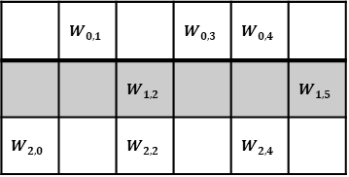


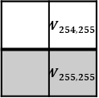

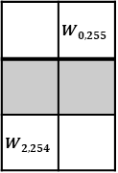

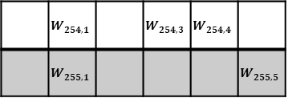

Introduction
Sparse Matrix Dense Vector multiplication
Design a module to implement the sparse matrix dense vector multiplication
Sparse matrix
In this project, we would provide you sparse matrix pruned with Bank-Balanced Sparsity format.
You can use any format or method to store the sparse matrix and implement the multiplication
 | $$W_{0,1}$$ |  | $$W_{0,3}$$ | $$W_{0,4}$$
 |  | $$W_{1,2}$$ |  |  | $$W_{1,5}$$
$$W_{2,0}$$ |  | $$W_{2,2}$$ |  | $$W_{2,4}$$
 | $$W_{0,255}$$
$$W_{2,254}$$
$$f_{0}$$
$$f_{1}$$
$$f_{2}$$
$$b_{0}$$
$$b_{1}$$
$$b_{2}$$
…
.
.
.
.
.
.
.
.
.
$$×$$
.
.
.
$$+$$
.
.
.
 | $$W_{254,1}$$ |  | $$W_{254,3}$$ | $$W_{254,4}$$
 | $$W_{255,1}$$ |  |  |  | $$W_{255,5}$$
 | $$W_{254,255}$$
 | $$W_{255,255}$$
$$f_{254}$$
$$f_{255}$$
$$b_{254}$$
$$b_{255}$$
…

Slide 21
Input/Output
Signal Name | I/O | Width | Description
clk | I | 1 | System clock
rst | I | 1 | Reset signal
start_init | I | 1 | Ready to transmit the weight, position, bias
raw_input | I | 8 | Weight, position of nzv, bias, or dense vector
raw_data_request | O | 1 | Request for next element of dense vector
raw_data_valid | I | 1 | Transmitted element is valid
ld_w_request | I | 1 | Request for next weight, position or bias
w_input_valid | I | 1 | Transmitted weight, position or bias is valid
o_result | O | 22 | Result of sparse matrix dense vector mul.
o_valid | O | 1 | Output data is valid

Slide 22

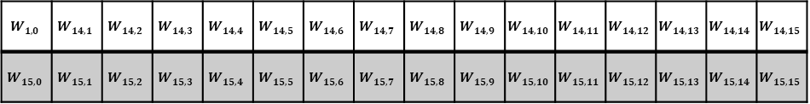
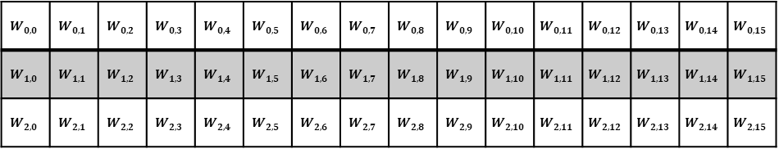
Sparse Matrix Configuration
Matrix
Shape : $256×256$
Pruning format - Bank-Balanced Sparsity
Bank-Shape : $1×64$ → 4 banks for each row
Sparsity : $12/64$ → 12 non-zero values in each bank → 48 non-zero values per row
Example
Shape : $16×16,$ Bank-Shape : $1×4,$ Sparsity : $2/4$
$$W_{0,0}$$ | $$W_{0,1}$$ | $$W_{0,2}$$ | $$W_{0,3}$$ | $$W_{0,4}$$ | $$W_{0,5}$$ | $$W_{0,6}$$ | $$W_{0,7}$$ | $$W_{0,8}$$ | $$W_{0,9}$$ | $$W_{0,10}$$ | $$W_{0,11}$$ | $$W_{0,12}$$ | $$W_{0,13}$$ | $$W_{0,14}$$ | $$W_{0,15}$$
$$W_{1,0}$$ | $$W_{1,1}$$ | $$W_{1,2}$$ | $$W_{1,3}$$ | $$W_{1,4}$$ | $$W_{1,5}$$ | $$W_{1,6}$$ | $$W_{1,7}$$ | $$W_{1,8}$$ | $$W_{1,9}$$ | $$W_{1,10}$$ | $$W_{1,11}$$ | $$W_{1,12}$$ | $$W_{1,13}$$ | $$W_{1,14}$$ | $$W_{1,15}$$
$$W_{2,0}$$ | $$W_{2,1}$$ | $$W_{2,2}$$ | $$W_{2,3}$$ | $$W_{2,4}$$ | $$W_{2,5}$$ | $$W_{2,6}$$ | $$W_{2,7}$$ | $$W_{2,8}$$ | $$W_{2,9}$$ | $$W_{2,10}$$ | $$W_{2,11}$$ | $$W_{2,12}$$ | $$W_{2,13}$$ | $$W_{2,14}$$ | $$W_{2,15}$$
.
.
.
$$W_{1,0}$$ | $$W_{14,1}$$ | $$W_{14,2}$$ | $$W_{14,3}$$ | $$W_{14,4}$$ | $$W_{14,5}$$ | $$W_{14,6}$$ | $$W_{14,7}$$ | $$W_{14,8}$$ | $$W_{14,9}$$ | $$W_{14,10}$$ | $$W_{14,11}$$ | $$W_{14,12}$$ | $$W_{14,13}$$ | $$W_{14,14}$$ | $$W_{14,15}$$
$$W_{15,0}$$ | $$W_{15,1}$$ | $$W_{15,2}$$ | $$W_{15,3}$$ | $$W_{15,4}$$ | $$W_{15,5}$$ | $$W_{15,6}$$ | $$W_{15,7}$$ | $$W_{15,8}$$ | $$W_{15,9}$$ | $$W_{15,10}$$ | $$W_{15,11}$$ | $$W_{15,12}$$ | $$W_{15,13}$$ | $$W_{15,14}$$ | $$W_{15,15}$$

Slide 23
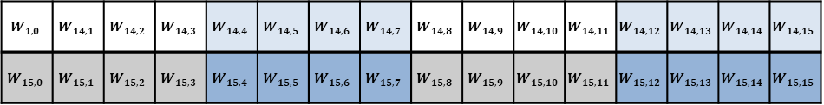
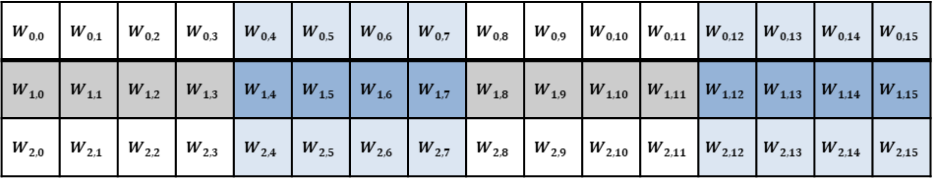
Sparse Matrix Configuration (cont.)
Matrix
Shape : $256×256$
Pruning format - Bank-Balanced Sparsity
Bank-Shape : $1×64$ → 4 banks for each row
Sparsity : $12/64$ → 12 non-zero values in each bank → 48 non-zero values per row
Example
Shape : $16×16,$ Bank-Shape : $1×4,$ Sparsity : $2/4$
$$W_{0,0}$$ | $$W_{0,1}$$ | $$W_{0,2}$$ | $$W_{0,3}$$ | $$W_{0,4}$$ | $$W_{0,5}$$ | $$W_{0,6}$$ | $$W_{0,7}$$ | $$W_{0,8}$$ | $$W_{0,9}$$ | $$W_{0,10}$$ | $$W_{0,11}$$ | $$W_{0,12}$$ | $$W_{0,13}$$ | $$W_{0,14}$$ | $$W_{0,15}$$
$$W_{1,0}$$ | $$W_{1,1}$$ | $$W_{1,2}$$ | $$W_{1,3}$$ | $$W_{1,4}$$ | $$W_{1,5}$$ | $$W_{1,6}$$ | $$W_{1,7}$$ | $$W_{1,8}$$ | $$W_{1,9}$$ | $$W_{1,10}$$ | $$W_{1,11}$$ | $$W_{1,12}$$ | $$W_{1,13}$$ | $$W_{1,14}$$ | $$W_{1,15}$$
$$W_{2,0}$$ | $$W_{2,1}$$ | $$W_{2,2}$$ | $$W_{2,3}$$ | $$W_{2,4}$$ | $$W_{2,5}$$ | $$W_{2,6}$$ | $$W_{2,7}$$ | $$W_{2,8}$$ | $$W_{2,9}$$ | $$W_{2,10}$$ | $$W_{2,11}$$ | $$W_{2,12}$$ | $$W_{2,13}$$ | $$W_{2,14}$$ | $$W_{2,15}$$
.
.
.
$$W_{1,0}$$ | $$W_{14,1}$$ | $$W_{14,2}$$ | $$W_{14,3}$$ | $$W_{14,4}$$ | $$W_{14,5}$$ | $$W_{14,6}$$ | $$W_{14,7}$$ | $$W_{14,8}$$ | $$W_{14,9}$$ | $$W_{14,10}$$ | $$W_{14,11}$$ | $$W_{14,12}$$ | $$W_{14,13}$$ | $$W_{14,14}$$ | $$W_{14,15}$$
$$W_{15,0}$$ | $$W_{15,1}$$ | $$W_{15,2}$$ | $$W_{15,3}$$ | $$W_{15,4}$$ | $$W_{15,5}$$ | $$W_{15,6}$$ | $$W_{15,7}$$ | $$W_{15,8}$$ | $$W_{15,9}$$ | $$W_{15,10}$$ | $$W_{15,11}$$ | $$W_{15,12}$$ | $$W_{15,13}$$ | $$W_{15,14}$$ | $$W_{15,15}$$

Slide 24
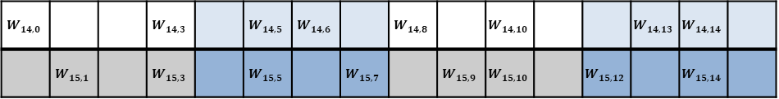
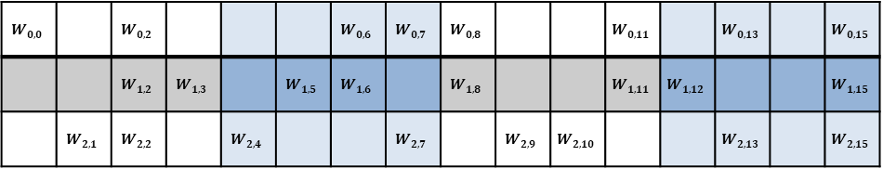
Sparse Matrix Configuration (cont.)
Matrix
Shape : $256×256$
Pruning format - Bank-Balanced Sparsity
Bank-Shape : $1×64$ → 4 banks for each row
Sparsity : $12/64$ → 12 non-zero values in each bank → 48 non-zero values per row
Example
Shape : $16×16,$ Bank-Shape : $1×4,$ Sparsity : $2/4$
$$W_{0,0}$$ |  | $$W_{0,2}$$ |  |  |  | $$W_{0,6}$$ | $$W_{0,7}$$ | $$W_{0,8}$$ |  |  | $$W_{0,11}$$ |  | $$W_{0,13}$$ |  | $$W_{0,15}$$
 |  | $$W_{1,2}$$ | $$W_{1,3}$$ |  | $$W_{1,5}$$ | $$W_{1,6}$$ |  | $$W_{1,8}$$ |  |  | $$W_{1,11}$$ | $$W_{1,12}$$ |  |  | $$W_{1,15}$$
 | $$W_{2,1}$$ | $$W_{2,2}$$ |  | $$W_{2,4}$$ |  |  | $$W_{2,7}$$ |  | $$W_{2,9}$$ | $$W_{2,10}$$ |  |  | $$W_{2,13}$$ |  | $$W_{2,15}$$
.
.
.
$$W_{14,0}$$ |  |  | $$W_{14,3}$$ |  | $$W_{14,5}$$ | $$W_{14,6}$$ |  | $$W_{14,8}$$ |  | $$W_{14,10}$$ |  |  | $$W_{14,13}$$ | $$W_{14,14}$$
 | $$W_{15,1}$$ |  | $$W_{15,3}$$ |  | $$W_{15,5}$$ |  | $$W_{15,7}$$ |  | $$W_{15,9}$$ | $$W_{15,10}$$ |  | $$W_{15,12}$$ |  | $$W_{15,14}$$

Slide 25
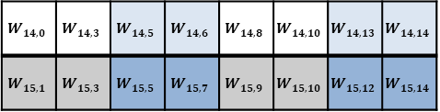
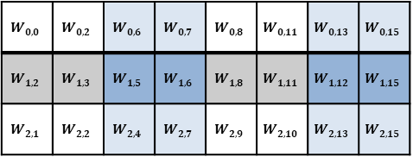
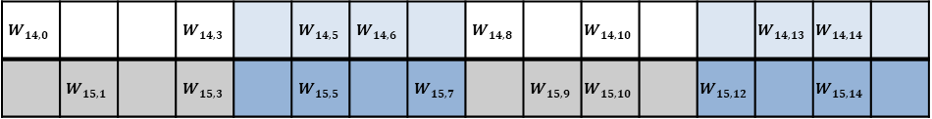
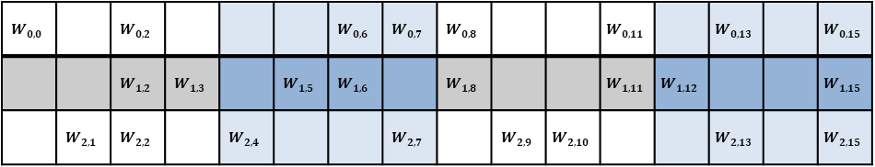
Sparse Matrix Configuration (cont.)
Matrix
Shape : $256×256$
Pruning format - Bank-Balanced Sparsity
Bank-Shape : $1×64$ → 4 banks for each row
Sparsity : $12/64$ → 12 non-zero values in each bank → 48 non-zero values per row
Example
Shape : $16×16,$ Bank-Shape : $1×4,$ Sparsity : $2/4$
Dense-value
$$W_{0,0}$$ |  | $$W_{0,2}$$ |  |  |  | $$W_{0,6}$$ | $$W_{0,7}$$ | $$W_{0,8}$$ |  |  | $$W_{0,11}$$ |  | $$W_{0,13}$$ |  | $$W_{0,15}$$
 |  | $$W_{1,2}$$ | $$W_{1,3}$$ |  | $$W_{1,5}$$ | $$W_{1,6}$$ |  | $$W_{1,8}$$ |  |  | $$W_{1,11}$$ | $$W_{1,12}$$ |  |  | $$W_{1,15}$$
 | $$W_{2,1}$$ | $$W_{2,2}$$ |  | $$W_{2,4}$$ |  |  | $$W_{2,7}$$ |  | $$W_{2,9}$$ | $$W_{2,10}$$ |  |  | $$W_{2,13}$$ |  | $$W_{2,15}$$
$$W_{0,0}$$ | $$W_{0,2}$$ | $$W_{0,6}$$ | $$W_{0,7}$$ | $$W_{0,8}$$ | $$W_{0,11}$$ | $$W_{0,13}$$ | $$W_{0,15}$$
$$W_{1,2}$$ | $$W_{1,3}$$ | $$W_{1,5}$$ | $$W_{1,6}$$ | $$W_{1,8}$$ | $$W_{1,11}$$ | $$W_{1,12}$$ | $$W_{1,15}$$
$$W_{2,1}$$ | $$W_{2,2}$$ | $$W_{2,4}$$ | $$W_{2,7}$$ | $$W_{2,9}$$ | $$W_{2,10}$$ | $$W_{2,13}$$ | $$W_{2,15}$$
.
.
.
.
.
.
$$W_{14,0}$$ |  |  | $$W_{14,3}$$ |  | $$W_{14,5}$$ | $$W_{14,6}$$ |  | $$W_{14,8}$$ |  | $$W_{14,10}$$ |  |  | $$W_{14,13}$$ | $$W_{14,14}$$
 | $$W_{15,1}$$ |  | $$W_{15,3}$$ |  | $$W_{15,5}$$ |  | $$W_{15,7}$$ |  | $$W_{15,9}$$ | $$W_{15,10}$$ |  | $$W_{15,12}$$ |  | $$W_{15,14}$$
$$W_{14,0}$$ | $$W_{14,3}$$ | $$W_{14,5}$$ | $$W_{14,6}$$ | $$W_{14,8}$$ | $$W_{14,10}$$ | $$W_{14,13}$$ | $$W_{14,14}$$
$$W_{15,1}$$ | $$W_{15,3}$$ | $$W_{15,5}$$ | $$W_{15,7}$$ | $$W_{15,9}$$ | $$W_{15,10}$$ | $$W_{15,12}$$ | $$W_{15,14}$$

Slide 26
Sparse Matrix Configuration (cont.)
Matrix
Shape : $256×256$
Pruning format - Bank-Balanced Sparsity
Bank-Shape : $1×64$ → 4 banks for each row
Sparsity : $12/64$ → 12 non-zero values in each bank → 48 non-zero values per row
Example
Shape : $16×16,$ Bank-Shape : $1×4,$ Sparsity : $2/4$
Position of nzv
$$W_{0,0}$$ |  | $$W_{0,2}$$ |  |  |  | $$W_{0,6}$$ | $$W_{0,7}$$ | $$W_{0,8}$$ |  |  | $$W_{0,11}$$ |  | $$W_{0,13}$$ |  | $$W_{0,15}$$
 |  | $$W_{1,2}$$ | $$W_{1,3}$$ |  | $$W_{1,5}$$ | $$W_{1,6}$$ |  | $$W_{1,8}$$ |  |  | $$W_{1,11}$$ | $$W_{1,12}$$ |  |  | $$W_{1,15}$$
 | $$W_{2,1}$$ | $$W_{2,2}$$ |  | $$W_{2,4}$$ |  |  | $$W_{2,7}$$ |  | $$W_{2,9}$$ | $$W_{2,10}$$ |  |  | $$W_{2,13}$$ |  | $$W_{2,15}$$
0 | 2 | 2 | 3 | 0 | 3 | 1 | 3
2 | 3 | 1 | 2 | 0 | 3 | 0 | 3
1 | 2 | 0 | 3 | 1 | 2 | 1 | 3
.
.
.
.
.
.
$$W_{14,0}$$ |  |  | $$W_{14,3}$$ |  | $$W_{14,5}$$ | $$W_{14,6}$$ |  | $$W_{14,8}$$ |  | $$W_{14,10}$$ |  |  | $$W_{14,13}$$ | $$W_{14,14}$$
 | $$W_{15,1}$$ |  | $$W_{15,3}$$ |  | $$W_{15,5}$$ |  | $$W_{15,7}$$ |  | $$W_{15,9}$$ | $$W_{15,10}$$ |  | $$W_{15,12}$$ |  | $$W_{15,14}$$
0 | 3 | 1 | 2 | 0 | 2 | 1 | 2
1 | 3 | 1 | 3 | 1 | 2 | 0 | 2

Slide 27
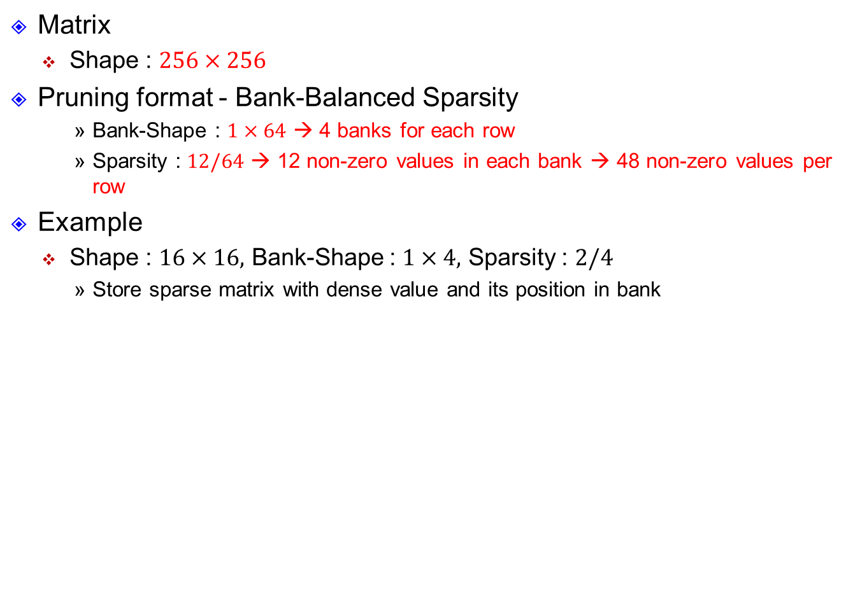
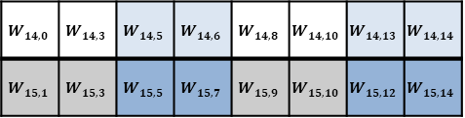
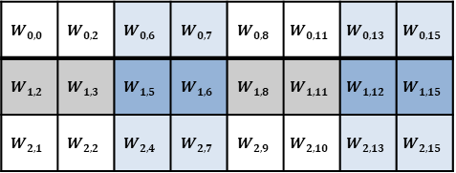
Sparse Matrix Configuration (cont.)
Matrix
Shape : $256×256$
Pruning format - Bank-Balanced Sparsity
Bank-Shape : $1×64$ → 4 banks for each row
Sparsity : $12/64$ → 12 non-zero values in each bank → 48 non-zero values per row
Example
Shape : $16×16,$ Bank-Shape : $1×4,$ Sparsity : $2/4$
Store sparse matrix with dense value and its position in bank
Dense-value
Position of nzv
$$W_{0,0}$$ | $$W_{0,2}$$ | $$W_{0,6}$$ | $$W_{0,7}$$ | $$W_{0,8}$$ | $$W_{0,11}$$ | $$W_{0,13}$$ | $$W_{0,15}$$
$$W_{1,2}$$ | $$W_{1,3}$$ | $$W_{1,5}$$ | $$W_{1,6}$$ | $$W_{1,8}$$ | $$W_{1,11}$$ | $$W_{1,12}$$ | $$W_{1,15}$$
$$W_{2,1}$$ | $$W_{2,2}$$ | $$W_{2,4}$$ | $$W_{2,7}$$ | $$W_{2,9}$$ | $$W_{2,10}$$ | $$W_{2,13}$$ | $$W_{2,15}$$
0 | 2 | 2 | 3 | 0 | 3 | 1 | 3
2 | 3 | 1 | 2 | 0 | 3 | 0 | 3
1 | 2 | 0 | 3 | 1 | 2 | 1 | 3
.
.
.
.
.
.
$$W_{14,0}$$ | $$W_{14,3}$$ | $$W_{14,5}$$ | $$W_{14,6}$$ | $$W_{14,8}$$ | $$W_{14,10}$$ | $$W_{14,13}$$ | $$W_{14,14}$$
$$W_{15,1}$$ | $$W_{15,3}$$ | $$W_{15,5}$$ | $$W_{15,7}$$ | $$W_{15,9}$$ | $$W_{15,10}$$ | $$W_{15,12}$$ | $$W_{15,14}$$
0 | 3 | 1 | 2 | 0 | 2 | 1 | 2
1 | 3 | 1 | 3 | 1 | 2 | 0 | 2

Slide 28
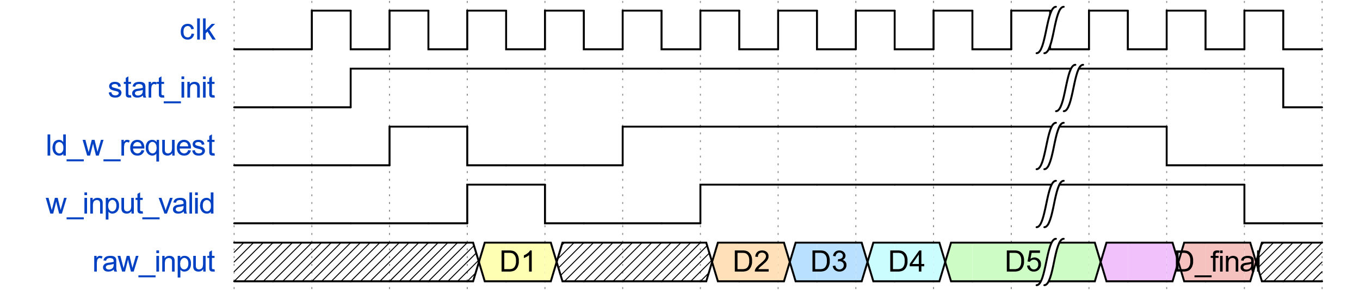
Sparse Matrix Configuration (cont.)
Data transmission
When “start_init” is high, you can request for data.
Set “ld_w_requeset” high to request, and data would be transmitted next cycle with “w_input_valid” is high.
After all data are transmitted, “start_init” is set to low at negedge.

Slide 29
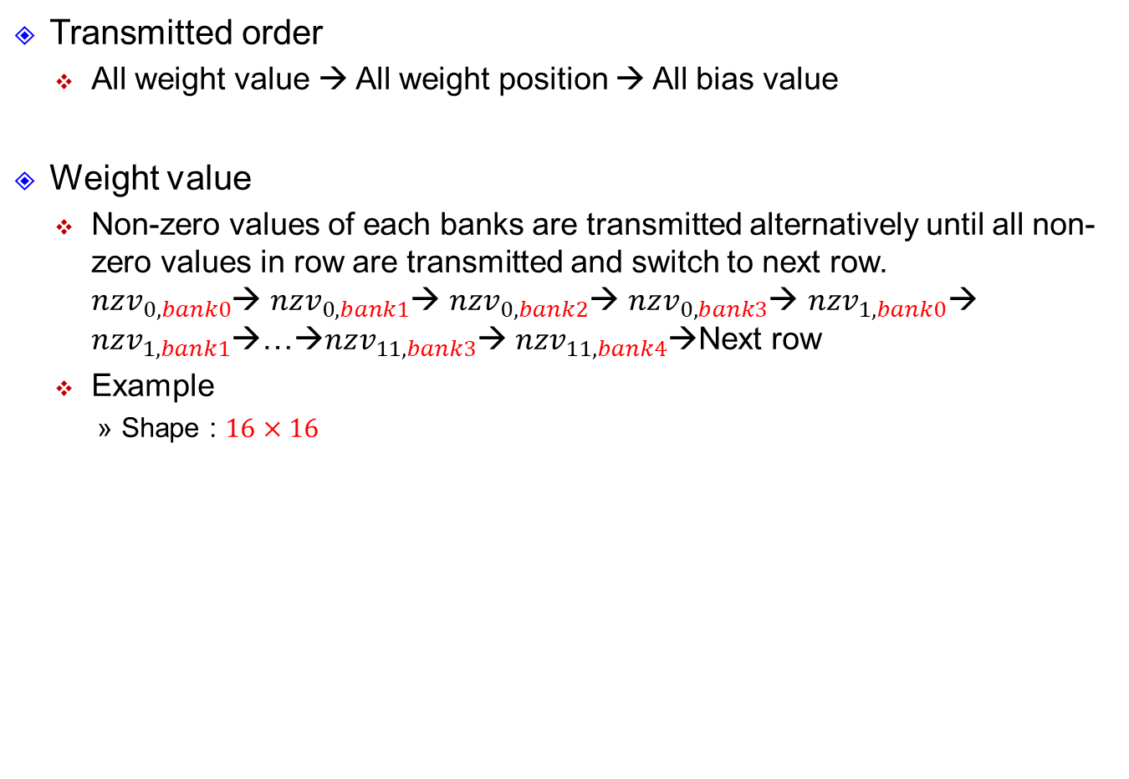
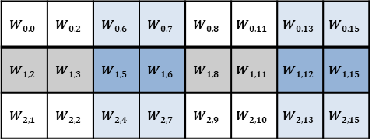
Sparse Matrix Configuration (cont.)
Transmitted order
All weight value → All weight position → All bias value
Weight value
Non-zero values of each banks are transmitted alternatively until all non-zero values in row are transmitted and switch to next row. $nzv_{0,bank0}$→ $nzv_{0,bank1}$→ $nzv_{0,bank2}$→ $nzv_{0,bank3}$→ $nzv_{1,bank0}$→ $nzv_{1,bank1}$→…→$nzv_{11,bank3}$→ $nzv_{11,bank4}$→Next row
Example
Shape : $16×16$
0
Transmitted order
$$W_{0,0}$$ | $$W_{0,2}$$ | $$W_{0,6}$$ | $$W_{0,7}$$ | $$W_{0,8}$$ | $$W_{0,11}$$ | $$W_{0,13}$$ | $$W_{0,15}$$
$$W_{1,2}$$ | $$W_{1,3}$$ | $$W_{1,5}$$ | $$W_{1,6}$$ | $$W_{1,8}$$ | $$W_{1,11}$$ | $$W_{1,12}$$ | $$W_{1,15}$$
$$W_{2,1}$$ | $$W_{2,2}$$ | $$W_{2,4}$$ | $$W_{2,7}$$ | $$W_{2,9}$$ | $$W_{2,10}$$ | $$W_{2,13}$$ | $$W_{2,15}$$
Value

Slide 30
Sparse Matrix Configuration (cont.)
Transmitted order
All weight value → All weight position → All bias value
Weight value
Non-zero values of each banks are transmitted alternatively until all non-zero values in row are transmitted and switch to next row. $nzv_{0,bank0}$→ $nzv_{0,bank1}$→ $nzv_{0,bank2}$→ $nzv_{0,bank3}$→ $nzv_{1,bank0}$→ $nzv_{1,bank1}$→…→$nzv_{11,bank3}$→ $nzv_{11,bank4}$→Next row
Example
Shape : $16×16$
0 |  | 1
Transmitted order
$$W_{0,0}$$ | $$W_{0,2}$$ | $$W_{0,6}$$ | $$W_{0,7}$$ | $$W_{0,8}$$ | $$W_{0,11}$$ | $$W_{0,13}$$ | $$W_{0,15}$$
$$W_{1,2}$$ | $$W_{1,3}$$ | $$W_{1,5}$$ | $$W_{1,6}$$ | $$W_{1,8}$$ | $$W_{1,11}$$ | $$W_{1,12}$$ | $$W_{1,15}$$
$$W_{2,1}$$ | $$W_{2,2}$$ | $$W_{2,4}$$ | $$W_{2,7}$$ | $$W_{2,9}$$ | $$W_{2,10}$$ | $$W_{2,13}$$ | $$W_{2,15}$$
Value

Slide 31
Sparse Matrix Configuration (cont.)
Transmitted order
All weight value → All weight position → All bias value
Weight value
Non-zero values of each banks are transmitted alternatively until all non-zero values in row are transmitted and switch to next row. $nzv_{0,bank0}$→ $nzv_{0,bank1}$→ $nzv_{0,bank2}$→ $nzv_{0,bank3}$→ $nzv_{1,bank0}$→ $nzv_{1,bank1}$→…→$nzv_{11,bank3}$→ $nzv_{11,bank4}$→Next row
Example
Shape : $16×16$
0 |  | 1 |  | 2
Transmitted order
$$W_{0,0}$$ | $$W_{0,2}$$ | $$W_{0,6}$$ | $$W_{0,7}$$ | $$W_{0,8}$$ | $$W_{0,11}$$ | $$W_{0,13}$$ | $$W_{0,15}$$
$$W_{1,2}$$ | $$W_{1,3}$$ | $$W_{1,5}$$ | $$W_{1,6}$$ | $$W_{1,8}$$ | $$W_{1,11}$$ | $$W_{1,12}$$ | $$W_{1,15}$$
$$W_{2,1}$$ | $$W_{2,2}$$ | $$W_{2,4}$$ | $$W_{2,7}$$ | $$W_{2,9}$$ | $$W_{2,10}$$ | $$W_{2,13}$$ | $$W_{2,15}$$
Value

Slide 32
Sparse Matrix Configuration (cont.)
Transmitted order
All weight value → All weight position → All bias value
Weight value
Non-zero values of each banks are transmitted alternatively until all non-zero values in row are transmitted and switch to next row. $nzv_{0,bank0}$→ $nzv_{0,bank1}$→ $nzv_{0,bank2}$→ $nzv_{0,bank3}$→ $nzv_{1,bank0}$→ $nzv_{1,bank1}$→…→$nzv_{11,bank3}$→ $nzv_{11,bank4}$→Next row
Example
Shape : $16×16$
0 |  | 1 |  | 2 |  | 3
Transmitted order
$$W_{0,0}$$ | $$W_{0,2}$$ | $$W_{0,6}$$ | $$W_{0,7}$$ | $$W_{0,8}$$ | $$W_{0,11}$$ | $$W_{0,13}$$ | $$W_{0,15}$$
$$W_{1,2}$$ | $$W_{1,3}$$ | $$W_{1,5}$$ | $$W_{1,6}$$ | $$W_{1,8}$$ | $$W_{1,11}$$ | $$W_{1,12}$$ | $$W_{1,15}$$
$$W_{2,1}$$ | $$W_{2,2}$$ | $$W_{2,4}$$ | $$W_{2,7}$$ | $$W_{2,9}$$ | $$W_{2,10}$$ | $$W_{2,13}$$ | $$W_{2,15}$$
Value

Slide 33
Sparse Matrix Configuration (cont.)
Transmitted order
All weight value → All weight position → All bias value
Weight value
Non-zero values of each banks are transmitted alternatively until all non-zero values in row are transmitted and switch to next row. $nzv_{0,bank0}$→ $nzv_{0,bank1}$→ $nzv_{0,bank2}$→ $nzv_{0,bank3}$→ $nzv_{1,bank0}$→ $nzv_{1,bank1}$→…→$nzv_{11,bank3}$→ $nzv_{11,bank4}$→Next row
Example
Shape : $16×16$
0 | 4 | 1 | 5 | 2 | 6 | 3 | 7
Transmit next row
Transmitted order
$$W_{0,0}$$ | $$W_{0,2}$$ | $$W_{0,6}$$ | $$W_{0,7}$$ | $$W_{0,8}$$ | $$W_{0,11}$$ | $$W_{0,13}$$ | $$W_{0,15}$$
$$W_{1,2}$$ | $$W_{1,3}$$ | $$W_{1,5}$$ | $$W_{1,6}$$ | $$W_{1,8}$$ | $$W_{1,11}$$ | $$W_{1,12}$$ | $$W_{1,15}$$
$$W_{2,1}$$ | $$W_{2,2}$$ | $$W_{2,4}$$ | $$W_{2,7}$$ | $$W_{2,9}$$ | $$W_{2,10}$$ | $$W_{2,13}$$ | $$W_{2,15}$$
Value

Slide 34
Sparse Matrix Configuration (cont.)
Transmitted order
All weight value → All weight position → All bias value
Weight value
Non-zero values of each banks are transmitted alternatively until all non-zero values in row are transmitted and switch to next row. $nzv_{0,bank0}$→ $nzv_{0,bank1}$→ $nzv_{0,bank2}$→ $nzv_{0,bank3}$→ $nzv_{1,bank0}$→ $nzv_{1,bank1}$→…→$nzv_{11,bank3}$→ $nzv_{11,bank4}$→Next row
Example
Shape : $16×16$
0 | 4 | 1 | 5 | 2 | 6 | 3 | 7
8 | 12 | 9 | 13 | 10 | 14 | 11 | 15
16 | 20 | 17 | 21 | 18 | 22 | 19 | 23
Transmitted order
Transmit next row
$$W_{0,0}$$ | $$W_{0,2}$$ | $$W_{0,6}$$ | $$W_{0,7}$$ | $$W_{0,8}$$ | $$W_{0,11}$$ | $$W_{0,13}$$ | $$W_{0,15}$$
$$W_{1,2}$$ | $$W_{1,3}$$ | $$W_{1,5}$$ | $$W_{1,6}$$ | $$W_{1,8}$$ | $$W_{1,11}$$ | $$W_{1,12}$$ | $$W_{1,15}$$
$$W_{2,1}$$ | $$W_{2,2}$$ | $$W_{2,4}$$ | $$W_{2,7}$$ | $$W_{2,9}$$ | $$W_{2,10}$$ | $$W_{2,13}$$ | $$W_{2,15}$$
Value

Slide 35
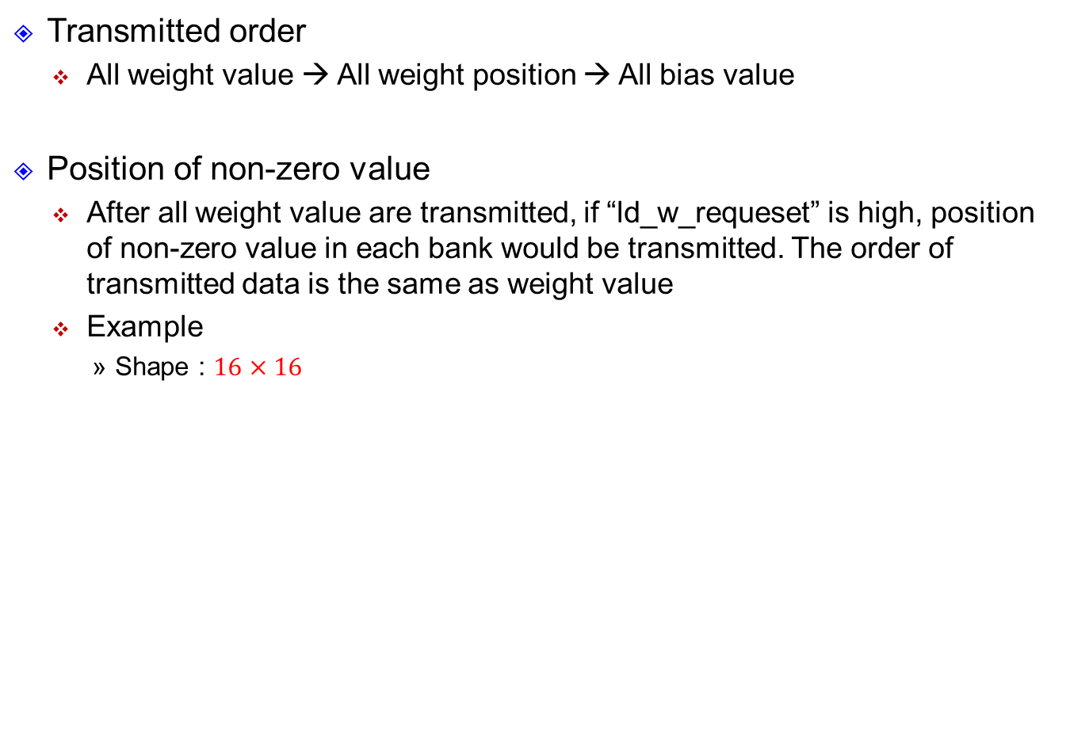
Sparse Matrix Configuration (cont.)
Transmitted order
All weight value → All weight position → All bias value
Position of non-zero value
After all weight value are transmitted, if “ld_w_requeset” is high, position of non-zero value in each bank would be transmitted. The order of transmitted data is the same as weight value
Example
Shape : $16×16$
0 | 4 | 1 | 5 | 2 | 6 | 3 | 7
8 | 12 | 9 | 13 | 10 | 14 | 11 | 15
16 | 20 | 17 | 21 | 18 | 22 | 19 | 23
Transmitted order
Transmit next row
0 | 2 | 2 | 3 | 0 | 3 | 1 | 3
2 | 3 | 1 | 2 | 0 | 3 | 0 | 3
1 | 2 | 0 | 3 | 1 | 2 | 1 | 3
Position of nzv

Slide 36



Sparse Matrix Configuration (cont.)
Transmitted order
All weight value → All weight position → All bias value
Bias value
After all positions of non-zero value are transmitted, if “ld_w_requeset” is high, bias would be transmitted
Bias values are transmitted by its original order → From $b_{0}$ to $b_{255}$
$$b_{0}$$
$$b_{1}$$
$$b_{2}$$
.
.
.
$$b_{254}$$
$$b_{255}$$

Slide 37
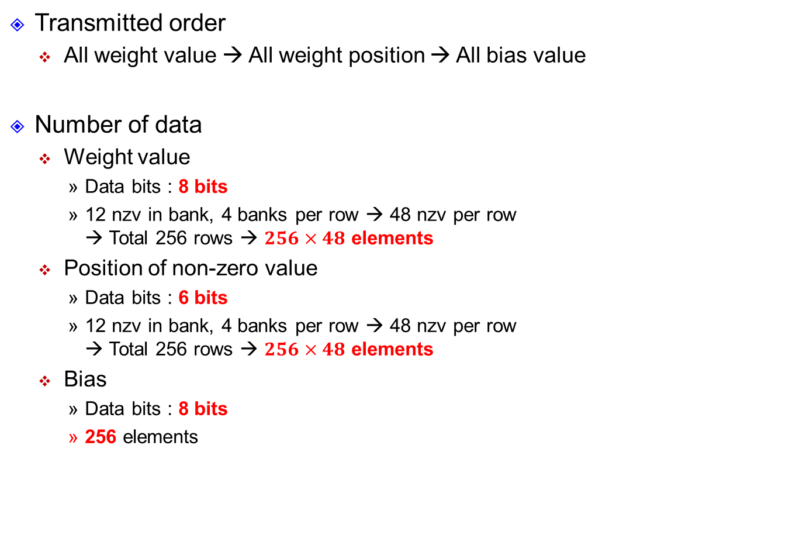
Sparse Matrix Configuration (cont.)
Transmitted order
All weight value → All weight position → All bias value
Number of data
Weight value
Data bits : 8 bits
12 nzv in bank, 4 banks per row → 48 nzv per row → Total 256 rows → $256×48$ elements
Position of non-zero value
Data bits : 6 bits
12 nzv in bank, 4 banks per row → 48 nzv per row → Total 256 rows → $256×48$ elements
Bias
Data bits : 8 bits
256 elements

Slide 38
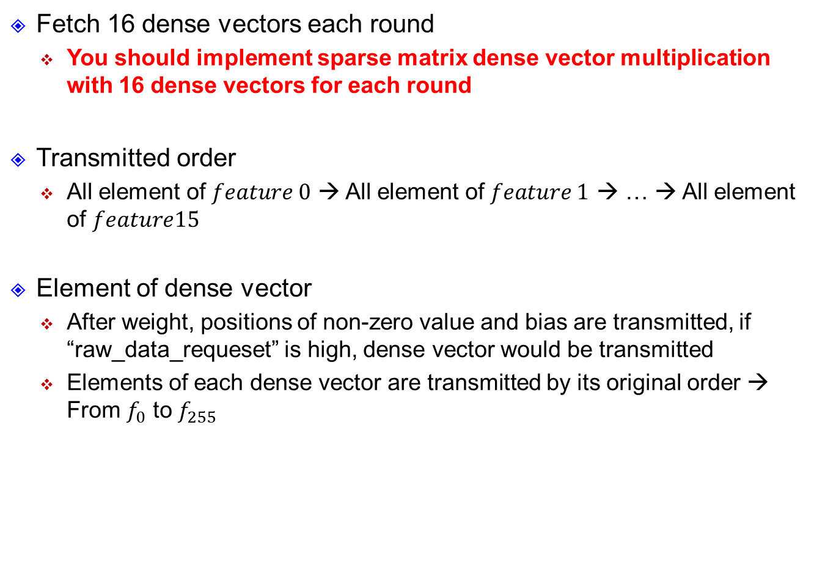
Dense Vectors
Fetch 16 dense vectors each round
You should implement sparse matrix dense vector multiplication with 16 dense vectors for each round
Transmitted order
All element of $feature 0$ → All element of $feature 1$ → … → All element of $feature15$
Element of dense vector
After weight, positions of non-zero value and bias are transmitted, if “raw_data_requeset” is high, dense vector would be transmitted
Elements of each dense vector are transmitted by its original order → From $f_{0}$ to $f_{255}$

Slide 39
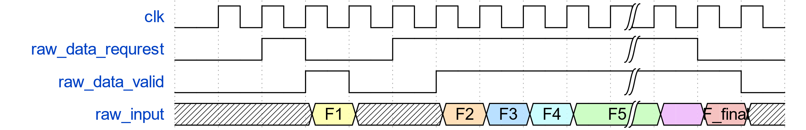
Dense Vectors (cont.)
Data transmission
Set “raw_data_requrest” high to request, and data would be transmitted next cycle with “raw_data_valid” is high.

Slide 40

Dense Vectors (cont.)
Summary
Data bits : 8 bits
Each dense vector have 256 elements, 16 dense vector for each round → $256×16$ elements for each round

Slide 41
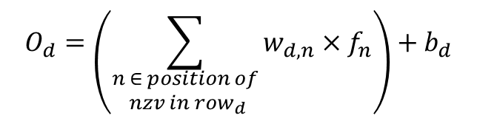
Data Presentation
2’s complement (exclude position of nzv)
Ex. 8bits (2-int bits + 6 frac bits) → S1.6
Weight
Value : S2.5
Position of nzv : unsigned 6 bits (0~63)
Bias
Value : S0.7
Dense vector
Value : S1.6
Output
Value : S10.11
$$O_{d}=\left(\sum_{\begin{aligned}n ∈ position of \\ nzv in row_{d}\end{aligned}}{w_{d,n}×f_{n}}\right)+b_{d}$$
S2.5
S1.6
S0.7
48 elements
S4.11
S10.11
extension
S10.11
Output

Slide 42
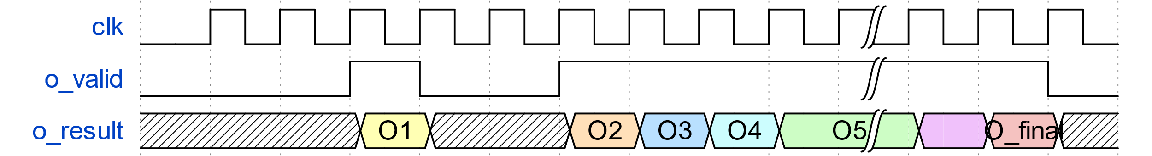
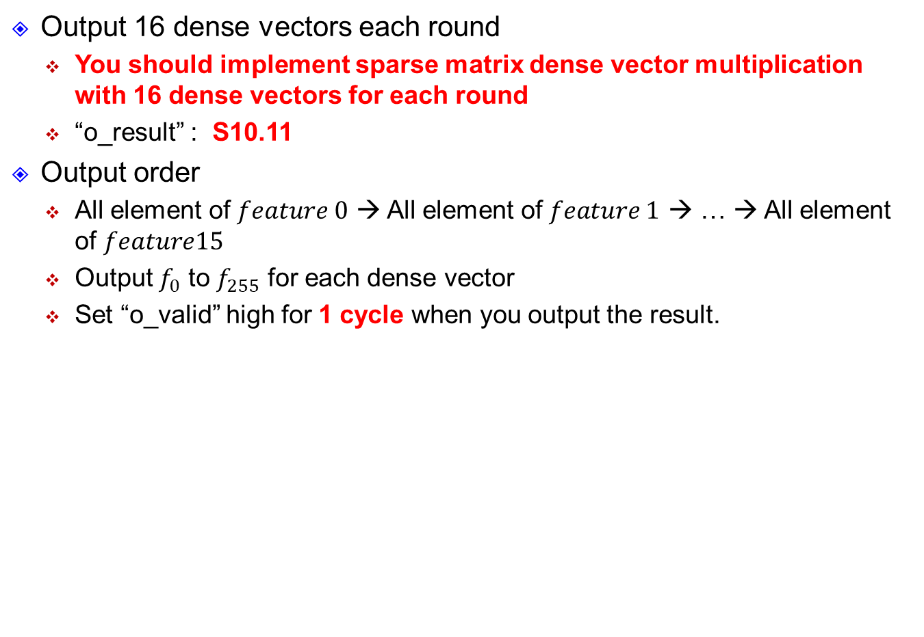
Result output
Output 16 dense vectors each round
You should implement sparse matrix dense vector multiplication with 16 dense vectors for each round
“o_result” : S10.11
Output order
All element of $feature 0$ → All element of $feature 1$ → … → All element of $feature15$
Output $f_{0}$ to $f_{255}$ for each dense vector
Set “o_valid” high for 1 cycle when you output the result.

Slide 43
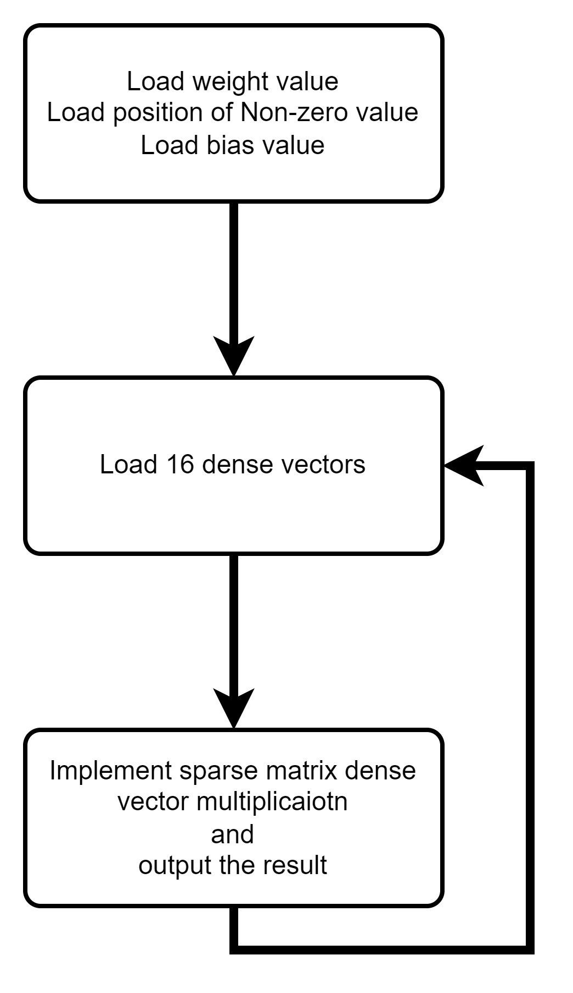
Summary

Slide 44
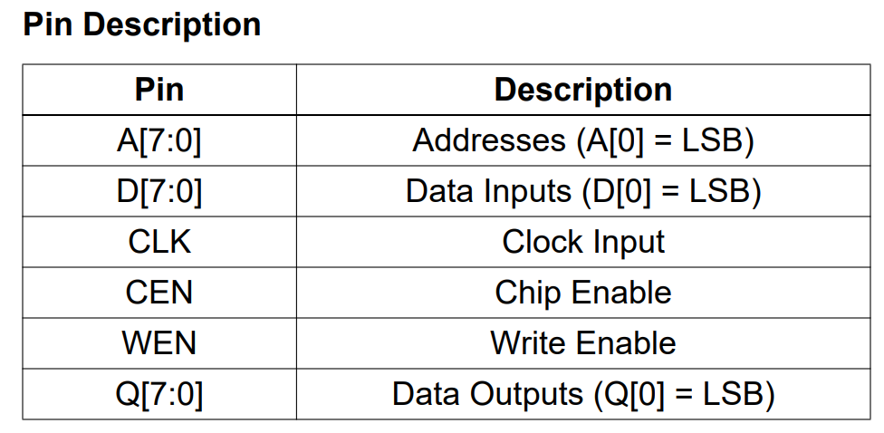

SRAM
3 types of SRAM
You can use the SRAM to store the data
$256×8, 512×8, 4096×8$
Pin description – Take $256×8$ as example

Slide 45
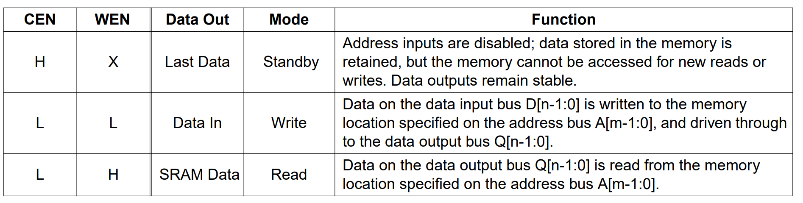
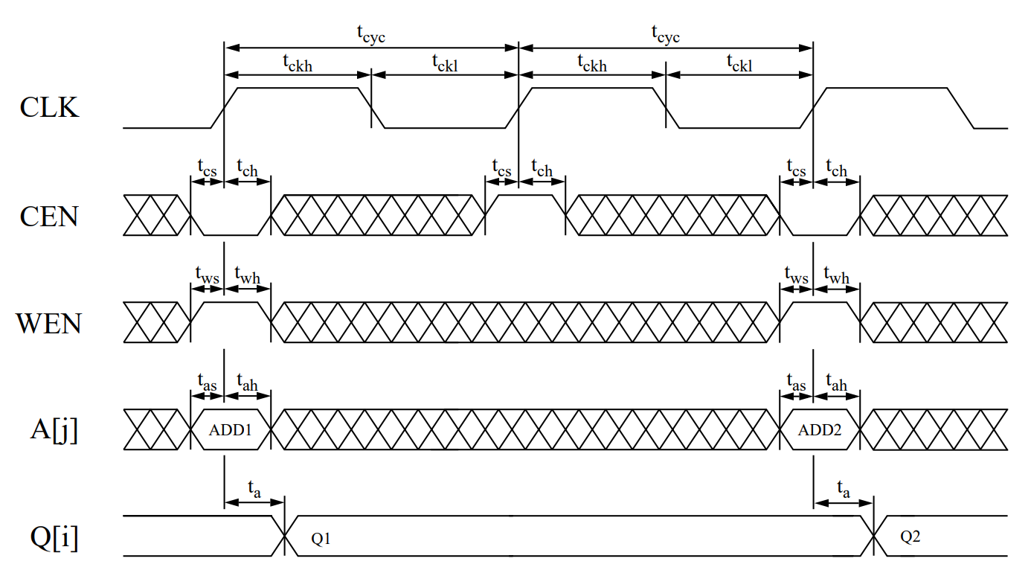

SRAM (cont.)
Logic table – Take $256×8$ as example
Read cycle

Slide 46
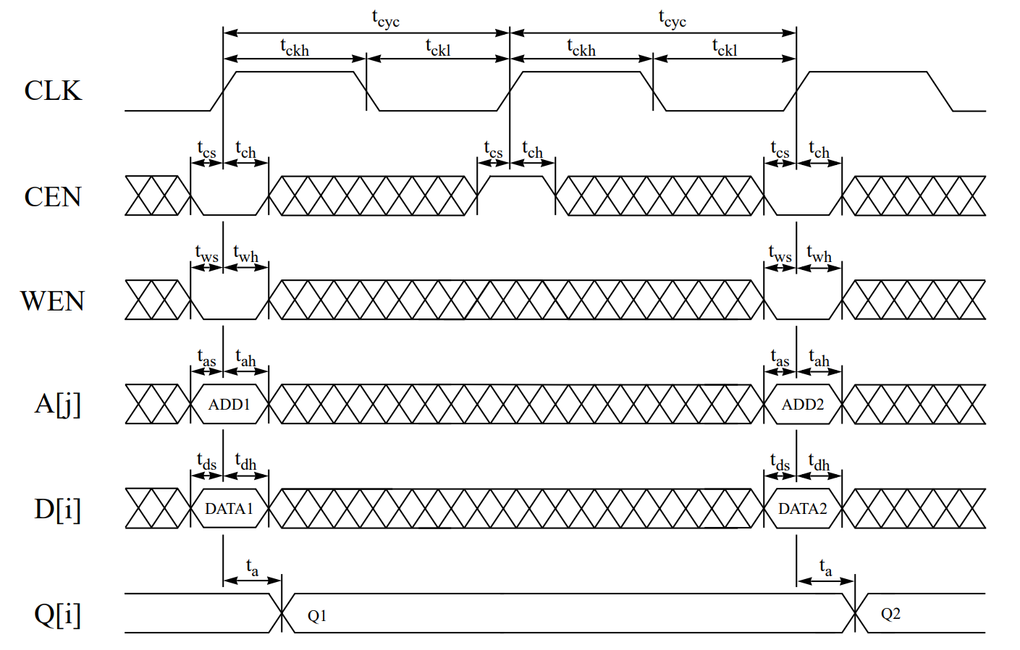
SRAM (cont.)
Write cycle
Read datasheet for details

Slide 47
SIMULATION

Slide 48
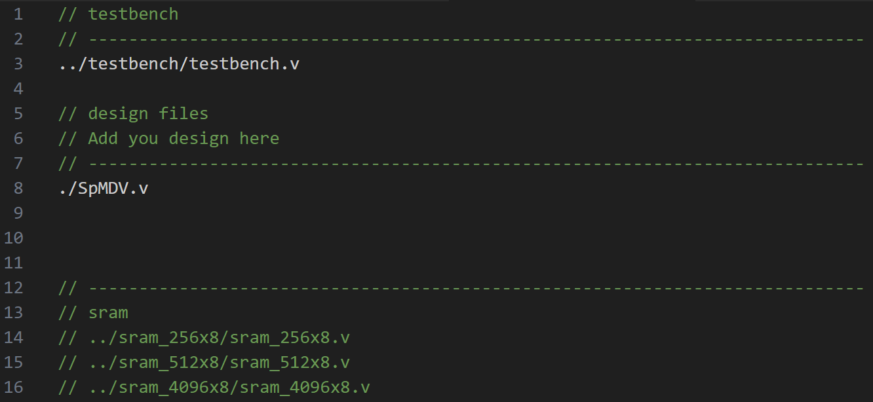


RTL
rtl.f
Add your own module
Remove the '//' that corresponds to the SRAM you are using
Run the RTL simulation under RTL
Run the command
If you can’t simulate with ./run_rtl, type in chmod u+x ./run_rtl and run the “./run_rtl” again

Slide 49

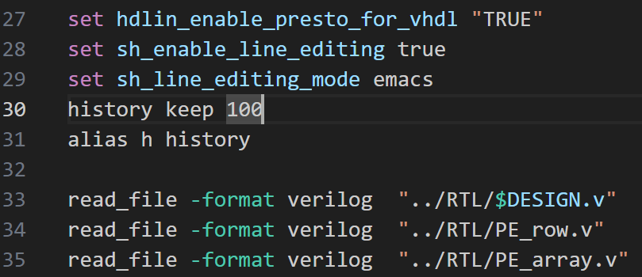
SYN
SpMDV.sdc
Adjust cycle time and check cycle time in testbench.v
syn.tcl
Add your design here if necessary
Run the synthesis under SYN
Run the command
If you can’t simulate with ./02_run.dc, type in chmod u+x ./02_run.dc and run the “./02_run.dc” again

Slide 50
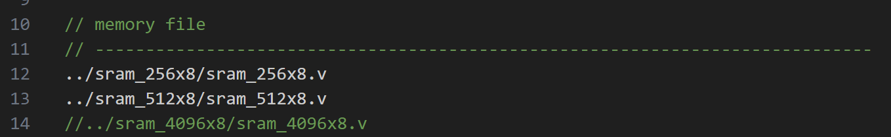

GATE
rtl_03.f
Remove the '//' that corresponds to the SRAM you are using
Run the gate-level simulation under GATE
Run the command
If you can’t simulate with ./03_run, type in chmod u+x ./03_run and run the “./03_run” again

Slide 51



POWER
scrip.tcl
Modify the time interval
Run the power analysis under POWER
Run the command
If you can’t simulate with ./04_run, type in chmod u+x ./04_run and run the “./04_run” again

Slide 52

Precautions
Run simulation without generating .fsdb file
RTL → run_rtl, GATE → 03_run
Add + FSDBOFF after tb0 as follow
Before power analysis
You have to dump the .fsdb file for gate-level simulation

Slide 53
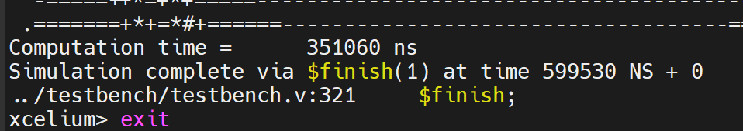

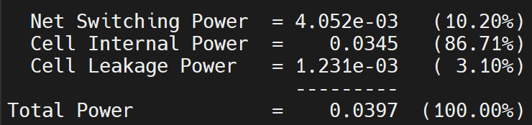

Performance
Performance
Area ($μm^{2}$)
Time (ns) – Exclude time to load weight value, position of nzv, bias value
→AT = Area $×$ Time
Power(W)

