Slide 1

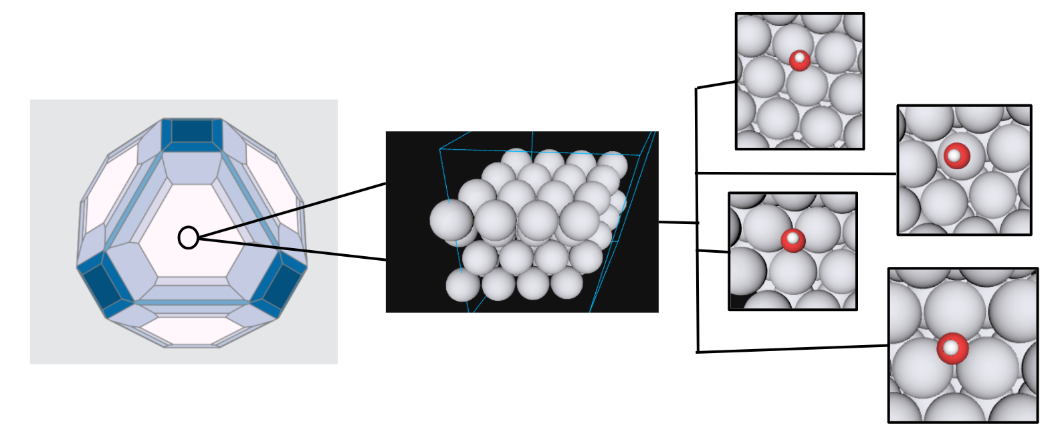

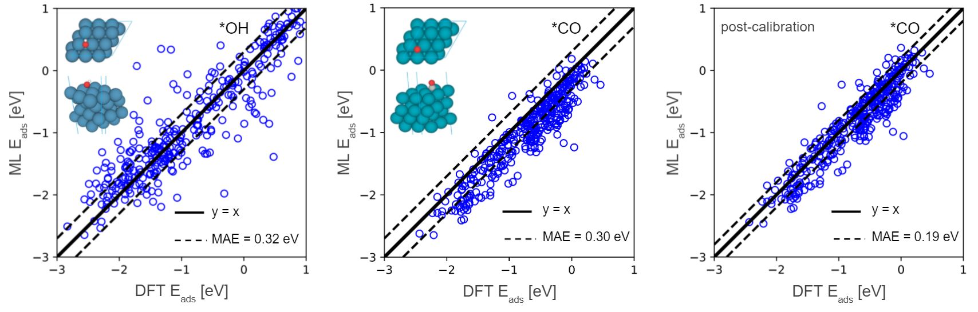
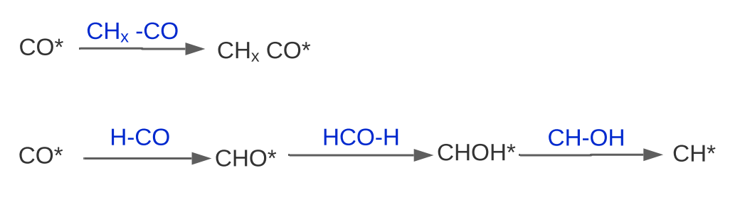
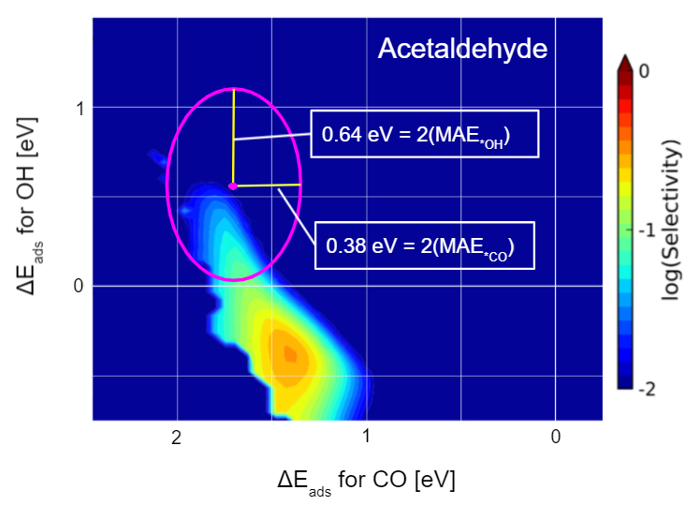
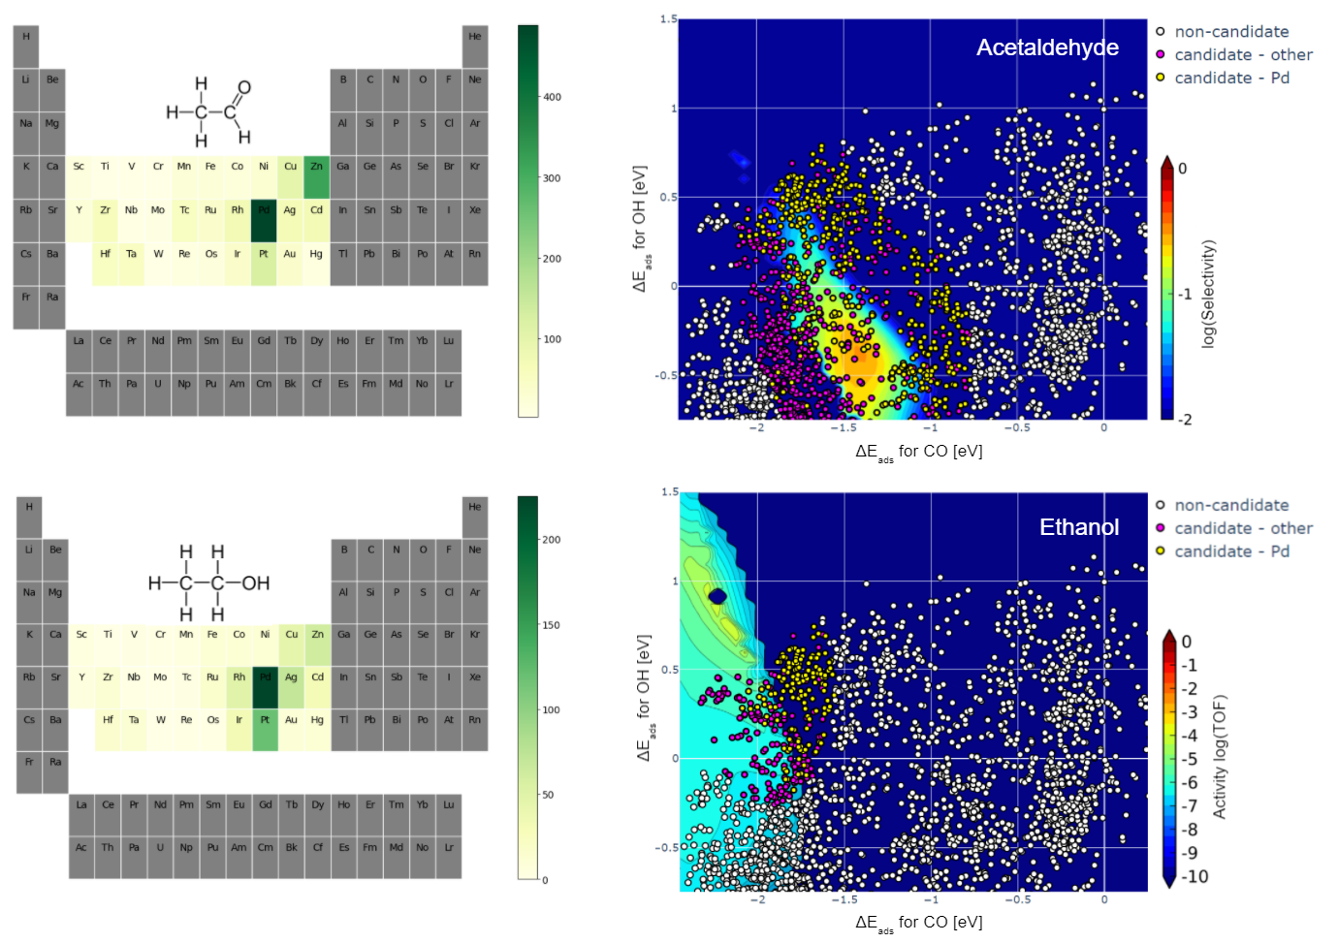
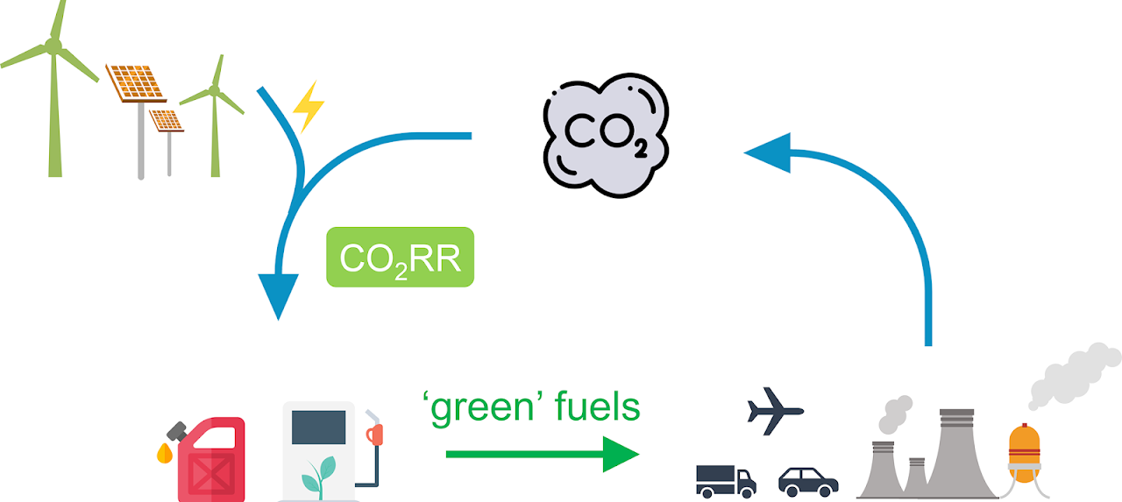
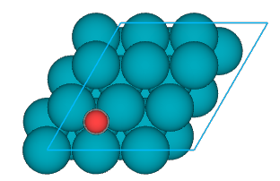
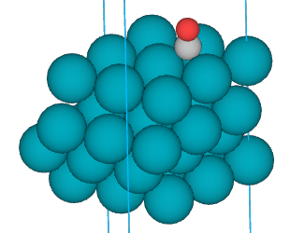
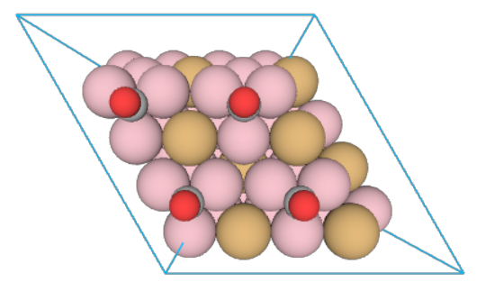
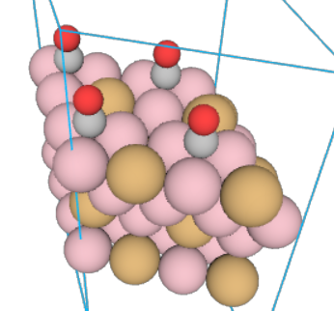
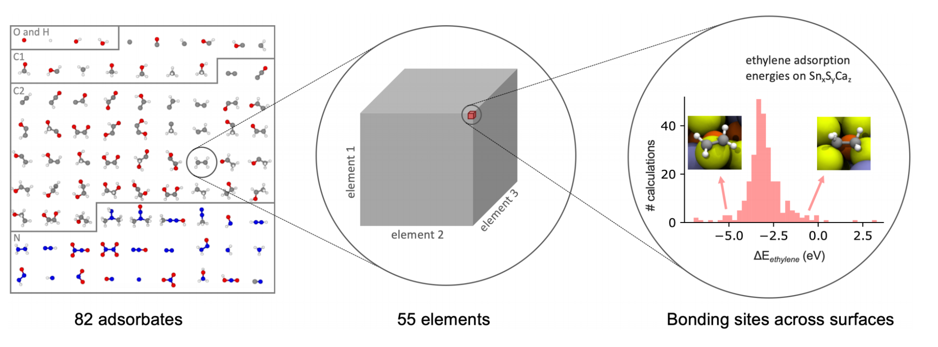
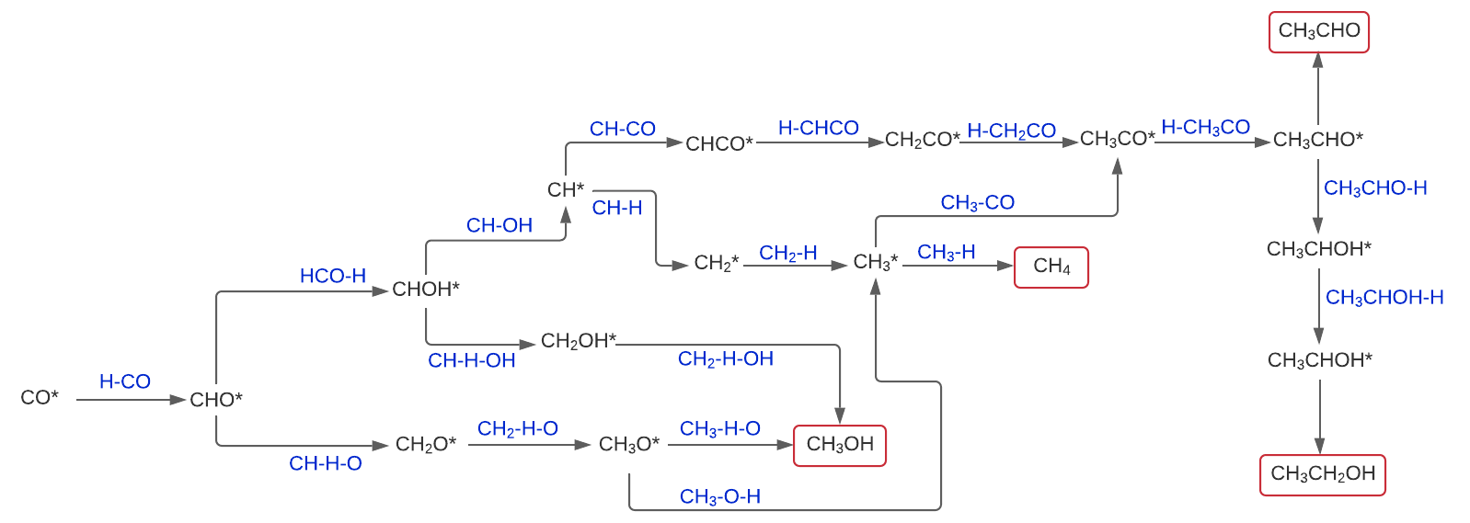
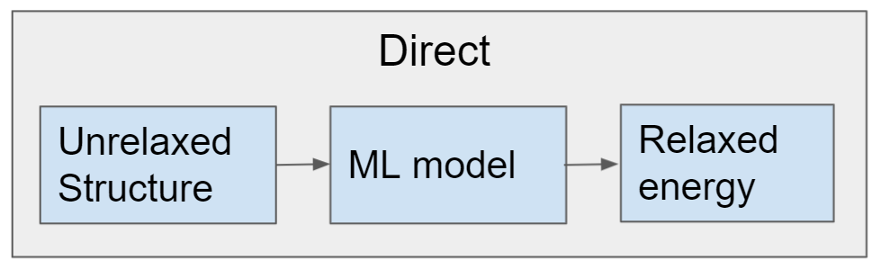
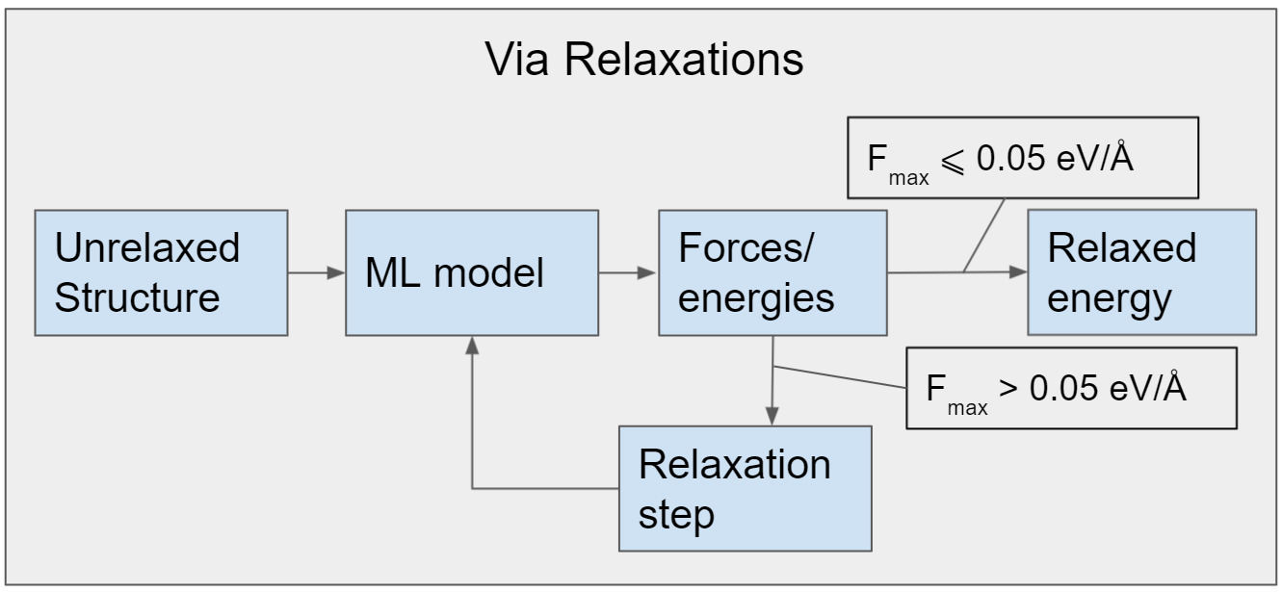
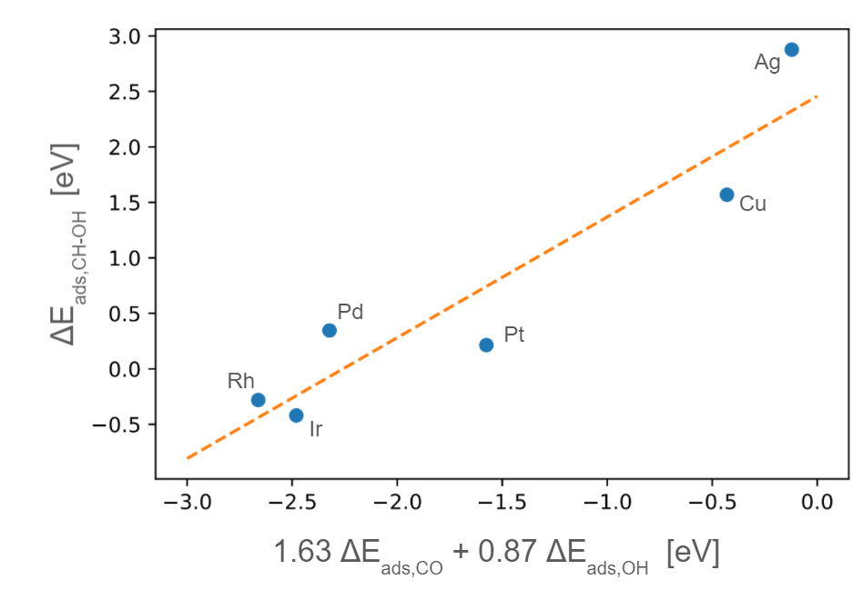
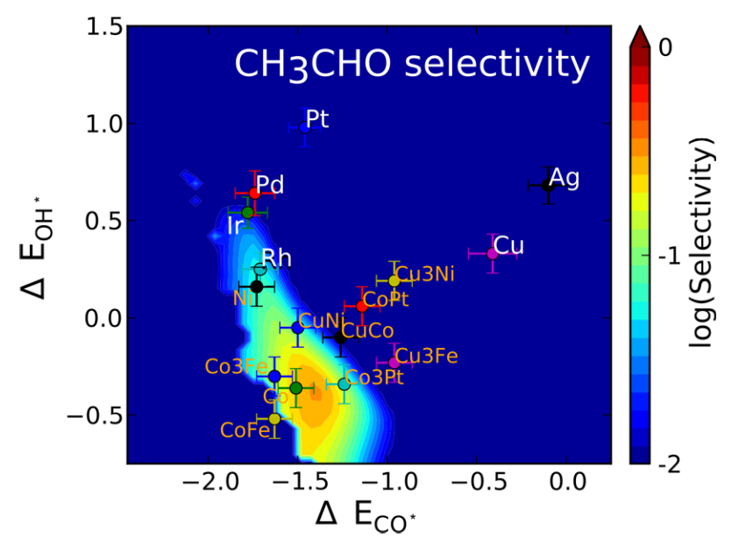
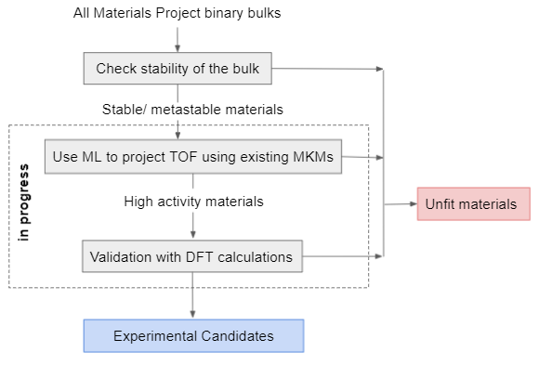
High throughput screening of binary intermetallics for the
direct conversion of syngas to multi-carbon oxygenates
Brook Wander, Zachary Ulissi
Chemical
Engineering
Objective
Background
Results
Discover novel catalysts that facilitate the selective conversion of syngas to multi-carbon oxygenates.
Binary Intermetallic Design Space
ML Mean Absolute Errors
Motivation
Synthesis gas chemistries are a pillar of the petrochemical industry. Syngas can be made from biomass. Carbon monoxide can be made from CO₂ reduction reaction. With access to sustainable hydrogen, syngas chemistries could prove to be an attractive way to access value-added carbon products sustainably in a post-fossil fuel era.
We consider all transition metal binary intermetallic materials. A variety of unique sites on surfaces with miller indices less than 2 are considered. This requires the calculation of 3.2 million descriptor energies.
Reaction Network Difficulty
Transition Metal Candidates
Good catalysts must dissociate *CO to form *CH_{x} intermediates, but also maintain *CO for insertion. Rhodium and CuCo systems demonstrated promise experimentally.
Rhodium
Copper - Cobalt
Methods
Surfaces with minimum binding energies that capture a design space with selectivity ≥ 0.1 are considered
A majority of candidates are palladium containing, which is relatively unexplored
More CuCo candidates should be considered for pipeline validation
Fengwang Li Group https://fengwangli.com/research
Background
Machine Learning (ML) Inference
Reaction network
Models were trained using the OC20 dataset, a dataset of 460,000 density functional theory calculations. The materials of interest here are well represented by the dataset.
Chanussot, L. et al. ACS Catal. 2021, 11, 10, 6059-6072
Two approaches can be used. The direct approach was used to screen all 1.6 million *OH energies. The relaxation approach was used for *CO energies where the minimum *OH values over a surface were in the range considered in the microkinetic model.
Conclusions
J.Schumann et al. ACS Catal. 2018, 8, 3447−3453
Syngas chemistries could prove to be effective for accessing value-added multi-carbon products in a post-fossil fuel era
ML models are well suited for broad design space exploration for the discovery of novel catalysts
Two descriptor microkinetic models
Material Pipeline
ML inference was parallelized using a custom dask (an open-source parallel computing platform) workflow. This allowed many calculations to be performed at one time over many cores.
Next Steps
Many elementary step networks can be reduced to functions of just 2 descriptors by developing relations between all the energies in the network and the descriptors.
Deploy an interactive web dashboard of results to facilitate communication and collaboration
Consider other materials databases for broader exploration
J.Schumann et al. ACS Catal. 2018, 8, 3447−3453
Contact
Brook Wander: bwander@andrew.cmu.edu
Zachary Ulissi: zulissi@andrew.cmu.edu
Carnegie Mellon University

