Slide 1


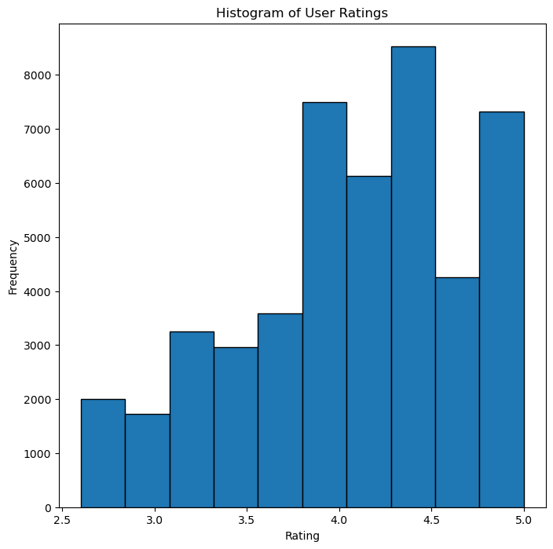
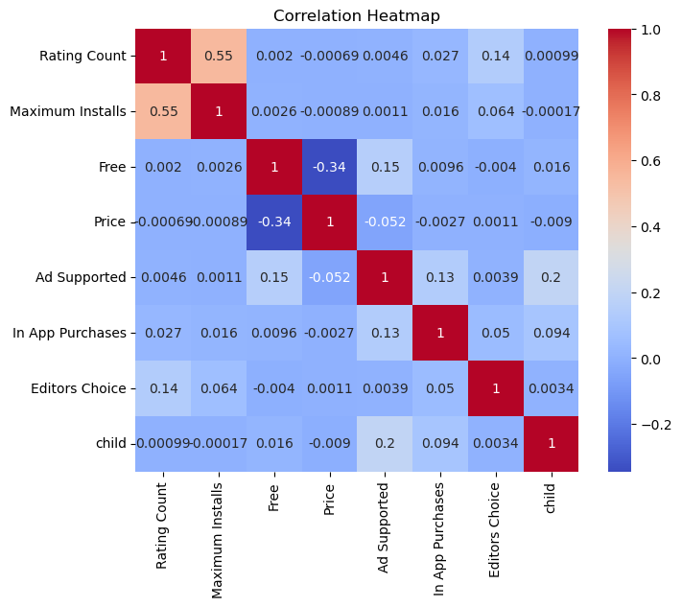
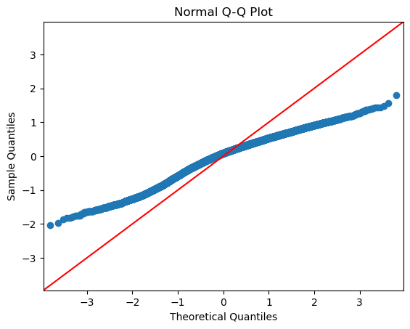
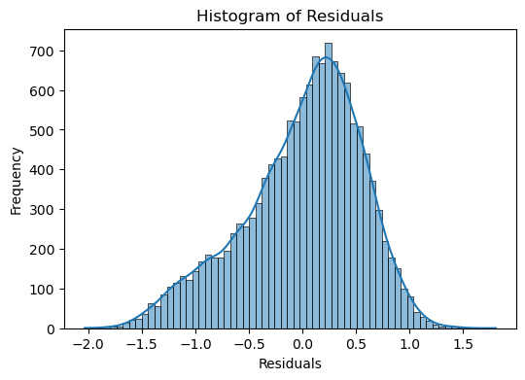
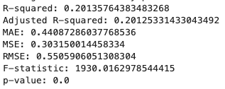
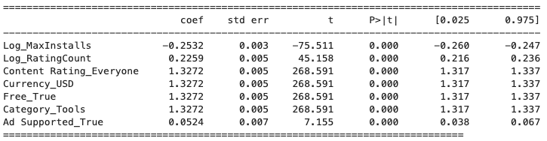
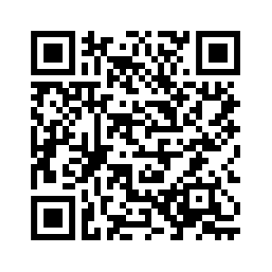
Enjoying This Poster? Leave a Review! —
Predicting User Ratings for Applications in the Google Play Store
Megan Wilder – Expected Graduation: Spring 2025
INTRODUCTION
Dr. Sudhashree Sayenju
DISCUSSION
When in the process of creating an application for consumers, developers may want advice on the best course of action to promote the success of their app. With the goal of helping developers determine where their focus should lie, this project investigates the connections between an application’s qualities and the average user rating it receives.
The dataset utilized was sourced from Kaggle and consists of information relating to over 2.3 million applications on the Google Play Store as of June 2021. Variables that were included in this dataset include descriptive information on each app as well as statistics on the app’s performance in the play store.
Pre-Modeling Assumptions
Graphs and Figures:
Figure 1 and Figure 2 help to visualize some of the assumptions checked prior to performing the Multiple Linear Regression analysis. Figure 1 shows a histogram of the dependent variable, “Ratings”, and we can see that the distribution is somewhat skewed, but still is acceptable to assume normality of distribution. Figure 2 displays the low amount of multicollinearity between the quantitative predictor variables.
Figure 3 and Figure 4 display visualizations for residuals produced during modeling. Figure 3 shows a less-than-ideal Q-Q plot for normality of distribution amongst the residuals. Figure 4 shows a decently normally-shaped distribution of the residuals, but the peak of this bell curve falls a bit too far to the right from 0 to be ideal.
Discussion:
As can be seen in the graphs and by the relatively low R-squared value of about 0.20, this model is not ideal for use in prediction purposes. While this model does not provide an amazing insight into user preference and interests, there are still a few things that can be observed from the results.
One observation I found from the results was that, while number of installs had a negative association with an app’s rating, number of ratings had a positive association with the rating. The reason for this may be that a small but loud majority of displeased users are leaving negative reviews on an app, but if the average user were asked to review an app, they are more likely to leave a neutral or positive rating.
Thus, developers may consider creating incentives for more of their users to leave ratings on their app. One way to incentivize users to rate the app while also conditioning them to think more positively during their review is to reward them with in-app currency or rewards. If this option is not applicable to an app, the developers may want to try prompting their users to leave a review after they have successfully used the app for its intended purpose. For example, a person using a grammar-checking app such as Grammarly is more likely to leave a positive review for it after receiving accurate and meaningful changes to their submitted writing than a person who has only just opened the app and never truly used it.
This suggestion also relates to the positive association an app’s rating has with whether that app falls under the “Tools” category. If a developer is trying to decide what type of app may be received most positively, they may want to consider making something functional over something like a game. If the developer did want to create a game however, the data suggests that family-friendly games may perform better than age-restricted games based on the positive association between an app’s rating and the content rating “Everyone”.
For concerns a developer may have about making money, they may want to consider making their app free and having advertisements within the app to earn money. This is because, while free apps appear to be more highly rated than paid apps by over a whole star rating, whether an app contains ads has hardly any affect on its rating.
Developers interested in more accurate and helpful criteria for the sorts of apps they should be making would benefit from further research with a greater variety of predictors. This project was limited due to the number of variables as well as the descriptiveness of the variables.
METHODS
A Multiple Linear Regression analysis was performed using Python to determine what variables most greatly affect the user rating an app will receive. A Random Forest Regression was also created and analyzed, but it was found to have very little predictive power.
Firstly, the dataset was cleaned and prepared for modeling. During this preparation, transformed versions of certain continuous predictors were created. A 70-30 split was used to separate the dataset into training and testing datasets, then the training dataset was further split into training and validation datasets. A stepwise selection was used on the training dataset to determine variables for an initial linear regression model. This initial model was then quality tested using the validation dataset. In this model, the following variables were found to have statistical significance in predicting an app’s rating:
Note: Highlighted variables indicate a variable that was used in its log-transformed form for modeling.
Maximum Installs: The estimated maximum number of installs that an app received.
Rating Count: The # of ratings the app has received from users.
Content Rating_Everyone: Whether the app’s content rating falls under ”Everyone” (1) or not (0).
Currency_USD: Whether the app accepts USD (1) as opposed to other currencies (0).
Free: Whether an app is free (1) or not (0).
Ad Supported: Whether the app contains advertisements (1) or not (0).
Category_Tools: Whether an app falls under the “Tools” category (1) or not (0).
Additionally, graphs, visualizations, and tables were produced along the way for observation and verification purposes.
Figure 1: Histogram of the dependent variable “Ratings”.
Figure 2: Correlation heatmap of the continuous and binary predictor variables in the data.
Post-Modeling Results
RESULTS
Goodness of Fit Statistics:
R² = 0.2014, which means that 20.14% of the variance in rating can be explained by the independent variables. This is a low level of prediction.
Coefficient Interpretations:
For every 1% increase in number of installs an app receives, the average rating of an app is expected to decrease by .0025.
For every 1% increase in number of ratings an app receives, the average rating of the app is expected to increase by .0022.
Apps that have the content rating “Everyone” are expected to have an increase in rating by about 1.33.
If an app uses USD as its currency, the average rating of the app is expected to increase by 1.33 as opposed to apps using other currencies.
If an app is Free, the average rating of the app is expected to increase by 1.33 as opposed to apps that are not free.
If an app falls under the category “Tools”, the average rating of the app is expected to increase by 1.33 as opposed to apps in other categories.
If an app includes ads, the average rating of the app is expected to increase by 0.05 as opposed to apps that do not include ads.
Figure 3: Q-Q plot of the Multiple Linear Regression model that was produced.
Figure 4: Histogram of the residuals produced by the Multiple Linear Regression model.
Table 1: Goodness of Fit statistics produced based on the Multiple Linear Regression model.
PYTHON CODE
Link to GitHub repository:
Table 2: Coefficients, standard error, t-statistics, p-values, and confidence intervals produced for the independent variables in the Multiple Linear Regression model.

