Slide 1


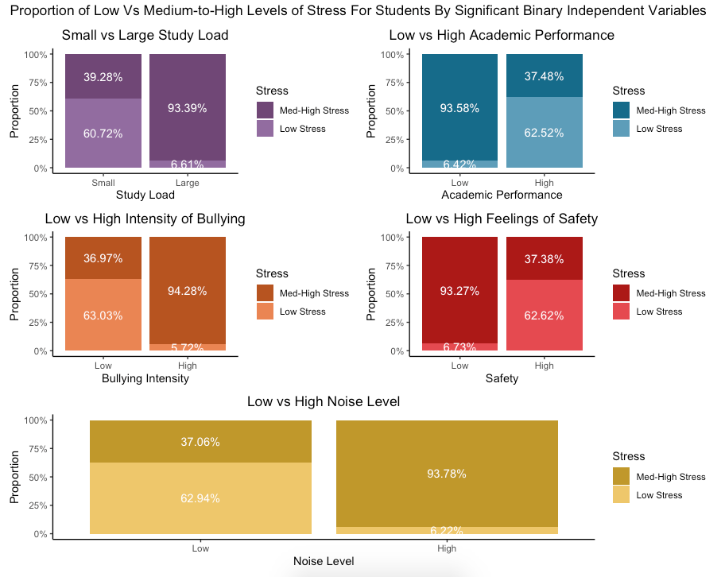
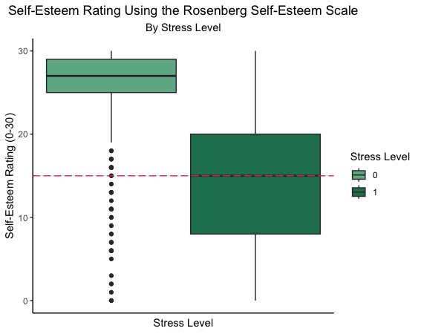
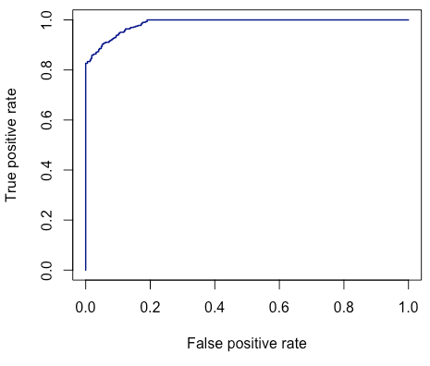
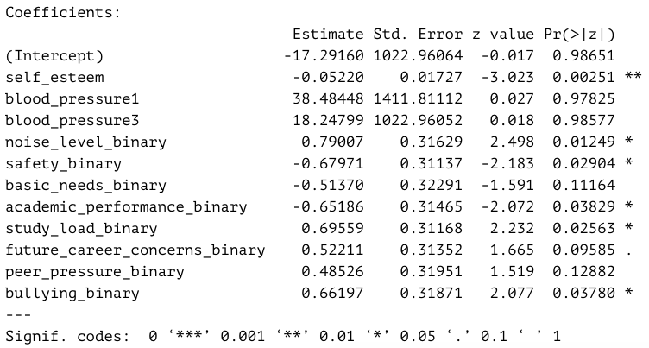
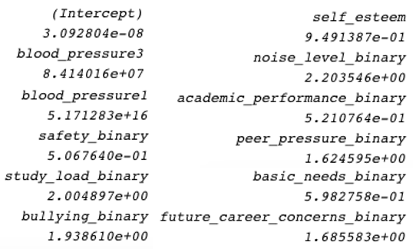
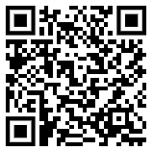
Don’t Stress Out!
Student Stress and How Schools Can Help
Megan Wilder – Expected Graduation: Spring 2025
INTRODUCTION
Dr. Austin Brown, Prof. Michael Frankel
DISCUSSION
Many high school and college-aged students struggle with mental health as they work to meet high academic standards while also managing the newly acquired responsibilities of adulthood. During this time of change, understanding the factors that affect a student’s level of stress can help them determine what areas of their life they may need help to improve.
The dataset utilized was provided on Kaggle by author Chhabi Acharya and was collected via a survey in 2022, which gathered 1,100 responses. The data collected includes self-reported stress levels of high school and college-aged students in Dharan, Nepal, as well as psychological, physiological, social, environmental, and academic factors that may affect their feelings of stress.
Graphs
Many students with high self-esteem scores reported experiencing low stress, while students with average-to-low self-esteem scores mostly reported experiencing medium-to-high stress, as can be seen in Figure 2.
In Figure 1, the distribution of students in each bar plot who experience low vs. medium-to-high stress displays similar percentages across each of the independent variables.
Figure 3 shows the ROC curve for the logistic regression model, which has a c-statistic of 0.986, meaning the model has incredibly good fit.
Discussion
The results show a positive relationship for large study loads, low academic performance, high amount of bullying, low feelings of safety, and high noise level in relation to stress. Then, what can be done to decrease students’ feelings of stress that may stem from these factors?
Schools may be able to decrease feelings of stress for their students by providing quiet, safe spaces for the students to work and relax. Some students may not have access to a comfortable work environment at home, so ensuring that all students are allowed access to study rooms can help lessen their feelings of stress related to their environment.
Part of ensuring students feel safe at school involves controlling the amount and severity of bullying between them. Schools should take steps to properly discourage and punish students who engage in bullying.
Students can also benefit from access to quick and open communication with school counselors and teachers. Faculty should strive to make students feel safe and listened to when they are experiencing stress at school or at home. When students feel like they have an outlet with which to share their stressors, their overall stress levels may be more likely to be manageable.
Teachers and school counselors should also check in with students regarding workload and academic performance. When students are given more assignments than they can handle, their academic performance is likely to drop. Teachers should consider whether the homework they are assigning students is truly necessary, or if alternative teaching methods, such as in-class activities or discussions, may be just as beneficial for learning.
Further research into this topic may benefit from more detailed survey questions relating to each variable. For example, asking students whether they feel safe with their peers vs. their teachers vs. at home can provide better insight than simply their overall feelings of safety. This can also help reduce problems relating to self-reported data, as more specific questions leave less room for varying interpretations.
METHODS
A logistic regression analysis was performed to determine which variables most greatly affect whether a student experiences medium-to-high levels of stress.
Using R, the variables underwent a stepwise selection that determined which variables would be used as predictors in the logistic regression model. The following variables were found to have statistical significance in predicting stress:
stress: Whether the student experiences a low level of stress (0) or a medium-to-high level of stress (1).
study_load: Low (0) versus high (1) amount of schoolwork the student has.
academic_performance: Whether the student is doing well in school (1) or not (0).
bullying: Whether the student experiences a low amount/severity of bullying (0) or a high amount/severity of bullying (1).
safety: Whether the student feels safe in their school and home environments (1) or not (0).
noise_level: Whether the workspace the student utilizes has a low noise level (0) or a high noise level (1).
self_esteem: Scored from 0-30 using the Rosenberg Self-Esteem Scale, where lower values indicate low self-esteem.
Descriptive graphs were generated for each of the relevant variables to show the frequency distribution of students by their reported level of stress. Additionally, an ROC curve plot was generated to visualize the fit of the model.
Figure 1: 100% Bar Charts of Binary Predictor Variables by Whether the Student Experiences Low or Medium-to-High Stress.
RESULTS
An increase in a student’s self-esteem by one point on the Rosenberg Self-Esteem scale is associated with a decrease in odds of medium-to-high stress by approximately 5.1%.
Students who live/work in environments with high noise levels are approximately 2.2 times more likely to experience medium-to-high stress than students in low noise level environments.
Students with larger study loads are approximately 2 times more likely to experience medium-to-high stress than students with smaller study loads.
Students experiencing a high amount of bullying are nearly 2 times more likely to experience medium-to-high stress than students experiencing a low amount of bullying.
Students in low-safety environments are approximately 49.3% more likely to experience medium-to-high stress than students in high-safety environments.
Students who have high academic performance are approximately 47.9% less likely to experience medium-to-high stress than students who have low academic performance.
Figure 2: Boxplot of Self-Esteem by Whether the Student Experiences Low or Medium-to-High Stress.
Figure 3: ROC Curve Showing Good Fit for the Model.
R CODE
Link to GitHub Repository
Table 1: Table Showing Estimates, Errors, Z-Statistics, and P-Values for Variables in the Logistic Regression Model.
Table 2: Odds Ratios for Independent Variables in the Logistic Regression Model.

