Slide 1
Disneyland Reviews Sentiment Analysis
By Megan Tan

Slide 2
Dataset information and preprocessing

Slide 3
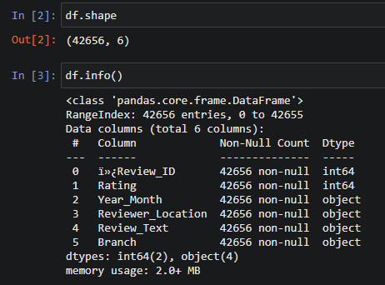
Dataset Information - Exploration

Slide 4
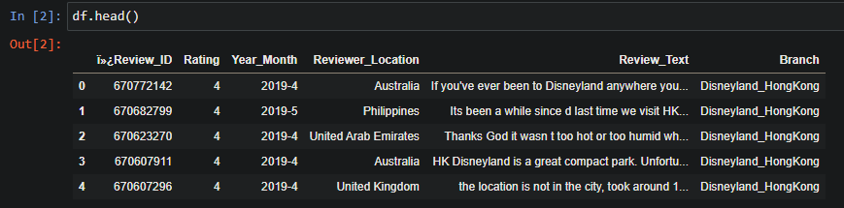
Dataset Information - Exploration
42656 rows, 6 columns
columns of interest are rating, and review_text

Slide 5
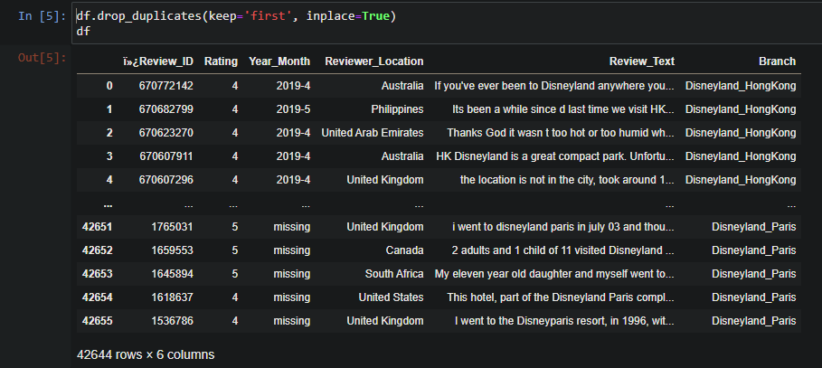
Dataset Information - Preprocessing
42644 rows after removing duplicates

Slide 6
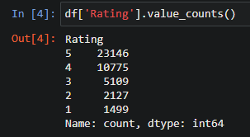
Dataset Information - Preprocessing
Predictor variable is “Review_Text”.
  Lowercasing and stop word removal applied
Response variable is “Sentiment”
  Sentiment is based on rating.
    Positive sentiment = 4-5
    Negative sentiment = 1-3

Slide 7
Label distributions FOR DATASET

Slide 8
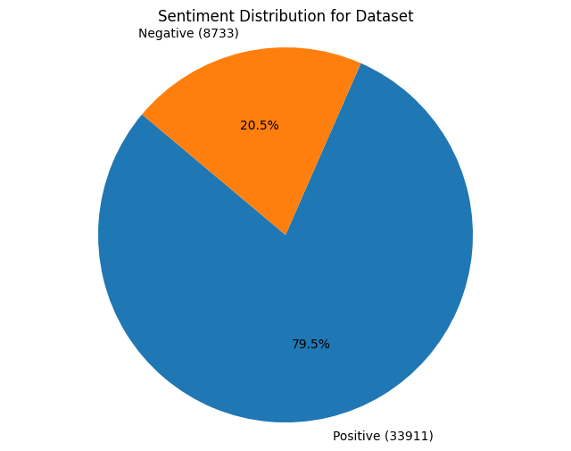
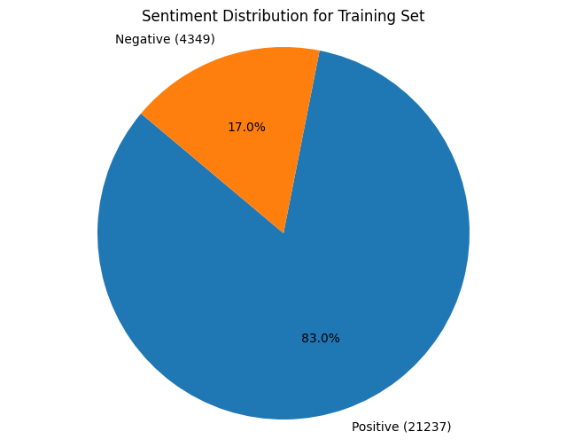
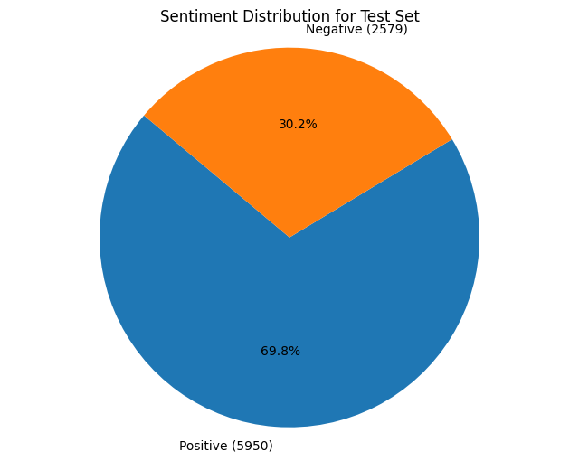
LABEL DISTRIBUTION
Training set is first 80% of data
Test set is last 20% of data

Slide 9
Model Information

Slide 10
PseudoCode
Clean Data – drop duplicates, remove stopwords, apply lowercasing to reviews
Split test and training sets – training set is first 80% of data, test set is last 20% of data
Get vocabulary from the entire dataframe
Using binary bag-of-words technique, set presence of a token in a review to 1 for each review in the training set
Using binary bag-of-words technique, set presence of token in a review to 1 for each review in the test set
Calculate probability of having a positive sentiment and a negative sentiment in the training set.
  E.g. P(positive) = count of positive sentiment in training set/number of rows in training set
Calculate probability of each token given each sentiment. Use +1 smoothing
  Formula is ((Count x= X, y = Y) + 1)/(count(number of words when y = Y) + number of words in Vocabulary)
    x is the token, y is the sentiment
Predict sentiments for the test set’s reviews
Compare predicted sentiments with actual sentiments to calculate metrics

Slide 11
PseudoCode – Prediction
predictions = []
log_probability_negative = log(probability review is negative) #step 6
log_probability_positive = log(probability review is positive) #step 6
log_probabilities_token_negative = log(probabilities of each token given negative sentiment) #step 7
log_probabilities_token_positive = log(probabilities of each token given positive sentiment) #step 7
For each review to predict
log_probability_this_review_negative = log_probability_negative
log_probability_this_review_positive = log_probability_positive
For each word in review
log_probability_this_review_negative = log_probabilities_token_negative[this_token]
log_probability_this_review_positive = log_probabilities_token_positive[this_token]
prediction = 1 if log_probability_this_review_positive > log_probability_this_review_negative else 0
push prediction into predictions

Slide 12
PseudoCode- Alternative Model
Clean Data – drop duplicates, remove stopwords, apply lowercasing to reviews
Split test and training sets – training set is first 80% of data, test set is last 20% of data
Undersample training set so that training and test sets are the same size
Get vocabulary from the entire dataframe
Using binary bag-of-words technique, set presence of a token in a review to 1 for each review in the training set
Using binary bag-of-words technique, set presence of token in a review to 1 for each review in the test set
Calculate probability of having a positive sentiment and a negative sentiment in the training set.
  P(positive) = count of positive sentiment in training set/number of rows in training set
Calculate probability of each token given each sentiment. Use +1 smoothing
  Formula is ((Count x= X, y = Y) + 1)/(count(number of words when y = Y) + number of words in Vocabulary)
    x is the token, y is the sentiment
Predict sentiments for the test set’s reviews
Compare predicted sentiments with actual sentiments to calculate metrics

Slide 13
PackageS
Numpy – for array operations
Pandas – to store dataframe
Matplotlib – for plotting data
Nltk – tokenize reviews and remove stopwords
Scipy – for sparse matrix to store binary bag of words as the data set is large
Sklearn – for confusion matrix calculation, ROC curve calculation and resampling training set in the alternative model
Seaborn – for confusion matrix visualization
Calculating binary bag of words and probabilities, and predicting sentiment are done manually without any packages for the calculations

Slide 14
Model Evaluation

Slide 15
Model metrics
METRIC | MODEL | ALTERNATE MODEL
Number of True Positives | 2245 | 1788
Number of True Negatives | 4840 | 5421
Number of False Positives | 334 | 791
Number of False Negatives | 1110 | 529
Sensitivity (recall) | 0.6692 | 0.7717
Specificity | 0.9355 | 0.8727
Precision | 0.8705 | 0.6933
Negative Predictive Value | 0.8134 | 0.9111
Accuracy | 0.8307 | 0.8452
F-score | 0.7567 | 0.7304

Slide 16
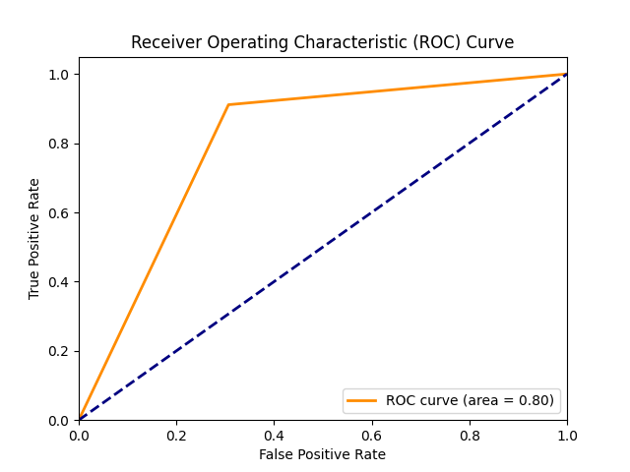
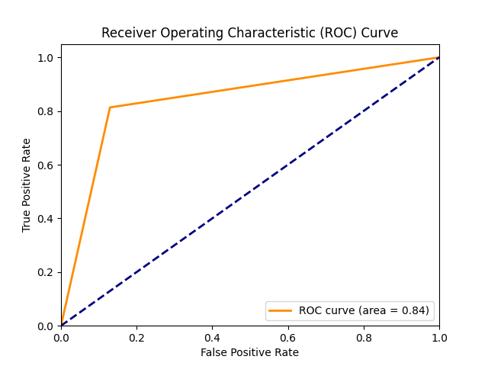
ROC CURVE
Model
Alternate Model

Slide 17
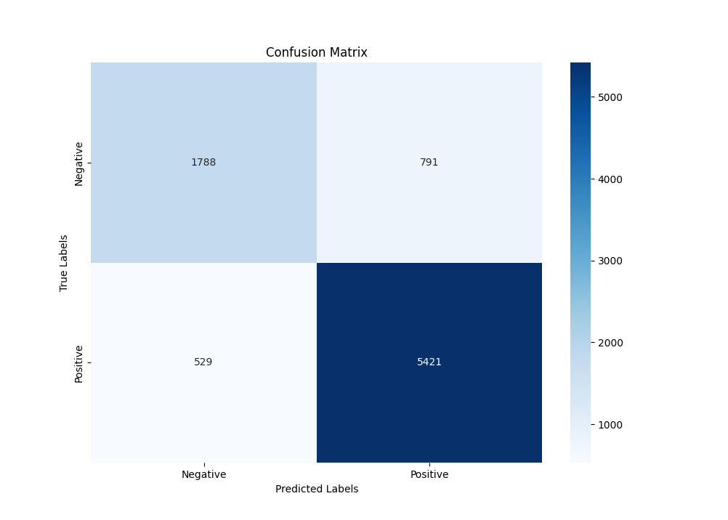
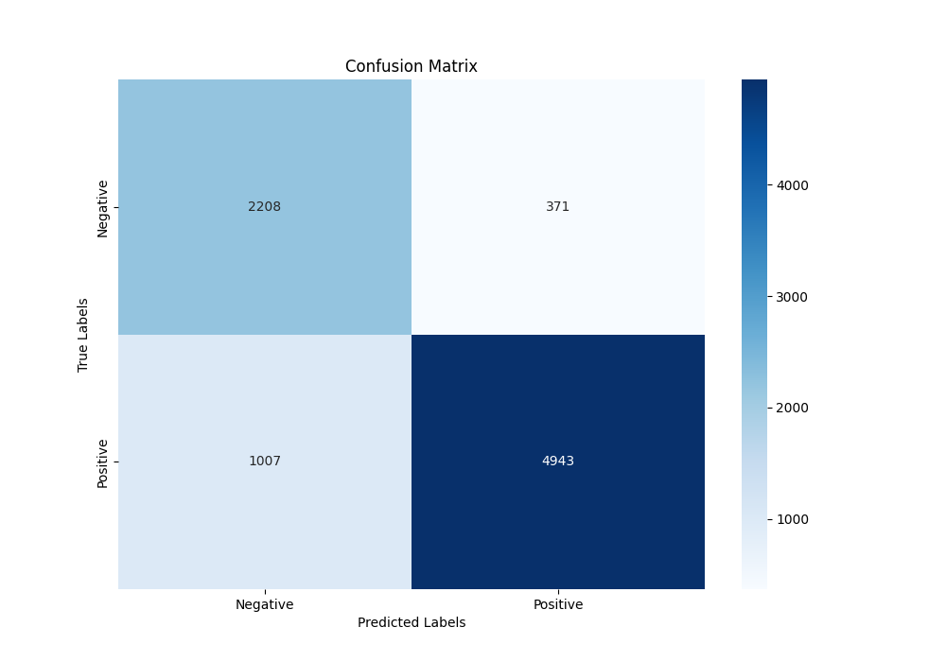
Confusion Matrix
Model
Alternate Model

Slide 18
Observations and SUmmary

Slide 19
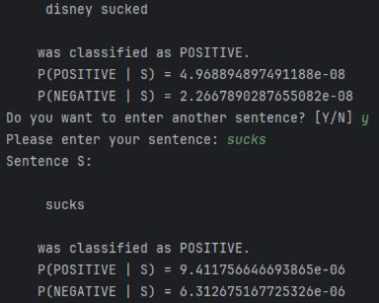
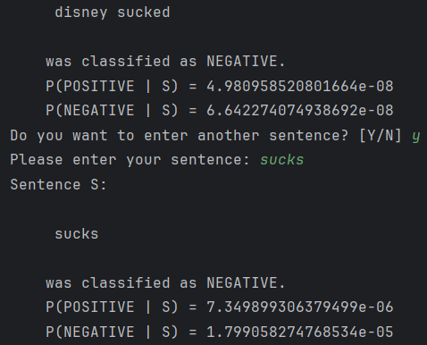
Summary
Alternate model performed better. This is expected as the imbalance data was dealt with
Surprisingly, the word “sucks” is positive in the model. However, it is negative in the alternate model
Model Testing
Alternate Model Testing

Slide 20
Summary
To improve performance
  Data can be shuffled when splitting into training and test sets
  Dictionary of positive and negative words can be provided
  Use cross validation techniques
  Use a different technique (not Naïve Bayes)

