Slide 1


INTERNAL PITCH · ENGINEERING
Pulumi
A modern approach to Infrastructure as Code
Write infrastructure in real programming languages.
Collaborate, secure, and ship faster with Pulumi Cloud.
Megan · Cloud Support Engineer, Pulumi

Slide 2
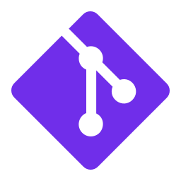





FOUNDATIONS
What is Infrastructure as Code?
Manage cloud resources through code instead of clicking through consoles. Define what you want; the tool makes it so.
Versioned
Repeatable
Auditable
Infra changes live in Git alongside app code. Full history, diffable, reviewable.
Spin up identical environments in seconds. Dev, staging, prod stay in sync.
Every change has an author and a reason. Compliance and security teams sleep better.
Fast
Automatable
Collaborative
Stop hand-rolling resources. Reduce time-to-environment from days to minutes.
Plug into CI/CD. No more snowflake servers or 'works on my machine' infra.
Teams work on infra the same way they work on code: branches, PRs, reviews.
2 / 10

Slide 3
COMPARISON
Pulumi vs. other IaC tools
 | Pulumi | Terraform | CloudFormation
Language | Python, TS, Go, .NET, Java, YAML | HCL (custom DSL) | JSON / YAML
Loops, conditionals, abstractions | Native (it's just code) | Limited (count, for_each) | Limited / verbose
Cloud coverage | AWS, Azure, GCP, K8s + 150 more | Broad (provider ecosystem) | AWS only
Testing | Unit + integration tests | Plan diffing only | Plan diffing only
IDE support | Full (autocomplete, refactor, types) | Partial (HCL plugin) | Partial (schema)
Embed as library (Automation API) | Yes | No (CLI only) | No (CLI only)
Pulumi can also consume existing Terraform modules and providers, so you can adopt incrementally.
3 / 10

Slide 4
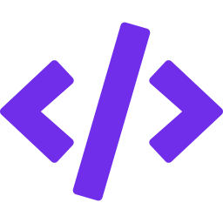



PULUMI IAC · CORE CAPABILITIES (1 / 2)
Build infra the way you build software
Real programming languages
Python, TypeScript, Go, .NET, Java, YAML. No DSL to learn. Use what your team already knows.
Loops, conditionals, functions
Create 50 buckets with a for-loop. Build classes for reusable patterns. Refactor with IDE confidence.
Testing
Unit, property, and integration tests for infra. Run in CI before anything touches the cloud.
Secrets handling
Per-stack encryption with cloud KMS, Pulumi-managed keys, or a passphrase. Secrets stay encrypted in state.
Automation API
Embed Pulumi as a library in your own Go/Python/TS app. Build self-service portals and SaaS-style provisioning.
Policy as Code (CrossGuard)
Write compliance rules in Python or TS. Block or warn on violations. OPA-compatible.
4 / 10

Slide 5
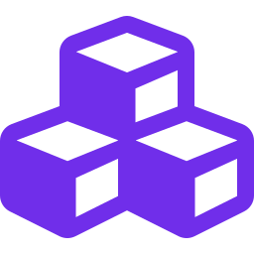




PULUMI IAC · CORE CAPABILITIES (2 / 2)
Compose, reuse, and reach any cloud
Component Resources
Package multi-resource patterns (standard VPC, EKS-with-observability) as reusable components. Publish internally.
Multi-language packages
Author a component once, consume it from any supported language. Win for polyglot platform teams.
Stacks
First-class environments (dev/staging/prod) with per-stack config. Same code, different inputs.
Any cloud, any resource
150+ providers: AWS, Azure, GCP, Kubernetes, Cloudflare, Datadog, GitHub, Snowflake. Native providers track APIs same-day.
Import + dynamic providers
Bring unmanaged resources under Pulumi with `pulumi import`. Write custom providers when none exist.
5 / 10

Slide 6
LIVE DEMO
From zero to deployed in two minutes
import pulumi_aws as aws
user_data = """#!/bin/bash
echo 'Hello, World!' > /var/www/html/index.html
systemctl start httpd"""
web = aws.ec2.Instance("web", ami=ami.id, user_data=user_data)
lb = aws.lb.LoadBalancer("alb", subnets=subnets, ...)
pulumi.export("url", lb.dns_name)
$ pulumi up
✓ Resources: 8 created
Switch to terminal: provision an EC2 instance behind an ALB serving 'Hello, World!', then curl the output URL.
6 / 10

Slide 7






PULUMI CLOUD
The managed control plane
The Pulumi IaC engine is open source. Pulumi Cloud adds the team and enterprise capabilities you need to operate at scale.
ESC
RBAC + SSO
Deployments
Environments, Secrets, Config. Centralized, hierarchical, dynamic.
Org / team / stack roles. SAML, SCIM, audit logs.
Managed remote pulumi up. Git push to deploy. Review stacks per PR.
Insights
Neo
IDP
Search and analytics across every resource in every stack.
AI assistant for querying infra, debugging, and generating code.
Self-service templates so developers get approved infra without writing IaC.
7 / 10

Slide 8

PULUMI CLOUD · ESC
One source of truth for config & secrets
Stop scattering config across .env files, CI variables, and secret managers.
staging-environment.yaml
imports:
- base/aws-creds
- shared/db
values:
aws:
login:
fn::open::aws-login:
oidc:
roleArn: arn:aws:...
db:
host: rds.staging
password: ${ssm.dbPass}
Centralized & hierarchical
Environments compose. Inherit from base, override per team or stage.
Dynamic secrets
Pull from AWS, Azure, GCP, or Vault at runtime. No long-lived creds in CI.
OIDC for short-lived creds
Pulumi Deployments and CI/CD get scoped, temporary cloud credentials.
Use anywhere
Consume via CLI, SDK, Kubernetes operator, or direct API, even outside Pulumi IaC.
Versioned & audited
Every change tracked. Roll back to any prior version.
8 / 10

Slide 9
PULUMI CLOUD · RBAC
Least-privilege access from day one
Organization
Role granularity
Org Admin · Team Admin · Stack Admin · Write · Read
Team-based access
Team: Platform
Team: AppDev
Map IdP groups to teams; teams map to stacks. Onboard with one click.
SSO & SCIM
SAML SSO and SCIM provisioning available on Enterprise.
Stack: prod
Stack: api-dev
Audit logs
Every org action logged. Exportable for SIEM ingestion.
Stack: staging
Stack: web-dev
Token scoping
Personal, team, and organization access tokens with explicit permissions.
Permissions cascade. Teams map to stack-level roles.
9 / 10

Slide 10
DISCUSSION
Questions?
Thanks for listening.

