Slide 1
Game Implementation- ZapperMine
Mégane Kickoama and Samuel Gallo

Slide 2
CONTENTS
Game Context
Characters (protagonists and antagonists)
Storyline
Goal of the game
How you win and how you lose
What has been done
Actors and their methods and types
Worlds and their purpose/methods/hierarchy
All applications/resources used to make the game
Implemented Game Mechanics
What is left to do
Non-implemented/unfinished Game Mechanics
Non-implemented/unfinished Worlds and Actors
Further ideas

Slide 3
01
Game Context
Characters $∘$ Storyline $∘$ Goal $∘$Winning Conditions

Slide 4
MAIN ACTORS
ZAPPER
FANG
BOSS FANG

Slide 5
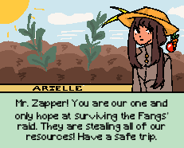
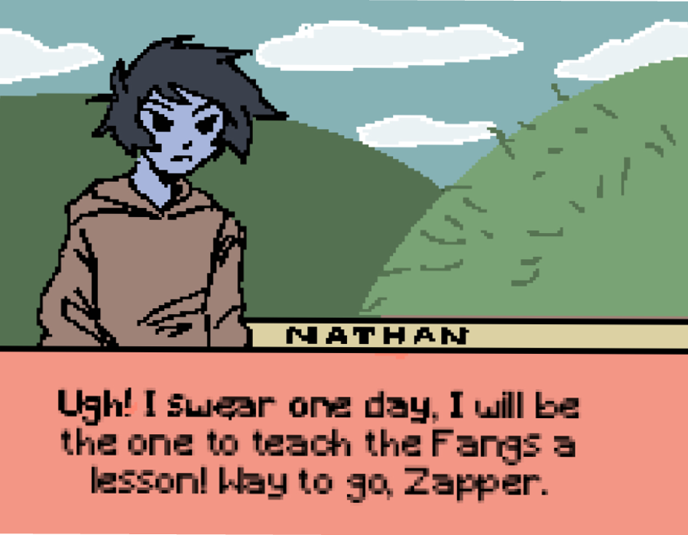
STORYLINE & NPCs
The Fangs, enemies of the ZapperWorld, are stealing resources from civilians, making it impossible for them to live a sustainable life. Luckily, the Zapper is here to save them all !

Slide 6

02
What has been done
Actors $∘$ Worlds $∘$ Resources $∘$ Mechanics

Slide 7
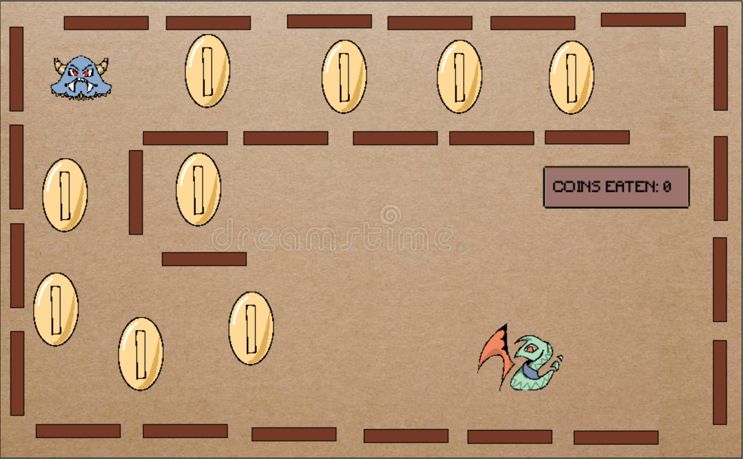
GOAL OF THE GAME
The Zapper collects coins, and so do the Fangs. Whoever gets the last coin wins, However, whoever gets a silver coin first is also the winner. They must be protected at all cost, using the surrounding obstacles. If the Zapper touches an obstacle, it dies. If a Fang touches one, it turns around. The boss Fang is able to eat the Zapper.

Slide 8
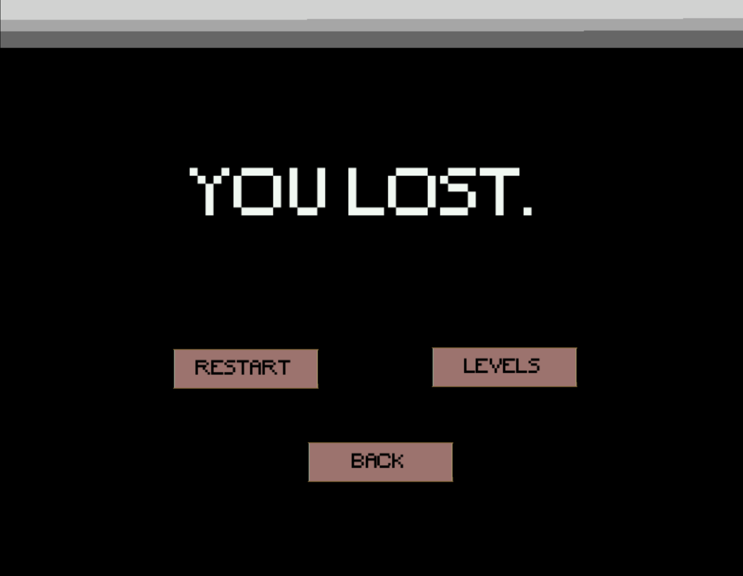
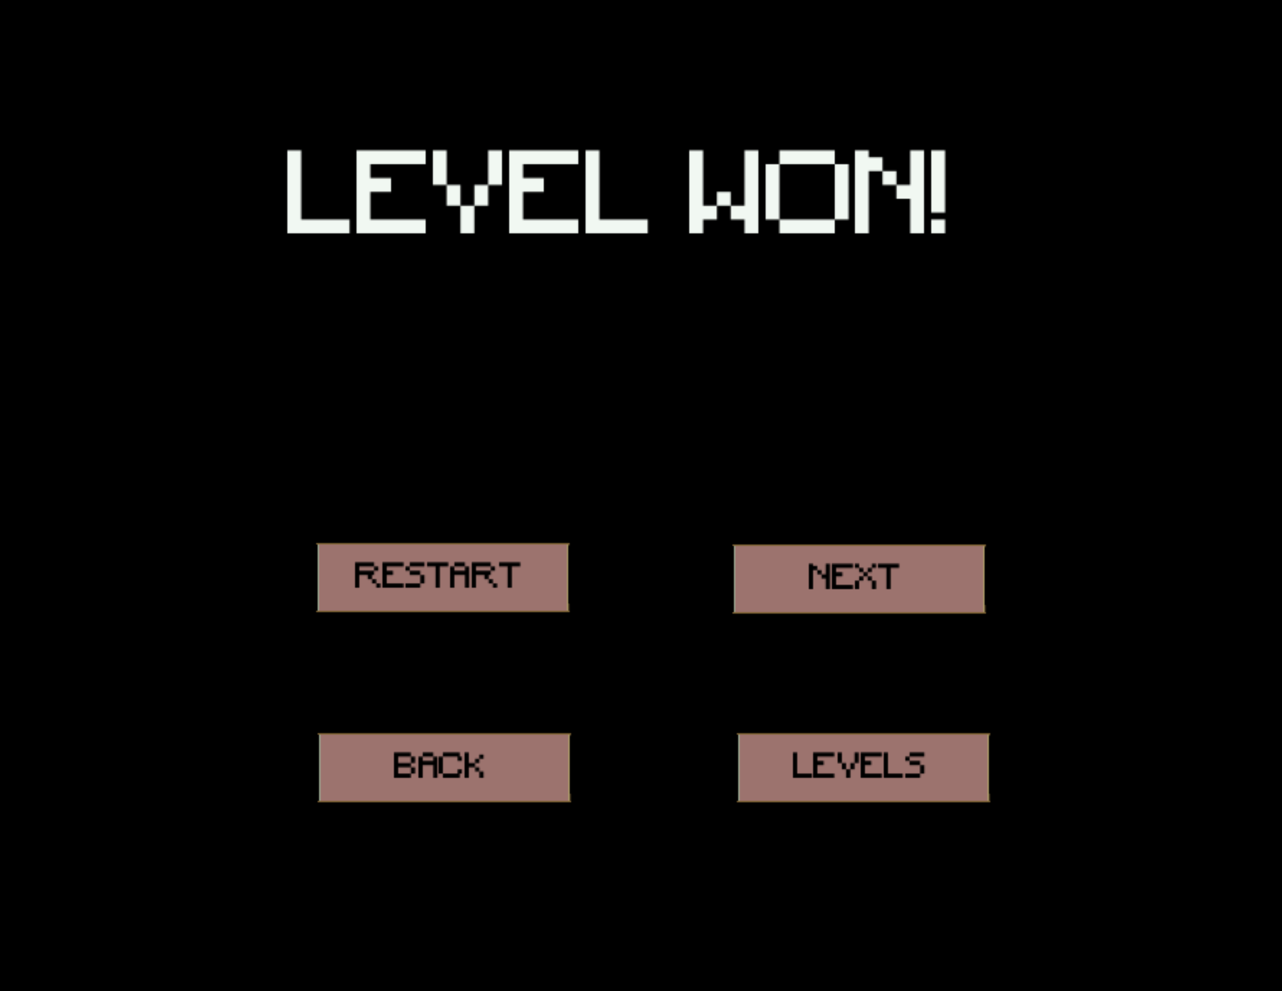
WORLDS
Level_1
Level_2
Level_3
Level_4
Splash_Screen
Context
Nathan_Dialogue
Arielle_Dialogue
Fangs_And_Boss_Dialogue
Zapper_Dialogue
Level_Won
Level_Lost
Game_Lost
Access_Level

Slide 9
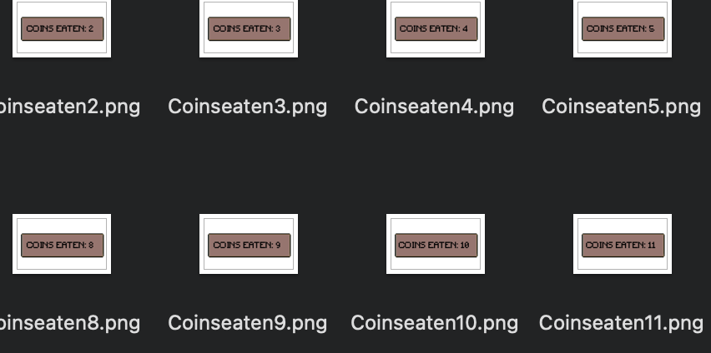
NON-CHARACTER ACTORS
Coins
Buttons
Silver coins
Horizontal and Vertical Bars

Slide 10
IMPLEMENTATION
ZAPPER
Fang
Boss_Fang
Obstacles
Buttons
eatSilverCoin()
eatCoin()
Commands()
Static int(s) coinsEaten
eatCoin()
touchBlock()
eatCoin()
touchBlock()
eatZapper()
dragBlock()
killZapper()
Boolean isZapperDead()
transitionToLevelLost
Boolean canStillDrag()
(no methods, all setImage in instances of getWorld())

Slide 11



RESOURCES
PROCREATE
ZAPSLAT & Free Stock Music
APPLICATION FOR DRAWING AND EDITING. USED TO MAKE GIFS, WORLDS AND DRAWINGS
COPYRIGHT FREE MP3 FREE AUDIO ONLINE

Slide 12

03
What’s left to do
Game mechanics • Actors $∘$ Worlds

Slide 13




FURTHER IMPLEMENTATION
MAGNET MECHANIC
CODE CLEANUP
FINISH COUNTER
FINISH ALL BUTTONS

Slide 14

MORE WORLDS
Level_5
Level_6
Level_7
Level_8
(Finished) Context
(Finished) Zapper_Dialogue
(Finished) Boss_And_Fangs_Dialogue
Game_Won

Slide 15
04
Further ideas

Slide 16
MORE IDEAS
Coin counter minimum to win level
Obstacle Displacement Limit per Level
Timer Mechanic
Unmovable blocks
Teleport Mechanic

Slide 17
THANK YOU

