Slide 1
Ground truth system
PA3 : HEMORRHAGE IN BRAIN CT SLIDES

Slide 2
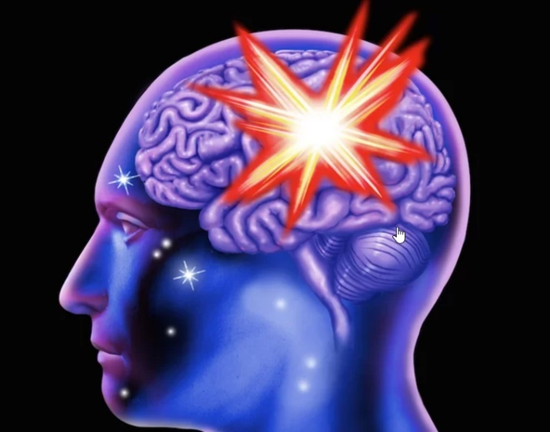
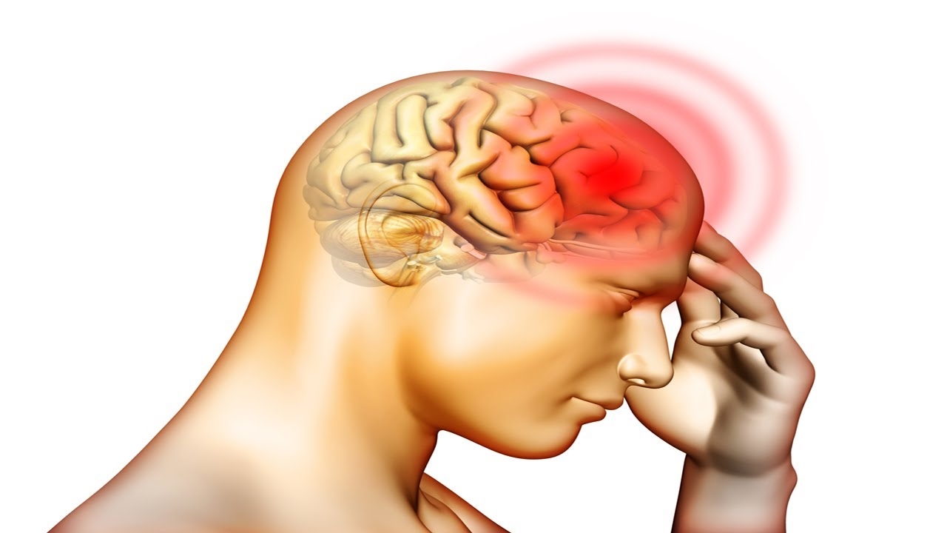
How hemorrhage in the brain is important ?
A brain hemorrhage is a type of stroke. It's caused by an artery in the brain bursting and causing localized bleeding in the surrounding tissues. This bleeding kills brain cells.

Slide 3
Why we build the ground truth system ?

Slide 4
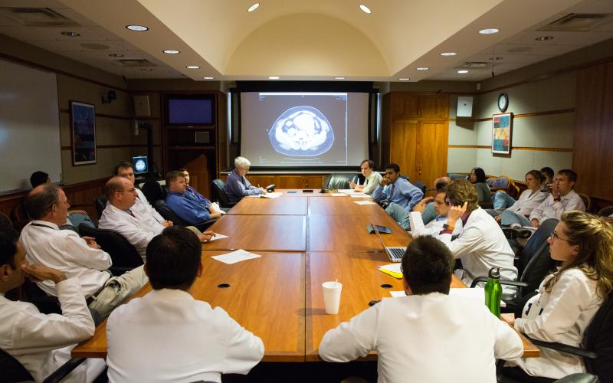
1. Medical diagnosis
In the present, when doctors want to diagnose some patients that had bleeding in the brain, Everyone must attend the conference room to analyze Brain CT slides of the patient.

Slide 5

2. Patient’s Time
We aware of every patients , so doctor must work against time to help patients as fast as possible.

Slide 6
Key point of this problems !
1. Medical diagnosis
- Each doctors cannot attend to conference every time.
- Analyze in efficient.
2. Patient’s time
- As fast as possible.

Slide 7
Ground Truth System

Slide 8
Purpose of ground truth system ?
- To solve problems including Medical diagnosis and Patient’s time.
- To Help doctor and patients to save time to analyst hemorrhage in the brain.
- Use easy way to interact between doctors and patients.
- To reduce cost of medical equipment.

Slide 9
What is ground truth system ?
Ground Truth System is the system that provide to doctors who are specialize in Brain Analysis. This system they can draw the boundary ,compare their boundary with other doctors and see the section of boundary that they thinks alike.

Slide 10
