Slide 1

Comp90042
Workshop
Week 4
23 March

Slide 2
Table of Content
Part-of Speech Tagging
Hidden Markov Model

Slide 3
Table of Content
Part-of Speech Tagging
Hidden Markov Model

Slide 4
Definition
What is Part-of-Speech (POS) tag?
Label of word’s grammatical (primarily syntactic) properties of in the sentence.

Slide 5
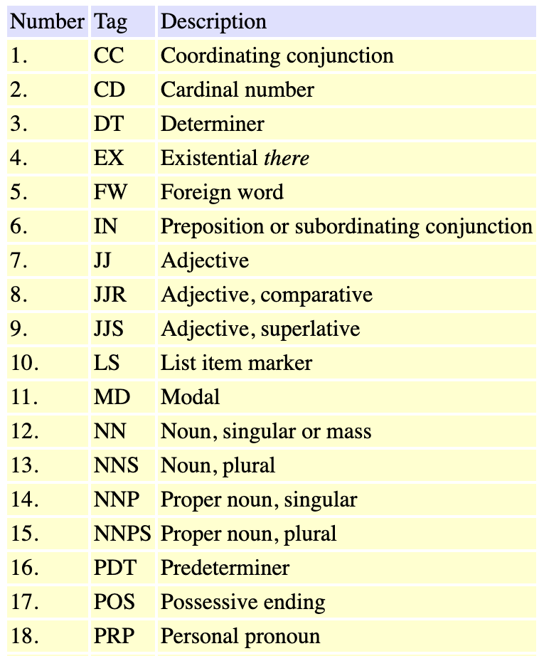
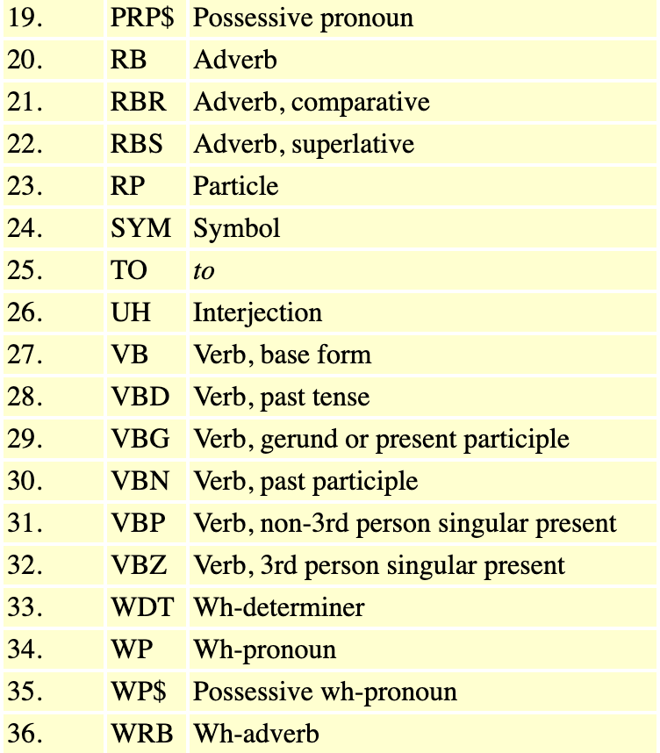
POS Tag Set
Penn Treebank Tag Set

Slide 6
POS Tagging
POS tag (by hand) the following sentence:
Pierre Vinken , 61 years old , will join the board as a nonexecutive director Nov. 29 .

Slide 7
POS Tagging
Pierre
Vinken
,
61
years
old
,
Will
join
the
board
as
a
nonexecutive
director
Nov.
29
.
NNP
NNP
,
CD
NNS
JJ
,
MD
VB
DT
NN
IN
DT
JJ
NN
NNP
CD
.
Tag set may vary in different datasets!

Slide 8
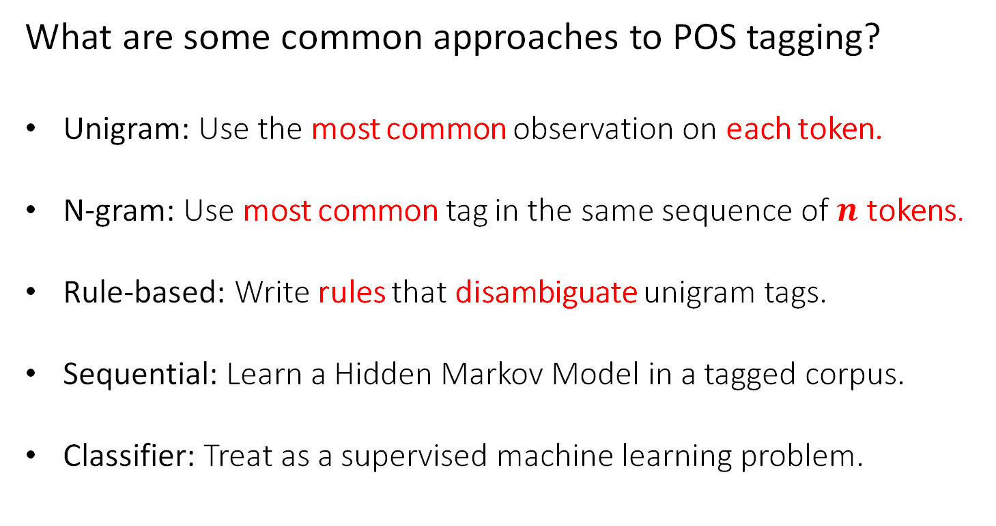
POS Tagging
What are some common approaches to POS tagging?
Unigram: Use the most common observation on each token.
N-gram: Use most common tag in the same sequence of $n$ tokens.
Rule-based: Write rules that disambiguate unigram tags.
Sequential: Learn a Hidden Markov Model in a tagged corpus.
Classifier: Treat as a supervised machine learning problem.

Slide 9
Table of Content
Part-of Speech Tagging
Hidden Markov Model

Slide 10
Hidden Markov Model
What are the assumptions in Hidden Markov Model (HMM)?
Markov assumption
  the likelihood of transitioning into a given state depends only on the current
  state, and not the previous state(s) (or output(s))
2. Output independence assumption
the likelihood of a state producing a certain word (as output) does not depend
on the preceding (or following) state(s) (or output(s)).

Slide 11
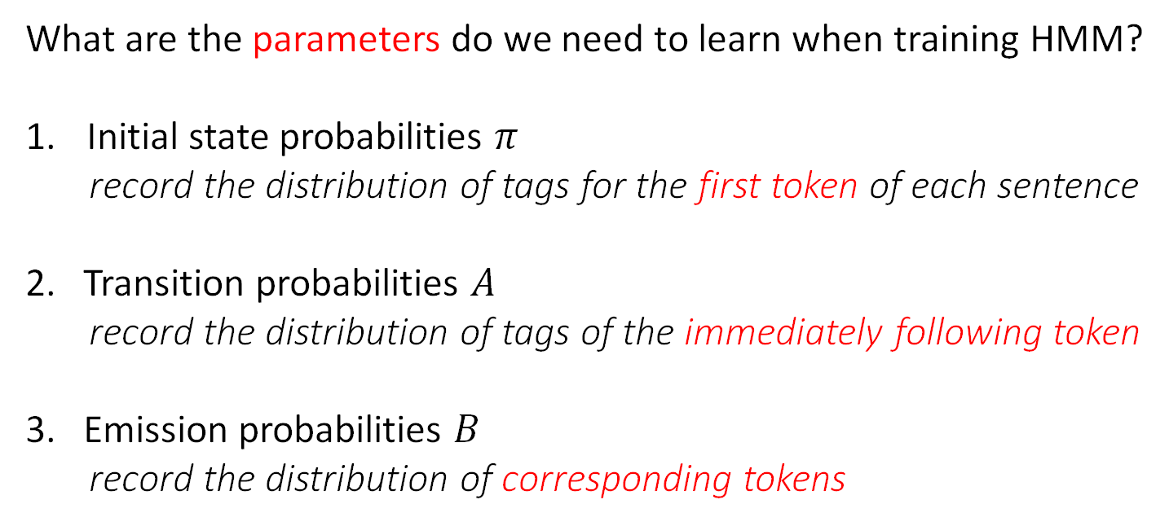
Hidden Markov Training
What are the parameters do we need to learn when training HMM?
Initial state probabilities $π$
record the distribution of tags for the first token of each sentence
2. Transition probabilities $A$
record the distribution of tags of the immediately following token
3. Emission probabilities $B$
record the distribution of corresponding tokens

Slide 12
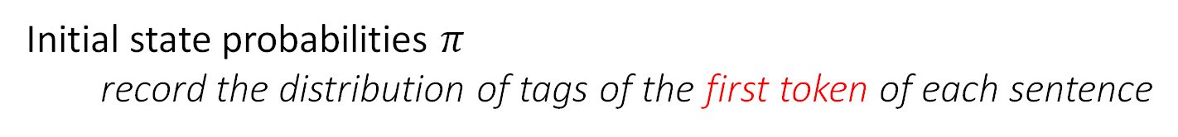
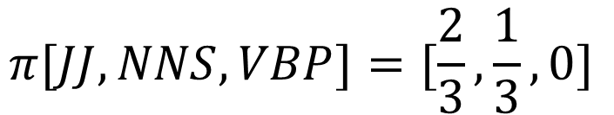
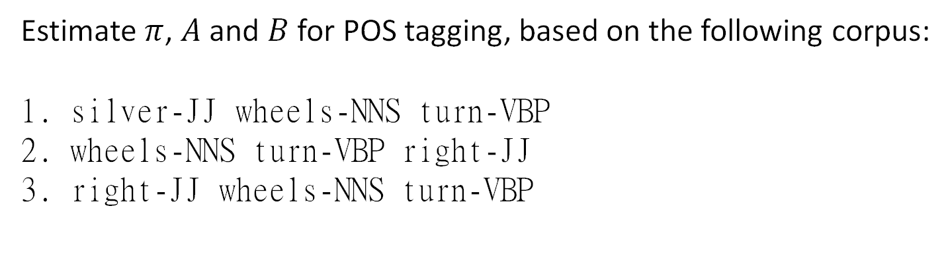
Hidden Markov Training
Estimate $π$, $A$ and $B$ for POS tagging, based on the following corpus:
silver-JJ wheels-NNS turn-VBP
wheels-NNS turn-VBP right-JJ
right-JJ wheels-NNS turn-VBP
Initial state probabilities $π$
record the distribution of tags of the first token of each sentence
$$π[JJ, NNS, VBP]=[\frac{2}{3}, \frac{1}{3}, 0]$$

Slide 13
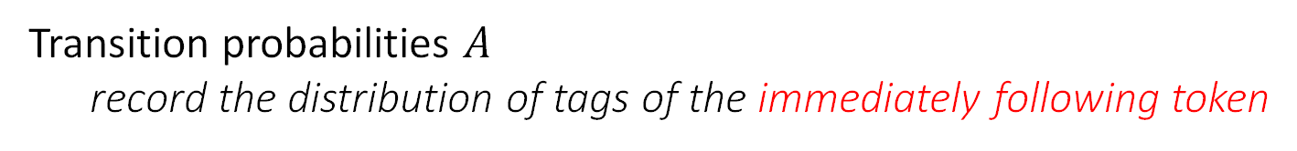
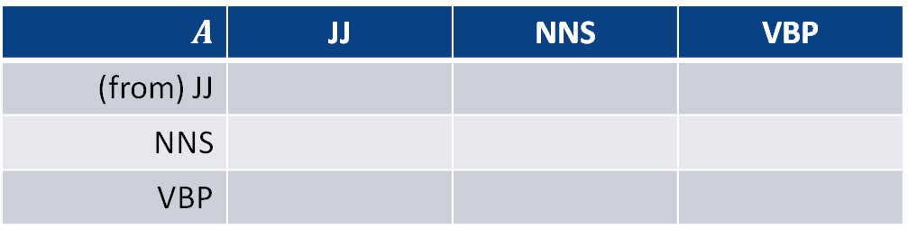
Hidden Markov Training
Estimate $π$, $A$ and $B$ for POS tagging, based on the following corpus:
silver-JJ wheels-NNS turn-VBP
wheels-NNS turn-VBP right-JJ
right-JJ wheels-NNS turn-VBP
Transition probabilities $A$
record the distribution of tags of the immediately following token
$$A$$ | JJ | NNS | VBP
(from) JJ
NNS
VBP
0
1
0
0
0
1
1
0
0

Slide 14

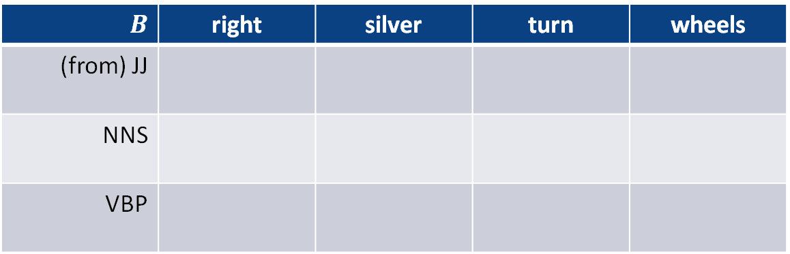


Hidden Markov Training
Estimate $π$, $A$ and $B$ for POS tagging, based on the following corpus:
silver-JJ wheels-NNS turn-VBP
wheels-NNS turn-VBP right-JJ
right-JJ wheels-NNS turn-VBP
Emission probabilities $B$
record the distribution of corresponding token
$$B$$ | right | silver | turn | wheels
(from) JJ
NNS
VBP
$$\frac{2}{3}$$
$$\frac{1}{3}$$
0
0
0
0
0
$$1$$
0
0
$$1$$
0

Slide 15
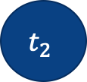
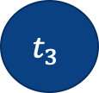
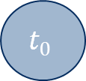

Hidden Markov Inference
Use the following Hidden Markov Model to tag the sentence
silver wheels turn
Visualize the HMM
unseen
$$t_{0}$$
$$t_{1}$$
$$t_{2}$$
$$t_{3}$$
observed
silver
wheels
turn

Slide 16
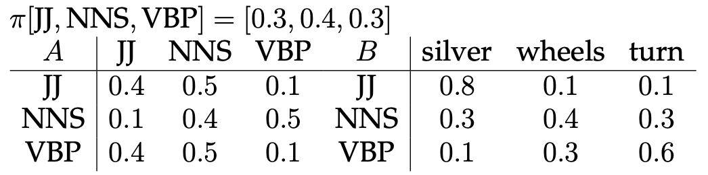
Hidden Markov Inference
What is Viterbi algorithm ?
a dynamic programming algorithm for finding the most likely sequence of
hidden states
Use the Viterbi algorithm with given parameters below
to find the optimal tag sequence.

Slide 17
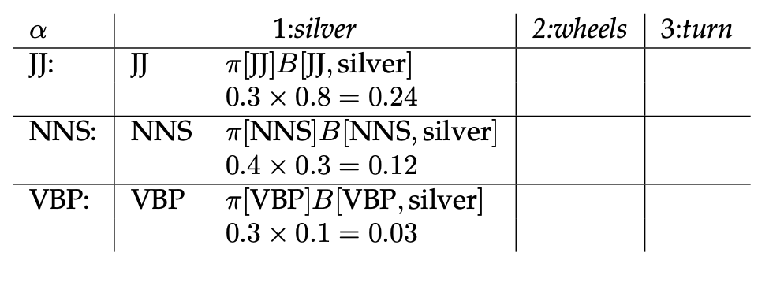
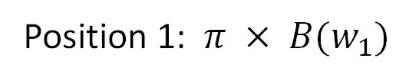
Position 1: $π × B(w_{1})$

Slide 18
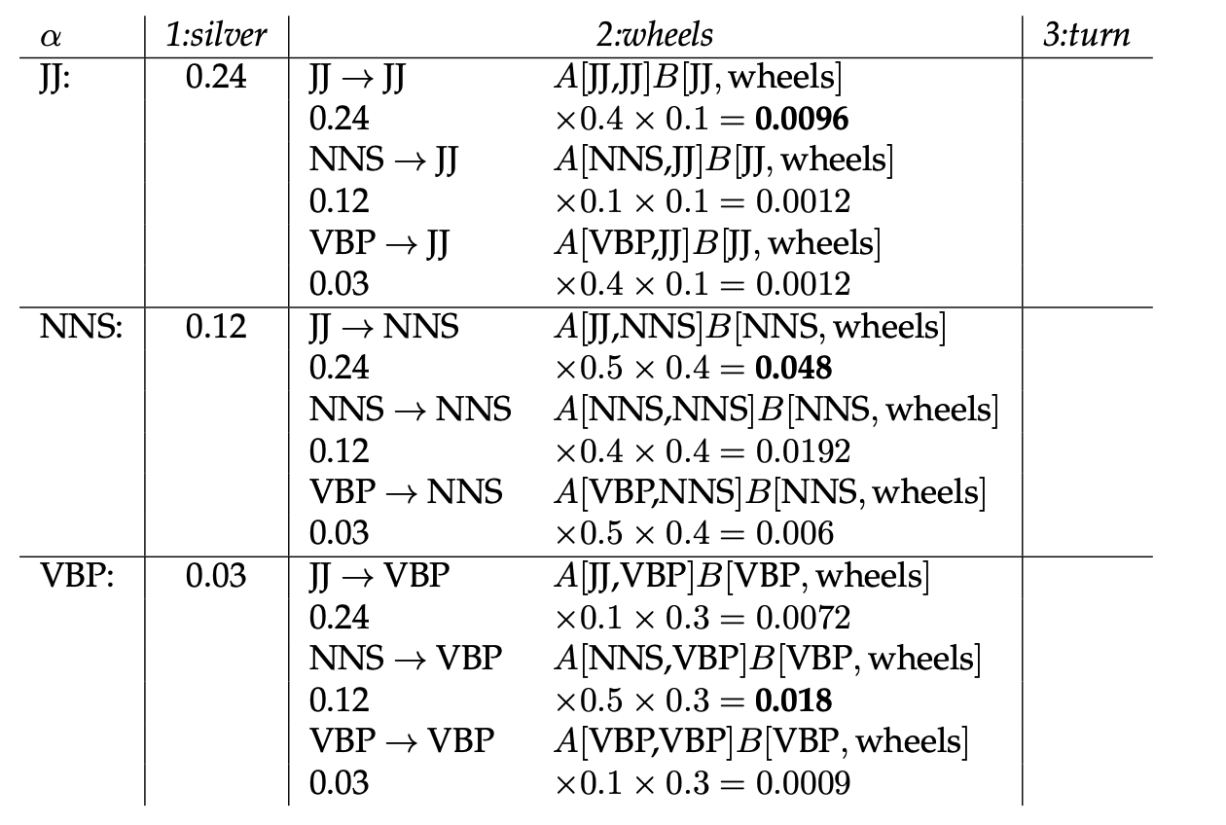
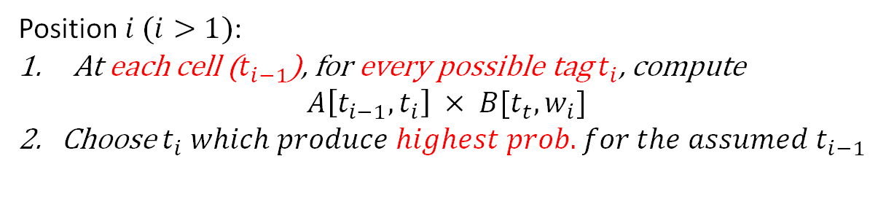

Position $i (i>1)$:
At each cell ($t_{i−1}$), for every possible tag $t_{i}$, compute
$$A\left[t_{i−1}, t_{i}\right] × B[t_{t}, w_{i}]$$
2. Choose $t_{i} which produce highest prob. for the assumed t_{i−1}$
$$highest prob.$$

Slide 19
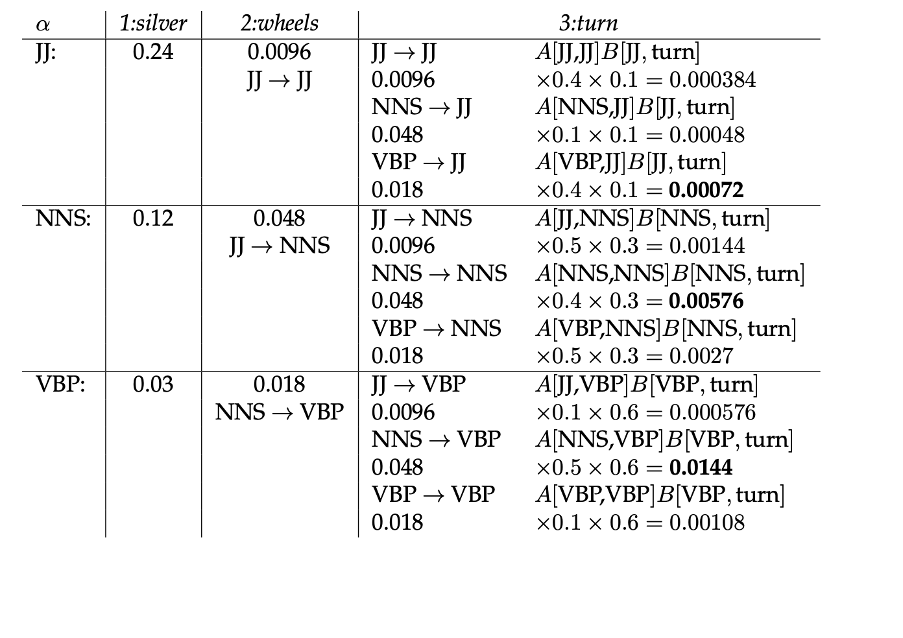
Repeat previous step until reach end of sentence
Only optimal sub-sequences are stored, with the back pointer to previous tag of this cell

Slide 20
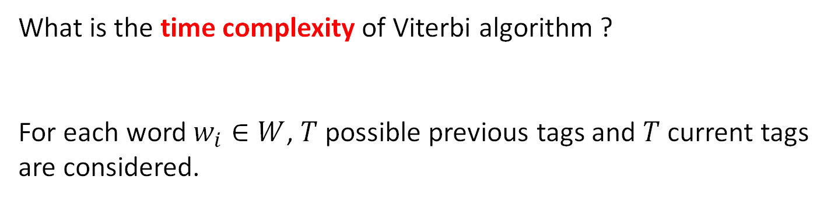

Hidden Markov Inference
What is the time complexity of Viterbi algorithm ?
For each word $w_{i}∈W$, $T$ possible previous tags and $T$ current tags
are considered.
$$O(T^{2}W)$$

Slide 21
Takeaways
Part-of-Speech tagging
- Definition (including common POS tag labels)
- Approaches
Hidden Markov Model (HMM)
- Assumptions
- Training (MLE)
- Inference (Viterbi)

