Slide 1

Comp90042
Workshop
Week 5
20 April

Slide 2
Table of Content
Neural Network Language Model
Parameters of a Neural Network
RNN vs N-gram language model
Vanishing Gradient Problem in RNN

Slide 3
Table of Content
Neural Network Language Model
Parameters of a Neural Network
RNN vs N-gram language model
Vanishing Gradient Problem in RNN

Slide 4
Neural Network language Model
What is Neural Network Language Model?
Basically, a language model that utilizes neural network. It can be feed-forward neural networks, RNN, CNN and etc.

Slide 5
Continuous V.S. Discrete
How does a Neural Network Language Model deal with sparsity? Consider why is it an advantage over n-gram Language Model?
Discrete representation
Continuous representation
Context | Cat | Dog | Eat
Run | 1 | 0 | 0
Walk | 0 | 1 | 0
Banana | 0 | 0 | 1
 | Dim 1 | Dim 2 | Dim 3
Cat | 0.8 | 0.9 | 0.1
Walk | 0.9 | 0.7 | 0
Banana | 0 | 0 | 0.9
NN models maps words into continuous vector space (i.e. word embeddings).
Word embeddings capture syntactic & semantic relationships between words.
Continuous representation generalize well in unseen sequence.

Slide 6
Word vectors in action
Consider the following two sentences:
Sentence 1 (in corpus)
The cat is walking in the bedroom.
Sentence 2 (unseen)
A dog was running in a room.
 | Cat | Dog | Walk | Run
Cat | 1 | 0.8 | 0.27 | 0.26
Dog | 0.80 | 1 | 0.37 | 0.30
Walk | 0.27 | 0.37 | 1 | 0.55
Run | 0.26 | 0.30 | 0.55 | 1
Word vector similarity in spaCy
The semantic of the second sentence can be inferred by looking similar sentences.

Slide 7
Table of Content
Neural Network Language Model
Parameters of a Neural Network
RNN vs N-gram language model
Vanishing Gradient Problem in RNN

Slide 8




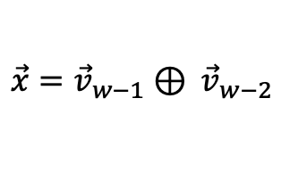
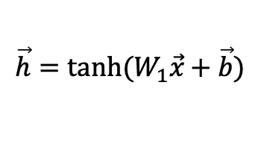
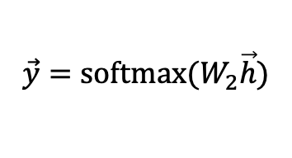
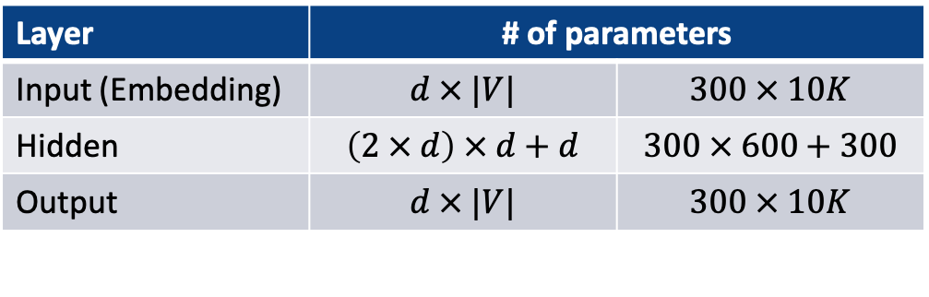
Feedforward Neural Network
Consider a Bi-gram Feed-Forward NN with:
1 hidden layer of 300D
10K unique words
Output layer
$$\vec{y}=softmax⁡(W_{2}\vec{h})$$
$$\vec{y}$$
Hidden layer
$$\vec{h}=tanh⁡(W_{1}\vec{x}+\vec{b})$$
$$\vec{h}$$
Input (Embedding) layer
$$\vec{x}={\vec{v}}_{w−1}{ ⊕ \vec{v}}_{w−2}$$
$${\vec{v}}_{w−2}$$
+
$${\vec{v}}_{w−1}$$
Layer | # of parameters
Input (Embedding) | $$d × |V|$$ | $$300 × 10K$$
Hidden | $$\left(2 × d\right) × d+d$$ | $$300 × 600+300$$
Output | $$d × |V|$$ | $$300 × 10K$$

Slide 9
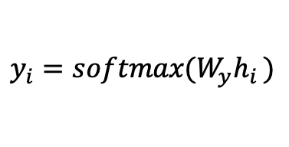




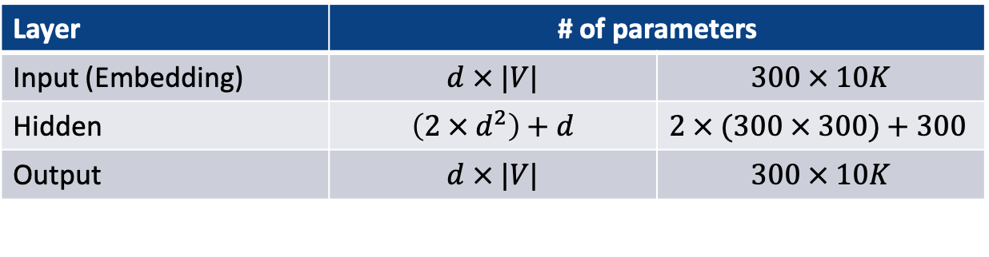
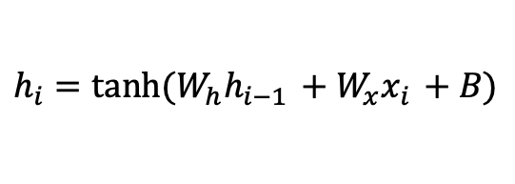
Example 2
Recurrent Neural Network
Output layer
$$y_{i}=softmax⁡(W_{y}h_{i })$$
$$y_{i}$$
$$h_{i−1}$$
RNN
$$h_{i}$$
Hidden layer
$$h_{i}=tanh⁡(W_{h}h_{i−1 }+W_{x}x_{i }+B)$$
Input (Embedding) layer
$$x_{i}$$
Layer | # of parameters
Input (Embedding) | $$d × |V|$$ | $$300 × 10K$$
Hidden | $$\left(2 × d^{2}\right)+d$$ | $2 × (300 × 300)+300$
Output | $$d × |V|$$ | $$300 × 10K$$

Slide 10
Table of Content
Neural Network Language Model
Parameters of a Neural Network
RNN vs N-gram language model
Vanishing Gradient Problem in RNN

Slide 11
RNN vs N-gram language model
What advantage does an RNN language model have over N-gram language model?
RNN can capture longer context, whereas the context size of N-gram LM is fixed.

Slide 12
Table of Content
Neural Network Language Model
Parameters of a Neural Network
RNN vs N-gram language model
Vanishing Gradient Problem in RNN

Slide 13

Vanishing Gradient Problem
What is gradient?
Gradient can be interpreted as the "direction and rate of fastest increase".
$$∇L=\left(\frac{∂L}{∂w_{1}},\frac{∂L}{∂w_{2}}\right)$$

Slide 14

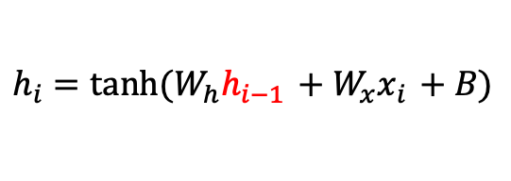
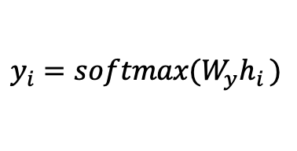
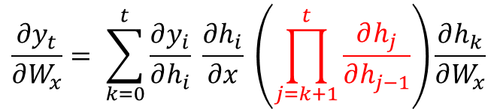

Vanishing Gradient Problem
Why vanish?
Chain rule: a formula to compute derivatives for composite functions
$$\frac{∂ f (g\left(x\right))}{∂x}= \frac{∂f}{∂g} \frac{∂g}{∂x}$$
Now, recall the formula of RNN
$$h_{i}=tanh⁡(W_{h}h_{i−1 }+W_{x}x_{i }+B)$$
$$y_{i}=softmax⁡(W_{y}h_{i })$$
Let’s try to get the partial derivative of $y_{t}$ with respect to $W_{x}$ at time step$t.$
$$\frac{∂y_{t}}{∂W_{x}}= \sum_{k=0}^{t}{\frac{∂y_{i}}{∂h_{i}} \frac{∂h_{i}}{∂x} \left(\prod_{j=k+1}^{t}{\frac{∂h_{j}}{∂h_{j−1}}}\right)\frac{∂h_{k}}{∂W_{x}}}$$

Slide 15
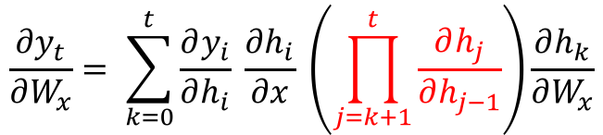
Vanishing Gradient Problem
RNN
RNN
$$h_{i−1}$$
RNN
$$h_{i}$$
……
$$x_{i}$$
RNN is a very deep network after unfolded.
$$\frac{∂y_{t}}{∂W_{x}}= \sum_{k=0}^{t}{\frac{∂y_{i}}{∂h_{i}} \frac{∂h_{i}}{∂x} \left(\prod_{j=k+1}^{t}{\frac{∂h_{j}}{∂h_{j−1}}}\right)\frac{∂h_{k}}{∂W_{x}}}$$
The gradient may vanish/explode as we move backwards to earlier time steps.
Eventually the model learn too slow than acceptable

Slide 16
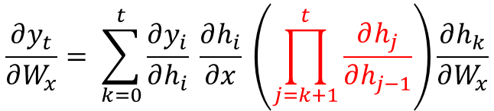
Gated Recurrent Neural Networks
$$\frac{∂y_{t}}{∂W_{x}}= \sum_{k=0}^{t}{\frac{∂y_{i}}{∂h_{i}} \frac{∂h_{i}}{∂x} \left(\prod_{j=k+1}^{t}{\frac{∂h_{j}}{∂h_{j−1}}}\right)\frac{∂h_{k}}{∂W_{x}}}$$
Ideally, we want the red part in the formula to be close to either 0 or 1
Challenge: how to pick 0 or 1?
Can we also let the model to learn that?
Gated Neural Networks
Long-short term memory networks (LSTM)
Gated Recurrent Unit (GRU)

Slide 17
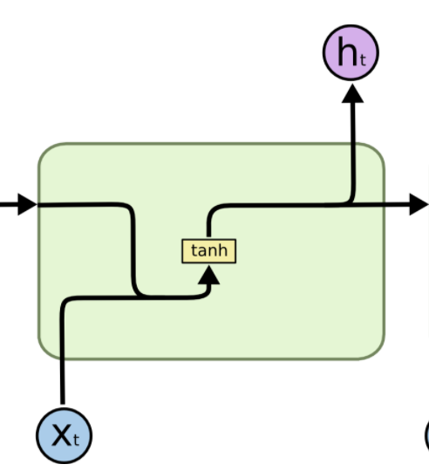
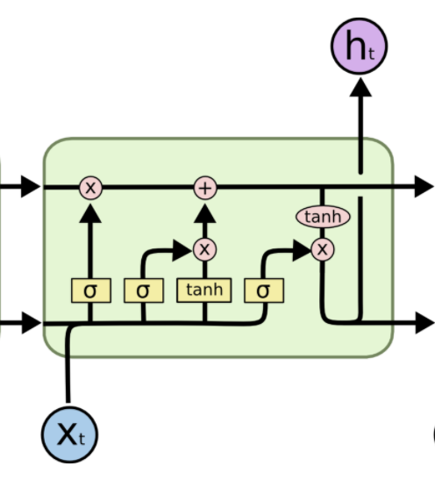
LSTM
LSTM Cell
RNN Cell
LSTM uses ’Gates’ to control the flow of information
Except hidden state, LSTM also has a cell state for holding it’s ”memory”.

Slide 18
Takeaways
Neural Network Language Model
  Definition
  How to deal with sparsity
Parameters of a Neural Network
  Feedforward neural network
  Recurrent neural network (RNN)
RNN vs N-gram language model
Vanishing Gradient Problem in RNN
  Reason
  Advantage of LSTM

