Slide 1

Comp90042
Workshop
Week 8
9 May

Slide 2
Table of Contents
Language theory
Parsing

Slide 3
Regular language
What are regular grammar and regular language? How are they different?
Language: set of acceptable strings (e.g., sentences)
Grammar: a generative description of a language
Regular language: language accepted by regular expression w
Regular grammar: a formal grammar defined by a set of productions rules
  A → xB,
  A → x
  A → ε
  where A and B are non-terminals, x is a terminal and ε is the empty string.

Slide 4
Regular grammar example
Rules:
  S → A
  A → a A
  A → ε
Example strings?
  a, aa, aaa, aaa.
Regular expression?
  (a)*

Slide 5
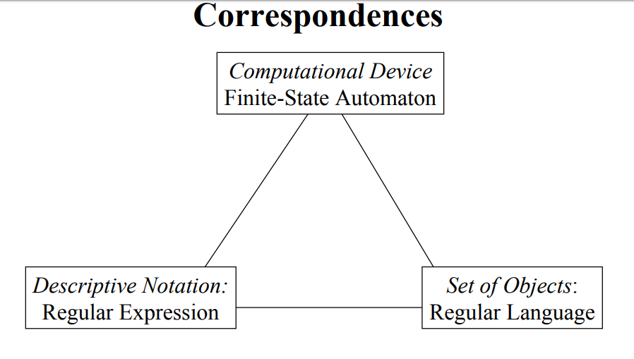
Rules:
  S → A
  A → a A
  A → ε
Example strings?
  a, aa, aaa, aaa.
Regular expression?
  (a)*

Slide 6

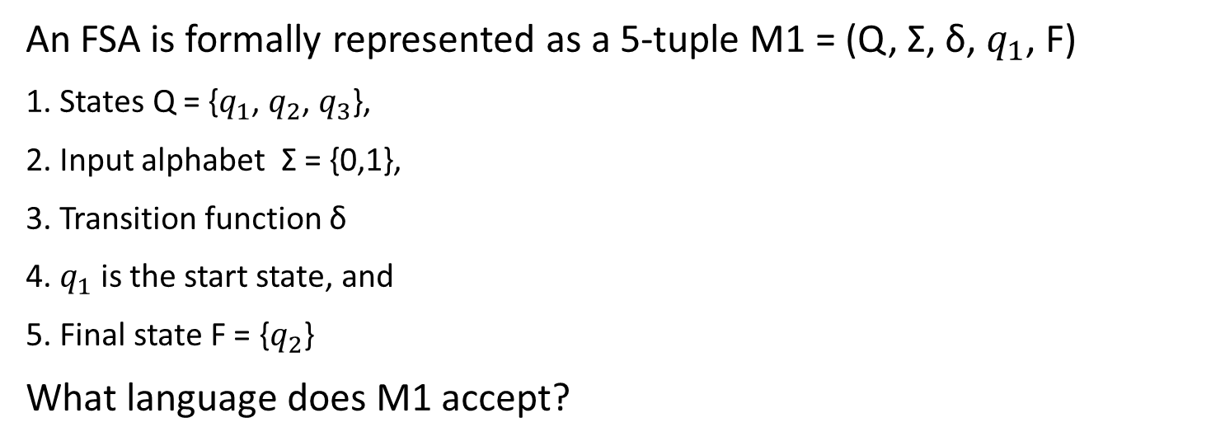
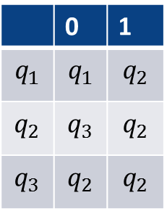
Finite State Automata
An FSA is formally represented as a 5-tuple M1 = (Q, Σ, δ, $q_{1}$, F)
1. States Q = {$q_{1}$, $q_{2}$, $q_{3}$},
2. Input alphabet Σ = {0,1},
3. Transition function δ
4. $q_{1}$ is the start state, and
5. Final state F = {$q_{2}$}
What language does M1 accept?
Transition function
 | 0 | 1
$$q_{1}$$ | $$q_{1}$$ | $$q_{2}$$
$$q_{2}$$ | $$q_{3}$$ | $$q_{2}$$
$$q_{3}$$ | $$q_{2}$$ | $$q_{2}$$

Slide 7
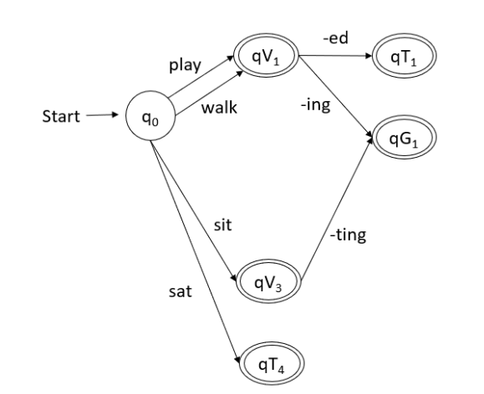
Example: Word Morphology
Draw a Finite State Acceptor (FSA) for word morphology to show the possible derivations from root forms using the words:
play, played, playing;
walk, walked, walking;
sit, sat, sitting.

Slide 8
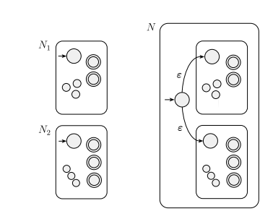
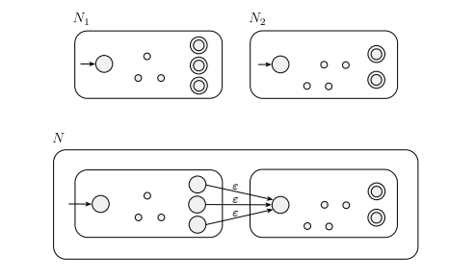
Properties of regular languages
Regular languages are closed under union, intersection and concatenation. What does it mean? Why is it important?
union
concatenation
If L1 and L2 are two regular languages, then the union, intersection and concatenation of L1 and L2 are also regular languages
NLP problems can be factored into small simple parts,
we can develop regular languages for each part,
and combine them into a complex system to handle the NLP problems.

Slide 9
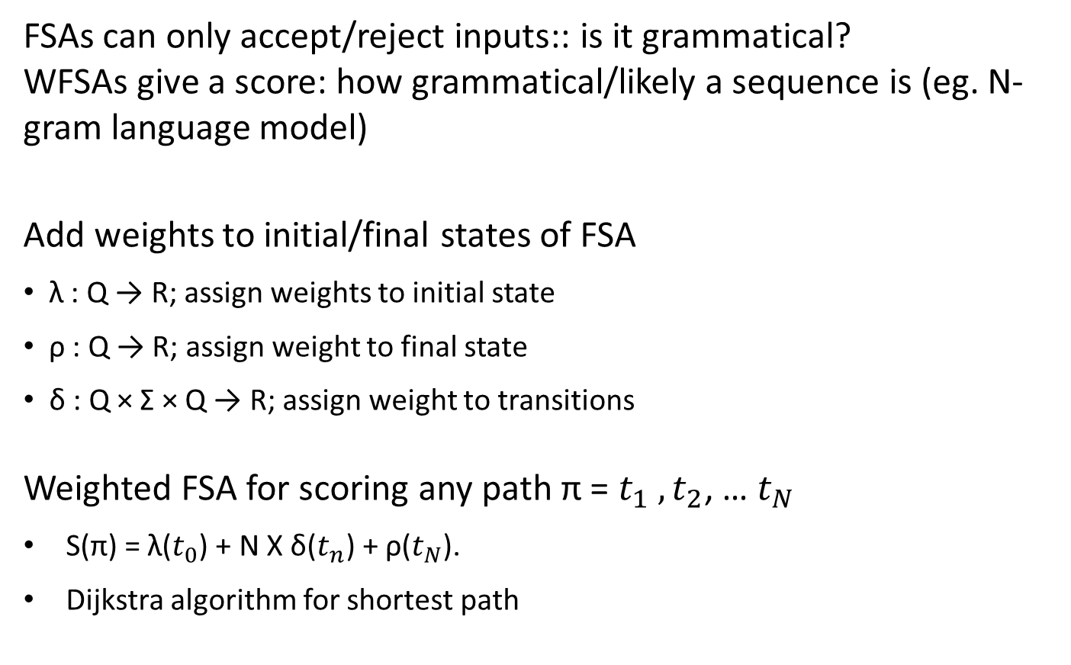
Weighted FSA
FSAs can only accept/reject inputs:: is it grammatical?
WFSAs give a score: how grammatical/likely a sequence is (eg. N-gram language model)
Add weights to initial/final states of FSA
λ : Q → R; assign weights to initial state
ρ : Q → R; assign weight to final state
δ : Q × Σ × Q → R; assign weight to transitions
Weighted FSA for scoring any path π = $t_{1} ,t_{2}$, … $t_{N}$
S(π) = λ($t_{0}$) + N X δ($t_{n}$) + ρ($t_{N}$).
Dijkstra algorithm for shortest path

Slide 10
Context-free grammar
  This is the dog that worried the cat that killed the rat that ate the malt that lay in the house that Jack built
  VS
  A man that a woman that a child that a bird that I heard saw knows loves
Notes:
Length is unbounded (recursive), but structure is local → can describe with FSA = Regular
Need to remember the n subject nouns, to ensure n verbs follow (and that they agree etc) * can’t be done with finite number of states

Slide 11
Context-free grammar
  A context-free grammar is a 4-tuple G = (V, Σ, R, S)
  V, a set of non-terminal symbols (or variables)
  Σ, a set of terminal symbols (disjoint from V)
  R a set of rules in the form A → β, where A is a non-terminal, β is a string of variables and terminals
  S ∈ V, the start variable

Slide 12
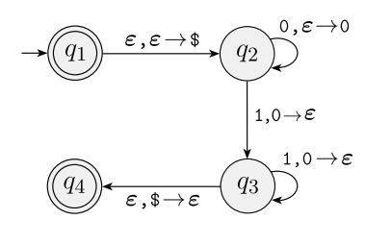
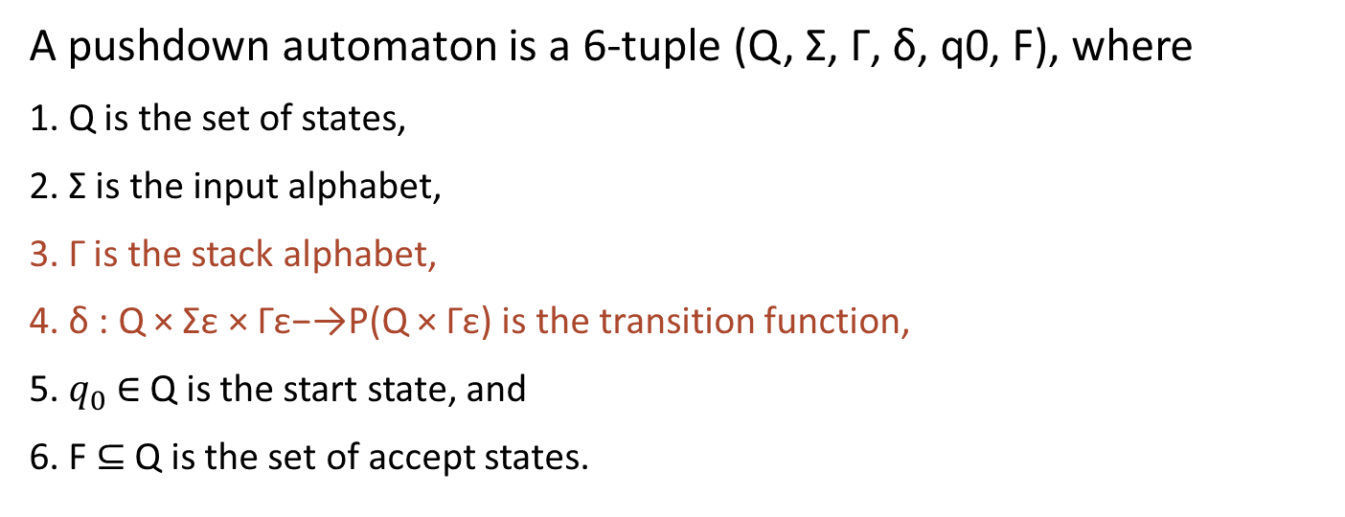
Pushdown automata
A pushdown automaton is a 6-tuple (Q, Σ, Γ, δ, q0, F), where
1. Q is the set of states,
2. Σ is the input alphabet,
3. Γ is the stack alphabet,
4. δ : Q × Σε × Γε−→P(Q × Γε) is the transition function,
5. $q_{0}$∈ Q is the start state, and
6. F ⊆ Q is the set of accept states.

Slide 13
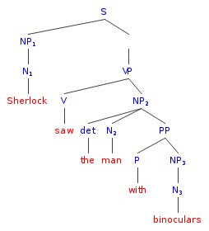
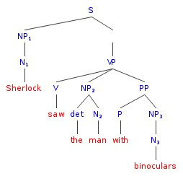
Parsing
Parsing in general is the process of identifying the structure(s) of a sentence, according to a grammar of the language.
Example parse trees

Slide 14
Parsing
(a) What changes need to be made to this CFG to make it suitable for CYK parsing?
S -> NP VP
VP -> V NP | V NP PP
PP -> P NP
V -> "saw" | "walked"
NP -> "John" | "Bob" | Det N | Det N PP
Det -> "a" | "an" | "the" | "my"
N -> "man" | "cat" | "telescope" | "park"
P -> "on" | "by" | "with"
Step 1: Chomsky Normal Form: Each rule consists of
  A -> B C
  A -> a a (single) non-terminal which re-writes as a single terminal
VP -> V X ​
X -> NP PP
NP -> Det Y
Y -> N PP
a (single) non-terminal which re-writes as exactly two non-terminals​

Slide 15
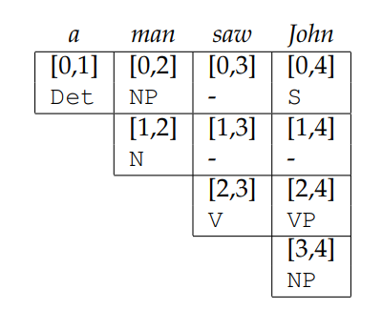
CYK Example 1
S
NP
VP
Det
N
V
NP
a
man
saw
John
S -> NP VP ​
VP -> V NP | V X
PP -> P NP ​
​X -> NP PP
Y -> N PP
NP -> "John" | "Bob" | Det N | Det Y
V -> "saw" | "walked" ​
Det -> "a" | "an" | "the" | "my"​
N -> "man" | "cat" | "telescope" | "park" ​
P -> "on" | "by" | "with"​

Slide 16
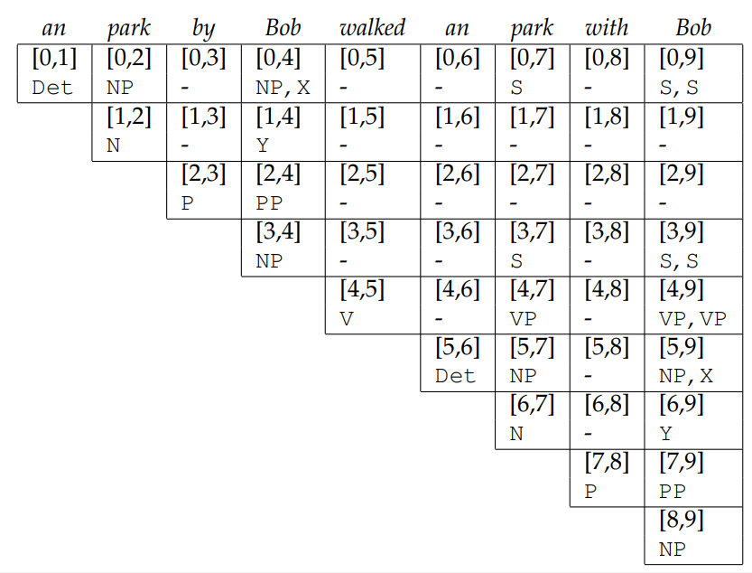
CYK example 2
S -> NP VP ​
VP -> V NP | V X
PP -> P NP ​
​X -> NP PP
Y -> N PP
NP -> "John" | "Bob" | Det N | Det Y
V -> "saw" | "walked" ​
Det -> "a" | "an" | "the" | "my"​
N -> "man" | "cat" | "telescope" | "park" ​
P -> "on" | "by" | "with"​

Slide 17
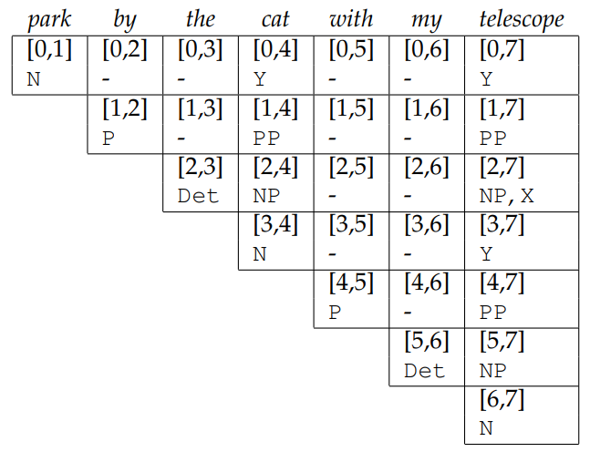
CYK example 3
S -> NP VP ​
VP -> V NP | V X
PP -> P NP ​
​X -> NP PP
Y -> N PP
NP -> "John" | "Bob" | Det N | Det Y
V -> "saw" | "walked" ​
Det -> "a" | "an" | "the" | "my"​
N -> "man" | "cat" | "telescope" | "park" ​
P -> "on" | "by" | "with"​

Slide 18
Takeaways
Regular languages:
  Regular Grammar
  Finite state acceptors (FSA)
  Weighted finite state acceptors (WFSA)
Context Free Languages
  Context Free Grammar
  CYK algorithm for parsing

