Slide 1
IoT ENERGY-SAVING AND MANAGEMENT OF TELECOM OPERATORS AND RCR USING BLYNK SERVER
Presented by
NAME
KNCET - DEPARTMENT OF ECE

Slide 2
CONTENTS
Abstract
Objective
Introduction
Literature Survey
Existing System
Proposed System
Hardware / Software Requirements
Partial Output
References
KNCET - DEPARTMENT OF ECE

Slide 3
ABSTRACT
In order to develop an energy-saving and management system based on the Internet of Things specifically designed for remote computer rooms (RCRs) owned by telecom carriers. The management system based on IoT technology for RCRs is designed. By using technologies such as embedded systems, sensor technology and Java Web, a system realizes equipment management and real-time data visualization of RCRs. Then, a simple but effective air conditioner energy-saving algorithm, called ET algorithm, is developed. Without causing high investment cost, ET algorithm minimizes the energy consumption of air conditioners which accounts for nearly 40% of total consumption, and thus improves the overall energy efficiency of RCRs. Moreover, the proposed system has been implemented at many Telecom operators’ RCRs distributed at different regions and stably operating for more than two years. Experimental results show that the proposed system not only effectively manages and monitors RCRs, but also achieves 16.64% energy-saving effect.
KNCET - DEPARTMENT OF ECE

Slide 4
OBJECTIVE
It depends on the IoT based Telecom Energy saving system.
Prioritize user-friendly design, portability, and offline capabilities while ensuring data security and privacy.
Aim for cost-effective production to make the technology accessible to a wider telecom application.
KNCET - DEPARTMENT OF ECE

Slide 5
INTRODUCTION
For energy savings in ACs, researchers have proposed various schemes such as designing novel energy-conserving equipment, utilizing renewable energy, and adopting intelligent control algorithms, etc.
Except for energy-saving issue, the management and maintenance of RCRs, especially for that in suburbs, is another challenging problem for operators. Without remote management system, engineers usually spend tremendous time and effort on the fault diagnosis of equipment in RCRs distributed across different regions, resulting in huge operation and maintenance cost.
By controlling the operational number of compressors and fans, the energy efficiency of the ACs can be increased.
Smart energy saving and management system using Telecom industry is designed
KNCET - DEPARTMENT OF ECE

Slide 6
LITERATURE SURVEY
S.NO | Author(s) | Title | Name of the Journal | Year | Remarks
1. | Liang Zhao, Shaocheng Qu, Jiahui Zeng | Energy Saving and Management of Telecom Operators Remote Computer Rooms Using IoT Technology | Institute of Electrical and Electronics Engineers | 2020 | Due to long distance network latency.
2. | Koch B. and Slezak D. | Less energy, more efficiency in server rooms and data centers | International Journal of Computer Science & Research Development | 2018 | In case of sensor failure whole system will collapse.
KNCET - DEPARTMENT OF ECE

Slide 7
Contd.,
S.NO | Author(s) | Title | Name of the Journal | Year | Remarks
3. | M. B. Yassein, W. Mardini and A. Khalil | Smart homes automation using Zwave protocol | International Conference on Engineering & MIS (ICEMIS) | 2016 | Appliances can be controlled only from a range.
4. | Abhay Kumar, Neha Tiwari | Energy Efficient Smart Home Automation System. | International Journal of Scientific Engineering and Research (IJSER) | 2015 | Delays in sending commands in case of weak mobile network.
KNCET - DEPARTMENT OF ECE

Slide 8
Contd.,
5. | Yash Mittal,paridhi toshniwal,Sonal sharma,Deepika Singhal,Ruchi Gupta,V.K.Mittal | A voice-controlled multi-functional Smart Home Automation System | Institute of Electrical and Electronics Engineers | 2015 | The user needs to input commands in Chatbox manually, which not only takes more time.
6. | Shanmugaraju, Sankarasekaran and Vaddemoni Swarna Rekha | ZIGBEE based Home Automation and Energy Conservation using Wireless Sensor Network | Journal of Environmental Science, Computer Science and Engineering & Technology | 2013 | Low end controller. No inbuilt module.
KNCET - DEPARTMENT OF ECE

Slide 9
EXISTING SYSTEM
Except for energy-saving issue, the management and maintenance of RCRs, especially for that in suburbs, is another challenging problem for operators. Without remote management system, engineers usually spend tremendous time and effort on the fault diagnosis of equipment in RCRs distributed across different regions, resulting in huge operation and maintenance cost.
Except for energy-saving issue, the management and maintenance of RCRs, especially for that in suburbs, is another challenging problem for operators.
Without remote management system, engineers usually spend tremendous time and effort on the fault diagnosis of equipment in RCRs distributed across different regions, resulting in huge operation and maintenance cost.
RF Communication
GSM- MSG communication
KNCET - DEPARTMENT OF ECE

Slide 10
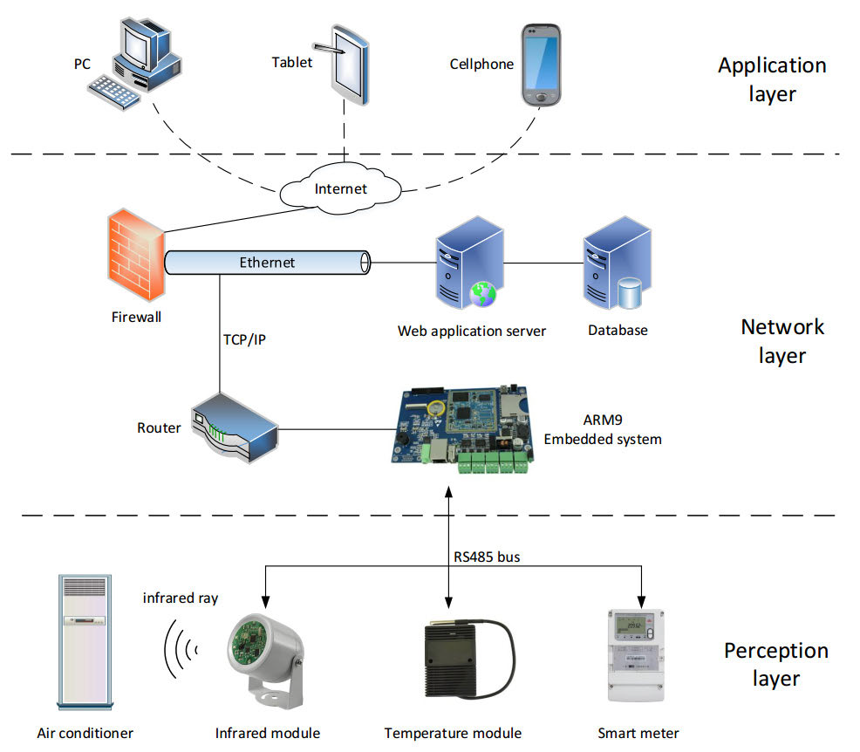

PROPOSED SYSTEM
KNCET - DEPARTMENT OF ECE

Slide 11
HARDWARE / SOFTWARE REQUIREMENTS
HARDWARE REQUIREMENT
SOFTWARE REQUIREMENT
NodeMCU ESP8266
Gas Sensor
Power Supply
12V Cooling Fan
DHT11 Sensor
LED Stanser
Relay Board
Arduino IDE 1.8.19
KNCET - DEPARTMENT OF ECE

Slide 12
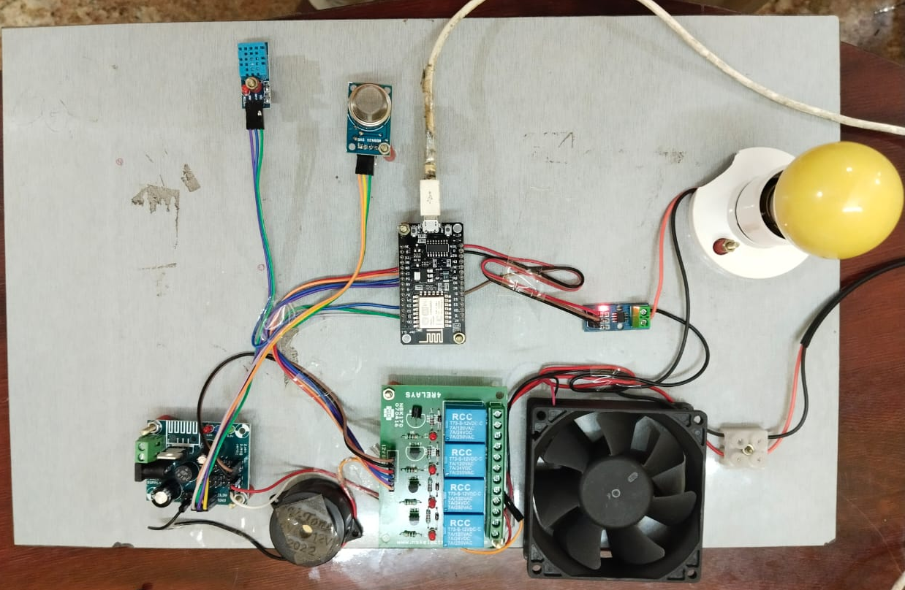
PARTIAL OUTPUT
KNCET - DEPARTMENT OF ECE

Slide 13
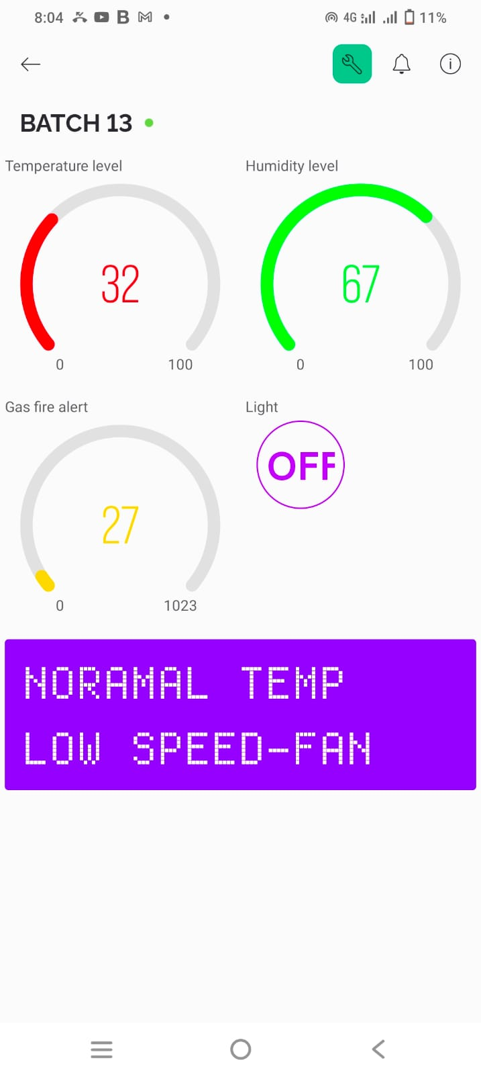
Contd.,
KNCET - DEPARTMENT OF ECE

Slide 14
REFERENCES
Berezovskaya Y., Yang C. W., Mousavi A., Vyatkin V. and Minde T. B. (2020) ‘Modular model of a data centre as a tool for improving its energy efficiency’, IEEE Access, Vol. 8, pp. 46559-46573.
Chang K. C., Chu K. C., Wang H. C., Lin Y. C. and Pan J. S. (2020) ‘Energy saving technology of 5G base station based on Internet of Things collaborative control’, IEEE Access, Vol. 8, pp. 32935-32946.
Chen W. H., Mo H. E. and Teng T. P. (2018) ‘Performance improvement of a split air conditioner by using an energy saving device’, Energy Buildings, Vol. 174, pp. 380-387.
Durand Estebe B., Le Bot C., Mancos J. N. and Arquis E. (2014) ‘Simulation of a temperature adaptive control strategy for an IWSE economizer in a data center’, Appl. Energy, Vol. 134.
Koch B. and Slezak D. (2018) ‘Poster abstract: Less energy, more efficiency in server rooms and data centers’, Computer Science & Research Development Vol. 33, No. 12, pp. 251-252.
KNCET - DEPARTMENT OF ECE

Slide 15
Contd.,
Khalil M. I. K., Ahmad I. and Almazroi A. A. (2019) ‘Energy efficient indivisible workload distribution in geographically distributed data centers’, IEEE Access, Vol. 7, pp. 82672-82680.
Ma Y., Saha S., Miller W. and Guan L. (2017) ‘Comparison of different solar assisted air conditioning systems for Australian office buildings’, Energies, Vol. 10, No. 10.
Nakamura Y., Matsuda K. and Matsuoka M. (2016) ‘Augmented data center infrastructure management system for minimizing energy consumption’, 5th IEEE International Conference of Cloud Networking (Cloudnet), pp. 106-109.
Shahnawaz Ahmed S., Shahmajid M., Novia H., and Abdrahman H. (2007) ‘Fuzzy logic-based energy saving technique for a central air conditioning system’, Energy, Vol. 32, No. 7, pp. 1222-1234.
Voas J. and Laplante P. (2017) ‘Curriculum considerations for the Internet of Things’, Computer, Vol. 50, No. 1, pp. 72-75.
KNCET - DEPARTMENT OF ECE

Slide 16
THANK YOU
KNCET - DEPARTMENT OF ECE

