Slide 1
SMART GARBAGE MONITORING SYSTEM USING IOT
PROJECT MEMBERS NAME

Slide 2
OUTLINE
    Objective
    Abstract
    Introduction
    Literature Review and Summary
    Existing system
    Proposed system
    Conclusion
    Queries

Slide 3
OBJECTIVE
To maintain the level of cleanliness in the city and form an environment which is better for living.
To warn the person about the garbage level using sensor detection
To monitor the garbage level and also to send a message when the garbage reaches 100% using IoT.

Slide 4
ABSTRACT
The increase in population, has led to tremendous degradation in the state of affairs of hygiene with respect to waste management system. The spillover of waste in civic areas generates the polluted condition in the neighboring areas.
This is proposed on IT based smart waste clean management system which checks the waste level over the dustbins by using Sensor systems.
To monitor and integrate an android application is developed for the desired information which is related to the various level of waste.
This is ensued the greenish in the environment and support for Swachh Bharat for cleanness.

Slide 5
INTRODUCTION
We are living in an age where tasks and systems are fusing together with the power of IOT to have a more efficient system of working and to execute jobs quickly.
One of the main concerns with our environment has been solid waste management which impacts the health and environment of our society.
The traditional way of manually monitoring the wastes in waste bins is a cumbersome process and utilizes more human effort, time and cost.
It can be easily avoided by our present technologies.

Slide 6
LITERATURE REVIEW
S. No | TITLE | AUTHOR(S) | REMARKS
1. | Smart garbage monitoring system using Internet of things | P. Arunadevi, S.Karthika, V.V.Swetha raj and K.Aamir suhail (2019) | The measuring distance is not accurate.
2. | A Survey of smart garbage management in cities using IOT | Ruhin mary saji, Drishya gopakumar, Mohammed sayed, Lakshmi and Harishkumar (2016), | More sensors is used so it need more maintenance.

Slide 7
LITERATURE REVIEW
S. No | TITLE | AUTHOR(S) | REMARKS
3. | A Survey on Garbage Collection and Monitoring System for smart cities using IoT | Neha shinde, Sayli Bhambre, Sharddha Thakur, and Varsha Devkule (2018) | Computational cost is high.
4. | A Review on smart garbage dustbin | Shephali Rakhunde, Shreya Ghavghave, Shraddha Jagtap, Priyanka Chimegaokar, and J.Y.Hande (2019) | Only detects the top of the garbage level.

Slide 8
LITERATURE REVIEW SUMMARY
The measuring distance is not accurate.
More sensors is used so it need more maintenance.
Computational cost is high.
Only detects the top of the garbage level.

Slide 9
EXISTING SYSTEM
The existing system has the limitations as time consuming, trucks go and empty the containers, even they are empty.
The cost is high with unhygienic environment. Even the bad odour causes the unhealthy environment.
These systems use automation technique reduces human efforts.
GSM module sends message to the authorized person.

Slide 10
PROPOSED SYSTEM
In this project we can sense the garbage level and reduce the disesases,human effort,time.
System can be accessed anytime and from anywhere.
Avoids the overflows of garbage bins.
The ultrasonic sensor transmit/receive the signal from dustbin and the data send to the NodeMCU and store in cloud.

Slide 11
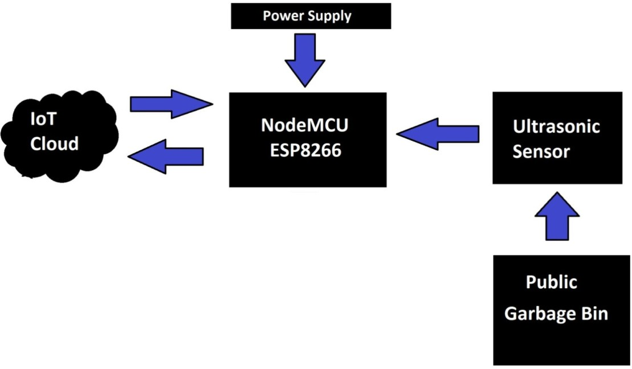
BLOCK DIAGRAM

Slide 12
DESCRIPTION
This project is proposed with garbage waste monitoring circuits organized together by connecting respective sensors to the NodeMCU.
The whole set up is associated with Internet of Things(IoT) to notify the garbage waste level.

Slide 13
HARDWARE REQUIREMENTS
S.No | Component
1 | NodeMCU(ESP8266)
2 | Ultrasonic sensor
3 | 9V HW Battery
4 | Jumper wires
5 | Garbage bin

Slide 14

SOFTWARE REQUIREMENTS
S.No | Software | Version
1 | Arduino IDE | 1.8.19

Slide 15
ADVANTAGES
Ultrasonic sensor accuracy is high.
To reduce the human effort,cost,time.
To reduce the diseases.
Real time information on the fill level of the dustbin.
Improves Environment quality.

Slide 16
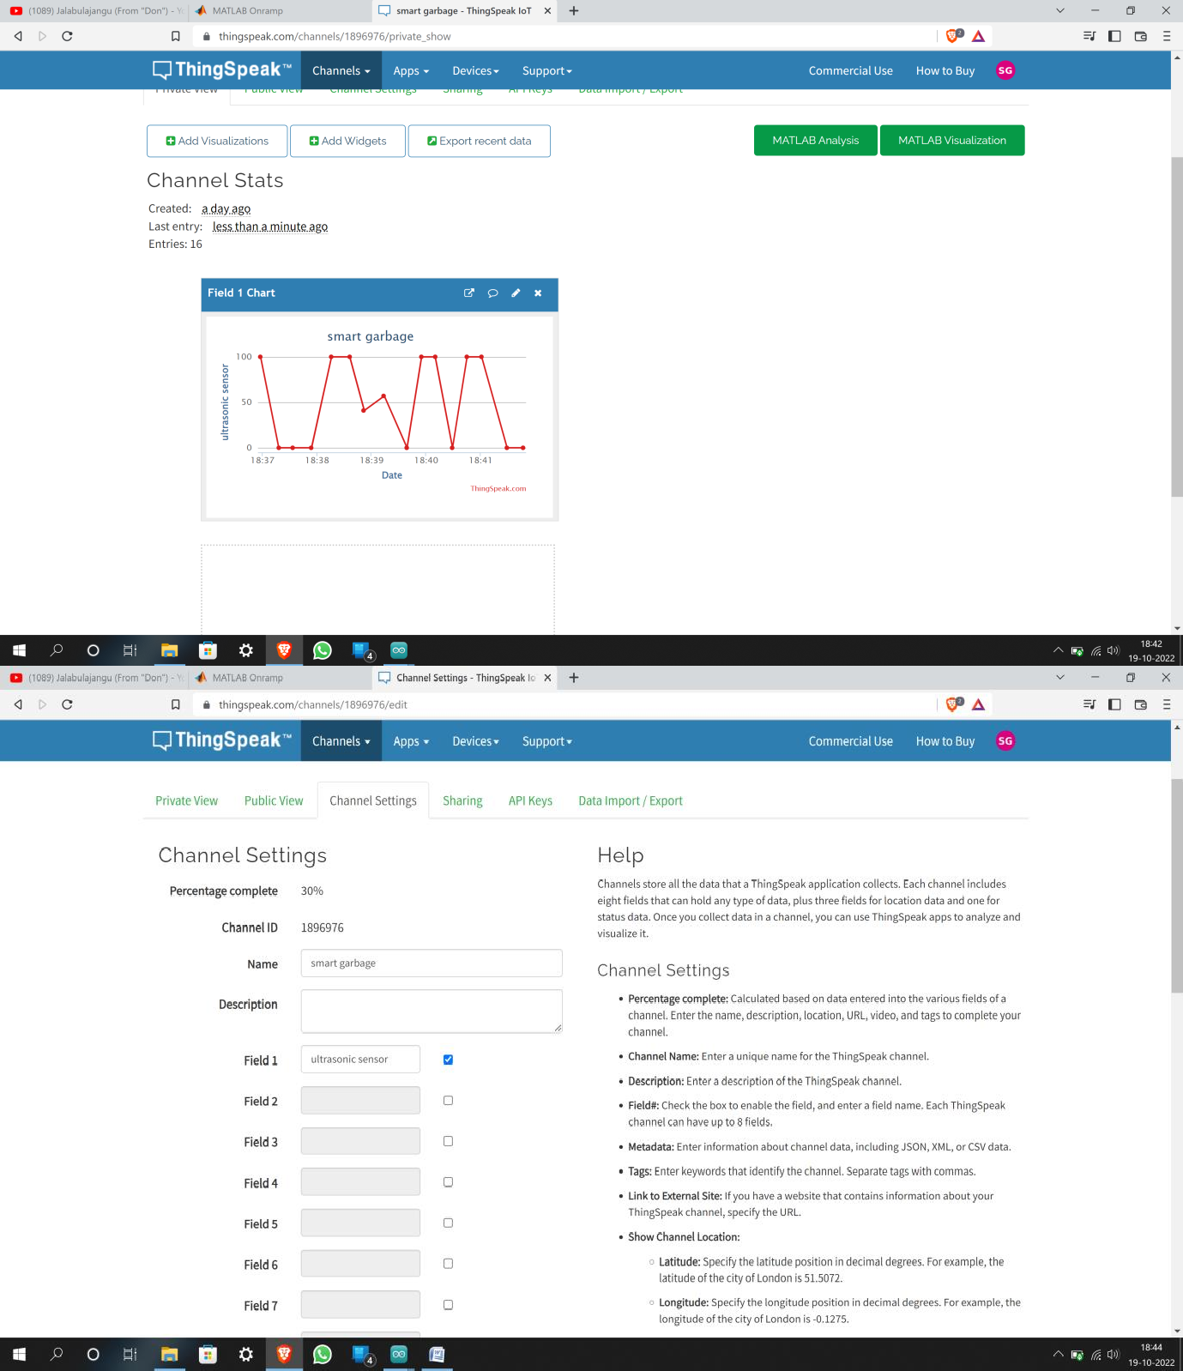
OUTPUT IMAGES
Garbage level graph representation.

Slide 17
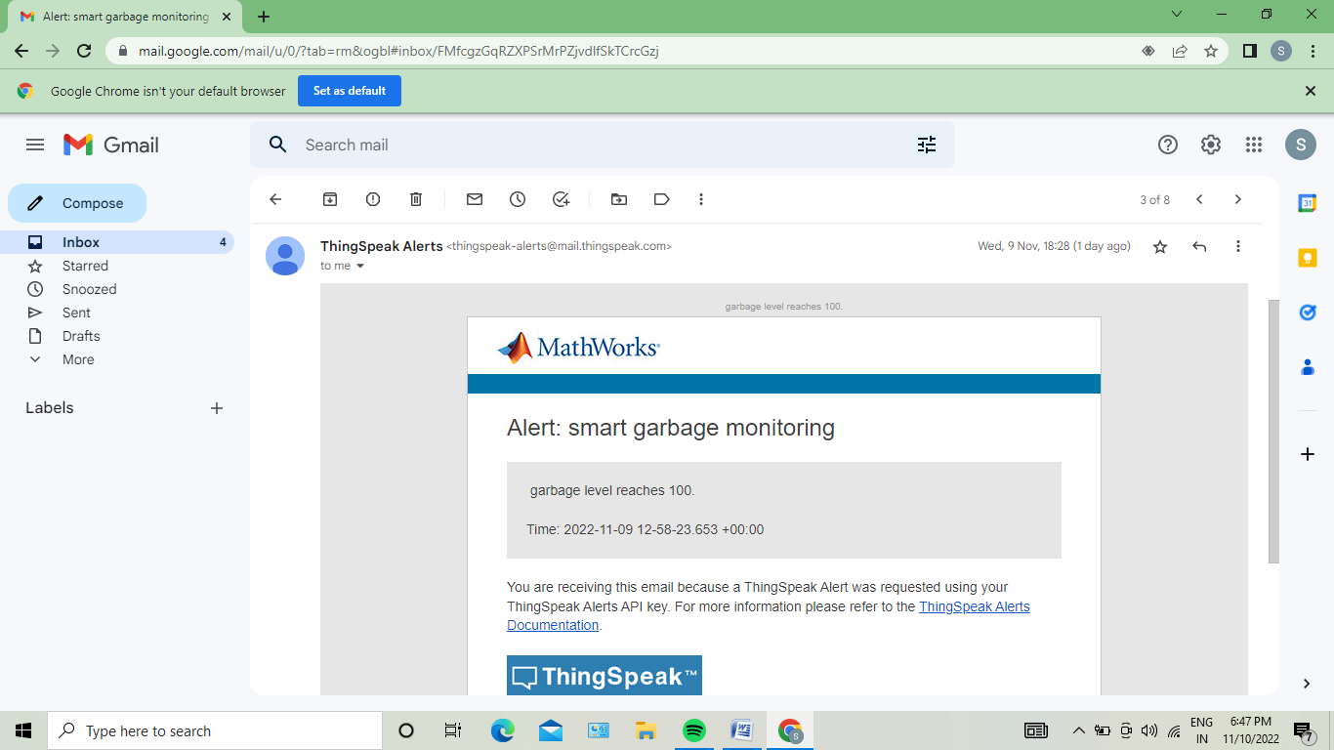
Trigger Email notification in mail

Slide 18
CONCLUSION
The main objective is to maintain the level of cleanliness in the city and form an environment which is better for living.
By using this system we can constantly check the level of the garbage in the dustbins.
If a dustbin has reached the maximum level then the employees can be informed and they can immediately take certain actions to empty it as soon as possible.
The employees can check the status of these bins anytime on their mobile phones. This can prove to be a very useful system if used properly.

Slide 19
FUTURE WORKS
The system provides us with the real time information and status of garbage bins located in different areas.
With the help of this real time information we can monitor the bins and once the bins are full the workers can collect the garbage and set them to empty again.
This system is cost effective and can be accessed from anywhere.

Slide 20
REFERENCES
1. Alexey Medvedev, Petr Fedchenkov, ArkadyZaslavsky, Theodoros, Anagnostopoulos Sergey Khoruzhnikov (2015), “Waste Management as an IoT- Enabled Service in Smart Cities”.
2. Fetulhak Abdurahman, Sileshi Aweke and Chera Assefa (2018), “Automated Garbage Monitoring System using Arduino”, in IOSR Journal of Computer Engineering (IOSR-JCE),Volume 20.
3. Ghose M.K., Dikshit A.K, Sharma S.K (2006),“A GIS based transportation model for solid waste disposal – A case study on Asansol municipality.

Slide 21
REFERENCES
4. Guerrero, L.A., Maas, G., Hogland W. (2013), “Solid waste management challenges for cities in developing countries. Journal of Waste Management.
5. Monika K A, Nikitha Rao, Prapulla S B, Shobha G,(2017),“Smart Dustbin,An Efficient Garbage Monitoring System”.

Slide 22
Queries

Slide 23
thank you

