Slide 1
Single-Cell Immune Response to Nanoplastic Particles
scRNA-seq of human PBMCs exposed to 40 nm / 200 nm / mixed polystyrene nanoparticles vs control
Genome Informatics, ETF Belgrade, 2026
Notes:
Hi, my name is Vuk Djordjevic. I'm a master's student at the School of Electrical Engineering in Belgrade, and this is my project for Genome Informatics, 2026: a single-cell analysis of how human immune cells respond to nanoplastic particles of different sizes. Nanoplastics are tiny plastic particles, now found in human blood in direct contact with our immune cells. My question is whether size matters: do small and large nanoplastics cause different responses, and does a mixture of both do something neither size does alone? To answer it I used single-cell RNA sequencing, which reads which genes are active in each individual cell.

Slide 2
Question & dataset
Do small vs large nanoplastics provoke different immune responses?
Does the 40+200 nm mixture do something neither size does alone?
4 samples, one donor: PSNP_40nm, PSNP_200nm, PSNP_mixture, control
~34,000 PBMCs, AnnData/.h5ad (Zenodo 10.5281/zenodo.15866724)
Notes:
The data is four samples from a single donor: peripheral blood immune cells exposed to 40-nanometre particles, to 200-nanometre particles, to a mixture of both, and one unexposed control. About 34,000 cells in total. One thing to be upfront about: one donor, one sample per condition, so no biological replicates. That shaped how I did the statistics, and I flag it throughout.

Slide 3
Pipeline (6 stages, one reproducible driver)
1. QC & preprocessing - thresholds justified on real percentiles
2. Integration - Harmony batch correction, UMAP, Leiden
3. Annotation - celltypist, cross-checked vs Azimuth & CoDi (~93%)
4. Composition - proportions + log2 fold-change vs control
5. Differential expression - per-lineage Wilcoxon + pathway enrichment
6. Size-specific effects - unique / shared / mixture-emergent genes
Notes:
The whole analysis runs through one pipeline of six stages: quality control, integration, cell-type annotation, composition analysis, differential expression, and size-specific effects. A single command reproduces all of it from the raw data, and each stage has automated tests.

Slide 4
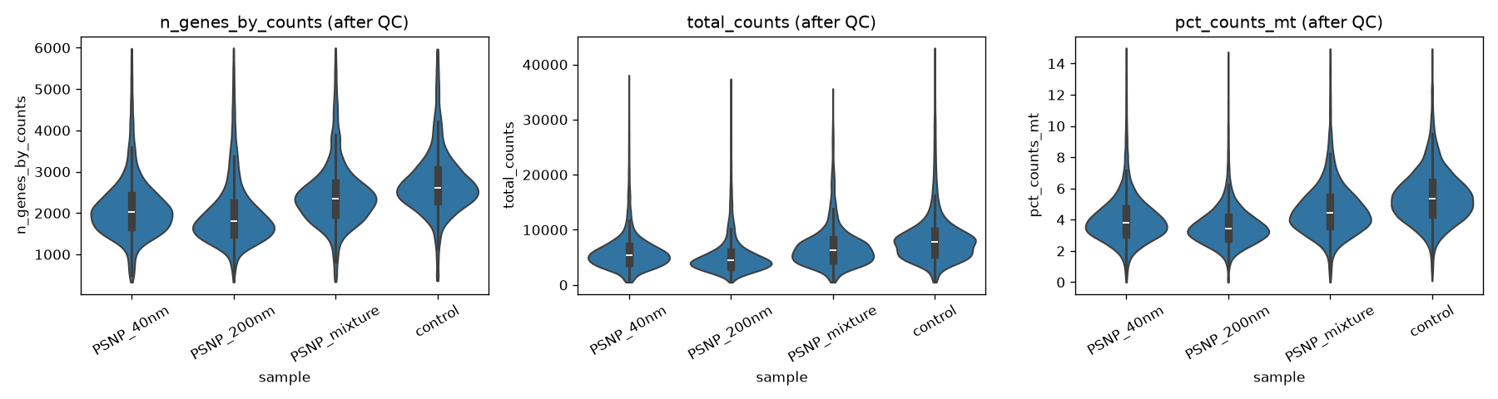
QC & preprocessing (1/2): per-sample QC metrics
Violins of the 3 QC metrics after filtering. Thresholds justified on the real distribution (max_genes ~p99, max_mito between p95-p99).
Notes:
The first stage is quality control: removing low-quality cells before trusting anything. These three plots are violins, basically histograms on their side, fatter where more cells sit; along the bottom are my four samples. Left is how many genes each cell expressed, middle is total reads per cell, right is the percent of mitochondrial reads, a sign of a dying cell. This is after cleaning, and the shapes look healthy and similar across all samples. I set the cutoffs from the real distribution, not by guessing: drop cells with too many genes, usually two stuck together, and cells with too much mitochondria, which are dying.

Slide 5
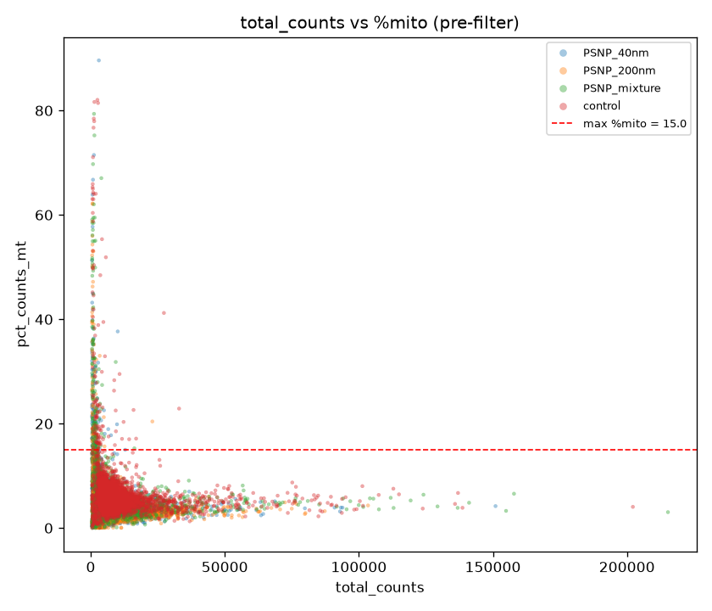
QC & preprocessing (2/2): counts vs %mito
total_counts vs %mito (pre-filter); threshold lines drawn. Drops likely doublets and dying cells.
Notes:
This is the same cleaning step, drawn a different way. Every dot here is one cell. Left-to-right is how many reads the cell has, and bottom-to-top is how mitochondrial it is. The red dashed line is my cutoff at 15 percent. Almost all the cells form a dense cloud hugging the bottom, with low mitochondria, which is exactly what healthy cells look like. The handful of dots floating up above the red line are dying or broken cells, and those get thrown out.

Slide 6
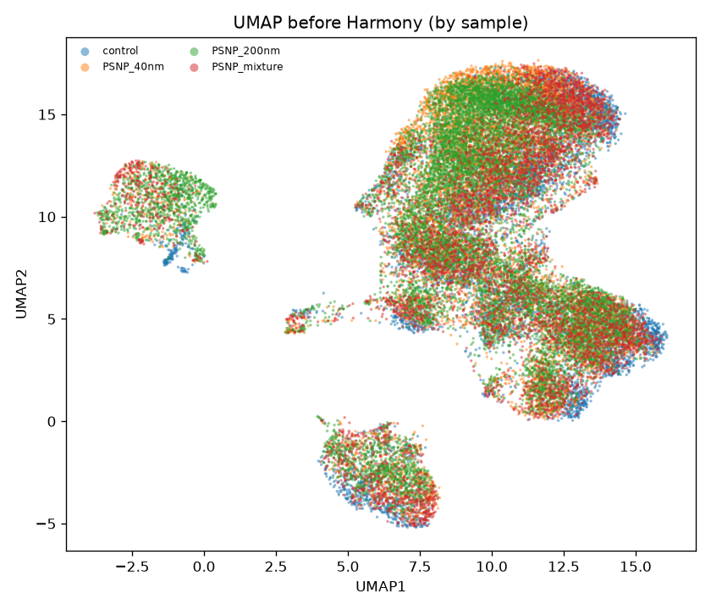
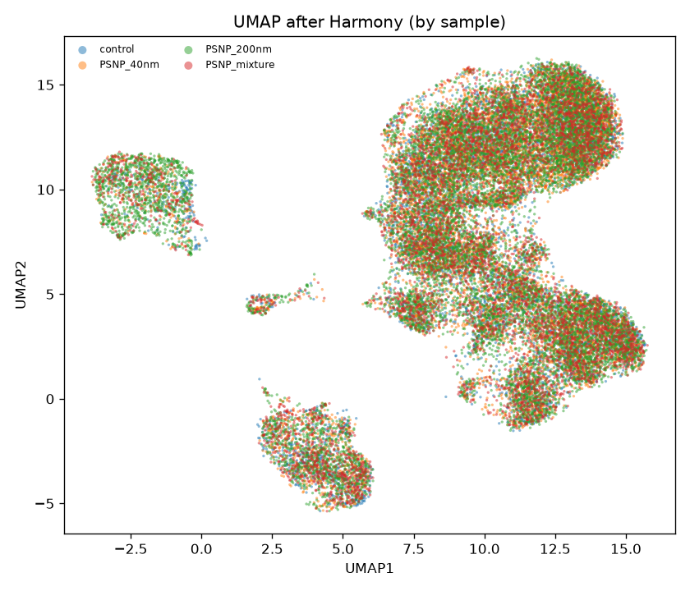
Integration removes the batch effect
Before (left) vs after Harmony (right), coloured by sample: samples mix after correction.
Notes:
The second stage is integration. Both pictures are a UMAP: each cell has thousands of genes, and UMAP squashes that down to one dot on a map, so cells with similar gene activity land close together. The axes are just map coordinates; only closeness matters. Each dot is a cell, coloured by sample. I want the colours well mixed: if cells clumped by colour, the sample would matter more than the biology, a technical artefact. Here they're nicely blended, so cells group by cell type, not batch. One honest caveat: with a single sample per condition, batch and treatment are tied together, so for the gene-level results later I use the uncorrected data, where this can't bias anything.

Slide 7
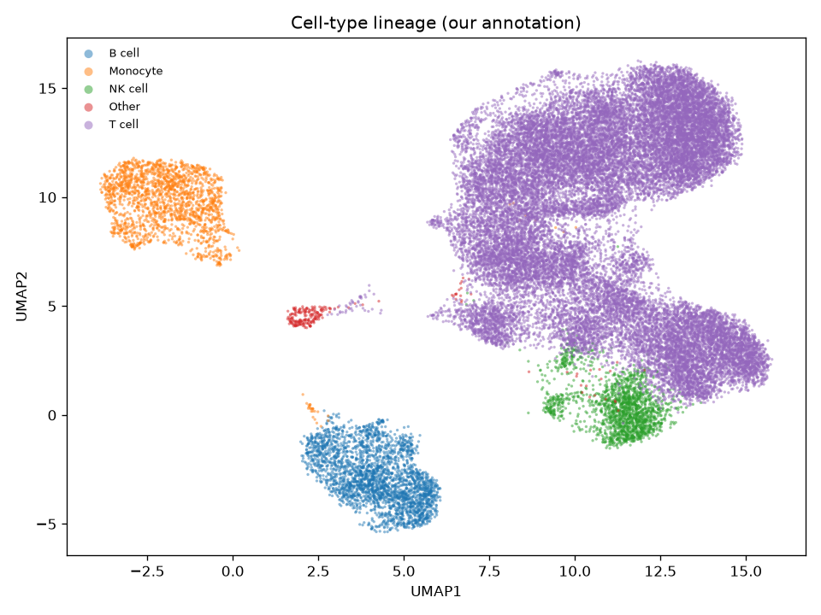
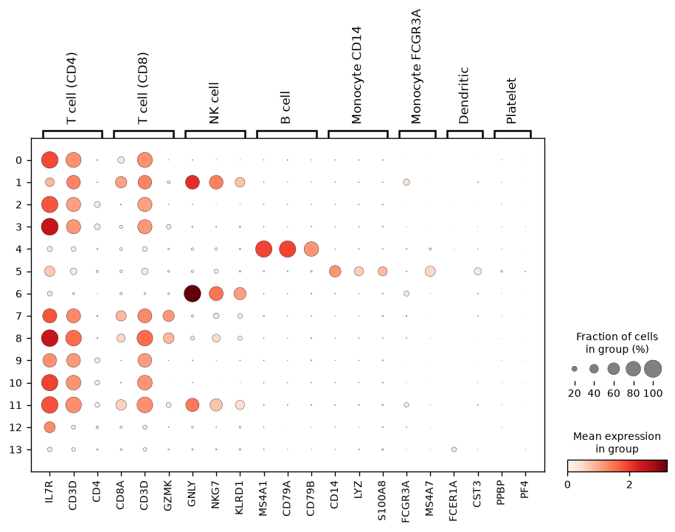
Cell-type annotation
celltypist lineages; agreement with Azimuth 92.7% and CoDi 93.1% (independent references).
Notes:
The third stage is labelling the cell types. On the left, the same cell-map coloured by cell type: T cells the big purple mass on the right, monocytes the orange island top-left, B cells blue at the bottom, NK cells green. Clean separate islands mean the types are real. On the right, a dot-plot that proves the labels: rows are clusters, columns are marker genes like CD3D for T cells or CD14 for monocytes. A big dark dot means that gene is strongly on in that cluster, and the dark dots line up on the diagonal, so each cluster lights up its own marker. I labelled with a tool called celltypist and cross-checked against two independent methods; they agreed at about 93 percent.

Slide 8
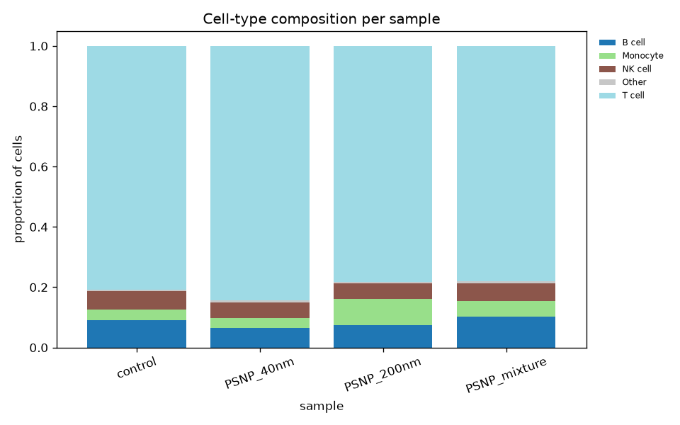
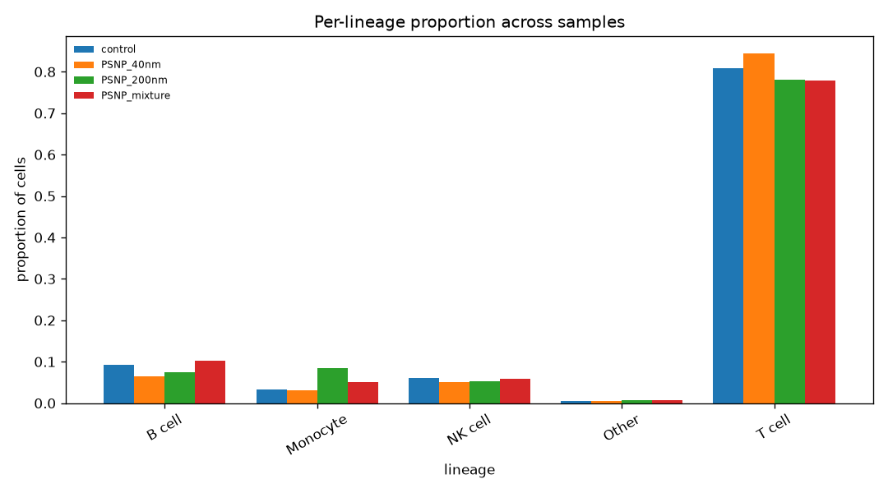
Composition shifts vs control
Cell-type proportions per sample; PSNP_200nm shows the largest compositional shift.
Notes:
The fourth stage asks whether exposure changed how many of each cell type there are. The bars show what fraction of a sample is each cell type, and the four bars per group are the four samples. T cells dominate every sample, the tall bars on the right at around 80 percent, which is normal for blood. The thing to notice is the Monocyte group: the green 200-nanometre bar is noticeably taller, roughly two and a half times the control's monocyte fraction, while everything else barely moves. So 200 nanometres specifically bumps up the monocytes. With no replicates, I report this as a descriptive shift and treat any test as exploratory.

Slide 9
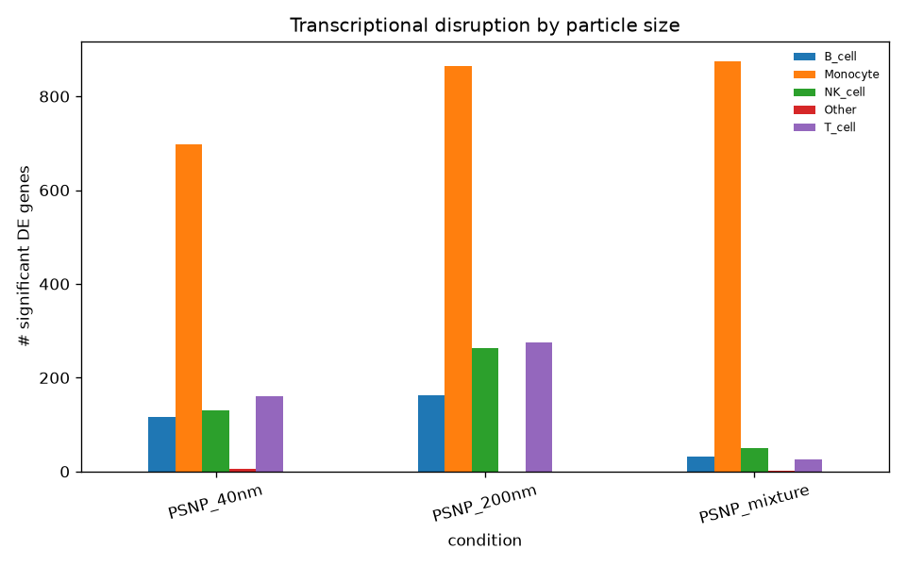
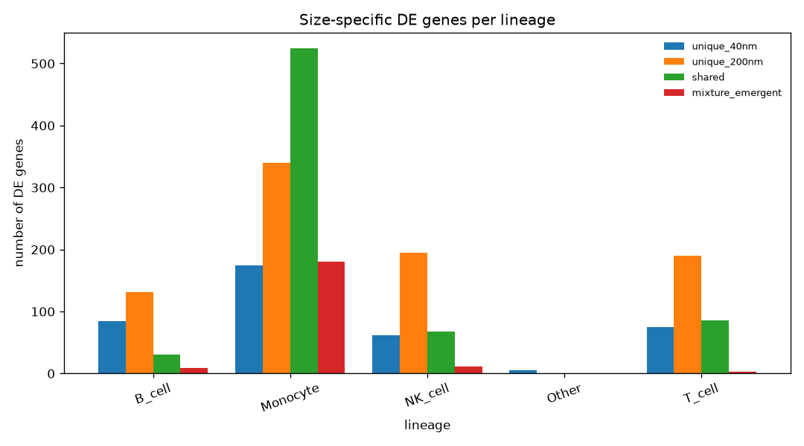
Differential expression: dose-response
Monocytes respond most; 200 nm drives more unique genes than 40 nm; mixture-emergent in monocytes.
Notes:
The fifth stage asks which genes actually change on exposure, within each cell type. In both bar charts, bar height is the number of genes that significantly changed. The left chart groups by condition, coloured by cell type: the orange Monocyte bars tower over everything, because monocytes eat and clear foreign particles, and the 200-nanometre bar beats the 40-nanometre one, so bigger particles, bigger response. The right chart is the sixth stage, showing where those genes overlap. Four bars per cell type: genes reacting only to 40, only to 200, to both, and the key one in red, genes that fire only in the mixture and in neither size alone. In monocytes that red bar is about 180 genes, a whole response that only appears when both sizes are combined.

Slide 10
Key biological finding
Monocytes show the strongest transcriptional response to nanoplastic.
200 nm particles drive MORE lineage-unique genes than 40 nm.
The 40+200 nm mixture produces an EMERGENT monocyte response – genes significant only in the mixture, in neither single size.
In lymphocytes the mixture is weaker than either size (sub-additive).
Notes:
So let me pull the main findings together. First, monocytes show the strongest response to nanoplastic of any cell type. Second, the 200-nanometre particles drive more cell-type-unique genes than the 40-nanometre ones. And third, the biggest one: the 40 plus 200-nanometre mixture produces an emergent monocyte response, about 180 genes that are significant only in the mixture and in neither single size. Interestingly, in the lymphocytes the opposite happens, the mixture is actually weaker than either size alone. Either way, the combination of the two sizes does something the individual sizes do not.

Slide 11
What the mixture does: emergent inflammation
The 180 mixture-only monocyte genes are dominated by INFLAMMATION.
Pathway enrichment (p ~ 1e-21): interleukin, cytokine & TNF signalling, and 'response to lipopolysaccharide' - i.e. a bacterial-attack-like program.
Top mixture-only genes up: RIPK2, TRAF1, PIK3CB (innate/TNF signalling).
Interpretation: two sub-threshold exposures together push monocytes over an inflammatory activation threshold - an emergent, non-additive effect.
Real exposure is always to mixtures -> single-size studies may under-estimate risk.
Notes:
So what is that new thing? I ran pathway enrichment on those 180 mixture-only monocyte genes, and it points clearly at inflammation. The top pathways, with strong statistical support, are interleukin, cytokine, and TNF signalling, plus the response to lipopolysaccharide. That last one is the program a monocyte runs during a bacterial infection, except here it's set off by plastic. Two of the strongest genes going up are RIPK2 and TRAF1, core innate-immune and TNF genes. My reading: 40 and 200 nanometres each cause small, sub-threshold changes, but together they push the monocyte over the edge into an inflammatory state. And since real exposure is always to a mix of sizes, testing single sizes alone could underestimate the risk.

Slide 12
Additional analyses (5 implemented)
1. Module scoring - stress & inflammation gene programs per sample (shown next).
2. Mixture additivity - is the mixture = 40nm + 200nm? (shown next).
3. Clustering robustness - clusters stable across Leiden resolutions (ARI).
4. Ligand-receptor - shift in cell-to-cell communication on exposure.
5. Dose-response - disruption magnitude vs particle size.
All five reinforce the same story: size-dependent, non-additive, monocyte-centred.
Notes:
For the additional-insights part of the project I implemented five extra analyses, which this slide lists, and the next slides show each one. They are module scoring, a mixture additivity test, a clustering robustness check, a ligand-receptor communication analysis, and dose-response. I'll walk through them in the next few slides. All five point the same way: a size-dependent, non-additive response centred on the monocytes.

Slide 13
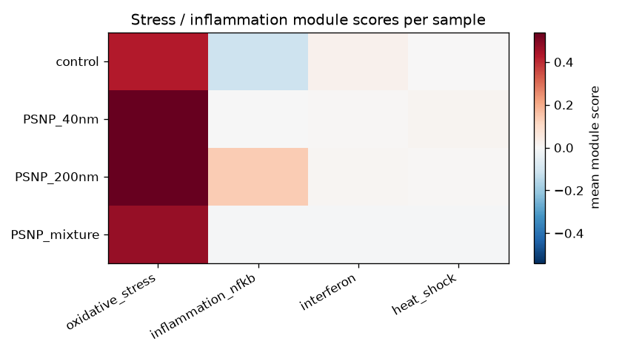
Additional analyses: stress/inflammation module scores
Analysis 1 of 5. Per-sample mean module scores for stress and inflammation gene programs.
Notes:
The first additional analysis is module scoring: a colour grid where each row is a sample and each column is a biological program, a named group of genes: oxidative stress, NF-kB inflammation, interferon, heat shock. Red means the program is turned up. The whole oxidative-stress column goes deep red in all three exposed samples but not the control, so plastic reliably stresses the cells, and the inflammation column turns pink specifically under 200 nanometres. So the size effect shows up here too, in independent gene programs.

Slide 14
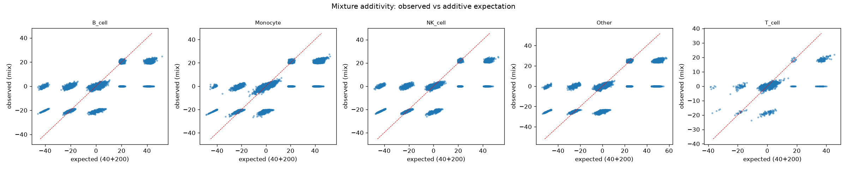
Additional analyses: mixture additivity
Analysis 2 of 5. Observed mixture response vs the 40+200 nm additive expectation, per lineage.
Notes:
The second analysis is a direct test of whether the mixture is just 40 plus 200 added together. One scatter per cell type, each dot a gene: left-to-right is what I'd predict if the mixture were the two sizes summed, bottom-to-top is what it actually did, and the red diagonal is where the prediction would be perfect. If every gene sat on that line, the mixture would be boringly additive. But in the Monocyte panel there are clear blobs of genes off the line, genes the mixture switched on or off that you'd never predict from the single sizes. That off-the-line behaviour is exactly the emergent, non-additive effect.

Slide 15
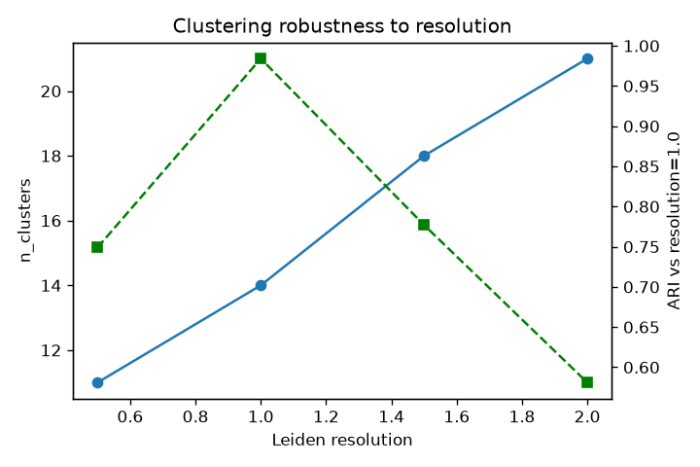
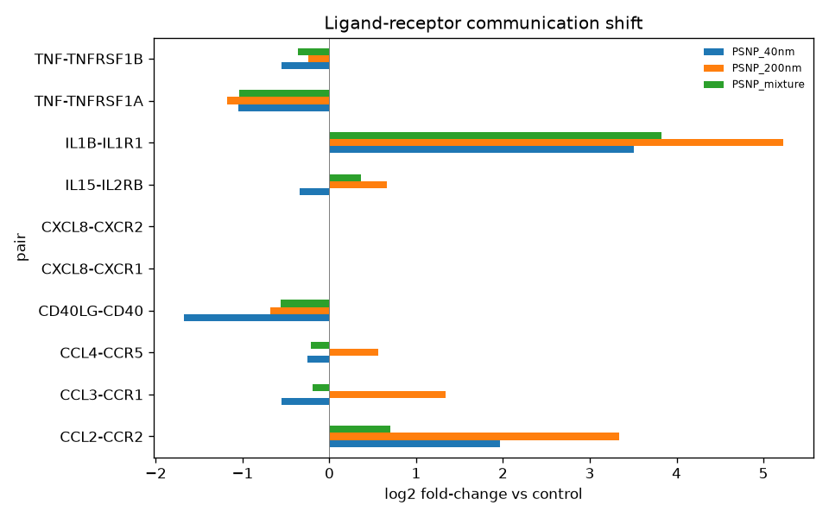
Additional analyses: robustness & communication
Analyses 3 & 4 of 5. Left: clustering robustness (ARI across Leiden resolutions). Right: ligand-receptor communication shift on exposure. (Analysis 5, dose-response, is on the DE slide.)
Notes:
The third and fourth analyses. The left plot is a sanity check on my clustering: the green dashed line is how much the grouping still agrees with my default setting, where 1.0 is identical. It stays high, so my cell groups aren't a fluke of one setting. The right plot is cell-to-cell messaging: each row is a signalling pair, and a bar goes right if that message got louder after exposure. The standout is IL1B, a classic inflammation alarm, shooting far right in all exposed samples and furthest under 200 nanometres, so the cells are shouting inflammation at each other. The fifth analysis, dose-response, I already showed on the earlier DE slide.

Slide 16
Limitations & reproducibility
One donor, one sample per condition -> NO biological replicates.
DE is cell-level Wilcoxon (not pseudobulk); p-values exploratory, pseudoreplication caveat.
No external gene-level ground truth; DE validated internally + biologically.
Everything reproduces: `python run_pipeline.py --all`; 37 offline intent tests.
Notes:
Finally, to be clear about the limits. One donor and no replicates mean the differential expression is done per cell and is exploratory, with a pseudoreplication caveat. There's no external gene-level reference, so I validated the results internally and biologically. But everything reproduces from the repository with a single command and a full test suite. Thanks for watching.

