Slide 1
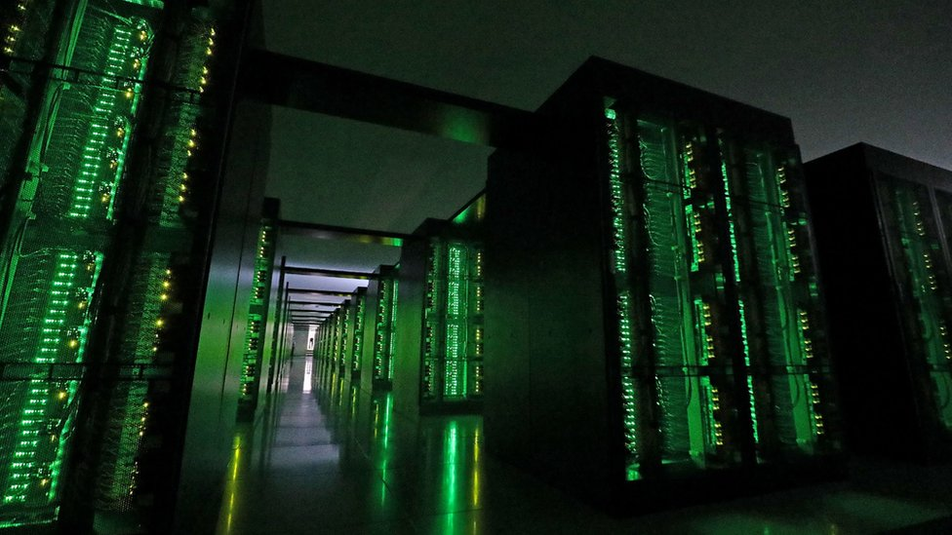
The Ultimate SuperComputer-on-a-Chip for Big Data and Machine Learning
Veljko Milutinović

Slide 2

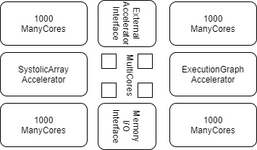
The Optimal Architecture
ControlFlow:
N MultiCore CPUs
1000N ManyCore GPUs
DataFlow:
An ASIC SystolicArray (Fixed)
An FPGA ExecutionGraph (Reconfigurable)
w Peripherals for External Accelerators (EnergyFlow):
Bio
Molecular
Opto
Quantum
+ w Memory and I/O (DiffusionFlow)

Slide 3
Optimal Distribution of Transistor Budget
Ceiling-Dependent:
VLSI: 100BTr
WSI: 1TTr
Application-Dependent:
SW DataFlow
ML
Strategy-Dependent:
CF-Oriented
DF-Oriented
Memory-Dependent!

Slide 4

The Current Efforts
Company | Product name | Country | City | Number of CPU cores | Number of GPU cores | CPU clock rate | Launched
Alibaba | XT910 | China | Hangzhou | 1/2/4 per cluster | N/A | 2.0 – 2.5 GHz | 2020
RISC-V | Micro Magic RISC-V Core [39] | US | San Francisco | 1 | N/A | 4.25 – 5.19 GHz | 2020
SiFive | FU740 RISC-V SoC [25] | US | San Francisco | 4 | 1 | 1.4 – 1.5 GHz | 2020
AMD | AMD Ryzen™ 5 3400G with Radeon™ RX Vega 11 Graphics [24] | US | Santa Clara | 4 | 11 | 3.7 – 4.2 GHz | 2019
Nvidia | Tegra Xavier [28] | US | Santa Clara | 8 | 512 CUDA | N/A | 2019
Esperanto Technologies | N/A | US | Mountain View | 16 ET-Maxion cores | 4096 ET-Minion cores + ET-Graphics [26,27] | 2+GHz | 2018
Intel | Intel Sandy Bridge [23] | US | Santa Clara | 1-4 (4-6 Extreme, 2-8 Xeon) | 6 | 1.60 – 3.60 GHz | 2011
Moscow Center of SPARC Technologies (MCST) | Elbrus-2S+ (1891ВМ7Я) [29] | Russia | Moscow | 2 Elbrus 2000 cores | 4 DSP Elcore-09 cores | 300 – 800 MHz | 2011

Slide 5
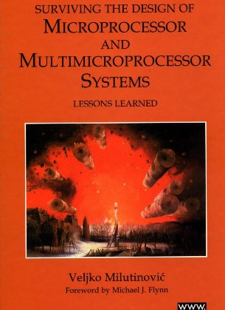
Past Experiences: MultiCore
Split Cache
Milutinovic, V. (1996). The Split Temporal/Spatial Cache: Initial Performance Analysis. SCIzzL-5, March 1996, 63-69.

Slide 6
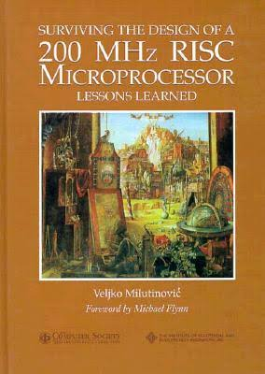
Past Experiences: ManyCore
GaAs Microprocessor
Milutinovic, V., Fura, D., & Helbig, W. (1986). An Introduction To GaAs Microprocessor Architecture for VLSI. Computer, (3), 30-42.

Slide 7
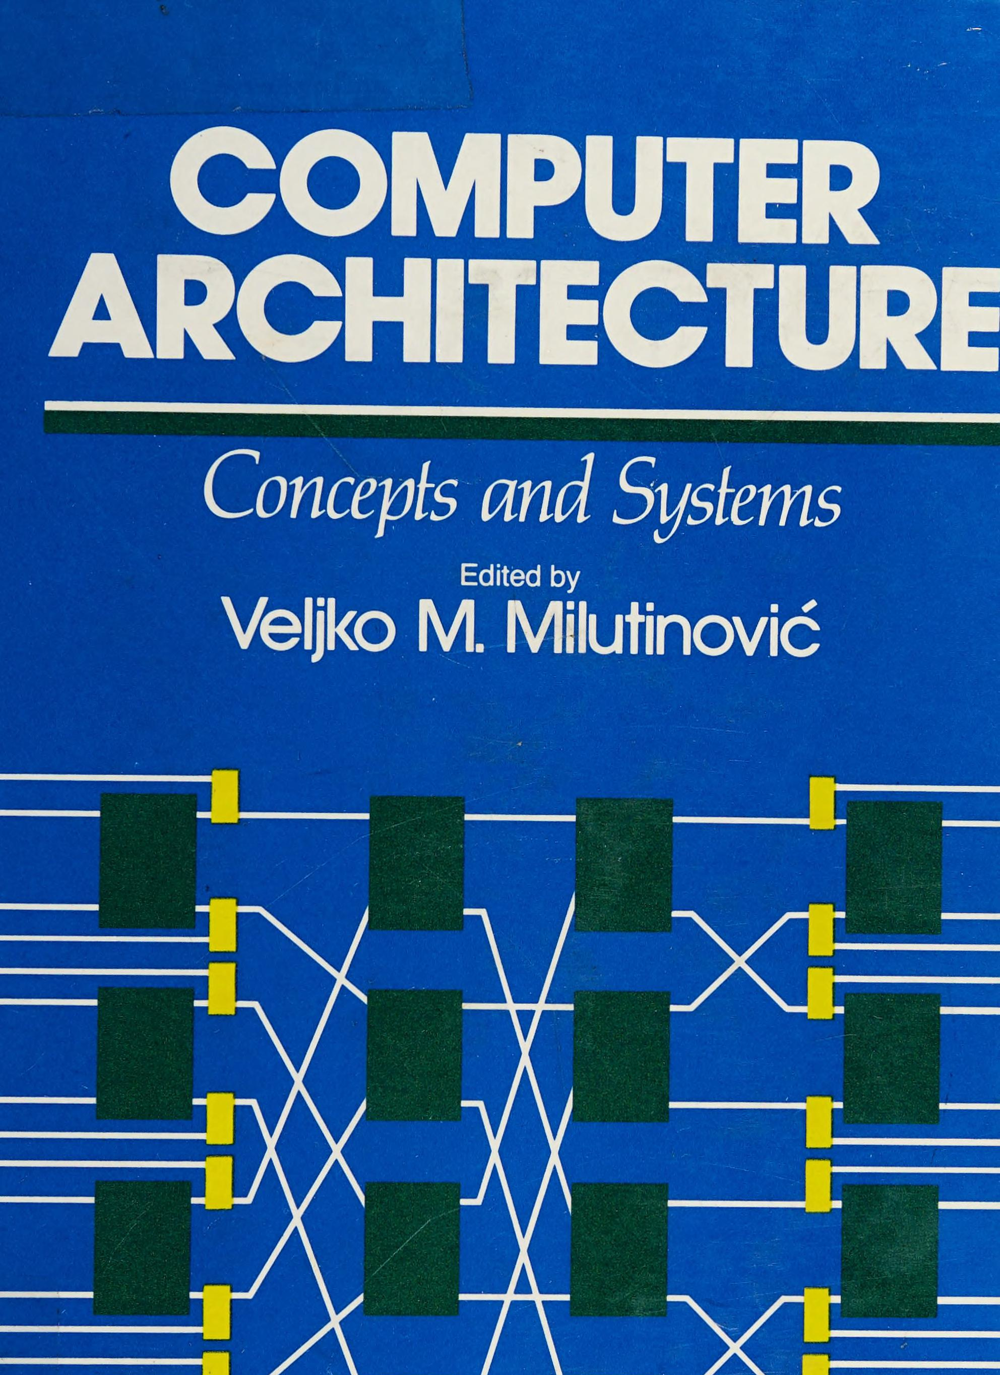
Past Experiences: SystolicArrays
GaAs Systolics
Fortes, J. A., Milutinovic, V., (1986, January). A High-Level Systolic Architecture for GaAs. In Proc. 19th Ann. Hawaii Int'l Conf. System Sciences (pp. 253-258).

Slide 8
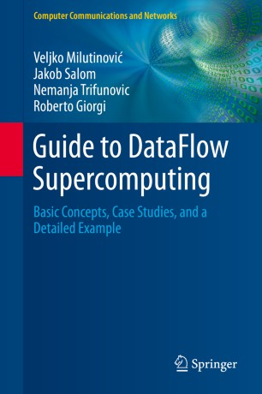
Past Experiences: ExecutionFlow
DataFlow
Milutinović, V., Salom, J., Trifunović, N., & Giorgi, R. (2015). Guide to DataFlow Supercomputing. Cham: Springer Nature.

Slide 10
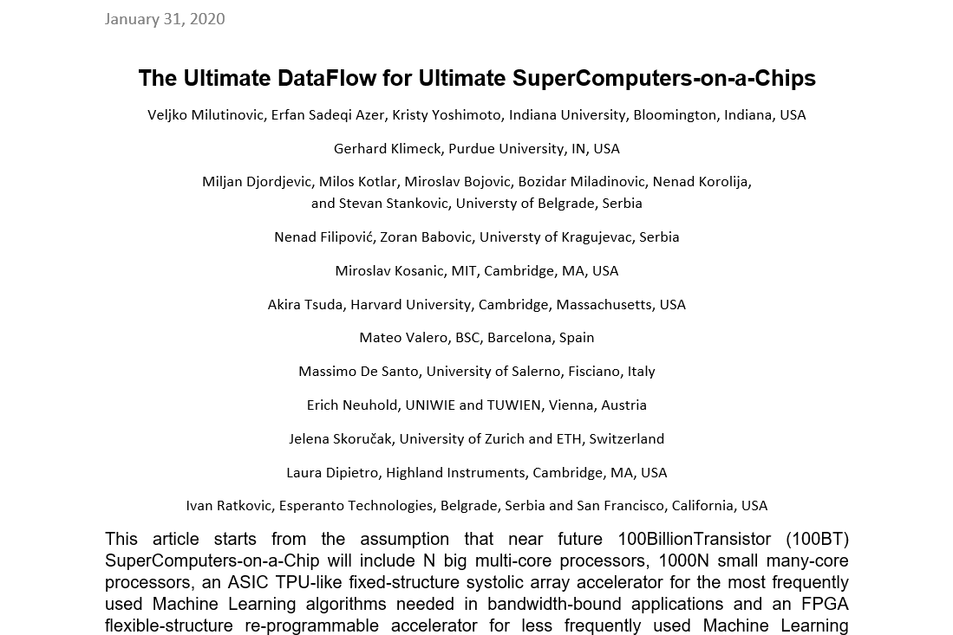
Current Research: Miljan Đorđević, at al.

Slide 11
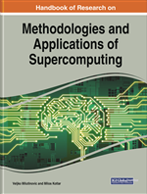
Handbook of Research on Methodologies and Applications of Supercomputing

Slide 12
Table of Contents
An introduction to Controlflow and Dataflow Supercomputing
Introduction to Control Flow
Optimal Scheduling of Parallel Jobs With Unknown Service Requirements
Intelligent Management of Mobile Systems Through Computational Self-Awareness
Paradigms for Effective Parallelization of Inherently Sequential Graph Algorithms on Multi-Core Architectures
Introduction to Dataflow Computing
Data Flow Implementation of Erosion and Dilation
Transforming the Method of Least Squares to the Dataflow Paradigm
Forest Fire Simulation: Efficient Realization Based on Cellular Automata
High Performance Computing for Understanding Natural Language
Deposition of Submicron Particles by Chaotic Mixing in the Pulmonary Acinus: Aciner Chaotic Moxing

Slide 13
Table of Contents #2
Recommender Systems in Digital Libraries Using Artificial Intelligence and Machine Learning: A Proposal to Create Automated Links Between Different Articles Dealing With Similar Topics
Unified Modeling for Emulating Electric Energy Systems: Toward Digital Twin That Might Work
A Backtracking Algorithmic Toolbox for Solving the Subgraph Isomorphism Problem
AI Storm ... From Logical Inference and Chatbots to Signal Weighting, Entropy Pooling...: Future of AI in Marketing
Efficient End-to-End Asynchronous Time-Series Modeling With Deep Learning to Predict Customer Attrition
Mind Genomics With Big Data for Digital Marketing on the Internet
Supercomputing in the Study and Stimulation of the Brain
An Experimental Healthcare System: Essence and Challenges
What Supercomputing Will Be Like in the Coming Years
The Ultimate Data Flow for Ultimate Super Computers-on-a-Chip

Slide 14
Reviews and Testimonials of 8 Nobel Laureates

Slide 15
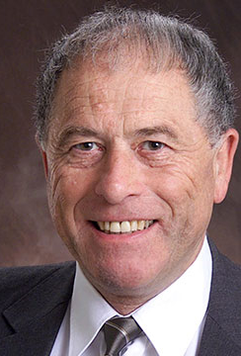
"I want to commend Dr. Veljko Milutinovic and Dr. Milos Kotlar for having completed this volume in the timely field of supercomputing in these difficult times, and I want to share their optimism regarding its use as a textbook around the world."
– Prof. Kurt Wüthrich, Nobel Laureate, Switzerland

Slide 16
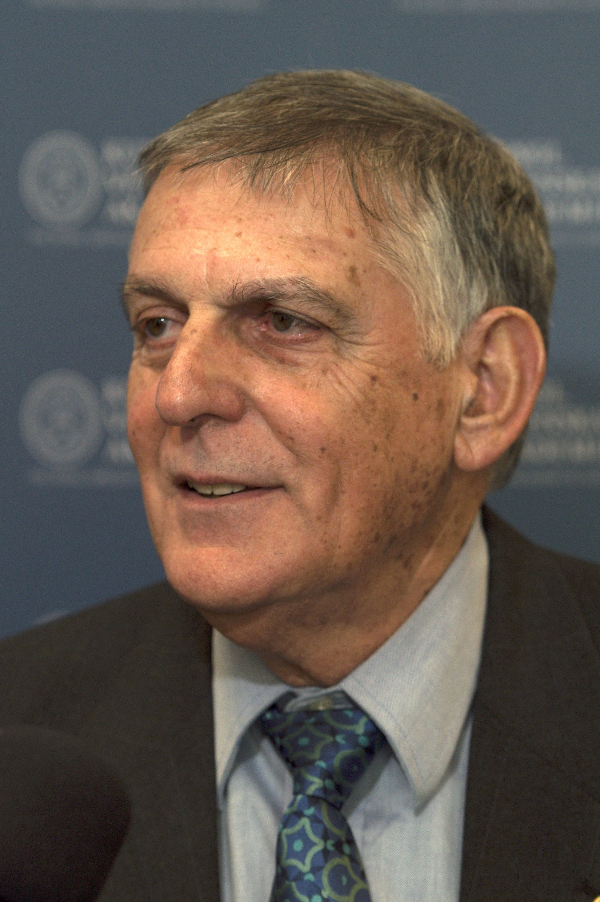
"Our complex and fast-moving world meets big data issues that call for reliable, efficient analysis and prompt response. A most advanced approach to dealing with these issues is presented in this book where algorithms of Control Flow represent the host architecture of supercomputers and Data Flow represents the acceleration architecture. A comprehensive list of applications is illustrated in the book including natural language processing, medical research, customer-oriented studies, and many more.“
– Prof. Dan Shechtman, Nobel Laureate, Israel

Slide 17
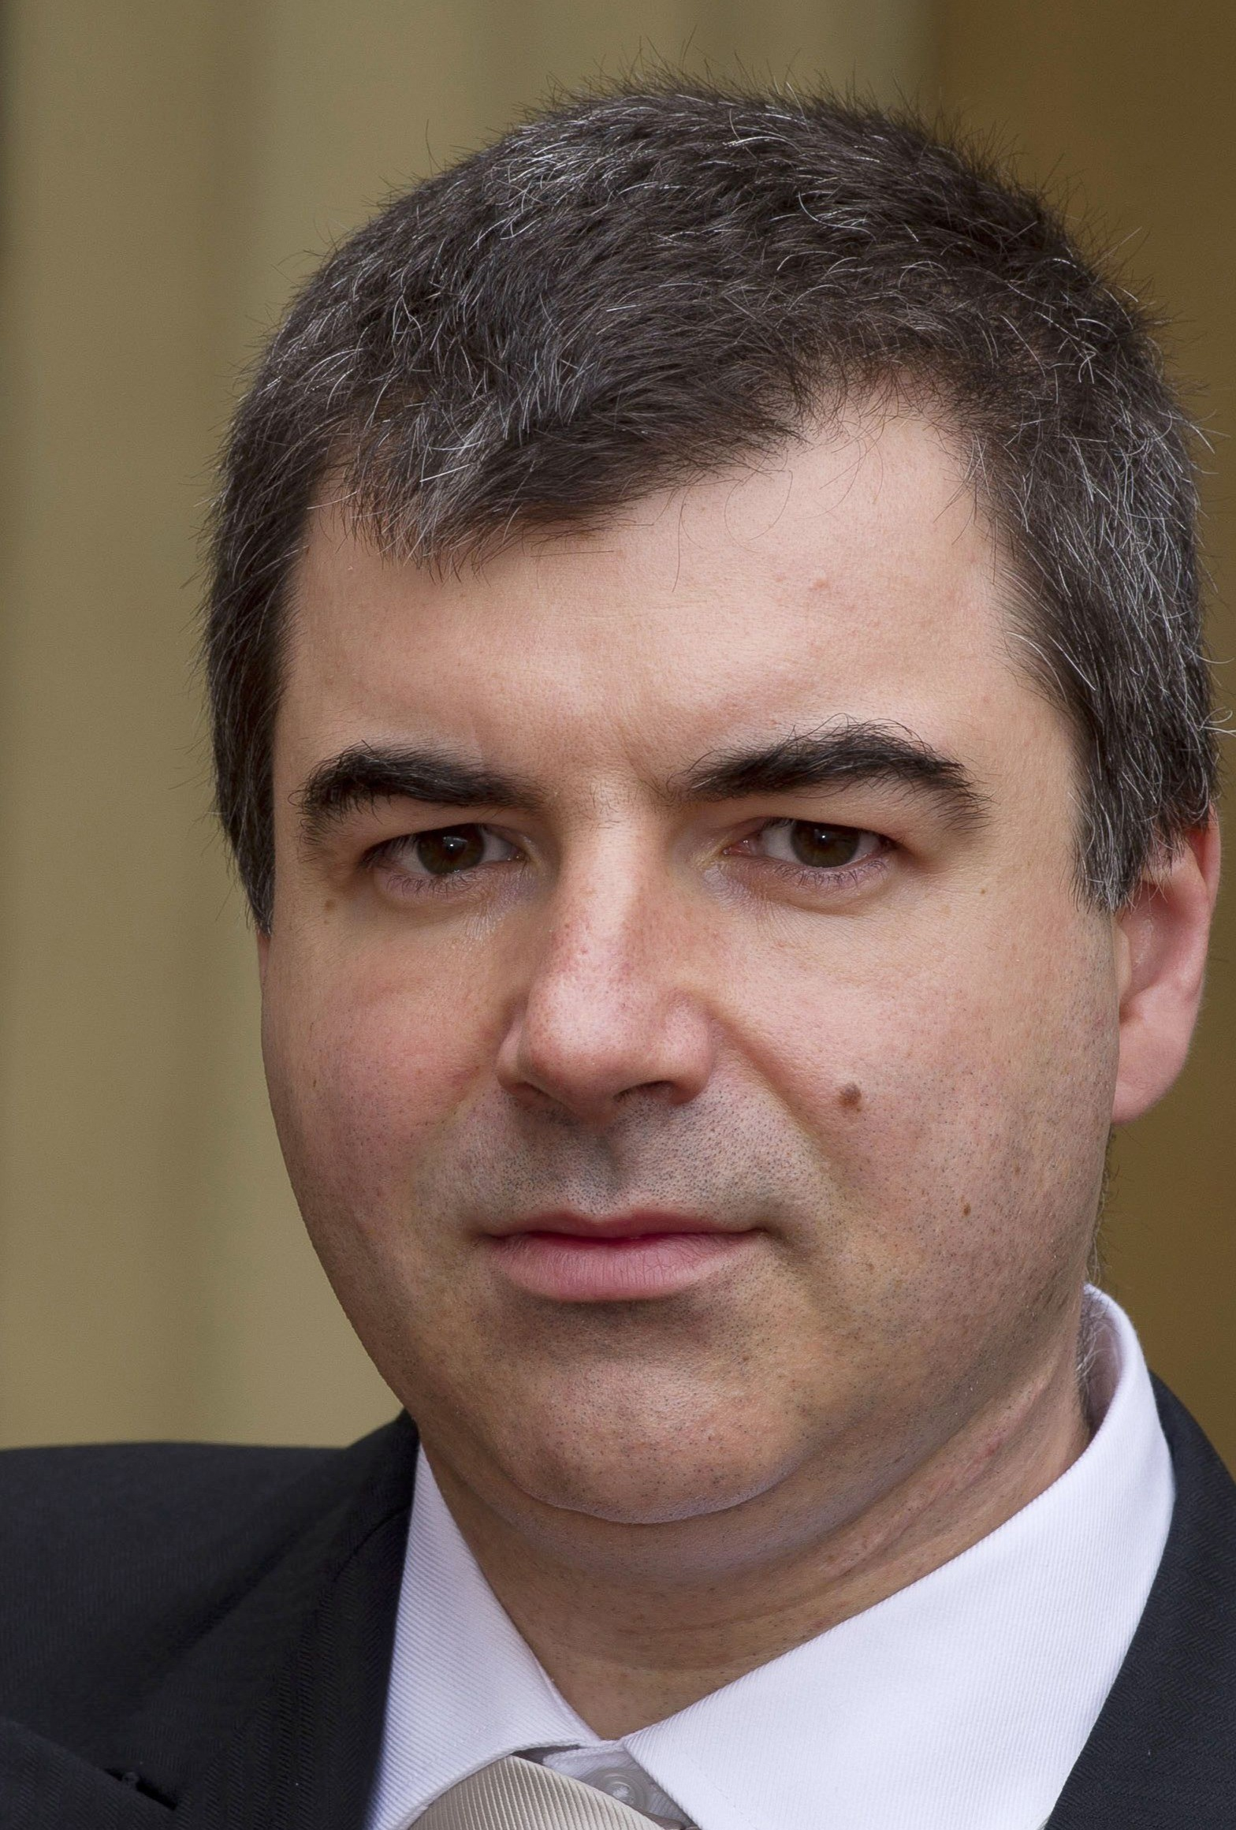
"Supercomputers have become a ubiquitous instrument in many areas of science and technology. Very hard to imagine modern physics, biology or chemistry without the use of this versatile tool. The breakthroughs in the development of supercomputers expand the range of problems we can tackle. Supercomputers, as well as specialised computers will undoubtedly contribute significantly to the overall landscape of discoveries in many different disciplines in the future."
– Prof. Konstantin Novoselov, Nobel Laureate, National University of Singapore, Singapore– Prof. Kurt Wüthrich, Nobel Laureate, Switzerland

Slide 18
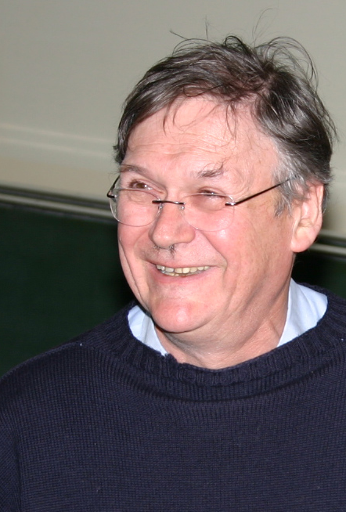
"It’s clear that computers can do anything, as the pioneers already recognised, and it’s probably only a matter of time before they can perform any of the kinds of tasks we humans take for granted quicker than blinking. I guess this book represents a stage on this exciting and very important journey."
– Prof. Tim Hunt, Nobel Laureate, UK

Slide 19
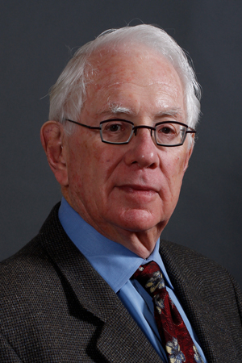
"Computers have become essential tools for the pursuit of both experimental and theoretical physics, as well as synthetic chemistry, paleontology, the medical sciences, economics the social sciences and so much more. Science, being the most international of all endeavors, will be well served by this important book, which honors the golden anniversary of the creation of Montinegro’s Academy of Science."
– Prof. Sheldon Glashow, Nobel Laureate, Boston University and Harvard University, USA

Slide 20
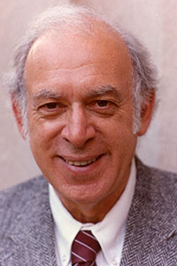
"Humankind’s continuing quests to uncover, understand, and utilize the secrets of nature have been greatly enhanced and will be further extended by the power of supercomputers."
– Prof. Jerome I Friedman, Nobel Laureate, USA

Slide 21
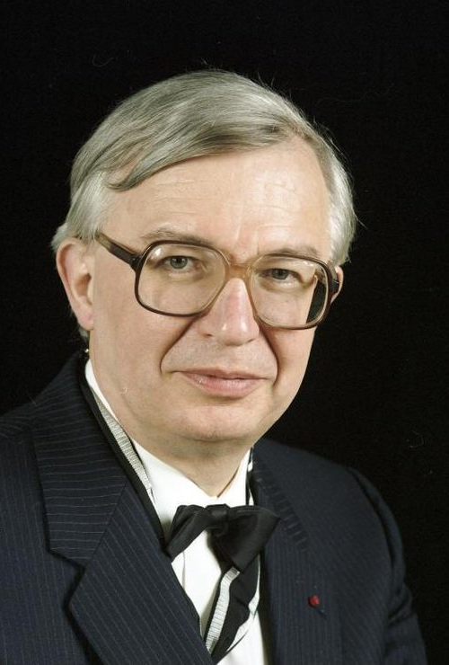
"I wish to congratulate very warmly the Montenegrin Academy of Arts and Sciences on the occasion of its 50th Anniversary and wish the CANU a highly successful future. Science shapes the Future of Mankind."
– Prof. Jean-Marie Lehn, Nobel Laureate, France

Slide 22
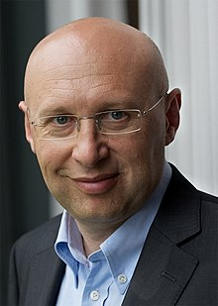
"Aim high, stay grounded! These four crisp words of wisdom accompany the best wishes for the 50th anniversary of the Montenegrin Academy of Sciences and Arts."
– Prof. Stefan Hell, Nobel Laureate, Germany

