Slide 1
Introduction and Motivation
Presenter
MaxAcademy Lecture Series – V1.0, September 2011

Slide 2
Lecture Overview
Challenges of the Exaflop Supercomputer
How much of a processor does processing?
Custom computers
FPGA accelerator hardware
Programmability

Slide 3
Rise of x86 Supercomputers

Slide 4
The Exaflop Supercomputer (2018)
How do we program this?
1 exaflop = 10¹⁸ FLOPS
Using processor cores with 8FLOPS/clock at 2.5GHz
50M CPU cores
What about power?
Assume power envelope of 100W per chip
Moore’s Law scaling: 6 cores today → ~100 cores/chip
500k CPU chips
50MW (just for CPUs!) → 100MW likely
‘Jaguar’ power consumption: 6MW
Who pays for this?

Slide 5
What do 50M cores look like?
Spatial decomposition on a 10000³ regular grid
1.0 Terapoints
20k points per core
27³ region per core
Computing a 13x13x13 convolution stencil: 66% halo

Slide 6
Power Efficiency
Green500 list identifies the most energy efficient supercomputers from the Top500 list
At 1.6 GFLOPs/W; 1 exaflop = 625MW
To deliver 1 Exaflop at 6MW we need 170 GFLOPS/W
 | Power efficiency (GFLOPS/W)
Best (BlueGene/Q) | 1.6
Average accelerator | 0.76
Average non-accelerator | 0.21
3.6x

Slide 7
Intel 6-Core X5680 “Westmere”
Execution units
L1 data cache
L2 Cache & interrupt servicing
Computation
Memory ordering and execution
Paging
Core
Out-of-order scheduling & retirement
Branch prediction
Instruction decode and microcode
Instruction fetch & L1 cache
Memory controller
Core
Core
Core
Core
Core
Core
I/O and QPI
Shared L3 cache
Uncore
Shared L3 cache
I/O and QPI

Slide 8
A Special Purpose Computer
A custom chip for a specific application
No instructions ➔ no instruction decode logic
No branches ➔ no branch prediction
Explicit parallelism ➔ No out-of-order scheduling
Data streamed onto-chip ➔ No multi-level caches
Rest of the world
MyApplication Chip
(Lots of) Memory

Slide 9
A Special Purpose Computer
But we have more than one application
Generally impractical to have machines that are completely optimized for only one code
Need to run many applications on a typical cluster
Rest of the world
OtherApplication Chip
Network
MyApplication Chip
Network
MyApplication Chip
Memory
Network
MyApplication Chip
Memory
Memory
Memory

Slide 10
A Special Purpose Computer
Use a reconfigurable chip that can be reprogrammed at runtime to implement:
Different applications
Or different versions of the same application
Network
Config 1
Optimized for Application A
Optimized for Application B
Optimized for Application C
Optimized for Application D
Optimized for Application E
Memory

Slide 11
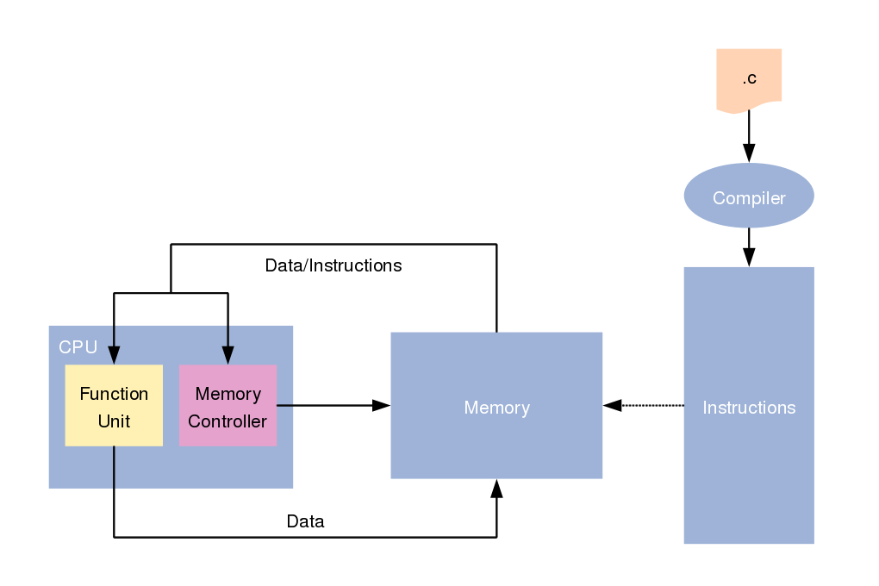
Instruction Processors

Slide 12
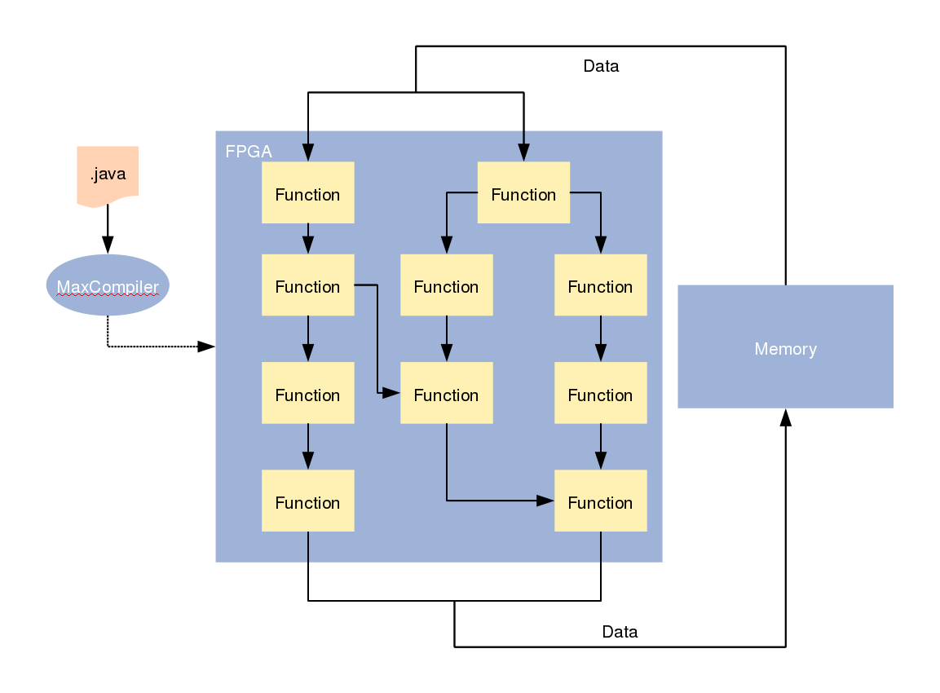
Dataflow/Stream Processors

Slide 13
Accelerating Real Applications
The majority of LoC in most applications are scalar
CPUs are good for: latency-sensitive, control-intensive, non-repetitive code
Dataflow engines are good for: high throughput repetitive processing on large data volumes
➔ A system should contain both
 | Lines of code
Total Application | 1,000,000
Kernel to accelerate | 2,000
Software to restructure | 20,000

Slide 14
Custom Computing in a PC
Processor
Register
file
Where is the Custom Architecture?
On-Chip w/ access to register file
Co-processor w/ access to level 1 cache
Next to level 2 cache
In an adjacent processor socket, connected using QPI/Hypertransport
As Memory Controller instead of North/South Bridge
As main memory (DIMMs)
As a peripheral on PCI Express bus
Inside the peripheral, i.e. a customizable Disk controller
L1$
L2$
North/South Bridge
PCI Bus
Dimms
QPI/ Hypertransport
Disk

Slide 15
Embedded Systems
Instructions
“Harvard” Architecture
Partitioning of Programs into software and hardware (custom architecture) is called Hardware Software Co-design
System-on-a-Chip (SoC)
Custom architecture as extension of the processor instruction set.
Processor
Register
file
Custom
Architecture
Data

Slide 16
Is there an optimal location?
Depends on the application
More specifically it depends on the
systems “Bottleneck” for the application
Possible Bottlenecks:
Memory access latency
Memory access bandwidth
Memory size
Processor local memory size
Processor ALU resource
Processor ALU operation latency
Various bus bandwidths

Slide 17
Major Bottlenecks: Examples
 | Throughput | Latency
Memory | Convolution | Graph algorithms
CPU | Monte Carlo | Optimization

Slide 18
Examples
for(int i=0;i<N;i++){
a[i]=b[i];
}
is limited by: ………………………….
for(int i=0;i<N;i++){
for(int j=0;j<1000;j++){
a[i]=a[i]+j;
}
}
is limited by: ………………………….
Notes:
First memory bandwidth
Second ALU latency

Slide 19
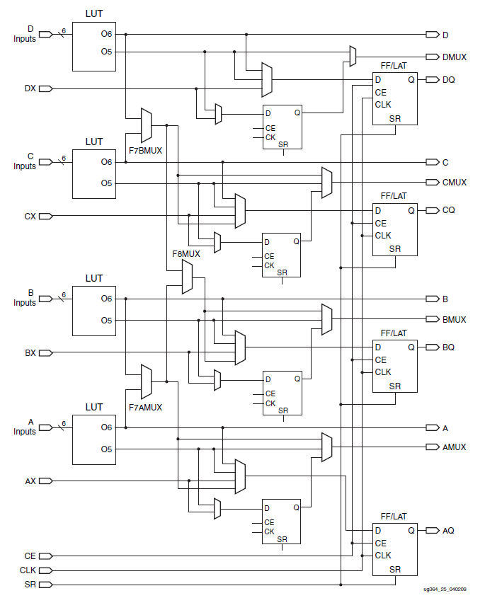
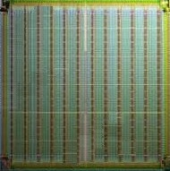
Reconfigurable Computing with FPGAs
DSP Block
IO Block
Logic Cell (10⁵ elements)
Xilinx Virtex-6 FPGA
Block RAM
DSP Block
Block RAM (20TB/s)
Notes:
Incur an overhead/cost for this reconfigurability; but can make that back by efficient architecture (dataflow)

Slide 20
CPU and FPGA Scaling
1.00E+010
1000000
FPGAs on the same curve as CPUs (Moore’s law)
1.00E+009
100000
1.00E+008
10000
1.00E+007
CPU Transistors
FPGA Registers
1.00E+006
1000
1993
1995
1998
2001
2004
2006
2009
2012

Slide 21
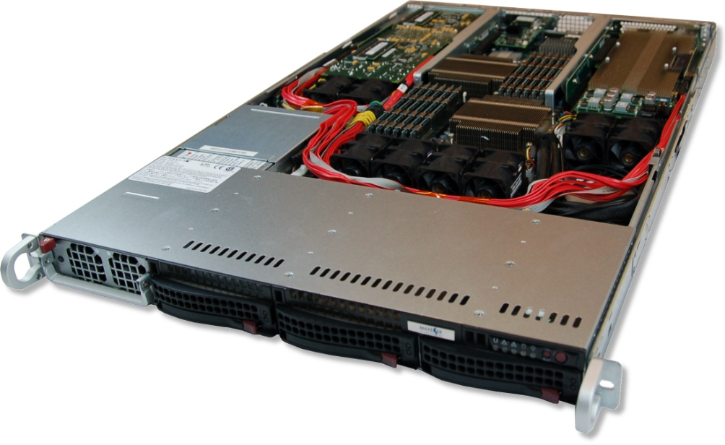
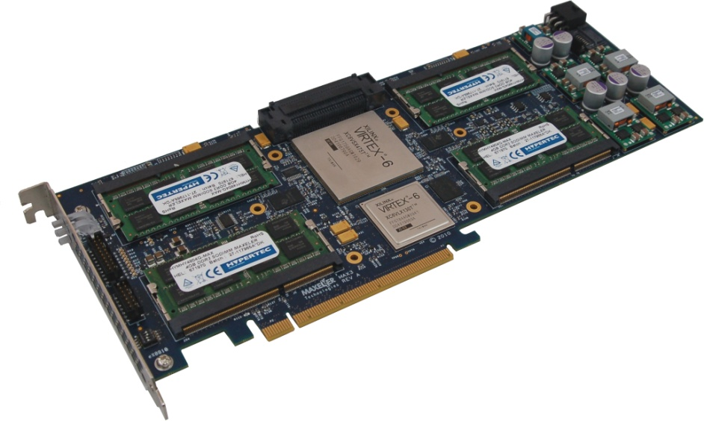
High Density Compute with FPGAs
1U Form Factor
4x MAX3 cards with Virtex-6 FPGAs
12 Intel Xeon cores
Up to 192GB FPGA RAM
Up to 192GB host RAM
MaxRing interconnect
Infiniband/10GE
Notes:
21

Slide 22
Exercises
Given a computer system which is never limited by the memory bus with N Mb memory and a processor with 2 ALUs (write down any additional assumptions you make). For each of the points below write a pseudo program which is limited in performance by:
Memory access latency
Memory size
Processor ALU resources
Find 3 research projects on the web, working on something related to this lecture and describe what they do and why in your own words.

