Slide 1
Dataflow Programming with MaxCompiler
Presenter
MaxAcademy Lecture Series – V1.0, September 2011

Slide 2
Lecture Overview
Programming FPGAs
MaxCompiler
Streaming Kernels
Compile and build
Java meta-programming

Slide 3
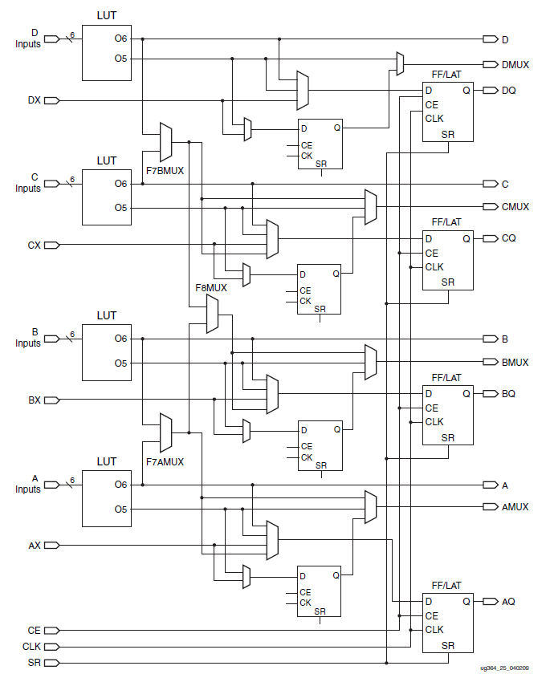
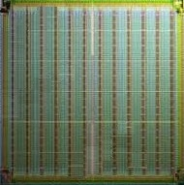
Reconfigurable Computing with FPGAs
DSP Block
IO Block
Logic Cell (10⁵ elements)
Xilinx Virtex-6 FPGA
Block RAM
DSP Block
Block RAM (20TB/s)
Notes:
Incur an overhead/cost for this reconfigurability; but can make that back by efficient architecture (dataflow)

Slide 4
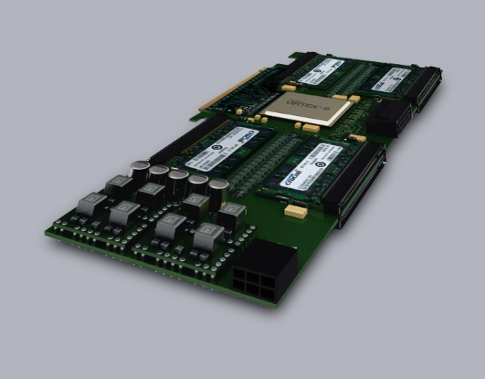
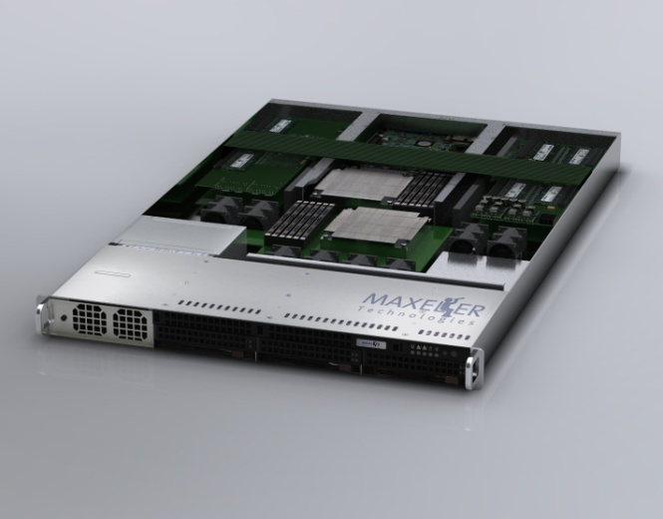
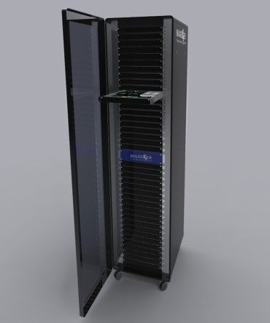
FPGA Acceleration Hardware Solutions
MaxRack
10U, 20U or 40U
MaxCard
MaxNode
MaxRack
PCI-Express Gen 2
Typical 50W-80W
24-48GB RAM
1U server
4 MAX3 Cards
Intel Xeon CPUs
10U, 20U or 40U Rack

Slide 5
How could we program it?
Schematic entry of circuits
Traditional Hardware Description Languages
VHDL, Verilog, SystemC.org
Object-oriented languages
C/C++, Python, Java, and related languages
Functional languages: e.g. Haskell
High level interface: e.g. Mathematica, MatLab
Schematic block diagram e.g. Simulink
Domain specific languages (DSLs)

Slide 6
Accelerator Programming Models
DSL
DSL
DSL
DSL
Level of Abstraction
Higher Level Libraries
Higher Level Libraries
Flexible Compiler System: MaxCompiler
Possible applications

Slide 7
Acceleration Development Flow
Original Application
Identify code for acceleration and analyze bottlenecks
Transform app, architect and model performance
Write MaxCompiler code
Integrate with Host code
Simulate
Start
NO
NO
Meets performance goals?
Functions correctly?
Accelerated Application
YES
Build for Hardware
YES

Slide 8
MaxCompiler
Complete development environment for Maxeler FPGA accelerator platforms
Write MaxJ code to describe the dataflow accelerator
MaxJ is an extension of Java for MaxCompiler
Execute the Java → generate the accelerator
C software on CPUs uses the accelerator
class MyAccelerator extends Kernel {
public MyAccelerator(…) {
HWVar x = io.input("x", hwFloat(8, 24));
HWVar y = io.input(“y", hwFloat(8, 24));
HWVar x2 = x * x;
HWVar y2 = y * y;
HWVar result = x2 + y2 + 30;
io.output(“z", result, hwFloat(8, 24));
}
}

Slide 9
Application Components
CPU
Host application
MaxCompilerRT
MaxelerOS
Kernels
FPGA
PCI Express
+
Memory
+
*
Memory
Manager

Slide 10
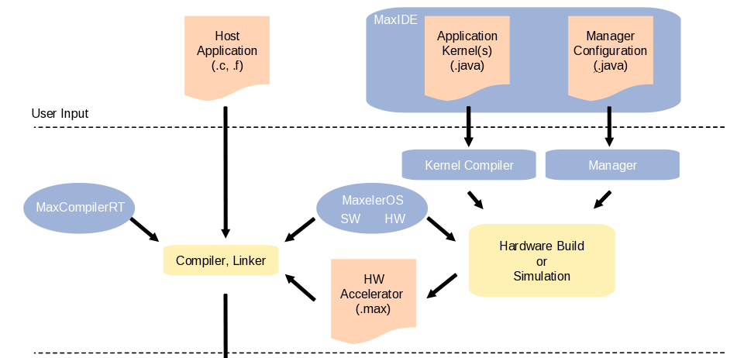
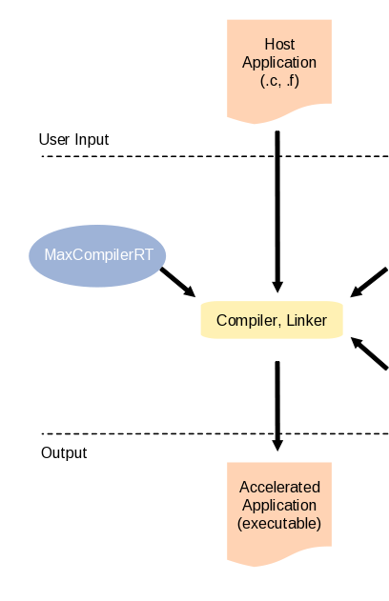
Programming with MaxCompiler
Computationally intensive components

Slide 11
Simple Application Example
CPU
Host
Code
Main
Memory
Host Code (.c)
for (int i =0; i < DATA_SIZE; i++)
y[i]= x[i] * x[i] + 30;
int*x, *y;

Slide 12
Development Process
CPU
Memory
x
Host
Code
FPGA
x
MaxCompilerRT
MaxelerOS
Manager
30
PCI
Express
+
Main
Memory
x
y
y
Host Code (.c)
Manager (.java)
MyKernel (.java)
Manager m = new Manager();
Kernel k =
new MyKernel();
m.setKernel(k);
m.setIO(
link(“x", PCIE),
m.build();
HWVar x = io.input("x", hwInt(32));
HWVar result = x * x + 30;
io.output("y", result, hwInt(32));
device = max_open_device(maxfile,
"/dev/maxeler0");
max_run(device,
max_input("x", x, DATA_SIZE*4),
max_runfor("Kernel", DATA_SIZE));
link(“y", PCIE));
for (int i =0; i < DATA_SIZE; i++)
y[i]= x[i] * x[i] + 30;
int*x, *y;
max_output("y", y, DATA_SIZE*4),

Slide 13
Development Process
CPU
Memory
x
y
Host
Code
FPGA
x
MaxCompilerRT
MaxelerOS
Manager
30
PCI
Express
+
Main
Memory
x
y
Host Code (.c)
Manager (.java)
MyKernel (.java)
device = max_open_device(maxfile,
"/dev/maxeler0");
max_run(device,
max_input("x", x, DATA_SIZE*4),
max_runfor("Kernel", DATA_SIZE));
Manager m = new Manager();
Kernel k =
new MyKernel();
m.setKernel(k);
m.setIO(
link(“x", PCIE),
m.build();
HWVar x = io.input("x", hwInt(32));
HWVar result = x * x + 30;
io.output("y", result, hwInt(32));
device = max_open_device(maxfile,
"/dev/maxeler0");
int*x, *y;
link(“y", DRAM_LINEAR1D));

Slide 14
The Full Kernel
x
public class MyKernel extends Kernel {
public MyKernel (KernelParameters parameters) {
super(parameters);
HWVar x = io.input("x", hwInt(32));
HWVar result = x * x + 30;
io.output("y", result, hwInt(32));
}
}
x
30
+
y

Slide 15
Streaming Data through the Kernel
5 4 3 2 1 0
x
0
x
0
30
+
30
y
30

Slide 16
Streaming Data through the Kernel
5 4 3 2 1 0
x
1
x
1
30
+
31
y
30 31

Slide 17
Streaming Data through the Kernel
5 4 3 2 1 0
x
2
x
4
30
+
34
y
30 31 34

Slide 18
Streaming Data through the Kernel
5 4 3 2 1 0
x
3
x
9
30
+
39
y
30 31 34 39

Slide 19
Streaming Data through the Kernel
5 4 3 2 1 0
x
4
x
16
30
+
46
y
30 31 34 39 46

Slide 20
Streaming Data through the Kernel
5 4 3 2 1 0
x
5
x
25
30
+
55
y
30 31 34 39 46 55

Slide 21
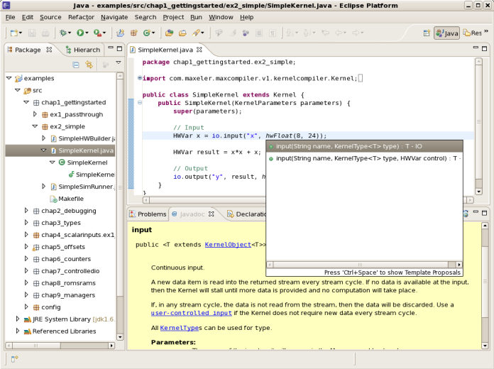
Compile, Build and Run
Java program generates a MaxFile when it runs
Compile the Java into .class files
Execute the .class file
Builds the dataflow graph in memory
Generates the hardware .max file
Link the generated .max file with your host program
Run the host program
Host code automatically configures FPGA(s) and interacts with them at run-time

Slide 22
Java meta-programming
You can use the full power of Java to write a program that generates the dataflow graph
Java variables can be used as constants in hardware
int y; HWVar x; x = x + y;
Hardware variables can not be read in Java!
Cannot do: int y; HWVar x; y = x;
Java conditionals and loops choose how to generate hardware → not make run-time decisions

Slide 23
Dataflow Graph Generation: Simple
x
What dataflow graph is generated?
HWVar x = io.input(“x”, type);
HWVar y;
y = x + 1;
io.output(“y”, y, type);
1
+
y

Slide 24
Dataflow Graph Generation: Simple
x
What dataflow graph is generated?
HWVar x = io.input(“x”, type);
HWVar y;
y = x + x + x;
io.output(“y”, y, type);
+
+
y

Slide 25
Dataflow Graph Generation: Variables
What’s the value of h if we stream in 1?
HWVar h = io.input(“h”, type);
int s = 2;
s = s + 5
h = h + 10
h = h + s;
1
+
10
+
7
18
What’s the value of s if we stream in 1?
HWVar h = io.input(“h”, type);
int s = 2;
s = s + 5
h = h + 10
s = h + s;
Compile error.
You can’t assign a hardware value to a Java int

Slide 26
Dataflow Graph Generation: Conditionals
What dataflow graph is generated?
HWVar x = io.input(“x”, type);
int s = 10;
HWVar y;
if (s < 100) { y = x + 1; }
else { y = x – 1; }
io.output(“y”, y, type);
x
1
+
y
What dataflow graph is generated?
HWVar x = io.input(“x”, type);
HWVar y;
if (x < 10) { y = x + 1; }
else { y = x – 1; }
io.output(“y”, y, type);
Compile error.
You can’t use the value of ‘x’ in a Java conditional

Slide 27
Conditional Choice in Kernels
Compute both values and use a multiplexer.
x = control.mux(select, option0, option1, …, optionN)
x = select ? option1 : option0
Ternary-if operator is overloaded
x
HWVar x = io.input(“x”, type);
HWVar y;
y = (x > 10) ? x + 1 : x – 1
io.output(“y”, y, type);
>
10
+
1
-
1
y

Slide 28
Dataflow Graph Generation: Java Loops
What dataflow graph is generated?
HWVar x = io.input(“x”, type);
HWVar y = x;
for (int i = 1; i <= 3; i++) {
y = y + i;
}
io.output(“y”, y, type);
x
1
+
2
+
3
+
Can make the loop any size – until you run out of space on the chip!
Larger loops can be partially unrolled in space and used multiple times in time – see Lecture on loops and cyclic graphs
y

Slide 29
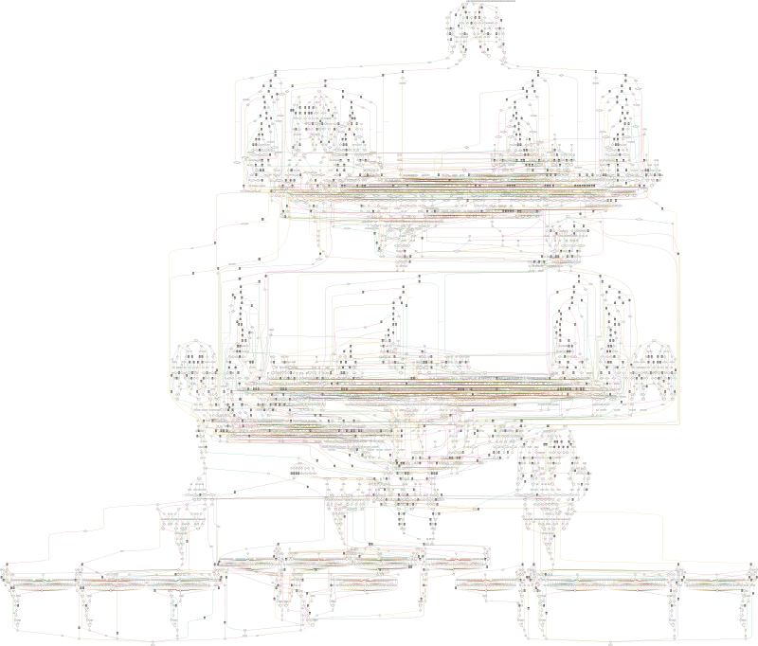
Real data flow graph as
generated by MaxCompiler
4866 nodes; 10,000s of stages/cycles

Slide 30
Exercises
Write a MaxCompiler kernel program that takes three input streams x, y and z which are hwInt(32) and computes an output stream p, where:
Draw the dataflow graph generated by the following program:
for (int i = 0; i < 6; i++) {
HWVar x = io.input(“x”+i, hwInt(32));
HWVar y = x;
if (i % 3 != 0) {
for (int j = 0; j < 3; j++) {
y = y + x*j;
}
} else {
y = y * y;
}
io.output(“y”+i, y, hwInt(32));
}

