Slide 1

Sasa Stojanovic
stojsasa@etf.rs
Veljko Milutinovic
vm@etf.rs

Slide 2

Introduction
One has to know
how to program Maxeler machines,
in order to get
the best possible speedup out of them!
For some applications (G),
there is a large difference between
what an experienced programmer achieves,
and
what an un-experienced one can achieve!
For some other applications (B),
no matter how experienced the programmer is,
the speedup will not be revolutionary
(may be even <1).

Slide 3

Introduction
Lemas:
  1. The what-to and what-not-to is important to know!
  2. The how-to and how-not-to is important to know!
N.B.
  The what-to/what-not-to is taught
  using a figure and formulae
  (the next slide).
  The how-to is taught through
  most of the examples to follow
  (all except the introductory one).

Slide 4

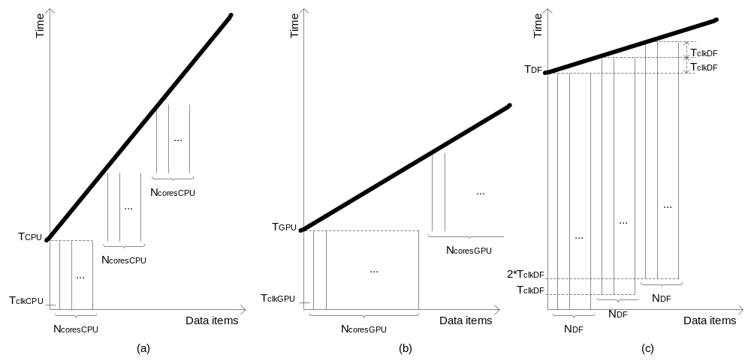
Introduction
t_{CPU} =
N * N_{OPS} * C_{CPU}*T_{clkCPU} /N_{coresCPU}
t_{GPU} =
N * N_{OPS} * C_{GPU}*T_{clkGPU} / N_{coresGPU}
t_{DF} = N_{OPS} * C_{DF} * T_{clkDF} +
(N – N_{DF}) * T_{clkDF} / N_{DF}
Assumptions:
1. Software includes enough parallelism to keep all cores busy
2. The only limiting factor is the number of cores.

Slide 5

Introduction
When is Maxeler better?
  If
  the number of operations in a single loop iteration
  is above some critical value
  Then
  More data items means more advantage for Maxeler.
In other words:
  More data does not mean better performance
  if the #operations/iteration is below a critical value.
  Ideal scenario is to bring data (PCIe relatively slow to MaxCard),
  and then to work on it a lot (the MaxCard is fast).
Conclusion:
  If we see an application with a small #operations/iteration,
  it is possibly (not always) a “what-not-to” application,
  and we better execute it on the host;
  otherwise, we will (or may) have a slowdown.
ADDITIVE SPEEDUP ENABLER
ADDITIVE SPEEDUP MAKER

Slide 6

Introduction
Maxeler: One new result in each cycle
e.g. Clock = 200MHz
Period = 5ns
One result every 5ns
[No matter how many operations in each loop iteration]
Consequently: More operations does not mean proportionally more time;
however, more operations means higher latency till the first result.
CPU: One new result after each iteration
e.g. Clock=4GHz
Period = 250ps
One result every 250ps times #ops
[If #ops > 20 => Maxeler is better, although it uses a slower clock]
Also: The CPU example will feature an additional slowdown,
due to memory hierarchy access and pipeline related hazards
=>
critical #ops (bringing the same performance) is significantly below 20!!!

Slide 7

Introduction
Maxeler has no cache,
but does have a memory hierarchy.
However,
memory hierarchy access with Maxeler
is carefully planed
by the programmer
at the program write time (FPGAmem+onBoardMEM).
As opposed to
memory hierarchy access
with a multiCore CPU/GPU
which calculates the access address
at the program run time.

Slide 8

Introduction
Now we are ready for examples
which show how-to ☺
My questions,
from time to time,
will ask you about time consequences
of how-not-to alternatives ☹

Slide 9

Introduction
We have chosen many simple examples
[small steps]
which together build a realistic application
[mountain top]
vs
father
three sons with 1-stick bunches
a 3-stick bunch

Slide 10
Introduction
Java to configure Maxeler!
C to program the host!
One or more kernels!
Only one manager!
In theory,
Simulator builder not needed
if a card is used.
In practice,
you need it until the testing is over,
since the compilation process is slow, for hardware,
and fast, for software (simulator).

Slide 11

Content
E#1: Hello world
E#2: Vector addition
E#3: Type mixing
E#4: Addition of a constant and a vector
E#5: Input/output control
E#6: Conditional execution
E#7: Moving average 1D
E#8: Moving average 2D
E#9: Array summation
E#10: Optimization of E#9

Slide 12

Content
E#11: TBD
E#12: TBD
E#13: TBD
E#14: TBD
E#15: TBD
E#16: TBD
E#17: TBD
E#18: TBD
E#19: TBD
E#20: TBD

Slide 13

Example No. 1
Write a program that sends the “Hello World!” string
from the Host to the MAX2 card,
for the MAX2 card kernel to return it back to the host.
To be learned through this example:
  How to make the configuration of the accelerator (MAX2 card) using Java:
    How to make a simple kernel (ops description)
    using Java (the only language),
    How to write the standard manager (configuration description based on kernel(s))
    using Java,
  How to test the kernel using a test (code+data) written in Java,
  How to compile the Java code for MAX2,
  How to write a simple C code that runs on the host
  and triggers the kernel,
    How to write the C code that streams data to the kernel,
    How to write the C code that accepts data from the kernel,
  How to simulate and execute an application program in C
  that runs on the host and periodically calls the accelerator.

Slide 14

Example No. 1
One or more kernel files, to define operations of the application:
  <app_name>Kernel[<additional_name>].java
One (or more) Java file, for simulator-based testing of the kernel(s);
here we only test the kernel(s), with various data inputs:
  <app_name>SimRunner.java
One manager file for transforming the kernel(s)
into the configuration of the MAX card
(instantiation and connection of kernels);
instantiation maps into DFEs the behavior defined by kernels;
if more kernels, connection links outputs and inputs of kernels:
  <app_name>Manager.java
Simulator builder (Java kernel(s) compiled and linked to host code, for simulation
(on a PC):
  <app_name>HostSimBuilder.java
Hardware builder (same as above, for execution (on a MAX card or a MAX system):
  <app_name>HWBuilder.java
Application code that uses the MAX card accelerator:
  <app_name>HostCode.c
Makefile (comes together with any Maxeler package)
  A script file that defines the compilation related commands and their sequence,
  plus the user’s selection of the “make” argument,
  e.g. “make app-sim,” “make build-sim,” etc (type: make w/o an argument, to see options).

Slide 15

Example No. 1
package ind.z1; // it is always good to have an easy reusability
import com.maxeler.maxcompiler.v1.kernelcompiler.Kernel;
import com.maxeler.maxcompiler.v1.kernelcompiler.KernelParameters;
import com.maxeler.maxcompiler.v1.kernelcompiler.types.base.HWVar;
// all above comes with the MaxelerOS
// the class Kernel includes all the necessary code and is open for the user to extend it
public class helloKernel extends Kernel {
public helloKernel(KernelParameters parameters) {
super(parameters);
// Input:
HWVar x1 = io.input("x", hwInt(8));
HWVar result = x1;
// Output:
io.output("z", result, hwInt(8));
}
}
// concrete parameters are passed to the general Kernel = passing to a superClass
// x comes from the PCIe bus; HWVar x1 is a memory location on the FPGA chip, of the type HWVar
// type HWVar is defined by the package imported from the Maxeler library (the line 3 above)
It is possible to substitute the last three lines with:
io.output("z",
io.input(“x”, hwInt(8)),
hwInt(8));

Slide 16

Example No. 1
package ind.z1;
import com.maxeler.maxcompiler.v1.managers.standard.SimulationManager;
// now the kernel has to be tested
public class helloSimRunner {
public static void main(String[] args) {
SimulationManager m = new SimulationManager(“helloSim");
helloKernel k = new helloKernel(m.makeKernelParameters());
m.setKernel(k); // the simulation manager m is set to use the kernel k
m.setInputData("x", 1, 2, 3, 4, 5, 6, 7, 8); // this method passes test data to the kernel
m.setKernelCycles(8); // it is specified that the kernel will be executed 8 times
m.runTest(); // the manager is activated, to start the process of 8 kernel runs
m.dumpOutput(); // the method to prepare the output is also provided by Maxeler
double expectedOutput[] = {1, 2, 3, 4, 5, 6, 7, 8}; // we define what we expect
m.checkOutputData("z", expectedOutput); // we compare the obtained and the expected
m.logMsg("Test passed OK!"); // if “execution came till here,” a screen message is displayed
}
}
// static – only one instance of main
// viod – main returns no data; just shows data on the screen

Slide 17

Example No. 1
package ind.z1;
// more import from the Maxeler library is needed!
import static config.BoardModel.BOARDMODEL; // the universal simulator is nailed down
import com.maxeler.maxcompiler.v1.kernelcompiler.Kernel; // now we can use Kernel
import com.maxeler.maxcompiler.v1.managers.standard.Manager; // now we can use Manager
import com.maxeler.maxcompiler.v1.managers.standard.Manager.IOType; // now can use IOType
public class helloHostSimBuilder {
public static void main(String[] args) {
Manager m = new Manager(true,”helloHostSim", BOARDMODEL); // making Manager
Kernel k = new
helloKernel(m.makeKernelParameters(“helloKernel")); // making Kernel
m.setKernel(k); // linking Kernel k to Manager m
m.setIO(IOType.ALL_PCIE); // the selected type is bit-compatible with PCIe
m.build(); // an executable code is generated, to be executed later
// the build method is defined by Maxeler inside the imported manager class
}
}

Slide 18

Example No. 1
package ind.z1;
// the next 4 lines are the same as before
import static config.BoardModel.BOARDMODEL;
import com.maxeler.maxcompiler.v1.kernelcompiler.Kernel;
import com.maxeler.maxcompiler.v1.managers.standard.Manager;
import com.maxeler.maxcompiler.v1.managers.standard.Manager.IOType;
// the next lines differ in only one detail: The parameter “true” is missing; defined by Maxeler
public class helloHWBuilder {
public static void main(String[] args) {
Manager m = new Manager(“hello", BOARDMODEL);
Kernel k = new helloKernel( m.makeKernelParameters() );
m.setKernel(k);
m.setIO(IOType.ALL_PCIE);
m.build();
}
}

Slide 19

Example No. 1
#include <stdio.h> // standard input/output
#include <MaxCompilerRT.h> // the MaxCompilerRT functionality is included
int main(int argc, char* argv[])
{
// the next 5 lines define data
char *device_name = (argc==2 ? argv[1] : "/dev/maxeler0");
// default device defined
max_maxfile_t* maxfile;
max_device_handle_t* device;
char data_in1[16] = "Hello world!";
char data_out[16];
printf("Opening and configuring FPGA.\n"); // the lines to follow initialize Maxeler
maxfile = max_maxfile_init_hello(); // defined in MaxCompilerRT.h
device = max_open_device(maxfile, device_name);
max_set_terminate_on_error(device);

Slide 20

Example No. 1
printf("Streaming data to/from FPGA...\n"); // screen dump
// the next statement passes data to/from Maxeler
// and tells Manager to run Kernel 16 times
max_run(device,
max_input("x", data_in1, 16 * sizeof(char)),
max_output("z", data_out, 16 * sizeof(char)),
max_runfor(“helloKernel", 16),
max_end());
printf("Checking data read from FPGA.\n"); // screen dump
max_close_device(device); // freeing the memory, by closing the device,
max_destroy(maxfile); // and by destroying the maxfile
return 0;
}

Slide 21

Example No. 1
# ALL THE CODE BELOW IS DEFINED BY MAXELER
# Root of the project directory tree
BASEDIR=../../..
# Java package name
PACKAGE=ind/z1
# Application name
APP=example1
# Names of your maxfiles
HWMAXFILE=$(APP).max
HOSTSIMMAXFILE=$(APP)HostSim.max
# Java application builders
HWBUILDER=$(APP)HWBuilder.java
HOSTSIMBUILDER=$(APP)HostSimBuilder.java
SIMRUNNER=$(APP)SimRunner.java
# C host code
HOSTCODE=$(APP)HostCode.c
# Target board
BOARD_MODEL=23312
# Include the master makefile.include
nullstring :=
space := $(nullstring) # comment
MAXCOMPILERDIR_QUOTE:=$(subst $(space),\ ,$(MAXCOMPILERDIR))
include $(MAXCOMPILERDIR_QUOTE)/examples/common/Makefile.include

Slide 22

Example No. 1
package config;
import com.maxeler.maxcompiler.v1.managers.MAX2BoardModel;
public class BoardModel {
public static final MAX2BoardModel BOARDMODEL = MAX2BoardModel.MAX2336B;
}
// THIS ENABLES THE USER TO WRITE BOARDMODEL,
// INSTEAD OF USING THE COMPLICATED NAME EXPRESSION
// IN THE LAST LINE

Slide 23

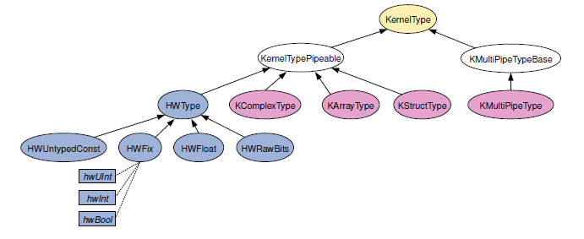
Types
// we used: HWFloat

Slide 24

Types
Floating point numbers - HWFloat:
  hwFloat(exponent_bits, mantissa_bits);
  float ~ hwFloat(8,24)
  double ~ hwFloat(11,53)
Fixed point numbers - HWFix:
  hwFix(integer_bits, fractional_bits, sign_mode)
    SignMode.UNSIGNED
    SignMode.TWOSCOMPLEMENT
Integers - HWFix:
  hwInt(bits) ~ hwFix(bits, 0, SignMode.TWOSCOMPLEMENT)
Unsigned integers - HWFix:
  hwUint(bits) ~ hwFix(bits, 0, SignMode.UNSIGNED)
Boolean – HWFix:
  hwBool() ~ hwFix(1, 0, SignMode.UNSIGNED)
  1 ~ true
  2 ~ false
Raw bits – HWRawBits:
  hwRawBits(width)

