Slide 1
More MaxCompiler Programming
Presenter
MaxAcademy Lecture Series – V1.0, September 2011

Slide 2
Lecture Overview
Counters / loop iteration variables
Ways of getting data in and out of the chip
Stream offsets
How MaxCompiler maps to hardware

Slide 3
Working with Loop Counters
How can we implement this in MaxCompiler?
for (int i = 0; i < N; i++) {
q[i] = p[i] + i;
}
How about this?
d
i
HWVar p = io.input(“p”, hwInt(32));
HWVar i = io.input(“i”, hwInt(32));
HWVar q = p + i;
io.output(“q”, q, hwInt(32));
+
Yes…. But, now we need to create an array i in software and send it to the FPGA as well
q

Slide 4
Working with Loop Counters
There is very little ‘information’ in the i stream.
Could compute it directly on the FPGA itself
HWVar p = io.input(“p”, hwInt(32));
HWVar i = control.count.simpleCounter(32, N);
HWVar q = p + i;
io.output(“q”, q, hwInt(32));
d
cnt
+
Half as many inputs
Less data transfer
q
Counters can be used to generate sequences of numbers
Complex counters can have strides, wrap points, triggers:
E.g. if (y==10) y=0; else if (en==1) y=y+2;

Slide 5
Scalar Inputs
Stream inputs/outputs process arrays
Read and write a new value each cycle
Off-chip data transfer required: O(N)
Counters can compute intermediate streams on-chip
New value every cycle
Off-chip data transfer required: None
Compile time constants can be combined with streams
Static value through the whole computation
Off-chip data transfer required: None
What about something that changes occasionally?
Don’t want to have to recompile → Scalar input
Off-chip data transfer required: O(1)

Slide 6
Scalar Inputs
Consider:
In fn2, we can change the value of C without recompiling, but it is constant for the whole loop
MaxCompiler equivalent:
void fn1(int N, int *q, int *p) {
for (int i = 0; i < N; i++)
q[i] = p[i] + 4;
}
void fn2(int N, int *q, int *p, int C) {
for (int i = 0; i < N; i++)
q[i] = p[i] + C;
}
VS.
d
HWVar p = io.input(“p”, hwInt(32));
HWVar C = io.scalarInput(“C”, hwInt(32));
HWVar q = p + C;
io.output(“q”, q, hwInt(32));
Written by host
C
+
A scalar input can be changed once per stream, loaded into the chip before computation starts.
q

Slide 7
Common uses for Scalar Inputs
Things that do not change every cycle, but do change sometimes and we do not want to rebuild the .max file.
Constants in expressions
Flags to switch between two behaviours
result = enabled ? x+7 : x;
Control parameters to counters, e.g. max, stride, etc
if (cnt==cnt_max) cnt=0; else cnt = cnt + cnt_step;

Slide 8
On-chip memories / tables
An FPGA has a few MB of very fast block RAM
Can be used to explicitly store data on chip:
Lookup tables
Temporary Buffers
Mapped ROMs/RAMs can also be accessed by host
for (i = 0; i < N; i++) {
q[i] = table[ p[i] ];
}
d
Mapped ROM table
Written by host
HWVar p = io.input(“p”, hwInt(10));
HWVar q = mem.romMapped(“table”, p, hwInt(32), 1024);
io.output(“q”, q, hwInt(32));
q

Slide 9
Getting data in and out of the chip
In general we have streams, ROMs (tables) and scalars
Use the most appropriate mechanism for the type of data and required host access speed.
Stream inputs/outputs can operate for a subset of cycles using a control signal to turn them on/off
Type | Size (items) | Host write speed | Chip area cost
Scalar input/output | 1 | Slow | Low
Mapped memory (ROM / RAM) | Up to a few thousand | Slow | Moderate
Stream input/output | Thousands to billions | Fast | Highest

Slide 10
Stream Offsets
So far, we’ve only performed operations on each individual point of a stream
The stream size doesn’t actually matter (functionally)!
At each point computation is independent
Real world computations often need to access values from more than one position in a stream
For example, a 3-pt moving average filter:

Slide 11
Stream Offsets
Stream offsets allow us to compute on values in a stream other than the current value.
Offsets are relative to the current position in a stream; not the start of the stream
Stream data will be buffered on-chip in order to be available when needed → uses BRAM
Maximum supported offset size depends on the amount of on-chip BRAM available. Typically 10s of thousands of points.

Slide 12
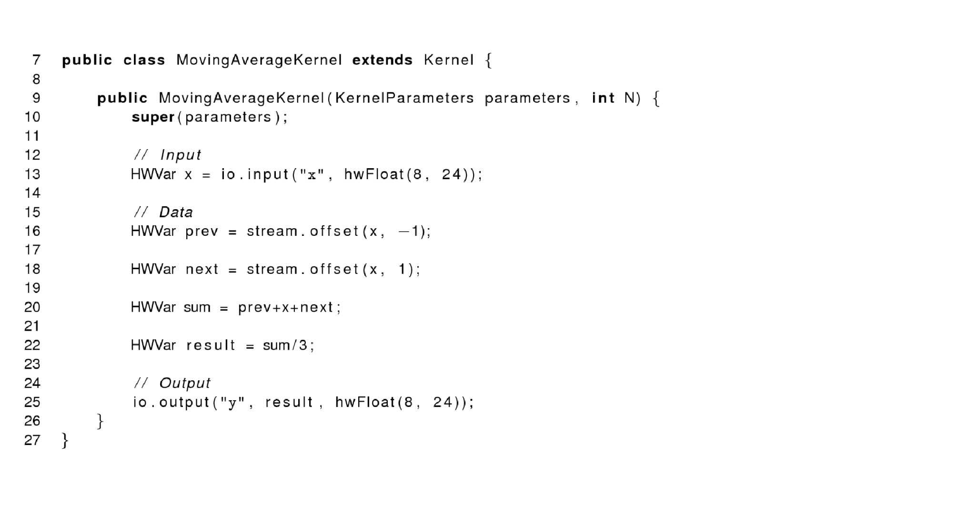
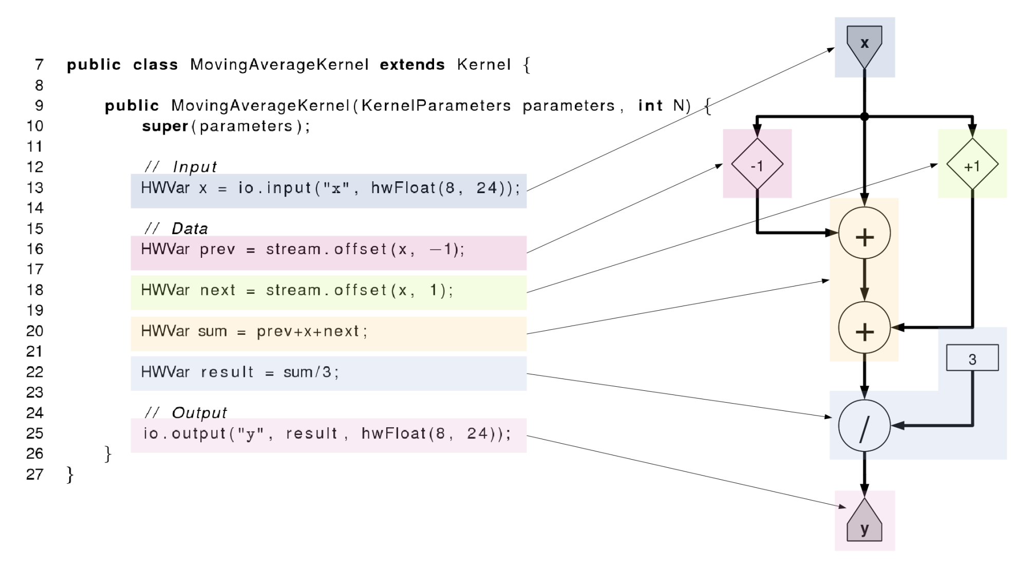
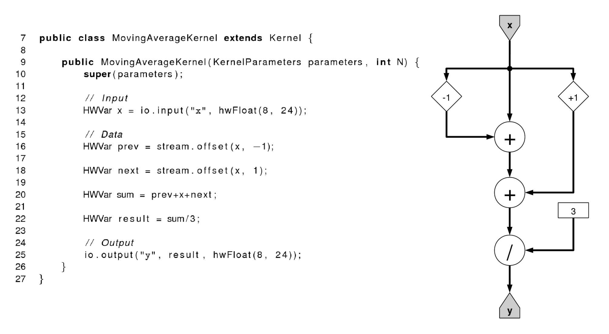
Moving Average in MaxCompiler

Slide 13
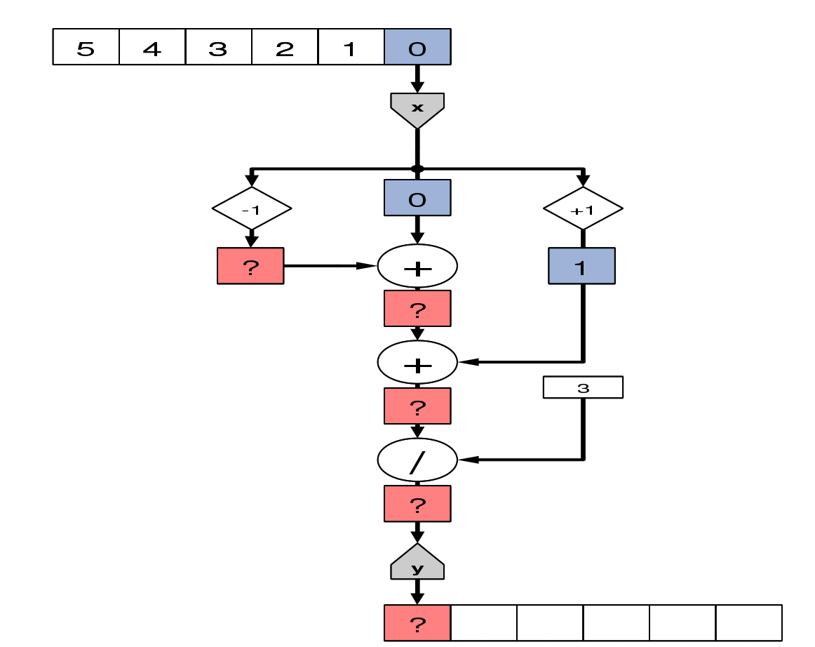
Kernel Execution

Slide 14
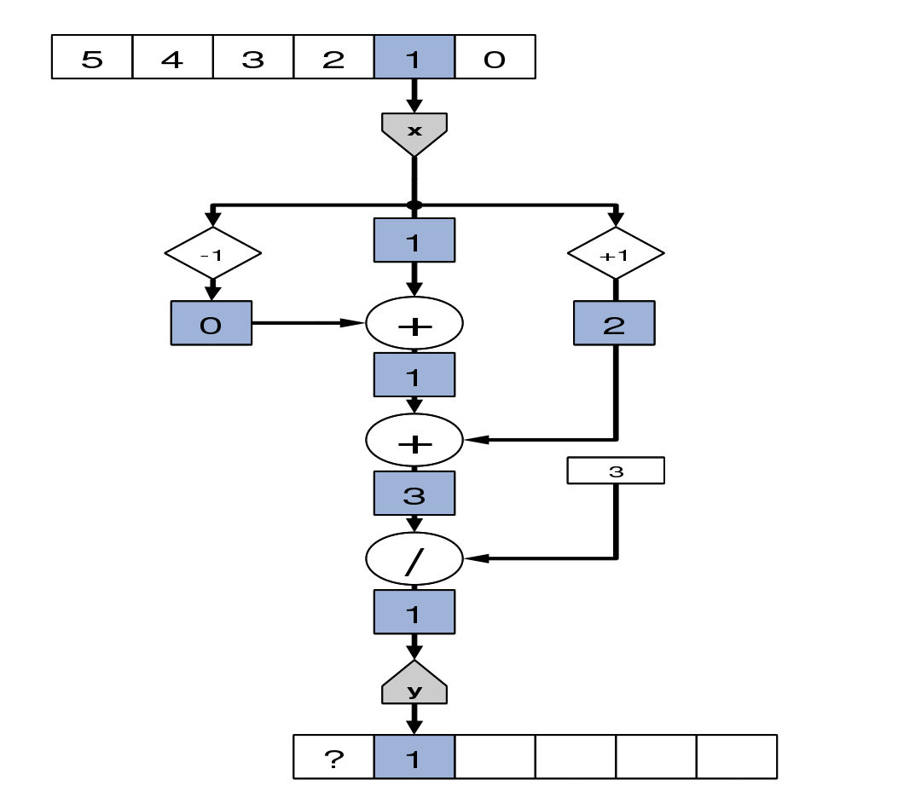
Kernel Execution

Slide 15
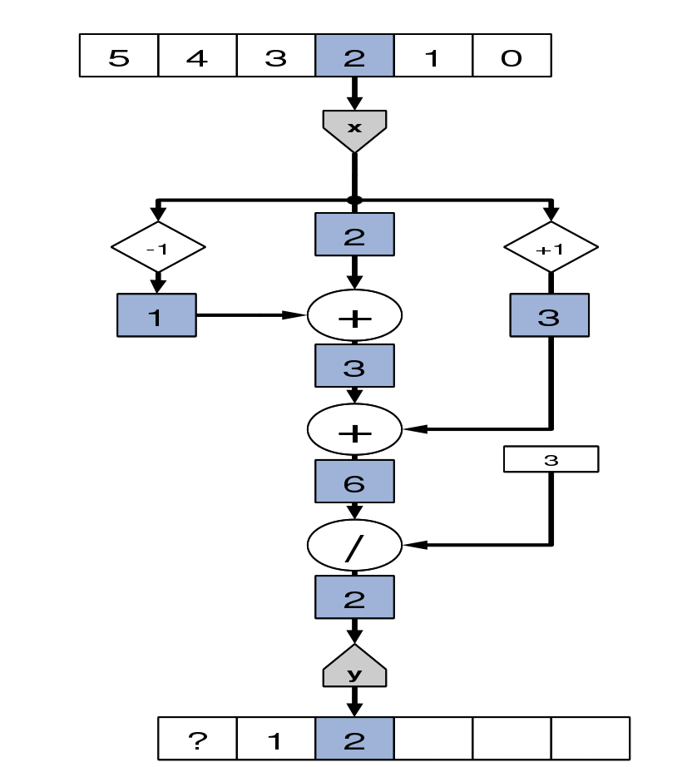
Kernel Execution

Slide 16
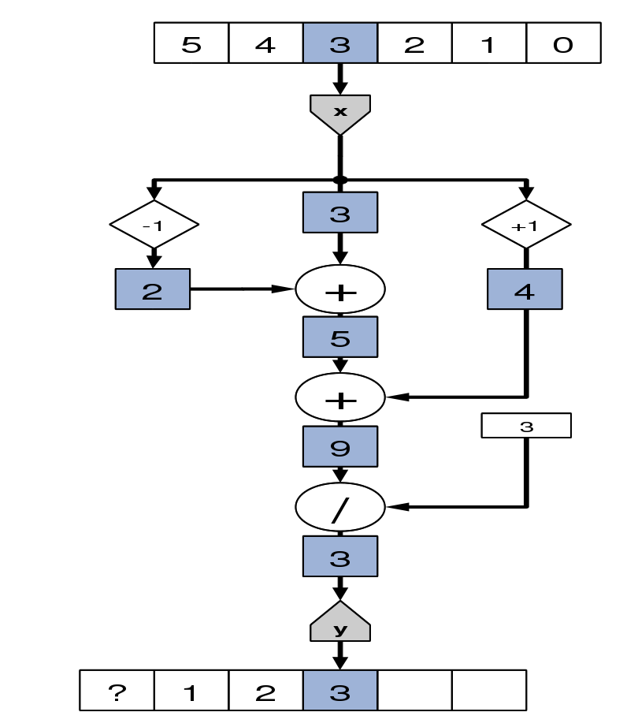
Kernel Execution

Slide 17
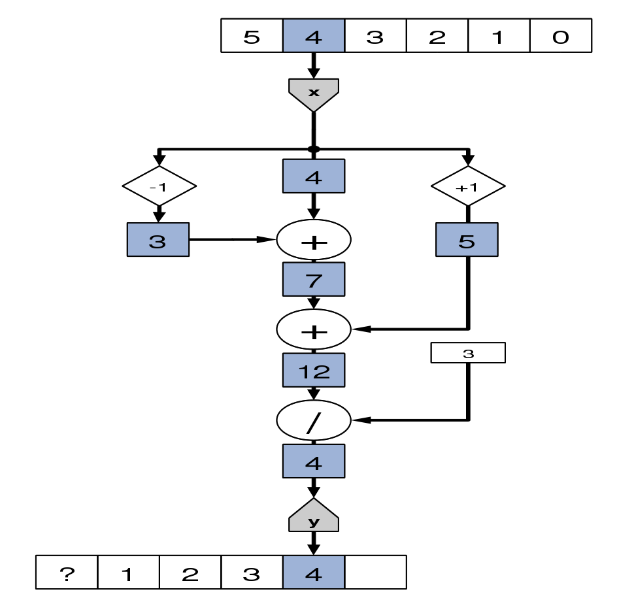
Kernel Execution

Slide 18
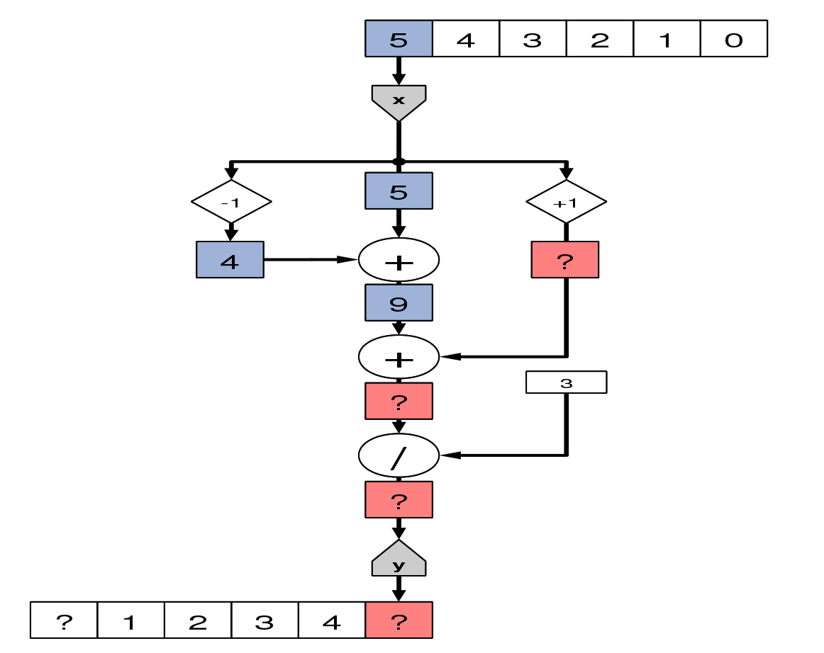
Kernel Execution

Slide 19
Boundary Cases
What about the boundary cases?

Slide 20
More Complex Moving Average
To handle the boundary cases, we must explicitly code special cases at each boundary

Slide 21
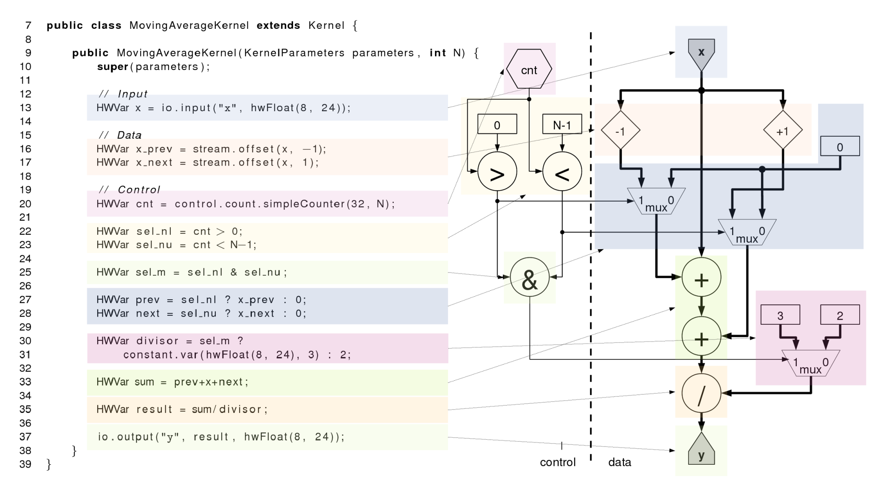
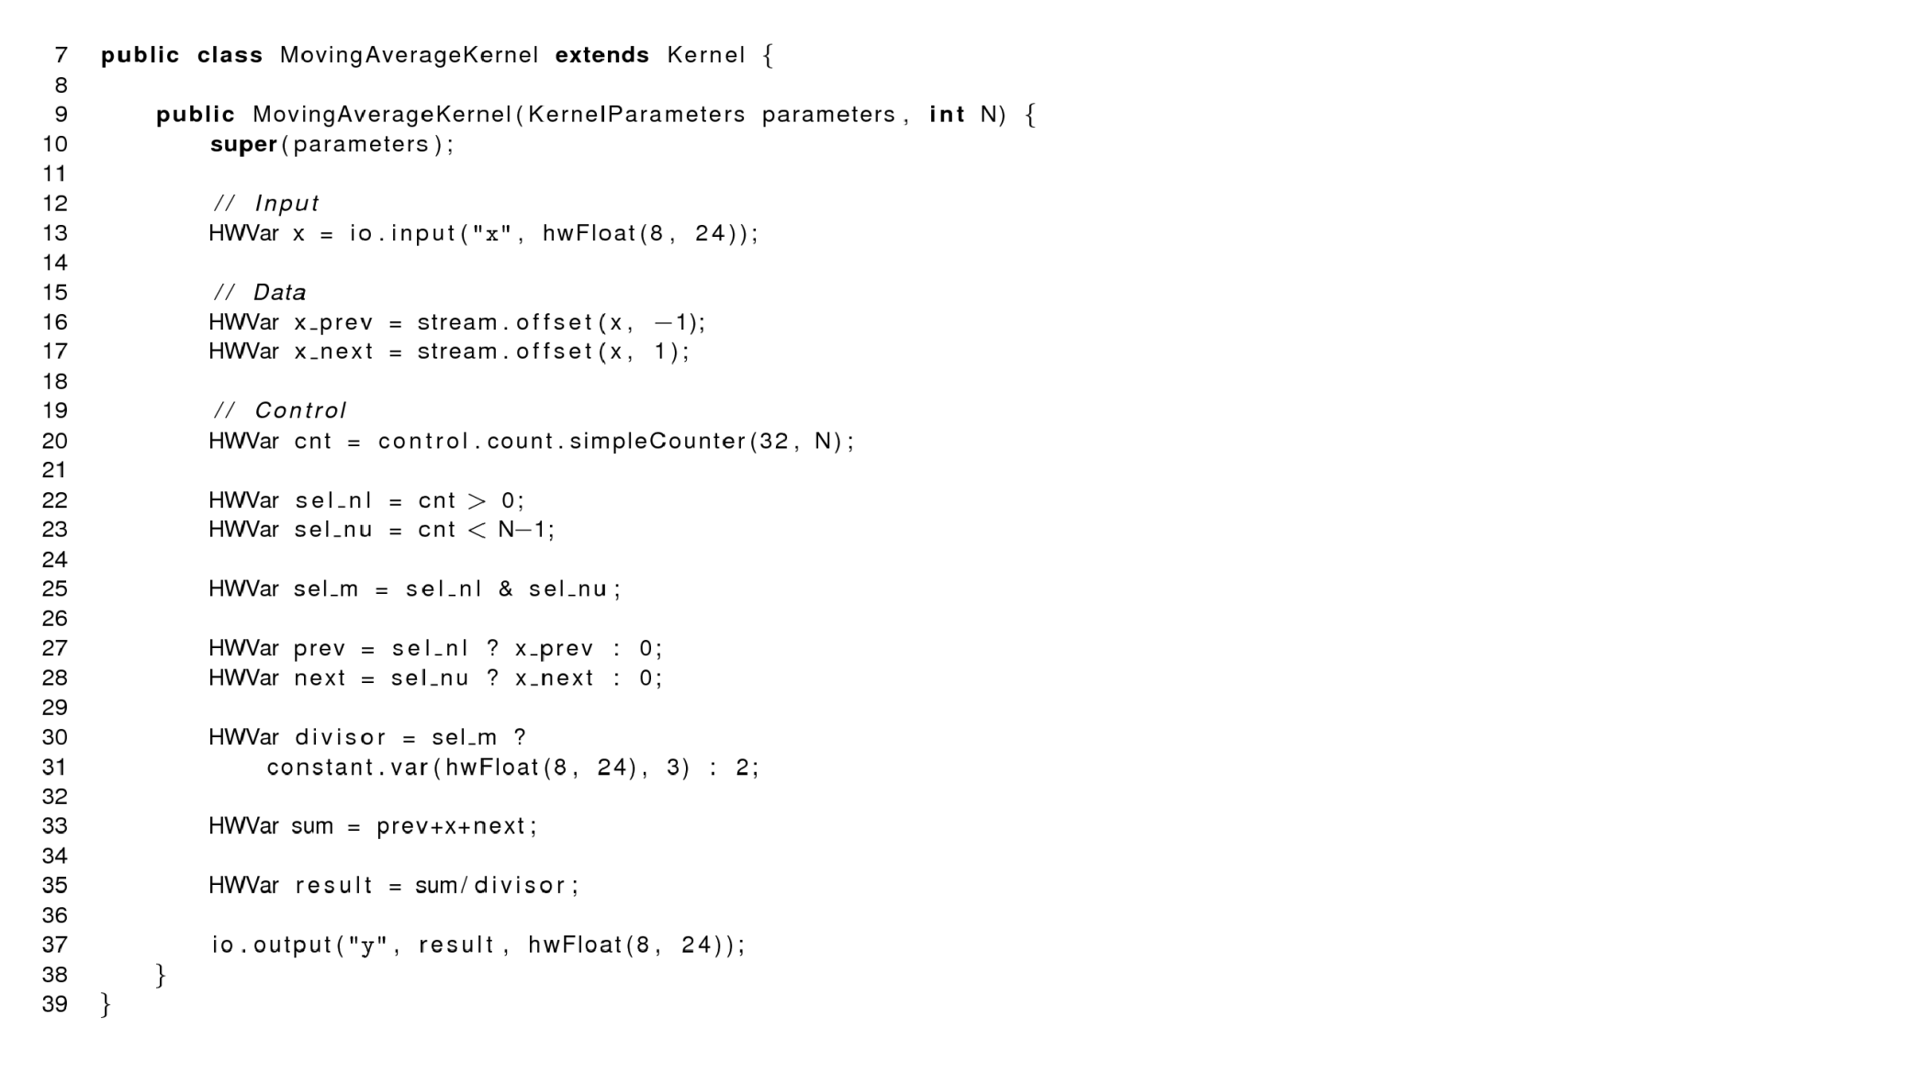
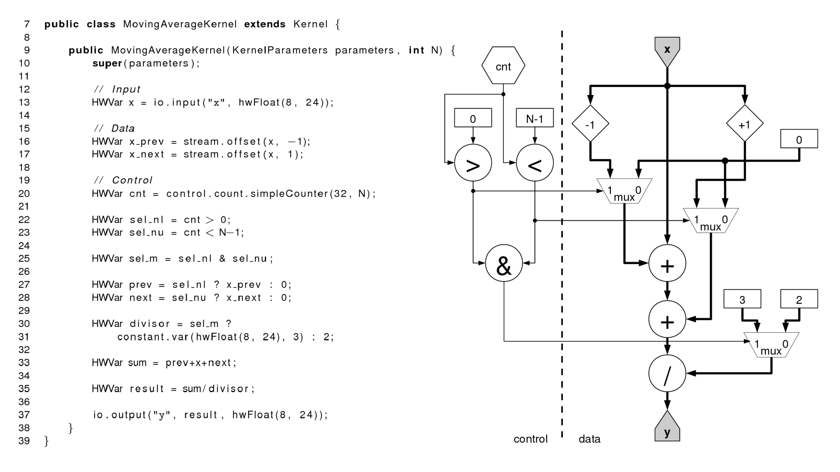
Kernel Handling Boundary Cases

Slide 22
Multidimensional Offsets
Streams are one-dimensional but can be interpreted as multi-dimensional structures
Just like arrays in CPU memory
A multidimensional offset, is the distance between the points in the one dimensional stream ➔ linearize
for (int y = 0; y < N; y++)
for (int x = 0; x < N; x++)
p[y][x] = q[y-1][x] + q[y][x-1] + q[y][x] + q[y][x+1] + q[y+1][x]
for (int y = 0; y < N; y++)
for (int x = 0; x < N; x++)
p[y*N+x] = q[(y-1)*N+x] + q[y*N+x-1] + q[y*N+x] + q[y*N+x+1] + q[(y+1)*N+x]
And of course we now need to handle boundaries in both dimensions…

Slide 23
Stages of Compilation
MaxCompiler generates VHDL ready for FPGA vendor tools
Synthesis transforms VHDL into logical “netlist” – sets of basic logic expressions
Map fits basic logic into N-input look-up tables
Place puts LUTs, DSPs, RAMs etc at specific locations on chip
Route sets up wiring between blocks
MaxCompiler compilation
VHDL
Synthesis
Netlist
Map
LUTs
Place
Placed FPGA
Route
Complete FPGA
Generate Maxfile

Slide 24
How it maps to hardware
Tue 15:00: MaxCompiler version: 2010.1
Tue 15:00: Build "MovingAverage" start time: Tue Feb 16 15:00:27 GMT 2010
Tue 15:00: Instantiating manager
Tue 15:00: Instantiating kernel "MovingAverageKernel"
Tue 15:00: Compiling manager (PCIe Only)
Tue 15:00: Compiling kernel "MovingAverageKernel"
Tue 15:00: Generating hardware for kernel "MovingAverageKernel"
Tue 15:00: Generating VHDL + netlists (including running CoreGen)
Tue 15:00: Running back-end hardware build (10 build phases)
Tue 15:00: (1/10) - GenerateMaxFileDataFile
Tue 15:00: (2/10) - XST
Tue 15:02: (3/10) - NGCBuild
Tue 15:02: (4/10) - ResourceCounter
Tue 15:03: (5/10) - NGDBuild
Tue 15:03: (6/10) - MPPR
Tue 15:19: (7/10) - GenerateMaxFile
Tue 15:21: (8/10) – XDLBuild
Tue 15:22: (9/10) - ResourceUsageBuild
Tue 15:22: (10/10) - ResourceAnnotationBuildPass
Tue 15:22:
Tue 15:22: FINAL RESOURCE USAGE
Tue 15:22: LUTs: 9154 / 149760 (6.11%)
Tue 15:22: FFs: 10736 / 149760 (7.17%)
Tue 15:22: BRAMs: 21 / 516 (4.07%)
Tue 15:22: DSPs: 0 / 1056 (0.00%)
Tue 15:22:
Tue 15:22: MAX file: /oliver/builds/MovingAverage/results/MovingAverage.max
Tue 15:22: Build completed: Tue Feb 16 15:22:25 GMT 2010 (took 21 mins, 57 secs)
FPGA vendor specific back-end tool flow
Abstracted by MaxCompiler

Slide 25
On-chip Resources
DSP Block (~2000)
IO Block
Different operations use different resources
Main resources
LUTs
Flip-flops
DSP blocks (25x18 multipliers)
Block RAM (36Kbit)
Routing!
LUT/FF (~300k)
Block RAM (~1000)

Slide 26
Resource Usage Reporting
Allows you to see what lines of code are using what resources and focus optimization
Separate reports for each kernel and for the manager
LUTs FFs BRAMs DSPs : MyKernel.java
727 871 1.0 2 : resources used by this file
0.24% 0.15% 0.09% 0.10% : % of available
71.41% 61.82% 100.00% 100.00% : % of total used
94.29% 97.21% 100.00% 100.00% : % of user resources
:
: public class MyKernel extends Kernel {
: public MyKernel (KernelParameters parameters) {
: super(parameters);
1 31 0.0 0 : HWVar p = io.input("p", hwFloat(8,24));
2 9 0.0 0 : HWVar q = io.input("q", hwUInt(8));
: HWVar offset = io.scalarInput("offset", hwUInt(8));
8 8 0.0 0 : HWVar addr = offset + q;
18 40 1.0 0 : HWVar v = mem.romMapped("table", addr,
: hwFloat(8,24), 256);
139 145 0.0 2 : p = p * p;
401 541 0.0 0 : p = p + v;
: io.output("r", p, hwFloat(8,24));
: }
: }

Slide 27
Exercises
Write a MaxCompiler kernel program (using hwFloat(8,24)) that computes:
Draw the kernel dataflow graph.
Write a MaxCompiler kernel program that computes a 3x3 2D moving average on a single input stream of 1024x1024 values, ignoring any boundary conditions.
Extend the 3x3 moving average kernel from (2) to support a variable problem size at run-time, from 256² to 2048². Hint: you will need to use variable stream offsets (see MaxCompiler Kernel Compiler tutorial for more information).

